Slide 1
PPA Program Introduction
David MacFarlane
Associate Laboratory Director for PPA
DOE Review of the Laboratory Scientific Computing Program
February 9, 2011

Slide 2

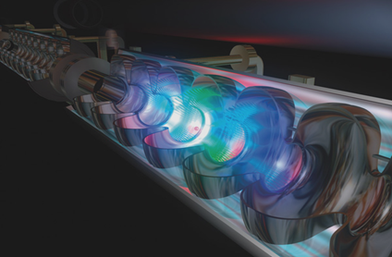
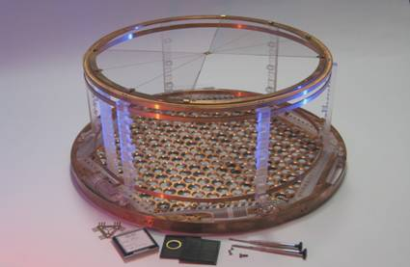
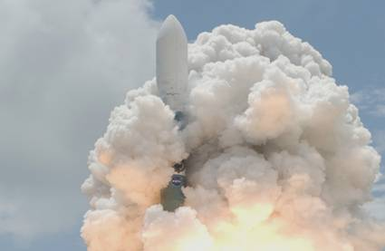
SLAC Particle Physics & Astrophysics
Accelerator research:
ILC, high-gradient,
plasma-wakefield, laser
Accelerator-based
particle physics:
ATLAS & BABAR
Underground physics:
EXO-200, CDMS
Astrophysics &
Cosmology:
Fermi GST, DES
Engineering, DAQ, trigger & computing core capabilities
Particle, Astrophysics, & Cosmology Theory

Slide 3
Main research program breakdown by FTEs
FY2010, 288 FTEs, $73M core, ILC, LARP, detector R&D [$95M total + FACET]
Detector R&D
ATLAS M&O
Proton
Electron
All others
EXO
LSST/DES
Fermi GST
LARP
ILC
Acc Development
Acc Science
FTEs
Includes faculty, staff, postdocs, and students

Slide 4
Future Projects
Energy Frontier
ATLAS
upgrades
LHC upgrades, ILC, CLIC, Muon Collider
Accelerator research:
ILC, high-gradient,
plasma-wakefield, laser
Accelerator-based
particle physics:
ATLAS & BABAR
Underground physics:
EXO-200, CDMS
Astrophysics &
Cosmology:
Fermi GST, DES

Slide 5
Future Projects
Intensity Frontier
Super B Factory
Super B collider
Accelerator research:
ILC, high-gradient,
plasma-wakefield, laser
Accelerator-based
particle physics:
ATLAS & BABAR
Underground physics:
EXO-200, CDMS
Astrophysics &
Cosmology:
Fermi GST, DES
Tonne-scale EXO

Slide 6
Future Projects
Cosmic Frontier
Accelerator research:
ILC, high-gradient,
plasma-wakefield, laser
Accelerator-based
particle physics:
ATLAS & BABAR
CMB
Underground physics:
EXO-200, CDMS
Astrophysics &
Cosmology:
Fermi GST, DES
LSST
SuperCDMS at SNOLAB
CTA

Slide 7
Capabilities and Projects
 | BABAR | FERMI | ATLAS | LSST | WFIRST | KIPAC | LCLS/ PS
DAQ/ trigger | ✓ | ✓ | ✓ | ✓ | ✓ |  | ✓
Space systems |  | ✓ |  |  | ✓
Pipeline processing | ✓ | ✓ | ✓ | ✓ | ✓ |  | ✓
Petascale datasets | ✓ | ✓ | ✓ | ✓ |  | ✓ | ✓
Petascale databases | (lessons learned!) |  |  | ✓ | ✓ | ? | ?
MPI/SMP | some analyses |  |  | some analyses |  | ✓ ✓ | ✓✓ (imaging)
Visualization |  | ✓? |  | ✓ | ✓? | ✓✓ | ✓
Advanced CPU/GPU use |  |  | will need someday |  |  | ✓ | ✓
established
developing
new
R&D

Slide 8
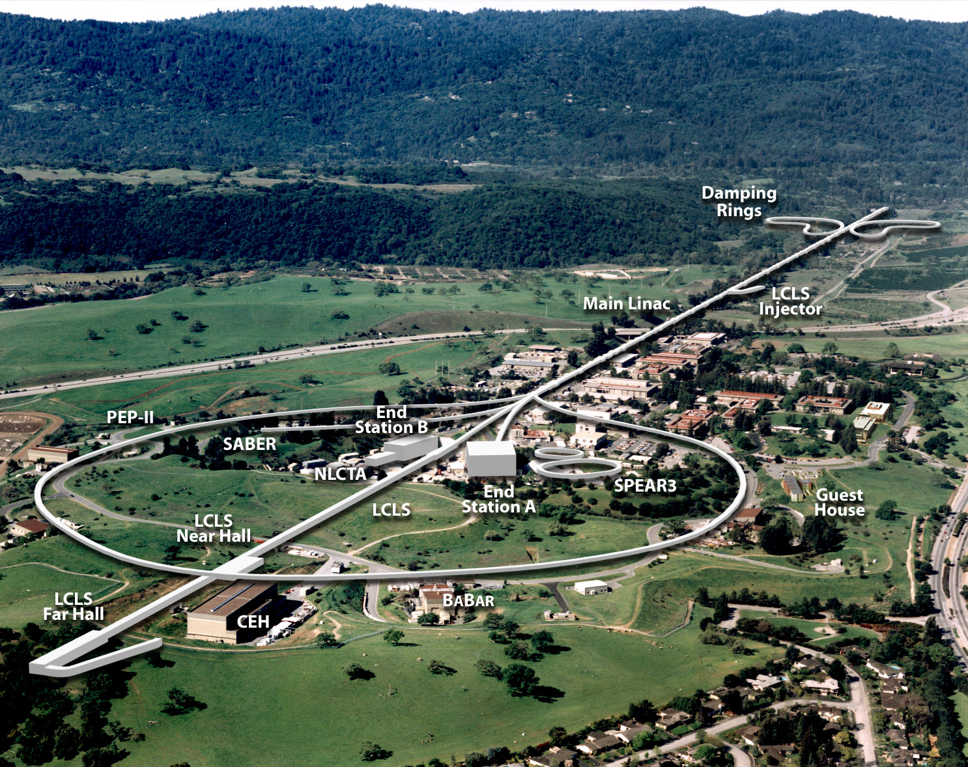

LCLS: Linac Coherent Light Source
Turn-on in 2009: LCLS will be the World’s First X-ray Laser
SLAC National Accelerator Laboratory
Persis Drell, Director
Alexander Merola, COO
FACET
Operations
A. Merola
Accelerator
N. Holtkamp
Particle Physics
& Astrophysics
D. MacFarlane
LCLS
J. Stohr
SSRL
C.-C.Kao
Photon Science
K. Hodgson
Computing Division
Accelerator Research
Sci Computing Applications
Particle Physics
Particle Astrophysics
Associate Laboratory Directors
Science Divisions

Slide 9
Presentation plan
PPA Program Introduction ― this talk
Operations and Cost Model ― Randy Melen
Scientific Computing Opportunities & Goals ― Richard Dubois
GEANT4 Effort ― Makoto Asai
Computational Cosmology Initiative ― Risa Wechsler
Budget and Support Model ― dbm

