Slide 1
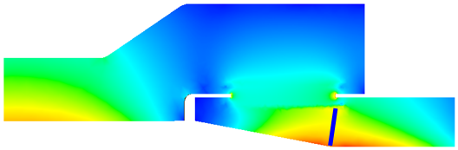
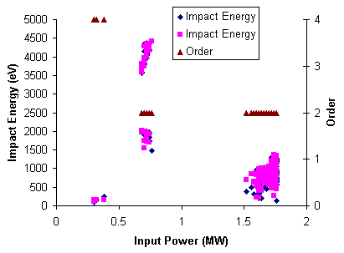
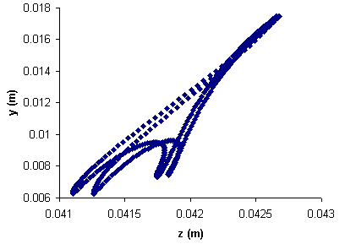
TTF3 Coupler - Ceramic Window
Track3P can handle interior emission surfaces, such as ceramic window
Resonant trajectories are found between the ceramic window and the inner conductor on the cold coax
Window
2 points 2nd order
Impact energy and order versus input power
A resonant particle’s trajectory

