Slide 1
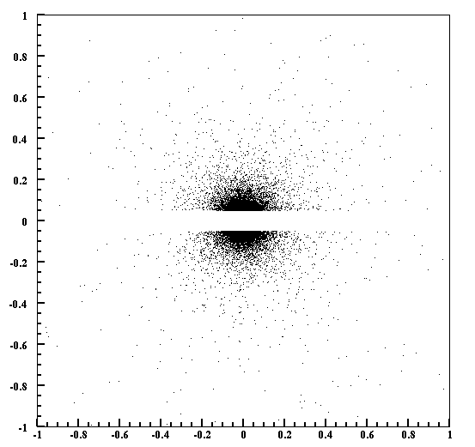
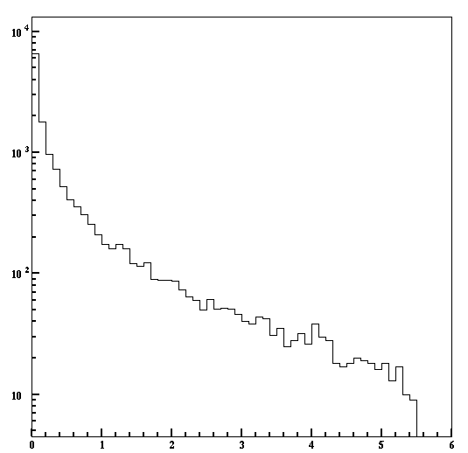
Pair production in Si Tracker
This is not a tracker background problem, but potentially a trigger problem.
Target
0.25% x0
Layer #1
e+
γ
e-
Si
Y (cm)
14,619 γs/ 10⁹ e-
2,514 γs/ 10⁹ E > 1 GeV
87% are in the guard ring
Energy (GeV)
X (cm)

Slide 2
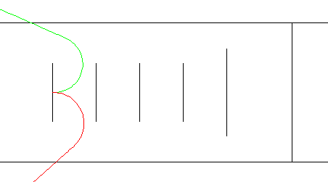
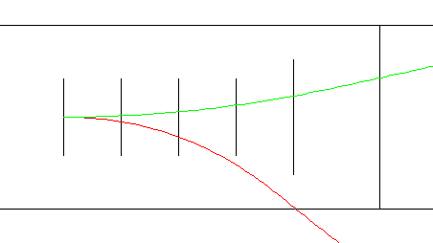
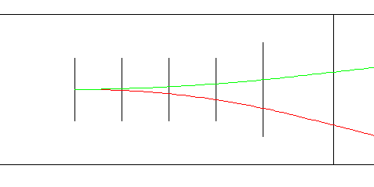
Trigger rate from pair conversion
ECAL
Layer #1
Both e+ and e- must reach ECAL
10 e+ and 15 e- reach ECAL, but only 5 pairs / 10⁹ incident from two layers of Si sensors.
→ 3 kHz @100nA
If the dead zone is 15 mrad, the photon flux in layer #2 - #5 is negligible.

