Slide 1
Scientific Computing
Towards a 5 year Roadmap
Amber Boehnlein

Slide 2
Overview
Tasked with producing a 5 year strategic plan for Scientific Computing for SLAC
Focus on areas that add capabilities
  That meet the SLAC scientific agenda where leadership in computing will advance the state of the science
  Where SLAC has skills and heritage
  That enable collaboration with Stanford Campus and other labs/universities
Areas that gain efficiency and reduce complexity

Slide 3
Scientific Computing
Management of digital scientific data that supports the scientific mission areas of the laboratory
  Scientific Data: experimental and simulated
  Content neutral manipulations of and interactions with data
Algorithms/Visualization
  Content specific manipulations of data
Scientific Simulations
  Modeling of the physical-accelerators, detectors, backgrounds
  Computational realizations of scientific theories
  Connecting theory and experiment
Production Hardware Facilities
  R&D to position for the future hardware architectures
DAQ/Controls

Slide 4
By 2017: Data Management
Management of digital scientific data that supports the scientific mission areas of the laboratory.
  A national facility for the repository, cataloging, disseminating and analyzing light source experimental data and associated domain science specific simulations.
  LSST data center and center for cosmological simulation data
Develop/deploy underlying tools with commonality in mind.
  Work with other labs/partners—Target SLAC effort at leadership and selected development areas.
Domain science specific tailoring at the user interface
Builds on existing expertise in large scale databases and data management; is aligned with current activities and opportunities.

Slide 5
By 2017: Simulation
Center for Simulations supporting the scientific mission areas of the laboratory
  Production end to end simulation for light source experiments
  Expanded expertise in accelerator modeling to support for next generation accelerator design for basic energy sciences and high energy physics
  Continued role in Geant4 and follow-ons; Continued expertise in large scale detector design.
Expanded program in large scale theoretical simulations for domain specific science in materials, catalysis, computational cosmology…
Develop a core expertise in applied math to support the center; develop partnerships with campus

Slide 6
By 2017: Hardware Facilities
Cost effect computing facilities that are operated to modern methodologies that meet the program needs with the appropriate mix of dedicated resources, local "cloud" and outsourcing to commercial or other academic “clouds”
  Evolution of Funding Model
    Balance capital investments and operational expenses
    Develop incentives
  Improved IT services
Program of research in Scientific Computing System R&D
  Exascale computing: R&D efforts required at various scales.
  Extensive expertise and interest on SLAC staff, Leverage ties with Stanford and to computing companies
  Separate R&D from production system usage
  SRCF unique opportunity

Slide 7
Computing Diversity:
Systems
Storage Cluster Summary
 | Values
Row Labels | Sum of # Servers | Sum of # Drives
Lustre Storage | 20 | 1351
KIPAC/Lustre/Orange | 10 | 140
LCLS/Lustre/ana01 | 6 | 611
LCLS/Lustre/ana02 | 4 | 600
NFS Storage | 113 | 3322
ACD/NFS | 2 | 23
BaBar/NFS | 39 | 935
CDMS/NFS | 1 | 46
CTA/NFS | 1 | 46
EPP/NFS | 2 | 64
EXO/NFS | 2 | 92
FGST/NFS | 14 | 376
KIPAC/NFS | 12 | 508
LCD/NFS | 5 | 169
LCLS/NFS | 1 | 22
Martinez/NFS | 2 | 92
MCC/NFS | 2 | 106
NLCTA/NFS | 1 | 9
SDC/NFS | 6 | 276
SIMES/NFS | 1 | 46
SLAC ATLAS/NFS | 2 | 78
SLAC BaBar/NFS | 10 | 263
SUNCAT/NFS | 1 | 12
Theory/NFS | 2 | 19
University ATLAS/NFS | 3 | 102
University BaBar/NFS | 4 | 38
Xrootd Storage | 82 | 4014
ATLAS/Xrootd | 27 | 1550
BaBar/Xrootd | 19 | 874
FGST/Xrootd | 36 | 1590
Grand Total | 215 | 8687
Row Labels | Sum of # Servers
Compute/Private | 1014
ATLAS/Private/Batch | 8
BaBar/Private/Batch | 255
FEL/Batch | 80
KIPAC/Batch/Coma | 21
KIPAC/Batch/Orange | 96
Klystron/Batch | 22
LCLS/Batch | 60
SDC/Batch | 40
SIMES/Batch | 69
SUNCAT/Batch | 260
SuperB/Batch | 103
Compute/Unmanaged | 155
Martinez/Fire | 155
Grand Total | 1169
Generated from the Recharge report
*Recharge report takes 90 hours to
Generate twice a year to assign charges
for 5.5 FTE
(Hide and Seek: 8 machine rooms;
Fragmented racks;)

Slide 8
Additional Areas
Algorithms/Visualization
  Closely tied to the specific science objectives of SLAC.
  Areas of opportunity
  Strategy determined within the science directorates
  Strategic program in computing possible
    Investigate possibilities for building underlying expertise in computer science/applied that could support simulation and algorithm development.
DAQ/Controls-largely tactical
  Closely tied to the facilities
  How to tie to Computing esp. Cybersecurity

Slide 9
Funding/Budgets
Gain efficiencies for the hardware facilities
  Cleaner roles and responsibilities between the scientific computing facilities and the enterprise side—align support
  Requires Lab wide commitment
  Requires short term investment-need to architect the systems; need to upgrade
Balance of investments in DM and Simulation across SLAC
  Get concrete on the budgets-current spending; how to evolve
Income Opportunities
  Possible Funding Opportunity for data management for BES facilities. SLAC should lead.
  Hardware R&D
  WFO opportunities in simulation area-Aerospace; accelerator design; large scale database

Slide 10
Next Steps
Launch projects targeted towards long term milestones.
  List of milestones (draft) for Data Management, Simulation and Hardware Facilities
  Working towards project infrastructure for Hardware Facilities following the nascent Computing Division procedures.
Propose several current individuals on SLAC staff take new roles in FY12 to provide management and coordination
  0.5 FTE Scientific Computing Architect
    technology road maps
  0.25 FTE Simulation Coordinator
  0.25 FTE coordinating prototyping effort for end-to-end xray simulation-targeting proposal for April 2012
  Redirection of others at lower levels of individual effort
  Define Data Management coordinator position

Slide 11
Key Milestones: 2012
DM: Data dissemination for JCSG using existing tools;
DM: incremental improvements in the use of standard tools; evaluate support models, small experiment support
DM: Explore policies for the management of light source
  data preliminary design for facility level scientific data management for light source data (working with partners)
SIM: Initial prototyping for end to end xray simulation; re-compete SciDAC
Fac: Stabilize ability to host new installations in Bld 50: EOL equipment and targeted EOL methodology (budget request)
Fac: Requirements gathering from the science directorates
Fac: Technology road maps for storage, networking and compute clusters (hardware, software and methodologies)

Slide 12
Key Milestones: 2013/2014
DM: Begin implementation for facility level scientific data management for light source data
Sim: Pursue WFO customers
Sim: Implementation of end to end x-ray simulation based on user feeback.
Fac:Use the roadmaps and science requirements and drivers to design an architecture for scientific computing including best uses of Bld 50, SRCF (phase I and phase 2); reduce satellite/ad hoc computing hosting facilities.
Fac: CIO in place; development of IT strategic plan and separation of roles and responsibilities between IT and Scientific Computing with appropriate funding models in place.

Slide 13
Backup

Slide 14
Scientific Computing Funding Model
The existing Scientific Computing Funding Model divides labor charges into three categories
  Infrastructure Services (fully operations funded)
  Shared Costs (50% operations, 50% “recharge”)
  Program specific costs
Develop similar model could be applicable for equipment and M&S costs.
SCFM explicitly states that BLD 50 infrastructure provisioning for space/power/cooling and basic networking is provided as an infrastructure cost.

Slide 15
Expanded hosting capability for BLD 50
Associated IGPE Funding: $971K
Enable ongoing hosting of computing equipment in BLD 50 in a consistent and planned way
  Adopt standard practice for hosting new installations in BLD 50 by building out integrated "pods" of rack space
  Over time use water or air cooled racks appropriate for power density
  Improves quality of service (getting equipment into production) with decreased labor costs through better use of staff time
  Proposal for 2012 enables continuation of modest expansion in line with requests for rack space in recent years
  Would not accommodate a PCDS purchase for 2012 hosted in BLD 50
  Does not accommodate improving equipment organization

Slide 16
STK Robotic Tape Systems
Associated IGPE Funding: $386K
2 interconnected robotic tape systems
47 x 1TB tape drives (43 or 92% for SciComp, 4 for Windows backup) with 19 tape drive servers
Approx. 13,000 slots for 1TB cartridges
10,000 1TB cartridges (97% for SciComp, 3% Windows backup)
78% full, 6-8 months left, no headroom if full
3000 empty slots = 3PB with 1TB cartridges or 15PB with 5TB cartridges
~35% LCLS growing, 30% BABAR static, 30% FGST slow growth
Best strategy in the near future is to add 5TB drives while we still have some empty slots available

Slide 17
Unified Shared Disk Storage
Associated IGPE Funding: $140K (seed funding)
Transitioning from a Lab driven by the needs of one large research project to one with many research projects.
Current State: Large numbers of independent data storage servers (storage islands)
  Increased overhead to manage the many storage islands
  No ability for clients to acquire storage capacity quickly
Vision: Storage as a service rather than something owned by each science group
  Centrally managed, (possibly) shared storage rather than storage islands
  Decreased time to provide storage capacity to science groups
  Decreased management cost for new storage

Slide 18
Replacement of end of life services equipment
Associated IGPE Funding: $165K
Deferred purchases have led to services being hosted on obsolete equipment.
  Leads to the risk of service outages in the case of hardware failures as well as skewing planning and leading to unpredictable uses of key staff
Need to develop EOL equipment policies and undertake targeted EOL methodology/equipment projects
  Work towards a model where the critical machines are replaced on a schedule leading to budget stability.
  Running obsolete equipment leads to outmoded methodologies
  4 year replacement cycles are common; 5 years likely acceptable, with possible extension to 6 years case by case.
  70% of oldest equipment targeted in year 1 of 2-year program

Slide 19
SciComp Infrastructure Servers & Arrays over 5 Years Old
Category | 11 years | 10 years | 9 years | 8 years | 7 years | 6 years | 5 years | Total
AFS | 1 | 5 |  | 9 | 3 |  | 1 | 19
Infrastructure | 2 | 3 | 2 |  | 16 | 3 | 2 | 28
Monitoring |  | 3 | 1 | 1 | 3 | 1 | 1 | 10
Shared SciComp |  |  | 5 | 2 | 21 | 1 | 13 | 42
Testbed |  |  |  |  | 5 | 11 |  | 16
Grand Total | 3 | 11 | 8 | 12 | 48 | 16 | 17 | 115

Slide 20
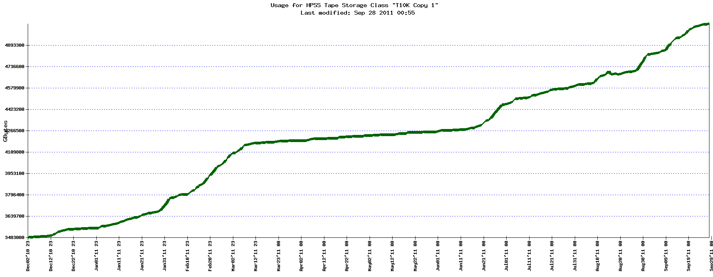
HPSS Copy 1 (all but second LCLS copy)
4.9 PB
3.5PB
Dec 2010
Sep 2011

Slide 21
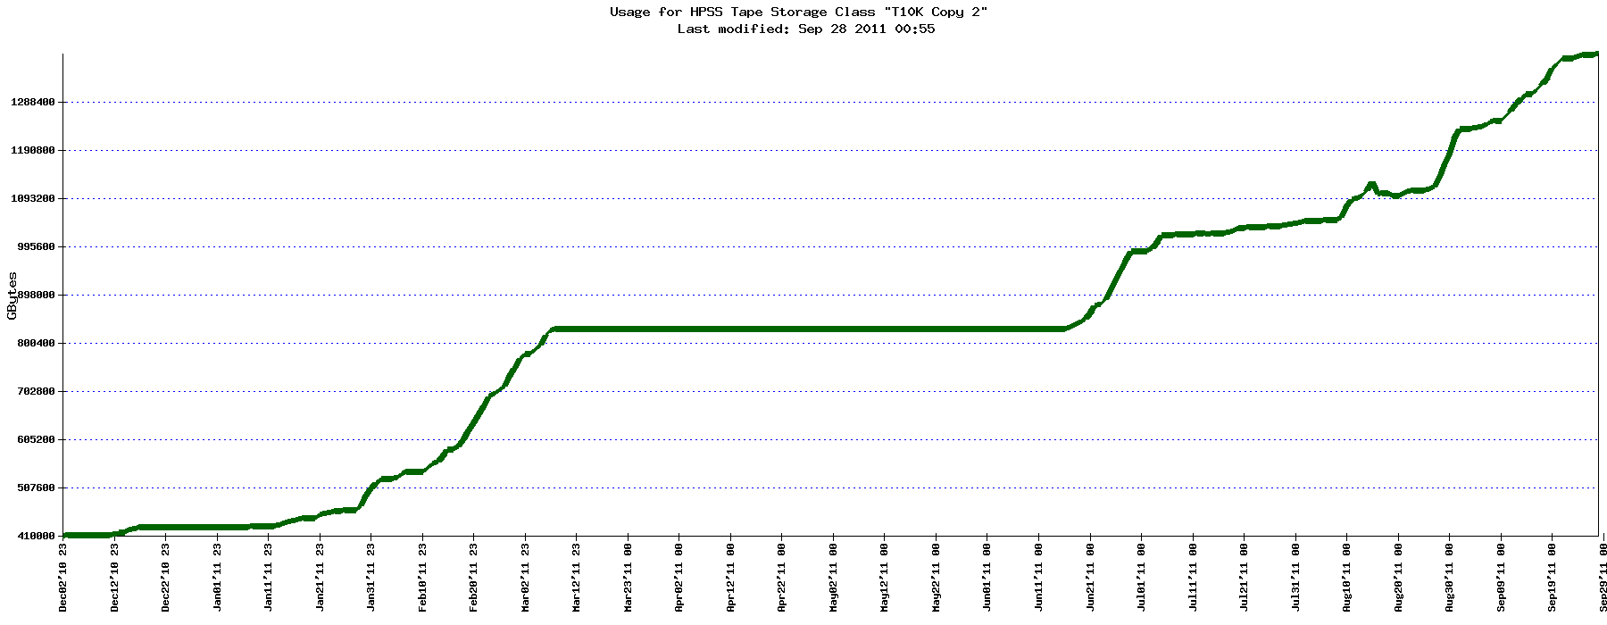
HPSS Copy 2 (just LCLS copy#2)
1.3 PB
0.4 PB
Dec 2010
Sep 2011

Slide 22
The LTDA Power
A deferred cost directly due to the ad hoc nature of the current model, $80K is requested for the express purpose of undoing the temporary power distribution required to accommodate 2011 purchases

Slide 23
Funding Scenario 3
Budget Element | Cost | Funding Model
BLD 50/2012 | $971K ($715/$256K) | Program/ops split
BLD 50/power (deferred from 2011) | $80K | Basic Infrastructure (ops)
Next generation tape drives | $386K | Direct charged back to the programs based on usage
Modest shared storage pool | $140K | Direct charged back to the program based on usage
End of Life Sci Comp | $165K | Basic Infrastructure
In this scenario-there is a renegotiation of responsibility for the BLD 50 infrastructure (or programs will choose to host their own equipment)
$1242K Program charged Costs
$500K Operations

