Slide 1



Fermi Large Area Telescope
“Running Monte Carlo for the Fermi Telescope using the SLAC farm”
Tony Johnson
Stanford Linear Accelerator Center
tonyj@slac.stanford.edu
Fermi Gamma-ray Space Telescope
http://glast-ground.slac.stanford.edu/DataPortal

Slide 2
Contents
Fermi Data Handling Overview
Fermi Processing Pipeline Overview
  Using Pipeline for MC processing
Future plans for Fermi pipeline

Slide 3
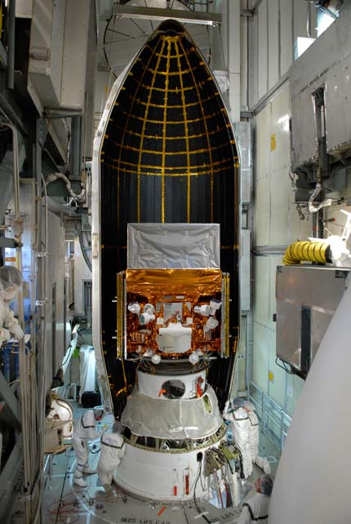
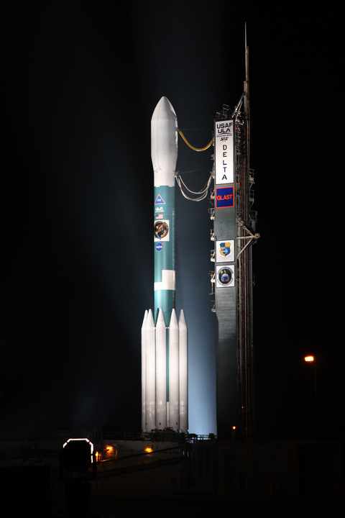
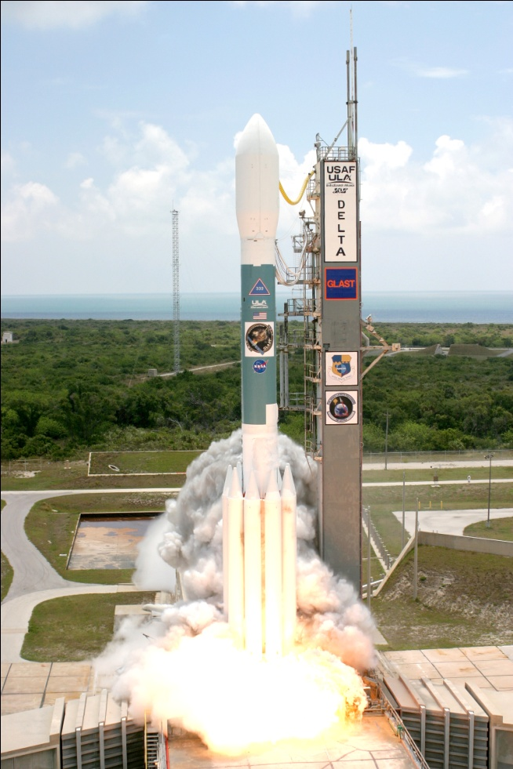
Launched 11 June 2008 – LAT activated 25 June

Slide 4
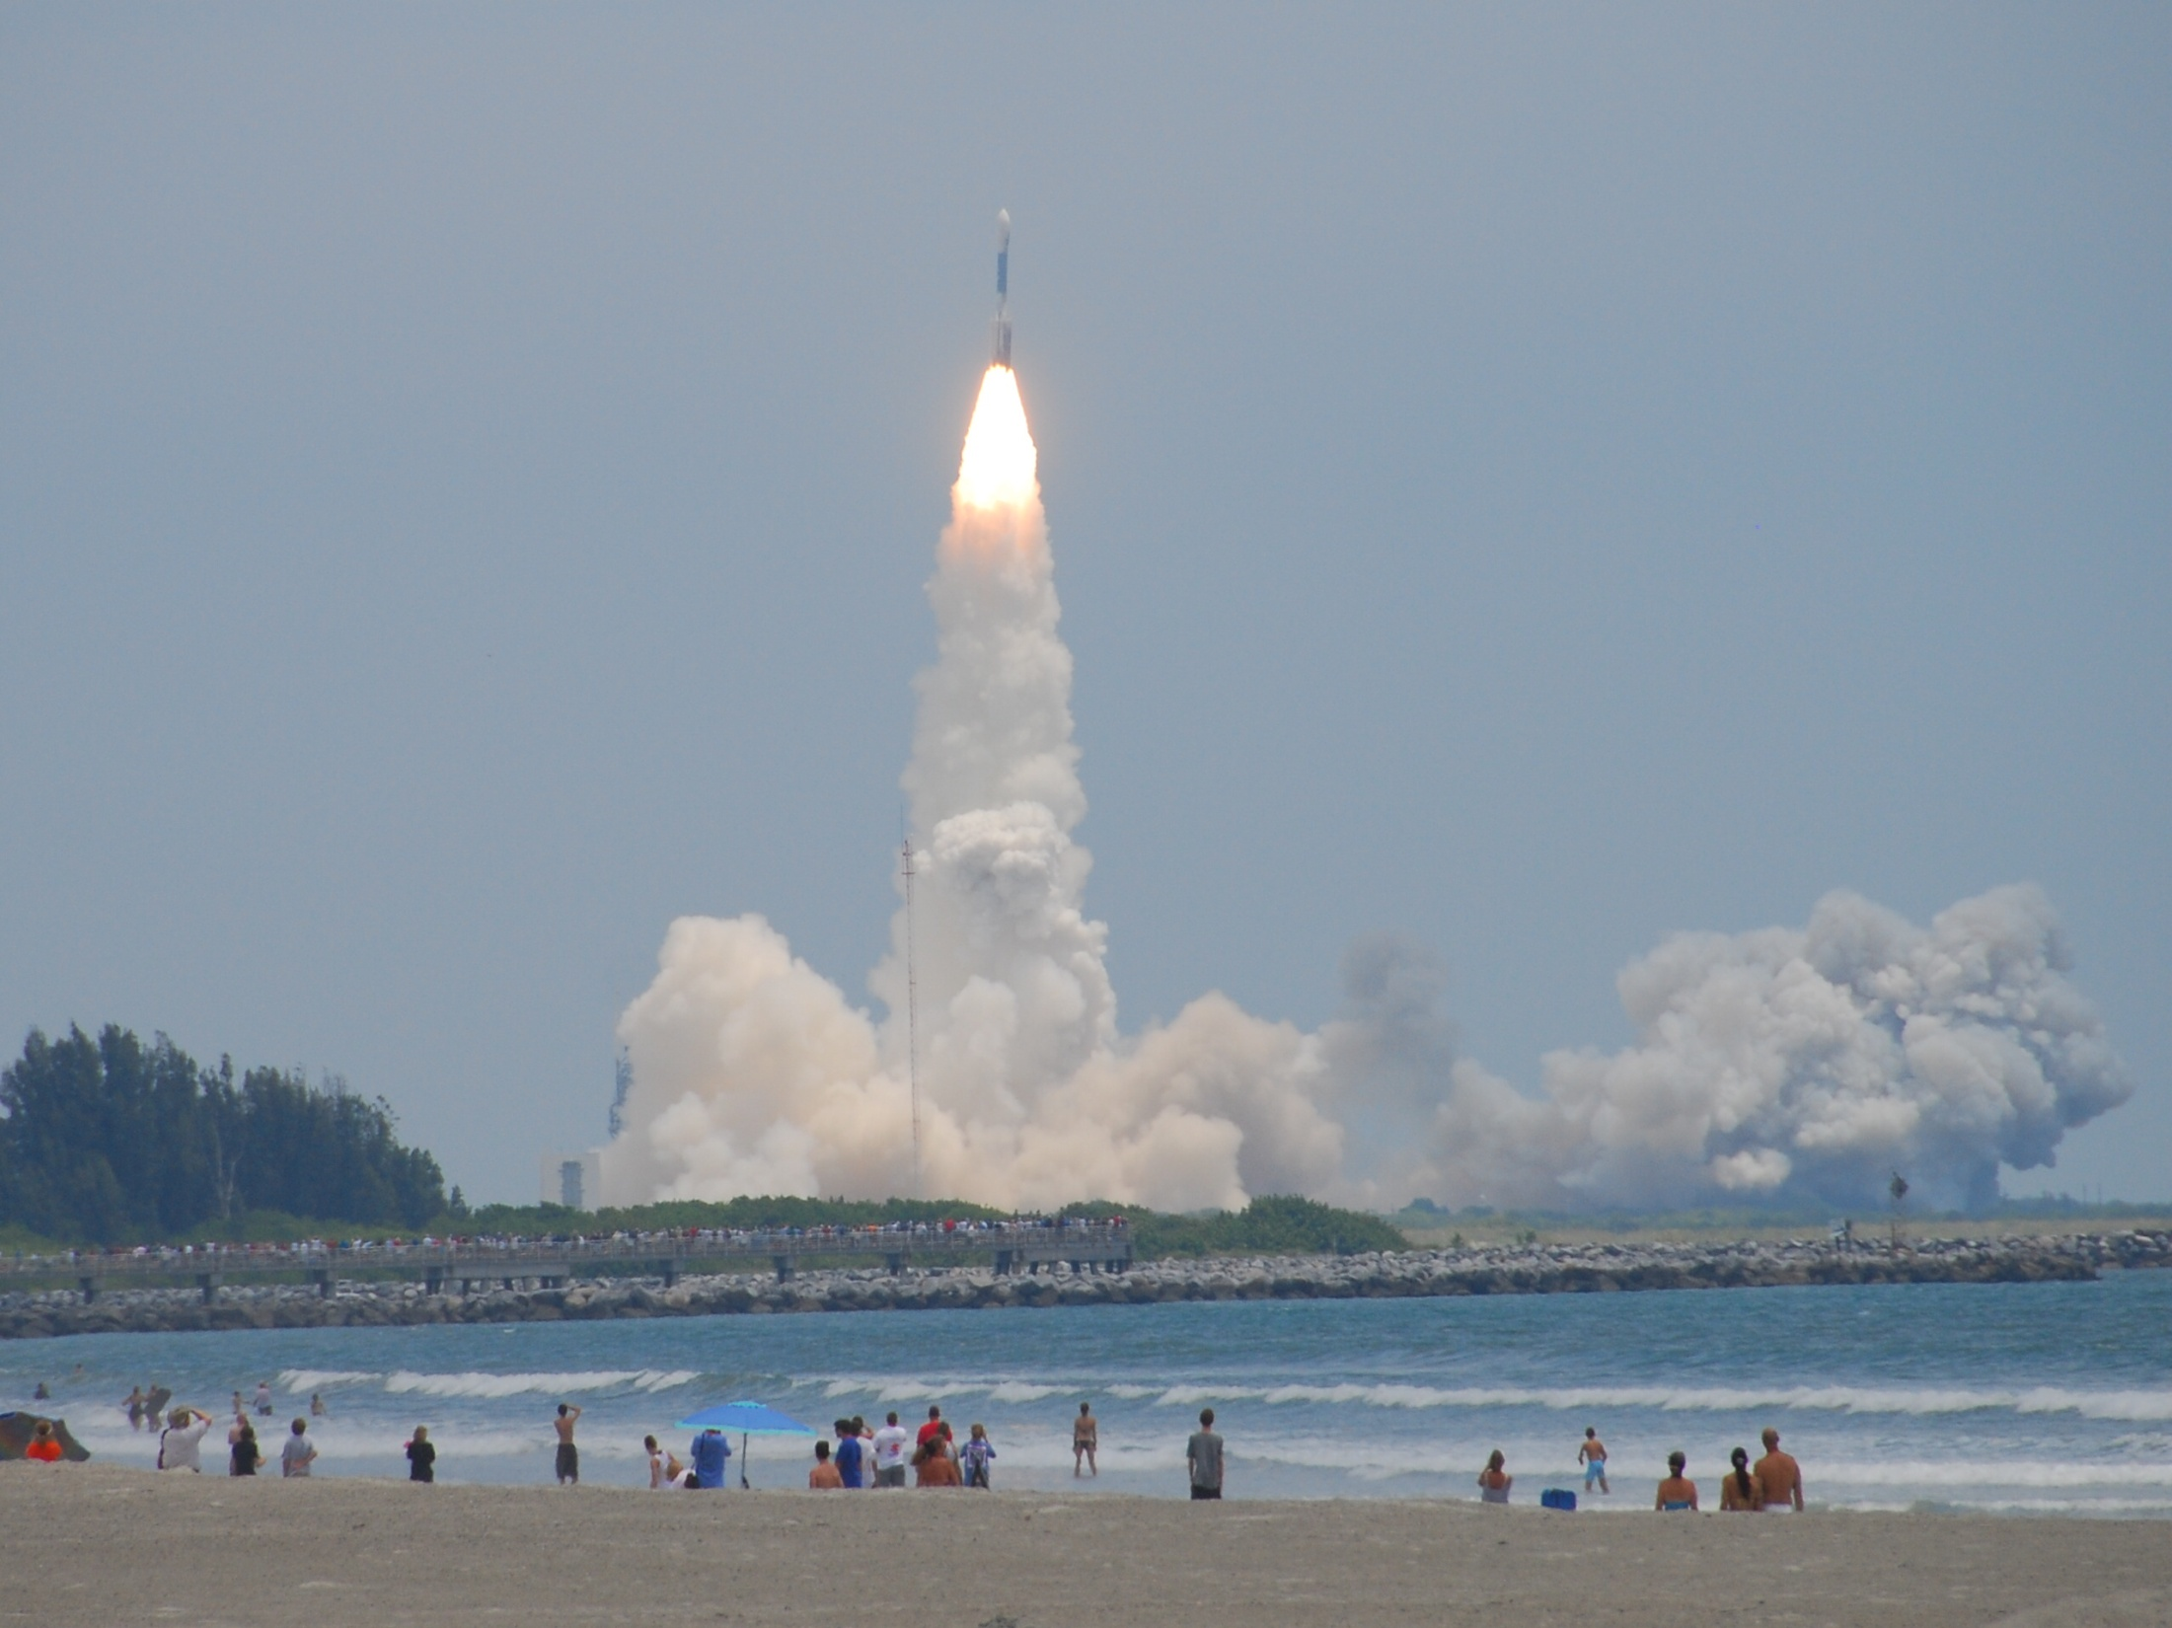

Slide 5

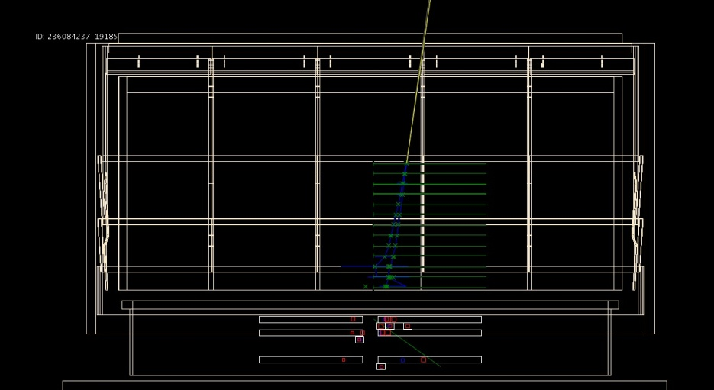
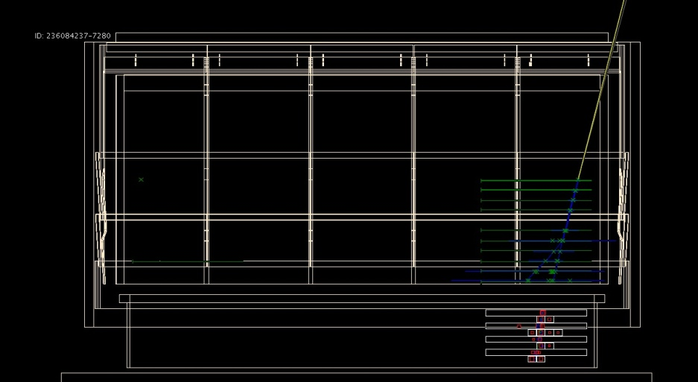
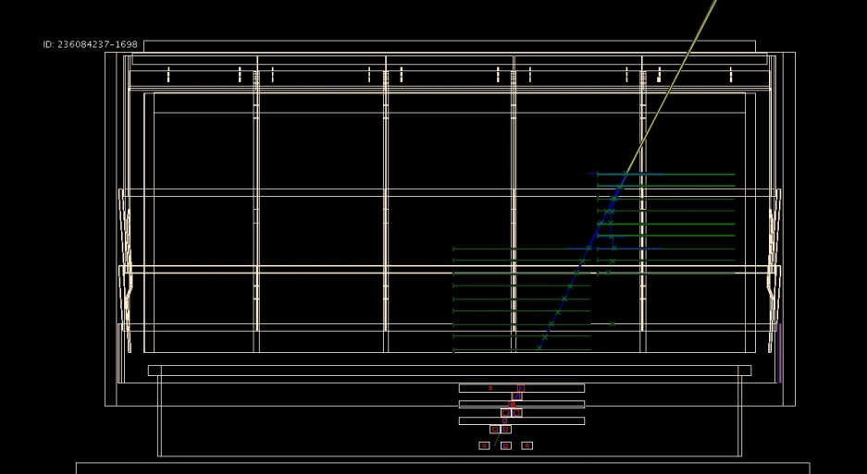
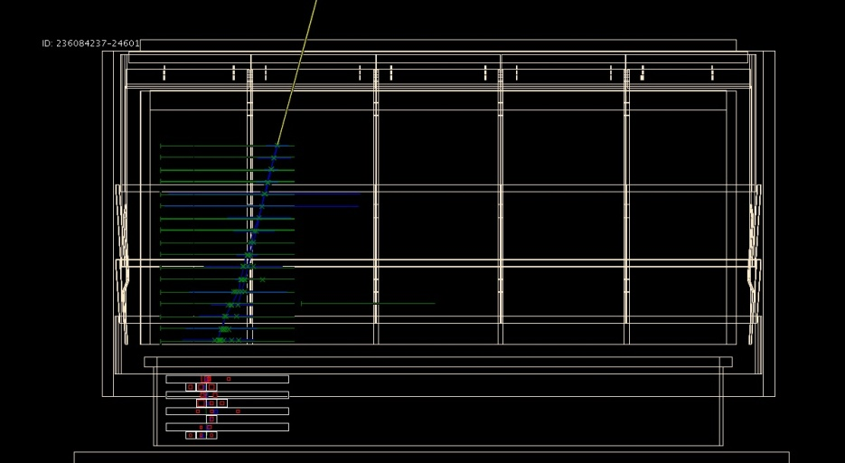
In Orbit: Single Events in the LAT
The green crosses show the detected positions of the charged particles, the blue lines show the reconstructed track trajectories, and the yellow line shows the candidate gamma-ray estimated direction. The red crosses show the detected energy depositions in the calorimeter.
0.25 CPU sec/event to reconstruct: downlink 500 Hz
Each photon event independent of others

Slide 6

Fermi One Year All Sky Map

Slide 7
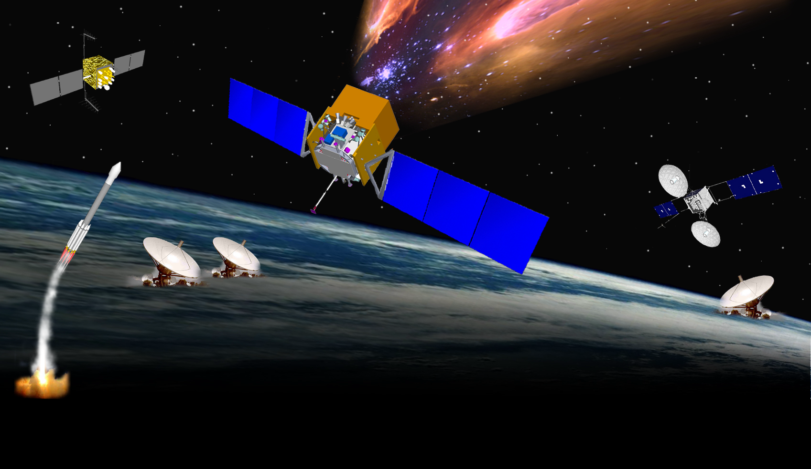
Fermi MISSION ELEMENTS
GPS
•
μ
sec
Large Area Telescope
& GBM
•
Fermi Spacecraft
•
Telemetry 1 kbps
-
•
TDRSS SN
S & Ku
DELTA
7920H
•
•
-
S
-
•
GN
•
LAT Instrument Science Operations Center (SLAC)
Schedules
White Sands
Mission Operations
Center (MOC)
Fermi Science
Support Center
HEASARC
GRB
Coordinates Network
Schedules
GBM Instrument
Operations Center
Alerts
Data, Command Loads

Slide 8
Data Processing Flow at SLAC
Downlink from Goddard Space Flight Center ~8/day
  15 GB total daily
Half-pipe
  Automatic launched as data arrives at SLAC
  Decode & repackage incoming data
    Split science data from telemetry data
Level 1 Processing
  Full event reconstruction: factor ~x50 expansion on raw data! 750 GB/day
    To turn around data in required timeframe we typically use ~800 cores
  Data Quality Monitoring
  Transfer science summary files to Goddard Science Support Ctr - 200 MB/day
  Processing requirements
ASP (Automated Science Processing)
  GRB and Flare detection
  Spectral analysis

Slide 9
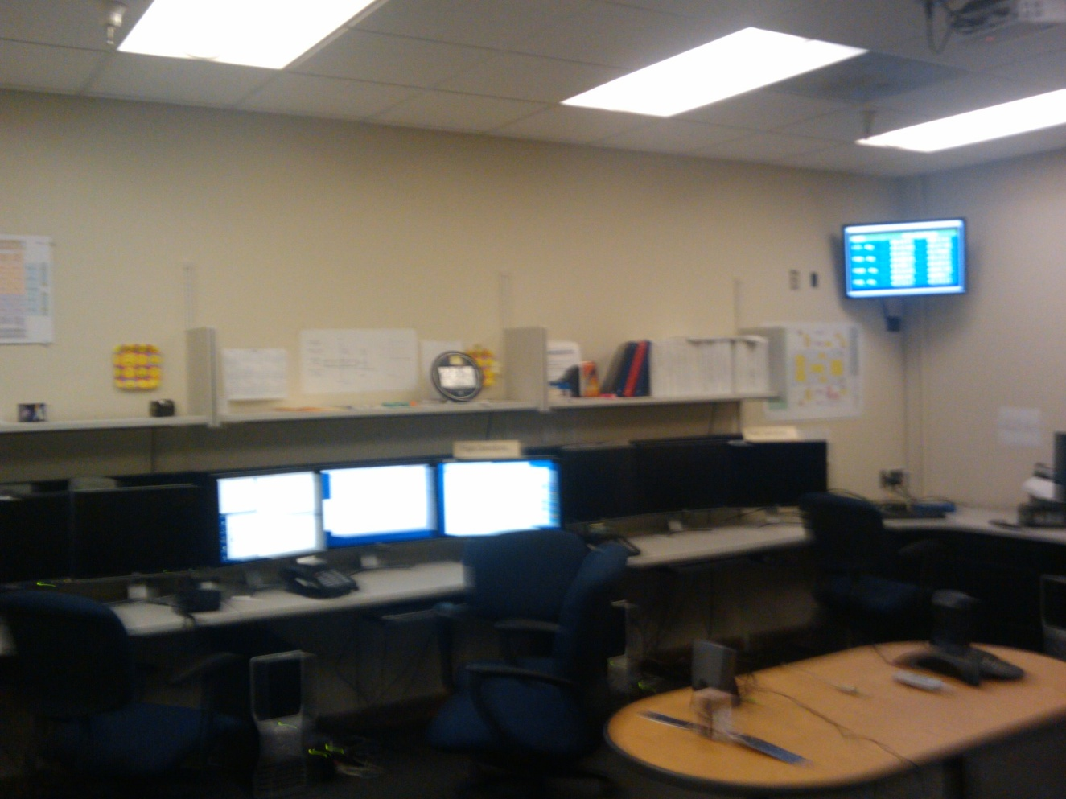
ISOC Control Room
All of the data processing and data quality monitoring can be done from the web
  No need for anyone in the control room, monitoring load shared globally

Slide 10
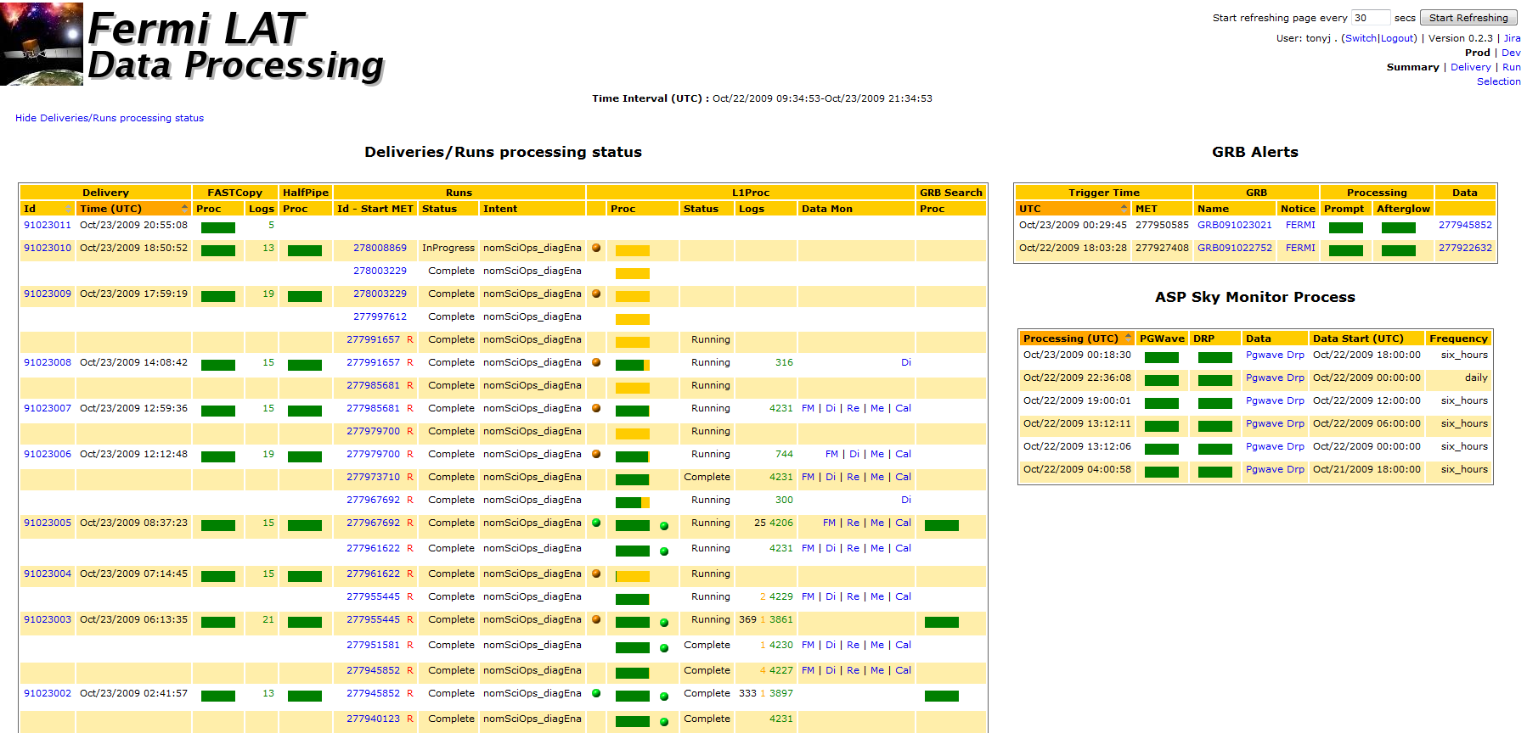
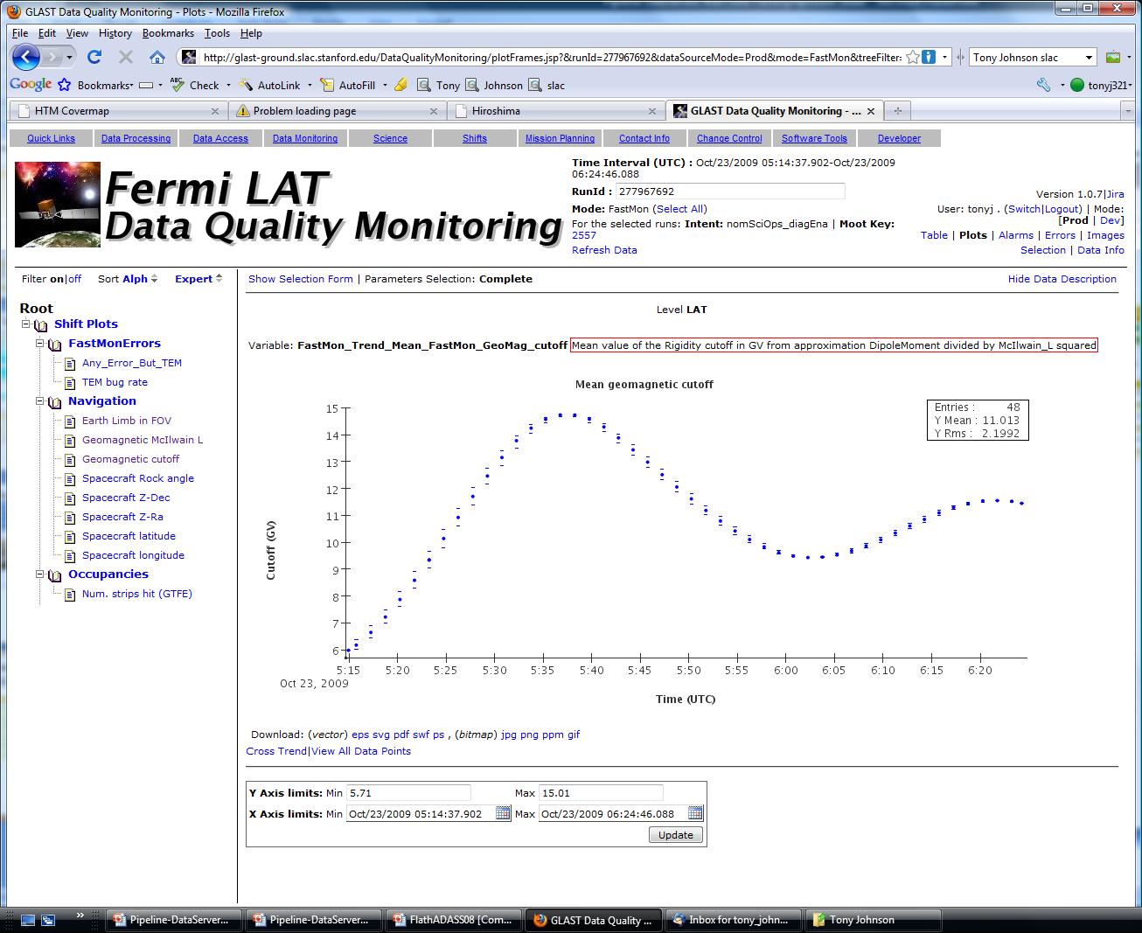
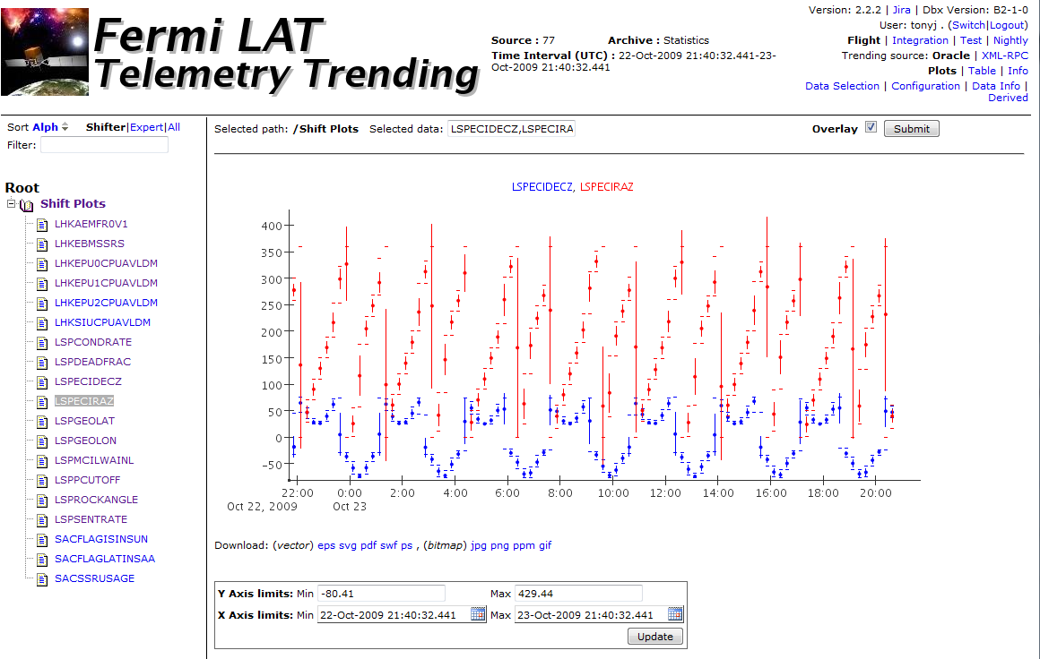
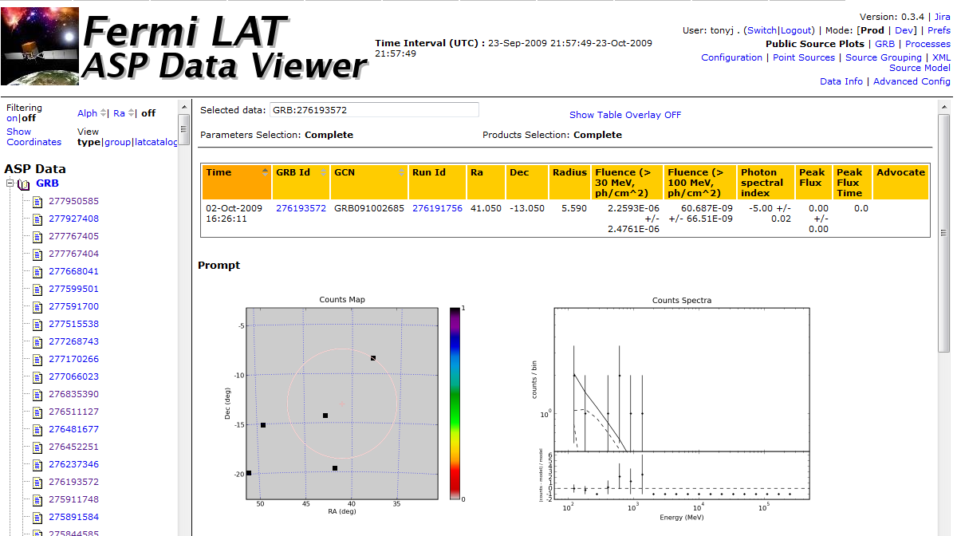
Monitoring Pipeline + Data Quality

Slide 11
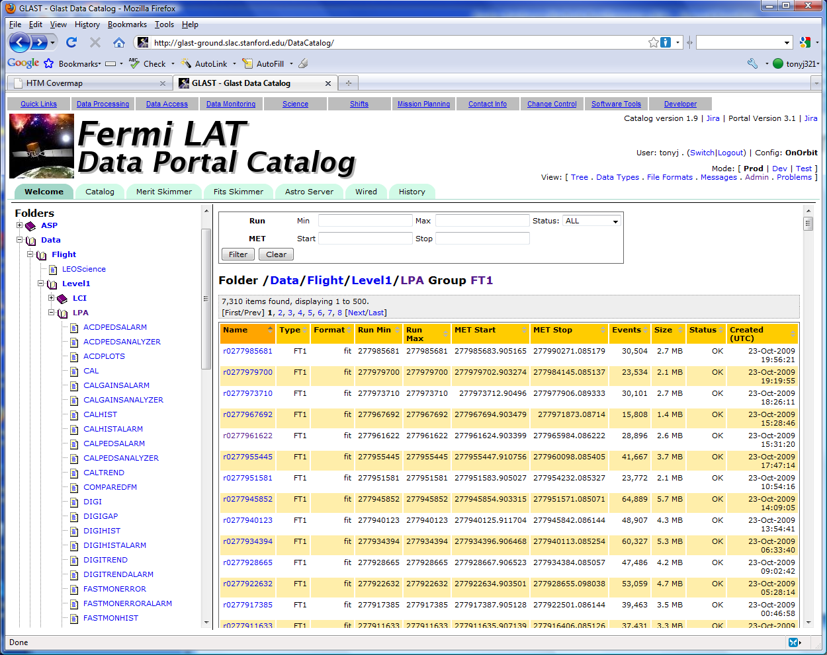
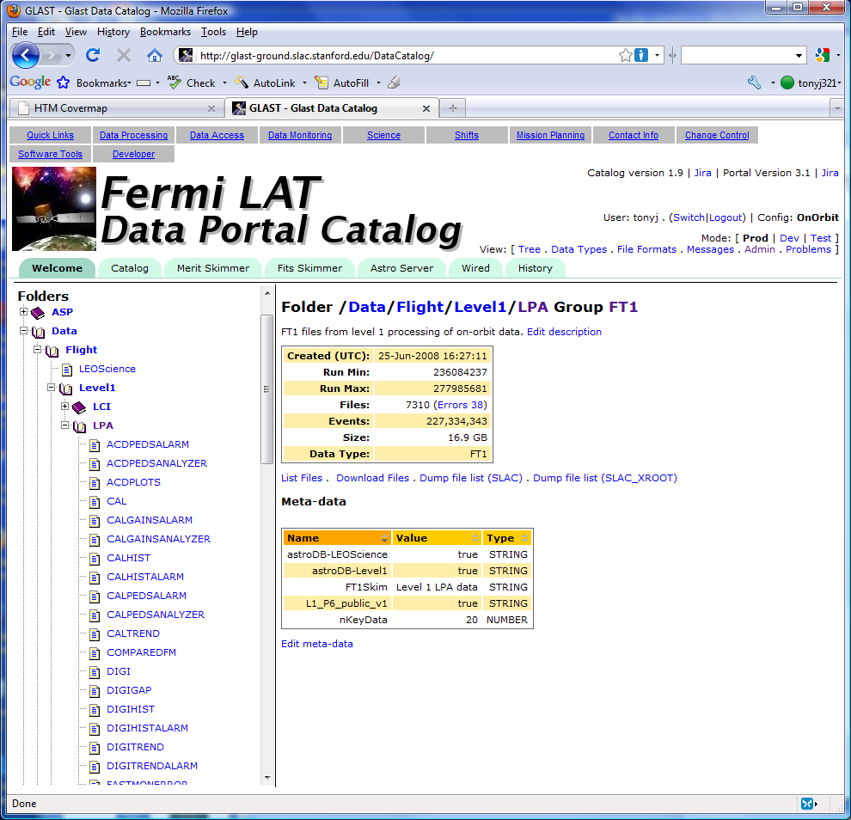
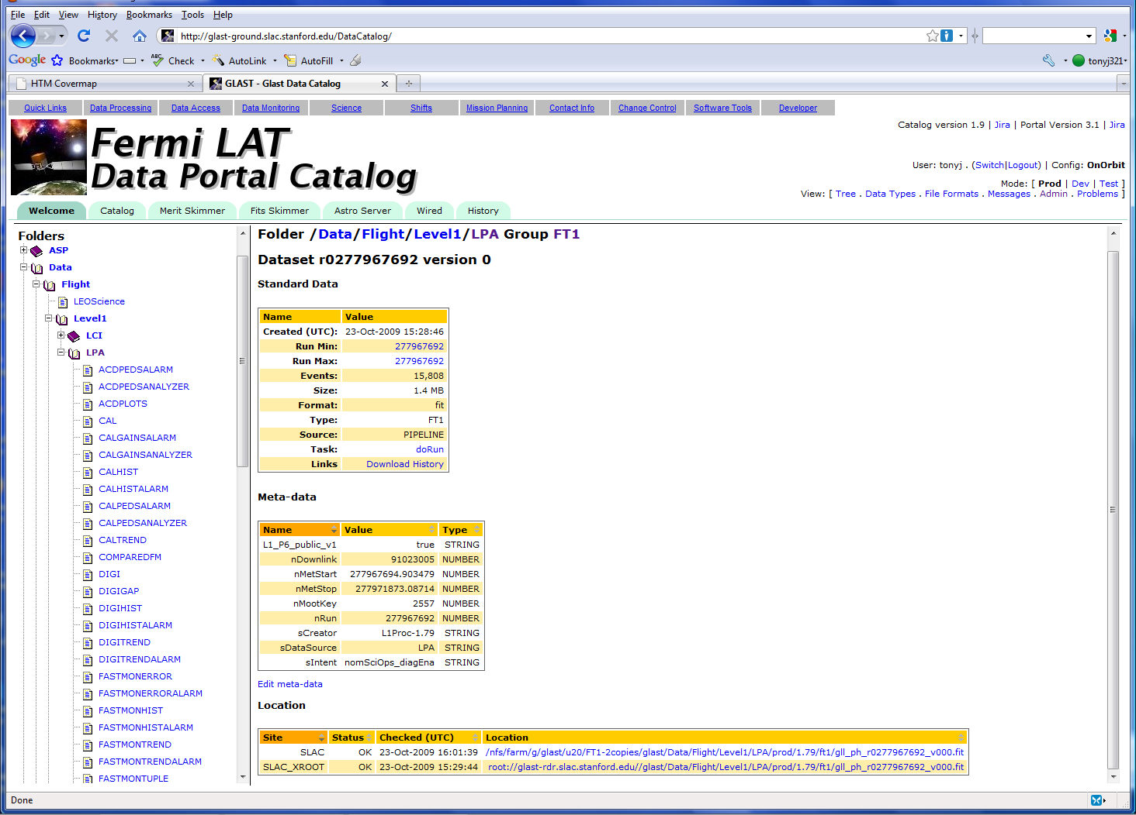
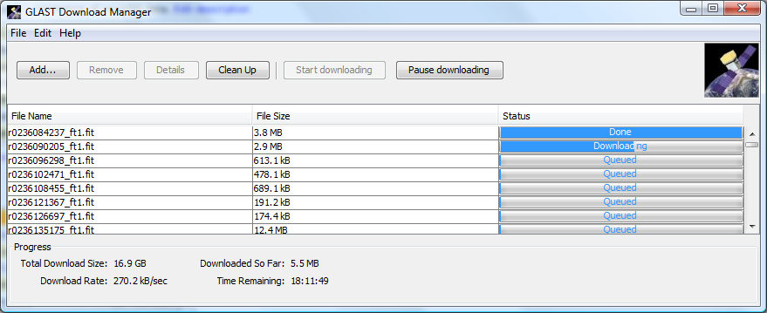
Data Access

Slide 12
Pipeline Introduction
Pipeline design goals
  Automated submission and monitoring of batch jobs
    Very high reliability
  Ability to define graph of jobs to be run
    Ability to parallelize processing tasks
    Ability to perform simple computations as part of job graph
      E.g. Compute how many parallel streams to create as a function of the number of events to be processed
  Ability to “Roll Back” jobs (whether successful or not)
    Capability to automatically compute sub-graph of jobs to rerun
  Maintain full history of all data processing
  Data catalog to keep track of all data products
  Web interface for monitoring jobs and submitting new tasks
    Plus command line client, and programmatic API

Slide 13
Pipeline and Data Catalog Components
SLAC
Oracle
Command
Client
read-only
Data
Catalog
Client
Catalog Web
Interface
Client
Data
Portal
Client
Client
SLAC
SLAC
Batch
Farm
Client
Job Control
Line Mode
Client
Pipeline
Server
IN2P3
Client
Batch
Farm
Job Control
Client
Oracle
INFN / Grid?
Pipeline
Web Interface
Jython
Engine
Batch
Farm
read-only
Job Control

Slide 14
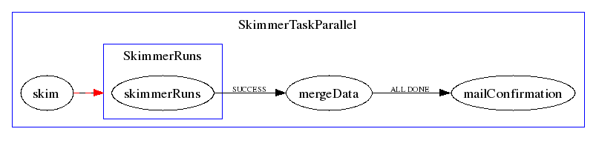
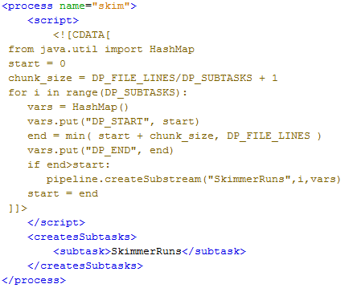
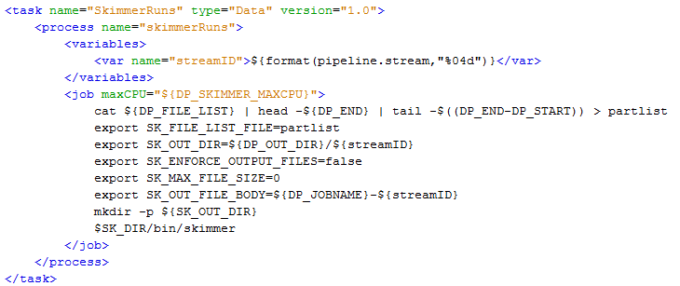
Pipeline Task specification (XML)

Slide 15
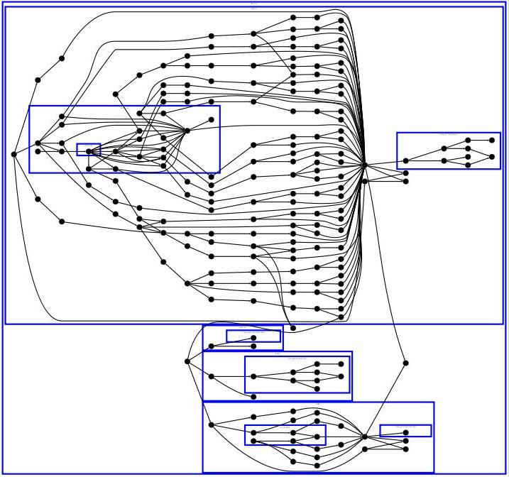
Level 1 Task Specification
Digitization
Reconstruction

Slide 16
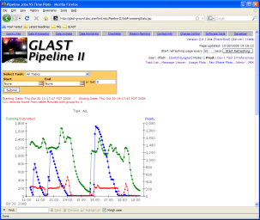
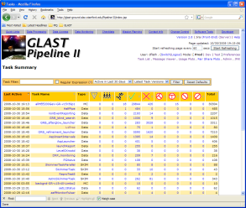
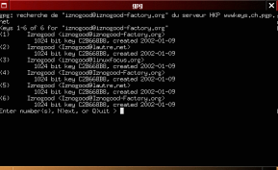
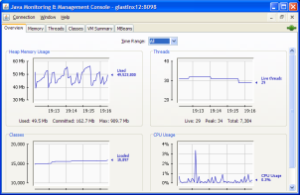
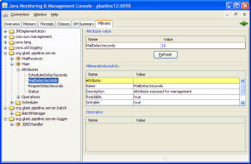
Pipeline Implementation
Back-End
Components
Connection
Pool
HTTP
Middle-Ware
Tomcat Server
Web
Application
Front-End
User Interfaces
Web Browser
Oracle
RDBMS
Stored
Procedures
JMX
RMI*
Connection
Pool
Pipeline
Server
SQL
MBean
Interface
JMX
Line-mode
Client
TNS
Data
SQL
JMX
JConsole Monitor
RMI
Scheduler
Job Control Service
Thread
Pool
Batch
Farms
Apache/James
Email
POP3

Slide 17
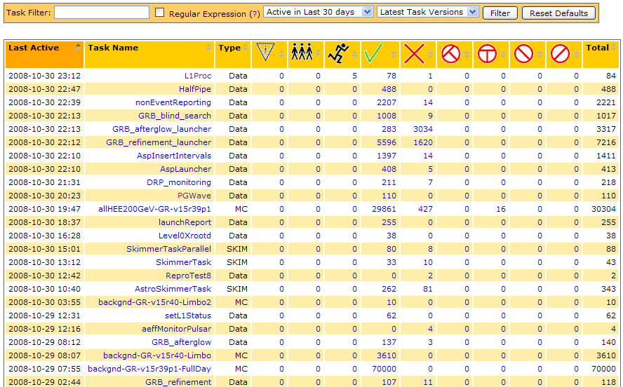
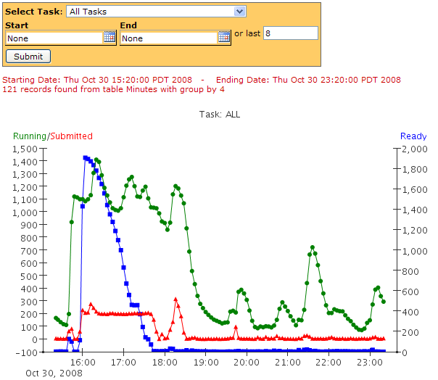
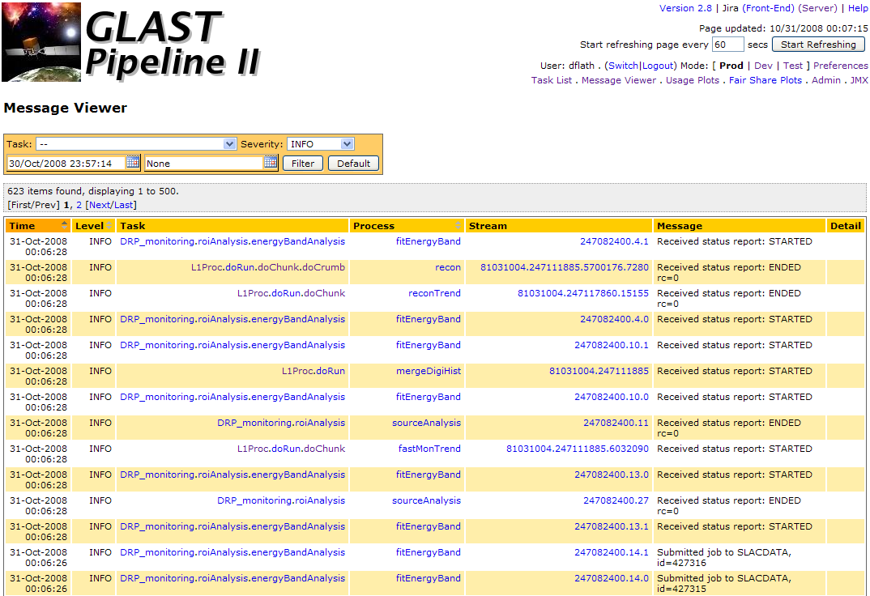
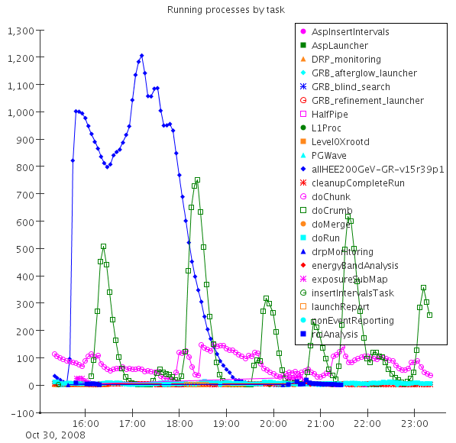
Pipeline Web Interface

Slide 18
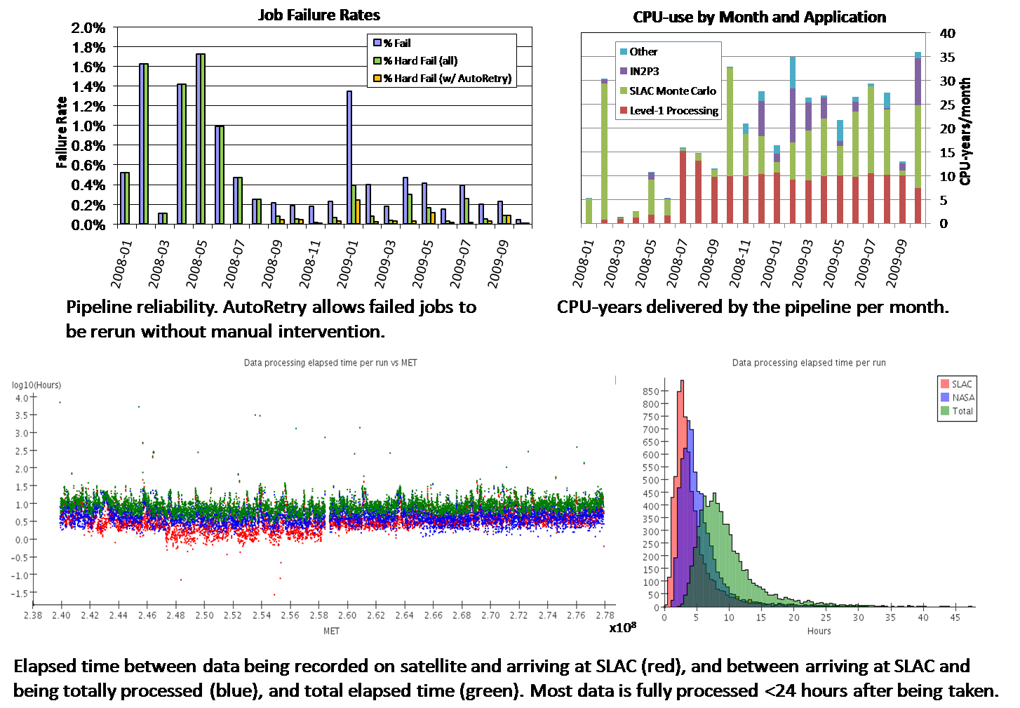
Pipeline Performance and Reliability
x10⁸

Slide 19
Pipeline for MC production
Why use the pipeline for MC production?
  Automated submission of thousands of jobs
  Complete bookkeeping and access to log files from web
  Ability to easily rerun failed jobs (automatically or manually)
  Data catalog + download manager simplifies access to data products
  Useful facilities not directly pipeline related
    “xrootd” alternative file system which scales to large number of readers/writers much better than NFS
    GPLTOOLS: Set of python utilities for staging input/output from scratch disk to/from NFS/xrootd
Fermi has used pipeline for all MC production
  250 CPU-years of MC production in last two years

Slide 20
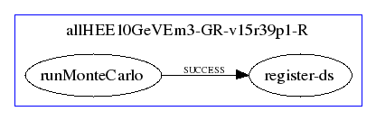
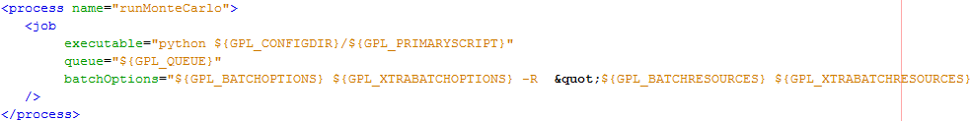
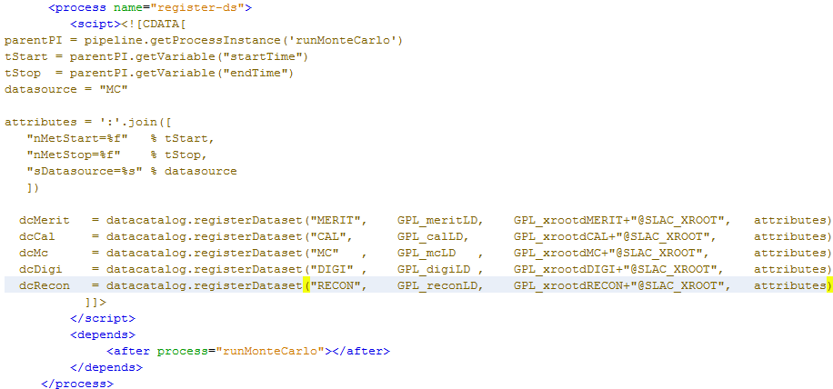
Pipeline for MC production

Slide 21
Pipeline + Data Catalog Plans
We have already set up a second “non-Fermi” version of pipeline server and data catalog
  Currently starting to be used for EXO and AGIS
    EXO will use pipeline for data processing starting next summer
    AGIS will use pipeline for MC data processing
We are working with Fermi Italian collaborators to create a job submission daemon to work with the Grid
  We would like to extend pipeline to be able to submit jobs to the “Cloud”
Improved Data Catalog web interface with more “AJAX” features.

