Slide 1

Fermi GBM Status, Results, & Plans
Colleen Wilson-Hodge
Fermi GBM PI, NASA/MSFC
Fermi Users Group Meeting
Aug 29, 2024

Slide 2
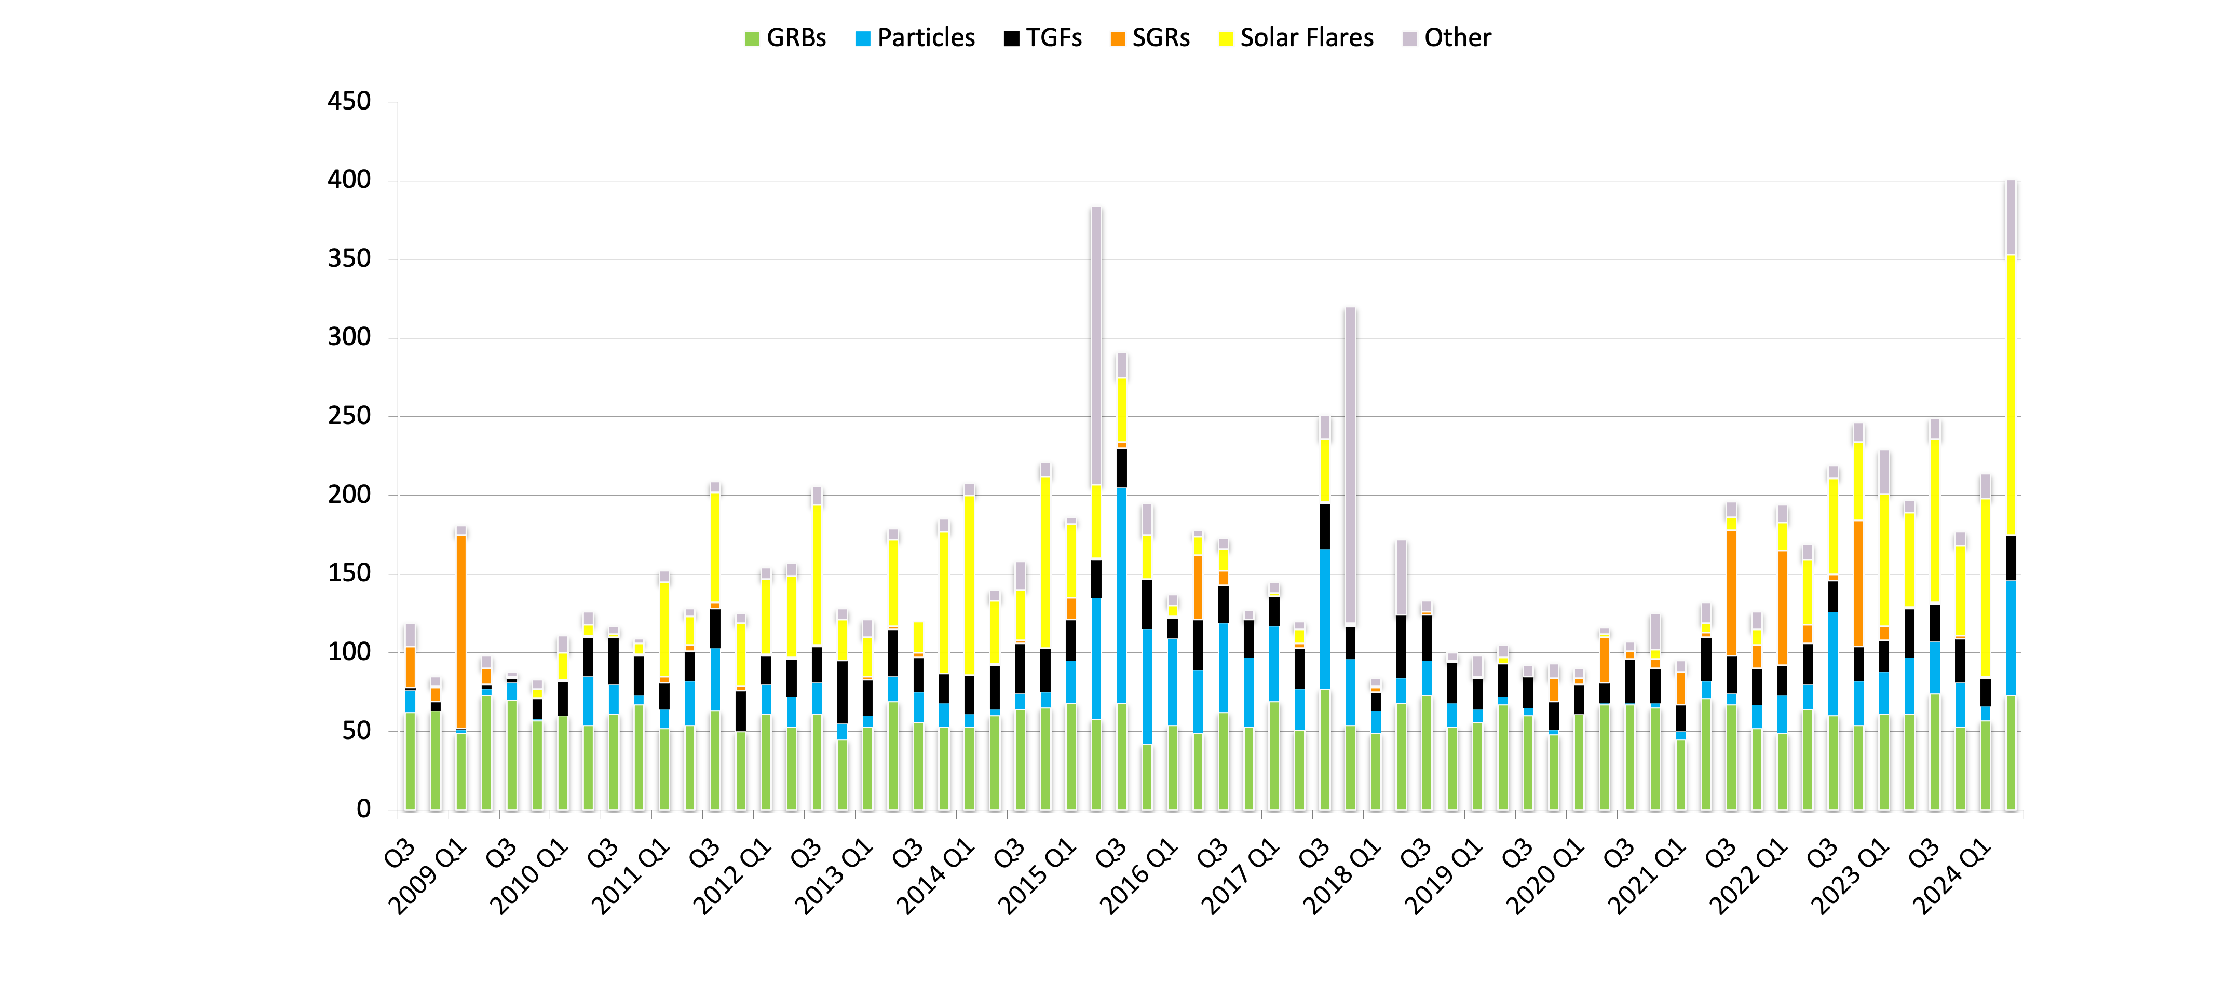
GBM Trigger History
As of Aug 25, 2024:
10648 Triggers
3829 GRBs
1565 Particles/SAA
1425 TGFs
644 SGRs
2124 Solar Flares
1034 Other
Triggers per Quarter
Quarters

Slide 3
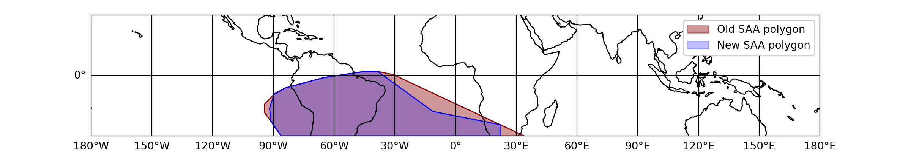
Operational Updates
Thresholds lowered from 4.5 to 4.2 for trigger algorithms 8-11 and algorithms 57-60 enabled with a 4.2 sigma threshold to allow more immediate alerts for subthreshold detections of SGRBs.
New GBM Flight Software loaded Mar 26, 2024
  Added repeats of the immediate summary packet (27 s, 87 s)
    In last quarter – 8 triggers used the new repeated packet to generate alerts
  Added GBM FSW commands to allow a two-part SAA region (see figure)
    increases livetime by about 2%.

Slide 4
GBM Progress on previous Senior Review Objectives
II.1.1 Exploring Multimessenger sources: Compact Binary Mergers
  Science objectives: disentangle jet structure & using time delays as probes – awaiting another GW/GRB detection
    Related science accomplishments
      Strongly constrained one model that predicts gamma-ray emission from BBHs (Fletcher et al. 2024 (GBM-O3) )
      Discovered two long GRBs associated with kilonovae and neutron star mergers: GRB 230307A ( Levan et al. 2023) and GRB 211211A (Veres et al. 2023) – GW detectors not active during these GRBs.
  Technical objectives
    Updating transient alert technology – updates of GBM alerts to GCN Kafka in progress. Expect to have active Kafka alerts by SR submission, providing additional information to the community not available in classic GCN.
    Targeted search alert automated – currently sending Kafka alerts to a private channel to LVK. Plan to make public along with targeted search results webpages
    Onboard threshold reduction tests
      Three additional SGRBs detected in 5 months: ~18% increase!
      Reduced threshold from 4.5 to 4.2 for four algorithms and activated 4 unused algorithms
      FSW consistently identifies non-GRB sub-threshold events, so no new GCNs needed

Slide 5
GBM Progress on previous Senior Review Objectives
II.2.1 Era of Big Surveys: Extreme Physics of Magnetars
  Science objectives: Provide clarity on FRB-SGR connection – in
  Technical objectives
    Search for CHIME FRB counterparts with adapted GBM targeted search
      In progress- MOU established with CHIME. Updates to targeted search funded by GI program. Expect to have initial search up and running by ~end of September 2024.
    Additional extra galactic Magnetar giant flares found: GRB 180128A (Trigg et al. 2024) and GRB 231115A (Trigg et al 2024 in prep – expected to be submitted in 1-2 months)
II.3.2 High Energy Universe: VHE GRBs
  Science objectives: constrain emission mechanisms & inform VHE facilities to perform follow-up observations
    GBM Team worked with H.E.S.S. to ingest GBM HEALPix localization files. GRB follow-up results found here https://grbhess.github.io
II.4 Low Probability High Reward: GRB neutrinos
  The GBM targeted search automatically follows-up reported astrophysical IceCube neutrinos. No detections yet.

Slide 6
Draft GBM science priorities & tech initiatives
GBM synergies with Rubin (possibly Roman) science
  Science
    Detect counterparts to GBM GRBs (e.g., kilonovae, afterglow, host galaxies, etc.) – expect ~dozens
    Determine redshift measurements for GBM GRBs w/ Rubin counterparts
  Tech initiatives
    Collaborate with Rubin scientists to develop a pipeline to filter Rubin transients for GRB counterpart properties
    Correlate filtered candidates with GBM localization regions

Slide 7
Draft GBM science priorities & tech initiatives
Enabling Multimessenger and TDAMM science
  Science
    Distinguish between different GRB origins – mergers, collapsars, magnetars through follow-up
      Identify GRBs for VHE (long) and kilonovae (short) follow-up
      Provide rapid spectral information to enhance Swift GUANO and SVOM
      Provide minimum variability timescales to identify magnetar origins
      Improve catalog information
      Improve localizations for long GRBs (VHE follow-up)
  Tech initiatives
    Provide the community with updated near-realtime analysis
      Update realtime analysis to include automated classification updates, brightness flags, spectral parameters, duration, and minimum variability timescales. Includes developing rapid response generation to support automated analysis
      Provide community tools to rapidly determine if a transient was in GBM’s field of view.
      Update the internal Burst Advocate tools to use the public Gamma-ray Data Tools package – also allowing development of public tools to replicate BA analysis and additional tutorials
    Modernize GBM catalogs and GRB Analysis
      Provide Full posteriors rather than only centroids and 1-sigma errors for GRB localizations
      Use t90 to calculate Eiso, including spectral evolution
      Provide tools to the community to perform these calculations
    Explore localization improvements
      Allow spectral templates to vary across long GRBs to incorporate attitude and spectral changes – important for VHE follow-up

Slide 8
Draft GBM science priorities & tech initiatives
Discover new gamma-ray transients with Fermi GBM
  Science
    Search for gamma-ray counterparts to Fast Radio Bursts – put preliminary search into automated production mode.
    Search for counterparts to Einstein Probe transients – longer timescales, softer spectra
  Technical objectives
    Extend targeted search capabilities to include different spectral shapes and timescales
    Study extending the untargeted search to report transients > 2 s
Improving Community access to GBM data
  Provide a web portal to allow community requests for targeted search analysis and access to targeted search results
  Provide Jupyter notebooks for a broadened set of examples to help users analyze GBM data.
  Currently exploring options for hosting the web portal and Jupyter notebooks
    NASA’s Science Managed Cloud Environment (SMCE), HEASARC’s Formax initiative, or the Fermi Science Support Center (FSSC)

Slide 9
Over guide technical initiatives
Full-update of the Burst Alert Processor
  rewrite from scratch, improving efficiency and adding features – person power for code development and testing.
Atmospheric Scattering
  update database using modern computers –needs computing resources and person power. Have had considerable community interest and need. Usable for other missions.
Localization improvements
  Produce custom DRMs for individual well localized GRBs (<1 deg), bypassing the response generator – to improve localization systematics – person power and possibly computer resources.
  Many GEANT simulations to perform a localization – finer sky grid, multiple spectral templates – requires a computer with many cores.

Slide 10
Inclusion initiatives and accomplishments
Fostering a community where everyone feels that their input is valued
  Slack channels, BA/MMBA activities, BA self-governing, open meetings
Enabling early career members to lead papers with mentorship
  BA/MMBA publication policies, foundational team papers (references), first authorship
Recommending early career members for invited talks
Developing policy for onboarding Burst Advocates
  Policy describes what is expected of BAs and must be agreed to by BA and supervisor
Performing team brainstorming sessions for GI proposals and Senior review initiatives – open meetings
Developing an anonymous feedback system – through slack
Participating in the Fermi-wide mentorship program
Holding frequent full-team meetings with post-meeting notes sent out
  Ensuring that unwritten policies are written down and agreed to by the team
  Revisiting Team and meeting norms to update for current team – future team meeting

