Slide 1
2w Cal Shot Cycle and Concept of Operations for AMCIA+ (if LLE were designing the controls)
Build shot template from Shot Executive
Approve/pre-shot template
Build Power Conditioning Template
Approve Power Conditioning Template
Download Power Conditioning Template
Load/set-up pulse shape
Load latest Wavefront Control Correction
Configure system for 1w alignment
Align injection table to 2w Diagnostic Package
Perform wavefront correction w/o PID
Align main cavity pinholes
Set up apodizers
Set timing
Sweep Bays
Run wavefront correction with PID
Enable SSD Bandwidth
Set beam energy
Configure devices for shot and confirm
Ensure Calorimeter software ready
Start PEPC
Start charging
Monitor systems during shot cycle
Resume normal access in bays
Review shot data

Slide 2
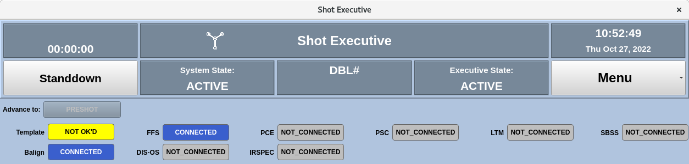
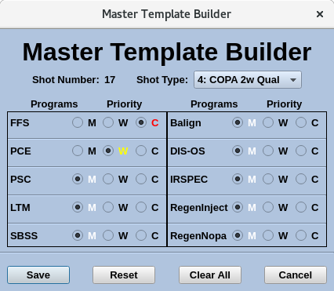
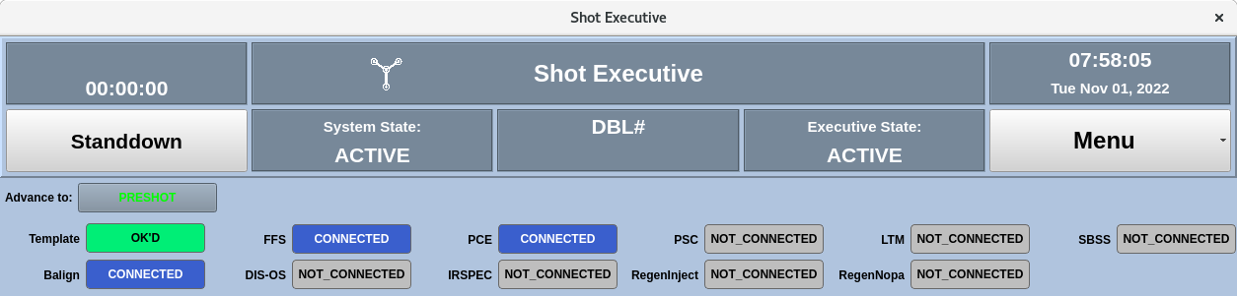
1. Build shot template from Shot Executive
2. Approve/pre-shot template
Click on the Template button (yellow ‘Not OK’D) to bring up the Master Template Builder (SE – Use Case 1)
Select the shot type, pulse shape (not shown), and Energy at Termination (not shown) (SE:MTB – Use Case 1)
Review and update the default template to ensure proper subsystems included in shot (SE:MTB – Use Case 2)
Save Master Template (SE:MTB – Use Case 3)
Click on the now Green Advance to Preshot button on the Shot Executive (SE – Use Case 2)

Slide 3
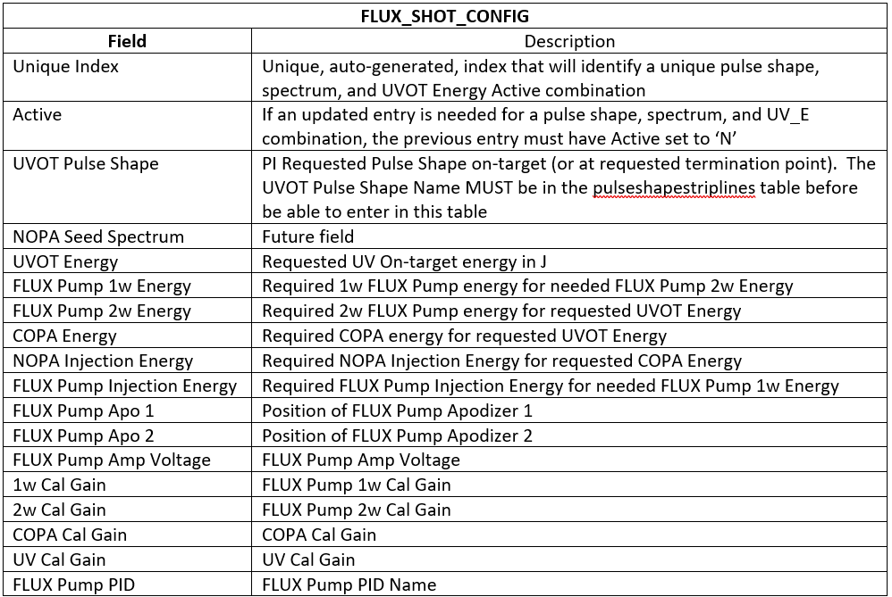
Important note about how this would be handled at LLE/FLUX
The system shot types/terminations, pulse shapes, and associated system configurations are managed by the database
The user selections and configuration is then saved to the database for other programs to access
Add pulseshapestriplines

Slide 4
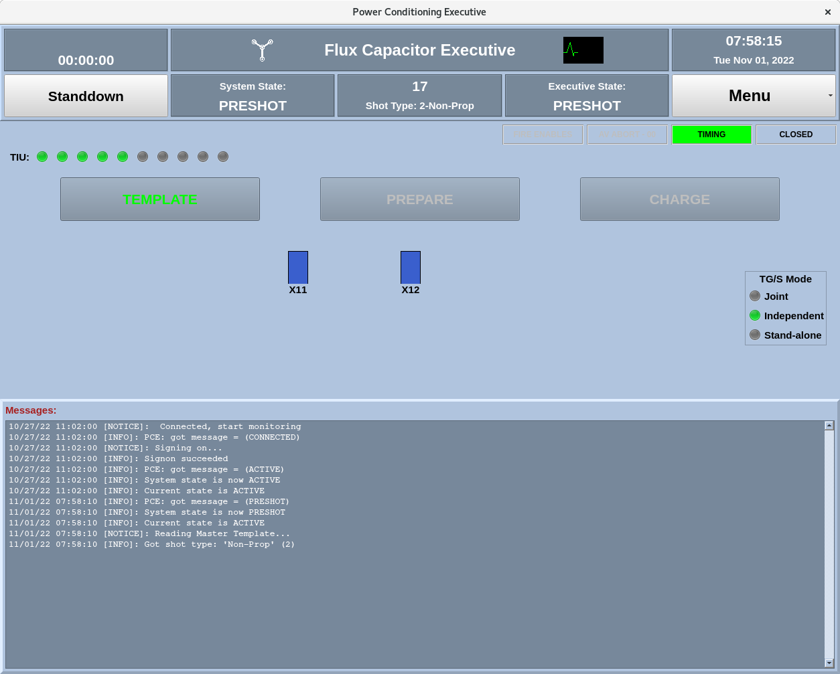
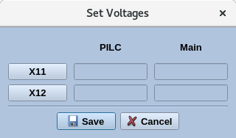
3. Build Power Conditioning Template
From the Power Conditioning Executive click on the ‘Template’ button (PCE - Use Case 1)
‘Set Voltages’ pop-up will come up auto-populated with voltages from selected configuration. (PCE - Use Case 2)
  Save Voltages (PCE - Use Case 3)

Slide 5
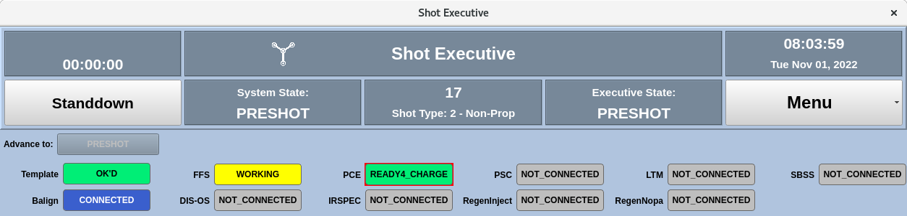
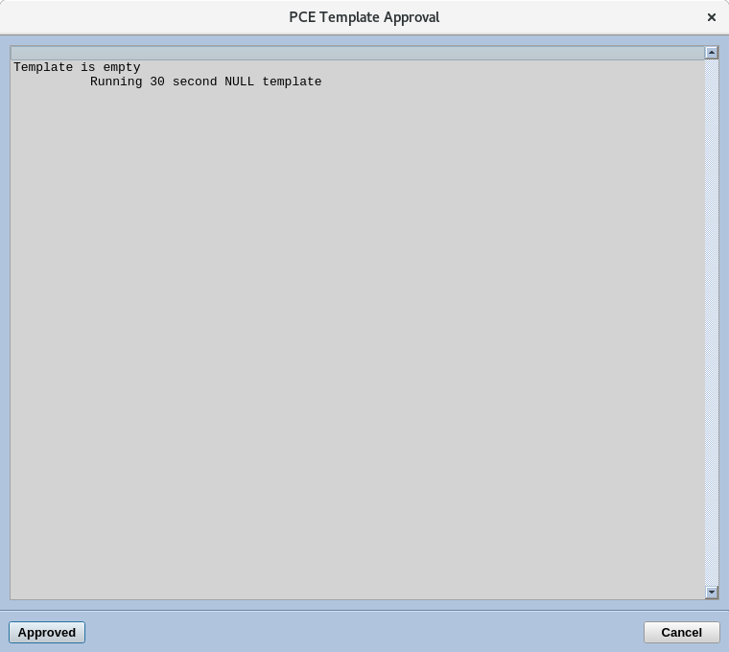
4. Approve Power Conditioning Template
The PCE Template Approval dialog will pop-up for the Shot Executive (SE - Use Case 3)
  The OMEGA system is designed on the premise that there are independent operators running the PCE and the SE
Review and Approve the PCE Template (SE - Use Case 3)

Slide 6
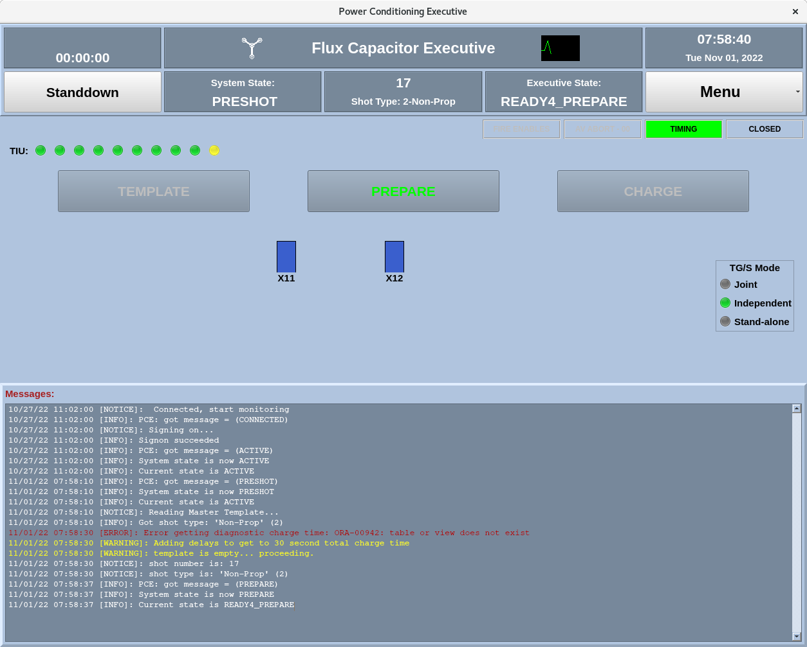
5. Download Power Conditioning Template
On the PCE, click on the ‘Prepare’ button (PCE - Use Case 4)

Slide 7
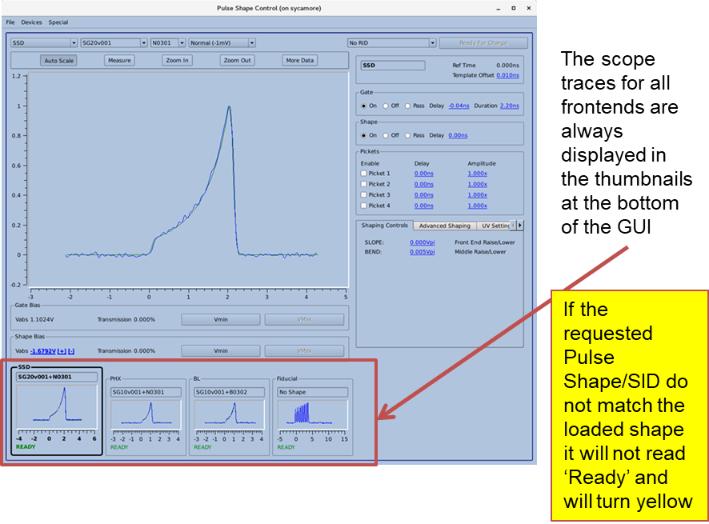
6. Load/set-up pulse shape
If the loaded pulse shape is the correct shape for the requested shot, continue (PSC – Use Case 1)
If not, the pulse shape name will be yellow (PSC – Use Case 2)
From the Injection Software, place the pre-amplifiers in standby mode (InjGUI – Use Case 1)

Slide 8
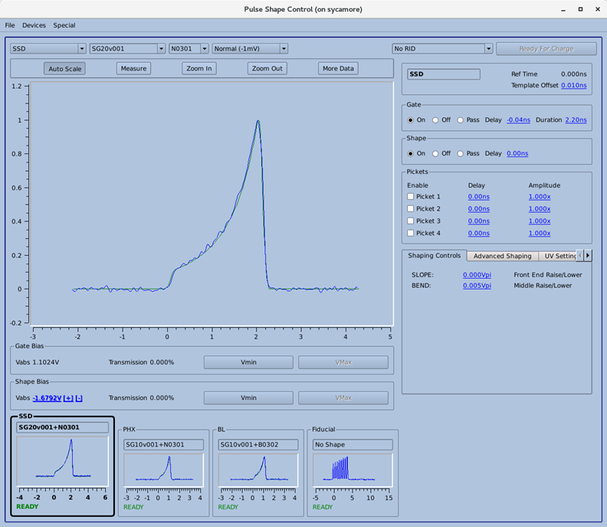
Select the desired pulse shape from the drop down at the top of the GUI
The available UV on-target shapes and SIDs is driven by the Pulse Shape Database (PSD) – more on this later

Slide 9
The Mode is selected from the drop down menu at the top of the GUI
The mode may be changed between:
Gate
Shape
Normal
Calibration
The mode is changed to complete system calibrations and pulse shape setup
The Mode must be ‘Normal’ for the GUI to be Ready4Charge

Slide 10
A scope is used to monitor the output of the pulse shaping system and to provide feed back to operators during pulse shape setup
The scope traces for all frontends are always displayed in the thumbnails at the bottom of the GUI
The selected pulse shape template for each mode is displayed along with data from the PSC scope for each frontend

Slide 11
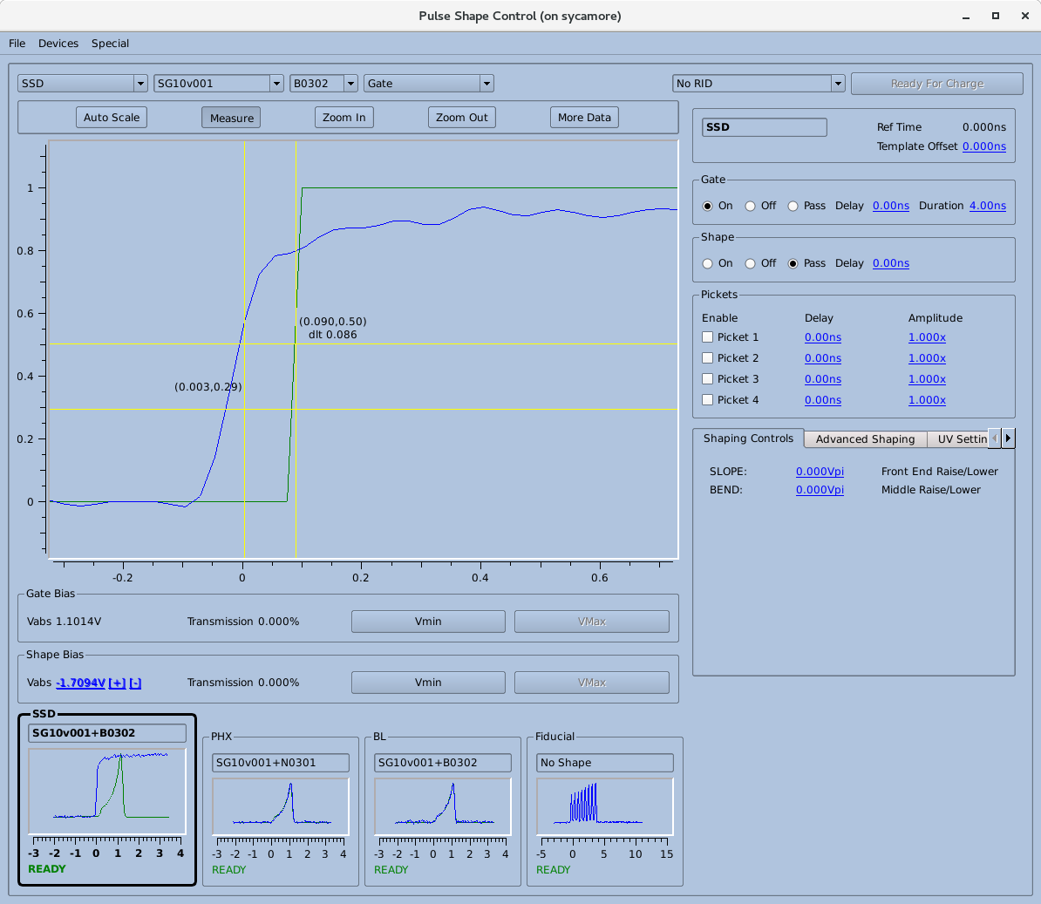
Pulse Shape Setup begins by setting the frontend mode to Gate and adjusting the template offset to bring the template to 0
3. Adjust the template offset value to move the template to 0
The ‘Ref. Time’ is the anticipated template delay based on LTM configuration
Set the mode to ‘Gate’
Use the ‘Zoom In’ and ‘Measure’ tools to determine template offset
The T-0 position for the scope trace and template is tracked in the Pulse Shape Control Database tables – more later

Slide 12
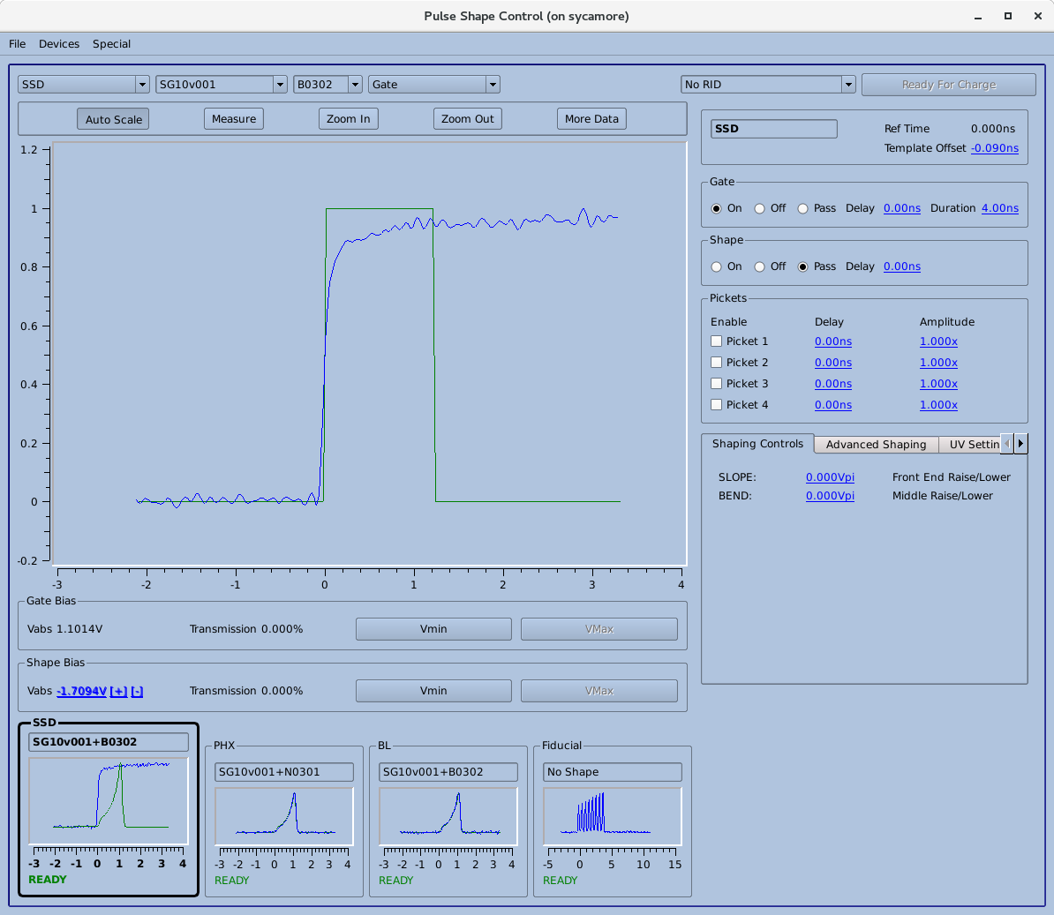
The Gate timing is then adjusted to overlap the leading edge of the pulse with the leading edge of the template
Either the Gate delay in PSC or the Group Delay in LTM is adjusted to bring overlap the Gate and the template
The method used to overlap the gate is based on the PSS and is specified in the operators pulse shape setup procedure

Slide 13
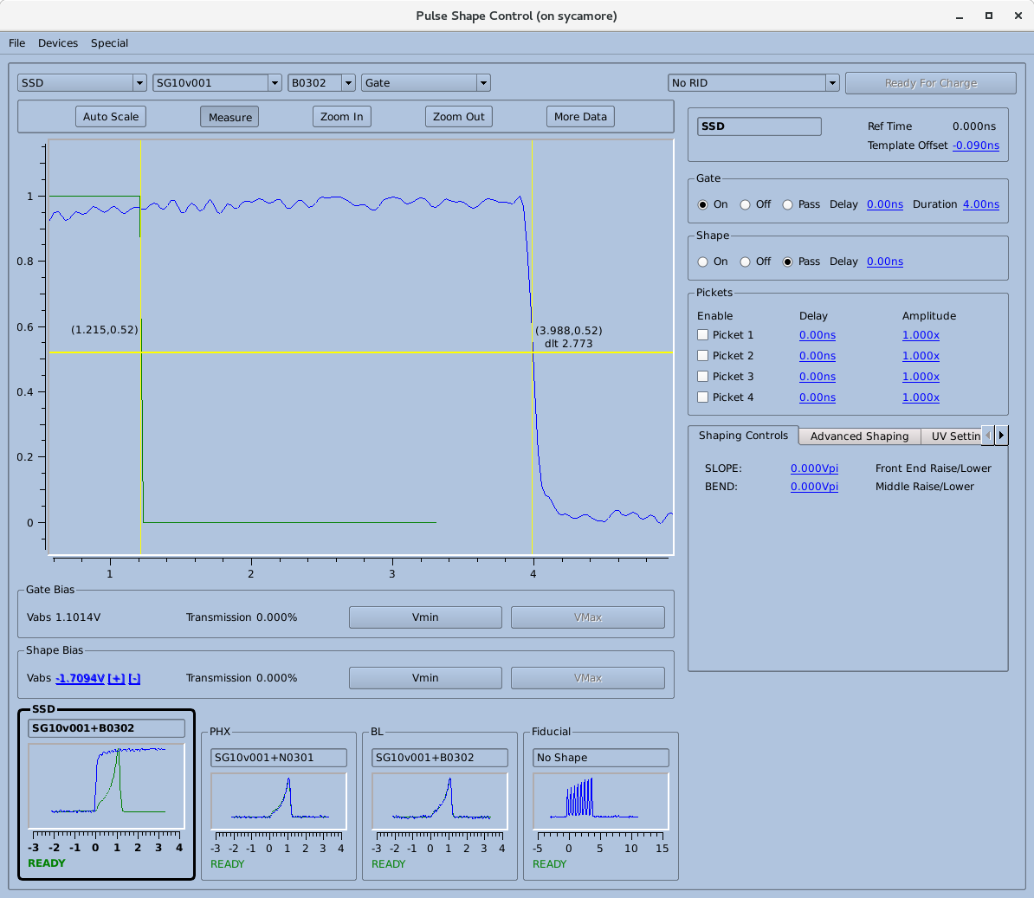
The Gate duration is then adjusted to match the length of the Gate Template
The Gate Width is measured and adjusted in a similar manner to the Template and Gate Delay

Slide 14
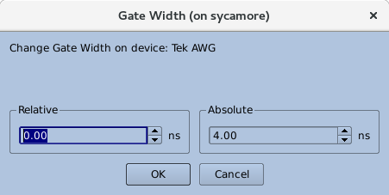
A pop-up is presented to the operator to adjust each of the PSC delays, durations, or amplitudes
The operator can always choose to make a relative or absolute move
  The default is relative

Slide 15
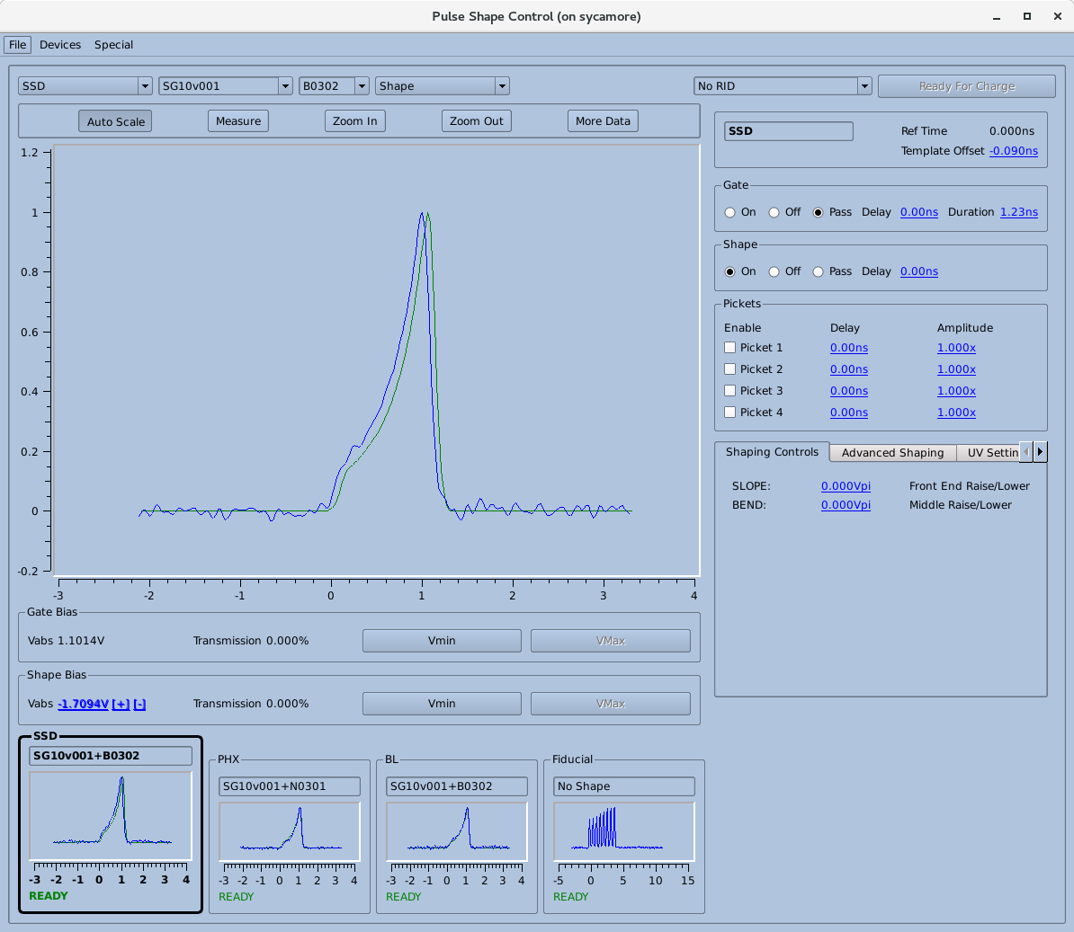
The mode is then changed to ‘Shape’ and the Shape delay is adjusted to match the template

Slide 16
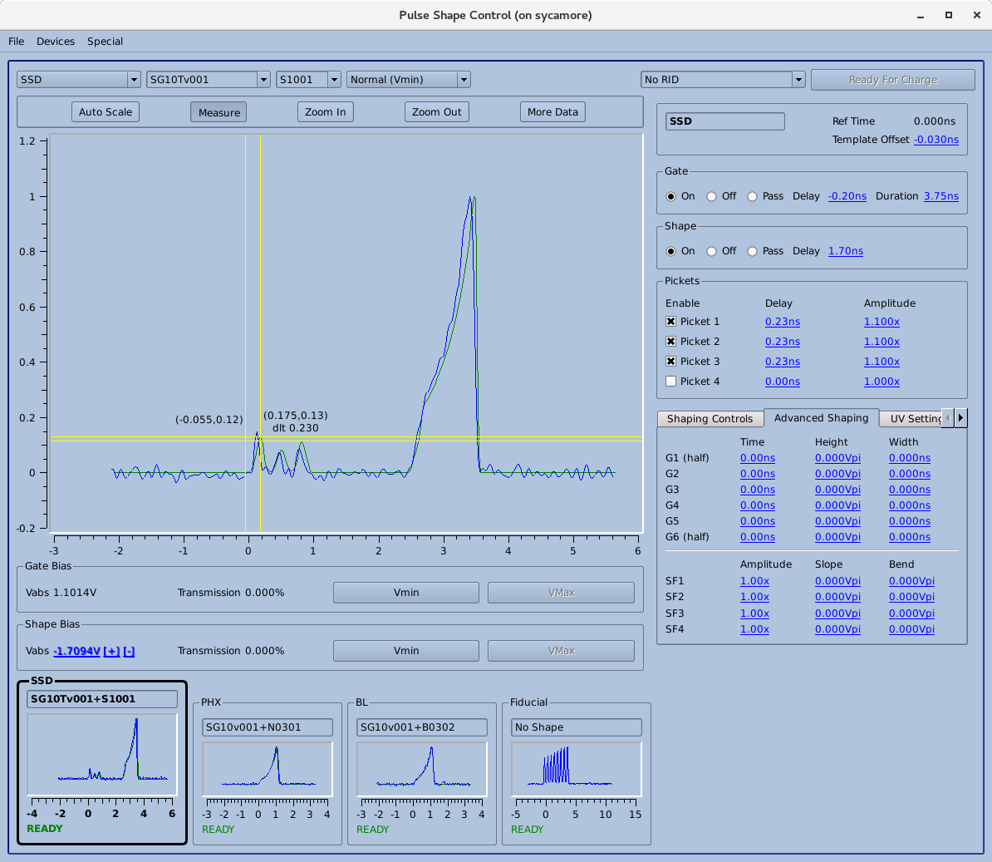
Return the mode to ‘Normal’ and setup pickets as applicable
A given pulse shape may have up to four pickets.
The Delay and Amplitude of each picket may be adjusted individually
Amplitude is changed a s percent of the current picket height
Delay is in units of ns

Slide 17
Run a pulse shape prediction and optimize pulse shape
Use the output from the Pulse Shape Measurement (PSM –Use Case 1) program Injection pick-off run a prediction (Pulse Shape Prediction – Use Case 1) of the anticipated full energy, 2w, temporal pulse shape.
Manually or through an automated loop feed adjustments back to the PSC program to adjust the AWG waveform to achieve the desired full-energy, 2w, pulse shape.

Slide 18
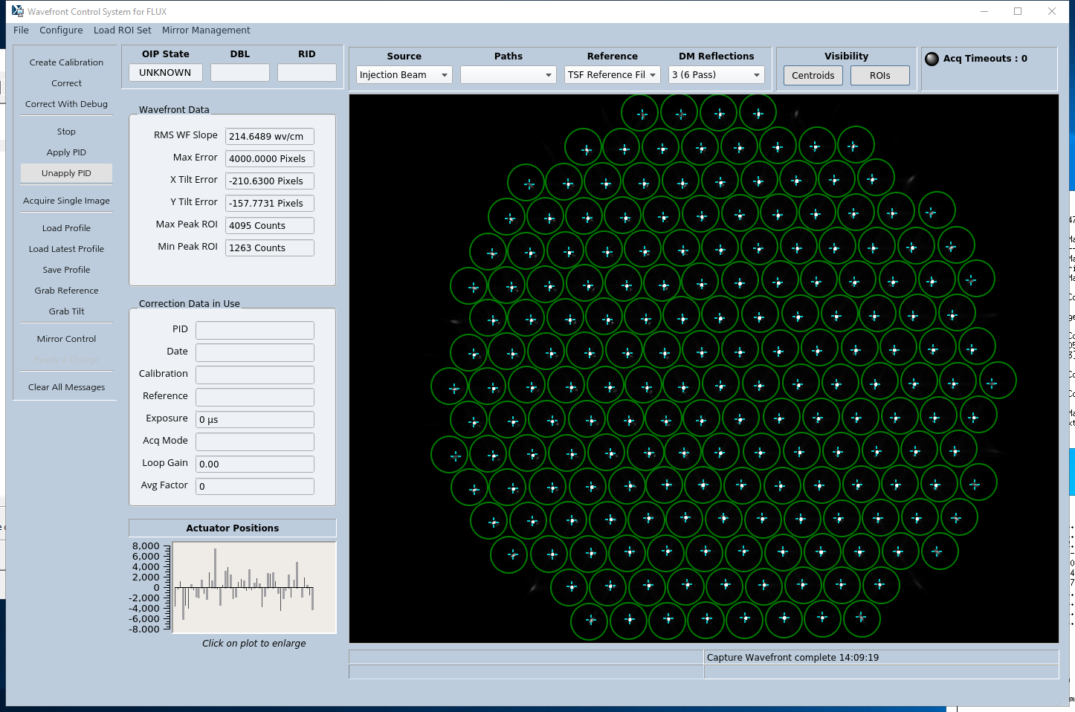
7. Load latest Wavefront Control Correction
From the Wavefront Control System (WCS) software ‘Load Latest Profile’ (WCS – Use Case ?)

Slide 19
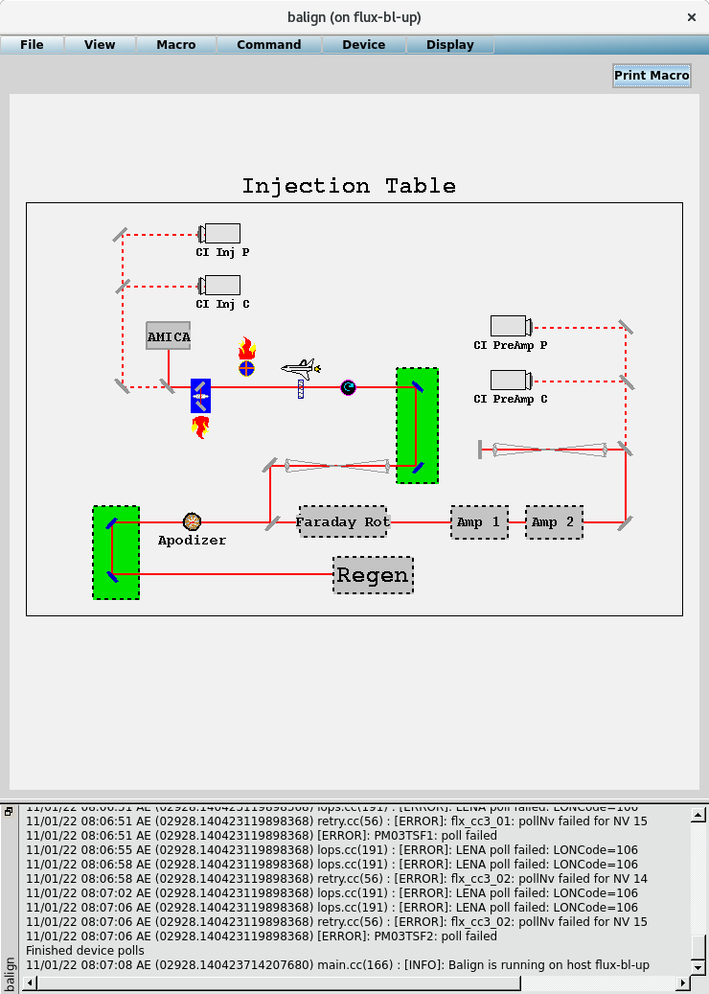
8. Configure system for 1w alignment
Run 1w Alignment Macro from the beam alignment software to put all devices in the correct position to begin Main beam alignment (balign – use case 3)

Slide 20
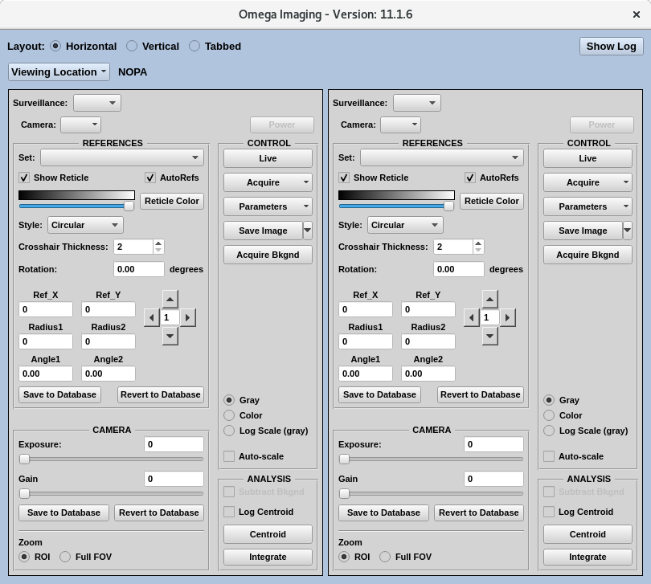
9. Align injection table to 2w Diagnostic Package
Align to Pre-Amp Pointing and Centering Cameras
  Select Pre-Amp Pointing and Centering Cameras from Imaging GUI (SIGUI – use case 1)
  If not using an imaging macro, select centroid for the pointing camera and grab continuous for the centering image (SIGUI – use case 2)
  Check if the pointing is on the saved software reference and if the centering image is within the saved software reticle
  If pointing is off reference, select the Pre-Amp Poitning mirror on the beam alignment (balign) software and move to bring on pointing (balign – use case 1)
    If pointing is within X (5?) pixels it may be adjusted with pre-amps running, if off by more the pre-amps must be secured
  If centering is no more than X out of specification the apodizer may be moved through balign to correct centering. If more the pre-amps must be secured
  Select centroid on the centering image and confirm that beam profile is still within specification
  If out of specification, use the centering mirror through balign to correct and the pointing mirror to correct introduced error. If pre-amps are running moves must be limited to x cts (or pix)

Slide 21
A little more details about balign and Imaging GUI

Slide 22
1w alignment continued – injection output
Align to Injection Pointing and Centering Cameras
  Select Injection Pointing and Centering Cameras from Imaging GUI
  If not using an imaging macro, select centroid for the pointing camera and grab continuous for the centering image
  Check if the pointing is on the saved software reference and if the centering image is on the injection crosshair (two-state device that was inserted by 1w alignment macro)
  If Pointing is out of specification, select the Injection Pointing mirror on the beam alignment software and bring the pointing onto software reference
  If Centering out of specification, select the Injection centering mirror on the balign software and bring onto reference
    Centering on crosshair may be calculated in the imaging software or by a stand-alone program to ensure that beam is properly aligned onto the injection crosshair
  Iterate between pointing and centering until both are within specification

Slide 23
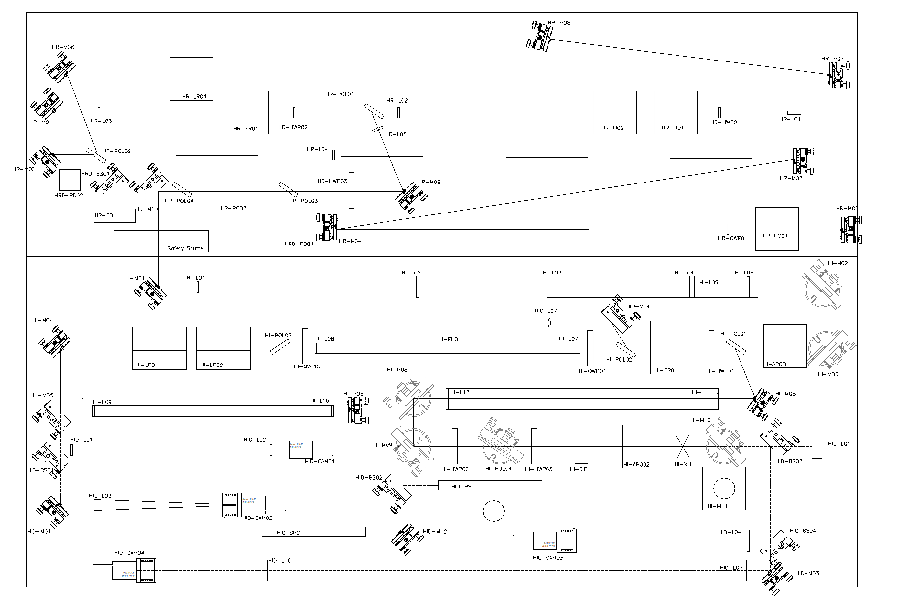
Injection Table Layout
REGEN
PA P/C Mirrors
PreAmps
Inj P/C Mirrors
PreAmp P/C Cameras
Injection P/C Cameras

Slide 24
1w alignment continued – 2w Diagnostic Package
Use the Imaging GUI to view the Green Output Pointing (GrOP) and Centering (GrOC) cameras
  Set the pointing camera to centroid
  Set the centering camera to grab continuous
From balign select the DM and adjust to bring the GrOP onto the saved software reference
From balign insert the Injection XH (balign – use case 4) and the 2w Cross hair
From balign, select the booster centering mirror and adjust the beam to overlap the crosshairs on the GrOC camera
From balign, select the booster pointing mirror and adjust the beam to bring the beam onto the GrOP pointing reference
Iterate previous two steps until both pointing and centering are within specification
From balign, remove the injection XH and the 2w Crosshair

Slide 25
10. Perform wavefront correction w/o PID
From the Wavefront Control System (WCS) software use the ‘Correct’ button to perform a wavefront correction (WCS – Use Case ?)

Slide 26
11. Align main cavity pinholes
While viewing the GrOP camera switch to the pinhole alignment reticle (draws a circle around the pointing reference the size of the pinhole) (SIGUI – use case 3)
From balign insert the alignment diffuser on the injection table
Check the roundness of the overlapped pinholes. If out of spec repeat the start-up pinhole alignment check
Start-up Pinhole Check:
Insert the TSF Pass 1 pinhole and align in x- and y- to the reference on the GrOP
Remove the TSF Pass 1 pinhole
Insert the CSF Pass 1 and align in x- and y- to the reference on the GrOP
Remove the CSF Pass 1 pinhole
Insert the CSF Pass 2 and align in x- and y- to the reference on the GrOP
Remove the CSF Pass 2 pinhole
Insert the TSF Pass 2 and align in x- and y- to the reference on the GrOP
Remove the TSF Pass 2 pinhole
Re-insert all pinholes and confirm that spot is round and within reference on GrOP camera

Slide 27
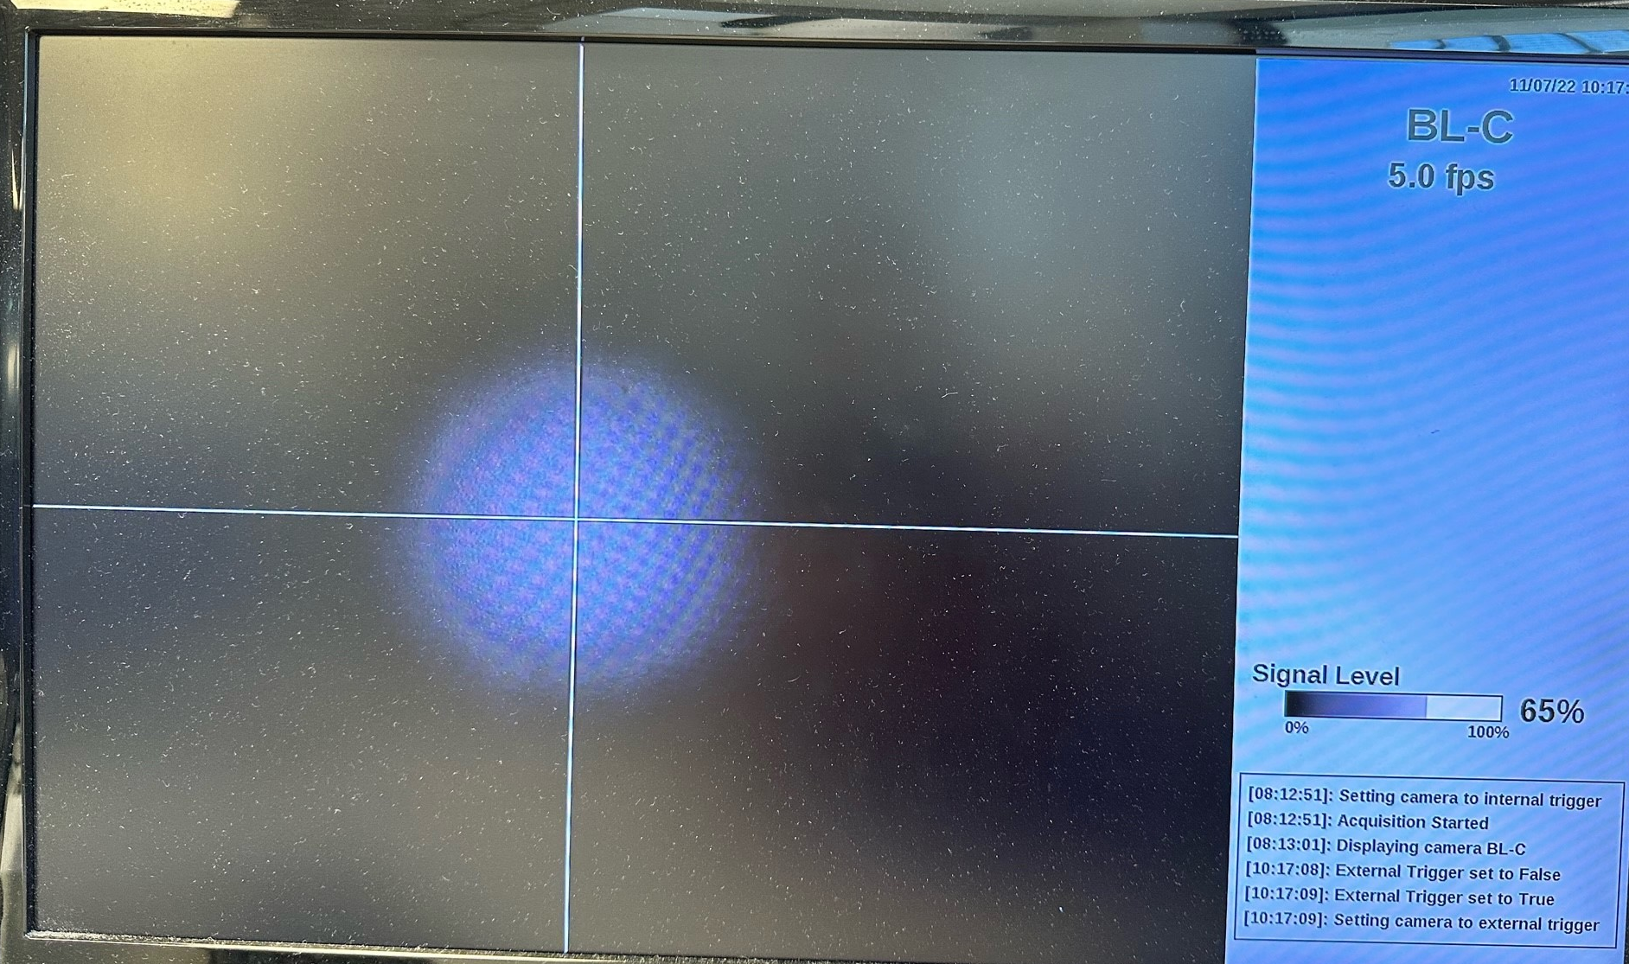
12. Set up apodizers
While viewing the Pre-Amp Centering Camera use balign to adjust the position of the first apodizer to be centered on the beam
Switch to viewing the Injection Output Centering camera and use balign to center the second apodizer on the beam
Save an image of the Injection Output Camera and compare to previous images to ensure the apodizer profile is properly located on the beam

Slide 28
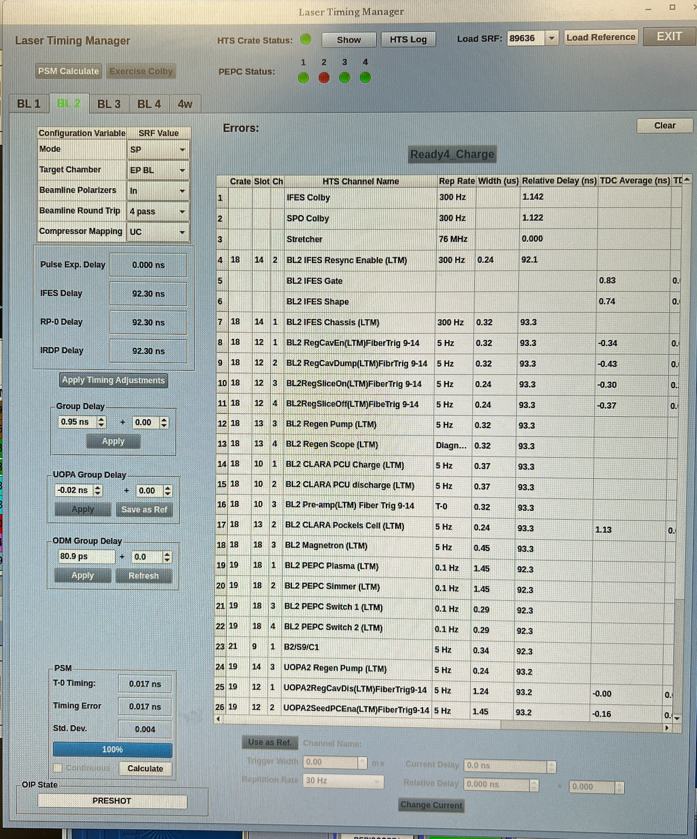
Set timing
There would not be a specified target chamber or experimental delay for a 2w cal shot, but one may be applied if target shots are planned for the day (LTM – Use Case 1)
Once the desired mode is selected and the experimental delay is confirm press the ‘apply timing adjustment’ button. (LTM – Use Case 2)
  The operator will NOT be able to apply the timing adjustment if the system is NOT in a safe condition (i.e. the PEPC is firing) (LTM – Use Case 3)
Once there are no errors (time-to-digital readings in range (LTM – Use Case 8)), and all timing delays have been applied, the ‘Ready4Charge’ button will illuminate (LTM – Use Case 4)
Check the PSM timing (LTM – Use Case 5) and make any small adjustments needed to bring timing within specification with the group delay (LTM – Use Case 6)
Click the ‘Ready4Charge’ button (LTM – Use Case 7)

Slide 29
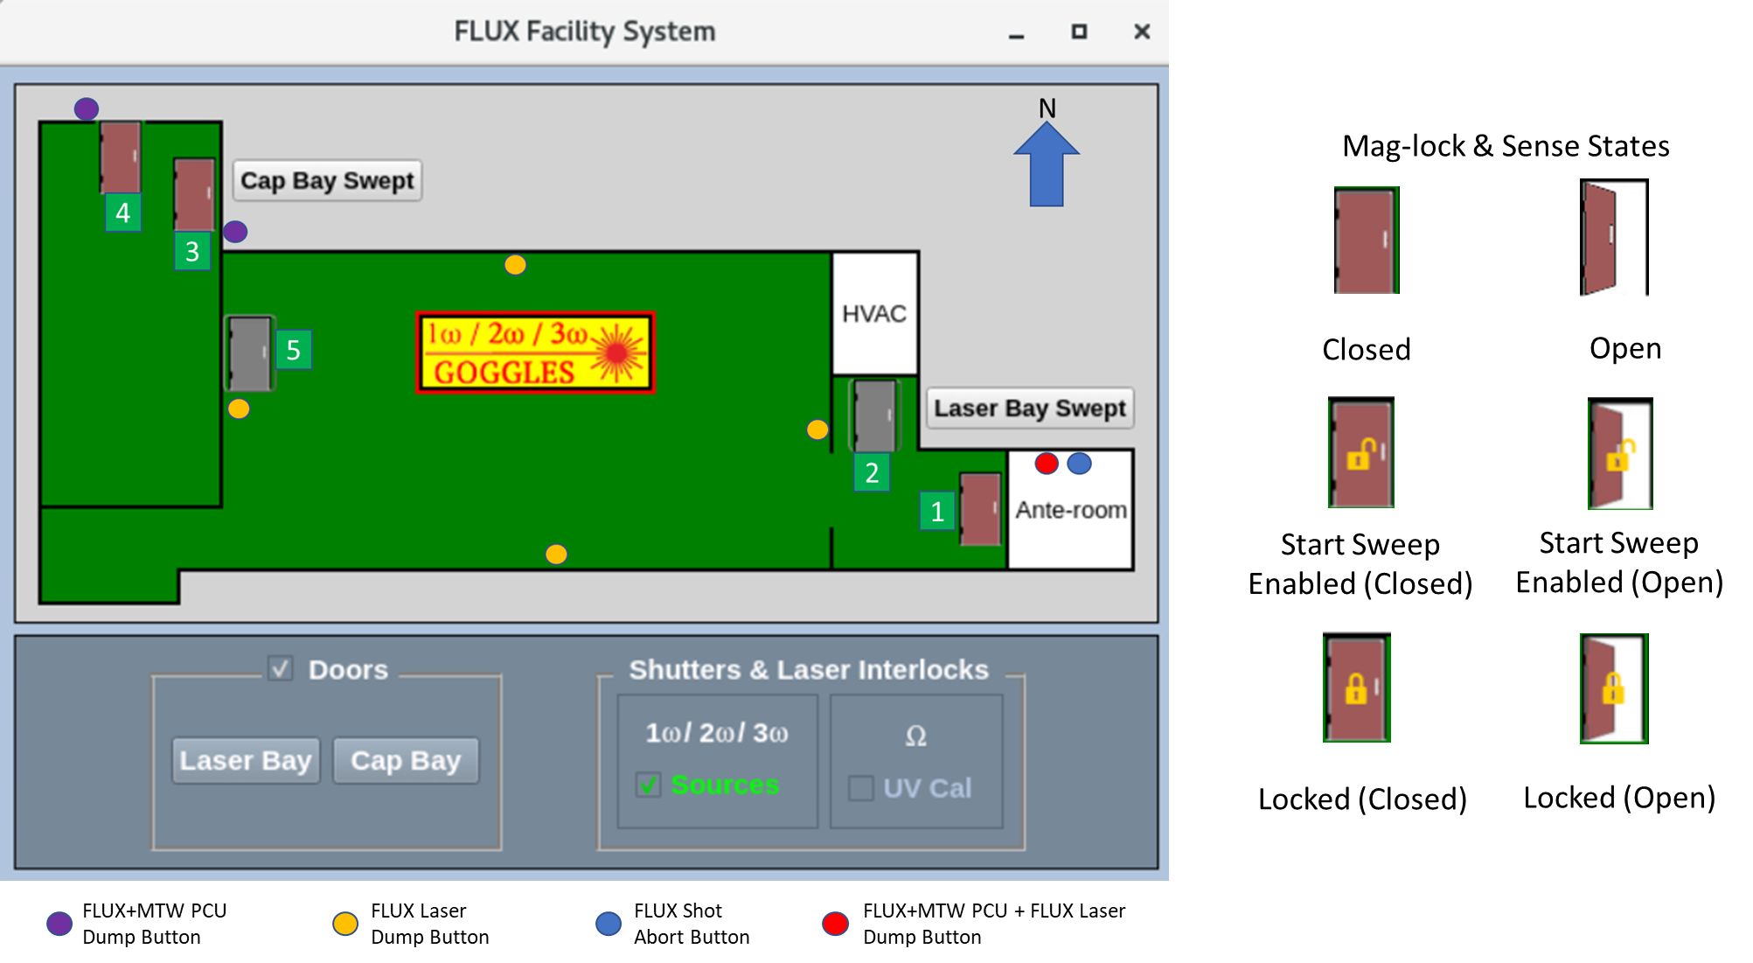
14. Sweep Bays
Use the Laser Bay Door button on the FLUX Facility System (FFS) software to issue the lock command
Enter the Laser Bay and announce loudly (megaphone?) that “The FLUX Laser Bay is now in CLOSED ACCESS, all personnel must exit”
Once all personnel have exited, press the Start Sweep button to engage the magnetic door locks
Confirm that the Laser Bay-Anteroom door is locked and sweep the bay by following the route on the map below. If any personnel are found or the sweep is stopped for any reason, return to the anteroom door and start the sweep from the beginning.
Use the illuminated Exit button to leave the Laser Bay, and mark the Laser Bay as swept in FFS
Use the Cap Bay Door button on the FLUX Facility System (FFS) software to issue the lock command
Enter the Cap Bay and announce loudly (megaphone?) that “The FLUX Cap Bay is now in CLOSED ACCESS, all personnel must exit”
Once all personnel have exited, press the Start Sweep button to engage the magnetic door locks
Confirm that the Cap Bay door is locked and sweep the bay by following the route on the map below. If any personnel are found or the sweep is stopped for any reason, return to the anteroom door and start the sweep from the beginning.
Use the illuminated Exit button to leave the Cap Bay, and mark the Cap Bay as swept in FFS

Slide 30
15. Run wavefront correction with PID
From the Wavefront Control System (WCS) software ‘Apply PID’
From the Wavefront Control System (WCS) software use the ‘Correct’ button to perform a wavefront correction

Slide 31
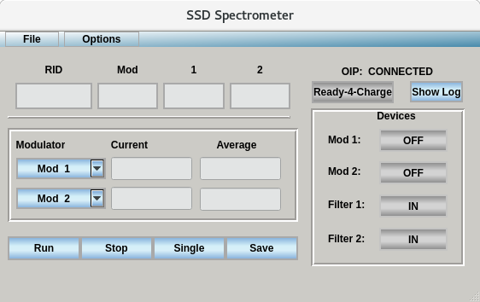
16. Enable SSD Bandwidth
From the SSD Spectrometer Software, enable the SSD modulation
Confirm that the measured bandwidth is within specification
Go Ready-4-Charge on the SSD Spectrometer software

Slide 32
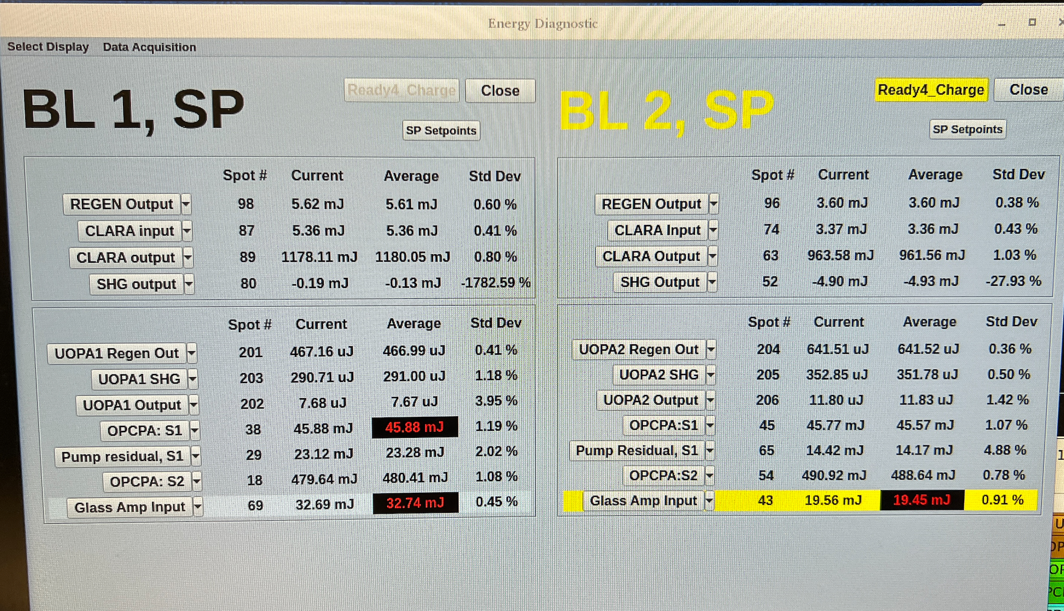
17. Set beam energy
The Energy Diagnostic program will read in the required injection energy for the requested config.
The critical channel will be ‘highlighted’ with a different background color to help operators key in on that channel
If the current energy is out of specification the Average energy the background for that channel will be black with red numbers
From balign select the injection throttle and adjust the position of the throttle until the Injection energy is within specification for that configuration
Go ‘Ready4_Charge’ for that Energy Diagnostic Beam
  This sends ‘Ready4_Charge’ to the SE

Slide 33
18. Configure devices for shot and confirm
From balign, run the macro for the current shot type (2w Cal).
‘Lock’ balign
  Locking balign stops communication to the devices and prevents anyone from remotely actuating a device away from the needed shot position
From balign, run a compare macro to ensure that all devices are at their commanded positions.
Press Ready4Charge (not seen on this version) on balign

Slide 34
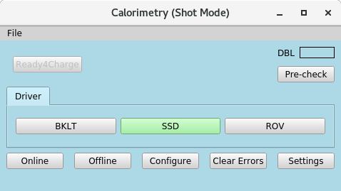
19. Ensure Calorimeter software ready
Select the 2w Cal and confirm that is has properly retrieved the desired configuration (gain) from the Shot Configuration database
Go Ready4Charge

Slide 35
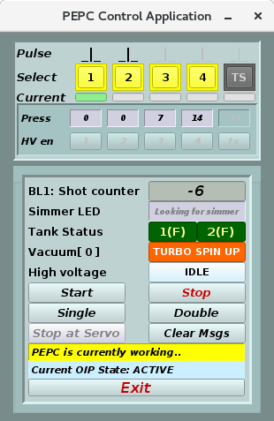
20. Start PEPC
Start PEPC from PEPC Application
  Software will go ready4charge after 10 successful fires

Slide 36
21. Start charging
22. Monitor systems during shot cycle
Once all sub-systems/software programs have been prepared for the shot and report ‘Ready4_Charge’ to the SE, the Advance to: Charge button will enable with green letters.
Press the ‘Charge’ button on the SE. This will enable the ‘Charge’ button on the PCE
Make an announcement in the area where hazards will be present in case personnel were missed during the sweep and to make personnel aware to not enter these areas.
Press the ‘Charge’ button on the PCE

Slide 37
23. Monitor systems during shot cycle
Monitor all software critical to system safety during charge as well as the SE and PCE.
  Errors from sub-systems will be propagated up to the SE allowing the operator to assess the criticality of the error
  Status of the PCU charging will be shown on the PCE
  Some programs will be marked as ‘Critical’ have a red outline on the SE – errors with these sub-systems have either machine safety/personnel safety concerns or are guaranteed to lead to bad data. If there is an error with one of these programs the shot will auto-abort.
Abort the shot if there is a critical error

Slide 38
24. Resume normal access in bays
Unlock doors to areas that are returning to open access

Slide 39
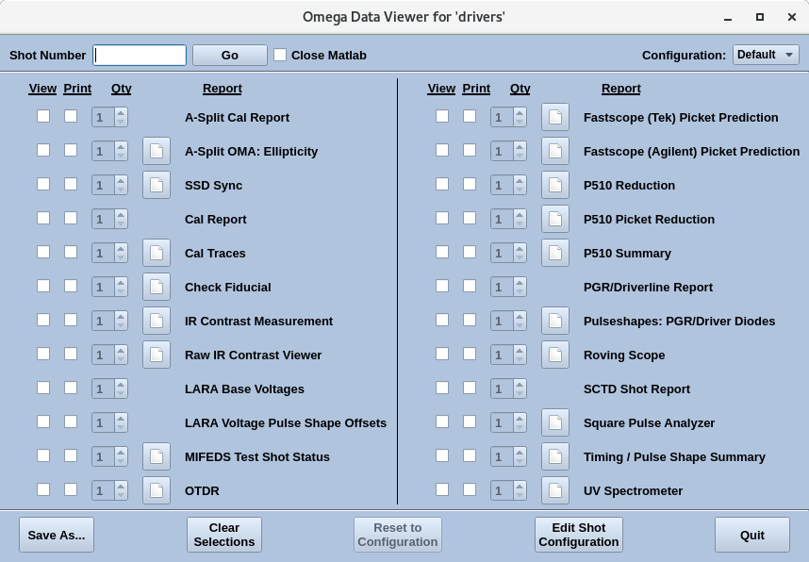
25. Review shot data
Once the state cycles to post-shot the analysis programs will start running from the Data Viewer. These are matlab, PV-Wave, etc. programs that will retrieve data from the archive, analyze the data and display/save the data for the user

Slide 40
backup

Slide 41
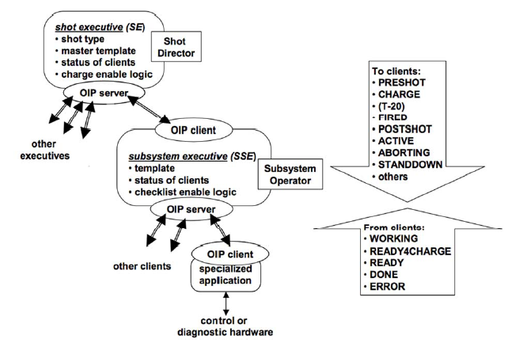
Shot Executive
The Shot Executive (SE) is the primary Omega Intercommunication Protocol (OIP) server for the laser control system and also provides the graphical user interface for the Shot Director. The Shot Director uses the SE to initiate each shot cycle and to monitor and control its progress. After charging of the Power Conditioning Units has been initiated, the system is sequenced by the Power Conditioning Executive (PCE). During and after charging, the shot coordination messages originate in the PCE and are sent to the SE. In both situations, the SE disseminates the messages to the remainder of the system.
For HE-LP the Shot Executive directly communicates with clients rather than sub-executives (other than the PCE)

Slide 42
Shot Executive: Use Cases
Use Case 1: Open Master Template Builder
Use Case 2: Advance to Preshot
Use Case 3: The PCE Template Approval dialog

Slide 43
Shot Executive – Master Template Builder: Use Cases
Use Case 1: Select configuration
Use Case 2: Set program priority
Use Case 3: Save Master Template
Add three new drop-downs:
Pulse Shape
Spectral Shape
Energy at Termination

Slide 44
To be “OIP Compliant”, a client must respond to certain messages
Message | Valid Responses
PRESHOT | READY – Received the message, but not actively working towards the shot. WORKING – Working towards the shot. ERROR – Error getting ready for the shot. READY4_CHARGE – All preshot activities complete and ready to take the shot. MUST BE SENT.
STANDDOWN | READY – Received message DONE – Done handling message
CHARGE | READY – Received the message. WORKING – Received message and has something to do. ERROR – Error.
T10_ENABLE | READY – Received the message. WORKING – Received message and has something to do. ERROR – Error.
POSTSHOT | Response not required immediately. DONE message required to indicate that the program is done with the shot.

Slide 45
State Changes signal activity
Shot Executive
ACTIVE
Master Template
Configures for shot
Reads SRF from DB
Shot Executive
Sub-system executive
Power Conditioning Executive
Facility Interlock Executive
Waits for all clients to be READY4_CHARGE
Does checklists with sub-system operators
Sub-system Template
Builds template with requested PCUs OR configures to do a “test” shot with no PCUs in the template (“NULL template”).
Online’s requested PCUs and sends voltages / charge delays / settings
Continually checks for faults in online units until start of CHARGE.
Coordinates “closed access” by engaging magnetic locks.
Verifies all areas are swept of personnel.
Verifies appropriate warning signs are engaged.
PRESHOT
Configures for shot
Reads master template from DB
Waits for all clients to be READY4_CHARGE
Does checklist with Shot Director when all clients are ready
Once all sub-systems are READY4_CHARGE, the system is ready to shoot.

Slide 46
State Changes signal activity (cont.)
Shot Executive
Sub-system executive
Power Conditioning Executive
Facility Interlock Executive
Transitions control of the state changes to the PCE.
Acts like a sub-executive until POSTSHOT.
Receives approximate total shot time from the PCE and relays it to the other executives.
Watches for errors.
Relays state messages to clients.
Receives approximate total charge time to send to clients.
Sends “charge” command to the PCUs.
Sends approximate total charge time to the Shot Executive.
PCUs charge at different rates so a delay is sent to some to make sure they reach AT VOLT within 10 seconds of each other.
Monitors magnetic locks and throws an error if a door opens unexpectedly.
CHARGE
Shot Executive
Sub-system executive
Power Conditioning Executive
Facility Interlock Executive
FIRE_ATVOLT
Continues to relay messages from the PCE to the other executives.
Watches for errors.
Relays messages to clients.
All PCUs AT_VOLT
Watches for 0.1Hz signal from the timing system before sending T10_ENABLE signal (T-20 seconds).
Watches for next 0.1Hz signal before sending T0_ENABLE signal (T-10 seconds). This enables the PCUs to fire.
Waits for next 0.1Hz signal to disable timing enable.
Monitors magnetic locks and throws an error if a door opens unexpectedly.

Slide 47
State Changes signal activity (cont.)
Shot Executive
Sub-system executive
Power Conditioning Executive
Facility Interlock Executive
Logs shot time and shot number to the database.
Continues to relay messages from the PCE to the other executives.
Watches for errors.
Relays state messages to clients.
Watches for shot messages from the PCUs to verify all PCUs fired.
Monitors magnetic locks and throws an error if a door opens unexpectedly.
FIRED
Shot Executive
Sub-system executive
Power Conditioning Executive
Facility Interlock Executive
POSTSHOT
Acquires control of state engine back from PCE.
Watches for completion messages from clients.
When all clients are “done”, transitions back to ACTIVE.
Watches for completion messages from clients.
When all clients are “done”, informs the Shot Executive that the sub-system shot is complete.
Logs postshot information from the PCUs into the database.
Releases magnetic locks on command from the Shot Director.
ACTIVE

Slide 48
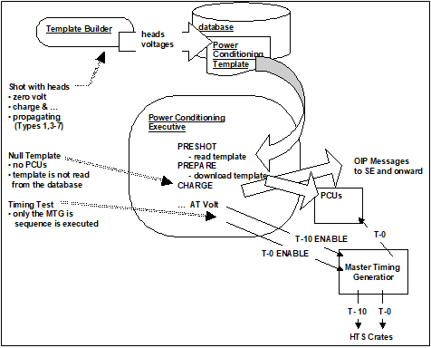
The Power Conditioning Executive (PCE) provides user access to a collection of Power Conditioning Units
Shot configuration, data collection, and hardware monitoring is controlled via the PCE
The PCE communicates via a socket level Ethernet interface to set command registers and to read status and waveform data
The PCE provides an OIP compliant interface to the upper-level Shot Executive

Slide 49
PCE Use Cases
click on the ‘Template’ button
Set Voltages’ pop-up will come up auto-populated with voltages from selected configuration
Save Voltages
click on the ‘Prepare’ button

Slide 50
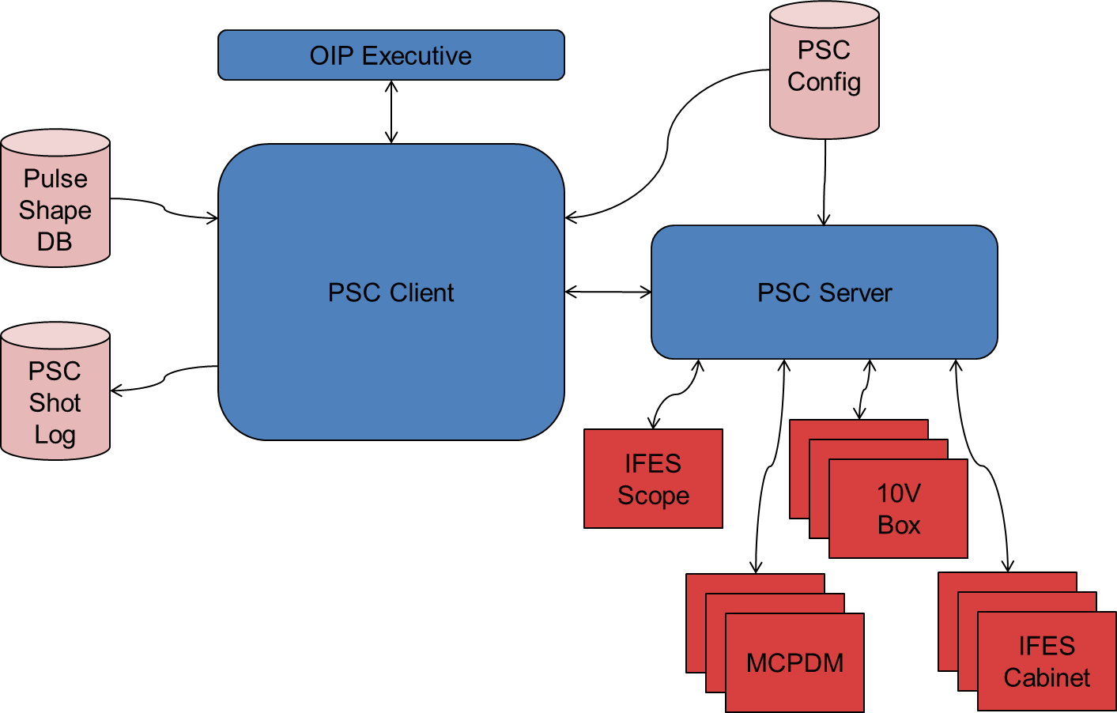
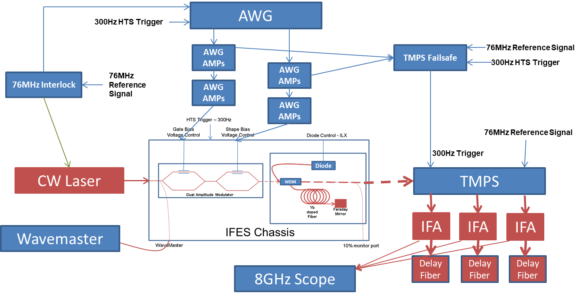
Pulse Shape Control Software
The Pulse Shape Control software is the user interface to the temporal pulse shaping hardware and databases. The software provides user feedback and tools to retrieve, load, and setup the user requested pulse shape

Slide 51
Pulse Shape Measurement
Pulse Shape Measurement system performs two primary functions: 1. user interface for the down stream pulse shape, and 2. timing of the pulse shape with respect to the timing fiducial.
Pulse Shape Measurement interfaces with a high bandwidth scope that has outputs from measurement points throughout the system. An ideal pulse shape template is convolved with the measured pulse shape.
The measured pulse shape and template are displayed for the operator to feed modification into PSC to ‘dial in’ the pulse shape to meet the requested template. The ‘dialing in’ is performed may be a manual operation performed by the operator based on pulse shape prediction
The separation of the second peak of the convolved fiducial template to the 2% point of the rising edge of the convolved pulse shape template for T-0 (nominal time on target) is tracked in the database. This current separation is fed to the Laser Timing Manager and differenced from the nominal separation to provide the user with timing information to dial in the request on-target timing

