Slide 1
LCLSII-HE Final Design Review
Timing System - Phase Reference Line
Bo Hong, SLAC Technology Innovation Directorate
October 31, 2023

Slide 2
Overview
LCLS-II-HE Timing PRL system overview
Technical scope maturity
Design management maturity
Cost and schedule maturity (external slides)
ES&H and QA considerations
Previous Review Recommendations
Conclusion

Slide 3
System Overview
HE Scope
HE Scope
LCLSII Scope
Phase Reference Line
The HE PRL provides the phase reference to the LLRF system. The PRL is extended at the end of L3 in the tunnel with 12 couplers. 1 coupler with 2x4-way splitters provides 4 Forward and 4 Reflected phase reference to 4 LLRF racks.

Slide 4
Requirements – Mostly the same as LCLSII PRL except for power level change at LLRF ports
Parameter | PRL Value | LO Line Value
Frequency | 1300MHz | 1320MHz
Frequency accuracy | <1e-10 absolute accuracy | <1e-10 absolute accuracy
Frequency drift | <1e-10 / month | <1e-10 / month
Phase noise | <0.005 deg [50Hz-5kHz] | <-152dBc/Hz [~20kHz-200kHz]
Jitter | <10 fs [50Hz-5kHz] | <18fs [20kHz-200kHz]
Stability | 1 fs/sec, 1 ps/day | 1 fs/sec, 1 ps/day
Power Level at LLRF ports | 0dBm+/-2dB | 2dBm+/-1dB @ LO coupler+Splitter module output
Outputs | 4 ports, >30dB Isolation | 3 ports, >30dB Isolation
Harmonics | <=-60dBc | <=-50dBc

Slide 5
Technical Scope Maturity - Documentation
Title | Number | Status
Timing System PRD | LCLSII-2.7-PR-0345-R0 | Released
Phase Reference System PRD | LCLSII-2.7-PR-0213-R0 | Released
LLRF Sensitivity to LO and PRL Noise in LCLS-II | LCLSII-2.7-EN-0640 | Released
Timing System ICD | LCLSII-2.7-IC-0314 | Released
Timing System FRS | LCLSII-2.7-FR-0527 | Released
Timing System ESD | LCLSII-2.7-ES-0258 | Draft
LCLS-II HE Accelerator Control System PRD | LCLSII-HE-1.5-PR-0046 | Released
LCLS-II-HE High Performance System Common Platform to Timing System, MPS ICD | LCLSII-HE-1.5-IC-0628 | Released
LCLS-II-HE Timing System FRS | LCLSII-HE-1.5-FR-0259 | Released
LCLSII-HE-Timing System ESD | LCLSII-HE-1.5-ES-0165 | Released

Slide 6
Technical Scope Maturity – System Diagram
L3 VCO & Control added in existing L2KG04-20 Timing rack
L4 VCO & Control rack near PEN1004
Two Timing racks as HE reference point near PEN0706
Notes:
1) The electronics will be mostly the same as LCLSII design. Phase lock loop control for L3 and L4 and Fwd&Rev phase averaging to compensate the temperature related drift. We also add more monitoring tools in HE.
2) Using RFOF to extend the MO to Sector 7. S7 will be the reference point for the HE Phase Reference Line.
3) Build PRL transmission line and couplers in the tunnel (Same as LCLSII).
4) LO distribution for L4.
5) Some modifications and improvement work from LCLSII PRL

Slide 7
Technical Scope Maturity - Interfaces
LLRF provides cabling and LO Amp & Dist. Chassis to stations from couplers in the gallery.
From HE PRL System | To other system
RFOF Master Source Transceiver | LCLSII Master Source
L3 PRL PLL and PA Control | LCLSII PRL L3 control; LLRF Systems; Water System
L4 PRL PLL and PA control | LLRF System; Water System
L4 PRL rigid line in the tunnel | LCLSII PRL L3 rigid line end termination; LLRF Systems; Pressured Air System
L4 LO Distribution | LLRF Systems
PRL Control in S4, S7 and S10 | Timing event switch and other network
LLRF performs phase
averaging for a stable
reference
LLRF provides cabling to
stations in the gallery from
couplers in the tunnel

Slide 8
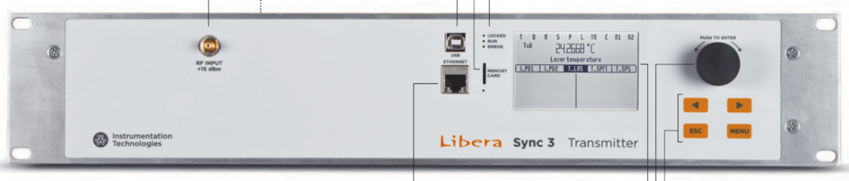
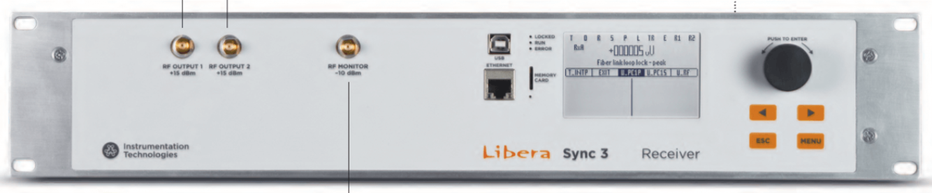
Technical Scope Maturity - RFOF from Sector 2 to Sector 7
Commercial RF over fiber distribution system
 | Libera | Cycle
Pro | Fairly mature technology, developed by PSI and ~40 links deployed for the SwissFEL. Mature software interface. | Able to compensate for the drift requirement at certain range (<5degC/hr). Willing to work with customer on new requirements and explore novel technology solutions.
Con | Cannot compensate for large drifts. We can use temperature compensated fiber to solve this problem. Can gain experience from Linac Locking RFOF. | Small company, with only one software engineer. Experienced somewhat inconsistent quality control from their software releases. Small company, support is inconsistent.
2U
Notes:
Supplement with a fiber oven to reduce fiber thermal drift to device specification. Duplicate the fiber oven design used in the LCLS NC timing system in NEH.
Use existing long haul fibers from LCLS SC timing fiber plant; need to splice fibers at patch locations. [Inconsistent with Libera Sync requirements: <1500m, 500ps drift]
Run new low TCD fiber [Furukawa PSOF] from S2 to S10 to meet Libera Sync phase drift excursion requirements.

Slide 9
Technical Scope Maturity - RFOF related HW & SW
Adding 1.3GHz MO Fanout. Small Impact to LCLSII MO. (S2)
1.3GHz x2 = 2.6GHz Module modification for RFOF Tx requirement. (S2)
Cleanup VCO with ATCA platform for PLL control. (S7)
Reinforce MO and VCO shielding – Mechanical design to immune the vibration. Steel shielding to prevent AC lines. (S0, S2, S4, S7 and S10)
Notes:
Due to more and more requirements of 1.3GHz, a MO fanout chassis/module is needed. This has certain impact to existing LCLSII MO-LO Gen system, including rack space shift and or chassis/module upgrade.
The RFOF Tx needs 15dBm RF input. The existing 1.3GHz x2 multiplier needs to be modified to have higher output power.
When operating in the field, the phase noise is higher. The power supply AC line and the acoustic noise from the environment are the major noise source.

Slide 10
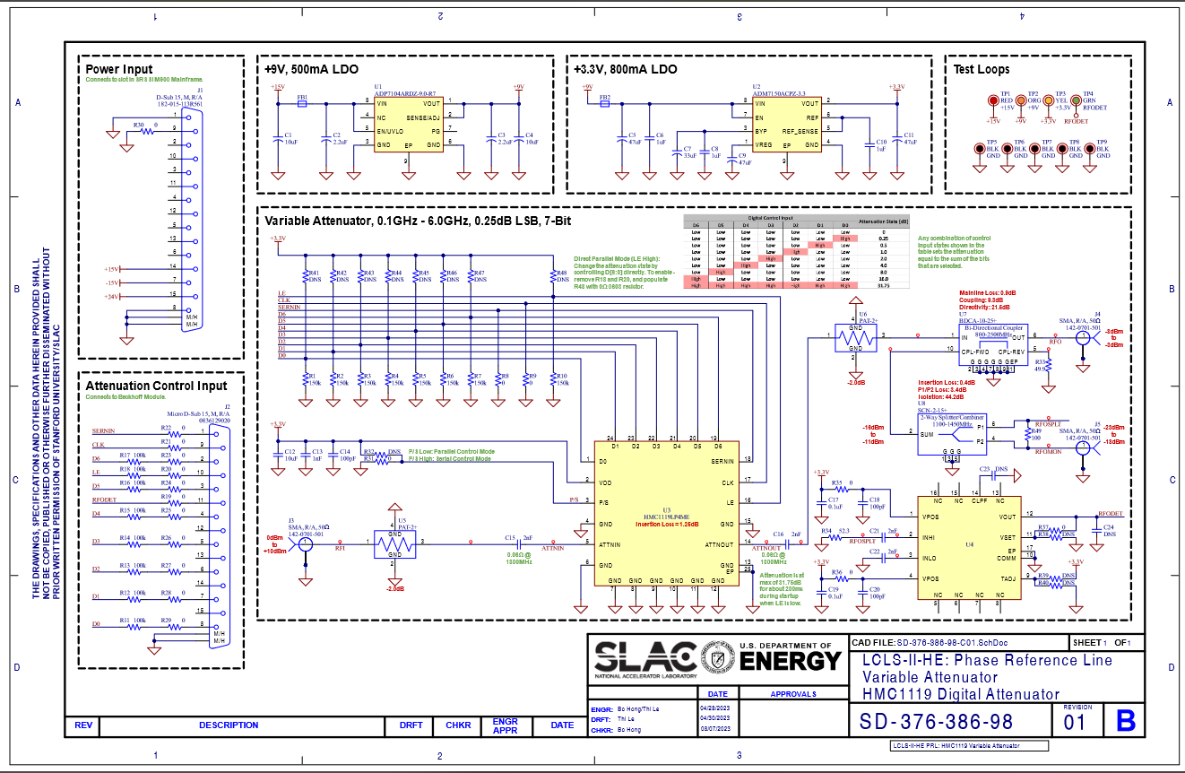
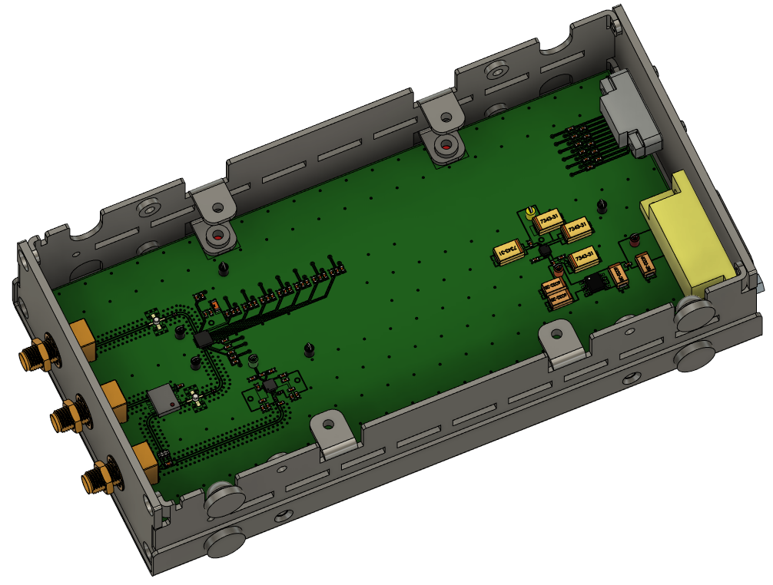
Technical Scope Maturity - Adding more monitors
Add monitors at PA input -- Modify the variable attenuator module. Helpful to isolate the between the PA drive and PA output.
Add averaged phase monitoring in PRL/Timing rack. Use LLRF PRC technology as preliminary plan. Dual-directional couplers will be added in Active-End chassis.

Slide 11
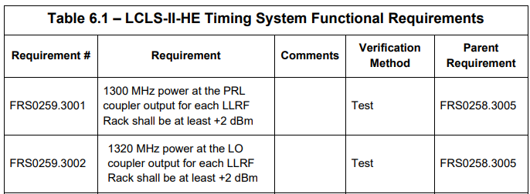
Technical Scope Maturity - Change of PA power level for PRL
Lower the PA power for PRL – LCLSII-HE-1.5-FR-0259-R0
  Old requirement: 80W for power at the LLRF PRC <14dBm for L0-L1 and L2, <6dBm for L3.
  New requirement: 50W for power at the LLRF PRC <5dBm (requirement:<2dBm). Quote with 50W amp from R&K: $6260/each with 5-6 pcs.
LO PA power will be the same as for LCLSII

Slide 12
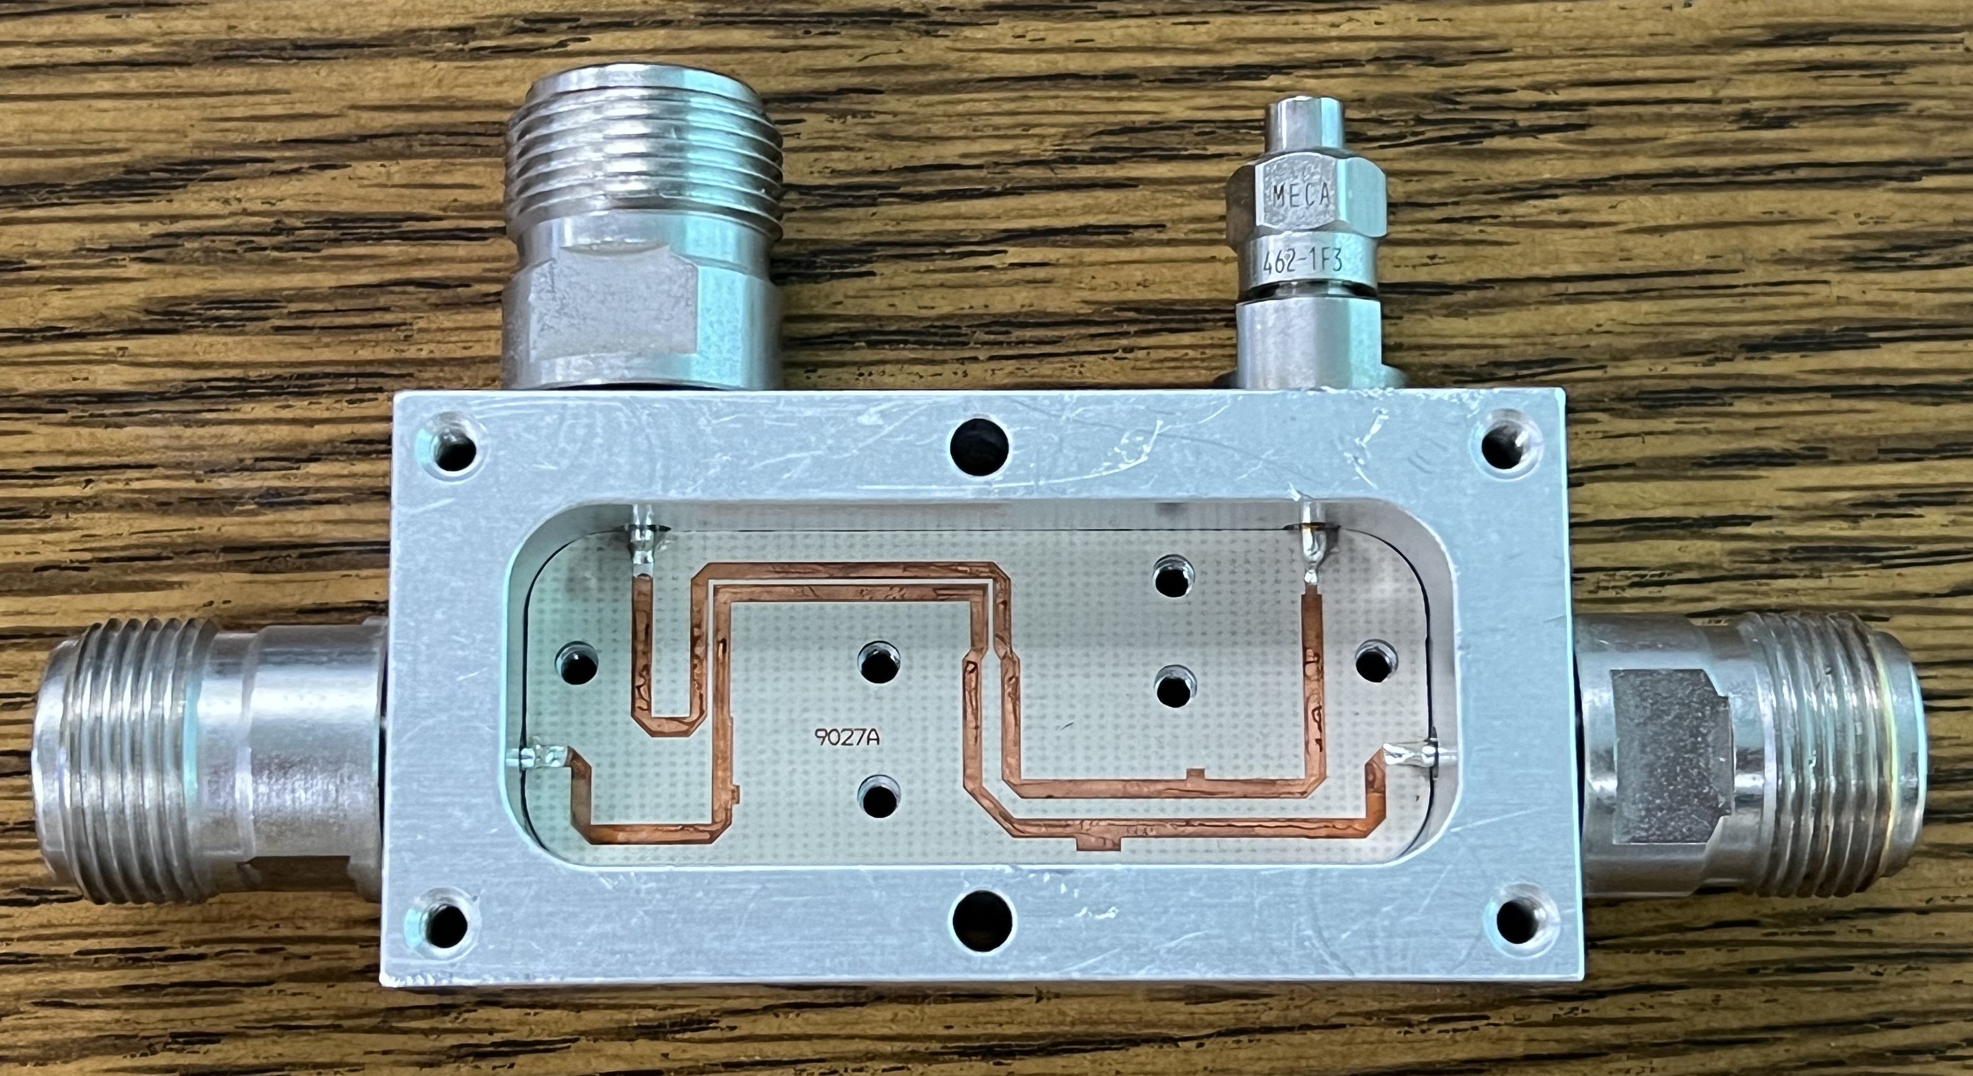
Technical Scope Maturity - LO Distribution Line
LO power is calculated based on the distance from timing rack to the last coupler along the LO line and distributed to the farthest LLRF rack.
Remove the termination at the end of L3 LO. Connect it to variable attenuator and then to the L4 LO PA.
15dB Coupler
7/8” Heliax
3ft LMR-400 for mechanical stress relief. – Curtesy to Mark Petree.
Notes:
There are some failure couplers in LCLSII commissioning. This is due to the mechanical stress with temperature swing. Soft pigtail cables are added at the in and out of the coupler to relief this stress.

Slide 13
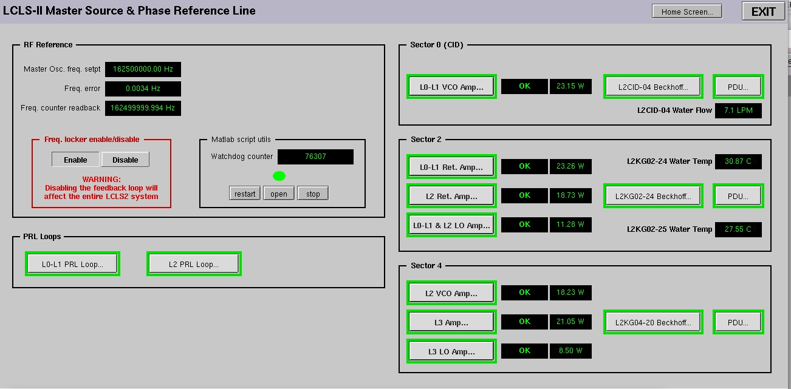
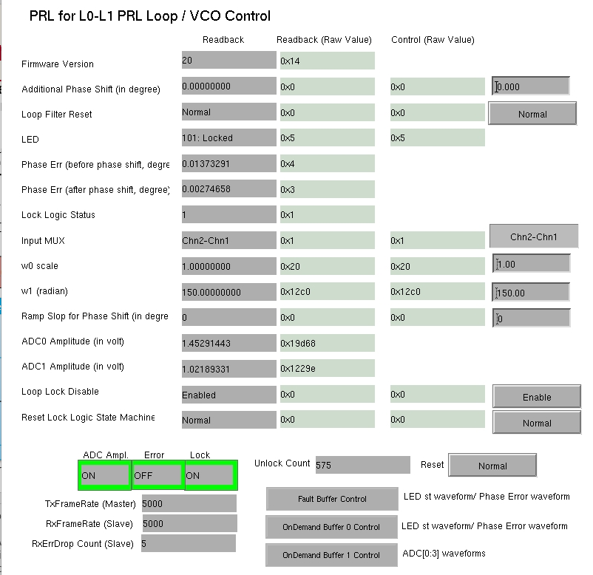
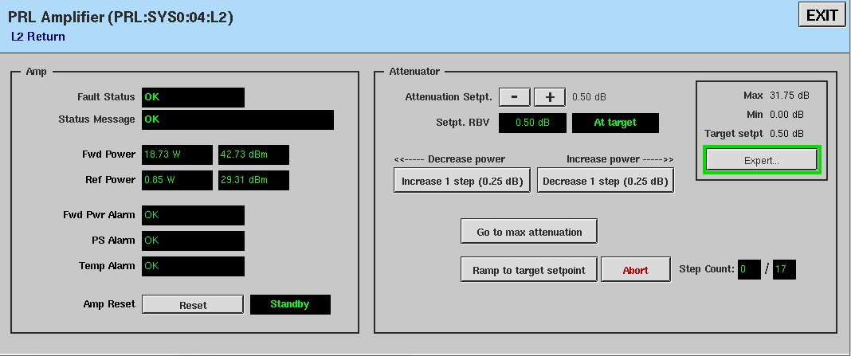
Technical Scope Maturity – Software/Firmware
LCLS-II Timing System software and firmware are deployed in production.
Nothing new is required by LCLS-II-HE.
No changes to the design.

Slide 14
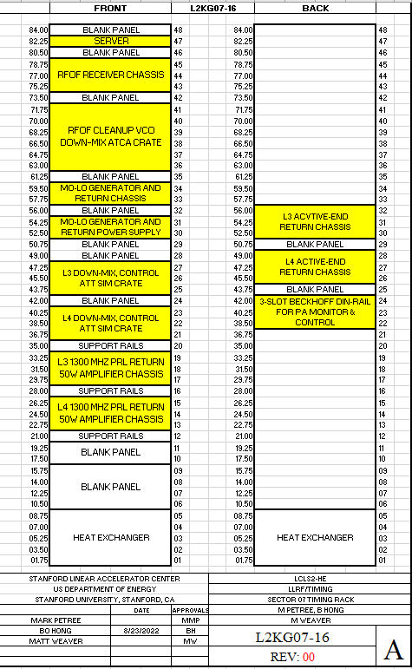
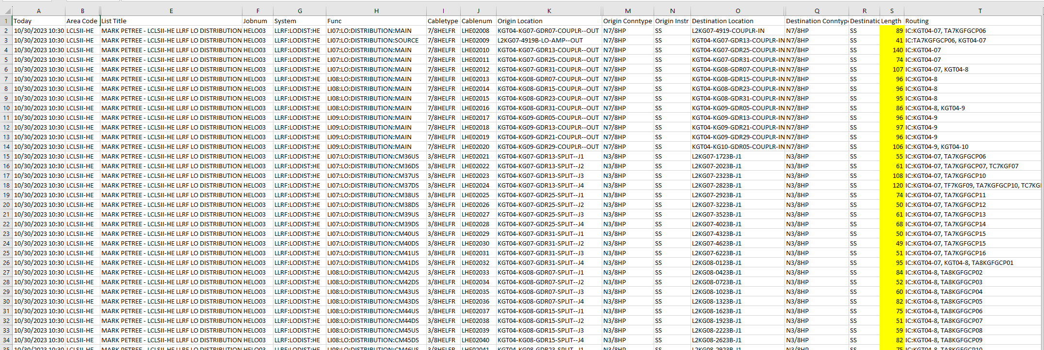
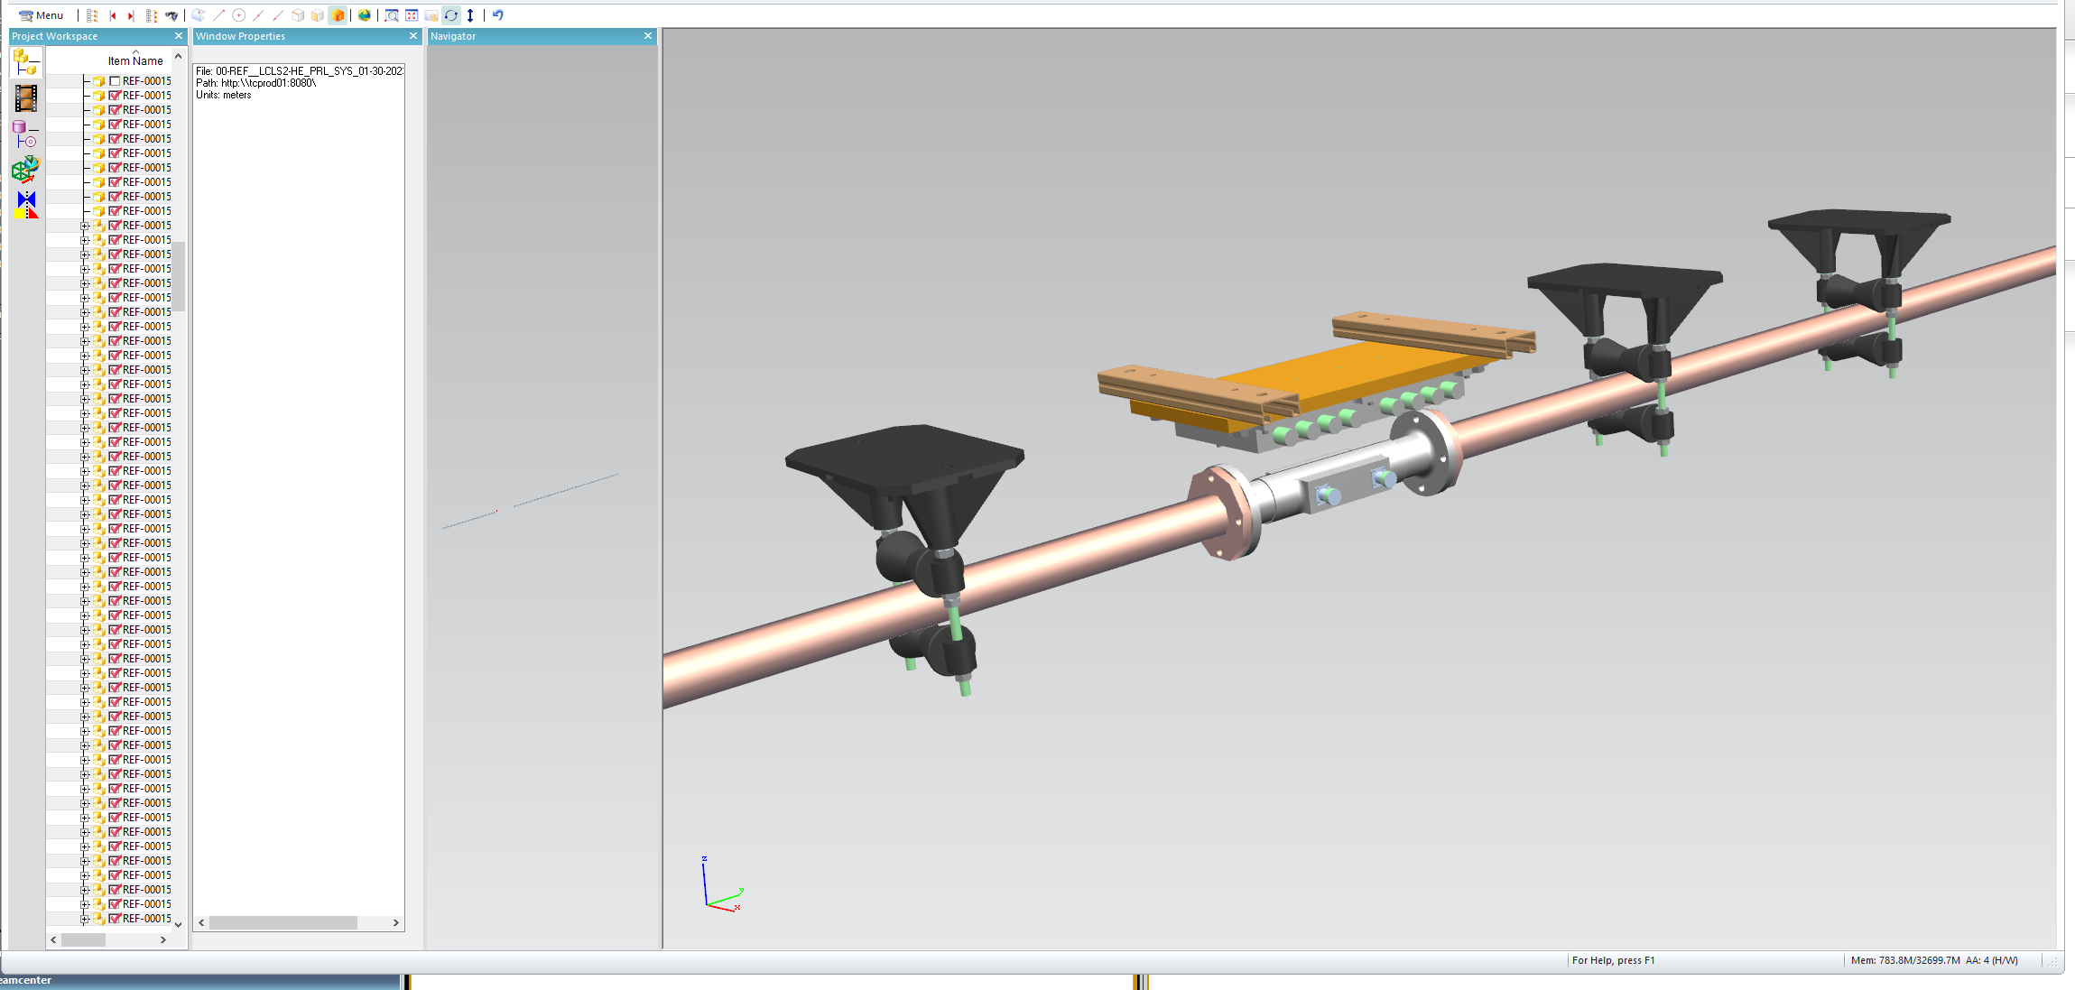
Technical Scope Maturity - Design Documentation
Rack space has been planned. (L2KG07-16, L2KG07-49 and L2KG10-23). L2KG04-20 profile will be modified to adapt to HE design.
The CAPTAR is completed. (curtesy to Mark Petree). Communication cables are updated. (curtesy to Daniel Sanchez).
The rigid line position in the HE mechanical structures “DSG-000056459/00-REF_LCLS2-HE”. PRL CAPTAR (coax) has been submitted to the system.
LO CAPTAR is 100% done.

Slide 15
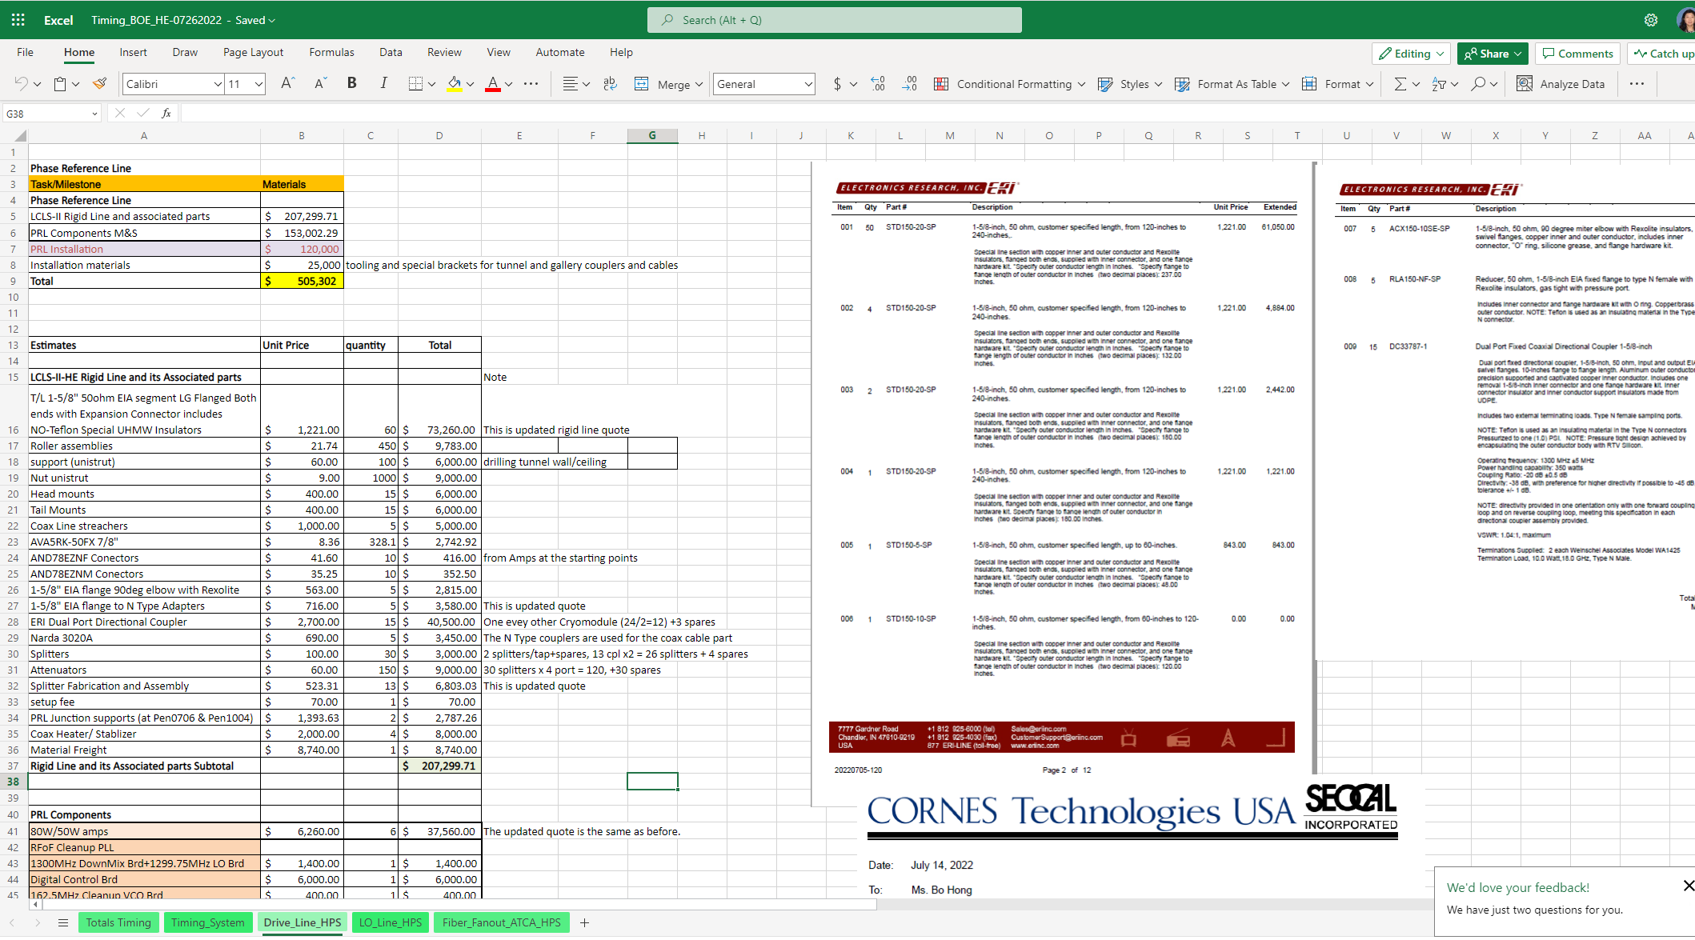
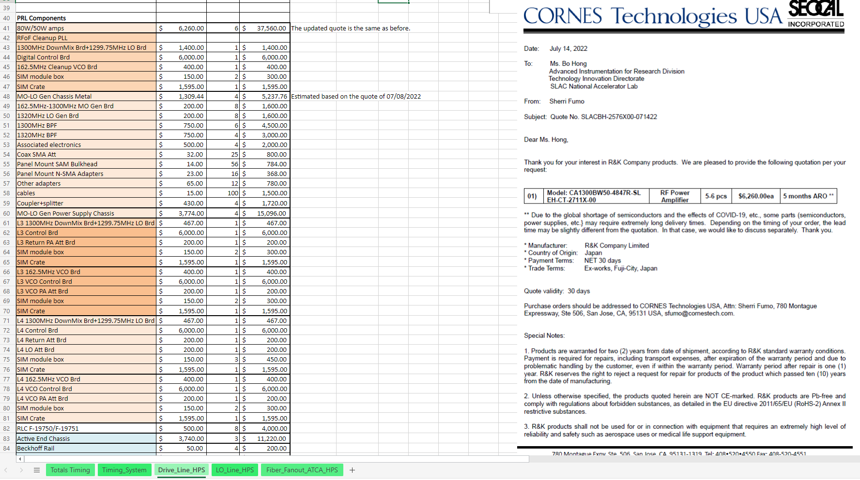
Technical Scope Maturity – Cost, Schedule & Procurement
Cost & Schedule have been updated.
In a separate talk.
Most of long lead time components have been ordered.

Slide 16
Design Management Maturity - Team
System Lead: Matt Weaver¹
  PRL subsystem lead: Bo Hong¹
  Hardware: Bo Hong¹, Larry Ruckman¹
  Software: Kukhee Kim^{1,}Michael Skoufis^{1,} Mike Duning³
  Firmware: Charlie Xu⁴, Lili Ma¹
  Engineering Associate: Mark Petree³
  ICD coordinator: Daniel Sanchez³
  ¹ Technology Innovation Directorate – Advanced Instrumentation for Research Division
  ² Accelerator Directorate – LINAC & FEL Division
  ³ Accelerator Directorate – EED Hardware
  4 LCLS Directorate – LCLS Engineering Division

Slide 17
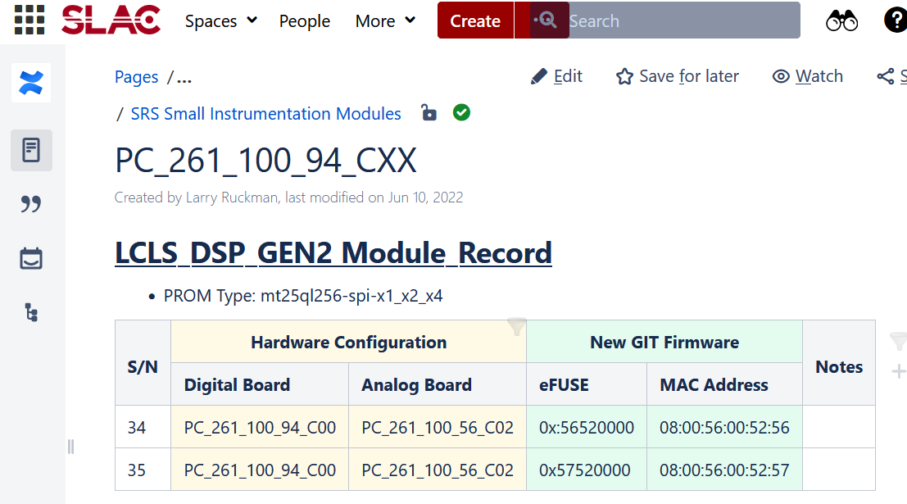
Design Management Maturity - Risk
Supply chain
Risk we can’t get what we want due to delays.
➡ Early procurement orders have been placed for PRL system. (08/2023)
Obsolescence
Hardware was designed several years ago.
➡ Designs have been updated for part replacements.
Lessons Learned:
Adding more monitors is very important.
Thermal related mechanical stress leads to long term failure of the LO couplers. New LO coupler module is being designed to avoid this issue.

Slide 18
ES&H and QA Considerations
PRL MO Gen, PLL and power amplifier devices and system will be tested in the lab prior to deployment. Procedures are documented.
All the devices will be EEIPed before delivery.
Lowering PA from 90W to 50W – much lower than NIRP safety threshold.
System drawings and cable plant database have been reviewed in dedicated QA sessions.

Slide 19
Previous Review Recommendations
Consider adding more effort to the RFoF system testing to move things along more quickly in order to determine viability and avert any issues sooner than later.
  -Matt’s comments and P8 & P9
Continue with the engineering development effort for additional diagnostics around the RF couplers; also consider adding more diagnostics to the overall system to help identify and isolate problems.
  -P10 & P12
Make sure to complete the obsolescence analysis of the PRL/LO system components and purchase any critical components as soon as possible
  -P17

Slide 20
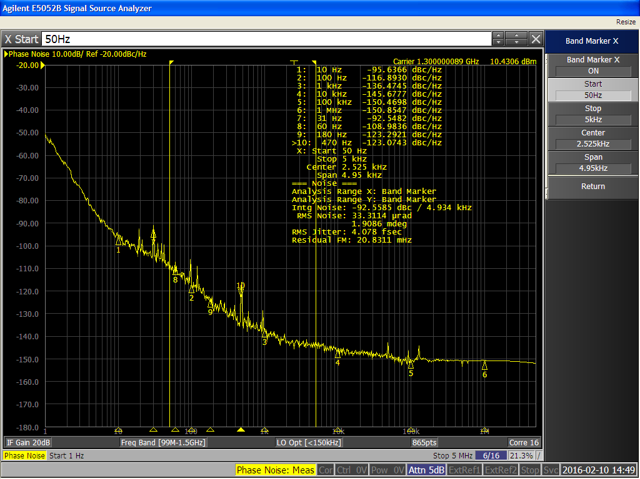
Previous Review Recommendations
The LCLS II PRD page 9 has a requirement: < 1fs integrated 1Hz to 10KHz. Has this been relaxed? It would be good to see a table of measured values compared to PRD. The presentation on slide 10 of PDR has some measurements but is not a one-to-one comparison of the numbers.
The updated requirement is in LCLSII-2.7-EN-0640, written by Larry Doolittle (LBNL). The requirements are <0.005 deg (<10fs) [50Hz-5kHz].
Our measurement is 4fs [50Hz-5kHz].
Sensitivity to LO and PRL Noise in LCLS-II
LCLSII-2.7-EN-0640
LLRF Sensitivity to LO and PRL Noise in LCLS-II
LCLSII-2.7-EN-0640
LRF Sensitivity to LO and PRL Noise in LCLS-II
LCLSII-2.7-EN-0640
1.3GHz Integral jitter:
50Hz-5kHz is 4fs [spec is 10fs]
Notes:
LLRF Sensitivity to LO and PRL Noise in LCLS-II
LLRF PRC PRL phase measurement shows 0.001deg (2.1fs) [22Hz-22.3kHz] – According to Larry Doolittle’s email response.

Slide 21
Summary
Designs are iterations on previous experience and proven in LCLSII.
Modification is mature.
Documentation is completed.
The design risks mitigation has been planned.

Slide 22
Thank you!
Questions?

