Slide 1
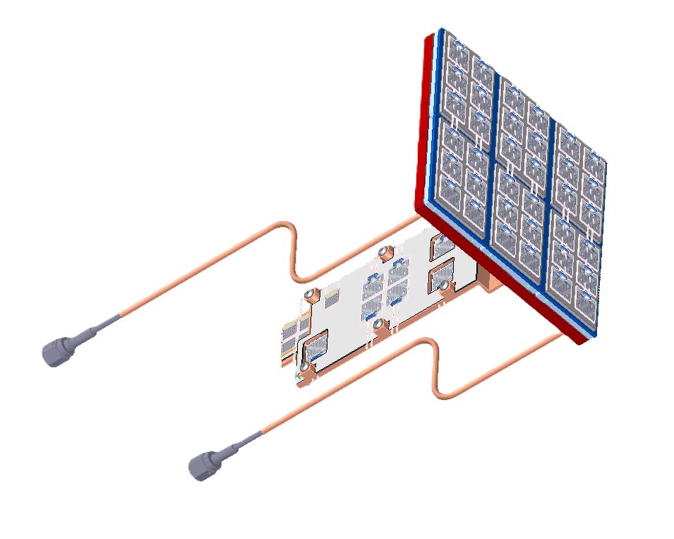
1MP Prototype Thermal Measurements

Slide 2
Scope
Determine the effectiveness of the thermal sensor cooling plate in drawing heat away from a heat source
  Check copper cooling lines effectiveness
Notes:
Eventually, can write up a list of requirements that correspond to experiments

Slide 3
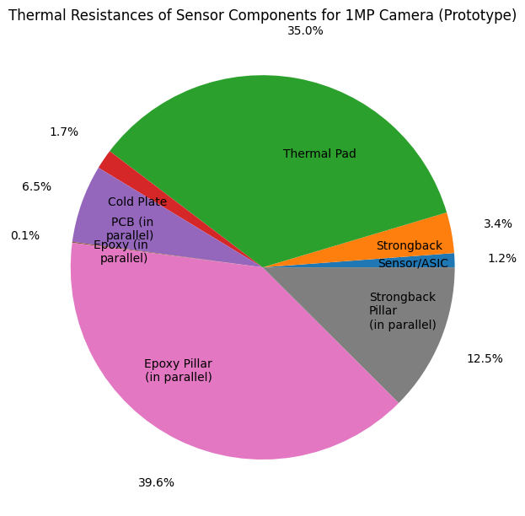
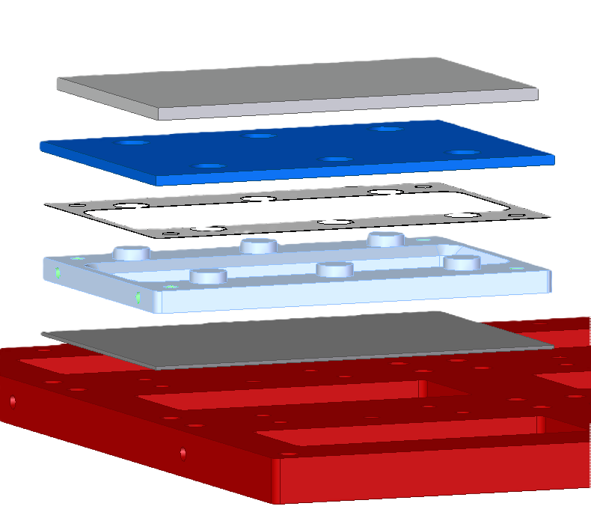
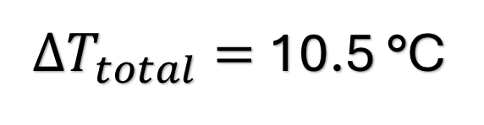
Thermal Simulations
10.5 °C
$ΔT_{total}=$10.5 °C
Notes:
Pie Chart taken on 8/7/24 from 1MPSensorThermalResistanceAnalysisResults.pptx (https://slac-my.sharepoint.com/:p:/r/personal/jmitiguy_slac_stanford_edu/Documents/1MP/1MPSensorThermalResistanceAnalysisResults.pptx?d=w4b554d81ebb34bcab0a46a54ebfb3fcb&csf=1&web=1&e=6TRzic&nav=eyJzSWQiOjMwMCwiY0lkIjoyMjIzNDg2NDc1fQ)

Slide 4
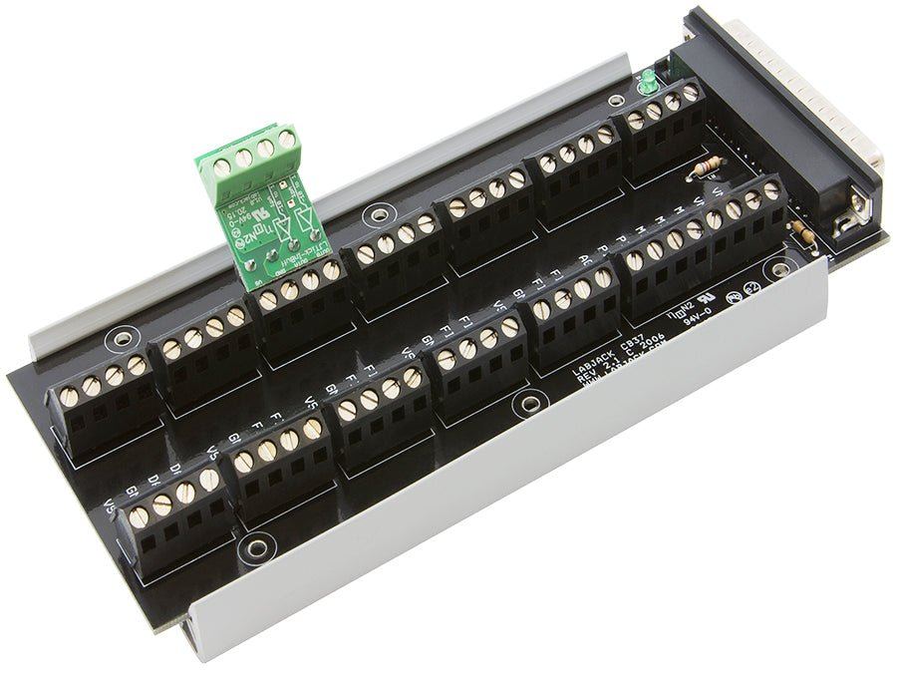


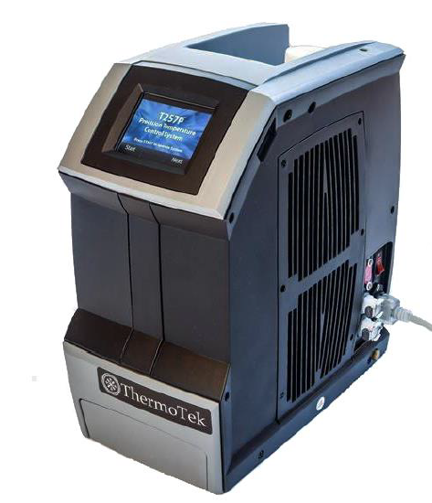
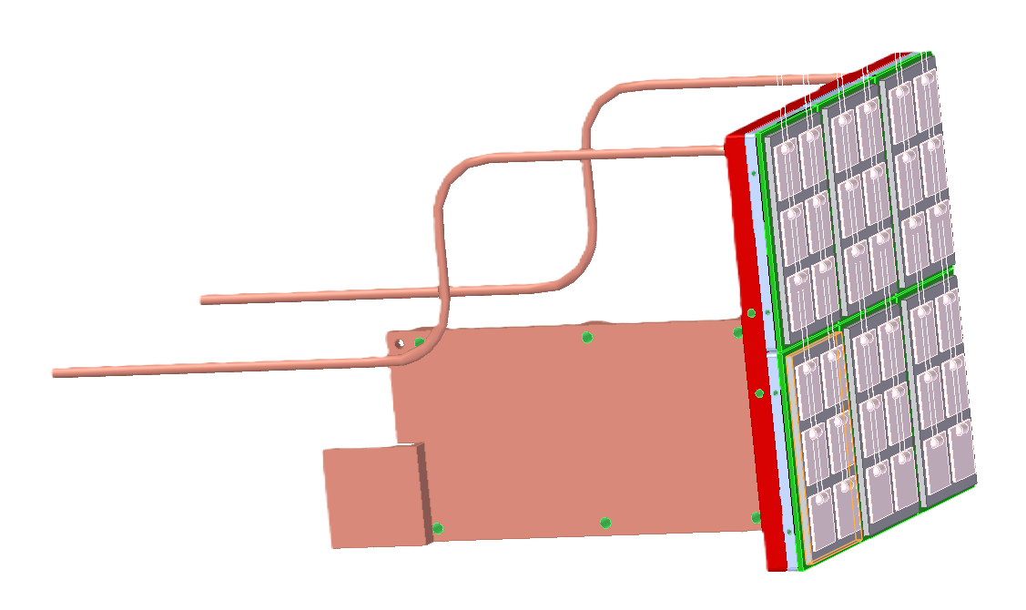
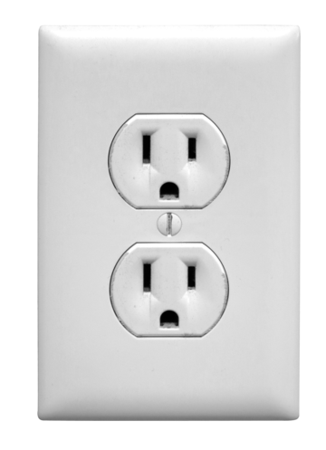
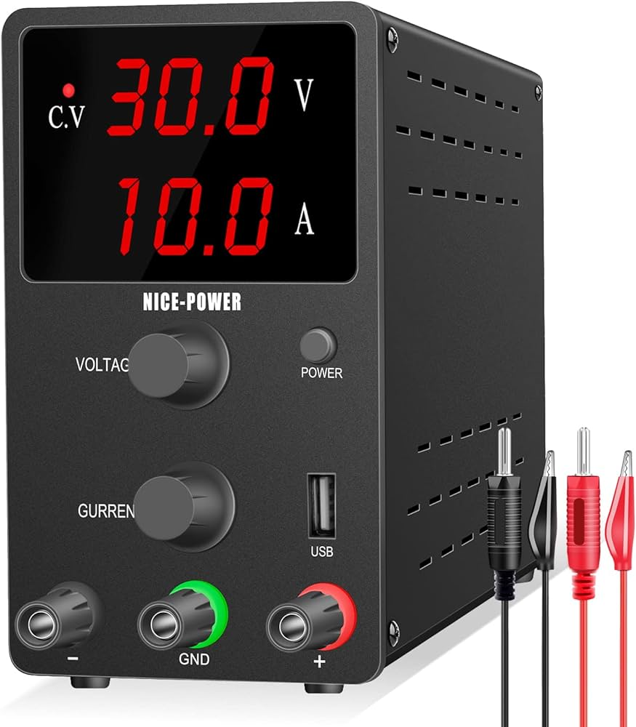
USB
Schematic & Set-Up
See next slide for more
See next slides for more
Notes:
Use LabJackT7SetUp.ipynb (https://slac-my.sharepoint.com/:u:/g/personal/jmitiguy_slac_stanford_edu/Eaq52xj2dtdKpL-JVnj5bSEBAcs0YexaWBdFCXmAW2EurQ?e=8xrxrs) to access data from LabJack.
See 4MP Cam Thermal testing.pptx (https://slac-my.sharepoint.com/:p:/g/personal/aidenjem_slac_stanford_edu/EQYnhESKkDxLqT9O2HrkpbYBgSaRTrRnamnGi70vrITFag?e=TPReDH) for more information.

Slide 5
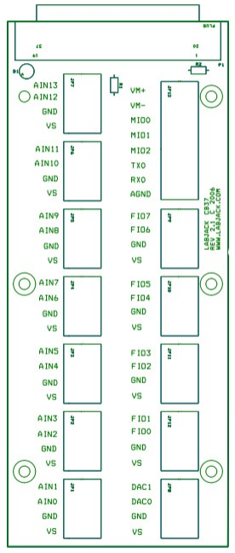
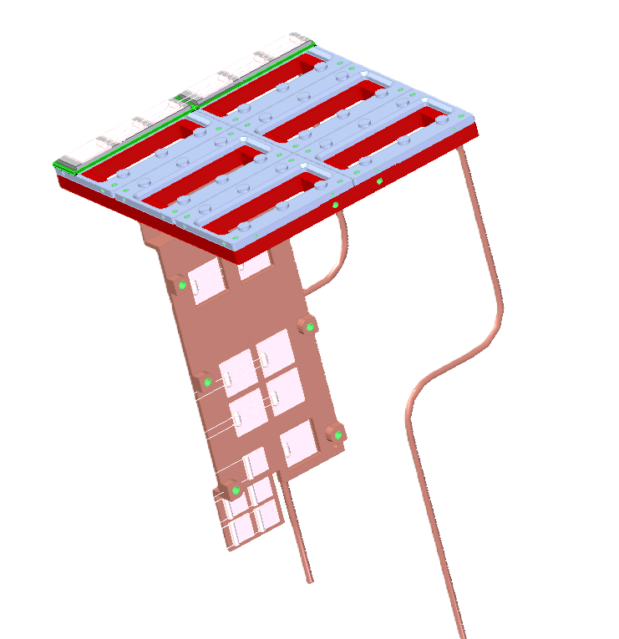
Section of Layers
Strongback
Detail View
AIN7
AIN8
AIN6
AIN9
USB
AIN11
AIN10
AIN12
AIN5
Detail View
AIN1
AIN4
AIN2
AIN3
See next slide for more
Room Temperature
AIN0
Notes:
Use LabJackT7SetUp.ipynb (https://slac-my.sharepoint.com/:u:/g/personal/jmitiguy_slac_stanford_edu/Eaq52xj2dtdKpL-JVnj5bSEBAcs0YexaWBdFCXmAW2EurQ?e=8xrxrs) to access data from LabJack.
See 4MP Cam Thermal testing.pptx (https://slac-my.sharepoint.com/:p:/g/personal/aidenjem_slac_stanford_edu/EQYnhESKkDxLqT9O2HrkpbYBgSaRTrRnamnGi70vrITFag?e=TPReDH) for more information.

Slide 6
Section of Layers
AIN9
Strongback
Detail View
AIN7
AIN8
AIN6
USB
AIN11
AIN10
AIN12
AIN5
Detail View
AIN2
AIN1
AIN4
AIN3
See next slide for more
Room Temperature
AIN0
Notes:
Use LabJackT7SetUp.ipynb (https://slac-my.sharepoint.com/:u:/g/personal/jmitiguy_slac_stanford_edu/Eaq52xj2dtdKpL-JVnj5bSEBAcs0YexaWBdFCXmAW2EurQ?e=8xrxrs) to access data from LabJack.
See 4MP Cam Thermal testing.pptx (https://slac-my.sharepoint.com/:p:/g/personal/aidenjem_slac_stanford_edu/EQYnhESKkDxLqT9O2HrkpbYBgSaRTrRnamnGi70vrITFag?e=TPReDH) for more information.

Slide 7
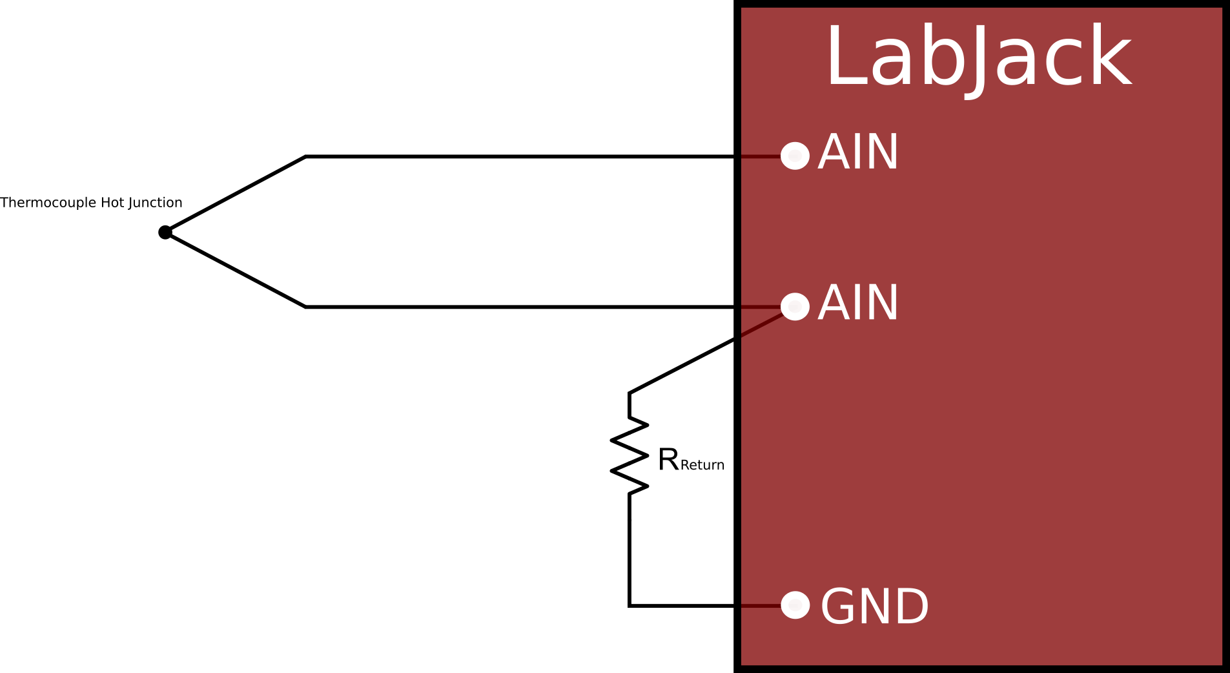
Noise, CB37
For increased accuracy of temperature measurements, use a differential connection to reduce noise
Notes:
https://support.labjack.com/docs/using-a-thermocouple-with-the-t7

Slide 8
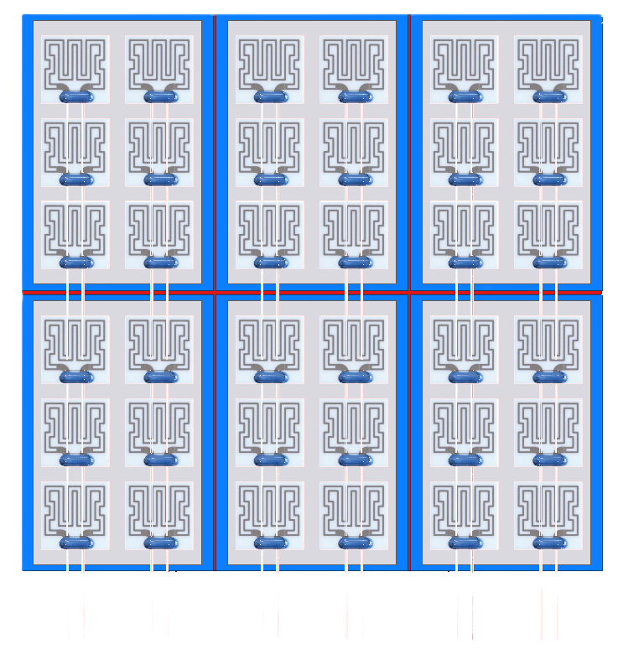
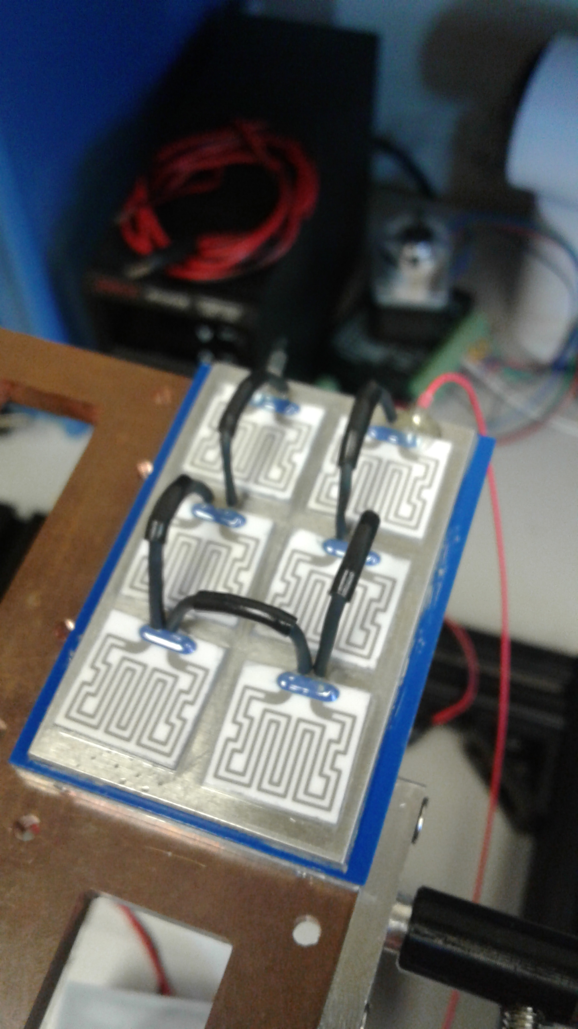
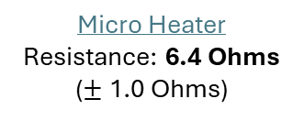
Circuit Diagram Part #1
Total (Heaters): $319.51
Micro Heater Resistance: 6.4 Ohms ($±$ 1.0 Ohms)
Required Voltage: 33.9 V
Expected Current Through Battery: 5.3 – 5.7 A
See later slides for more info
Expected Total Heat Power: 180 W
26 AWG
18-20’’
6 * 25 W + 20% Safety Factor
18?? AWG
Notes:
Experimentally measuring the resistances of the 6.4 Ohm resistors has yielded an average resistance closer to 6.2 Ohms.
Taken on 8/1/24 from: 1MPPrototypeHeaterCircuitSchematic.pptx (https://slac-my.sharepoint.com/:p:/r/personal/jmitiguy_slac_stanford_edu/Documents/1MP/Prototype/1MPPrototypeHeaterCircuitSchematic.pptx?d=w5018df576f8546a3bfd59d7cab3875cb&csf=1&web=1&e=ebBMvc&nav=eyJzSWQiOjI4OCwiY0lkIjoyOTM5NDk0NzQ2fQ)

Slide 9
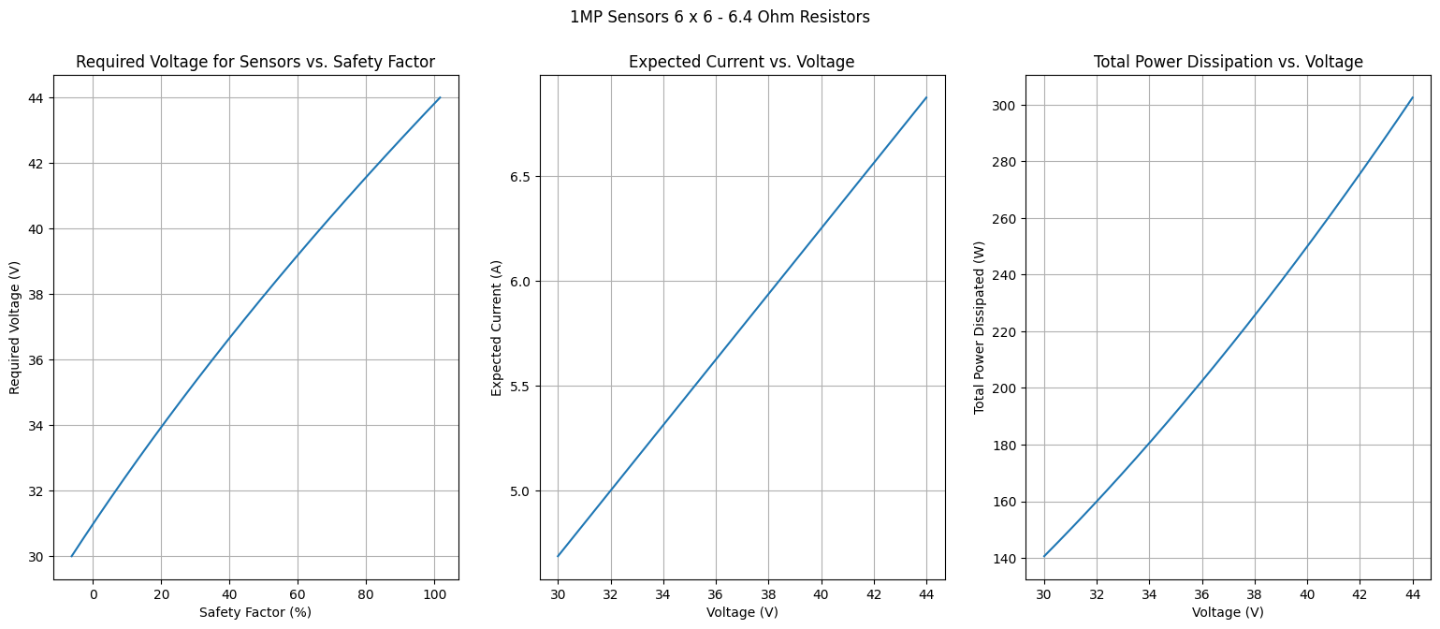
Notes:
Taken from: 1MPPrototypeHeaterCircuitSchematic.pptx (https://slac-my.sharepoint.com/:p:/r/personal/jmitiguy_slac_stanford_edu/Documents/1MP/Prototype/1MPPrototypeHeaterCircuitSchematic.pptx?d=w5018df576f8546a3bfd59d7cab3875cb&csf=1&web=1&e=9Bg8ua&nav=eyJzSWQiOjI5MiwiY0lkIjoxNDg2MjU2ODB9) on 8/1/24

Slide 10
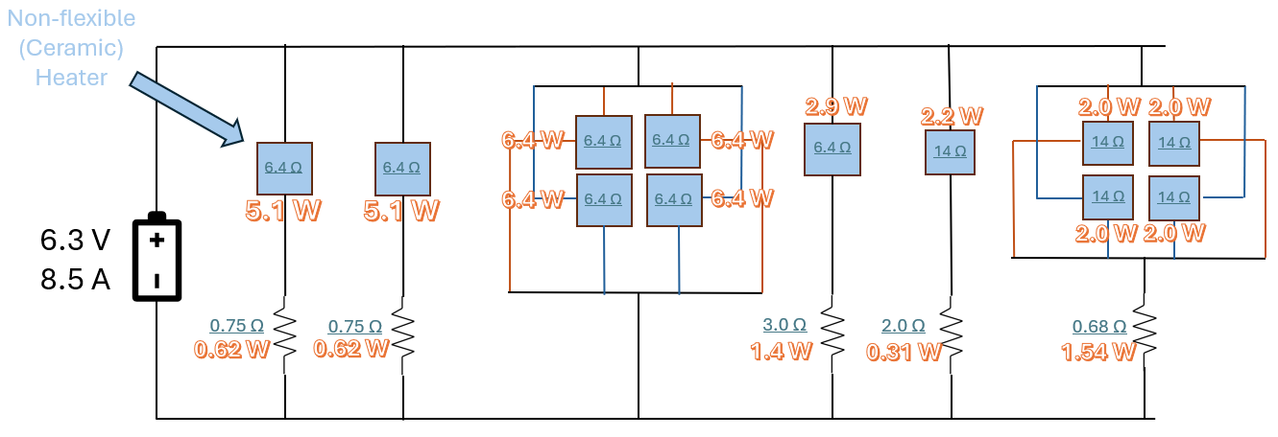
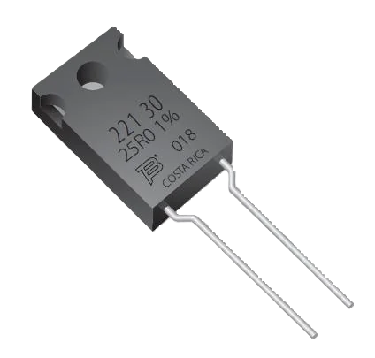
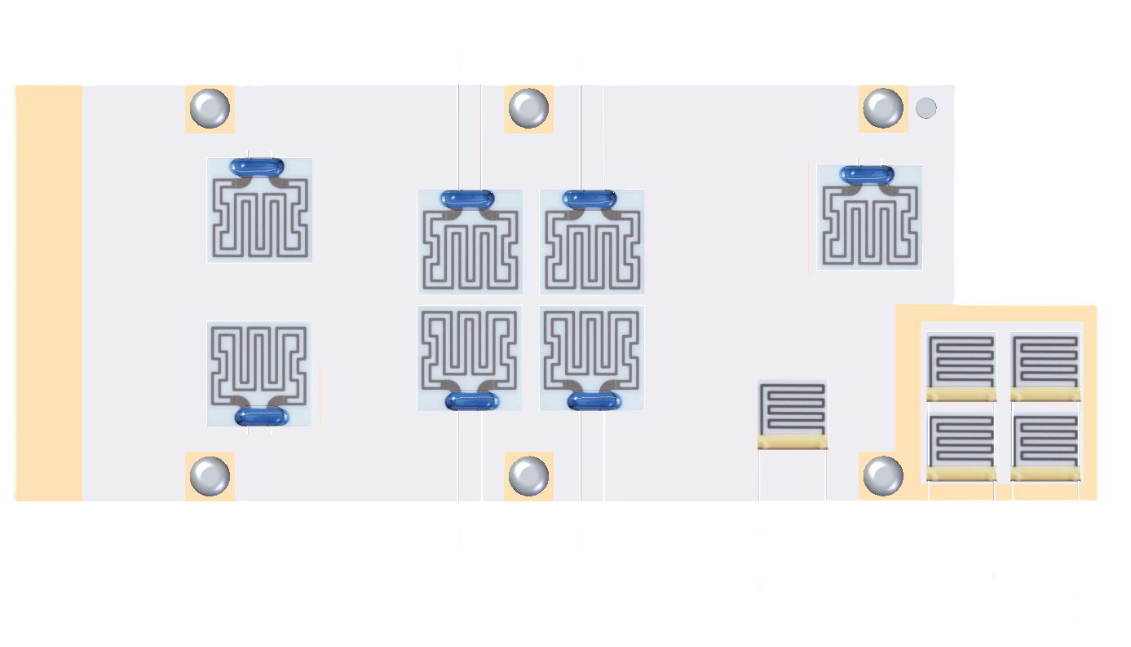
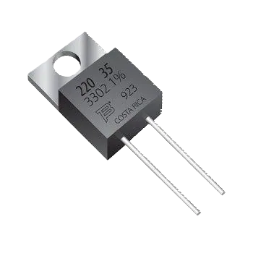
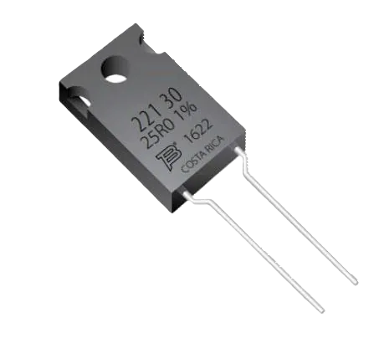


Circuit Diagram Part #2
0.75 Ω
3.0 Ω
Heaters: $170
Resistors: $27
(Purchase Link)
Total: $197
Micro Heater Resistance: 14 Ω ($±$ 2.0 Ohms)
Micro Heater Resistance: 6.4 Ω ($±$ 1.0 Ohms)
Voltage: 6.3 V
Expected Current Through Battery: 8.1 – 8.9 A
Expected Total Heat Power: 51 – 56 W
0.75 Ω
See next page for power distribution
2.0 Ω
0.68 Ω
Notes:
Circuitry Diagram taken on 8/1/24 from 1MPPrototypeHeaterCircuitSchematic.pptx (https://slac-my.sharepoint.com/:p:/r/personal/jmitiguy_slac_stanford_edu/Documents/1MP/Prototype/1MPPrototypeHeaterCircuitSchematic.pptx?d=w5018df576f8546a3bfd59d7cab3875cb&csf=1&web=1&e=Y6pZlt&nav=eyJzSWQiOjI4OSwiY0lkIjo2NzU4MTYxOTJ9)
Data taken on 8/5/24 from HeaterAnalysis1MP2V2.ipynb (https://slac-my.sharepoint.com/:u:/g/personal/jmitiguy_slac_stanford_edu/ESL4_MOwBC1Hr1mS4kcTBRcBDcflOeE2L5_FkBiDzDf6Zw)

Slide 11
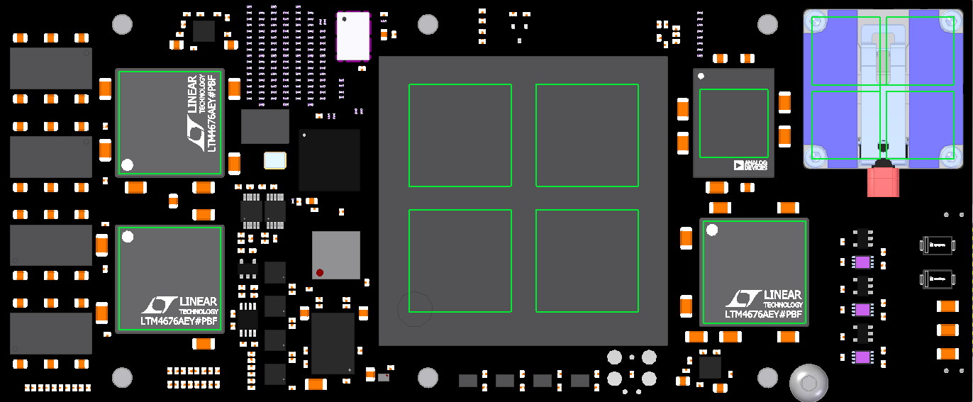
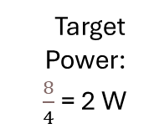
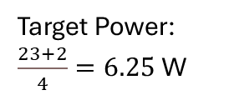
Heat Power Dissipated by Heaters
Target Power: 2.2 W
Shape of Heaters
POOR FIT
2.0 W
2.0 W
Target Power:
$\frac{8}{4}$ = 2 W
5.1 W
2.2 W
2.0 W
2.0 W
6.4 W
6.4 W
Target Power: 5 W
6.4 W
6.4 W
5.1 W
2.9 W
Target Power: $\frac{23+2}{4}=6.25$W
Target Power: 2.8 W
Notes:
Taken on 8/1/24 from: 1MPPrototypeHeaterCircuitSchematic.pptx (https://slac-my.sharepoint.com/:p:/r/personal/jmitiguy_slac_stanford_edu/Documents/1MP/Prototype/1MPPrototypeHeaterCircuitSchematic.pptx?d=w5018df576f8546a3bfd59d7cab3875cb&csf=1&web=1&e=aOZdpg&nav=eyJzSWQiOjI5MCwiY0lkIjo4OTk5Njg0OH0)

Slide 12
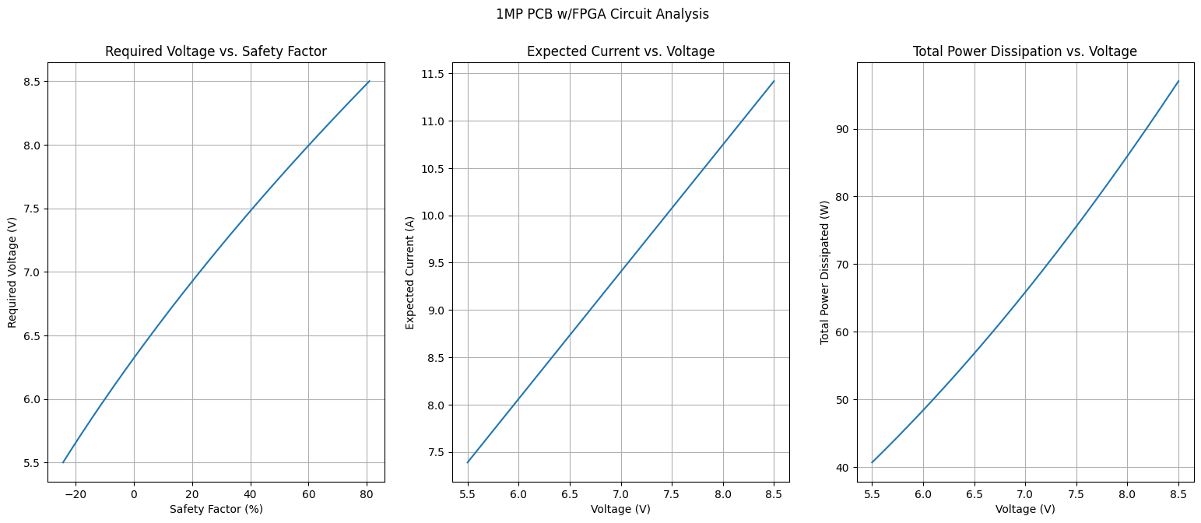
Notes:
Data taken on 8/1/24 from: 1MPPrototypeHeaterCircuitSchematic.pptx (https://slac-my.sharepoint.com/:p:/r/personal/jmitiguy_slac_stanford_edu/Documents/1MP/Prototype/1MPPrototypeHeaterCircuitSchematic.pptx?d=w5018df576f8546a3bfd59d7cab3875cb&csf=1&web=1&e=zWamHP&nav=eyJzSWQiOjI5NSwiY0lkIjoyMzkyMzIwNDMwfQ)

Slide 13
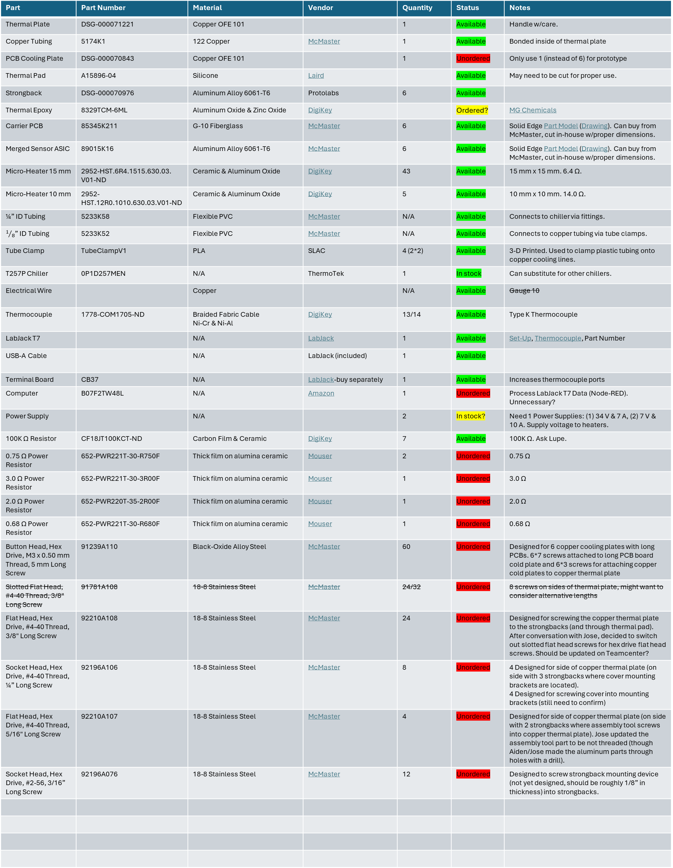
Bill of Materials
Part | Part Number | Material | Vendor | Quantity | Status | Notes
Thermal Plate | DSG-000071221 | Copper OFE 101 |  | 1 | Available | Handle w/care.
Copper Tubing | 5174K1 | 122 Copper | McMaster | 1 | Available | Bonded inside of thermal plate
PCB Cooling Plate | DSG-000070843 | Copper OFE 101 |  | 1 | Unordered | Only use 1 (instead of 6) for prototype
Thermal Pad | A15896-04 | Silicone | Laird |  | Available | May need to be cut for proper use.
Strongback | DSG-000070976 | Aluminum Alloy 6061-T6 | Protolabs | 6 | Available
Thermal Epoxy | 8329TCM-6ML | Aluminum Oxide & Zinc Oxide | DigiKey |  | Ordered? | MG Chemicals
Carrier PCB | 85345K211 | G-10 Fiberglass | McMaster | 6 | Available | Solid Edge Part Model (Drawing). Can buy from McMaster, cut in-house w/proper dimensions.
Merged Sensor ASIC | 89015K16 | Aluminum Alloy 6061-T6 | McMaster | 6 | Available | Solid Edge Part Model (Drawing). Can buy from McMaster, cut in-house w/proper dimensions.
Micro-Heater 15 mm | 2952-HST.6R4.1515.630.03. V01-ND | Ceramic & Aluminum Oxide | DigiKey | 43 | Available | 15 mm x 15 mm. 6.4 Ω.
Micro-Heater 10 mm | 2952-HST.12R0.1010.630.03.V01-ND | Ceramic & Aluminum Oxide | DigiKey | 5 | Available | 10 mm x 10 mm. 14.0 Ω.
¼” ID Tubing | 5233K58 | Flexible PVC | McMaster | N/A | Available | Connects to chiller via fittings.
$1/8$” ID Tubing | 5233K52 | Flexible PVC | McMaster | N/A | Available | Connects to copper tubing via tube clamps.
Tube Clamp | TubeClampV1 | PLA | SLAC | 4 (2*2) | Available | 3-D Printed. Used to clamp plastic tubing onto copper cooling lines.
T257P Chiller | 0P1D257MEN | N/A | ThermoTek | 1 | In stock | Can substitute for other chillers.
Electrical Wire |  | Copper |  | N/A | Available | Gauge 10
Thermocouple | 1778-COM1705-ND | Braided Fabric Cable Ni-Cr & Ni-Al | DigiKey | 13/14 | Available | Type K Thermocouple
LabJack T7 |  | N/A | LabJack | 1 | Available | Set-Up, Thermocouple, Part Number
USB-A Cable |  | N/A | LabJack (included) | 1 | Available
Terminal Board | CB37 | N/A | LabJack-buy separately | 1 | Available | Increases thermocouple ports
Computer | B07F2TW48L | N/A | Amazon | 1 | Unordered | Process LabJack T7 Data (Node-RED). Unnecessary?
Power Supply |  | N/A |  | 2 | In stock? | Need 1 Power Supplies: (1) 34 V & 7 A, (2) 7 V & 10 A. Supply voltage to heaters.
100K Ω Resistor | CF18JT100KCT-ND | Carbon Film & Ceramic | DigiKey | 7 | Available | 100K Ω. Ask Lupe.
0.75 Ω Power Resistor | 652-PWR221T-30-R750F | Thick film on alumina ceramic | Mouser | 2 | Unordered | 0.75 Ω
3.0 Ω Power Resistor | 652-PWR221T-30-3R00F | Thick film on alumina ceramic | Mouser | 1 | Unordered | 3.0 Ω
2.0 Ω Power Resistor | 652-PWR220T-35-2R00F | Thick film on alumina ceramic | Mouser | 1 | Unordered | 2.0 Ω
0.68 Ω Power Resistor | 652-PWR221T-30-R680F | Thick film on alumina ceramic | Mouser | 1 | Unordered | 0.68 Ω
Button Head, Hex Drive, M3 x 0.50 mm Thread, 5 mm Long Screw | 91239A110 | Black-Oxide Alloy Steel | McMaster | 60 | Unordered | Designed for 6 copper cooling plates with long PCBs. 6*7 screws attached to long PCB board cold plate and 6*3 screws for attaching copper cold plates to copper thermal plate
Slotted Flat Head, #4-40 Thread, 3/8" Long Screw | 91781A108 | 18-8 Stainless Steel | McMaster | 24/32 | Unordered | 8 screws on sides of thermal plate, might want to consider alternative lengths
Flat Head, Hex Drive, #4-40 Thread, 3/8" Long Screw | 92210A108 | 18-8 Stainless Steel | McMaster | 24 | Unordered | Designed for screwing the copper thermal plate to the strongbacks (and through thermal pad). After conversation with Jose, decided to switch out slotted flat head screws for hex drive flat head screws. Should be updated on Teamcenter?
Socket Head, Hex Drive, #4-40 Thread, ¼” Long Screw | 92196A106 | 18-8 Stainless Steel | McMaster | 8 | Unordered | 4 Designed for side of copper thermal plate (on side with 3 strongbacks where cover mounting brackets are located). 4 Designed for screwing cover into mounting brackets (still need to confirm)
Flat Head, Hex Drive, #4-40 Thread, 5/16" Long Screw | 92210A107 | 18-8 Stainless Steel | McMaster | 4 | Unordered | Designed for side of copper thermal plate (on side with 2 strongbacks where assembly tool screws into copper thermal plate). Jose updated the assembly tool part to be not threaded (though Aiden/Jose made the aluminum parts through holes with a drill).
Socket Head, Hex Drive, #2-56, 3/16” Long Screw | 92196A076 | 18-8 Stainless Steel | McMaster | 12 | Unordered | Designed to screw strongback mounting device (not yet designed, should be roughly 1/8” in thickness) into strongbacks.
Notes:
Thermocouple
Alloys
Omega
7
Type K, Dia./Ga.: 0.005 Length: 12”, Insul: Bare. Negative leg is red/shorter. Can get from Amazon

Slide 14
Ordering Materials/Shopping List – OUTDATED – SEE PREVIOUS SLIDE
Part | Part Number | Vendor | Quantity | Total Cost | Status | Lead Time/Delivery | Notes
Thermal Plate | DSG-000071221 |  | 1 |  | Available |  | Handle w/care.
Copper Tubing | 5174K1 | McMaster | 1 | $57.57 | Available | In stock | Bonded inside of thermal plate
PCB Cooling Plate | DSG-000070843 |  | 1 |  | Unordered |  | Only use 1 (instead of 6) for prototype
Strongback | DSG-000070976 | Protolabs | 6 |  | Available
Thermal Epoxy | 8329TCM-6ML | DigiKey |  | $26.68 | Ordered | In stock
Carrier PCB | 85345K211 | McMaster | 1 | $14.50 | Available | In stock | Solid Edge Part Model (Drawing). Can buy from McMaster, cut in-house w/proper dimensions.
Merged Sensor ASIC | 89015K16 | McMaster | 1 | $19.14 | Available | In stock | Solid Edge Part Model (Drawing). Can buy from McMaster, cut in-house w/proper dimensions.
Micro-Heater 15 mm | 2952-HST.6R4.1515.630.03. V01-ND | DigiKey | 43 | $381.63 | Available | In stock | 15 mm x 15 mm. 6.4 Ω.
Micro-Heater 10 mm | 2952-HST.12R0.1010.630.03.V01-ND | DigiKey | 5 | $86.05 | Available | In stock | 10 mm x 10 mm. 14.0 Ω.
Computer | B07F2TW48L | Amazon | 1 | $153.99 | Unordered | In stock | Process LabJack T7 Data (Node-RED)
100K Ω Resistor | CF18JT100KCT-ND | DigiKey | 7 | $0.30 | In stock? | In stock | 100K Ω
0.75 Ω Resistor | WHAR75FECT-ND | DigiKey | 2 | $1.78 | In stock? | In stock | 0.75 Ω
3.16 Ω Resistor | MF1/4DCT52R3R16F | DigiKey | 1 | $0.20 | In stock? | In stock | 3.16 Ω
2.0 Ω Resistor | ERX-3SJ2R0 | DigiKey | 1 | $0.62 | In stock? | In stock | 2.0 Ω
0.68 Ω Resistor | LR1LJR68 | DigiKey | 1 | $0.27 | In stock? | In stock | 0.68 Ω
Button Head, Hex Drive, M3 x 0.50 mm Thread, 5 mm Long Screw | 91239A110 | McMaster | 60 | $29.24 | Unordered | In stock | Designed for 6 copper cooling plates with long PCBs. 6*7 screws attached to long PCB board cold plate and 6*3 screws for attaching copper cold plates to copper thermal plate
Flat Head, Hex Drive, #4-40 Thread, 3/8" Long Screw | 92210A108 | McMaster | 24 | $5.17 | Unordered | In stock | Designed for screwing the copper thermal plate to the strongbacks (and through thermal pad). After conversation with Jose, decided to switch out slotted flat head screws for hex drive flat head screws. Should be updated on Teamcenter?
Socket Head, Hex Drive, #4-40 Thread, ¼” Long Screw | 92196A106 | McMaster | 8 | $5.74 | Unordered | In stock | 4 Designed for side of copper thermal plate (on side with 3 strongbacks where cover mounting brackets are located). 4 Designed for screwing cover into mounting brackets (still need to confirm)
Flat Head, Hex Drive, #4-40 Thread, 5/16" Long Screw | 92210A107 | McMaster | 4 | $4.91 | Unordered | In stock | Designed for side of copper thermal plate (on side with 2 strongbacks where assembly tool screws into copper thermal plate). Jose updated the assembly tool part to be not threaded (though Aiden/Jose made the aluminum parts through holes with a drill).
Socket Head, Hex Drive, #2-56, 3/16” Long Screw | 92196A076 | McMaster | 12 | $7.62 | Unordered | In stock | Designed to screw strongback mounting device (not yet designed, should be roughly 1/8” in thickness) into strongbacks.
Total |  |  |  | $792.24
Notes:
Thermocouple
Alloys
Omega
7
Type K, Dia./Ga.: 0.005 Length: 12”, Insul: Bare. Negative leg is red/shorter. Can get from Amazon

Slide 15
Hazards

Slide 16
Electrical
Keep Voltage below hazardous levels on variable power supply
Prevent short circuits
  Use insulated wires
  Keep wires organized
  Inspect circuit before and during power supply use
Use 10 gauge or lower electrical wire
  10 gauge – Max Current: 12 A
Ensure working area is dry
  E.g., remove open liquids from workspace
Do not use the power supply without people nearby
Maximum Run Time: 5 hours
Notes:
https://precmfgco.com/wire-gauge-sizes-guide/

Slide 17
Coolant
Distilled Water
Water/glycol [80/20]
Avoid touching liquids below 15 °C
Use caution when dealing with liquids below 7 °C
  Can cause numbness
Use extra caution when dealing with liquids below 0 °C
  Can cause frostbite
Notes:
https://ntrs.nasa.gov/api/citations/20100020960/downloads/20100020960.pdf

Slide 18
Risks

Slide 19
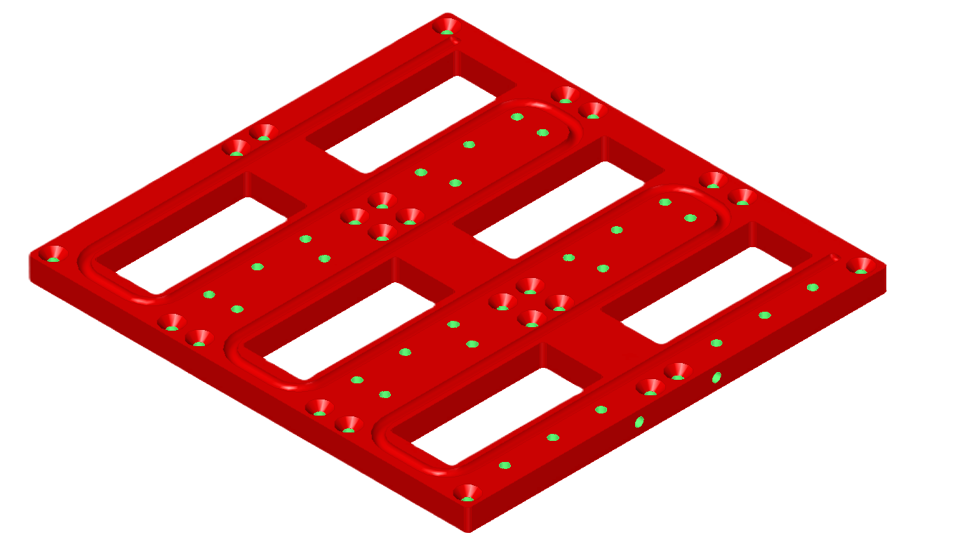
Cooling Plate
Do not drop copper thermal plate

Slide 20
T257P Chiller
Settings
  Distilled Water
  Room Temperature (20-25 °C)
  10 deg C
  High/Low…
Thermal Insulation – Foam

Slide 21
Experimental Procedural Setup
22 °C (1hr)
15 °C
10 °C
Avoid condensation

Slide 22

Logbook (To Print/Fill-in-blank)
Time/Date
Collaborators
Room Temperature
Humidity? (from LabJack T7?)
$Q=\dot{m}C_{p}ΔT$
$ΔT=\frac{Q}{\dot{m}C_{p}}$
$C_{p_{water}}=4186 \frac{J}{kg℃}$

