Slide 1
1MP Prototype Testing - Circuitry

Slide 2
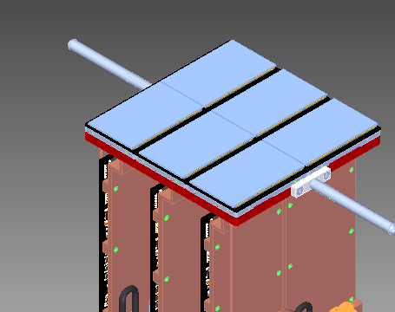
Heat Dissipation for Sensors/ASICs

Slide 3
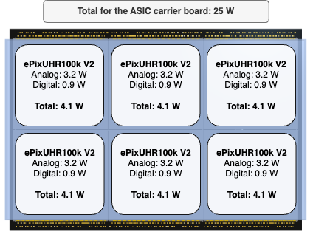
Notes:
Image taken from: https://confluence.slac.stanford.edu/display/ppareg/3x2+Readout+Overview#id-3x2ReadoutOverview-Boardpowermaps

Slide 4
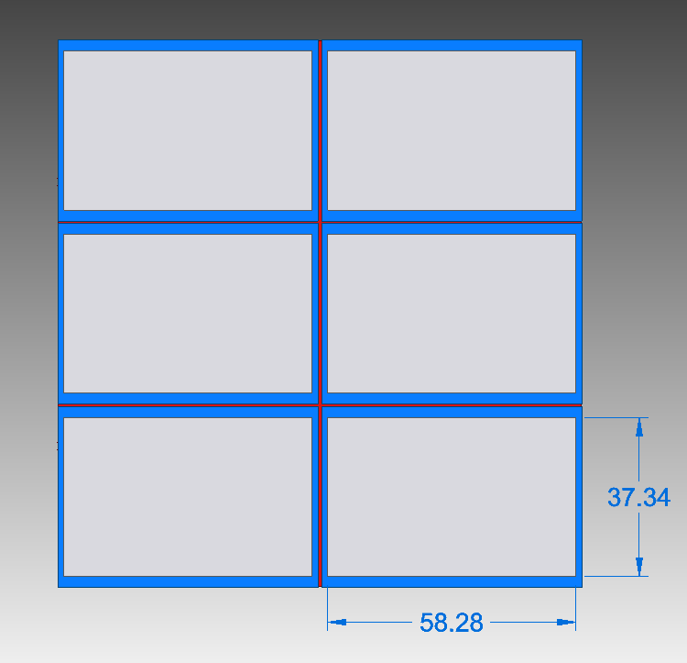

Slide 5
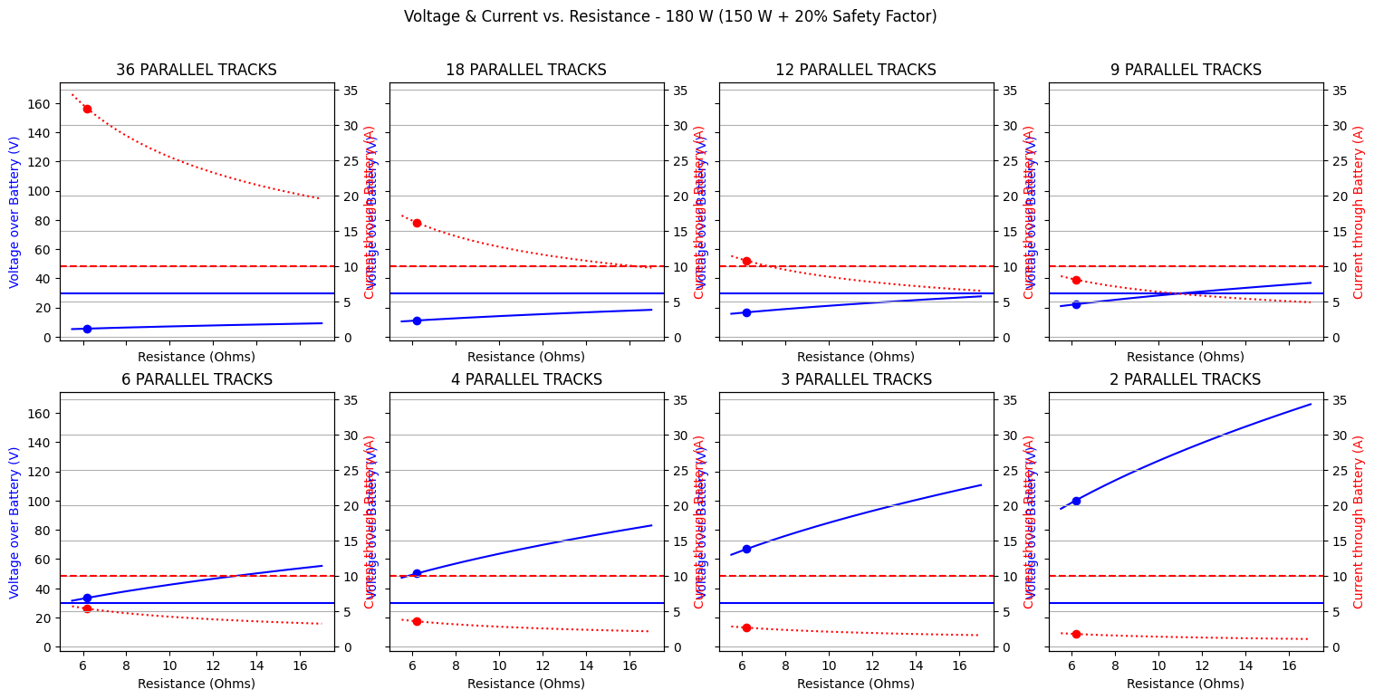
Notes:
Taken from: HeaterAnalysis1MP.ipynb (https://slac-my.sharepoint.com/:u:/g/personal/jmitiguy_slac_stanford_edu/Ed5YIdlSLDRMg1Xxdo90Te4BITdP3Y6J8fojrjBDnlpqhw?e=cHwHQM) on 8/1/24

Slide 6
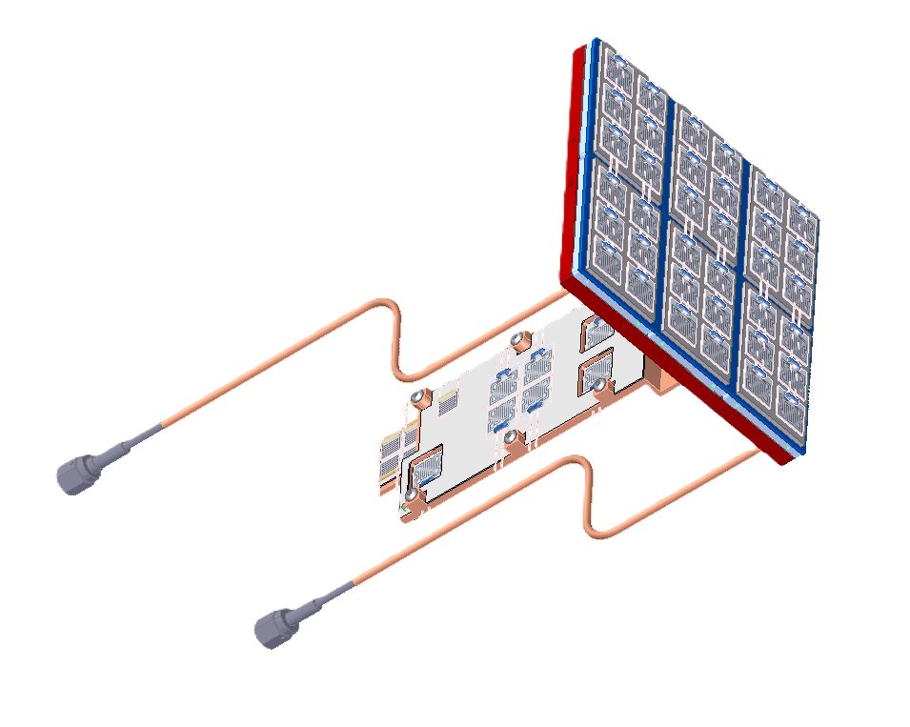
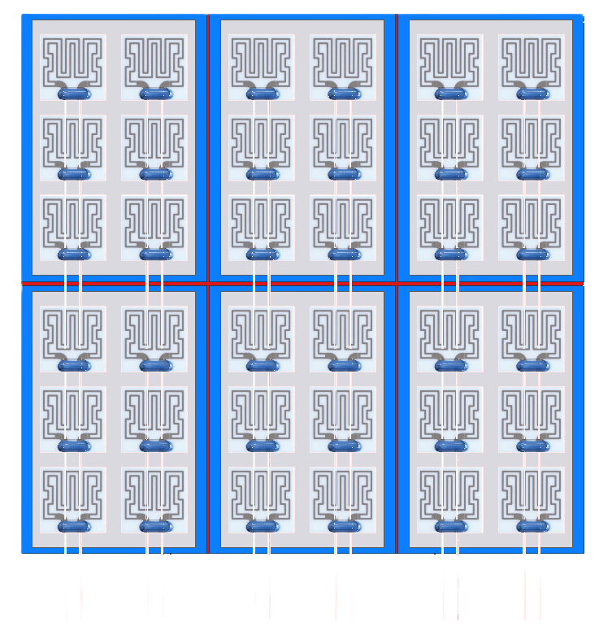
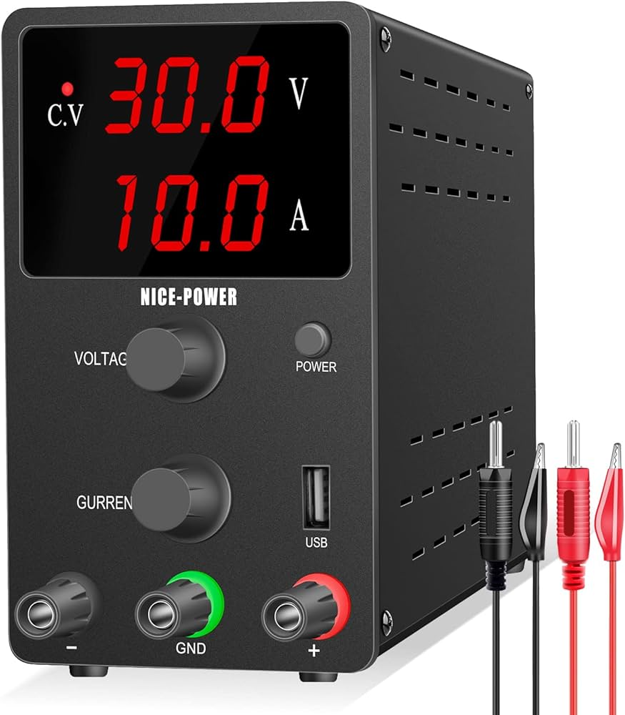
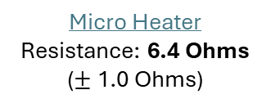
Circuit Diagram Part #1
Total (Heaters): $319.51
Micro Heater Resistance: 6.4 Ohms ($±$ 1.0 Ohms)
Required Voltage: 33.9 V
Expected Current Through Battery: 5.3 – 5.7 A
See later slides for more info
Expected Total Heat Power: 180 W
26 AWG
18-20’’
6 * 25 W + 20% Safety Factor
Notes:
Experimentally measuring the resistances of the 6.4 Ohm resistors has yielded an average resistance closer to 6.2 Ohms.
Taken from: HeaterAnalysis1MP.ipynb (https://slac-my.sharepoint.com/:u:/g/personal/jmitiguy_slac_stanford_edu/Ed5YIdlSLDRMg1Xxdo90Te4BITdP3Y6J8fojrjBDnlpqhw?e=cHwHQM) on 8/1/24
Used for 1MPPrototypeThermocoupleMeasurements.pptx (https://slac-my.sharepoint.com/:p:/r/personal/jmitiguy_slac_stanford_edu/Documents/1MP/Prototype/1MPPrototypeThermocoupleMeasurements.pptx?d=w72c5c6c626db42a987172786dc6dd0c1&csf=1&web=1&e=ROfbIn&nav=eyJzSWQiOjI5NSwiY0lkIjoyOTM5NDk0NzQ2fQ)

Slide 7
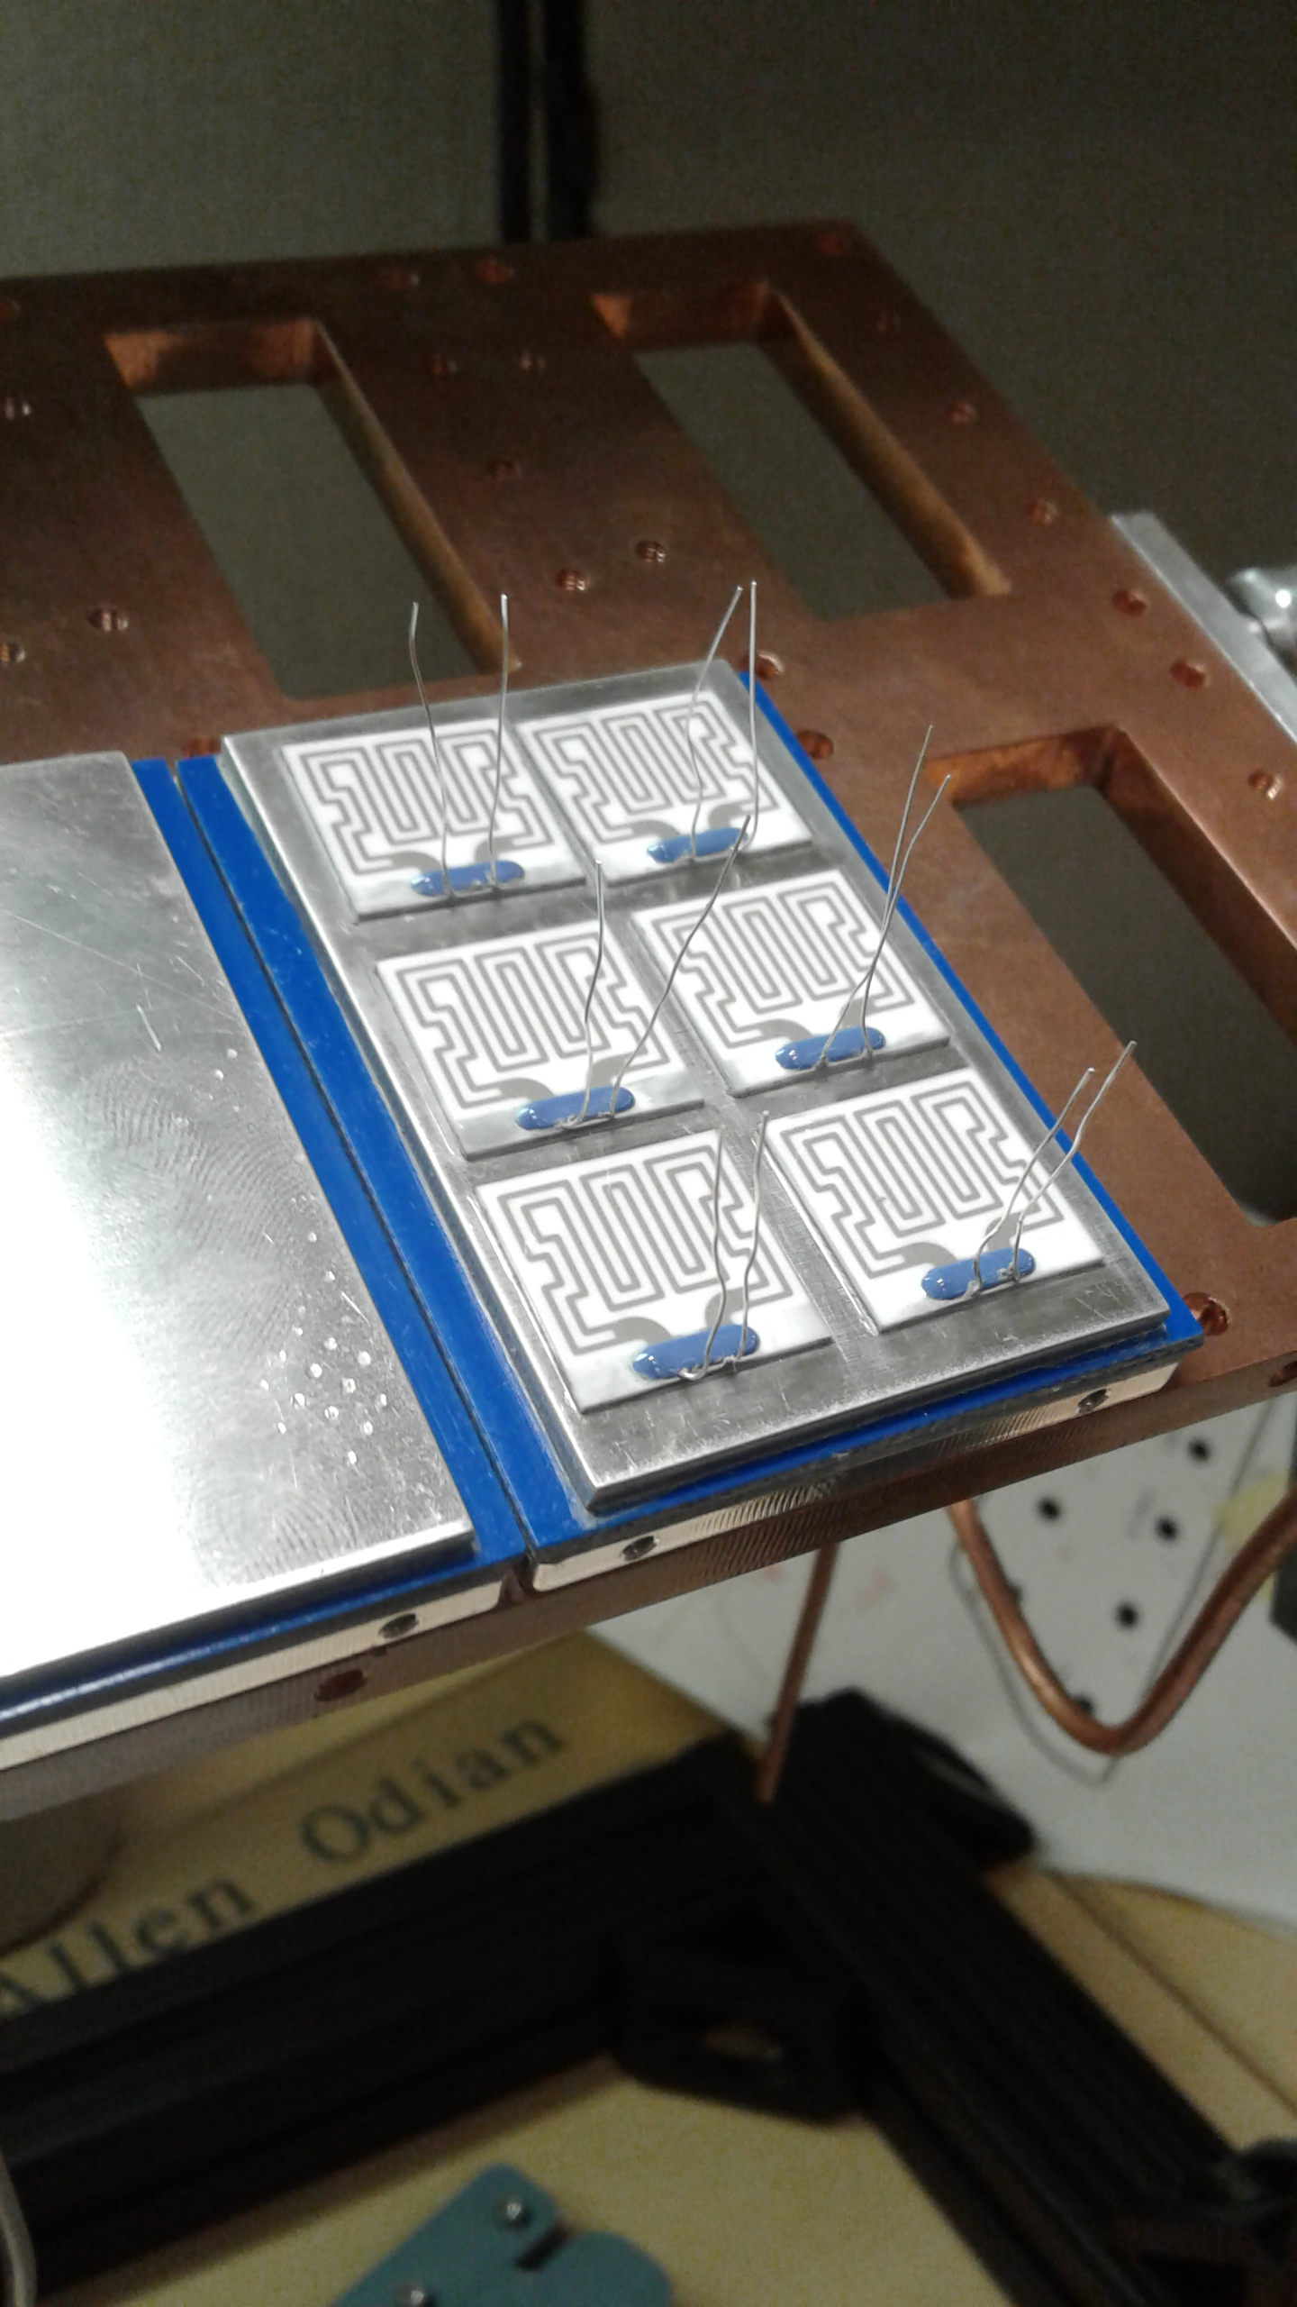
Prototype

Slide 8
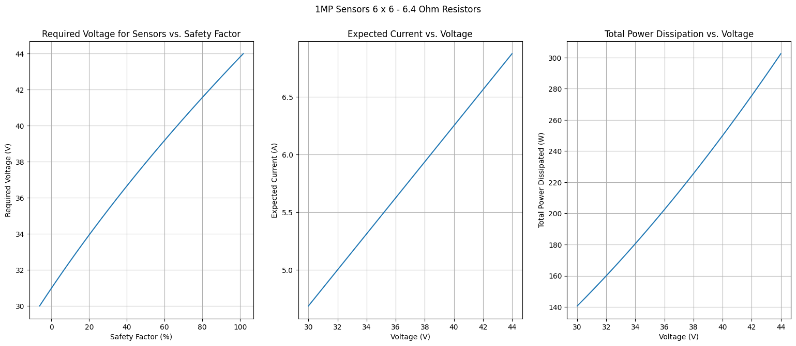
Notes:
Taken from: HeaterAnalysis1MP.ipynb (https://slac-my.sharepoint.com/:u:/g/personal/jmitiguy_slac_stanford_edu/Ed5YIdlSLDRMg1Xxdo90Te4BITdP3Y6J8fojrjBDnlpqhw?e=cHwHQM) on 8/1/24
Used for 1MPPrototypeThermocoupleMeasurements.pptx (https://slac-my.sharepoint.com/:p:/r/personal/jmitiguy_slac_stanford_edu/Documents/1MP/Prototype/1MPPrototypeThermocoupleMeasurements.pptx?d=w72c5c6c626db42a987172786dc6dd0c1&csf=1&web=1&e=tvwBJ4&nav=eyJzSWQiOjI5NiwiY0lkIjozNDE0NDk0OTcyfQ)

Slide 9
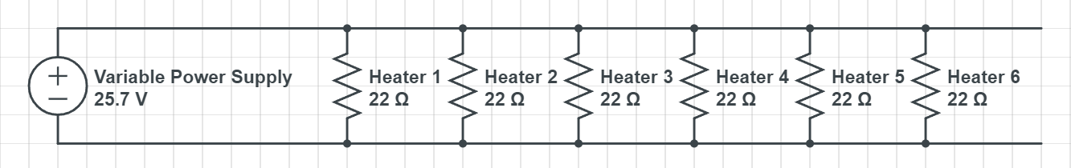
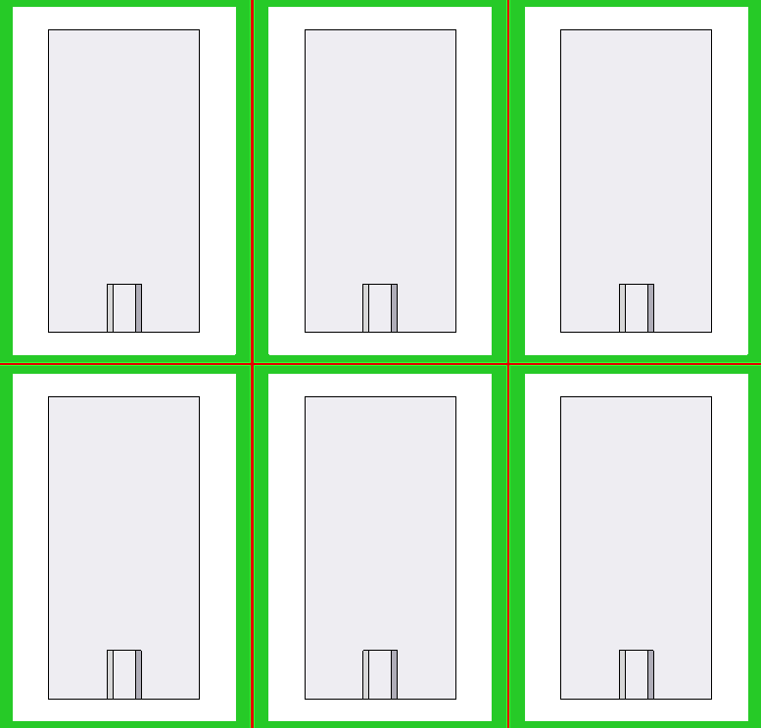
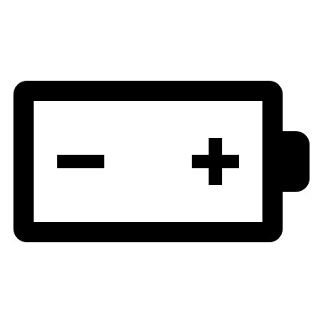
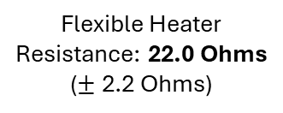

Circuit Diagram - OLD
Flexible Heater Resistance: 22.0 Ohms ($±$ 2.2 Ohms)
Total: $1146
25.7 V ($±$ 1.3 V)
Expected Current Through Battery: 6.7 – 7.4 A
Expected Total Heat Power: 180 W
6 * 25 W + 20% Safety Factor

Slide 10
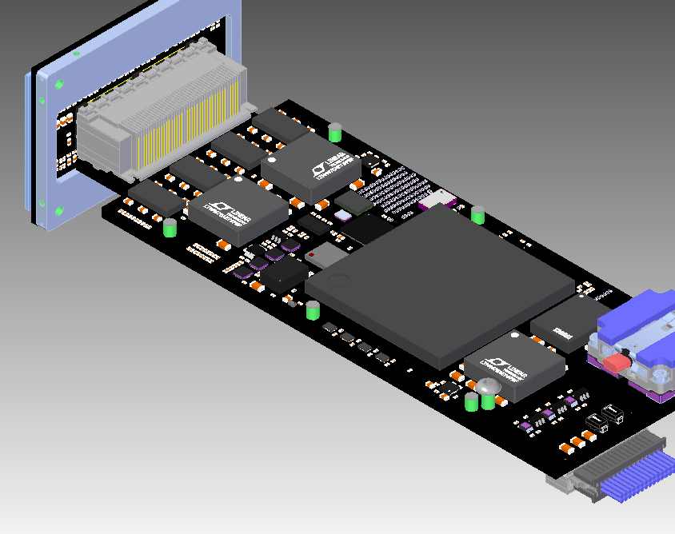
Heat Dissipation for Large PCB

Slide 11
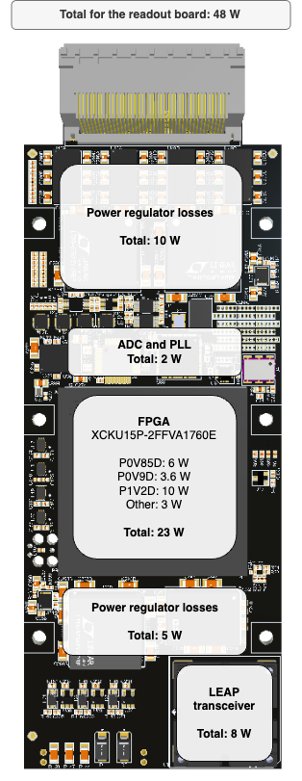
Notes:
Image taken from: https://confluence.slac.stanford.edu/display/ppareg/3x2+Readout+Overview#id-3x2ReadoutOverview-Boardpowermaps

Slide 12
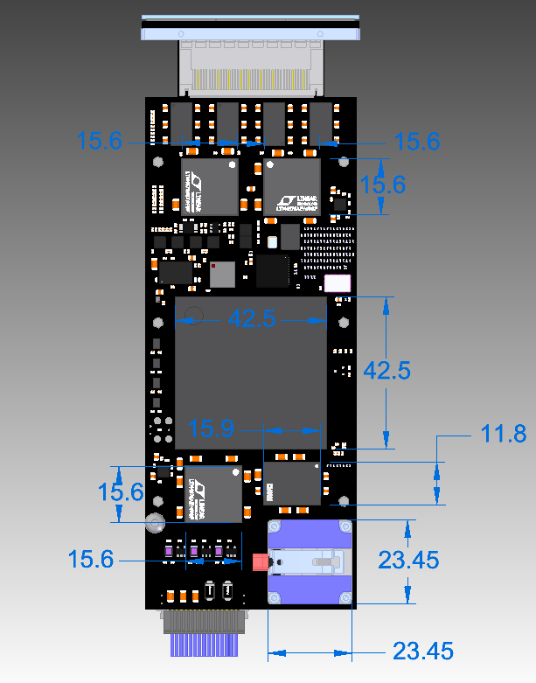

Slide 13
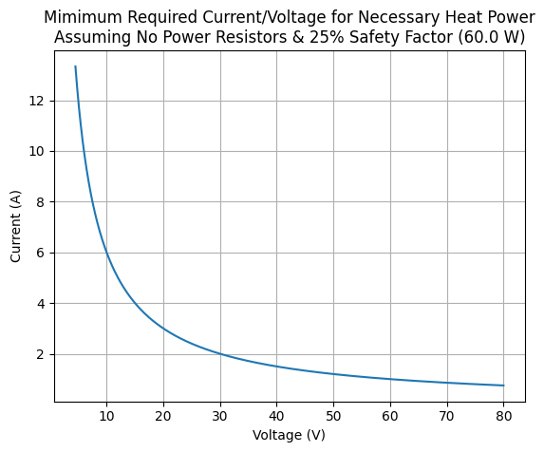
Notes:
Taken from: HeaterAnalysis1MP2V2.ipynb (https://slac-my.sharepoint.com/:u:/g/personal/jmitiguy_slac_stanford_edu/ESL4_MOwBC1Hr1mS4kcTBRcBDcflOeE2L5_FkBiDzDf6Zw?e=QVwph0) on 8/1/24

Slide 14
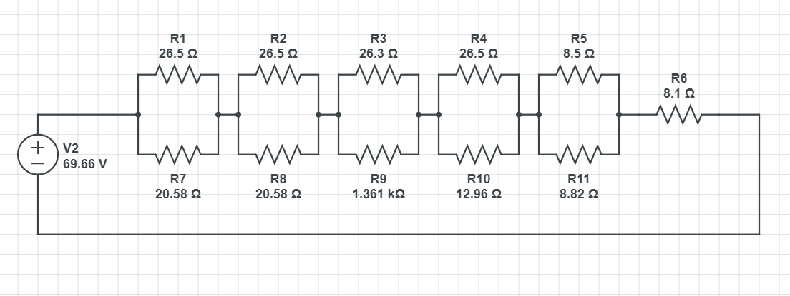
Option #1: High Heat Power Accuracy, Minimum Heaters - $3,533

Slide 15
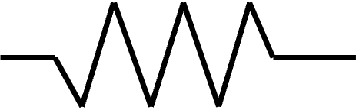
Option #2: Mediocre Heat Power Accuracy, Minimum Heaters - $3,636
26.5 Ω
26.3 Ω
26.5 Ω
8.5 Ω
26.5 Ω
13 Ω
8.87 Ω
1.37 kΩ
56 V
5.2 Ω

Slide 16
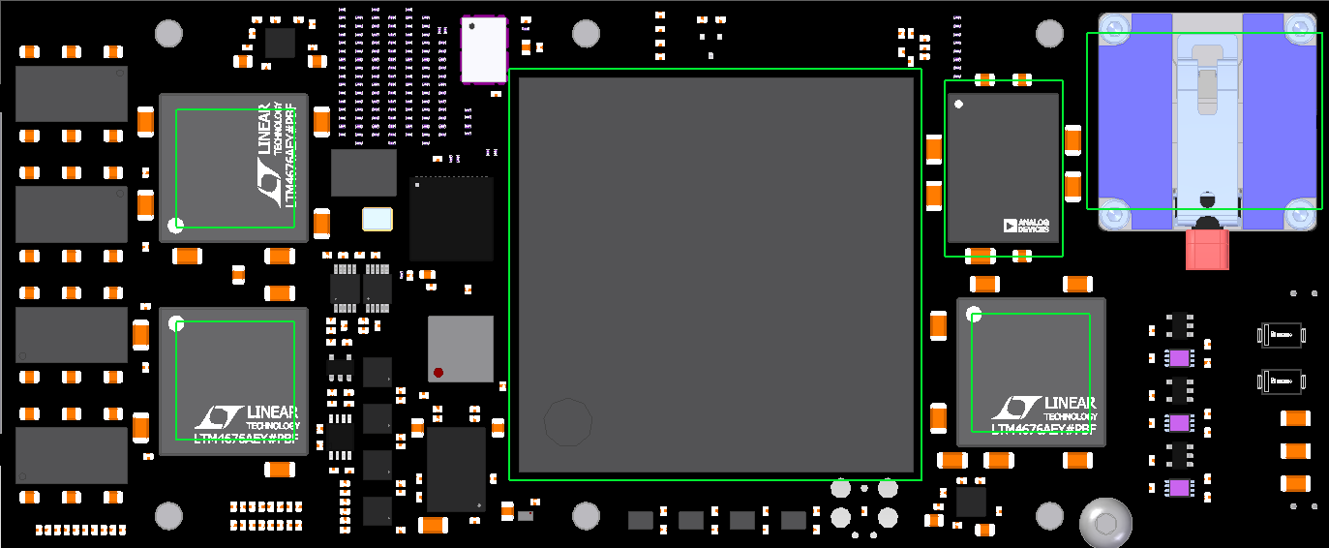
Heat Power Dissipated by Heaters
Shape of Heaters
Target Power: 2.2 W
Target Power: 8 W
4.9 W
6.3 W
2.1 W
Target Power: 5 W
24 W
6.3 W
2.7 W
Target Power: 23 + 2 W
Target Power: 2.8 W

Slide 17
Option #3: Mediocre Heat Power Accuracy, Minimum Heaters - $3,636
26.5 Ω
26.3 Ω
26.5 Ω
8.5 Ω
26.5 Ω
9.53 Ω
5.6 Ω
97.6 Ω
61 V
5.2 Ω

Slide 18
Heat Power Dissipated by Heaters
Shape of Heaters
Target Power: 2.2 W
Target Power: 8 W
8.0 W
10.2 W
2.1 W
Target Power: 5 W
25.1 W
10.2 W
2.9 W
Target Power: 23 + 2 W
Target Power: 2.8 W

Slide 19
Option #4: Low Current, Increased Number of Heaters & Complexity, $3854
26.5 Ω
26.5 Ω
26.5 Ω
8.5 Ω
4.6 Ω
4.6 Ω
4.6 Ω
4.6 Ω
2.0 Ω
1.1 Ω
2.7 Ω
2.7 Ω
47.8 V
4.7 A
1.87 Ω
5.2 Ω

Slide 20
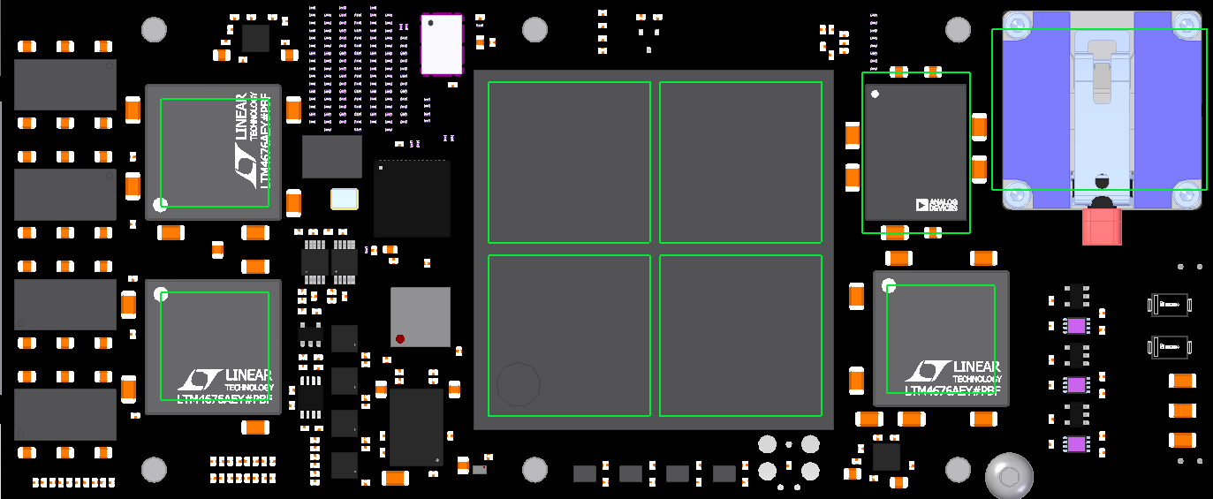
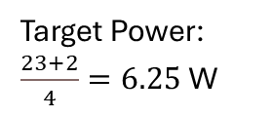
Heat Power Dissipated by Heaters
Target Power: 2.2 W
Shape of Heaters
Target Power: 8 W
7.9 W
4.9 W
6.25 W
6.25 W
2.4 W
Target Power: 5 W
6.25 W
6.25 W
2.8 W
4.9 W
Target Power: $\frac{23+2}{4}=6.25$W
Target Power: 2.8 W

Slide 21
Option #5: Low Current, Increased Number of Heaters & Complexity, Cheaper - $3038
26.5 Ω
26.5 Ω
26.5 Ω
26.5 Ω
4.6 Ω
4.6 Ω
4.6 Ω
4.6 Ω
2.0 Ω
1.78 Ω
2.7 Ω
2.7 Ω
51.1 V
4.7 A
1.87 Ω
5.2 Ω

Slide 22
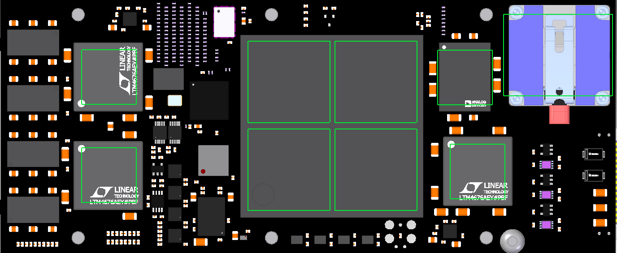
Heat Power Dissipated by Heaters
Target Power: 2.2 W
Shape of Heaters
Target Power: 8 W
7.9 W
4.9 W
6.25 W
6.25 W
2.3 W
Target Power: 5 W
4.9 W
6.25 W
6.25 W
2.8 W
Target Power: $\frac{23+2}{4}=6.25$W
Target Power: 2.8 W

Slide 23
Option #6: Low Voltage, Increased Number of Heaters & Complexity, Cheaper - $3038
4.6 Ω
4.6 Ω
26.5 Ω
26.5 Ω
11.4 Ω
11.5 V
7.0 A
4.6 Ω
4.6 Ω
26.5 Ω
26.5 Ω
8.87 Ω
13.7 Ω
2.26 Ω
1.3 Ω

Slide 24
Heat Power Dissipated by Heaters
Target Power: 2.2 W
Shape of Heaters
Target Power: 8 W
8.1 W
5.0 W
6.35 W
6.35 W
2.2 W
Target Power: 5 W
5.0 W
6.35 W
6.35 W
2.8 W
Target Power: $\frac{23+2}{4}=6.25$W
Target Power: 2.8 W

Slide 25
Option #7: Low Voltage, Increased Number of Heaters & Complexity, Cheaper - $2835
4.6 Ω
4.6 Ω
26.5 Ω
26.5 Ω
15.7 Ω
11.5 V
6.9 A
4.6 Ω
4.6 Ω
26.5 Ω
26.5 Ω
8.87 Ω
13.7 Ω
0.43 Ω
Optional
0.43 Ω
1.3 Ω

Slide 26

Heat Power Dissipated by Heaters
Target Power: 2.2 W
Shape of Heaters
With 0.43 Ω Resistor
Without 0.43 Ω Resistor
8.0/8.4 W
5.0 W
6.35 W
6.35 W
2.2 W
Target Power: 8 W
Target Power: 5 W
5.0 W
6.35 W
6.35 W
2.8 W
Target Power: $\frac{23+2}{4}=6.25$W
Target Power: 2.8 W

Slide 27
Option #8: Low Power, Low Complexity, Cheaper - $2747
26.5 Ω
26.5 Ω
26.5 Ω
26.5 Ω
58.4 Ω
25.6 V
2.8 A
26.3 Ω
32.4 Ω
32.4 Ω
52.3 Ω
63.4 Ω
10.7 Ω

Slide 28
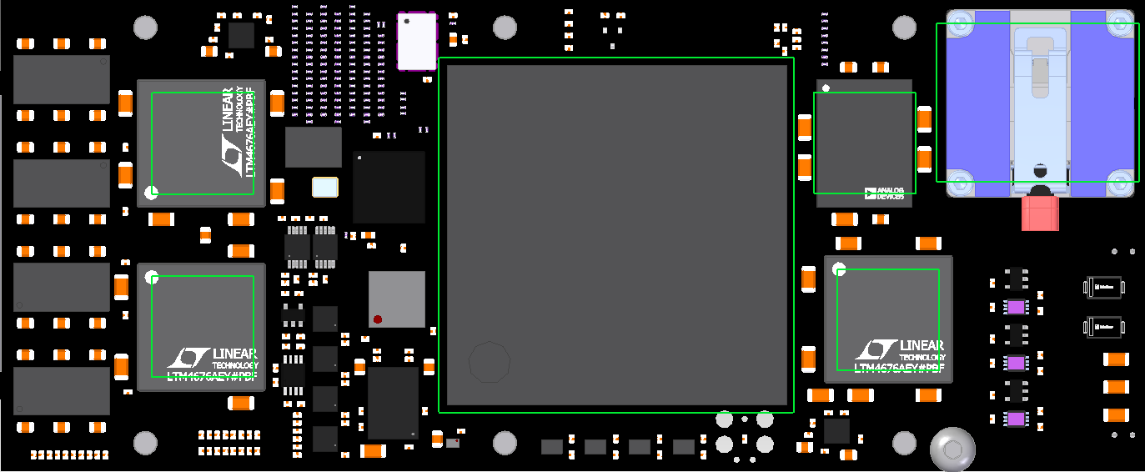
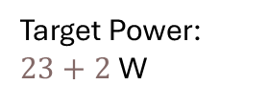
Heat Power Dissipated by Heaters
Target Power: 2.2 W
Shape of Heaters
8.0 W
5.0 W
2.2 W
Target Power: 8 W
Target Power: 5 W
25.0 W
5.0 W
2.8 W
Target Power: $23+2$W
Target Power: 2.8 W

Slide 29
Option #9: Low Voltage, Increased Number of Heaters & Complexity, Cheaper - $2080
4.6 Ω
4.6 Ω
26.5 Ω
26.5 Ω
4.6 Ω
11.5 V
7.5 A
4.6 Ω
4.6 Ω
26.5 Ω
26.5 Ω
8.87 Ω
13.7 Ω
4.02 Ω
1.3 Ω

Slide 30

Heat Power Dissipated by Heaters
Target Power: 2.2 W
Shape of Heaters
8.2 W
5.0 W
6.35 W
6.35 W
2.2 W
Target Power: 8 W
Target Power: 5 W
5.0 W
6.35 W
6.35 W
2.8 W
Target Power: $\frac{23+2}{4}=6.25$W
Target Power: 2.8 W

Slide 31
Option #10: Low Voltage/Power, Non-flexible Heaters, Cheap - $1048
Non-flexible (Ceramic) Heater
4.6 Ω
4.6 Ω
6.4 Ω
6.4 Ω
6.4 Ω
6.4 Ω
4.6 Ω
6.1 V
9.0 A
4.6 Ω
4.6 Ω
0.47 Ω
0.47 Ω
2.7 Ω
4.0 Ω
0.15 Ω

Slide 32
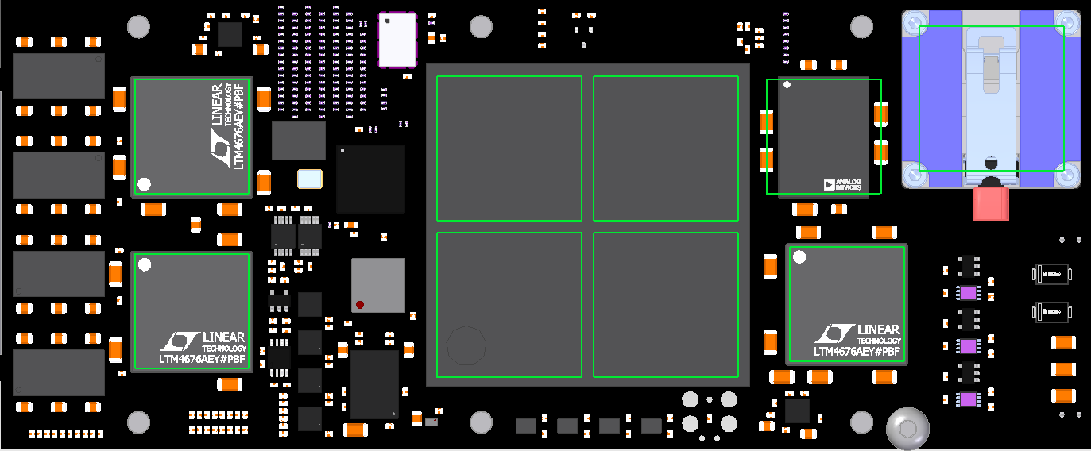
Heat Power Dissipated by Heaters
Target Power: 2.2 W
Shape of Heaters
POOR FIT
8.0 W
5.0 W
6.26 W
6.26 W
2.2 W
Target Power: 8 W
Target Power: 5 W
5.0 W
6.26 W
6.26 W
2.8 W
Target Power: $\frac{23+2}{4}=6.25$W
Target Power: 2.8 W

Slide 33
Option #11: Low Voltage/Power, Non-flexible Heaters, Cheap - $1053
Non-flexible (Ceramic) Heater
4.6 Ω
4.6 Ω
6.4 Ω
14 Ω
6.4 Ω
6.4 Ω
4.6 Ω
6.1 V
8.8 A
4.6 Ω
4.6 Ω
0.47 Ω
0.47 Ω
2.7 Ω
1.4 Ω
0.15 Ω

Slide 34

Heat Power Dissipated by Heaters
Target Power: 2.2 W
Shape of Heaters
POOR FIT
8.0 W
5.0 W
6.26 W
6.26 W
2.2 W
Target Power: 8 W
Target Power: 5 W
5.0 W
6.26 W
6.26 W
2.8 W
Target Power: $\frac{23+2}{4}=6.25$W
Target Power: 2.8 W

Slide 35
Option #12: Low Voltage/Power, Non-flexible Heaters, Cheapest - $170
Non-flexible (Ceramic) Heater
2.8 W
2.2 W
2.0 W
2.0 W
6.25 W
6.4 Ω
6.4 Ω
6.25 W
6.4 Ω
14 Ω
14 Ω
14 Ω
6.4 Ω
6.4 Ω
5.0 W
5.0 W
6.25 W
6.4 Ω
6.4 Ω
6.25 W
14 Ω
14 Ω
6.3 V
8.3 A
2.0 W
2.0 W
0.75 Ω
0.75 Ω
3.16 Ω
2.0 Ω
0.68 Ω
0.58 W
0.58 W
1.37 W
0.31 W
1.54 W

Slide 36

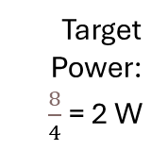
Heat Power Dissipated by Heaters
Target Power: 2.2 W
Shape of Heaters
POOR FIT
2.0 W
2.0 W
Target Power:
$\frac{8}{4}$ = 2 W
5.0 W
2.2 W
2.0 W
2.0 W
6.25 W
6.25 W
Target Power: 5 W
6.25 W
6.25 W
5.0 W
2.8 W
Target Power: $\frac{23+2}{4}=6.25$W
Target Power: 2.8 W

Slide 37
Option #13: Low Voltage/Power, Non-flexible Heaters, Power Resistors
Non-flexible (Ceramic) Heater
2.9 W
2.2 W
2.0 W
2.0 W
6.4 W
6.4 Ω
6.4 Ω
6.4 W
6.4 Ω
14 Ω
14 Ω
14 Ω
6.4 Ω
6.4 Ω
5.1 W
5.1 W
6.4 W
6.4 Ω
6.4 Ω
6.4 W
14 Ω
14 Ω
6.3 V
8.5 A
2.0 W
2.0 W
0.75 Ω
0.75 Ω
3.0 Ω
2.0 Ω
0.68 Ω
0.62 W
0.62 W
1.4 W
0.31 W
1.54 W
Notes:
Data taken from: HeaterAnalysis1MP2V2.ipynb (https://slac-my.sharepoint.com/:u:/g/personal/jmitiguy_slac_stanford_edu/ESL4_MOwBC1Hr1mS4kcTBRcBDcflOeE2L5_FkBiDzDf6Zw?e=QVwph0) on 8/1/24
Used for 1MPPrototypeThermocoupleMeasurements.pptx (https://slac-my.sharepoint.com/:p:/r/personal/jmitiguy_slac_stanford_edu/Documents/1MP/Prototype/1MPPrototypeThermocoupleMeasurements.pptx?d=w72c5c6c626db42a987172786dc6dd0c1&csf=1&web=1&e=RL3tda&nav=eyJzSWQiOjI2MiwiY0lkIjoxMjIwMjgzNTE1fQ

Slide 38
Heat Power Dissipated by Heaters
Target Power: 2.2 W
Shape of Heaters
POOR FIT
2.0 W
2.0 W
Target Power:
$\frac{8}{4}$ = 2 W
5.1 W
2.2 W
2.0 W
2.0 W
6.4 W
6.4 W
Target Power: 5 W
6.4 W
6.4 W
5.1 W
2.9 W
Target Power: $\frac{23+2}{4}=6.25$W
Target Power: 2.8 W
Notes:
Data taken from: HeaterAnalysis1MP2V2.ipynb (https://slac-my.sharepoint.com/:u:/g/personal/jmitiguy_slac_stanford_edu/ESL4_MOwBC1Hr1mS4kcTBRcBDcflOeE2L5_FkBiDzDf6Zw?e=QVwph0) on 8/1/24
Used for 1MPPrototypeThermocoupleMeasurements.pptx (https://slac-my.sharepoint.com/:p:/r/personal/jmitiguy_slac_stanford_edu/Documents/1MP/Prototype/1MPPrototypeThermocoupleMeasurements.pptx?d=w72c5c6c626db42a987172786dc6dd0c1&csf=1&web=1&e=rPkB7u&nav=eyJzSWQiOjI5NywiY0lkIjoyOTU5MDg5NTg4fQ)

Slide 39
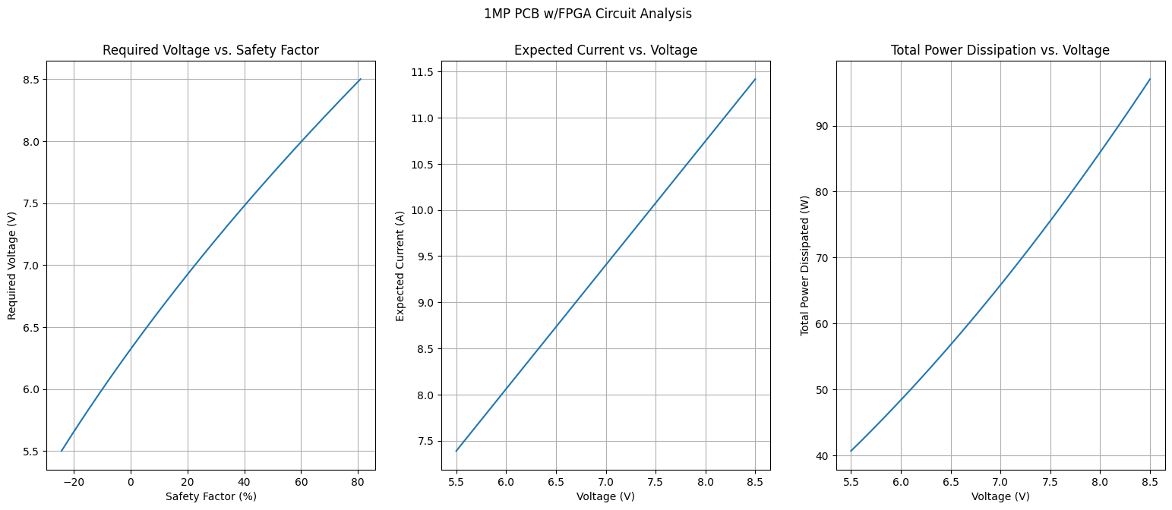
Notes:
Data taken from: HeaterAnalysis1MP2V2.ipynb (https://slac-my.sharepoint.com/:u:/g/personal/jmitiguy_slac_stanford_edu/ESL4_MOwBC1Hr1mS4kcTBRcBDcflOeE2L5_FkBiDzDf6Zw?e=QVwph0) on 8/1/24
Used for 1MPPrototypeThermocoupleMeasurements.pptx (https://slac-my.sharepoint.com/:p:/r/personal/jmitiguy_slac_stanford_edu/Documents/1MP/Prototype/1MPPrototypeThermocoupleMeasurements.pptx?d=w72c5c6c626db42a987172786dc6dd0c1&csf=1&web=1&e=GtzIeY&nav=eyJzSWQiOjI5OCwiY0lkIjoyMzkyMzIwNDMwfQ)

