Slide 1
BLEN 11
BLEN signal vs orbit, matching
David Cesar 8/2023

Slide 2
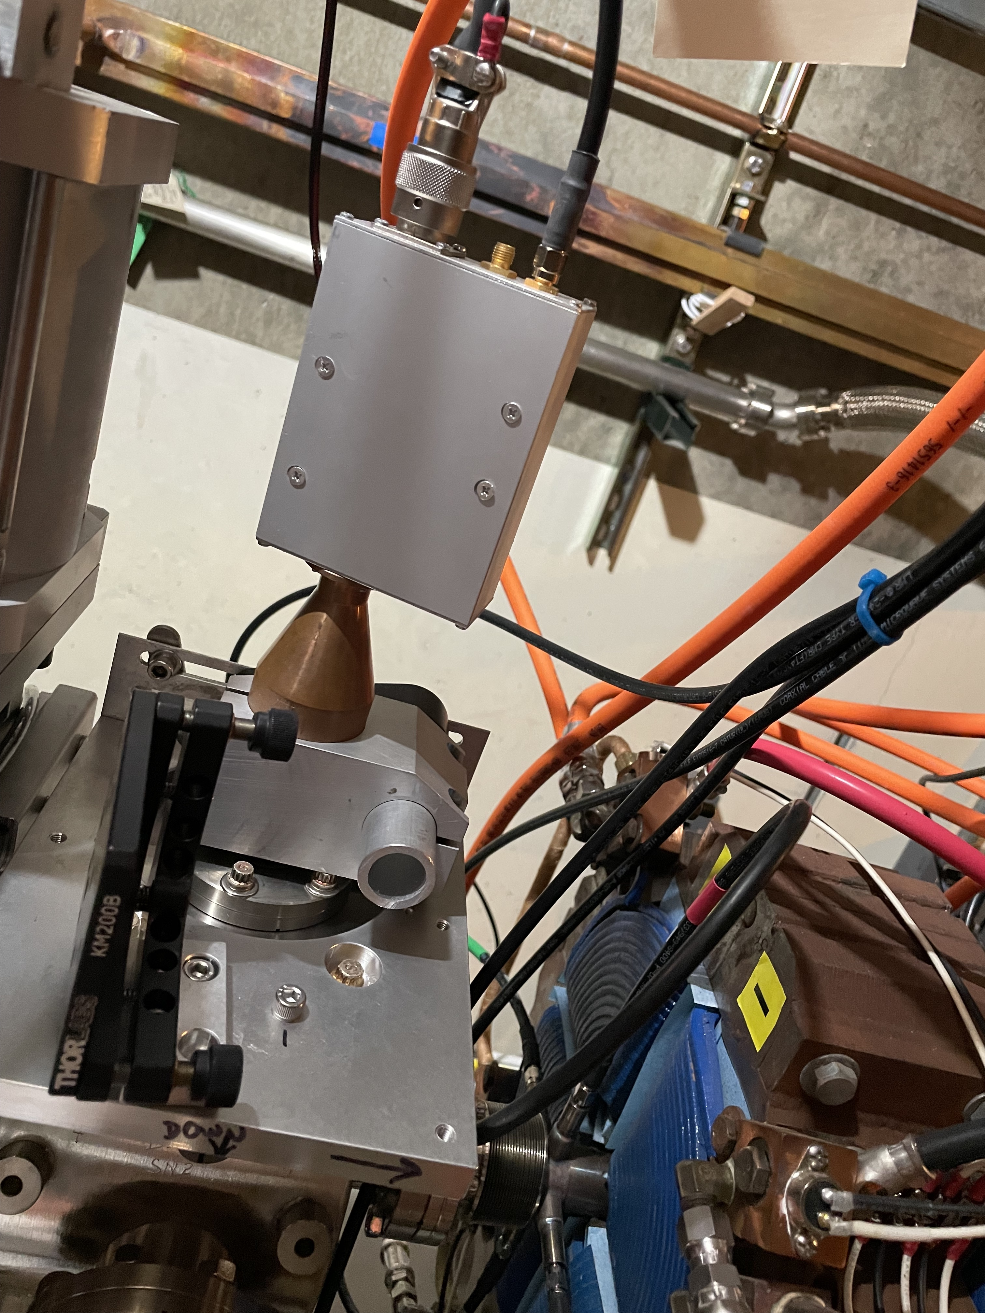
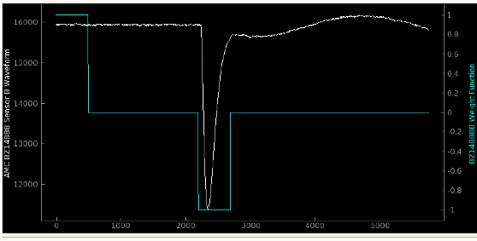
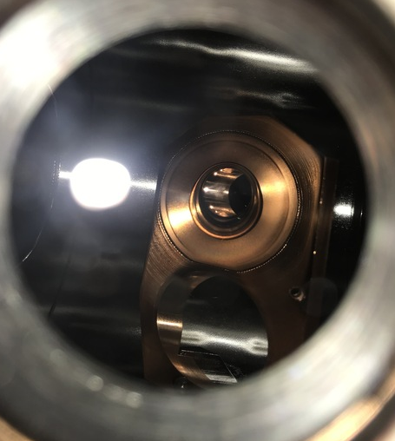

BLEN
Pyro
$$I\left(ω,θ\right)∝Q^{2}F_{∥}\left(ω\right)F_{⊥}\left(ω,θ\right)$$
$$F_{∥}\left(ω\right)≈e^{−{\left(ω\right)}^{2}σ_{t}^{2}}$$
$$F_{⊥}\left(ω,θ\right)≈e^{−{\left(ωcσ_{r}\right)}^{2}θ^{2}}$$
BLENs 11,14 are pyros integrating the head deposited by (filtered) radiation from the final bend of the bunch compressor

Slide 3
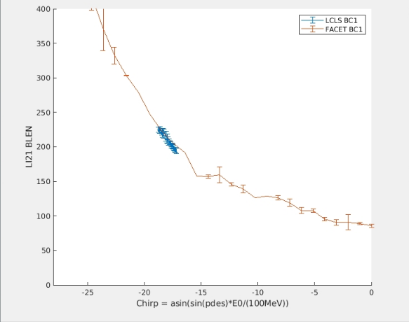

BLEN signal: LI11 chirp scan
“Chirp scan” actually PDES on 1 of the 2 stations
y scaled to match amplitude from LCLS.
x scaled to account for differences in cavity voltage
The shot to shot jitters can be roughly compared.
Measurement Jitter: $ℴ1deg$,
(but feedbacks can average over thousand of shots)

Slide 4
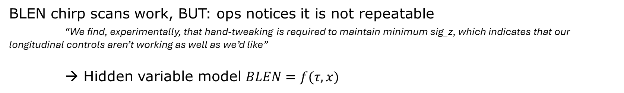
BLEN problems:
BLEN chirp scans work, BUT: ops notices it is not repeatable
“We find, experimentally, that hand-tweaking is required to maintain minimum sig_z, which indicates that our longitudinal controls aren’t working as well as we’d like”
→ Hidden variable model $BLEN=f(τ,x)$
Some possibilities for “x”:
  Microbunching
  Stations w/out feedback (e.g. Gun phase)
  Optics (beam position, BMAG, etc.)
  ….

Slide 5
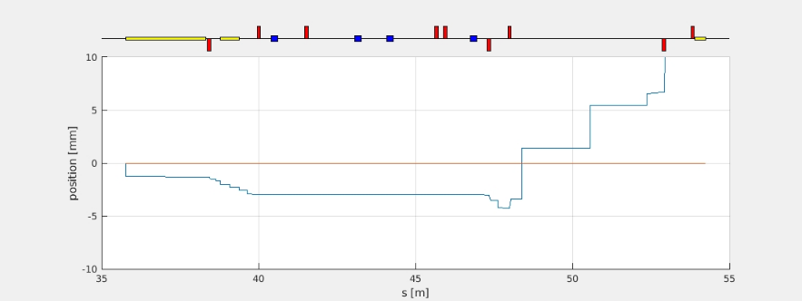
Measurement outline
BPM 333
BPM 358
BLEN11
XYCor 272
XYCor 304
Quad 265
Quad 301
I scan BLM response in ‘x’ (2 correctors), ‘y’ (2 correctors), match (2 quads), and charge (1 waveplate)
Use Lucretia to calculate correctors needed for pure position and pure angle (x position shown above)
  (X,X’,Y,Y’) each done as their own scan.
Use Lucretia to calculate quads needed for large change in beam size (assuming perfect match)
  Approximately 0.5x nominal beam size, to 4x nominal beam size, within quad constraints
Scan waveplate to fit charge variation
* I don’t close the orbit downstream, because that needs scp, but it hasn’t been a problem yet

Slide 6
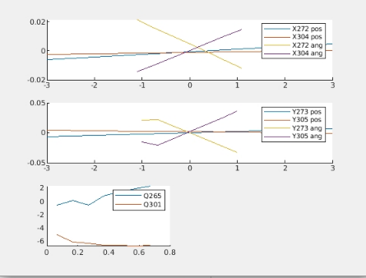
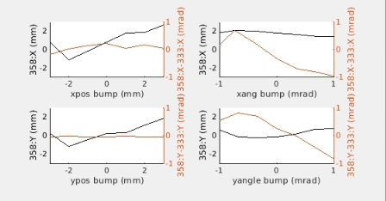
“Measured orbit”
Let us compare “BPM” based orbit to the orbit I calculated in Lucretia
BPM 333
BPM 358
BLEN11
XYCor 272
XYCor 304
Quad 265
Quad 301
X: Lucretia bump
Y: measured bump
They match reasonably well except for the first couple (negative) points
Magnet strengths used in the scans.

Slide 7
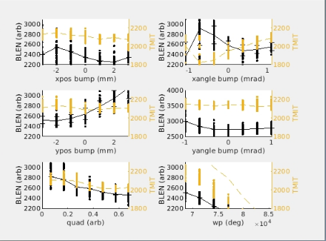
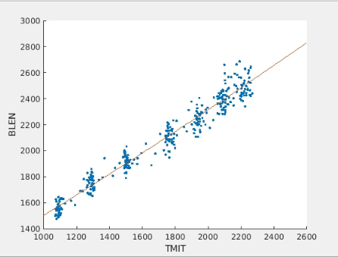
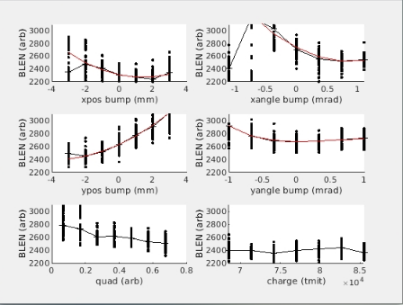
Charge Normalization
The BLEN depends strongly the bunch charge. If we loose charge (or simply have some low-frequency charge oscillation), then our data will be misleading. So, we normalize this out by fitting the charge dependence.
BLEN vs Lucretia setpoint
Fit to charge variation (scanning waveplate)
BLEN vs Lucretia setpoint (normalized for the charge variation)

Slide 8
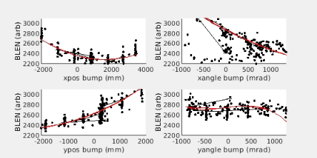
Measurement summary
BLEN variation
Red lines are polynomial fits to valid data
Facet BLEN depends on orbit and quad settings.

Slide 9
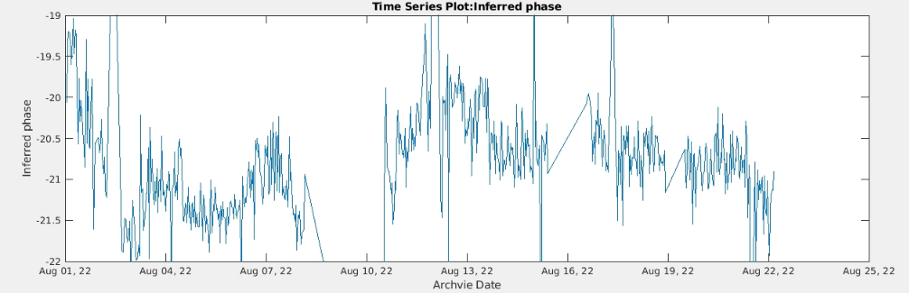
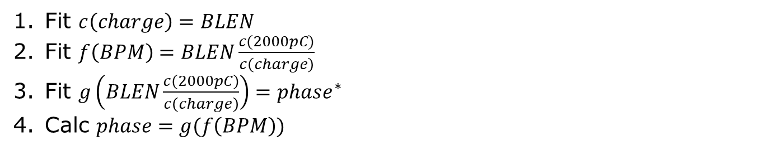
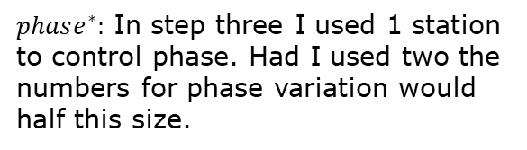
Archive data & inferred systematic error
(approximate) Inductive path:
Fit $c\left(charge\right)=BLEN$
Fit $f\left(BPM\right)=BLEN\frac{c(2000pC)}{c\left(charge\right)}$
Fit $g\left(BLEN\frac{c(2000pC)}{c\left(charge\right)}\right)=phase^{∗}$
Calc $phase=g(f\left(BPM\right))$
$phase^{∗}:$ In step three I used 1 station to control phase. Had I used two the numbers for phase variation would half this size.

Slide 10
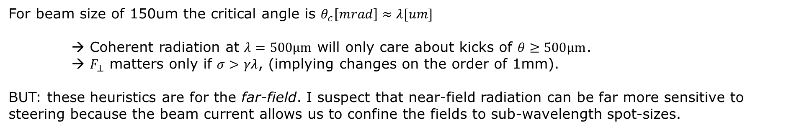
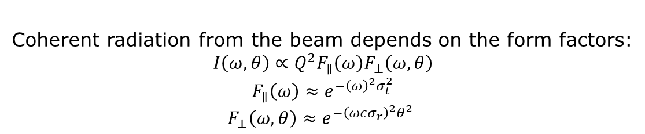
Physical basis
Coherent radiation from the beam depends on the form factors:
$$I\left(ω,θ\right)∝Q^{2}F_{∥}\left(ω\right)F_{⊥}\left(ω,θ\right)$$
$$F_{∥}\left(ω\right)≈e^{−{\left(ω\right)}^{2}σ_{t}^{2}}$$
$$F_{⊥}\left(ω,θ\right)≈e^{−{\left(ωcσ_{r}\right)}^{2}θ^{2}}$$
Pyro
Edge radiation is emitted in a cone centered on $\frac{1}{γ}\sim 1.5mrad.$
For beam size of 150um the critical angle is $θ_{c}\left[mrad\right]≈λ[um]$
→ Coherent radiation at $λ=500μm$ will only care about kicks of $θ≥500μm$.
→ $F_{⊥}$ matters only if $σ>γλ$, (implying changes on the order of 1mm).
BUT: these heuristics are for the far-field. I suspect that near-field radiation can be far more sensitive to steering because the beam current allows us to confine the fields to sub-wavelength spot-sizes.

Slide 11
Discussion
Analysis is preliminary. It should be repeated to be sure observed correlations are persistent.
It is not clear how the correlations depend on bunch length.
We should take care to align BPMs near B11 to <~0.25mm to be sure we are getting consistent readings.
  We should also match the beam. Quads matter too.
Is this effect big enough to explain the systematic error in BLEN feedback that ops noticed? Hard to say. A couple degrees at BC1 would be a big deal with BC2 feedback off… but with it on, it’s a much more subtle effect.

