Slide 1
Running the Frankenstein DAQ and analysis priority
C. Hansson and D. Doering

Slide 2
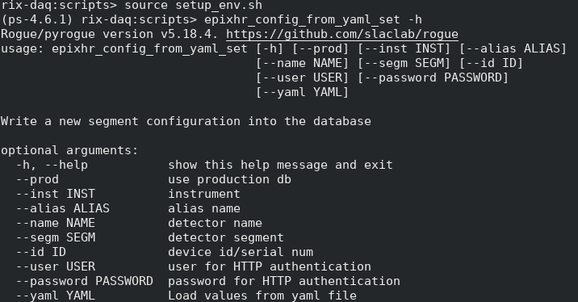
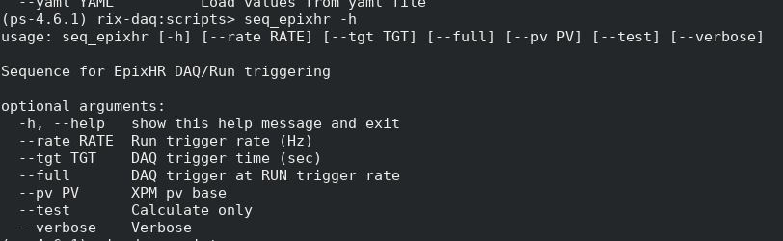
How to remote into the RIXS DAQ and launch the ePixHR Frankenstein setup
Log into rixopr@rixdaq:
  ssh username@psdev
  ssh rixopr@rixdaq
Source setup_env.sh
  Source from the script folder (cd scripts)
Procmgr restart mfx.cnf (launches the DAQ instance with the ePixHR detector in it.)
Setup and script running
Component tests in ASC Lab
ePix10k 2.1Mp detector
Epixhr_config_from_yml – sets which initialization we use
Ex: epixhr_config_from_yaml_set –yaml 5
Note: Pulls from the epix-hr-single10k depository
For ASIC v4, #5 is currently our default for running.
Seq_epixhr – Sets the daq and runtrigger values
Ex. Seq_epixhr – rate 2400 tgt 0.834e-3 (Runtrigger: 2400Hz, Daq trigger 120Hz)
Ex. Seq_epixhr – rate 2400 tgt 0.834e-3 -- full (Runtrigger: 2400Hz, Daq trigger 2400Hz)
Ex. Seq_epixhr – rate 2400 tgt 0.834e-3 – f360 (Runtrigger: 2400Hz, Daq trigger 360Hz)
Quad detector modules
Assembly in ASC Lab

Slide 3
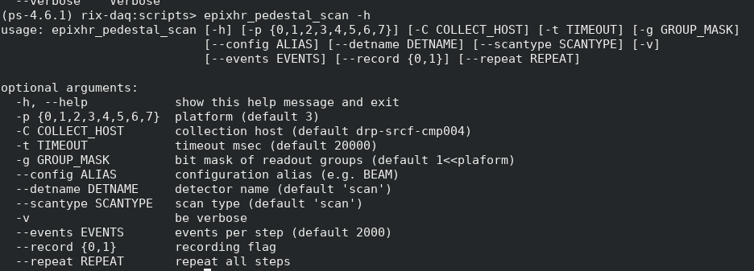
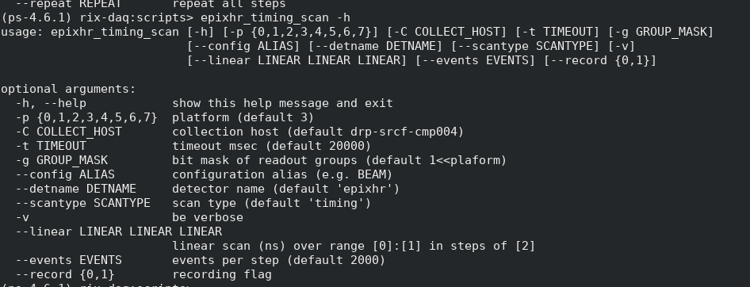
Pedestal scan and timing scan
Epixhr_pedestal_scan – performs a pedestal scan run
Ex: epixhr_pedestal_scan –record 1 (records a pedestal run)
Note: the scan is launched from the RIXS daq.
Epixhr_timing_scan – performas a timing scan by scanning the start_ns variable (delay created on the detector boards)
Ex: epixhr_timing_scan --linear 2000 40000 2000 --events 1000 --record 1 (scans start_ns from 2000 to 4000 in 2000 increment steps, at each point 1000 events are saved). The data is saved to disk.
Note: the scan is launched from the RIXS daq.

Slide 4
Linearity scans
Intensity scan: x.attenuator_single_scan
Log into hutch python at MFX using the mfx3 command (has to be from rix-daq, not rix-console). Command is:
x.attenuator_single_scan(events=2400, record=False, transmissions=[1.0, 0.61, 0.4, 0.2,0.1,0.05,0.01]).
(scans the MFX attenuators from 100% transmission (1.0) to 1% transmission (0.01), at each point 2400 events are collected).
The data is collected on the rixs daq but the scan is launched from the MFX daq. As such, you start collecting data, and then launch the scan.

Slide 5
Detector trigger timing for running the ePixHR v4 in the MFX/RIXS Frankenstein DAQ
890 us?
X-ray pulse arrival (120Hz)
tgt
834 us
External to camera
LCLS-1 trigger (T0)
user.start_ns
DAQ trigger (120 Hz)
14 us
user.start_ns
Run trigger (>120 Hz)
Internal to camera
14 us
Data not sent to daq
Data sent to daq
Data not sent to daq
Detector readout cycle
(see next slide for internal structure)
ACQ
Delay (internal to ASIC)
Signal development and sampling (~37us)
Readout cycle
(~146us for 320MHz Serdes)
The pulse has to be positioned just after (tgt + user_start_ns+ACQ_delay). Currently the number do not add up with 890 us. i.e. some delay is missing. The first time a detector is used tgt is set to 0, and the timing script scans start_ns over a large time frame and a good point to set the tgt value to is identified (need tgt window to run the detector to thermalize). Once we then specify tgt to a specific value in the seq_epixhr script to set the run and daq triggers, the start_ns variable starts from the tgt point.

Slide 6
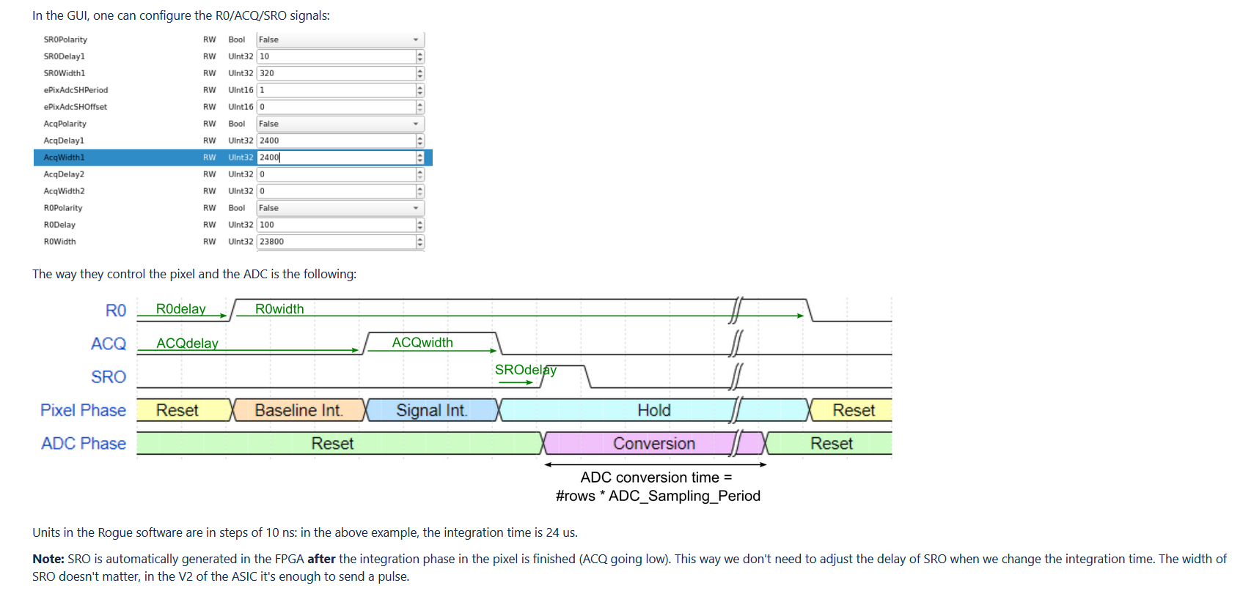
Detector timing (internal timing of detector readout cycle)
CSA start integration
First CDS sample
Second CDS sample
The timing diagram for the readout cycle of the ePixHR detector can be seen above (provided by Lorenzo and Dionisio). More detailed info on the ASIC can be found via the link at the bottom of this slide). The trigger arrival is located at the starting point on the left. Both the R0delay and ACQ delay are tied back to the trigger. The R0delay gives the time from the trigger arriving until the CSA is taken out of reset and start integrating the charge from the sensor. The ACQdelay gives the time from the trigger until the ACQ goes high and the first sampling of the CDS takes place. The second CDS sampling takes place at the end of the ACQ window. As such, the RO window, also referred to as the baseline integration is set by ACQdelay-R0delay, while the ACQ window, also referred to as the signal integration, is set by the ACQwidth. The ACQWidth starts form the end of the ACQ delay.
The SROdelay sets the time from the end of the ACQ window until the readout starts. Once the SRO signal goes high, the readout starts and the conversion time needed fully read out the collected values is dictated by the number of rows the ADC is reading out, and the SERDES clocking frequency used. The additional time needed in this readout scheme to reset the channel (CSA and CDS) is yet to be experimentally determined but is currently assumed to be in the 3-4 us range. All the registers are stated as units of 10ns. As such, setting ACQwidth to 2400 gives an ACQ (signal) integration window of 24 us.

Slide 7
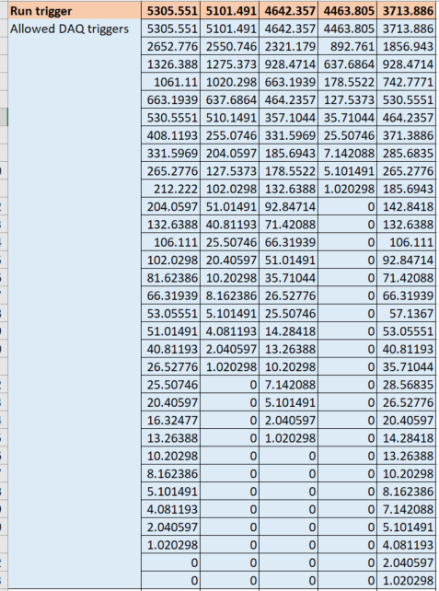
Allowed DAQ trigger rates for set Run trigger rate (i.e. DT is not DT running)
If we need to run the run trigger at a set value to be thermally stable, then we are limited to the stated machine harmonics for the DAQ trigger (the beam). If we can show we can calibrate the detector at one run trigger rate and the only change that happens if we run it at a different run trigger rate is a pedestal shift, the we can allow for the run trigger to be set to the same value as the daq trigger and we can run at any rate we want.

Slide 8
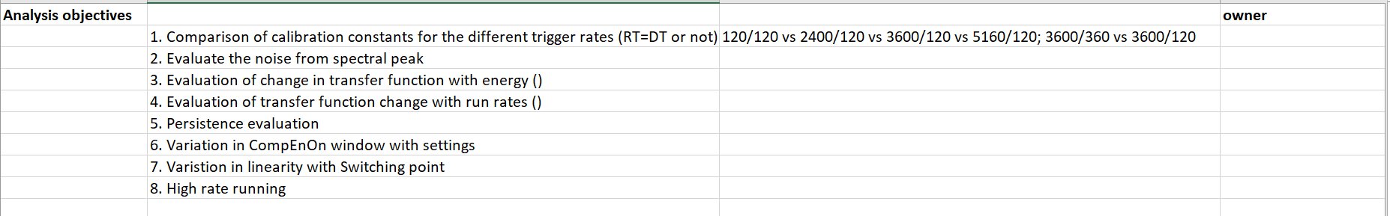
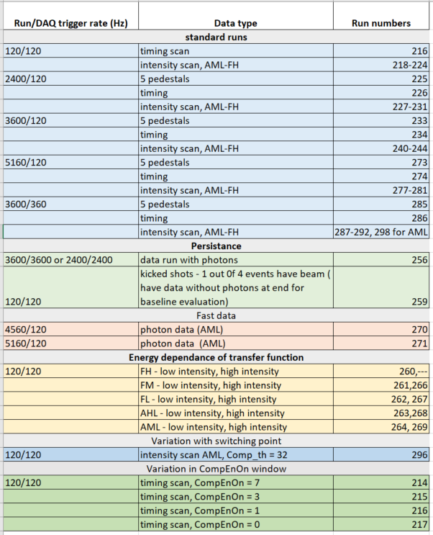
Beam time measurement breakdown and analysis priority.
The breakdown of the measurements performed at the MFX beam time 23 and 24 October 2023, and the analysis priority can be seen here.
Additionally include spectral analysis to get noise.

