Slide 1
ePixHR10k
Low-Noise, High-Dynamic Range,
High Rate Detectors for TXI
Electromechanical concept design status
April 2nd, 2021
Dionisio Doering*
*On behalf of SLAC teams

Slide 2
April 2nd TXI camera meeting agenda
Review goals and requirements
Concept design evolution
  Mechanical / cooling
  Electronics
Teams
Schedule

Slide 3
April 2nd TXI camera meeting agenda
Review goals and requirements
Concept design evolution
  Mechanical / cooling
  Electronics
Teams
Schedule

Slide 4
Requirements Table
Parameter​ | Threshold​ | Objective​ | ePixHR 2M​
Pixel Pitch (um)​ | 100​ | 100​ | 100​
Read Noise (e- rms)​ | 110​ | 80​ | 75​
Frame Rate (kHz)​ | >5​ | 10​ | 5​
Array size (pixels)​ Forward Scattering Detector Von Hamos/Low-Q | >2MPix​ >110kPix | 4MPix​ 135kPix | 2.6MPix (2x1536x864)​ 110kPix (384x288)
Well Depth (Number of 4keV photons)​ | 10000​ | 10000​ | >16000​
Quantum Efficiency (% 2-4keV) | 80 | 90 | 95
Vacuum Compatibility | < 10⁻⁷ | < 10⁻⁷ | < 10⁻⁷
Cabling and Cooling Line Length | Compatible with LUSI Vacuum Detector Stage Model number: SA-391-520-00. | Compatible with LUSI Vacuum Detector Stage Model number: SA-391-520-00 | Compatible with LUSI Vacuum Detector Stage Model number: SA-391-520-00
Physical Package Envelope
Maximum Power Dissipation | <400W | <350W | 200W
Positional Stability | 0.1 pixel | 0.1 pixel | 0.1 pixel
Lowest Primary Vibration Mode | ‘Level D’ | ‘Level D’ | ‘Level D’
Y jaw movement | 40mm | 40mm | 40mm
Z translation | 0.5m | 0.5m | 0.5m

Slide 5
Requirements Table
Primary requirements under investigation with the present concept design study
Parameter​ | Threshold​ | Objective​ | ePixHR 2M​
Pixel Pitch (um)​ | 100​ | 100​ | 100​
Read Noise (e- rms)​ | 110​ | 80​ | 75​
Frame Rate (kHz)​ | >5​ | 10​ | 5​
Array size (pixels)​ Forward Scattering Detector Von Hamos/Low-Q | >2MPix​ >110kPix | 4MPix​ 135kPix | 2.6MPix (2x1536x864)​ 110kPix (384x288)
Well Depth (Number of 4keV photons)​ | 10000​ | 10000​ | >16000​
Quantum Efficiency (% 2-4keV) | 80 | 90 | 95
Vacuum Compatibility | < 10⁻⁷ | < 10⁻⁷ | < 10⁻⁷
Cabling and Cooling Line Length | Compatible with LUSI Vacuum Detector Stage Model number: SA-391-520-00. | Compatible with LUSI Vacuum Detector Stage Model number: SA-391-520-00 | Compatible with LUSI Vacuum Detector Stage Model number: SA-391-520-00
Physical Package Envelope
Maximum Power Dissipation | <400W | <350W | 200W
Positional Stability | 0.1 pixel | 0.1 pixel | 0.1 pixel
Lowest Primary Vibration Mode | ‘Level D’ | ‘Level D’ | ‘Level D’
Y jaw movement | 40mm | 40mm | 40mm
Z translation | 0.5m | 0.5m | 0.5m

Slide 6
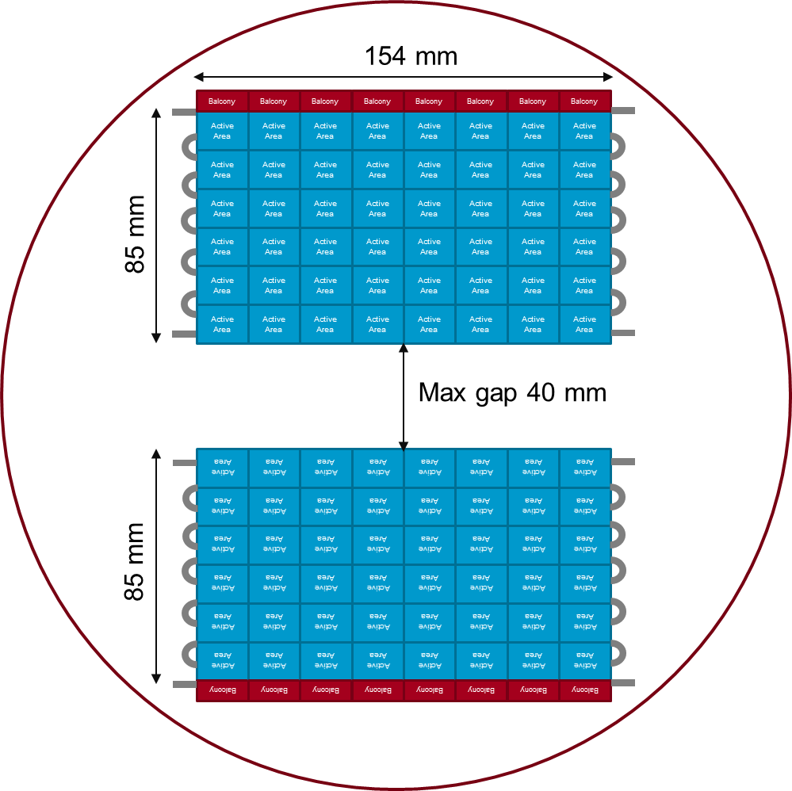

Shingled 2Mpix ePixHR 5kHz camera
Overall dimensions compatible with requirements
ePix10k / CSPAD envelope (OD. 286mm,
depth 175mm)
2 jaws with gap of
up to 40mm
Each jaw composed of 2 abut quads
Each module composed of 4 sensor/ASICs (24 per detector)
Alternative solution can be a geometry with 5 tiles / quad
  Design for 6 populate 5.
20W - less than ePixM

Slide 7
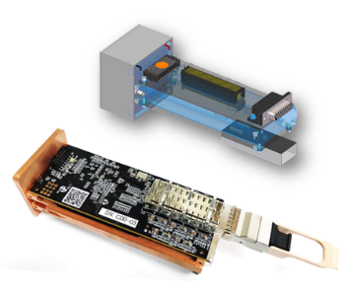
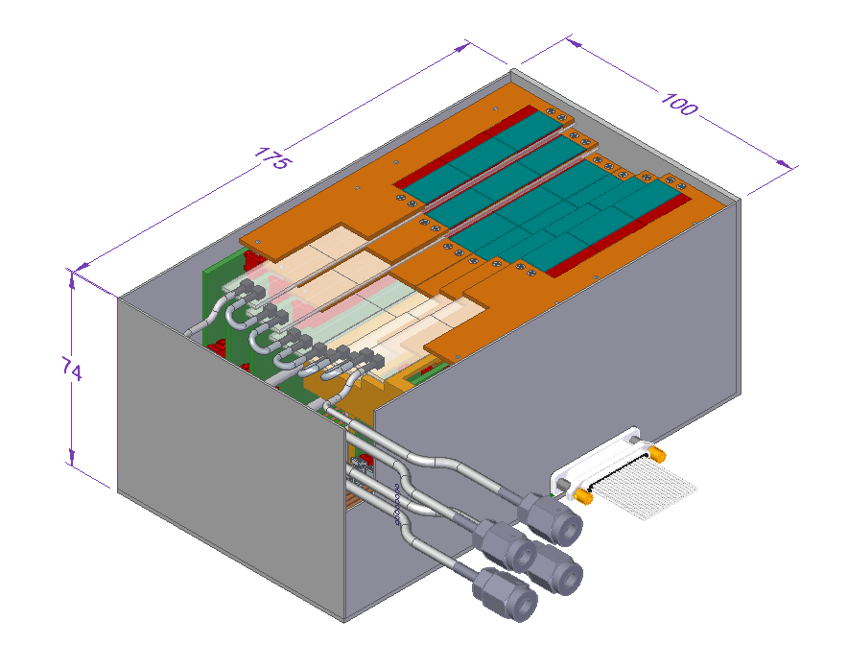
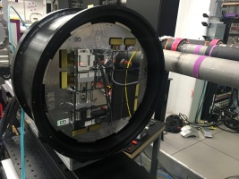
Drawing from experiences
ePix10k HR single
Direct related detectors developments
  ePix10kHR single
    Each tile is equivalent to a single HR camera
      Power
      Data volume
  ePix 10k Analog detector
    Same pixel matrix
    Similar geometry (exception is the jaw)
  ePixM HR concept design
    Analog shingle design concept
    Less restrictive for the ePix10k
      Higher temperature
      More space
TXI detector
ePixM HR shingle concept
ePix10k Analog detector

Slide 8
April 2nd TXI camera meeting agenda
Review goals and requirements
Concept design evolution
  Mechanical / cooling
  Electronics
Teams
Schedule

Slide 9
Proposed concept
4 independent quadrants to build 1 camera
  Power
  Data
2 independent halves
  Mechanics bonds these 4 quads
11 distinct boards
  Tile
  Flex (6 different lengths)
  Interposer (left/right) board
  Digital (left/right) board

Slide 10
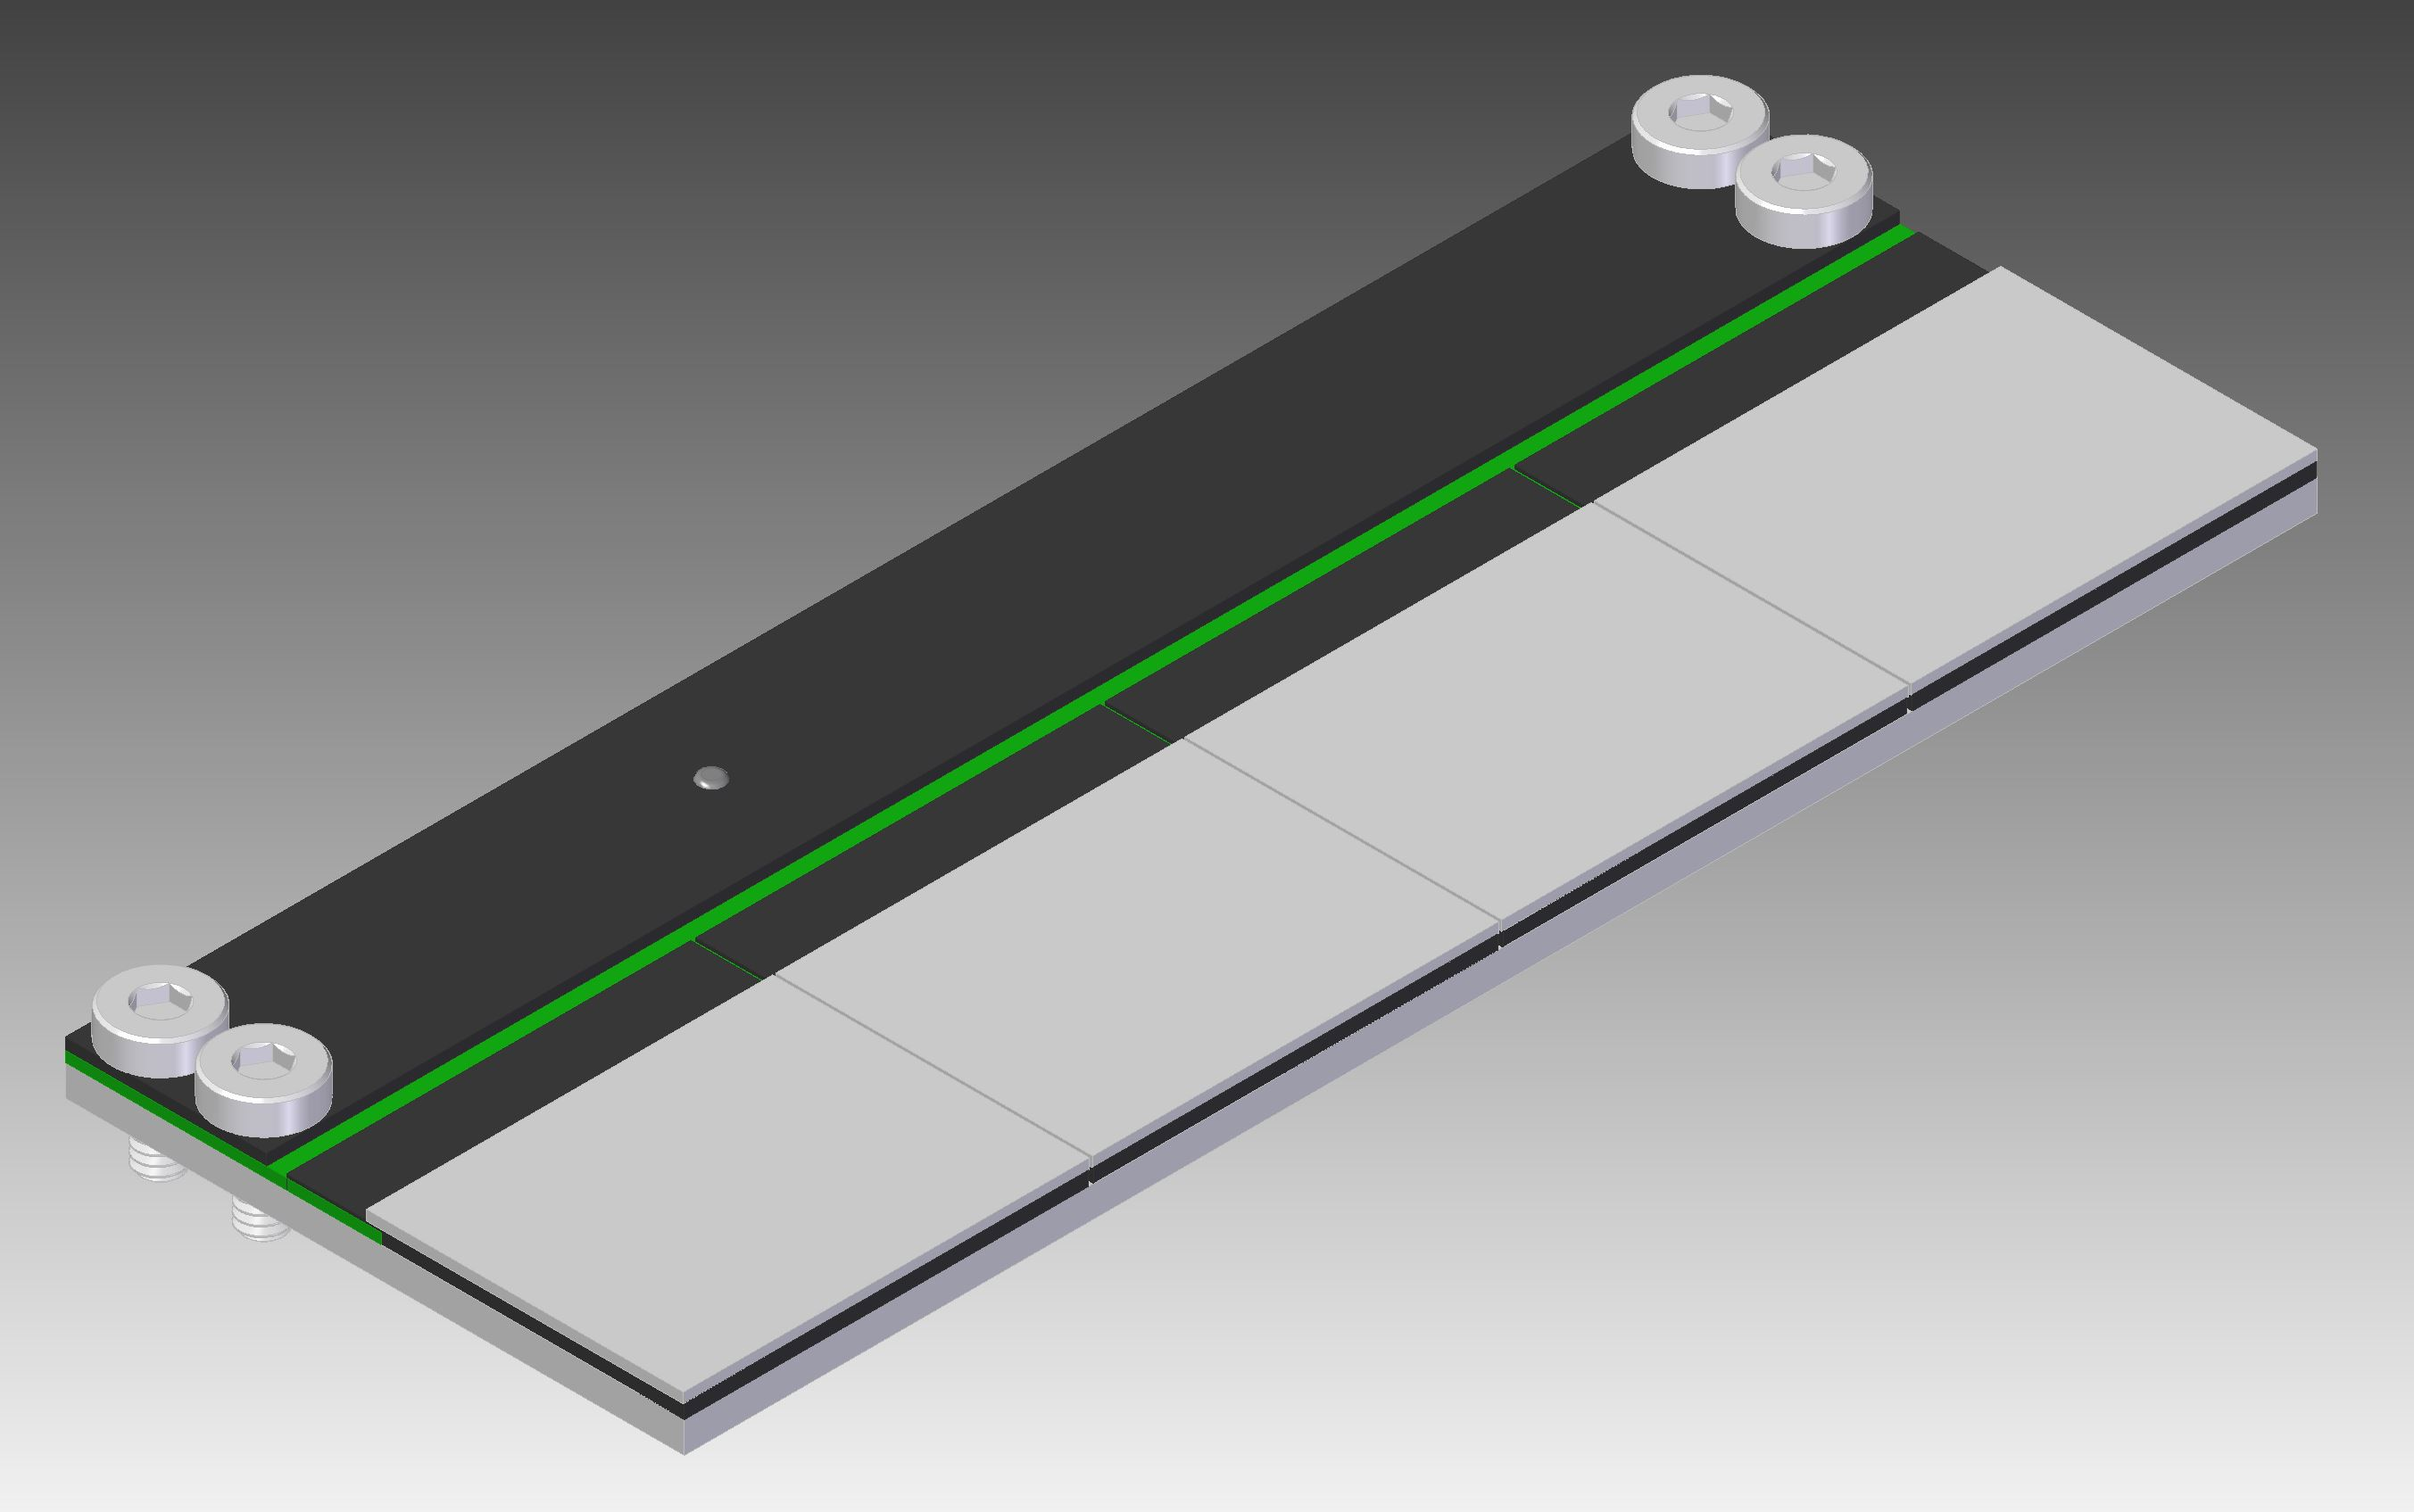
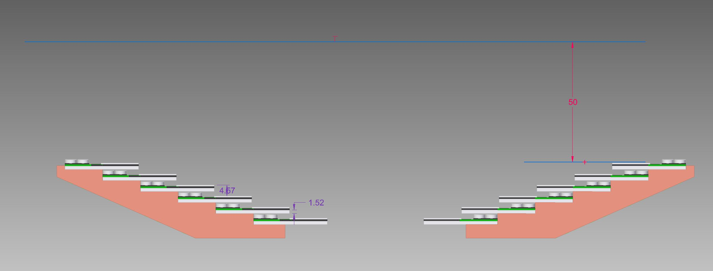
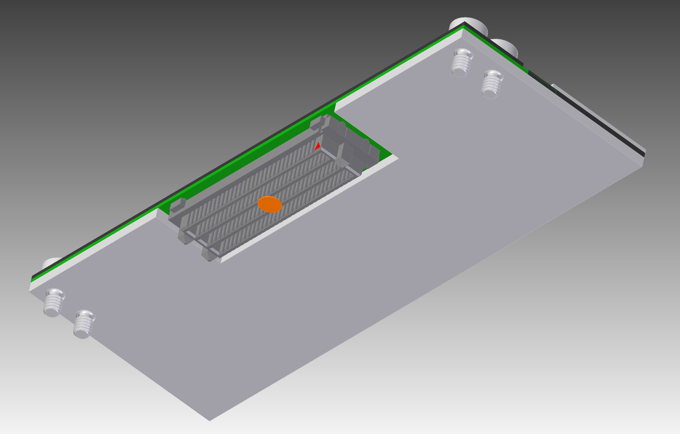
Tile specs
Each module composed of 4 sensor/ASICs (24 per detector)
4 ASICs
144*192 pixels * 4 ASICs = 110kpix
1 Sensor
PCB
Ceramic substrate for ASIC/Sensors cooling
Tiles are using a set of stringers
  Mechanical support
  Cooling path

Slide 11
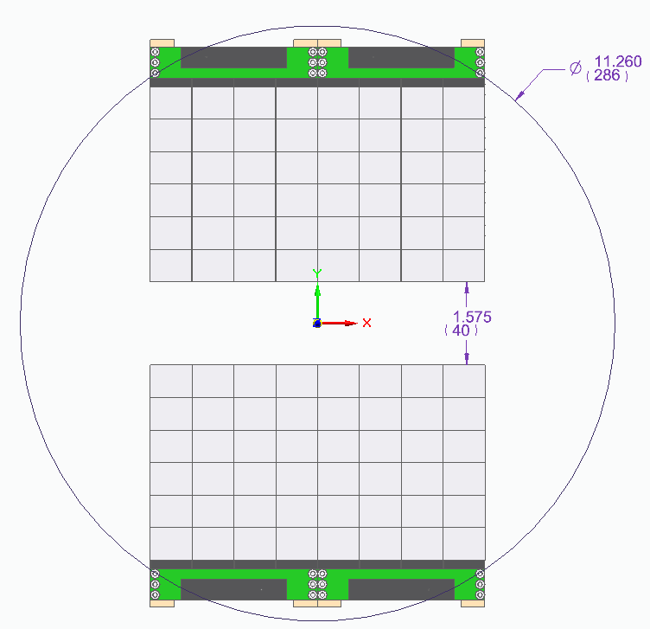
PPT to CAD
Alternative solution can be
  Geometry with 5 tiles / quad
  Reduce max gap
  Increase camera envelope
2.6MPix (2x1536x864)​

Slide 12
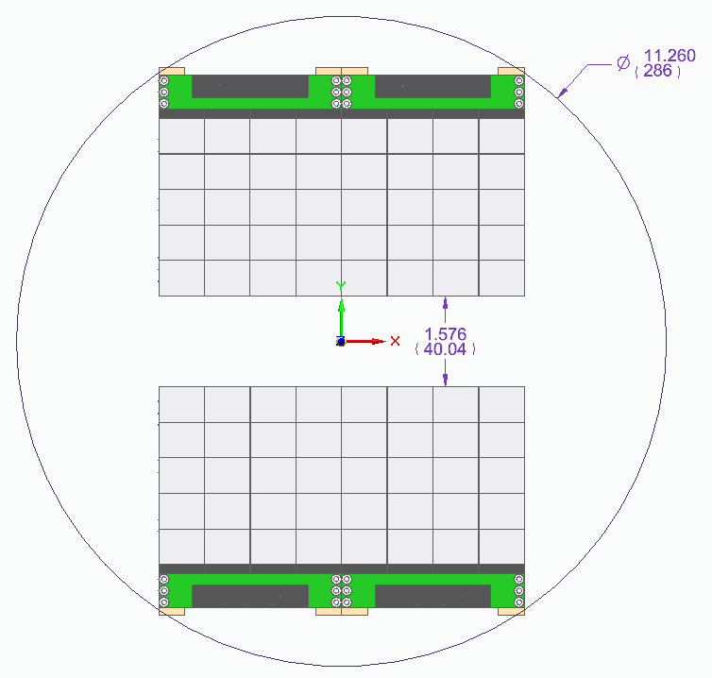
Reducing the number of tile to 5
* Does not include overlap of tiles
Alternative solution can be
  Geometry with 5 tiles / quad
  Reduce max gap
  Increase camera envelope
2.2MPix (2x1536x720)​

Slide 13
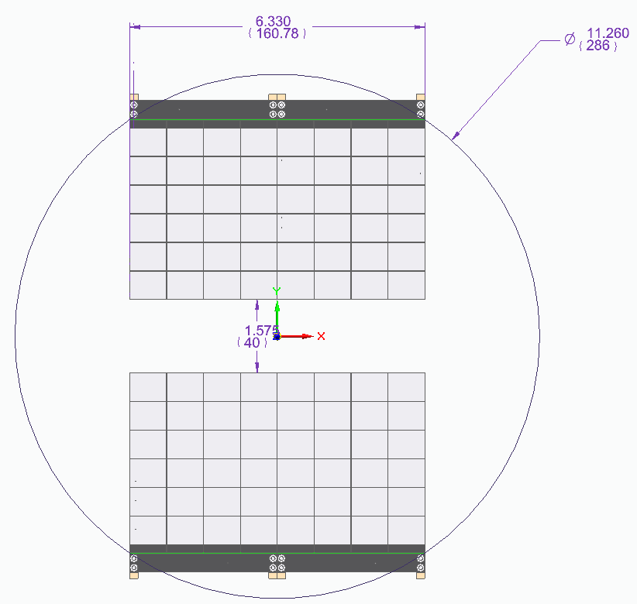
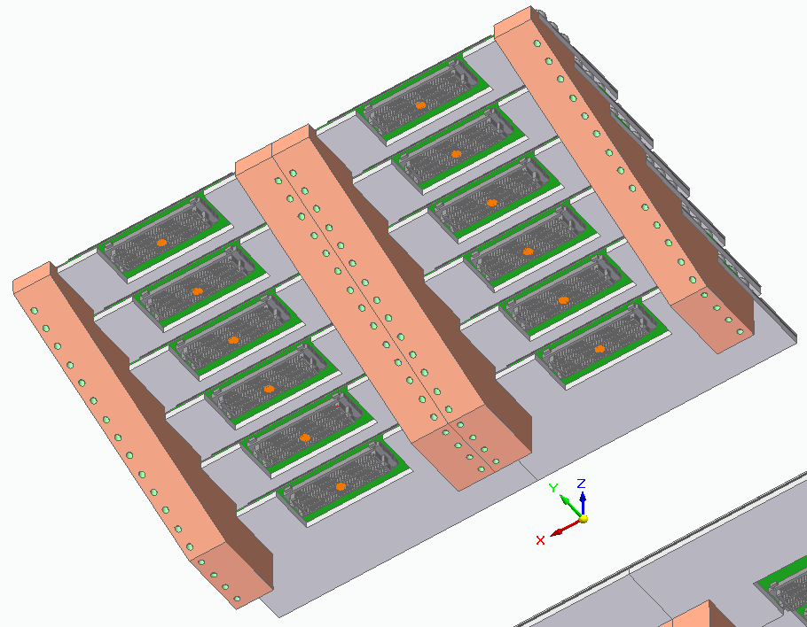
Concept design with 6 tiles – Multiple views
Front side of the tiles, showing shingle concept
Back side of the tiles showing single connector per time
Front view of the detector

Slide 14
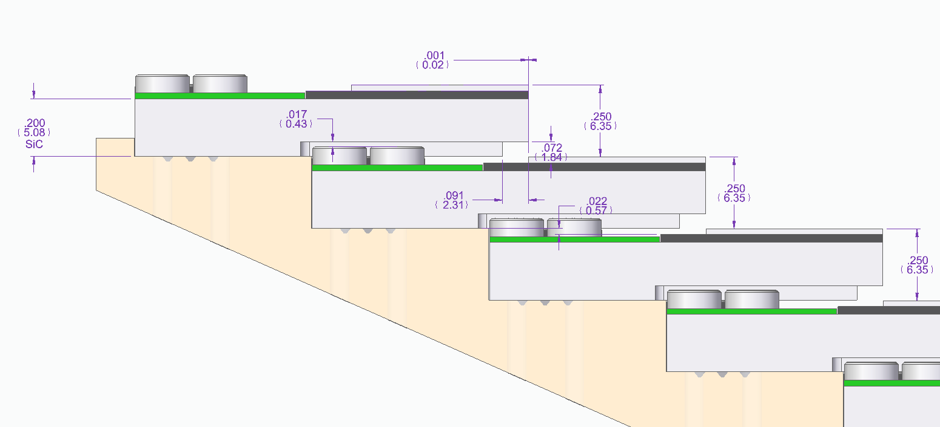
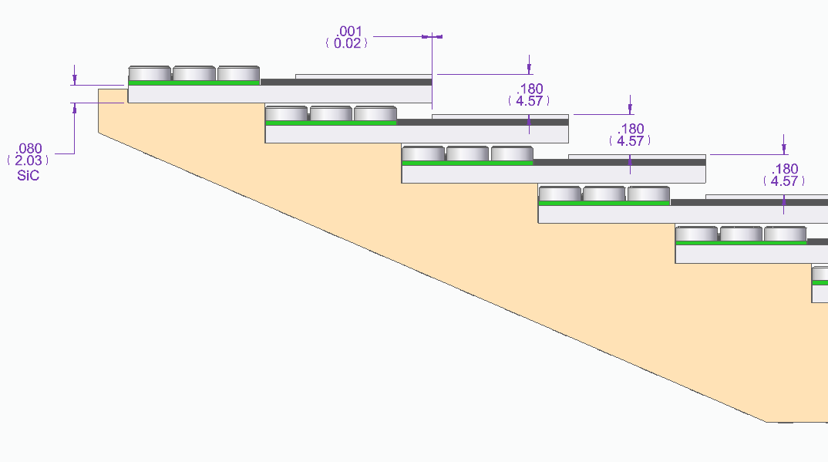
Tile step size
Optimizations are under way
  Based on simulation of the cooling for the tiles
  Option selection will be based on thermal analyses
    Ceramic substrate thickness
    Followed by step size
  Shingle overlap distance
    At the moment, it is set to zero
    Will be increase to minimize gaps
    Depends on the gap size
6.35mm/5mm
4.57mm/2mm
4.57mm/1.5mm

Slide 15
April 2nd TXI camera meeting agenda
Review goals and requirements
Concept design evolution
  Mechanical / cooling
  Electronics
Teams
Schedule

Slide 16
Tile to Interposer/analog board
143mm
Baseline until now was
  6 tile rows
  Evaluating impact on 5 tile rows
Connectors
  Tile connector to interposer
  Interposer to digital board
  Power connector
Tile support electronics
  LDO, ADC, DAC, temp. sensor
20mm
Active Area
Active Area
Active Area
Active Area
Active Area
Active Area
Active Area
Active Area
Active Area
Active Area
Active Area
Active Area
Active Area
Active Area
Active Area
Active Area
Active Area
Active Area
Active Area
Active Area
Active Area
Active Area
Balcony
Balcony
Balcony
Balcony
Active Area
Active Area
123mm
768
192
1536
Active area
864
Active Area
Active Area
Active Area
Active Area
Active Area
Active Area
Active Area
Active Area
Active Area
Active Area
Active Area
Active Area
Active Area
Active Area
Active Area
Active Area
Active Area
Active Area
Active Area
Active Area
Active Area
Active Area
144
Balcony
Balcony
Balcony
Balcony
Active Area
Active Area
Balcony

Slide 17
Tile to Interposer/analog board
143mm
Baseline until now was
  6 tile rows
  Evaluating impact on 5 tile rows
Connectors
  Tile connector to interposer
  Interposer to digital board
  Power connector
Tile support electronics
  LDO, ADC, DAC, temp. sensor
20mm
Active Area
Active Area
Active Area
Active Area
Active Area
Active Area
Active Area
Active Area
Active Area
Active Area
Active Area
Active Area
Active Area
Active Area
Active Area
Active Area
Active Area
Active Area
Active Area
Active Area
Active Area
Active Area
Balcony
Balcony
Balcony
Balcony
Active Area
Active Area
123mm
768
192
1536
Active area
720
Active Area
Active Area
Active Area
Active Area
Active Area
Active Area
Active Area
Active Area
Active Area
Active Area
Active Area
Active Area
Active Area
Active Area
Active Area
Active Area
Active Area
Active Area
Active Area
Active Area
Active Area
Active Area
144
Balcony
Balcony
Balcony
Balcony
Active Area
Active Area
Balcony
* Envelope violation will go away when overlap is defined.

Slide 18
ePix HR Interposer quad board
143mm
Interposer left and right quads
Connectors
  Tile connector to interposer
  Interposer to digital board
  Power connector
Tile support electronics
  LDO, ADC, DAC, temp. sensor
20mm
Data flow
123mm
Power

Slide 19
ePix HR Digital Quad board
143mm
Digital left and right quads
Single board per quad
  One large FPGA
  FO
  Local power
Functionalities
  ASIC control, configuration and data readout
  Support electronics control
  Data communication to DAQ
20mm
123mm
FO
Power?

Slide 20
Power estimation
1 ePix 10k ASIC(5.2W)
Power supply voltage level
  2.5V @ 2.1A
LVDS
  12 IOs for data transmission per ASIC
  2 IOs clock receiver
single ended
  17 control lines inputs and output
  1 x Analog monitor
4 ePix 10k ASIC(20.8W)
48/40 ePix 10k ASIC (249.6W/216W) / ½ camera
or
24/20 ePix 10k ASIC (124.8W/108W) / ¼ camera
Power supply voltage level
  2.5V @ 8.4A
LVDS
  72 data transmission per module
  3 clock receiver
single ended
  20 control lines inputs and output
  3 x Analog monitor
Power supply voltage level
  2.5V @ 50A
LVDS
  432 data transmission per camera
  6 clock receiver
single ended
  68 control lines inputs and output
  18 Analog monitor

Slide 21
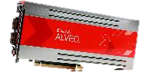
Data flow
x6 ASICs carriers and concentrator cards
Each ASICs carrier board is connected to a concentrator card
Concentrator I/O requirements:
  48 IO/module => 288 IO/Quad
  (6 x 2 IOs per line x 4 ASICs x 1 modules)
  44 (Ideal) / 23 (w/o monitors) IO/module for ASIC control =>130 IO/Quad
  12 Analog monitoring ADC IO /module
  8 Digital monitoring IO/module
Data volume at 5kFPS
  8.5Gbps/module
  (144*192 pixels * 4 ASICs * 16 b * 5kFPS, 66b/64b)
  51Gbps/quad (6 modules per quad)
  42.5Gbps/quad (6 modules per quad)
Data transmission 50Gbps/40Gbps* out
  2x25Gbps lanes/4x10Gbps lanes
  Assume a lossless compression will be used.
SM - FO
ASIC
ASIC
Power supply
ASIC
ASIC
Mon.
ADC
OSCs
ASIC
MM - FO
ASIC
FPGA
+
HBM*
50Gbps
ASIC
ASIC
LCLS-II timing (Optional)
…
ASIC
Control & Mon. link (1Gbps)
(Optional)
ASIC
ASIC
ASIC
*High Bandwidth Memory can be used to improve on camera processing. Example VUP37 with 8GB HBM

Slide 22
April 2nd TXI camera meeting agenda
Review goals and requirements
Concept design evolution
  Mechanical / cooling
  Electronics
Teams
Schedule

Slide 23
Working groups
Overall mechanics
  Andy, Serge, MMcK and design team (1/month)
  external interface, requirements, constraints
  Jaw movement
Internal electro-mechanical system
  Chris K., Angelo D., Martin N., Marco O., Maciej K., Bojan M., Umanath K., Steve B. and Dionisio D.) weekly
  Mechanical support and cooling
  Tile, analog and digital board design
Software/Firmware weekly (not started yet)
  Maciej K., Larry R., Dionisio D.
  Data collection, aggregation, pre-processing and transmission

Slide 24
April 2nd TXI camera meeting agenda
Review goals and requirements
Concept design evolution
  Mechanical / cooling
  Electronics
Teams
Schedule

Slide 25
Milestones and Deliverables
Key Milestones | Planned Date | Goal
Conceptual Design Review | 01/13/2021 - Today | Project High level review
Kick-off meeting | 02/19/2021 | Start design
Mechanical Design Review | 05/15/2021 | Structural and cooling design review
Electro-mechanical design concept | 05/31/2021 | Detector concept development including hutch integration
Preliminary Design Review | 06/01/2021 | Concept review
Detailed Electro-mechanical design completed | 10/20/2021 | Complete Detector design
Final Design Review | 10/21/2021 | Manufacturability review
Components fabrication starts | 10/22/2021 | Parts fabrication and procurement
Firmware Design completed | 12/08/2021 | Fully operational boards
Components fabrication completed with qualification | 01/07/2022 | Parts fabricated and qualified
Modules and Detector Assembled | 08/22/2022 | Assembled deliverables
Detector Characterization and Integration | 08/23/2022 | Parameter optimization and hutch integration
Detector Delivery | 09/21/2022 | Transfer to operations
Project closeout | 09/22/2022
New!
Deliverables:
1 ePixHR10k 2.6MPix (or 2.1MPix) with a 2 jaws design at 5KHz
2 ePixHR10k 110kPix at 5kHz (single planar module)

Slide 27
Electromechanical interface
Resources page about the project
https://confluence.slac.stanford.edu/display/ppareg/AIR+X-ray+Detectors

Slide 28
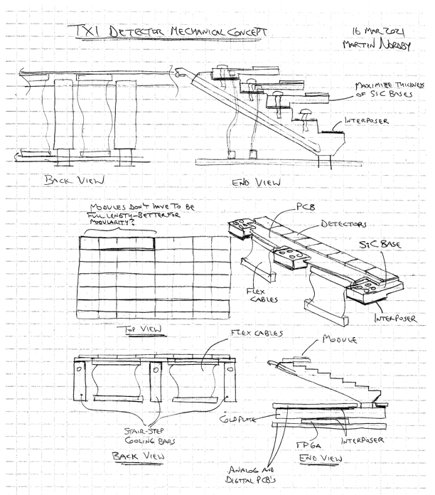
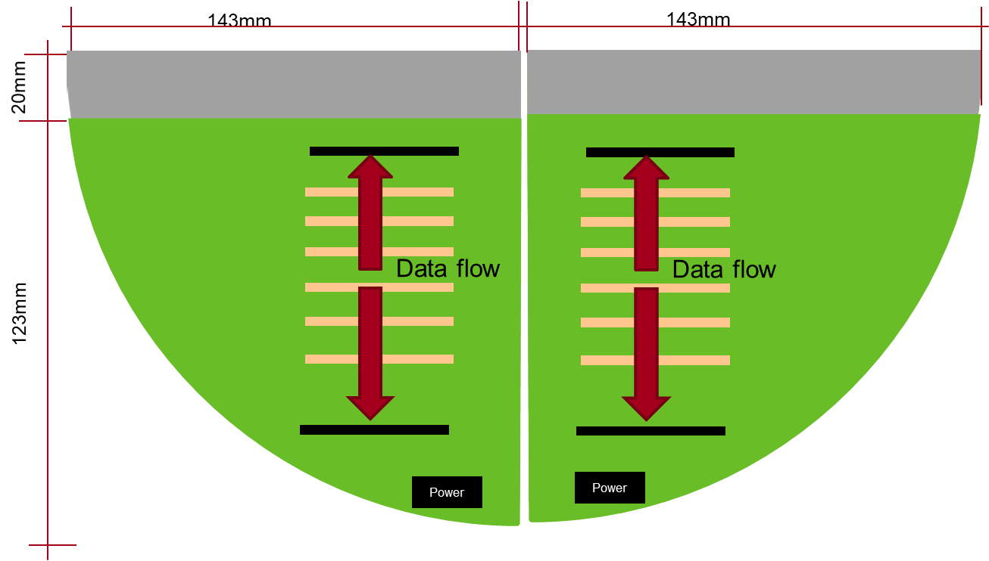
Discussion topics
Progress report on mechanical design concept

Slide 29
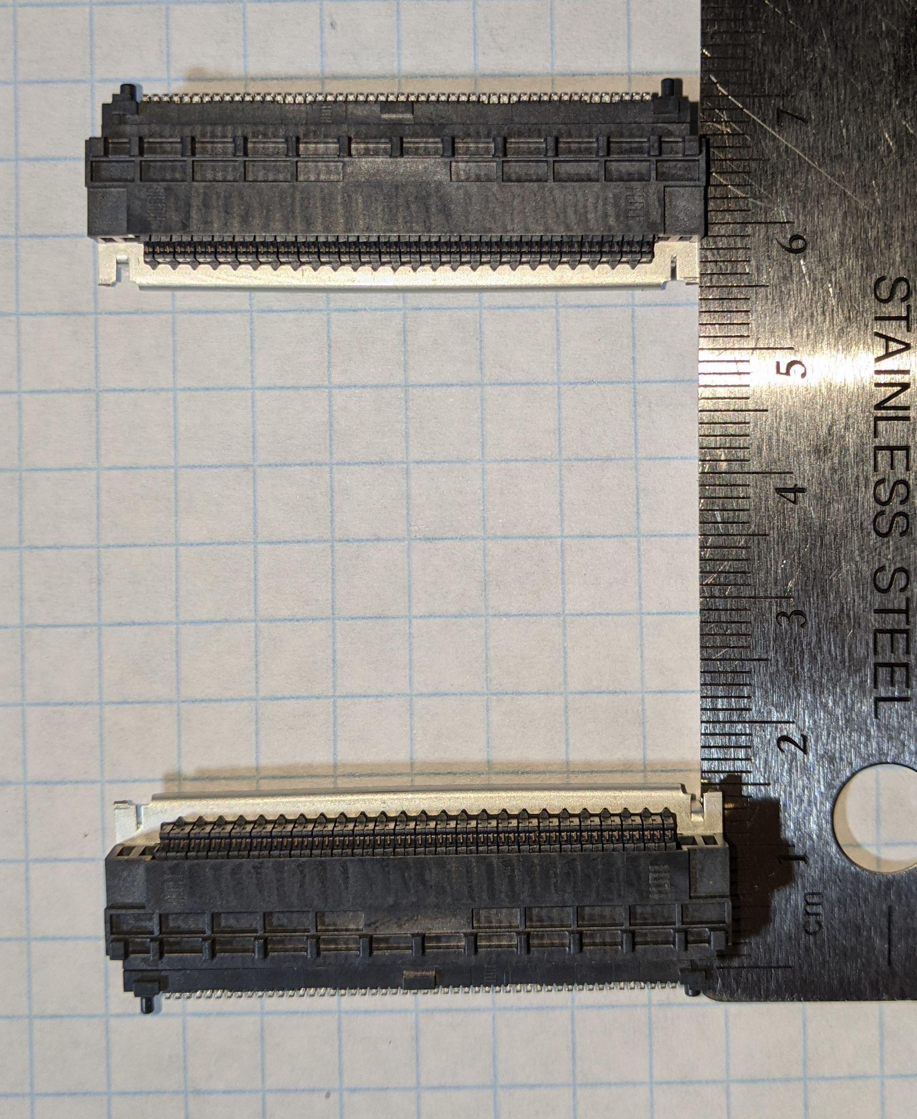
ePix HR quad Tile – Board view
Active Area
Active Area
Active Area
Active Area
Shortest (mated) flex 40mm with 10mm flexible length.
40mm
77mm
15.5 mm
46 mm
15.5 mm
70mm
50 mm
Longest (mated) flex 70mm with 40 mm flexible length.
Connectors:
SEAM8-50-S02.0-S-04-2
SEAF8-50-1-S-04-2-RA

Slide 30
ePix HR quad Tile – Ceramic substrate view
Active Area
Active Area
Active Area
Active Area
Shortest (mated) flex 40mm with 10mm flexible length.
40mm
77mm
15.5 mm
46 mm
15.5 mm
70mm
50 mm
Longest (mated) flex 70mm with 40 mm flexible length.
Connectors:
SEAM8-50-S02.0-S-04-2
SEAF8-50-1-S-04-2-RA

Slide 31
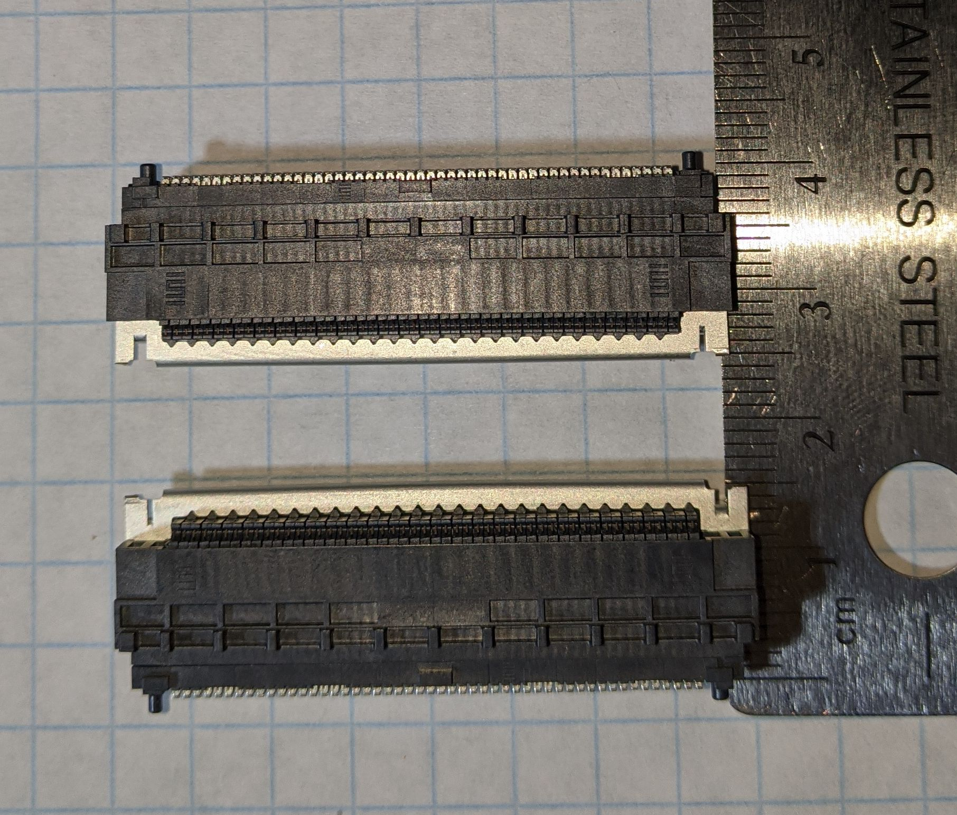
Space available
Shortest (mated) flex 40mm with 10mm flexible length.
Longest (mated) flex 70mm with 40 mm flexible length.
40mm
70mm
Connectors:
SEAM8-50-S02.0-S-04-2
SEAF8-50-1-S-04-2-RA

Slide 32
1 Schematic, 2 layout (left and right)
143mm
143mm
20mm
Data flow
Data flow
123mm
Power
Power

Slide 33
Tile to Interposer/analog board
143mm
Connectors
  Tile connector to interposer
  Interposer to digital board
  Power connector
Tile support electronics
  LDO, ADC, DAC, temp. sensor
20mm
77mm
50mm
Active Area
85mm
Active Area
Active Area
Active Area
Active Area
Active Area
Active Area
Active Area
Active Area
Active Area
Active Area
Active Area
Active Area
Active Area
Active Area
Active Area
Active Area
Active Area
Active Area
Active Area
Active Area
Active Area
Balcony
Balcony
Balcony
Balcony
Active Area
Active Area
123mm
768
5mm
192
1536
Active area
864
46mm
Active Area
Active Area
Active Area
Active Area
Active Area
Active Area
Active Area
Active Area
Active Area
Active Area
Active Area
Active Area
Active Area
Active Area
Active Area
Active Area
Active Area
Active Area
Active Area
Active Area
Active Area
Active Area
144
Balcony
Balcony
Balcony
Balcony
Active Area
Active Area
Balcony

Slide 34
ePix HR Interposer quad board
143mm
Interposer left and right quads
Connectors
  Tile connector to interposer
  Interposer to digital board
  Power connector
Tile support electronics
  LDO, ADC, DAC, temp. sensor
20mm
Data flow
123mm
Power

Slide 35
ePix HR Digital Quad board
143mm
Digital left and right quads
Single board per quad
  One large FPGA
  FO
  Local power
Functionalities
  ASIC control, configuration and data readout
  Support electronics control
  Data communication to DAQ
20mm
85mm
5mm
50mm
77mm
123mm
46mm
FO
Power?

Slide 36
ASIC characteristics
1 ePix 10k ASIC(5.2W)
Power supply voltage level
  2.5V @ 2.1A
LVDS
  12 IOs for data transmission per ASIC
  2 IOs clock receiver
single ended
  17 control lines inputs and output
  1 x Analog monitor
4 ePix 10k ASIC(20.8W)
48 ePix 10k ASIC(249.6W) / ½ camera
or
24 ePix 10k ASIC(124.8W) / ¼ camera
Power supply voltage level
  2.5V @ 8.4A
LVDS
  72 data transmission per module
  3 clock receiver
single ended
  20 control lines inputs and output
  3 x Analog monitor
Power supply voltage level
  2.5V @ 50A
LVDS
  432 data transmission per camera
  6 clock receiver
single ended
  68 control lines inputs and output
  18 Analog monitor
ePixM
1 ASIC(7W)
3 ASICs(21W)
18 ASICs (126W)

Slide 37
Infrastructure required from support electronics
ASIC
  Data connectivity
  Power regulated at 2.5V
  Control (SACI + Control lines such as clock, resets, start of readout, etc.)
DACs
  Bias DACs
  1 DAC for external (ramp) ADC tests
ADCs
  Fast ADCs
    Multiplex input, fast for the analog monitors (?)
    Can be multiplexed, or can skip some ASICs
  Slow ADCs for power and current consumptions (must have)
Transceivers
  High speed communication (50gpbs/quad minimum, consider 250gpbs)
Memory
  Internal HBM (desirable feature)

