Slide 1
ePixHR10k
Low-Noise, High-Dynamic Range,
High Rate Detectors for TXI
Initial electromechanical concept design
March 19th, 20201
Dionisio Doering*
*On behalf of SLAC teams

Slide 2

Project Scope
Scope of this project is to build a suite of high rate (5kHz) detectors for TXI
As defined in the following key documents:
  L2SI-GR-0002, Global Requirements Document L2S-I Beam Parameters
  L2SI-PR-0021-R0, NEH 1.2 Instrument Scope Document
1
2
3
4
Detector Description | Priority
Forward Scattering Detector (>1Mp, >5kHz, split and articulated in Y and in Z) | 1 | In scope
Von Hamos Detector (>110kp, >5kHz) | 2 | In scope
Downstream Low-q Detector (>110kp, >5kHz) | 3 | In scope
Soft X-ray Emission Spectrometer Detector (>115kp, >5kHz, single-photon @ 270eV) | 4 | Out of scope*
* Note: a small module 300kPix ePixM with 50um pitch at 7.5kHz satisfy this need

Slide 3
Milestones and Deliverables
Key Milestones | Planned Date | Goal
Conceptual Design Review | 01/13/2021 - Today | Project High level review
Kick-off meeting | 02/19/2021 | Start design
Mechanical Design Review | 05/15/2021 | Structural and cooling design review
Electro-mechanical design concept | 05/31/2021 | Detector concept development including hutch integration
Preliminary Design Review | 06/01/2021 | Concept review
Detailed Electro-mechanical design completed | 10/20/2021 | Complete Detector design
Final Design Review | 10/21/2021 | Manufacturability review
Components fabrication starts | 10/22/2021 | Parts fabrication and procurement
Firmware Design completed | 12/08/2021 | Fully operational boards
Components fabrication completed with qualification | 01/07/2022 | Parts fabricated and qualified
Modules and Detector Assembled | 08/22/2022 | Assembled deliverables
Detector Characterization and Integration | 08/23/2022 | Parameter optimization and hutch integration
Detector Delivery | 09/21/2022 | Transfer to operations
Project closeout | 09/22/2022
New!
Deliverables:
1 ePixHR10k 2.6MPix with a 2 jaws design at 5KHz
2 ePixHR10k 110kPix at 5kHz (single planar module)

Slide 4
Requirements Table
Parameter​ | Threshold​ | Objective​ | ePixHR 2M​
Pixel Pitch (um)​ | 100​ | 100​ | 100​
Read Noise (e- rms)​ | 110​ | 80​ | 75​
Frame Rate (kHz)​ | >5​ | 10​ | 5​
Array size (pixels)​ Forward Scattering Detector Von Hamos/Low-Q | >2MPix​ >110kPix | 4MPix​ 135kPix | 2.6MPix (2x1536x864)​ 110kPix (384x288)
Well Depth (Number of 4keV photons)​ | 10000​ | 10000​ | >16000​
Quantum Efficiency (% 2-4keV) | 80 | 90 | 95
Vacuum Compatibility | < 10⁻⁷ | < 10⁻⁷ | < 10⁻⁷
Cabling and Cooling Line Length | Compatible with LUSI Vacuum Detector Stage Model number: SA-391-520-00. | Compatible with LUSI Vacuum Detector Stage Model number: SA-391-520-00 | Compatible with LUSI Vacuum Detector Stage Model number: SA-391-520-00
Physical Package Envelope
Maximum Power Dissipation | <400W | <350W | 200W
Positional Stability | 0.1 pixel | 0.1 pixel | 0.1 pixel
Lowest Primary Vibration Mode | ‘Level D’ | ‘Level D’ | ‘Level D’
Y jaw movement | 40mm | 40mm | 40mm
Z translation | 0.5m | 0.5m | 0.5m

Slide 5
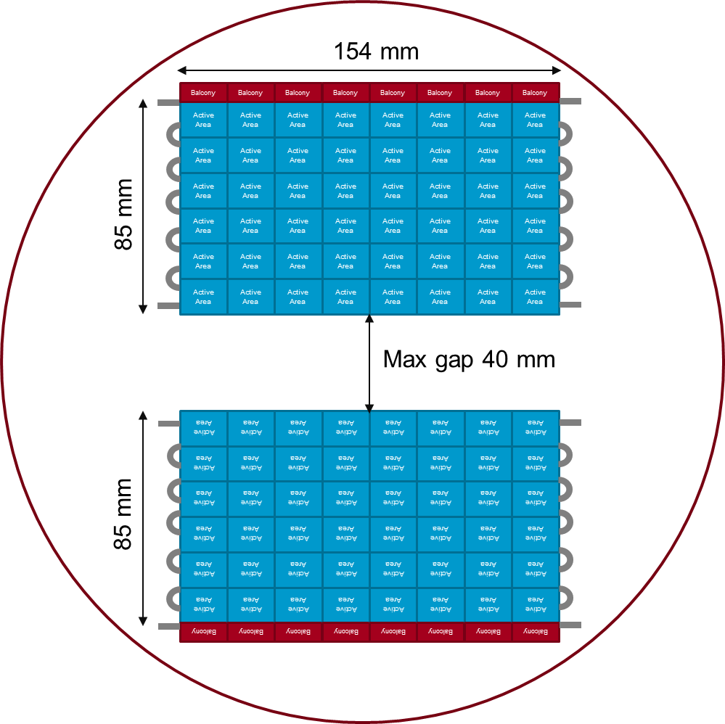

Shingled 2Mpix ePixHR 5kHz camera
Overall dimensions compatible with requirements
ePix10k / CSPAD envelope (OD. 286mm,
depth 175mm)
2 jaws with adjustable gap
up to 40mm
Each jaw composed of 2 abut quads
Each module composed of 4 sensor/ASICs (24 per detector)
Alternative solution can be a geometry with 5 tiles / quad
  Design for 6 populate 5.
20W - less than ePixM

Slide 6
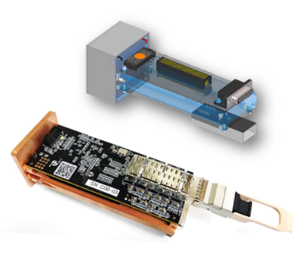
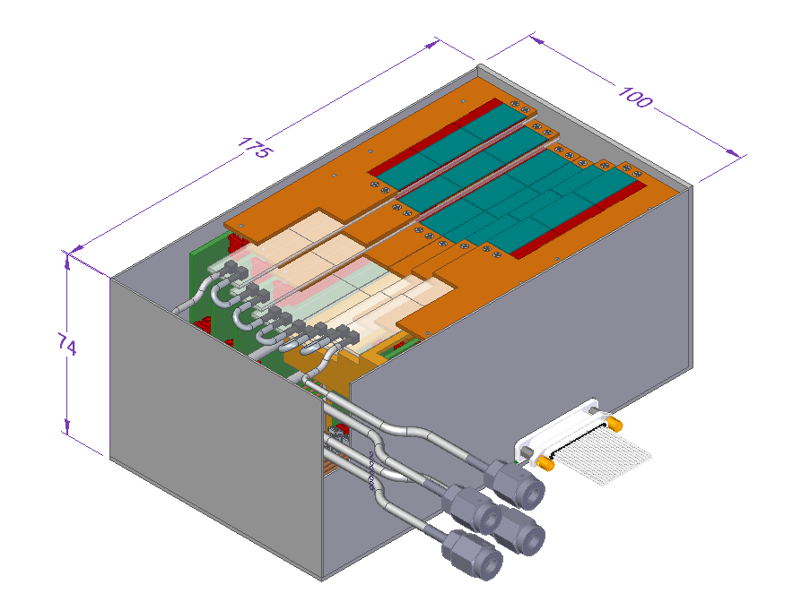
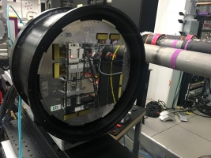
Drawing from experiences
ePix10k HR single
Direct related detectors developments
  ePix10kHR single
    Each tile is equivalent to a single HR camera
      Power
      Data volume
  ePix 10k Analog detector
    Same pixel matrix
    Similar geometry (exception is the jaw)
  ePixM HR concept design
    Analog shingle design concept
    Less restrictive for the ePix10k
      Higher temperature
      More space
TXI detector
ePixM HR shingle concept
ePix10k Analog detector

Slide 7
First proposed concept
4 independent quadrants to build 1 camera
  Power
  Data
2 independent halves
  Mechanics bonds these 4 quads
4 distinct board
  Tile
  Flex (6 different lengths)
  Interposer / analog board
  Digital board

Slide 8
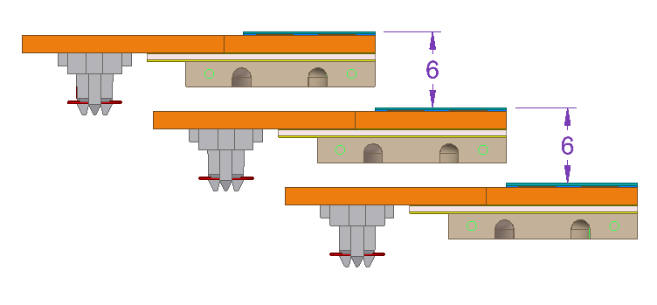

Space available
<123 (143mm – 20mm)
70mm
Cooling ladder
Available space for electronics and cooling
Base plate
105mm

Slide 9
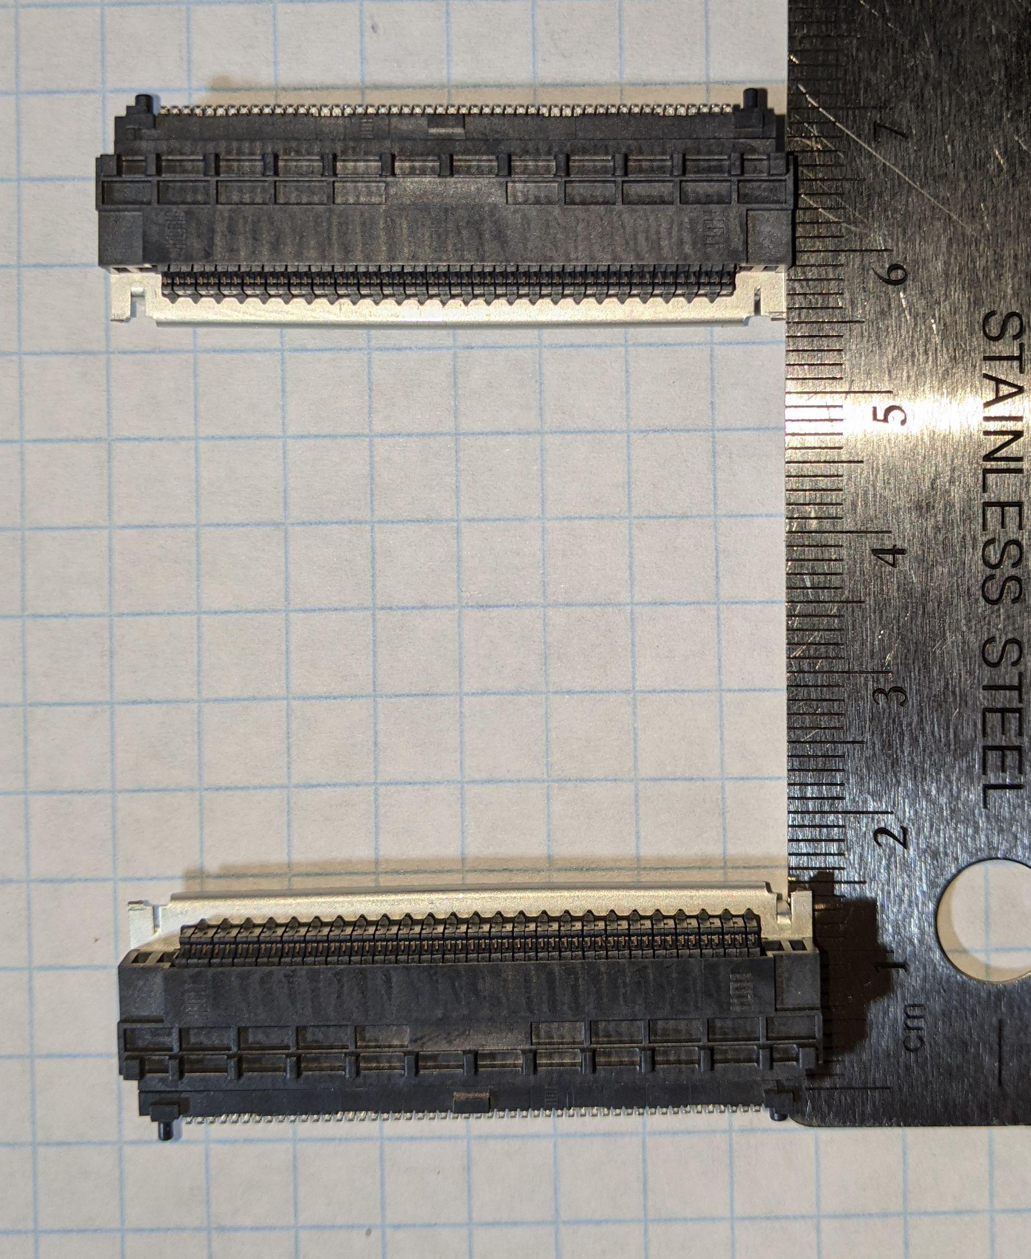
ePix HR quad flex – L1 to –L6
Active Area
Active Area
Active Area
Active Area
Shortest (mated) flex 40mm with 10mm flexible length.
40mm
77mm
15.5 mm
46 mm
15.5 mm
70mm
50 mm
Longest (mated) flex 70mm with 40 mm flexible length.
Connectors:
SEAM8-50-S02.0-S-04-2
SEAF8-50-1-S-04-2-RA

Slide 10
Tile to Interposer/analog board
143mm
Connectors
  Tile connector to interposer
  Interposer to digital board
  Power connector
Tile support electronics
  LDO, ADC, DAC, temp. sensor
20mm
77mm
50mm
Active Area
85mm
Active Area
Active Area
Active Area
Active Area
Active Area
Active Area
Active Area
Active Area
Active Area
Active Area
Active Area
Active Area
Active Area
Active Area
Active Area
Active Area
Active Area
Active Area
Active Area
Active Area
Active Area
Balcony
Balcony
Balcony
Balcony
Active Area
Active Area
123mm
768
5mm
192
1536
Active area
864
46mm
Active Area
Active Area
Active Area
Active Area
Active Area
Active Area
Active Area
Active Area
Active Area
Active Area
Active Area
Active Area
Active Area
Active Area
Active Area
Active Area
Active Area
Active Area
Active Area
Active Area
Active Area
Active Area
144
Balcony
Balcony
Balcony
Balcony
Active Area
Active Area
Balcony

Slide 11
ePix HR Interposer quad board
143mm
Interposer left and right quads
Connectors
  Tile connector to interposer
  Interposer to digital board
  Power connector
Tile support electronics
  LDO, ADC, DAC, temp. sensor
20mm
Data flow
123mm
Power

Slide 12
ePix HR Digital Quad board
143mm
Digital left and right quads
Single board per quad
  One large FPGA
  FO
  Local power
Functionalities
  ASIC control, configuration and data readout
  Support electronics control
  Data communication to DAQ
20mm
85mm
5mm
50mm
77mm
123mm
46mm
FO
Power?

Slide 13
ASIC characteristics
1 ePix 10k ASIC(5.2W)
Power supply voltage level
  2.5V @ 2.1A
LVDS
  12 IOs for data transmission per ASIC
  2 IOs clock receiver
single ended
  17 control lines inputs and output
  1 x Analog monitor
4 ePix 10k ASIC(20.8W)
48 ePix 10k ASIC(249.6W) / ½ camera
or
24 ePix 10k ASIC(124.8W) / ¼ camera
Power supply voltage level
  2.5V @ 8.4A
LVDS
  72 data transmission per module
  3 clock receiver
single ended
  20 control lines inputs and output
  3 x Analog monitor
Power supply voltage level
  2.5V @ 50A
LVDS
  432 data transmission per camera
  6 clock receiver
single ended
  68 control lines inputs and output
  18 Analog monitor
ePixM
1 ASIC(7W)
3 ASICs(21W)
18 ASICs (126W)

Slide 14

Data flow
x6 ASICs carriers and concentrator cards
Each ASICs carrier board is connected to a concentrator card
Concentrator I/O requirements:
  48 IO/module => 288 IO/Quad
  (6 x 2 IOs per line x 4 ASICs x 1 modules)
  44 (Ideal) / 23 (w/o monitors) IO/module for ASIC control =>130 IO/Quad
  12 Analog monitoring ADC IO /module
  8 Digital monitoring IO/module
Data volume at 5kFPS
  8.5Gbps/module
  (144*192 pixels * 4 ASICs * 16 b * 5kFPS, 66b/64b)
  51Gbps/quad
  (6 modules per quad)
Data transmission 50Gbps* out
  (2x25Gbps lanes fly by wire alternatives from Samtec)
  Assume a lossless compression will be used.
SM - FO
ASIC
ASIC
Power supply
ASIC
ASIC
Mon.
ADC
OSCs
ASIC
MM - FO
ASIC
FPGA
+
HBM*
50Gbps
ASIC
ASIC
LCLS-II timing (Optional)
…
ASIC
Control & Mon. link (1Gbps)
(Optional)
ASIC
ASIC
ASIC
*High Bandwidth Memory can be used to improve on camera processing. Example VUP37 with 8GB HBM

