Slide 1
Shingled ePix 2020 Design
M.Oriunno, September 25, 2020
on behalf ePix Design team

Slide 2
Goals and Requirements
  Develop a low risk concept for tileing ePixM prototype modules into a large area 1Mpix camera
  Setup the infrastructure for soft x-ray entrance window fabrication
Parameter | Threshold | Objective | REXS | XPCS | CS | 1MPixM
Pixel Pitch (um) | 50 | 50 | ✔ | ✔ | ✔ | 50
Read Noise (e- rms) | 15 | 10 |  | ✔ | ✔ | 12
Quantum efficiency (%, 275eV-1500eV) | 70 | 90 | ✔ | ✔ | ✔ | ~84
Frame Rate (kHz) | 5 | 10 | ✔ | ✔ | ✔ | 7.5
Array size (pixels) | 512x512 | 1024x1024 | ✔ | ✔ | ✔ | 1152x1152
Well Depth (Number of 530eV photons) | 1000 | 3000 | ✔ |  | ✔ | >1000
Vacuum outgassing rate (torr*L/s) | 2E-8 | 1E-8 | ✔ |  |  | 2E-8
Cabling and cooling length (m) | 2 | 4 | ✔ |  | ✔ | 2
Physical package envelope (WxLxD, mm) | 100x175x75mm | 75x150x50mm | ✔ |  |  | 100x175x75mm
Maximum Power dissipation (W) | 100¹ | 50 | ✔ | ✔ | ✔ | 250
1 – Assuming a 2x3 tiles or 768x576 consumes 125W

Slide 3
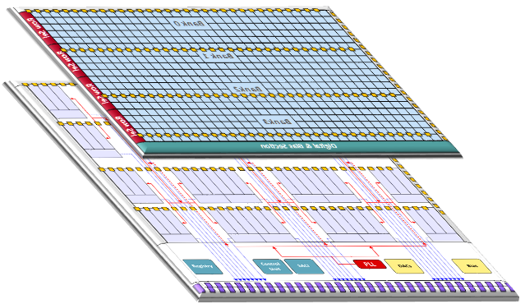
Detector Concept
Standard modular hybrid approach
Core module architecture:
ePixM monolithic front-end
X-rays E_{γ} = 250 eV – 2keV
Fully depleted CMOS Image Sensor with front-end circuitry
  on-sensors amplifier reduces input detector capacitance and thus noise
  Back-thinned and back illuminated
  Entrance window optimized for soft X-rays (demonstrated)
Standard micro-bumps
384
Readout ASIC (ROIC)
Active area
Variant of the ePixHR back-end
  4 arrays of 192 ADCs
  Each array is a copy of the ePixHR back-end (demonstrated)
192
CMOS sensor with 384 * 192 pixels.
  Size is 19.772 x 10.371 mm
ePixHR-M readout
  Size is 20.072 x 14.932 mm
Balcony

Slide 4
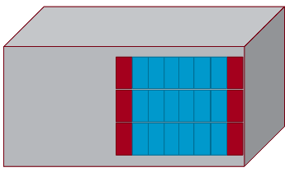
Tiling for a 1Mpix camera
Side view
Shingled assembly to maximize fill factor
Overall dimensions compatible with requirements
1152 (active area of ~ 57.2mmx 57.2mm)
Balcony
Balcony
Balcony
Active Area
Active Area
Active Area
Active Area
Active Area
Active Area
Active Area
Active Area
Active Area
1152
Active Area
Active Area
Active Area
D: 75 mm
Active Area
Active Area
Active Area
L: 75-100mm
Active Area
Balcony
Balcony
Active Area
Balcony
Active Area
Front view
W: 100-175mm

Slide 5
Engineering Requirement Flow-down
ASICs and Sensors
Design and Performance
L2S-I Soft X-ray Area Detector Physics Requirements
L2SI-PR-0168-R0
Cooling requirements
Assigned Camera Envelope
Power and Read-Out Interconnections
Vacuum Requirements
Assembly and Maintenance procedures
Services
Requirements
ePix 2020
Camera Design

Slide 6
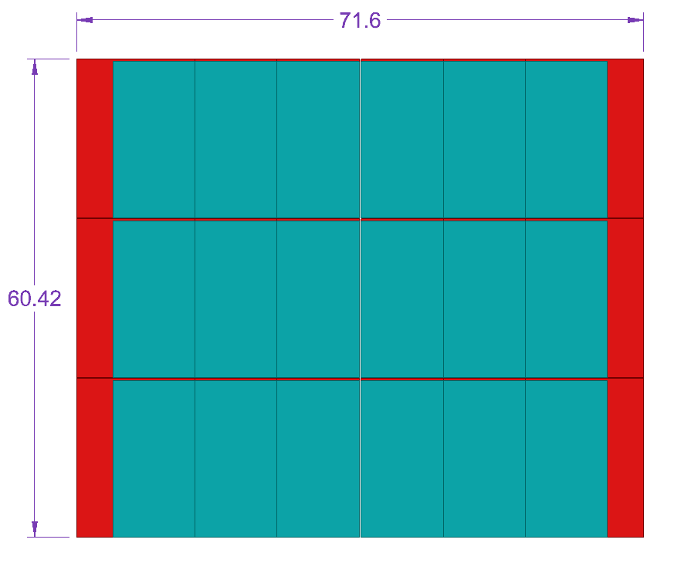
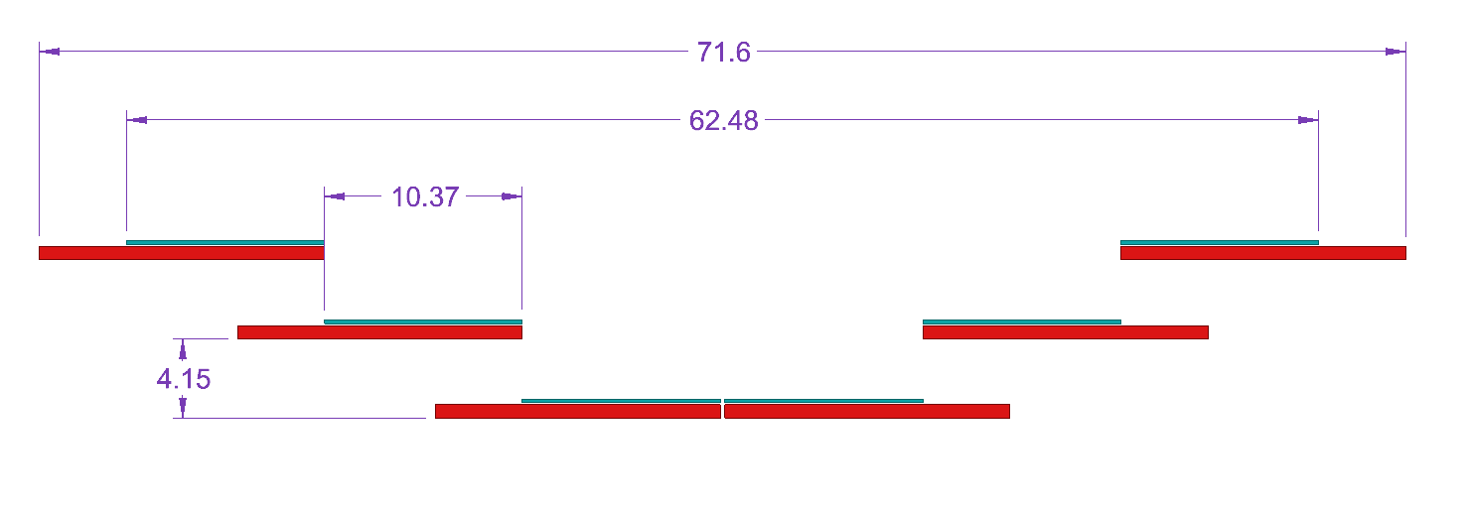
Active area Layout
Active area
ASIC
Sensor

Slide 7
Cooling Requirements
Cooling requirements are split in two sets:
  Remove heat generated by the sensors to run at the required Op. Temp. Performance Requirements
  The heat generated by the active components of the Read-out boards. Thermal neutrality
  Operation in Vacuum asks direct cooling, no-convection

Slide 8
Active liquid cooling
The high heat flux, 2.4 W/cm², makes impossible the use of passive conduction with cold-fingers
To minimize the thermal gradient across the sensors (<2 deg), active cooling by liquid circulation directly under the sensors

Slide 9
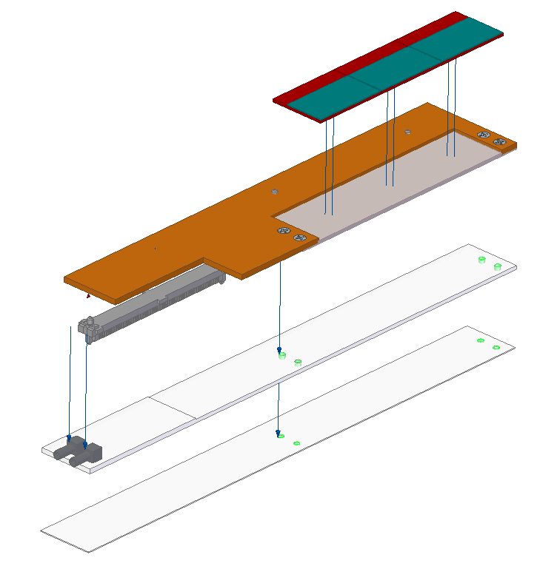
Cooling specifications
ASICS/Sensors
Op. Temperature = -20 C (threshold), -40 C (goal)
ASIC heat Dissipation (q_{a}) = 7 W
Total for one module (q_{m}) = 21 W
Total Camera ASIC only (q_{tot}) = 126 W
SiC thermal spreader
bonded to the carrier
Kapton Carrier
Micro-channeled
active spreader on the cold plate
Electrical Connector
Cooling fittings

Slide 10
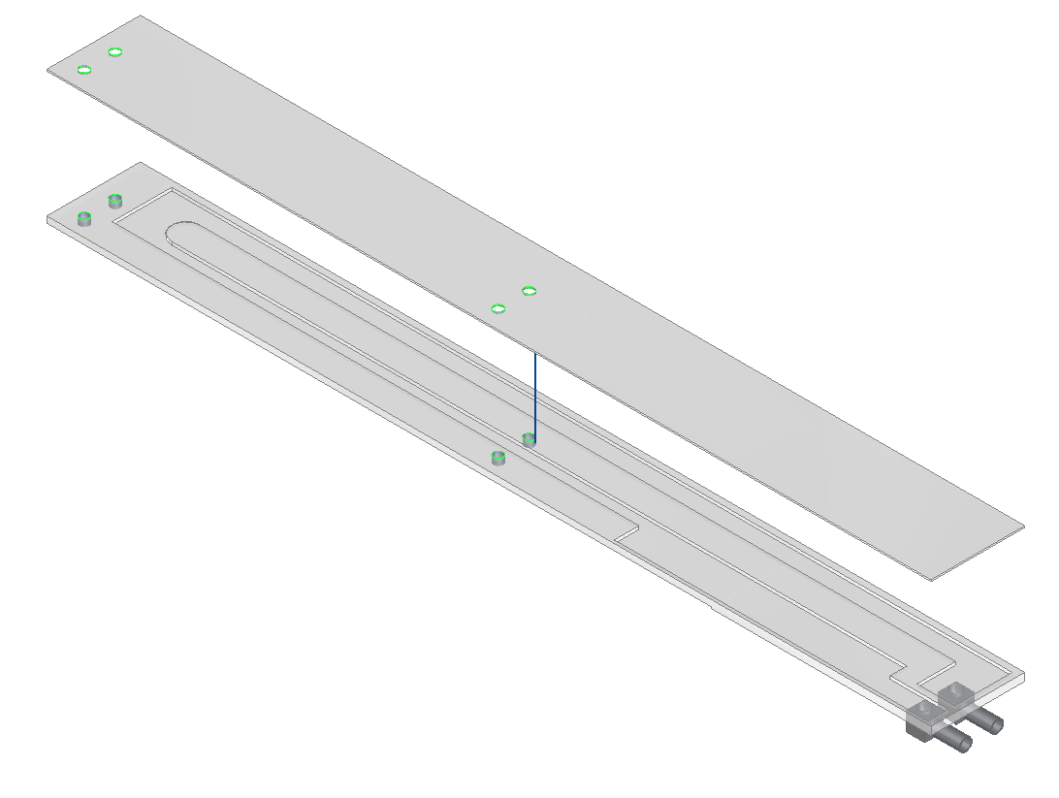
Cooling solution
Requirement : ΔT on the sensor < 2 deg
Evaporative cooling with microchannels is the only technology that allows to meet the requirement.
Available turnkey solutions:
  CO2, specially developed for scientific instruments, ATLAS-SLAC
  Industrial CFC based solutions
Htc [W/m2.K] | DT max | @-20C capable
500 | 29.2 | Monophase
1’000 | 15.5 | Monophase
8’000 | 2.6 | Evaporative
10’000 | 2.01 | Evaporative
SiC cold plate
microchannel

Slide 11
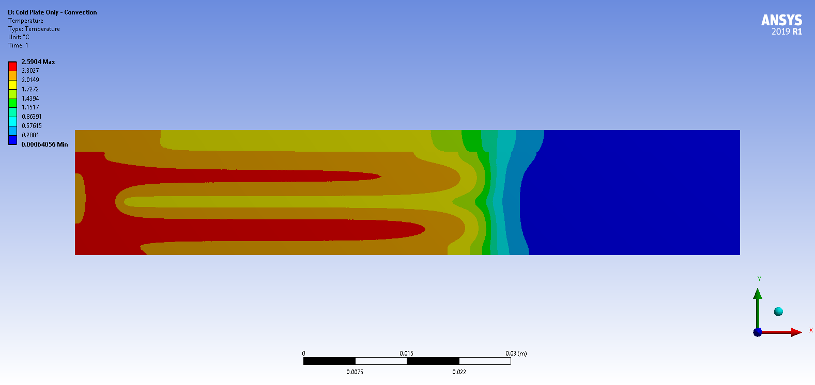
Thermal Simulation
h=8000, Q = 7 W (2.4 W/cm2)

Slide 12
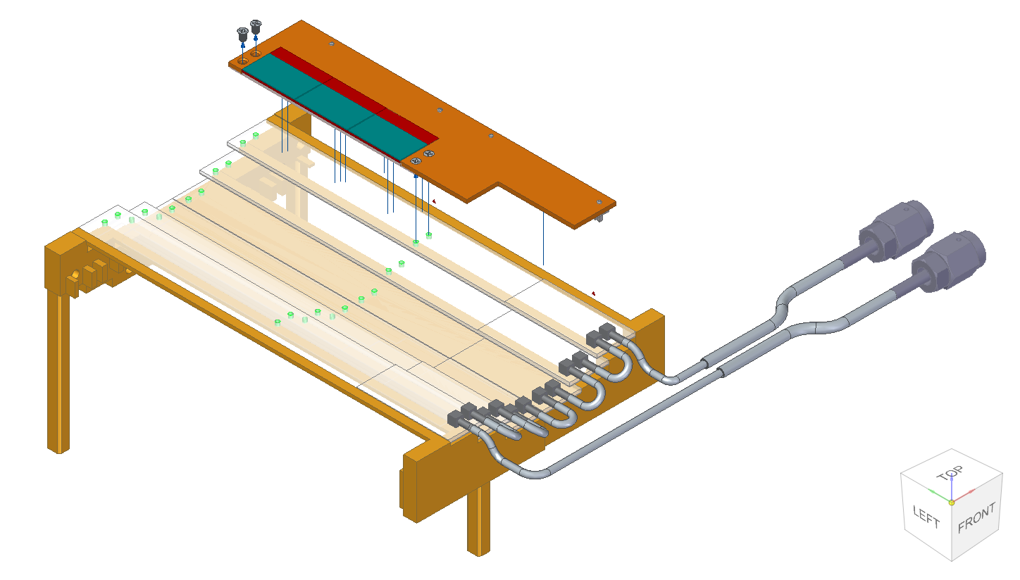
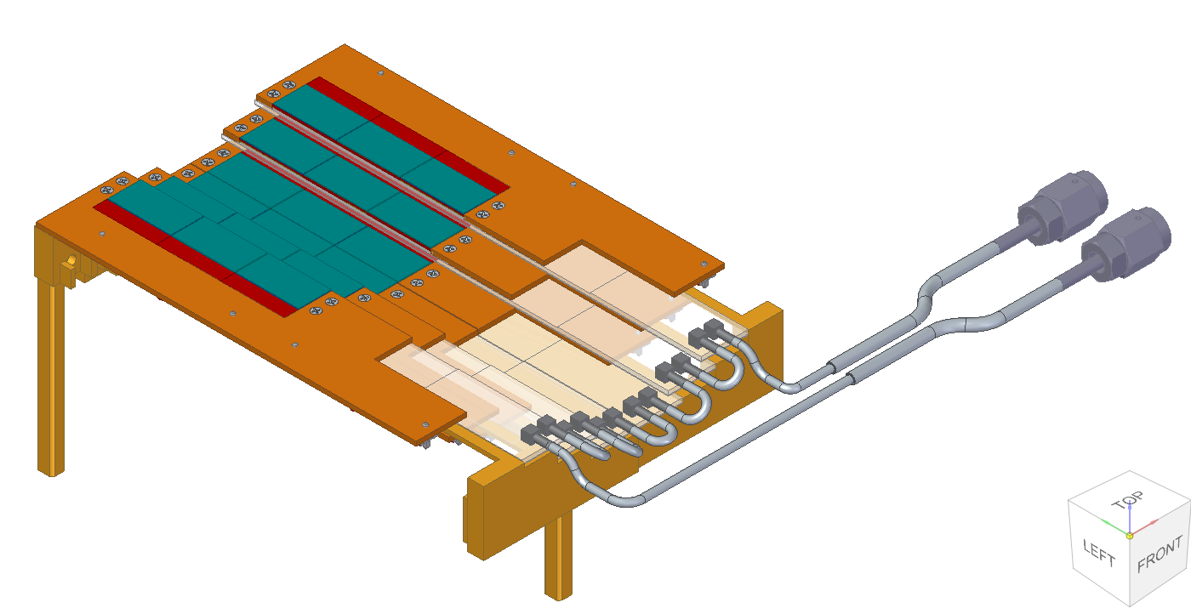
Cold Plate Assembly
The detector modules are individually fastened to the cold plate to allow the installation and the replacement of single units
The micro-channeled heat spreaders are bonded to a support structure and serially connected to the cooling manifold

Slide 13
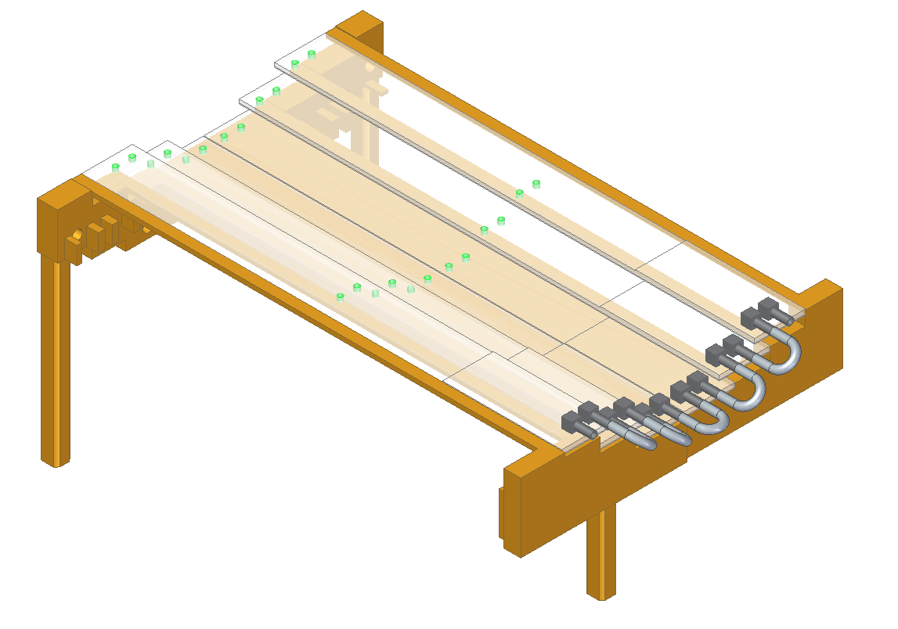
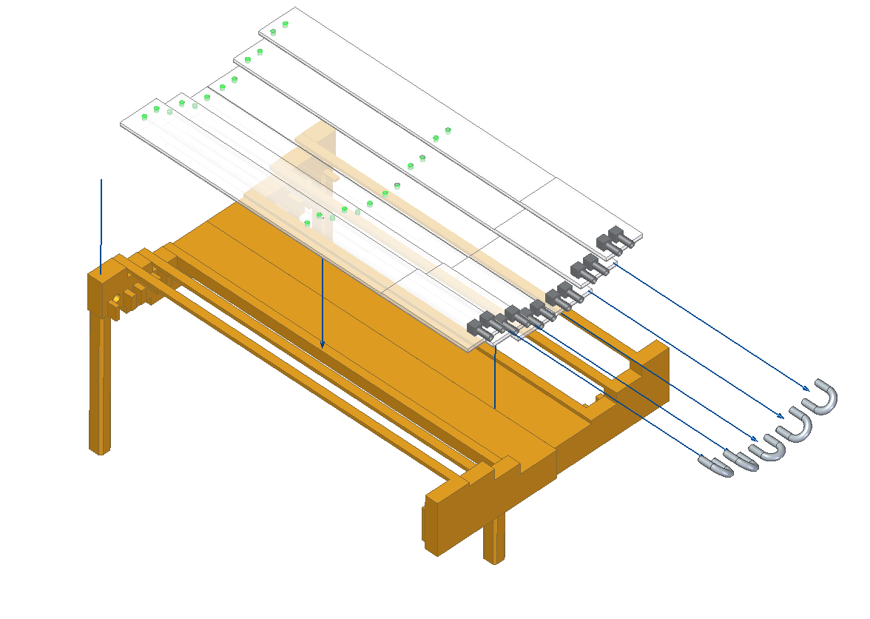
Cold Plate Construction
The high density of the electronic integration requires a cold plate design made of bonded low-CTE parts, ideally Silicon Carbide or SiC and Titanium
A pre-production development run will be done with the vendor, to optimize the manufacturing procedure of the final assembly

Slide 14
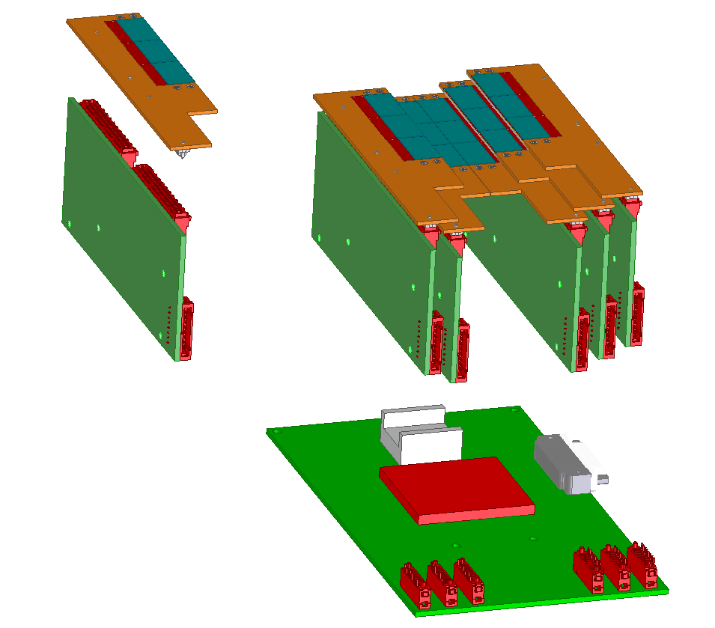
Integrated Electronics Architecture
Board-to-Board
Connectors
Concentrator Board
Cables
Cables to the VC Flanges
Mother Board

Slide 15
Read-Out Electronics Cooling
Requirement : remove the heat and keep the R/O electronic below the max. op. range. ~70 C
Heat loads :
  6 x Concentrator Boards, 14 W/ea = 84 W
  1 x Mother Board, 41 W
  Total R/O = 125 W
Active cold plate on a Water/Glycol cooling loop independent from the sensors' primary

Slide 16
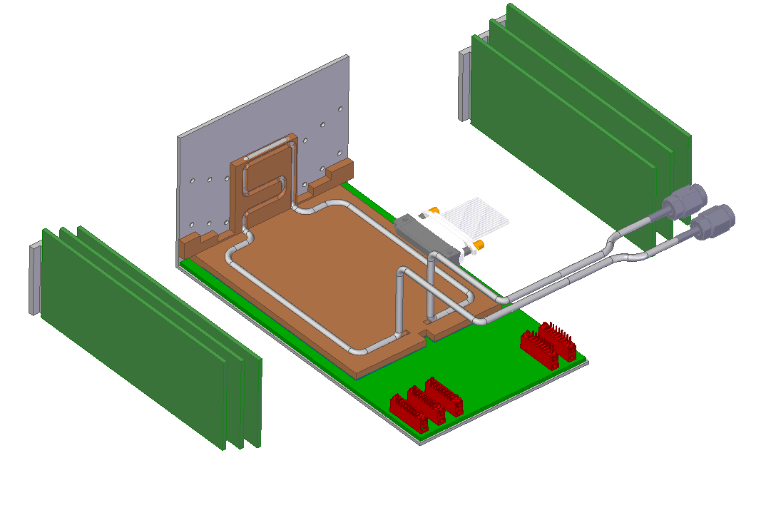
Enclosure Strongback
2 mm Alu
3 x 14 W
Water/Glycol @ 0C
Q_dot = 2 L/min
Dtout-Dtin = 2 deg
3 x 14 W
41 W

Slide 17
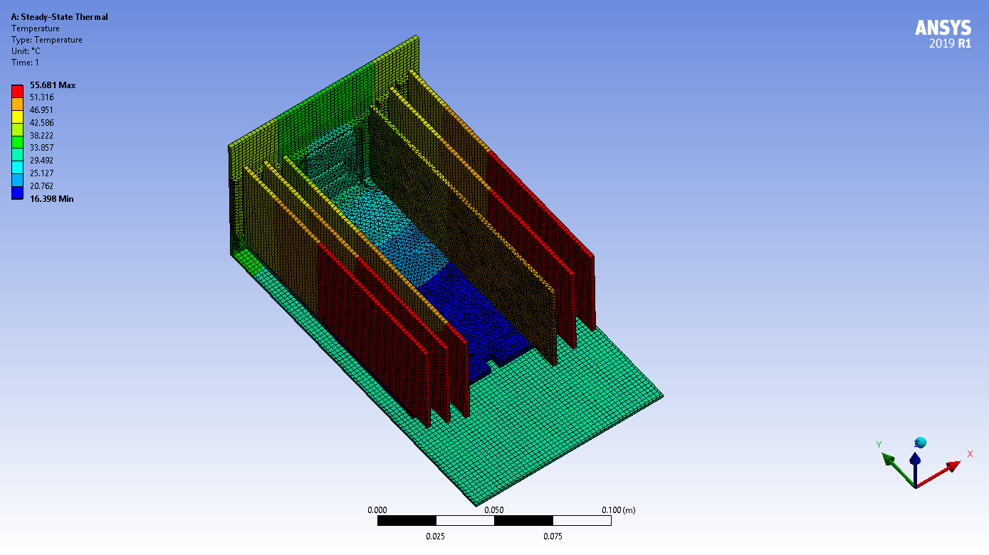
ΔT over the base temperature

Slide 18
Assembly Procedures

Slide 19
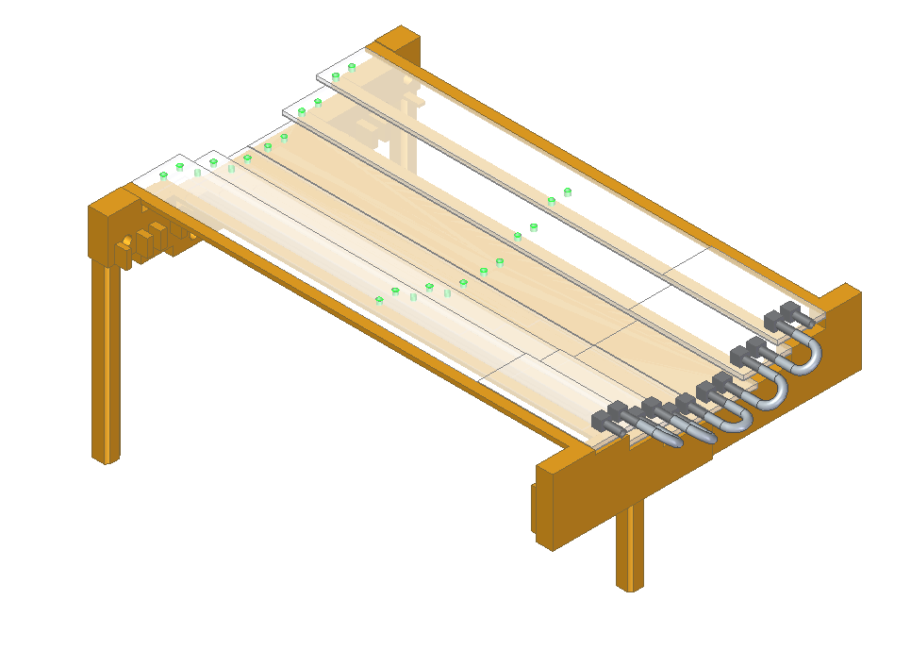
The Detector Cold Plate is secured to the assembly fixtures (granite table) and lifted up on ~ 2” posts
~ 2 inches

Slide 20
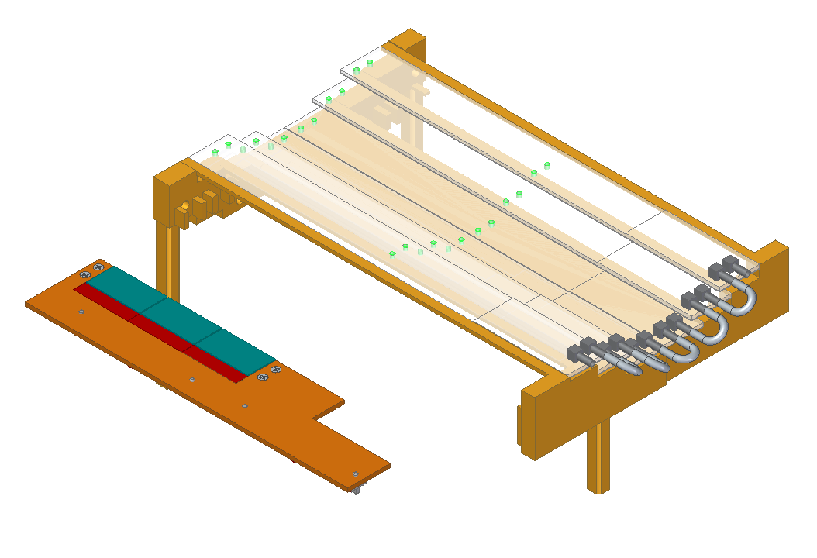
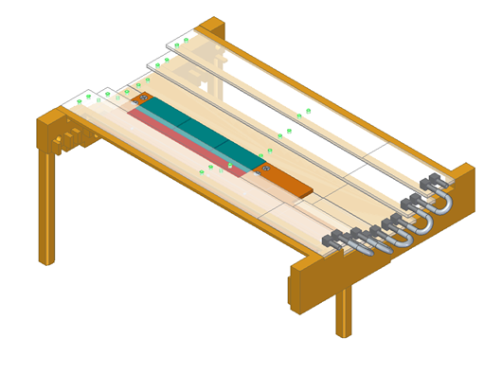
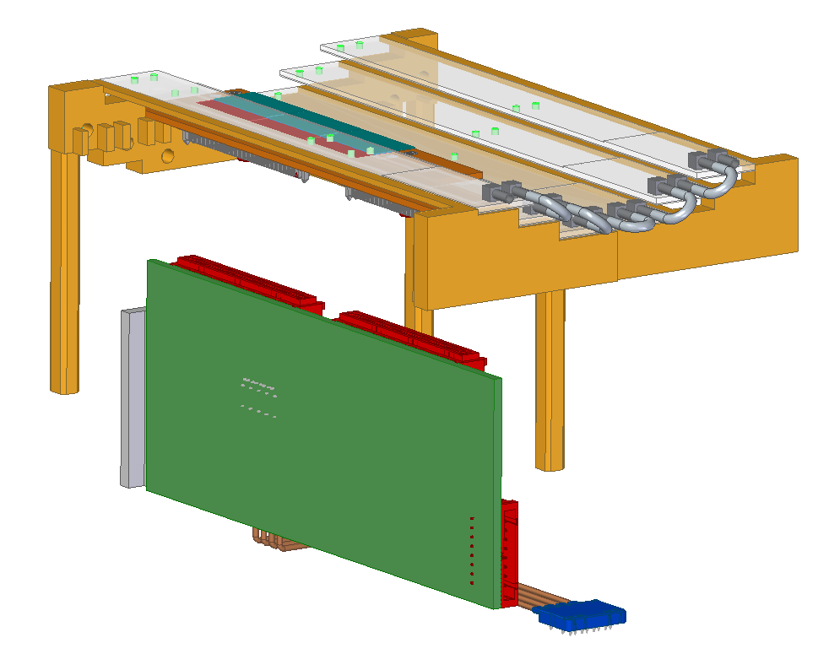
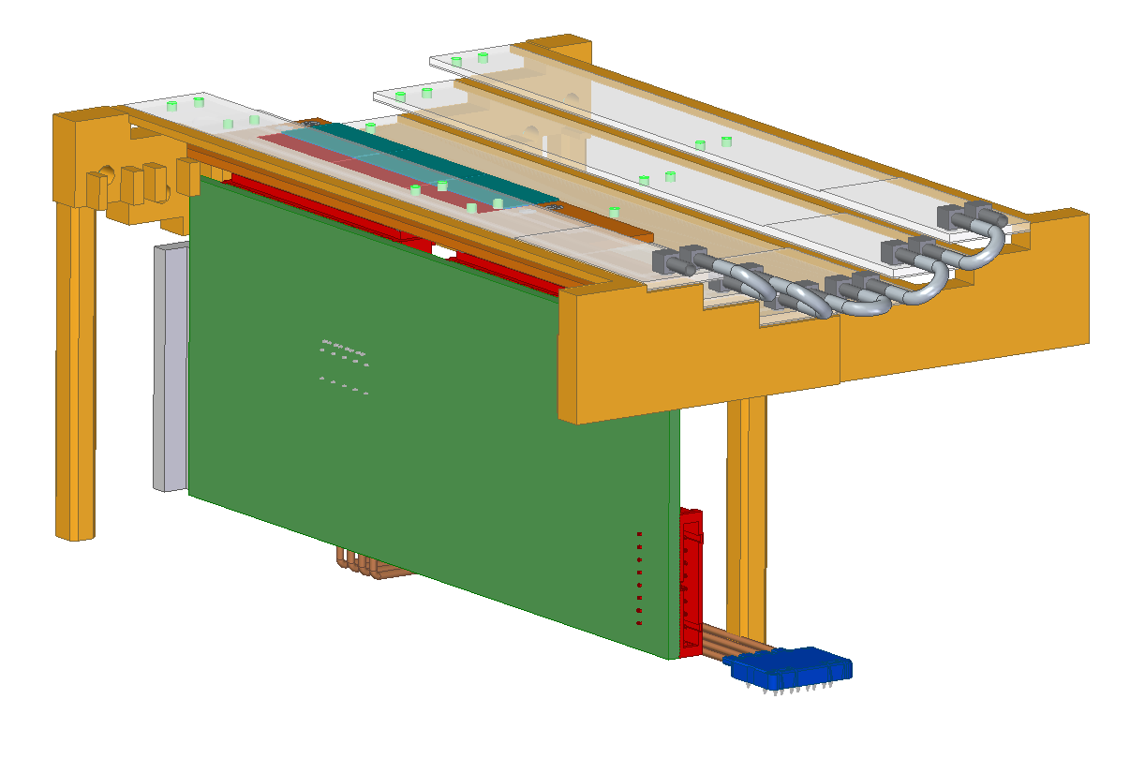
The carrier board is inserted horizontally from the two sides and brought to the final position with two lateral movements in the horizontal plan (a. & b.)
The Concentrator Board is connected once the Carrier Board is fastened to the cold plate (c. & d.)
a.
b.
c.
d.

Slide 21
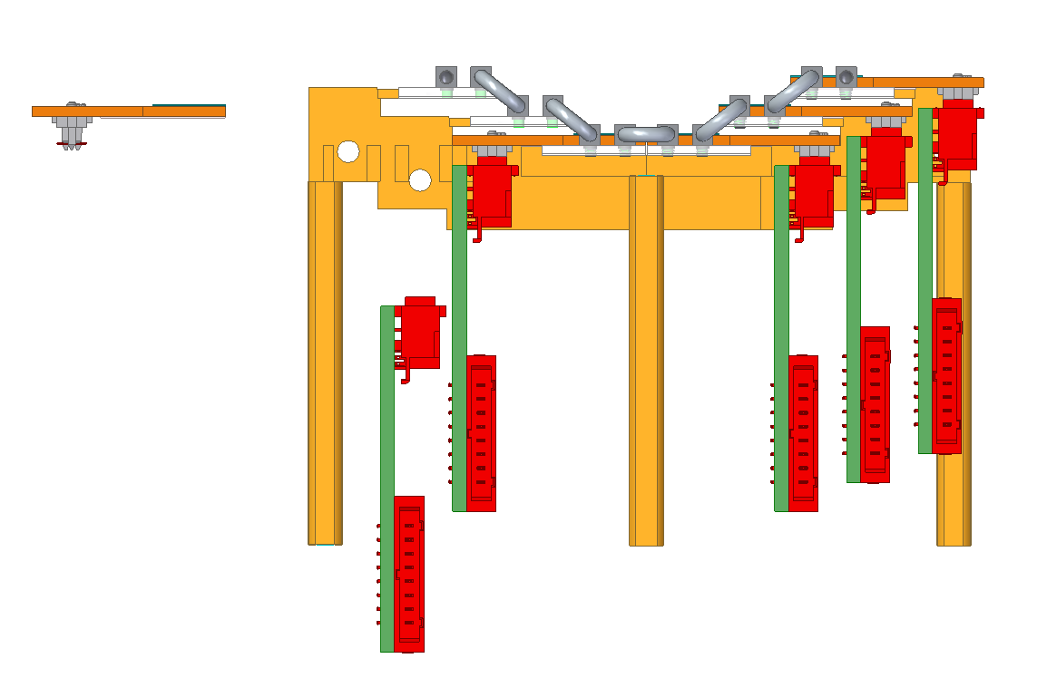
Carrier Board and Concentrator Installation

Slide 22
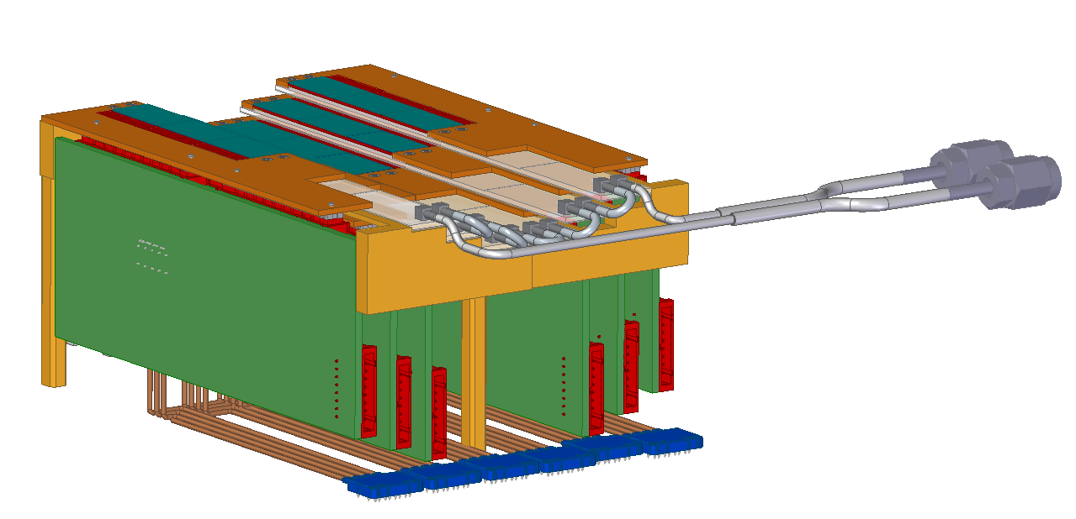
Full camera ready for the integration with motherboard on the enclosure
Data Cables are pre-connected to the concentrator boards

Slide 23
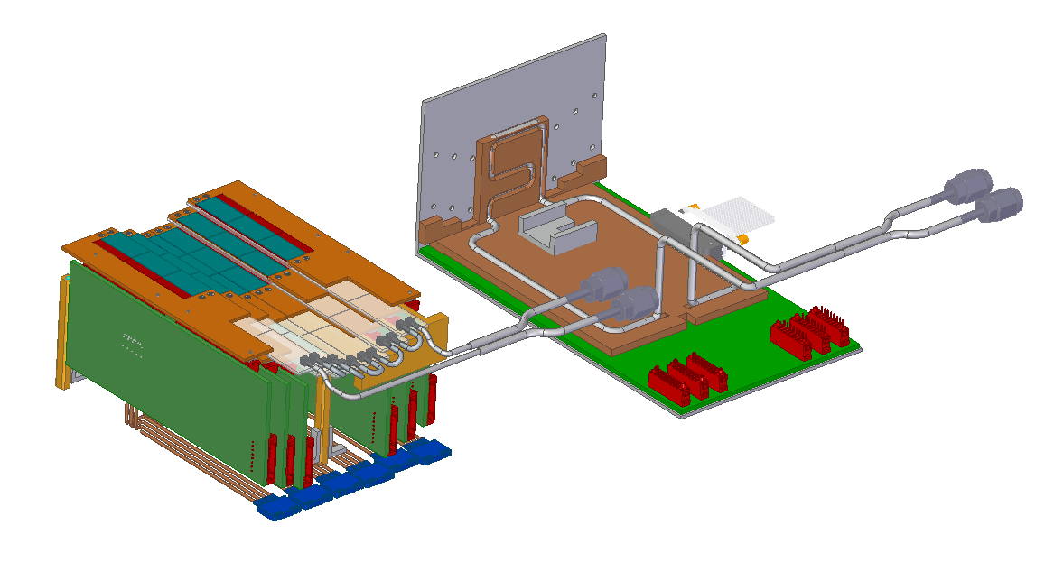
The Motherboard is pre-assembled and tested on the L-shaped enclosure strongback
The standoff of the cold plate bolt to the bottom of the strong back and the heat sink on the concentrator board bolts to the vertical wall

Slide 24
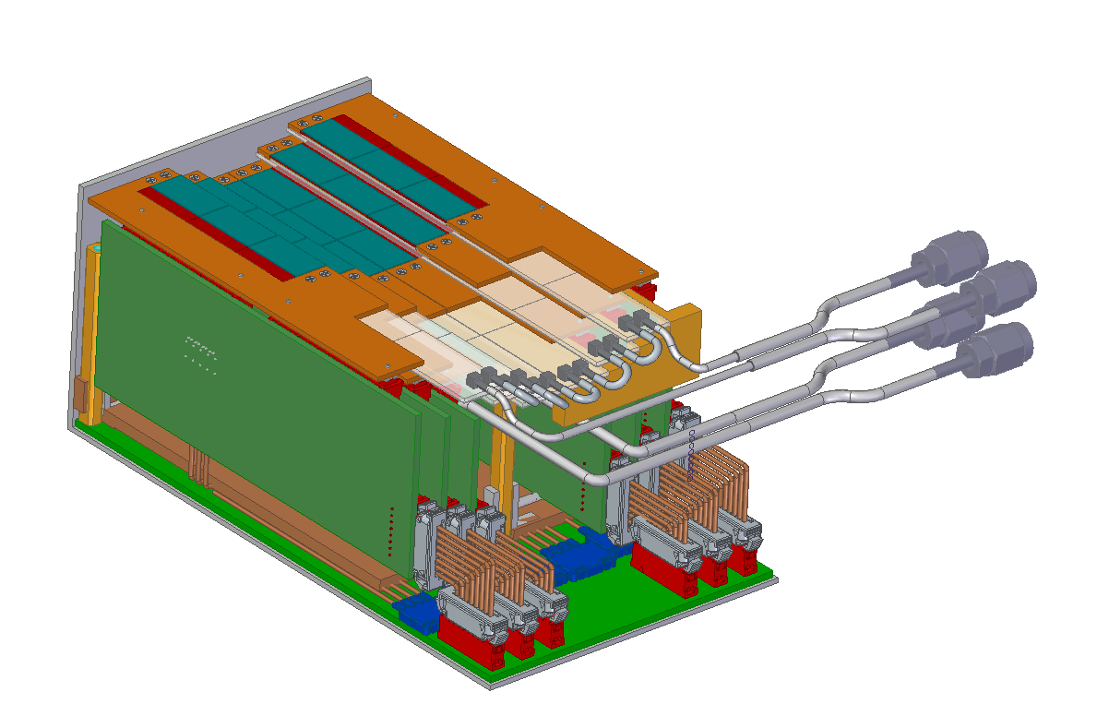
Camera ready for final testing before the installation in the vacuum chamber

Slide 25
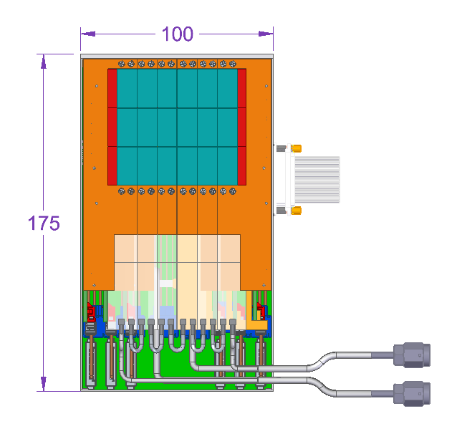
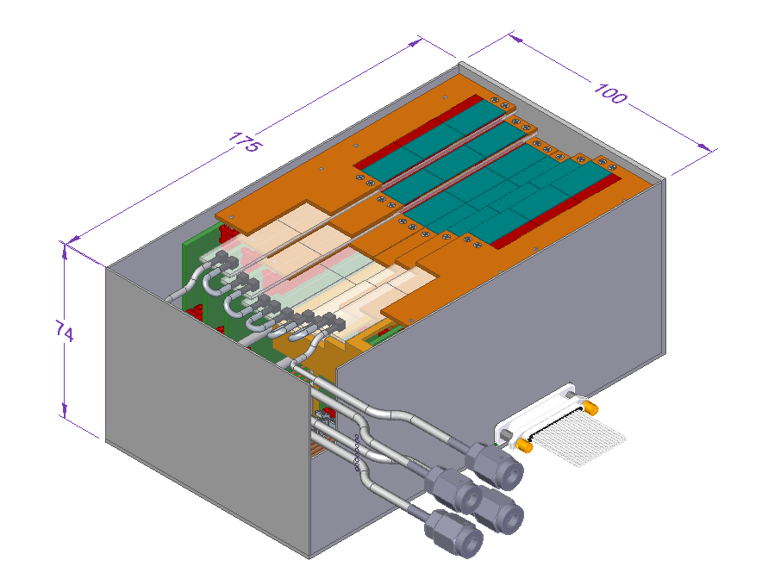
Camera in the envelope assigned by LCLS

Slide 26
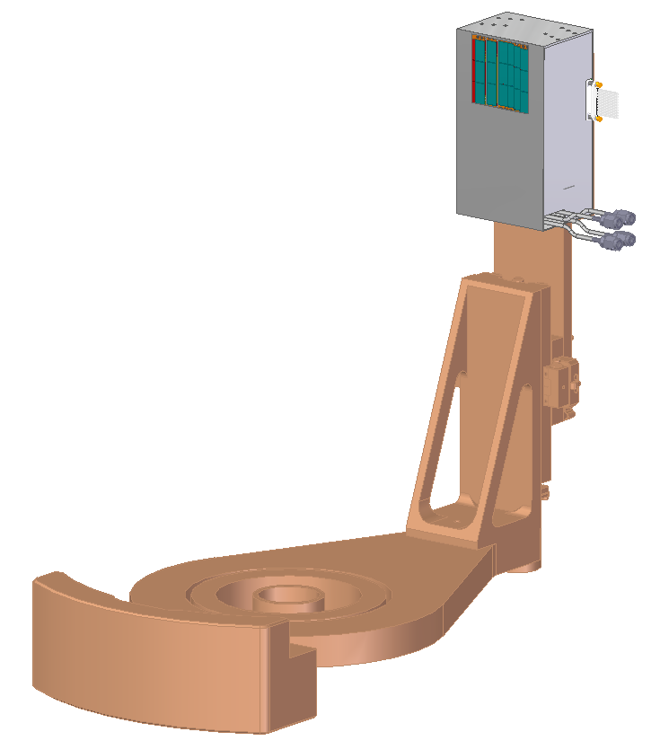
Camera on the theta-arm
Total mass of the camera = 0.9 kg
1 x Power Cable
1 x Optical Fiber Transceiver
2 x Flex Cooling lines - Sensors
2 x Flex Cooling lines - ReadOut

Slide 27
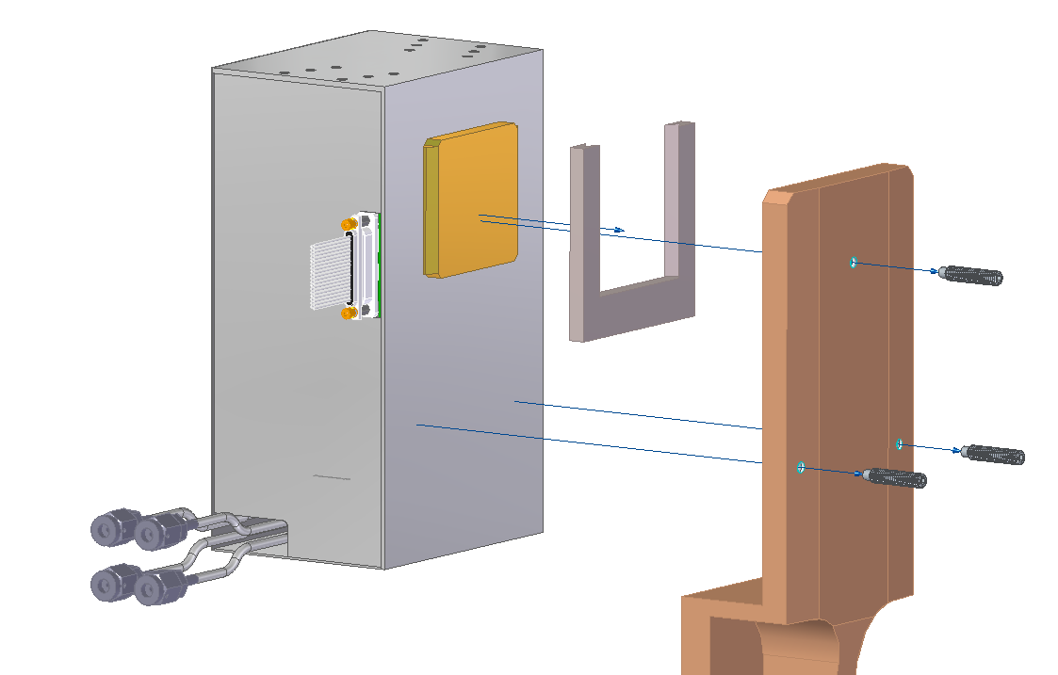
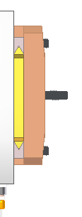
Low-thermal conductivity V-guides
Set screws
U-bracket attached to the theta-arm
V-guide detail
Kinematic mounting through set screw with 3 dof

Slide 28
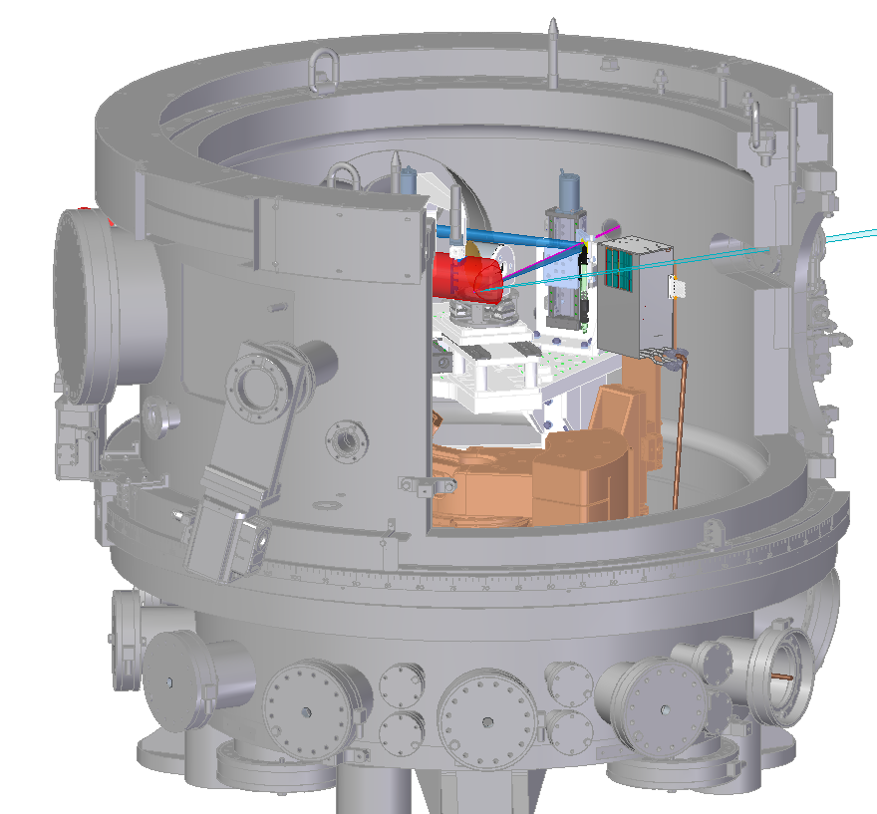
Integration with the RIXS instrument
Distance Camera-flanges ~ 1 m
Expected +500 mm slack for the On-OFF beam motion
Feedthrough 6” Flange - Cooling
Feedthrough 6” Flange - Cables

Slide 29
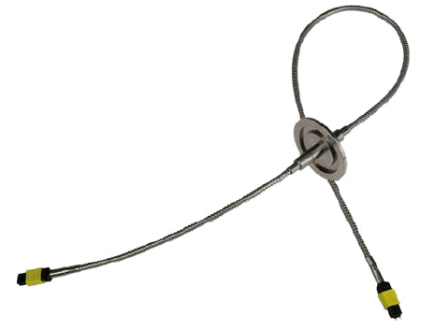
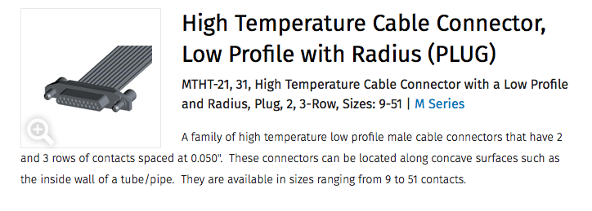
Power supply and fiber optic cable
Fiber optic ribbon hermetic feed-through (24 fiber MTP bundle)
Power supply cable 30 x 26 AWG wires with MTHT-212-037-161-415R AirBorn connector
About 0.5A per wire at 48V (3 meter length only 0.2V drop)
Minimum 3 isolated 48V supplies but up to 7 can be used for current split
High voltage bias power supply (-120V)

Slide 30
Vacuum testing
The required Vacuum outgassing rate threshold is 2e-8 (torr*L/s)
The active electronics (sensors, ASICs) and the cooling components are made of Silicon, Metal and SiCarbide which are low-outgassing. Cleaning and eventually bake-out of the parts will be part of the pre-assembly procedures
Most of the camera volume is filled by PCBs that are made of low-outgassing stratified polyamide. The final out-gassing rate will be tested with dummy PCBs of a representative volume in a vacuum chamber equipped with RGA
Connectors and cables are made of plastic based on the vendor catalogue. The outgassing properties of cable will be also tested and measured

Slide 31
Summary
  The Camera fits the assigned mechanical envelope. The amount of the required services is minimal and compatible with the existing flanges of the RIXS Vacuum chamber
  The cooling system proposed is based on active liquid cold plate with evaporative cooling, capable to span over RT to -40C with less than 2 deg thermal gradient across the sensor
  The performance are based on FEA and experience with similar detectors. Testing and development of a single unit will be required to tune the performance
  The assembly and maintenance procedures have been identified. The camera design has the modularity to replace single individual detector if required
  The max weight of the camera is 0.9 kg. Given the small amount of services and the low mass, the connection/disconnection and testing time is short and does not required special fixtures.

Slide 32
Backup slides

Slide 33
Charge : Technical Scope
  Does the mechanical design presented meet the physical requirements of the installation environment, including electrical and vacuum penetrations, cable and cooling management, and range of motion limitations?
  Is the cooling model well founded, and does it provide a means for assessing the thermal risk associated with operation at high (5kHz) rates?
  Given the limitations of the thermal model, is the design likely to operate effectively without compromising detector performance? Is sufficient testing identified to confirm successful operation in a vacuum environment?
  Are the assembly and disassembly procedures consistent with the needs to replace modules as needed? Have these procedures defined ad verified?
  Is physical complexity reasonably managed, and can the proposed design be successfully installed?
  Is detector serviceability addressed in an appropriate manner for a user facility like LCLS? Can he device be removed and repaired in a reasonable time should it be damaged or fail in use?

Slide 35
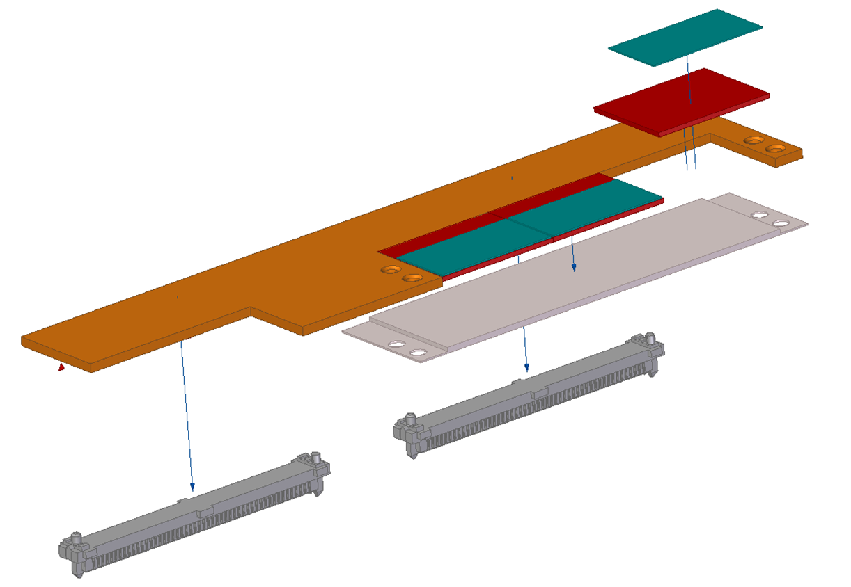
Sensor
ASIC
Kapton Carrier
SiC heat spreader
Liquid Cooling
Connector

Slide 36
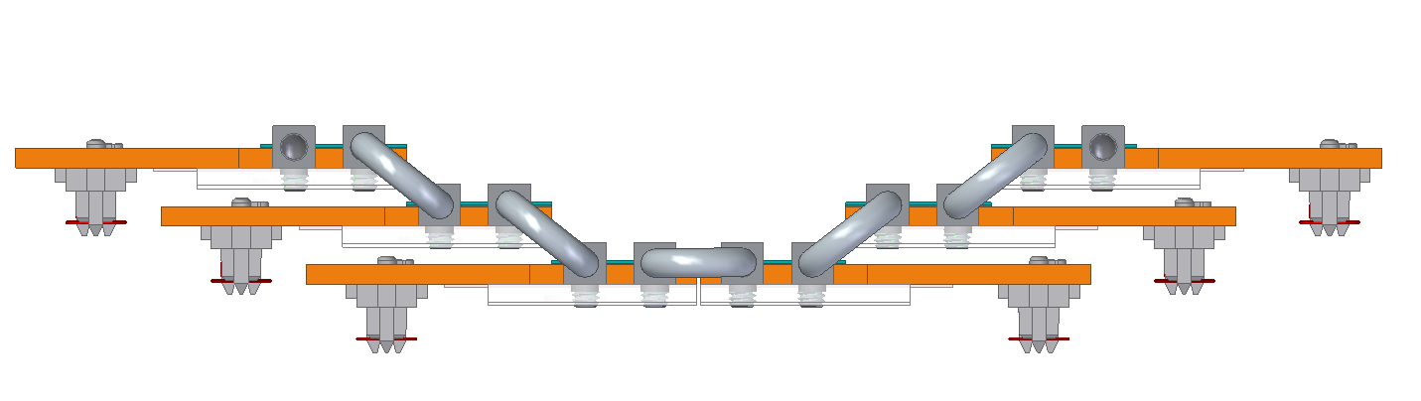

Slide 37
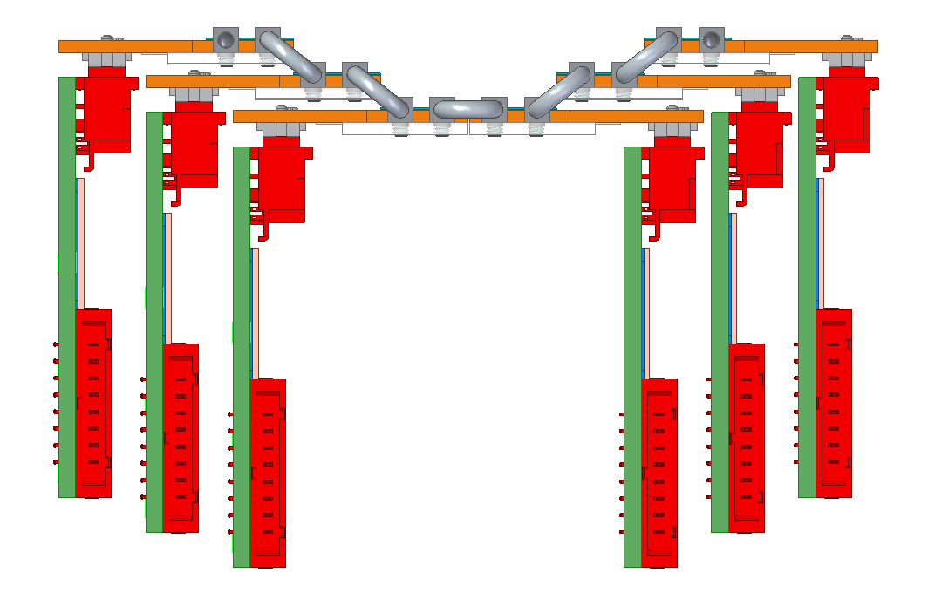

Slide 38
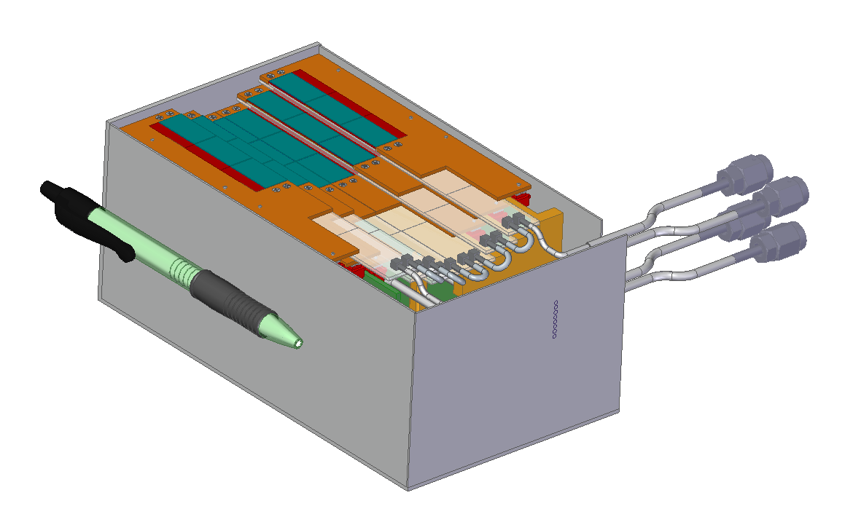

Slide 39
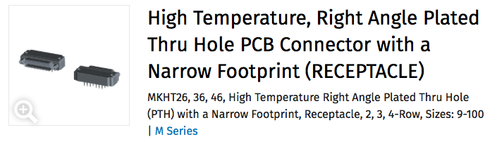
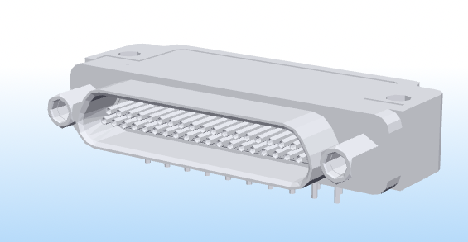
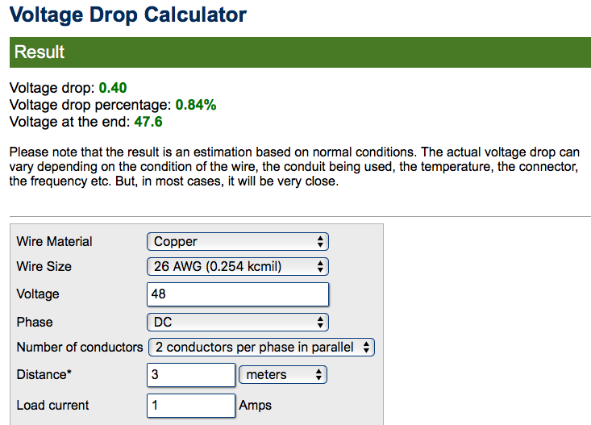
PCB mount and cable mount cables
MKHT-262-037-433-220S
MTHT-212-037-161-415R
Vin 48V
I/supply (2 wires) <1A
Wire thickness is 26AWG
Max length of 120” (3m)
Max drop per wire of 0.4V
Max 600V
I/contact 3A max
https://www.calculator.net/voltage-drop-calculator.html?material=copper&wiresize=133.9&voltage=48&phase=dc&noofconductor=2&distance=3&distanceunit=meters&amperes=1&x=71&y=20

Slide 40
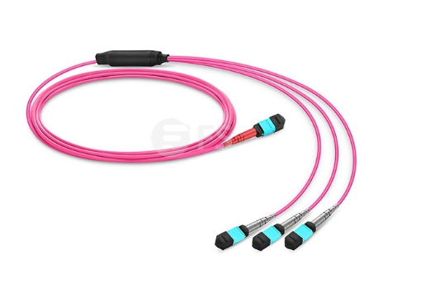
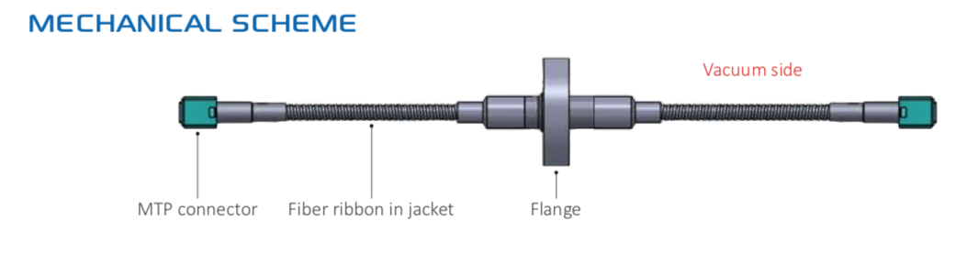
Fiber optics cable and vacuum feedthrough
https://www.fs.com/products/69995.html
RETA-RIB-CF40-12-050a-2-S48-11b
https://www.lasercomponents.com/fileadmin/user_upload/home/Datasheets/sedi/fibre-optic-ribbon-hermetic-feedthroughs.pdf

