Slide 1
Requirements will be traced from Science and Operations
CMB-S4 Science Req’s Doc (SRD)
Science requirements flow-down
Performance predictions by simulation
Resource Allocations (driven by system scientific throughput)
  Mechanical tolerances
  Optics specs
  Inter-exposure time
  Iteration
CMB-S4 Survey Req’s
Scientific Simulations
Inflation
Survey
Legacy Survey
CMB-S4 System Req’s
Operations Concept
Allocations-performance estimates (noise equiv. power, sidelobe, etc.), system analysis
Design Cycles
Baseline Design, Engineering Specifications
SAT Req’s
Det & Readout Req’s
LAT Req’s
Site Req’s
DM Req’s
DAQ Req’s
Cntr Req’s
Notes:
DESI configuration iterated using SE approach to develop Preliminary Design that meets science requirements

Slide 2
Interface Management and Verification
for CMB-S4

Slide 3
Interface management and control process helps manage across the broad collaboration
“System Engineering Management Plan” will describe processes for management of interfaces
Interface connectivity will been delineated for:
  Structural connection and mounts
  Thermal interfaces and heat transfer
  Logical command, telemetry, power, and protection
Interfaces between subsystem entities are being captured in block diagrams
Detailed interface agreements and deliverables are then managed by interface control documents (ICDs) and interface definition drawings (IDDs) between the subsystems
The level of maturity of the interface parallels that of the interfacing components; we identify 3 phases of interface maturity level to recognize this
  Phase 1: Define scope & responsibility at boundaries; interface features driving/being driven by the conceptual design
  Phase 2: interface details affecting component preliminary design and possibly costs
  Phase 3: final details to fully define all aspects of the interface

Slide 4
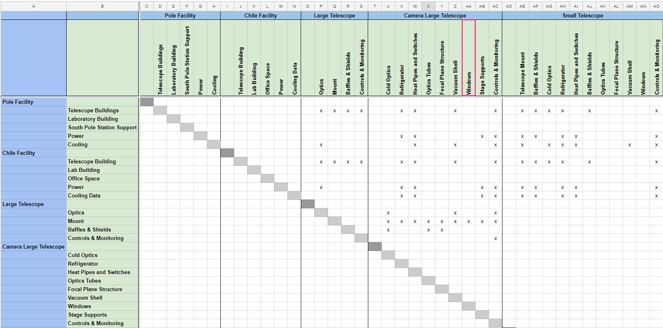
Defining Interfaces - N² Diagram
example

Slide 5
LSST & DESI Examples

Slide 6
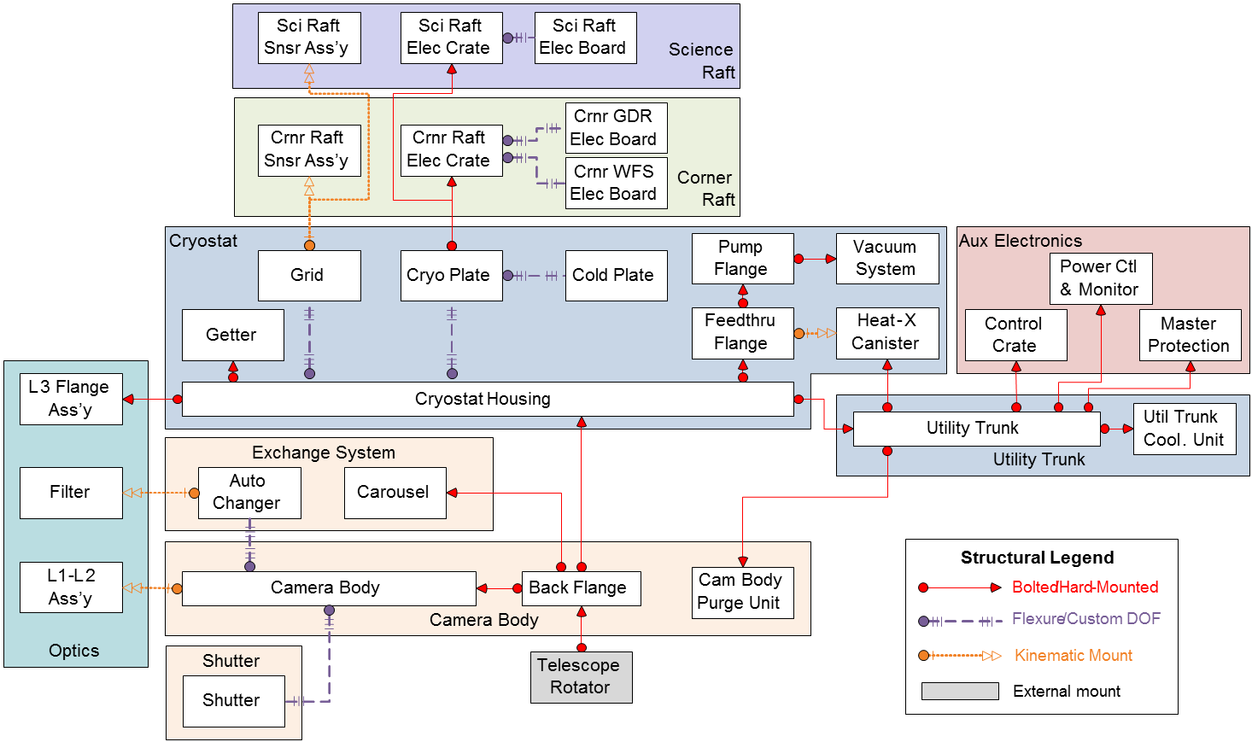
LSST Example: Camera Structural Block Diagram
Camera Structural Block Diagram

Slide 7
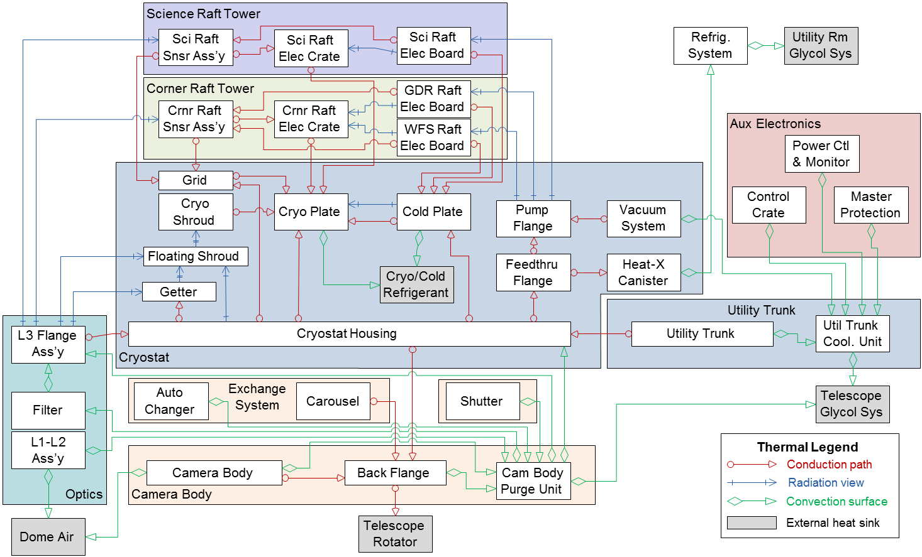
LSST Example: Camera Thermal Block Diagram
Camera Thermal Block Diagram

Slide 8
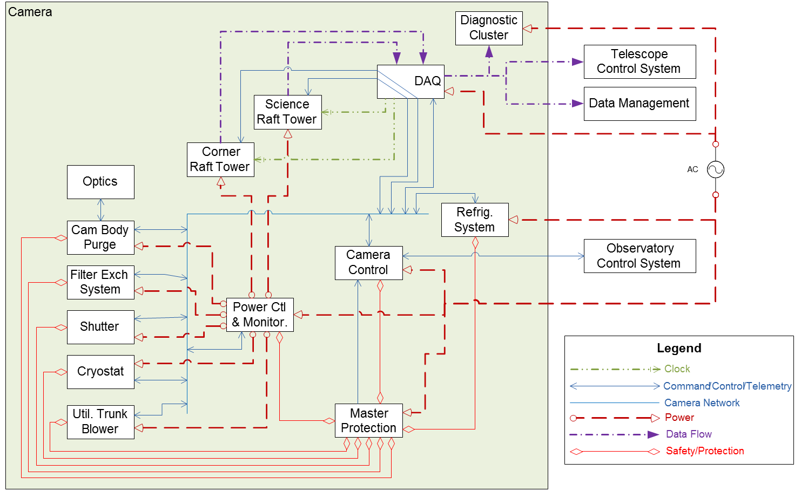
LSST Example: Camera Logical Block Diagram
Camera Logical Block Diagram

Slide 9
LSST Example: Interface control documents
CCS | Auxiliary Electronics |  |  | DAQ |  |  | Cryostat |  |  | CB&M |  | Sci Raft | Crnr Raft | Opt | I&T | WBS
Camera Control System | Electronics Infrastructure | Power Control & Monitoring | Master Protect. Module | CDS (Gnd Unit) | OTM (Optical Transition Module) | Cryostat | Utility Trunk | Refrig System (Gnd Unit) | Shutter | Camera Body | Filter Exch System | Science Raft Tower | Corner Raft Tower | Optics | Integration & Test | Entity | Entity Acronym
 | LCA-10839 <LCA-10771> |  |  | LCA-336 |  | LCA-10838 <LCA-10771> |  |  | LCA-230 | LCA-315 | LCA-231 | LCA-339 | LCA-340 |  | LCA-317 | Camera Control System | CCS
 |  |  |  | <LCA-10771> |  |  |  |  | <LCA-10771> | <LCA-10771> | <LCA-10771> | <LCA-10771> | <LCA-10771> |  | <LCA-10771>
 |  |  |  |  | LCA-10840 | LCA-10841 |  |  | LCA-10842 | LCA-10843 | LCA-10844 | LCA-10845 | LCA-10846 |  |  | Electronics Infrastructure | EI
 |  |  |  |  |  |  |  |  |  |  |  |  |  |  |  | Power Control & Monitoring | PCM
 |  |  |  |  |  |  |  |  |  |  |  |  |  |  |  | Master Protect. Module | MPM
 |  |  |  |  |  |  |  |  |  |  |  | LCA-335 | LCA-334 |  |  | CDS (Gnd Unit) | CDS
 |  |  |  |  |  |  |  |  |  |  |  | LCA-341 | LCA-341
 |  |  |  |  |  | LCA-332 |  |  |  |  |  |  |  |  |  | OTM | OTM
 |  |  |  |  |  |  |  |  |  | LCA-10847 (LCA-78) |  | LCA-151 (LCA-121) | LCA-311 (LCA-123) | LCA-310 (LCA-120) | LCA-10848
 |  |  |  |  |  |  |  |  |  |  |  |  |  |  |  | Cryostat | Cryo
 |  |  |  |  |  |  |  |  |  |  |  |  |  |  |  | Utility Trunk | UT
 |  |  |  |  |  |  |  |  |  |  |  |  |  |  |  | Refrig System (Gnd Unit) | Rfg
 |  |  |  |  |  |  |  |  |  | LCA-224 |  |  |  |  | LCA-289 | Shutter | Shtr
 |  |  |  |  |  |  |  |  |  | (LCA-73) |  |  |  |  | (LCA-10205)
 |  |  |  |  |  |  |  |  |  |  |  |  |  |  | (LCA-10206)
 |  |  |  |  |  |  |  |  |  |  | LCA-294
 |  |  |  |  |  |  |  |  |  |  | (LCA-72) |  |  | LCA-232 | LCA-284 | Camera Body | Body
 |  |  |  |  |  |  |  |  |  |  | (LCA-74) |  |  | (LCA-77)
 |  |  |  |  |  |  |  |  |  |  | (LCA-75)
 |  |  |  |  |  |  |  |  |  |  |  |  |  | LCA-338 | LCA-286 | Filter Exch System | Exch
 |  |  |  |  |  |  |  |  |  |  |  |  |  | (LCA-71) | (LCA-10204) |  | Exch
 |  |  |  |  |  |  |  |  |  |  |  |  |  |  | LCA-291 | Science Raft Tower | SRft
 |  |  |  |  |  |  |  |  |  |  |  |  |  |  | LCA-292 | Corner Raft Tower | CRft
 |  |  |  |  |  |  |  |  |  |  |  |  |  |  | LCA-287 | Optics | Opt
 |  |  |  |  |  |  |  |  |  |  |  |  |  |  |  | Integration & Test | I&T
Legend
LCA-12345 Interface Control Document (ICD)
<LCA-12345> Interface Support Document (ISD)
(LCA-12345) Interface Definition Drawing (IDD)

Slide 10
Camera system-level interface documents
Doc. # | Title | Latest Revision | Interface Description
LSE-18 | Camera Mechanical Definition Drawing | Released 14-May-2014 | Defines camera stayclear boundaries, interfaces to the telescope, and volumes/locations for camera lifts
LSE-64 | Camera-Telescope Utilities Interface | Released 22-Oct-2014 | Establishes utilities and utility lines provided by the telescope for camera use (power, refrig lines, glycol, air, …)
LSE-65 | Camera-Telescope Facilities Interface | Released 22-Oct-2014 | Establishes summit facility requirements to support camera servicing (room features, power, utilities, cranes, …)
LSE-66 | Guider Interface | Released 22-Oct-2014 | Defines requirements for camera guide sensor and read-out functionality to support telescope guiding needs
LSE-67 | Wavefront Sensor Interface | Released 25-Jul-2014 | Defines requirements for camera wavefront sensors to support telescope wavefront correction functions
LSE-68 | Camera Data Acquisition Interface | Released 22-Oct-2014 | Support document to LSE-69; delineates data flow, command, and telemetry interface details
LSE-69 | Camera DAQ-Data Management Interface | Released 22-Oct-2014 | Defines data flow interface between camera and Data Management
LSE-70 | OCS Communication Architecture | Released 12-May-2012 | Defines generic communication protocols
LSE-71 | Camera CCS-Observatory Control System Interface | Released 10-Oct-2014 | Defines command dictionary and protocols for OCS command of the camera
LSE-74 | System Dictionary | In work | Describes OCS systems and command and control standards
LSE-78 | Observatory Network | Released 1-Jan-2014 | Defines network connectivity for all systems
LSE-80 | Camera-Telescope Mechanical Interface | Released 14-May-2014 | Establishes mechanical, thermal, and access interfaces for the camera, and capabilities provided by the telescope
LSE-130 | Camera Data Items | In work for pre-FDR release | Lists data items to be delivered by the camera to support Data Management early data processing
LSE-164 | Utilities and Services Schematic | In work for pre-FDR release | Support schematics for LSE-64; delineates utilities routing, line, and connector details

Slide 11
Interface definitions developed with the system design, helped allocate responsibilities
Interfaces defined where subsystems meet
As designs have matured, interfaces iterated, refined, and documented in Interface Control Documents (ICDs)
Level of maturity of ICDs rated by Phase:
  Phase 1: At Preliminary Design maturity--scope, boundaries and responsibilities defined.
  Phase 2: Design-driven refinements to boundaries and responsibilities. Loads, flows, and functional requirements defined.
  Phase 3: At Final Design maturity--all details fully-documented. Subsystems can finalize their respective designs independently.
Note that interfaces within subsystems are managed by subsystem managers

Slide 12
Interfaces between subsystems managed at the project level. Interfaces within subsystems managed within the subsystem.
Populated cells indicate where an interface exists and shows type of interface and DESI document number of ICD.
ICDs tracked in DESI-0532

Slide 13
SE CD-1 Deliverables

Slide 14
SE, Path to CD-1
Response to Review Committee Questions
  Can you present list of your expected requirements/ICD document package for CD-1/PDR?
  Is there a rough development schedule for these documents?

Slide 15
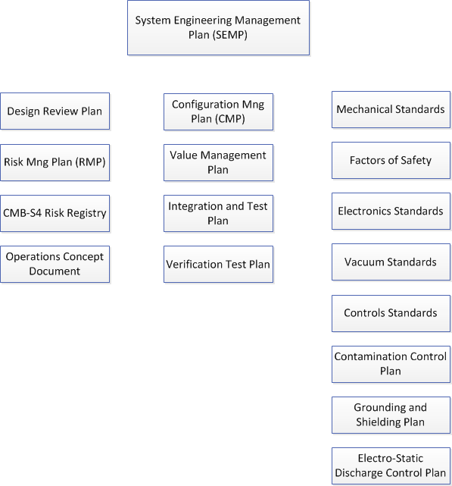
Complete, Release and Roll out Plans; Draft Standards
Draft Plan Discussion with L2 SE
Requirements management
Interface control
Draft
Draft
Technical Configuration Mng
Hold – coupled with PMCS & tools
Managing design development
Record
Draft created but approach driven by L2s and TBD
Value engineering
Risk management
Remaining drafts from LSST, DESI and Smithsonian. Need agreement on approach from SE Working Group
Verification planning
Standards & Plans
Standards have not started.
Standards have not started.

Slide 16
Requirement & Specification Timeline
CD-1, Conceptual Design: Q3FY21 (Apr-Jun)
Document | Initial Draft | Initial Review | System Function/ Requirement Review | Initial Release for CD-1 /NSF PDR
CMB-S4 Science Requirements Document | 2/2020 | 3/2020 | 8/2020 | 9/2020
CMB-S4 Survey Requirements (Inflation & Legacy) | 2/2020 | 3/2020 | 8/2020 | 9/2020
CMB-S4 System Requirements | 4/2020 | 5/2020 | 8/2020 | 9/2020
Operations Concept Document | 5/2020 | 7/2020 | 8/2020 | 9/2020

Slide 17
Requirement & Specification Timeline
Document | Initial Draft | Initial Review | CDR Review | Update for CD-1/ NSF PDR
SAT Req’s | 5/2020 | 6/2020 |  | 3/2021
LAT Req’s | 5/2020 | 6/2020 |  | 3/2021
Detector & Readout Req’s | 5/2020 | 6/2020 |  | 3/2021
DM Req’s | 5/2020 | 6/2020 |  | 3/2021
Site Req’s | 5/2020 | 6/2020 |  | 3/2021
DAQ Req’s | 5/2020 | 6/2020 |  | 3/2021
Controls Req’s | 5/2020 | 6/2020 |  | 3/2021

Slide 18
Defining Interfaces - N² Diagram
example

Slide 19
Thermal Block Diagram Example
Thermal Block Diagram

Slide 20
Interface Control Documents Timeline
Create Block Diagrams & Define N^2 Diagram
Complete ICD Phase 1 - define scope boundaries, interface features driving/being driven by the conceptual design
Document | Initial Draft By | Initial Review By | CDR Review Update & Release | Update & Release for CD-1/ NSF PDR
Block Diagrams | 2/2020 | 4/2020 |  | 3/2021
N^2 Diagram | 2/2020 | 4/2020 |  | 3/2021
Example List of ICD Documents
Utilities and Services ICD (SAT and Site) |  |  |  | 3/2021
Utilities and Services ICD (LAT and Site) |  |  |  | 3/2021
Utilities and Services ICD (Det&RO and Site) |  |  |  | 3/2021
Utilities and Services ICD (DMT and Site) |  |  |  | 3/2021
Utilities and Services ICD (DAQ and Site)
Utilities and Services ICD (Controls and Site)

Slide 21
Summary of SE Deliverables for CD-1
Plans
Requirements & Specification with status metrics
  Need science requirements and flowdown by early FY20 or sooner
  Work closely and support the Science Flowdown Coordinator
  Science Simulation support
Draft Operations Concept Document
  Use cases, storyboards and sequence diagrams
Draft of Standards
Technical budgets, analysis, margin
Interfaces
  Block Diagrams, N^2 diagram
  ICDs with status metrics
CDR section on SE & System Level Design
System level drawings
Hazard Identification and preliminary analysis

Slide 22
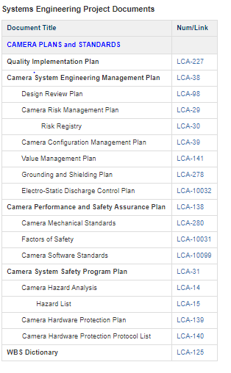
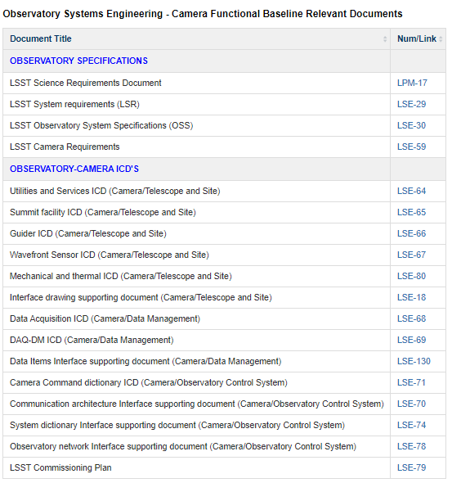
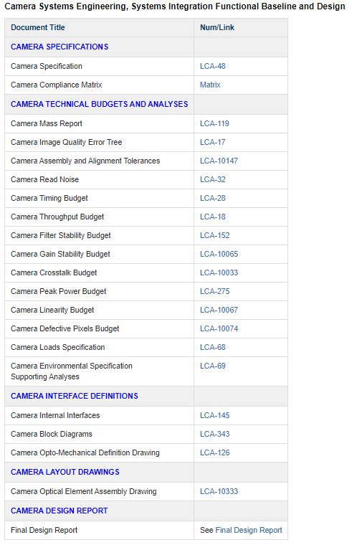
SE Deliverables from LSST CD-1

Slide 23
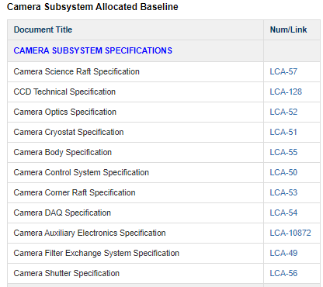
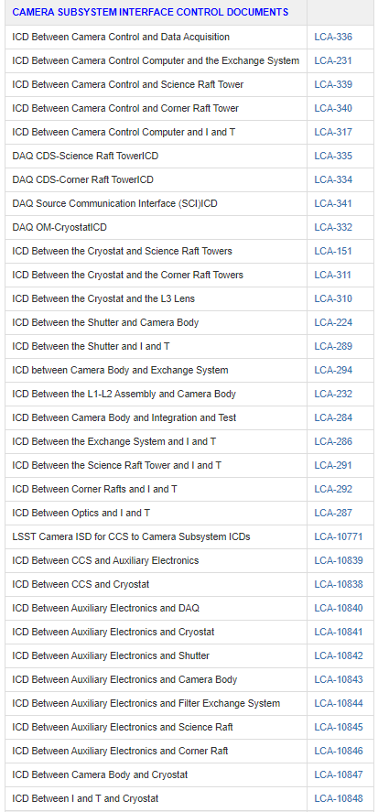
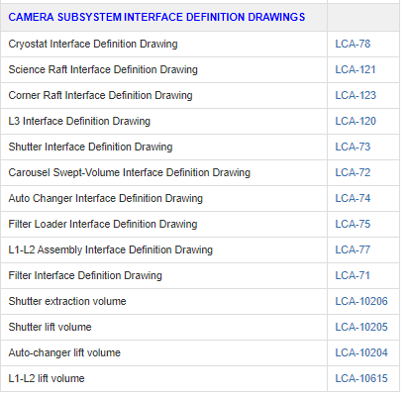
SE Deliverables from LSST CD-1

Slide 25
Requirements Management
CMB-S4 Science & Measurement Requirements Document (parent for all CMB-S4 requirements)
  Defines science & measurement goals and acceptable performance
CMB-S4 System Requirements (high level what CMB-S4 is and must do)
  Defines specific survey performance requirements
  Establishes high level functional requirements
CMB-S4 System Specification (high level how CMB-S4 will do what it must do)
  System Composition and Constraints
  Common System Functions & Performance
  Detailed System Specifications
    Telescopes
    Cameras
    Data
    Control
    Calibration
Component Specifications Documents (component-level how it will do what it must do)
Technical working groups to date have been working on deriving requirements for the reference design
Notes:
Science Requirements Document is the parent requirements flow down.
Defines a range (min, design, stretch goal) acceptable performance for the survey
Defines specific survey performance requirements
Establishes high level functional requirements
CMB-S4 System Specifications (CMB-S4 high level what it must)
System Composition and Constraints
Common System Functions & Performance
Detailed System Specifications
Science & Bulk Data
Optical System
System Throughput
Camera System
Photometric Calibration
System Timing and Dynamics

Slide 26
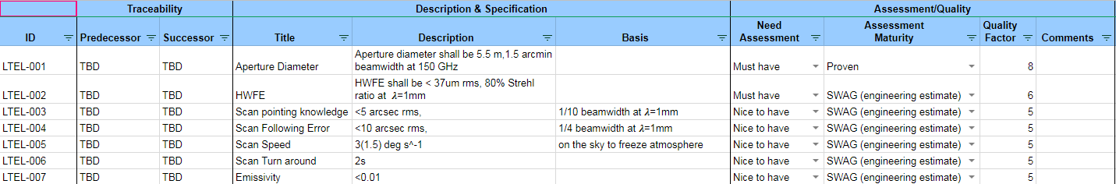
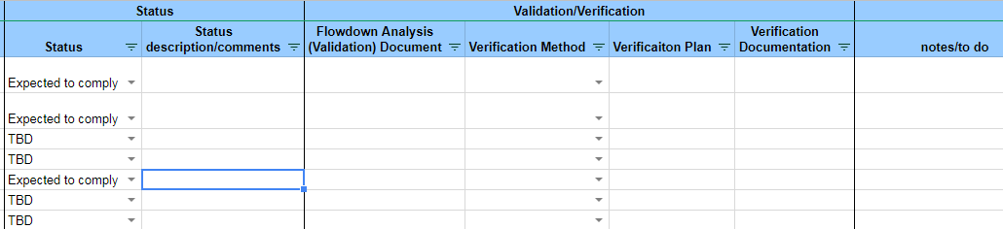
Example of Specification Sheet - Draft Methodology

Slide 27
Requirements Management
All requirements will be clearly defined in “CMB-S4 System Requirement”
  Each requirement has a unique ID and is checked for clarity and separability
  Separability, in particular, is important to ensure that clearly defined tests can be developed to verify the requirement
  Flow-down analysis and validation are also captured
In many cases, this flow-down analysis provides the starting point for defining test requirements and any pre-test analysis
  Verification methodology is identified for each requirement: design, analysis, inspection, demonstration, test
Beyond this, a discrete I&T test activity will be identified for each requirement
SE is starting to documenting and trace requirements
What should be the CD-1 goal for requirement/specifications?

