Slide 1
Fermi Users Group
FSSC News and GI Program Update
Chris Shrader, Fermi Science support Center, NASA/GSFC

Slide 2
FSSC Functional Overview
Archive and distribution of LAT, GBM science products
Maintenance and distribution of analysis SW
All areas of user support
GI program management
Operations support; scheduling & planning
Support of Fermi EPO

Slide 3
FSSC Status, Major Activities
FSSC Staffing
  Reduced science staff by 1 FTE
  Added 2 tech support FTEs
    Support for transition of DOE activity
User Support: Cycle 10 started in August
  Stage-II selections/awards finalized late July
  5 months after proposal deadline ➔ improvement over recent years by ~3 months
Cycle 11: Fermi ROSES text final by next month

Slide 4
FSSC Status, Major Activities
Scheduling and planning support nominal
  ToOs implemented in the last year for observations of six objects.
    Crab Nebula, novae, AGN, "mysterious" unnamed transient (2017-06-08)
    Done w/direct ToO orders & timeline re-plans.
  New sched/planning team member added

Slide 5
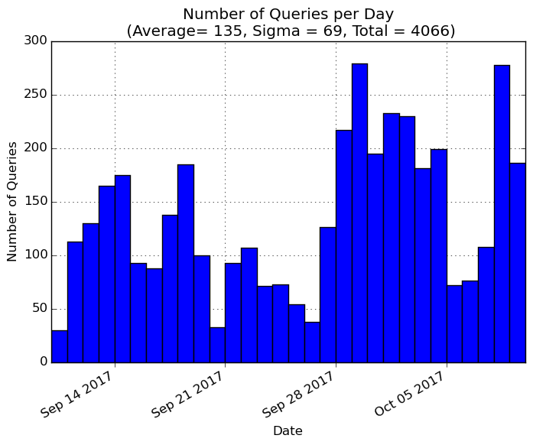
Archive Activity
Community interest continues at a robust level
FSSC has served ~37 TB of LAT photon data (not counting the weekly files)
Archive of reprocessed GBM daily TTE files started

Slide 6
Data Analysis, User Support
Science tools incremental release forthcoming in near future
  Newly supported systems include Mac OS Sierra, Ubuntu 16.04, and Ubuntu 16.10
  Upcoming release will be Science Tools version v11r5p3
FSSC help desk responds to 1 query per ~1.5 days.
Additional details in separate presentation

Slide 7
EPO Activities
RC continues to lead collaboration between Fermi scientists and art students at Maryland Institute College of Art.
  The most recent set of animations were about:
  merging black holes and gravitational waves, dark matter birth of a pulsar, X-ray mirrors
  Screening at GSFC on "Take your child to work day", well received by young people.
  Presented films at several venues, e.g. the "Escape Velocity" science fiction/science convention in DC.

Slide 8
EPO Activities
Web site "astroanimation.org" is about to go live, includes the animations and background information
FSSC also supports local EPO activities (“Explore NASA”, Science Jamboree,..) as well as at AAS winter meeting led by EF

Slide 9
Cycle 10 Summary
183 proposals received, 43 selected (2* Large, 1 $0)
  Flat response wrt Cy-8-9
    ~15% drop wrt peak, Cy-5-7
  23% approval rate, slight improvement wrt Cy 9
Funding levels:
  $2.7M for: $2.4M new awards after $0.32M Cy 8-9 obligations
  Average grant $57k
  Dollar over subscription, 4.5X

Slide 10
Cycle 10 Grants
FY17 awards issued and FY18 are being processed as we speak
Important point:
  Improvement in selection rate and ~7% increase in average grant were a result of decrease in obligations associated w/multi-year grants

Slide 11
Cycle 10 Proposal Statistics
Received:
---------------
183 proposals received (182 new), involving 493 individual investigators and 240 institutions
4 Large, 1 Progress Report
44% Data Analysis, 27% Theory, 23% Correlated Observations, 2% pointed observation requests
30% Extragalactic, 18% Pulsars, 16% GRBs,
12% diffuse/SNRs/stellar
$10.3M requested, $55k/yr average (excluding large)
$2.6M new funds (and 0.32$M obligation) dollar oversubscription is ~4.5X
Approved:
----------------
17 Data Analysis, 9 Theory, 15 Correlated Observations, 2 pointing requests
Joint Programs
(proposals/obs time) / quotas
Requested / Total Allocation
---------------------------------------------------------
NRAO: (18/752) / (450-600 hrs on GBT, VLA & VLBA)
NOAO: (4/214) / (3-5%,various telescopes)
VERITAS: (8/ ) / (120 hrs)
Arecibo: (1/45 ) / (300 hrs)
INTEGRAL: (0/0) / (300 ksec)
Approved
--------------------------------------------------------
NOAO (3 /204)
NRAO (5 /304)
Arecibo (0/0)
VERITAS (1/14)
INTEGRAL (0/0 )

Slide 12
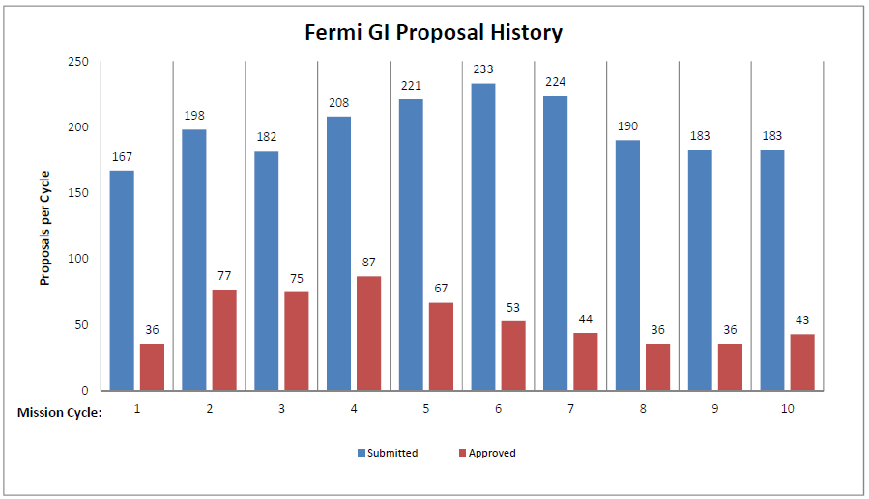
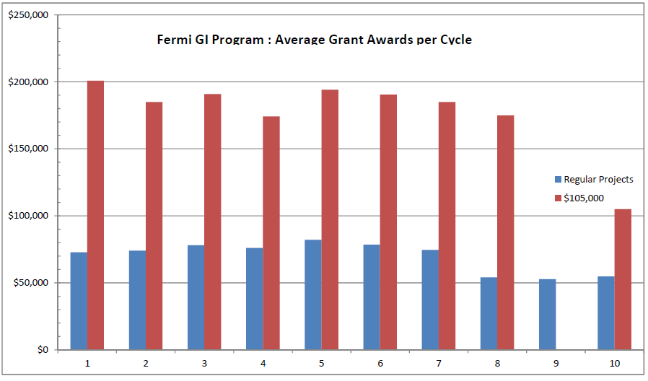
GI Program History

Slide 13
Joint Observation Programs
Status of Arecibo unclear for the near future
  No JP observations in Cycle 10, but could impact Cycle 11
GBT has so far continued despite split from NRAO, but uncertain for long term
INTEGRAL joint program has not proven beneficial
  ~1 request per year, 0 total selections
Some concern w/NOAO JP
  Backdoor for foreign proposers?

Slide 14
Peer Evaluation Committee Feedback
The benefit of Large Projects in the current era of diminishing and uncertain budgets was questioned by some panelists
  Recurring argument was that one approval costs the same as 9 regular projects
  Also, the predominance of multi-wave monitoring campaigns and the value of extending beyond 10 years
Recap, limit number of selections, eliminate or leave as is?

Slide 15
Cycle 11
Schedule: Feb. 23,2018 due date
  ~early May review, July stage-II awards
Budgeting tbd, hopefully program can continue to support 30-40 awards
No significant policy changes anticipated
  Unless FUG consensus on Large projects, other issues?

Slide 16
Extra Slides

