Slide 1
Boat Trip
Anglers Fishing Center
Get there at 5:45pm
Please bring $3-$5 for tip

Slide 2
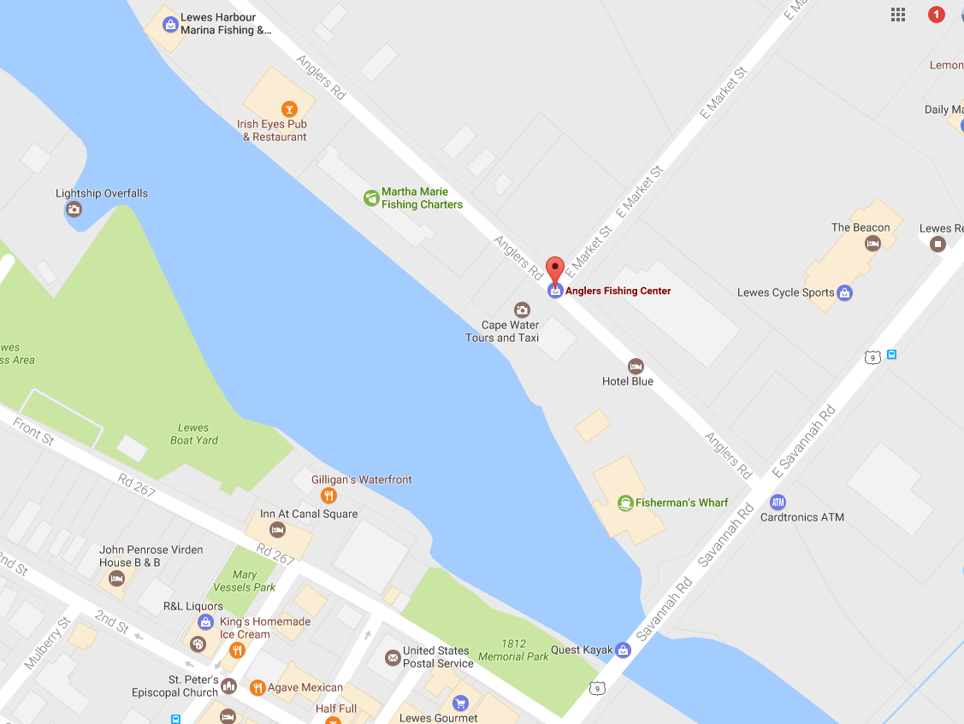

Slide 3
