Slide 1
On-line analysis tools
Elisabetta Cavazzuti
ASI and GSFC
Fermi Summer School 2017, Lewes

Slide 2
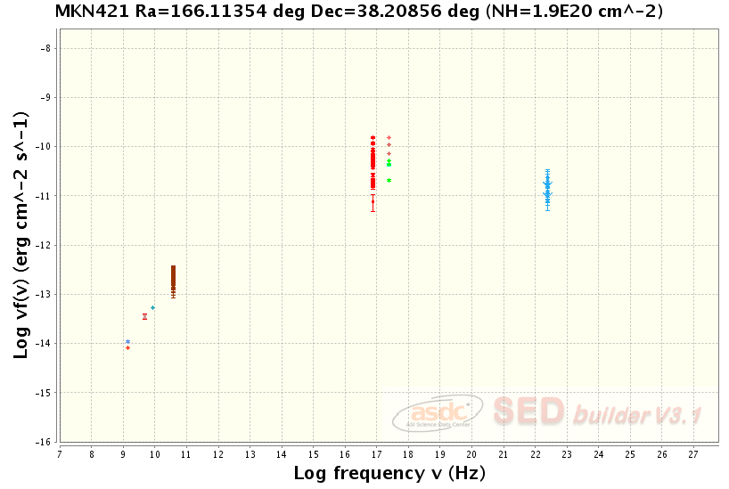
MRK 421, the SED in 1995

Slide 3
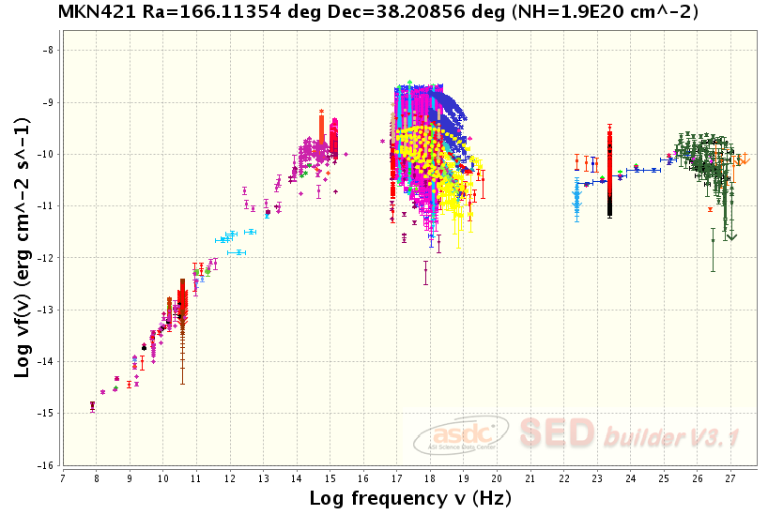
MRK 421, the SED today

Slide 4
MRK 421, the SED today
Radio and μ-wave
IR
Optical, UV, X-ray
Soft γ-ray
γ-ray
TeV

Slide 5
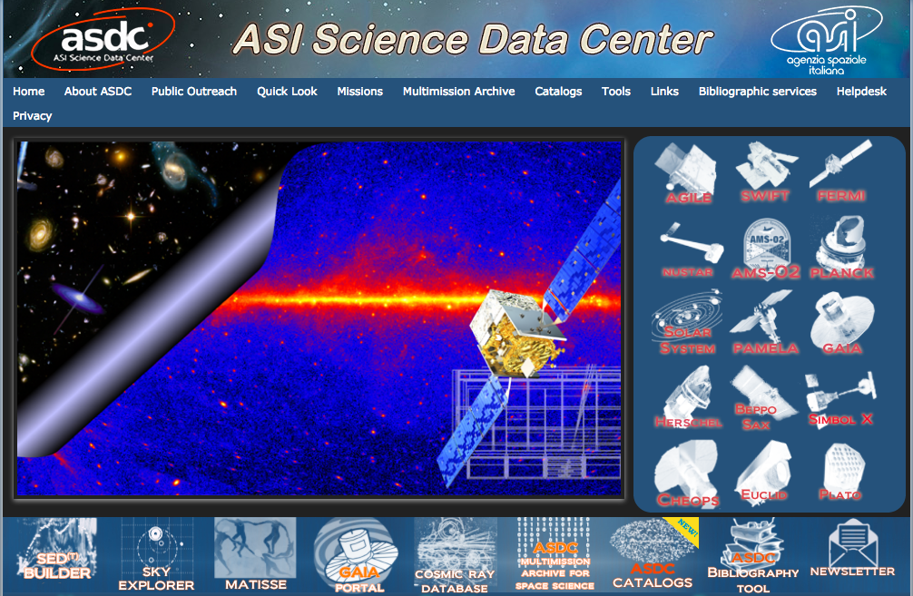
http://www.asdc.asi.it/

Slide 6
http://www.asdc.asi.it/

Slide 7
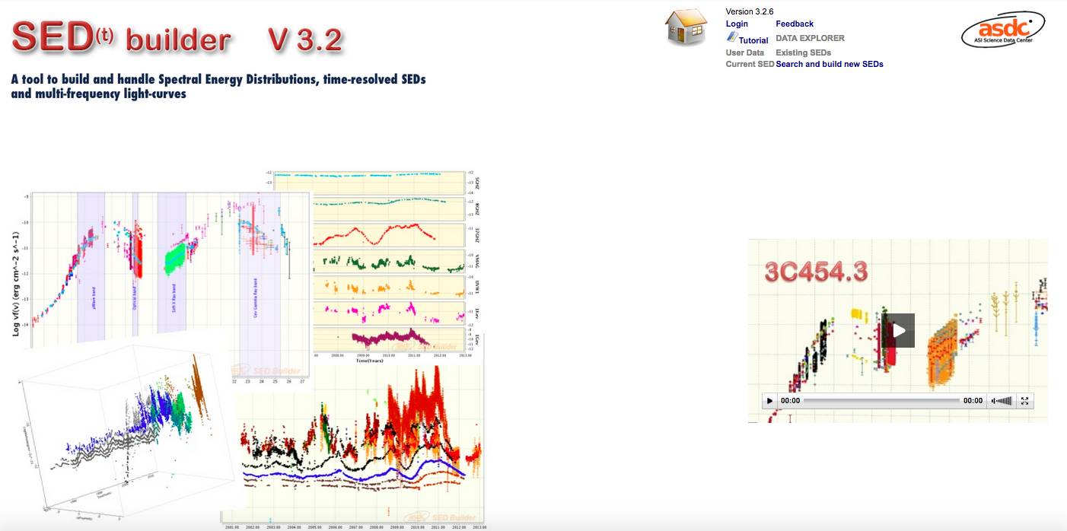
https://tools.asdc.asi.it/SED/

Slide 8
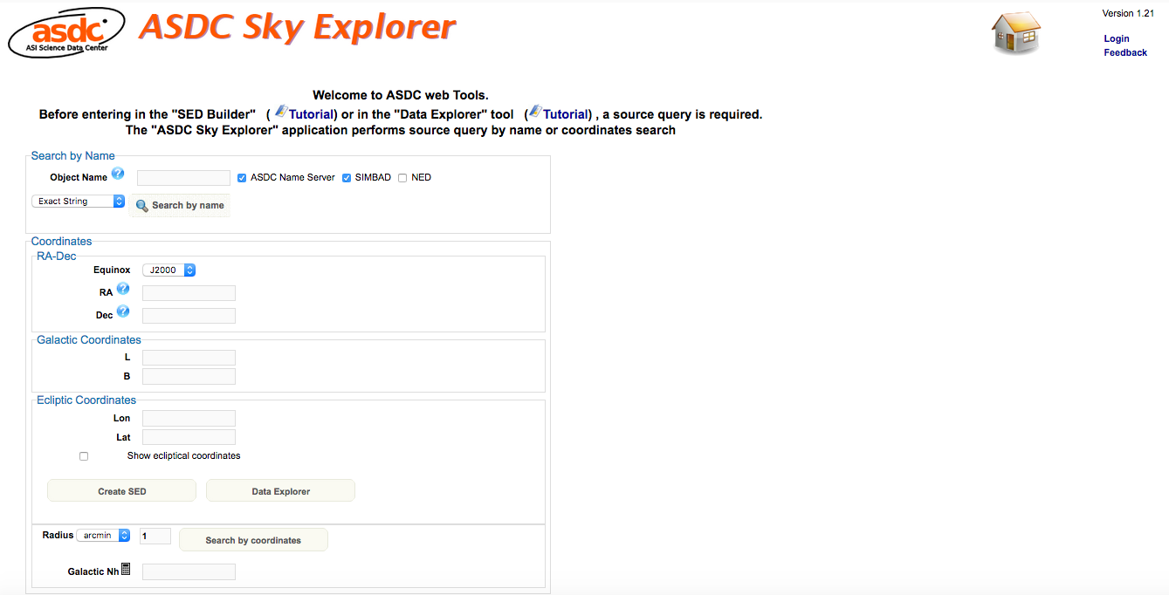
https://tools.asdc.asi.it/

Slide 9
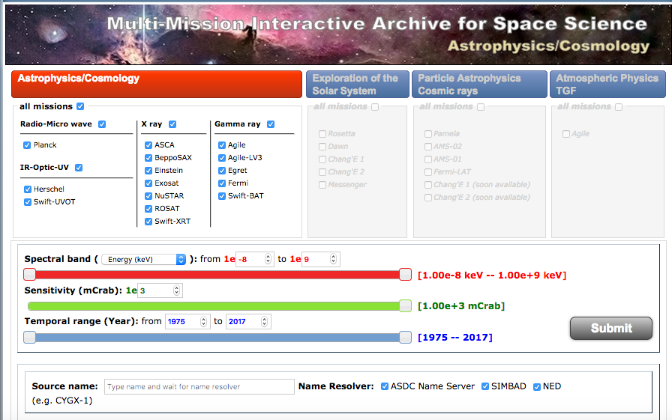
http://www.asdc.asi.it/mma.html

Slide 10
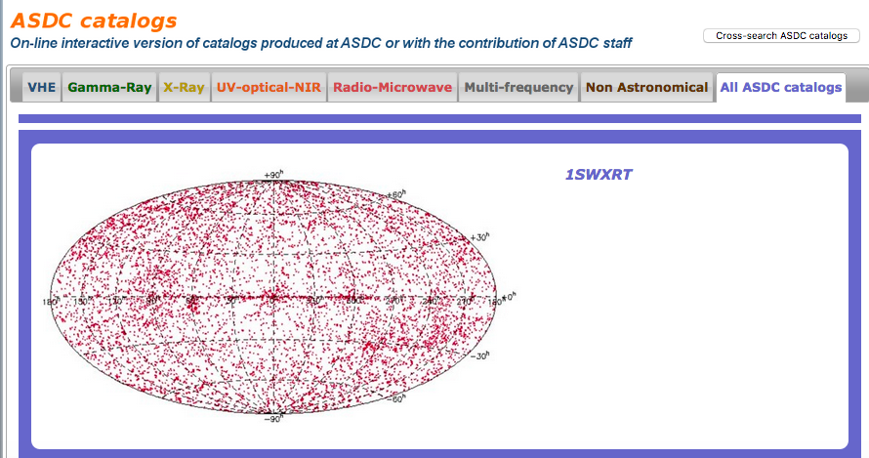
http://www.asdc.asi.it/ASDC_source_catalogs.html

Slide 11
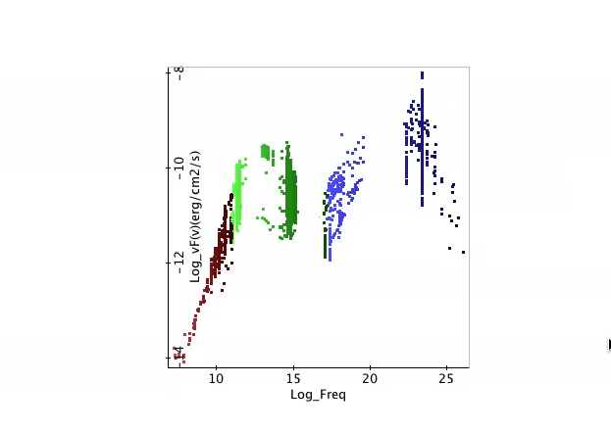
Multi: frequency, time, messenger

Slide 12
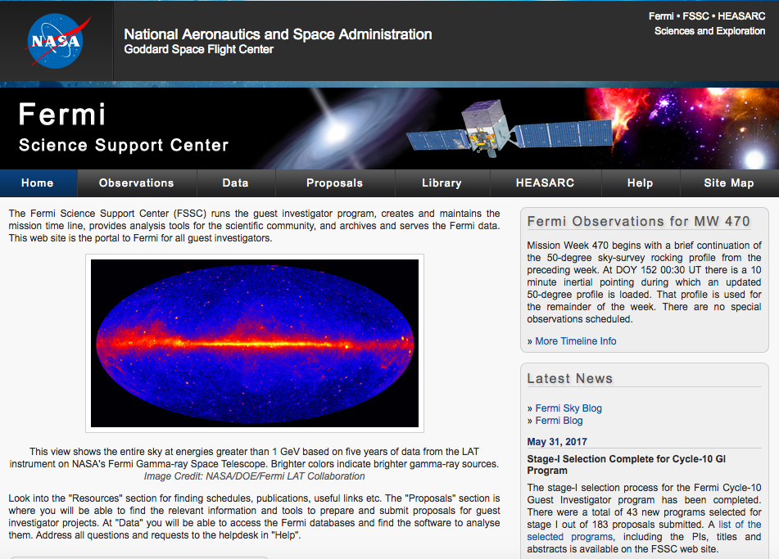
https://fermi.gsfc.nasa.gov/ssc/

Slide 13
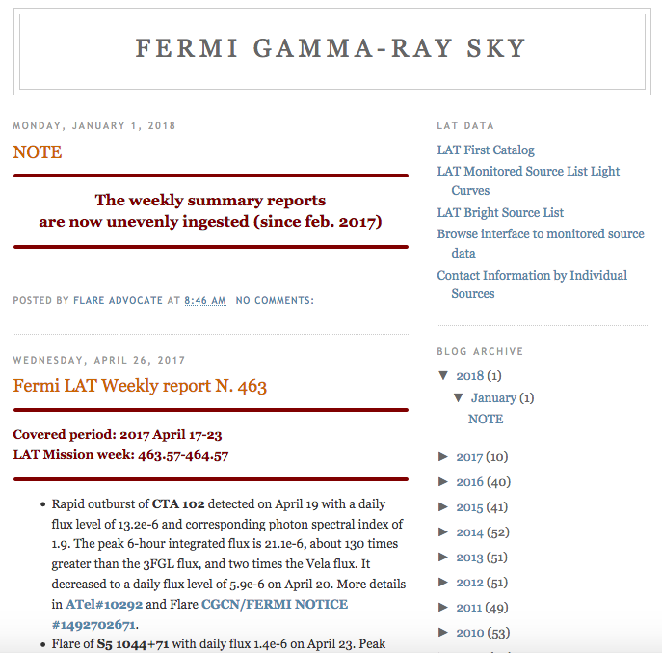
http://fermisky.blogspot.com/

Slide 14
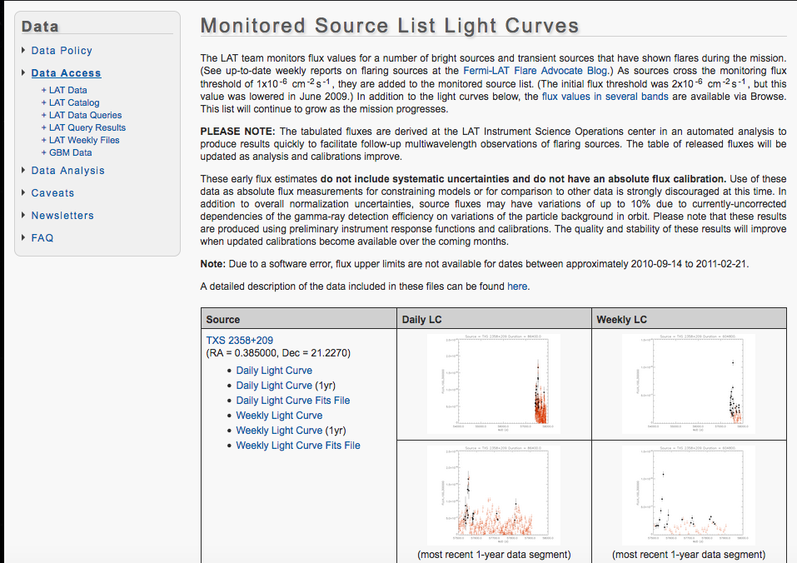
https://fermi.gsfc.nasa.gov/ssc/data/access/lat/msl_lc/

Slide 15
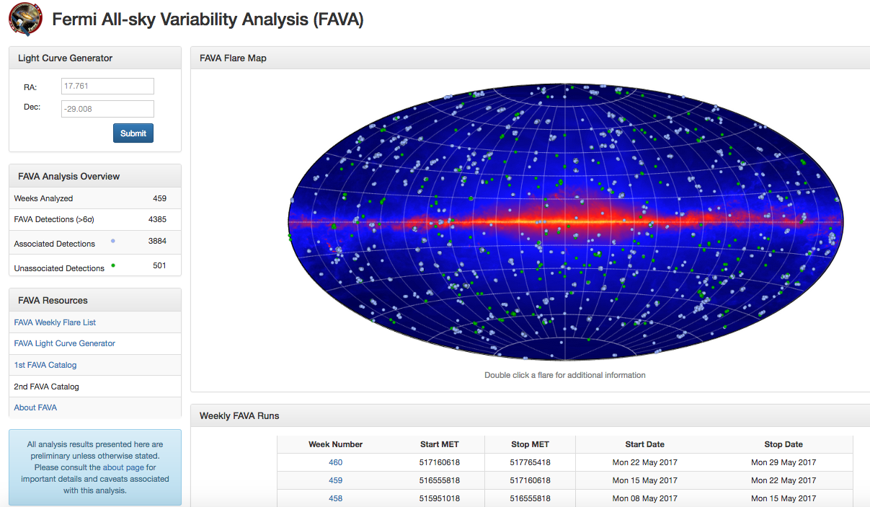
https://fermi.gsfc.nasa.gov/ssc/data/access/lat/FAVA/

