Slide 1
A short introduction of Fast Radio Bursts
Bing Li
libing@ihep.ac.cn
Collaborator：Y. F., Huang¹, L. M., Song², L. B., Li¹ , H. Yu¹
1,School of Astronomy and Space Science, Nanjing University (NJU)
2,Laboratory for Particle Astrophysics, Institute of High Energy Physics (IHEP)

Slide 2
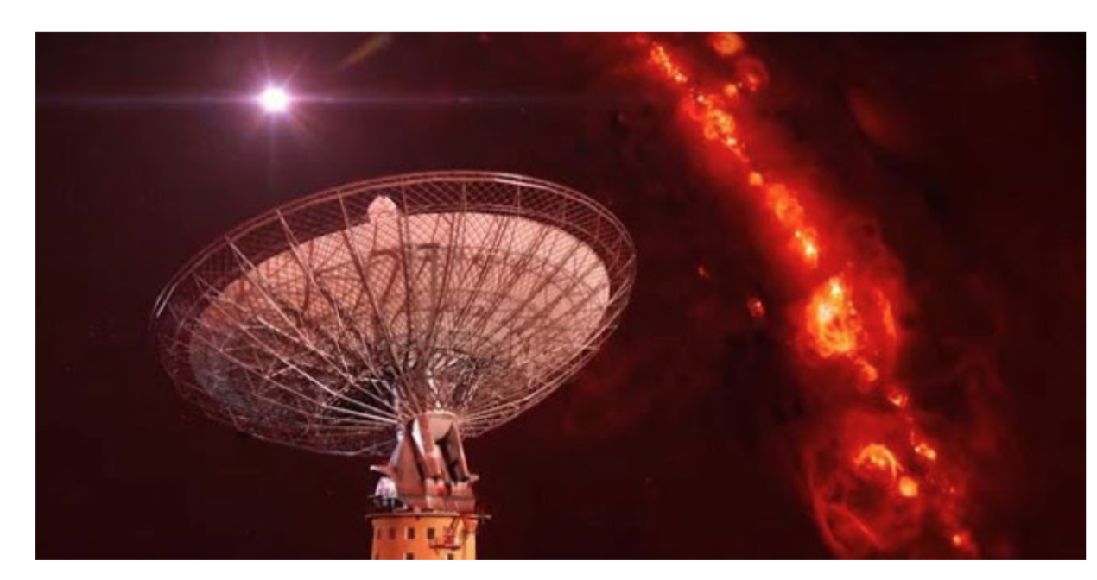
A mystery radio signal…
Spitler

Slide 3
What is observed?
• 17 bursts published (include FRB 121102-- 17 repetitions )
• Peak flux ~0.1—1.0 Jansky
• high galactic latitude ~|b| > 40°
• L-band ~1.4 GHz ( except FRB 110523 ～800MHz）
• Highly dispersed ~dispersion measure(DM) ,300 -- 1300 pc cm⁻³
• Pulse widths ~few millisecond durations
• Evidence for scattering
• Singular events?
• Different sky locations
• No counterparts so far

Slide 4
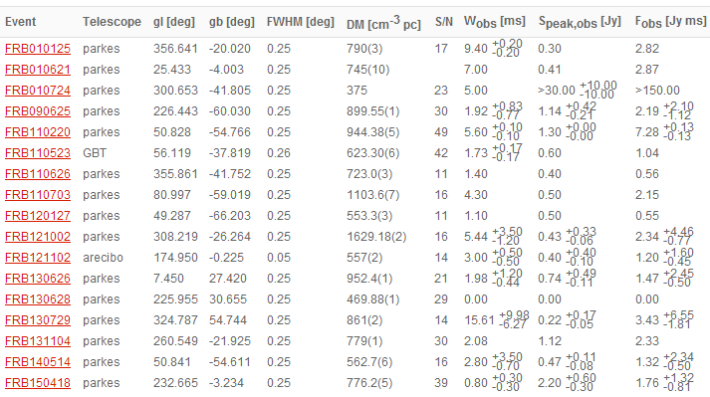
17 bursts now
Parkes Observatory ,
64-metre ,
in Australia
Arecibo Radio Telescope
350-metre
Green Bank Telescope/GBT,
~100-metre,
in USA
FAST Radio Telescope
500-metre，in China

Slide 5
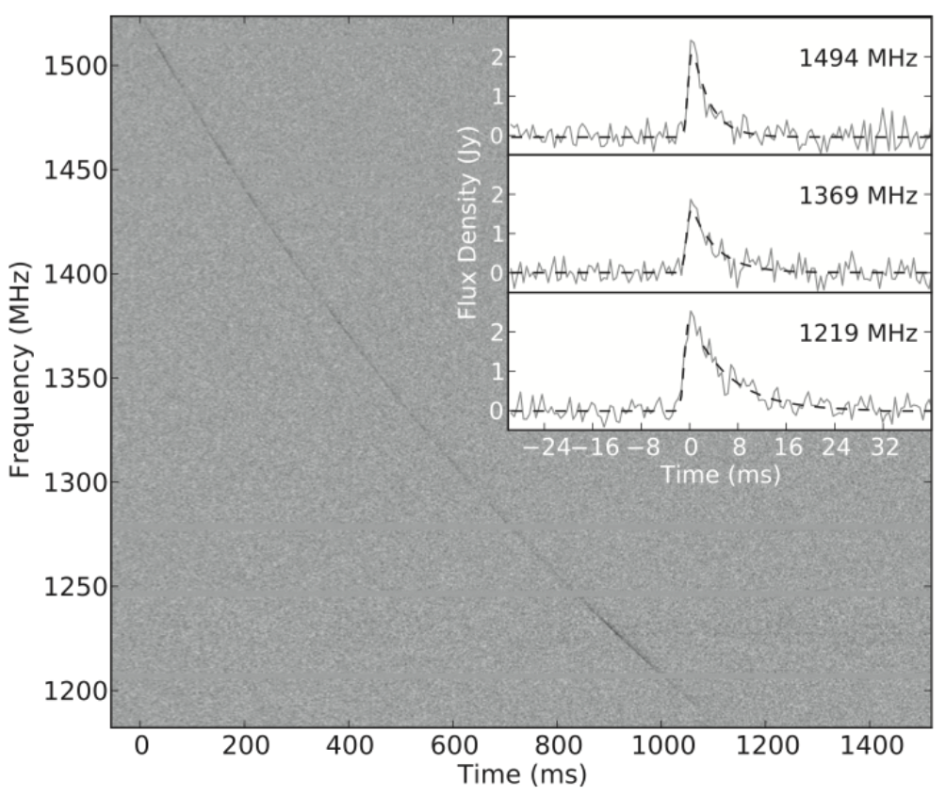
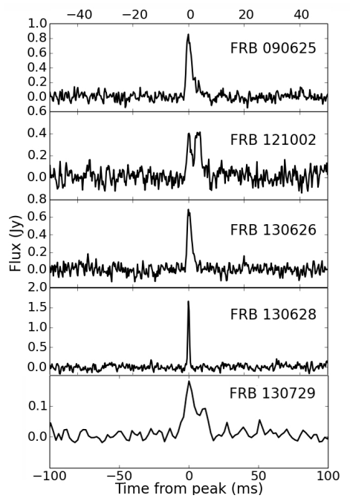
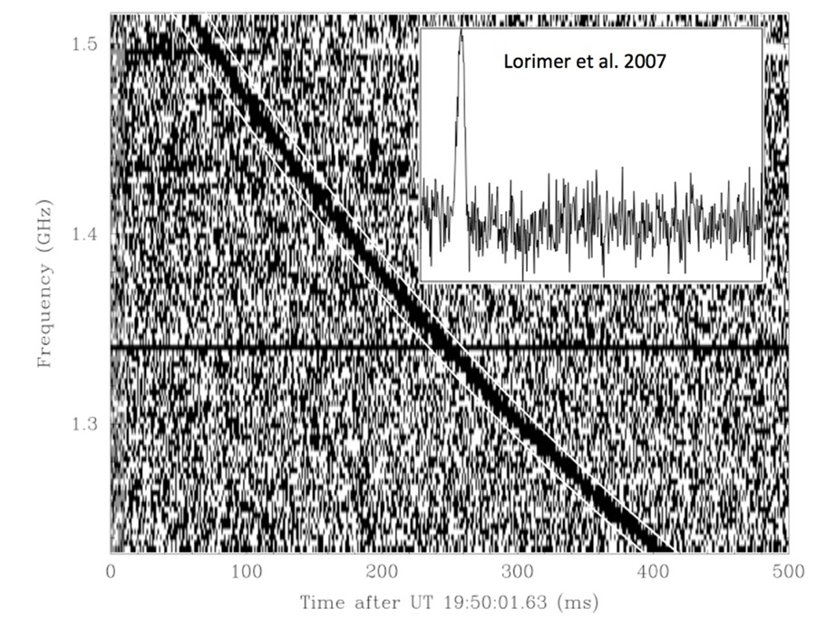
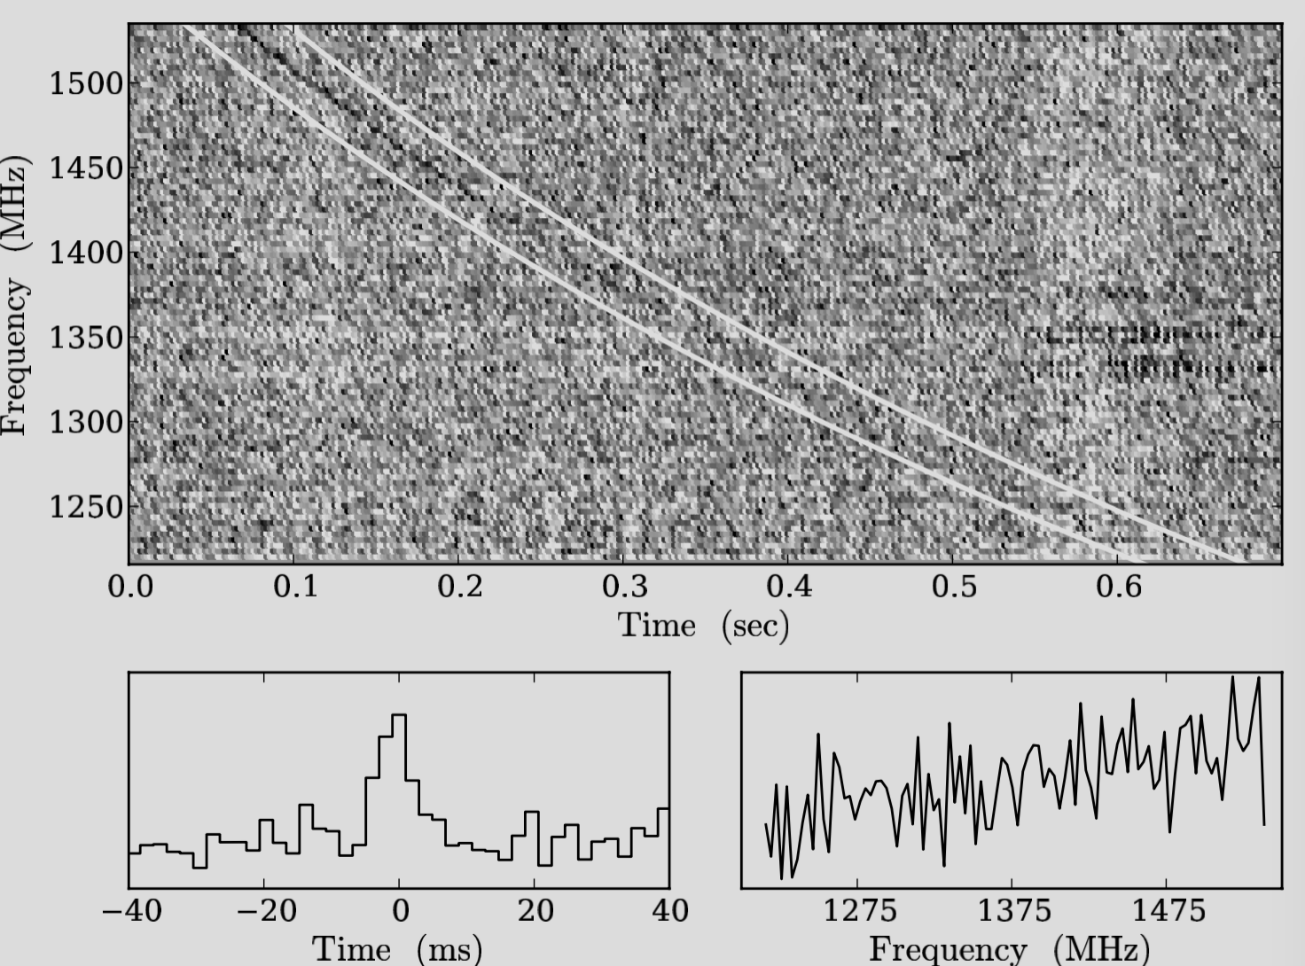
Thornton et al. 2013, Science
Brightness? Yes
Peak flux ~0.1—1.0 Jansky,
imply high isotropic equivalent energy release of ∼ 10³⁸ − 10⁴⁰ ergs and luminosity of 10⁴² − 10⁴³ erg s⁻¹
FRB 110220
Lorimer et al. 2006, Science
Spitler et al. 2014, ApJ, 790, 101
FRB 010724
FRB 121102
Champion et al.2015,MNRAS

Slide 6
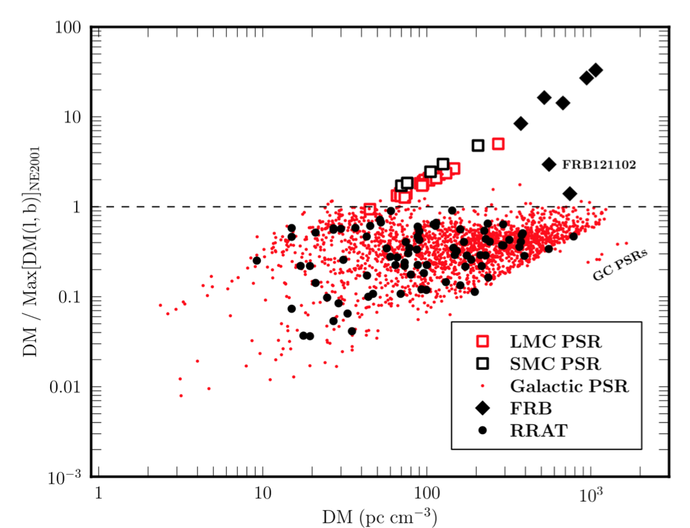
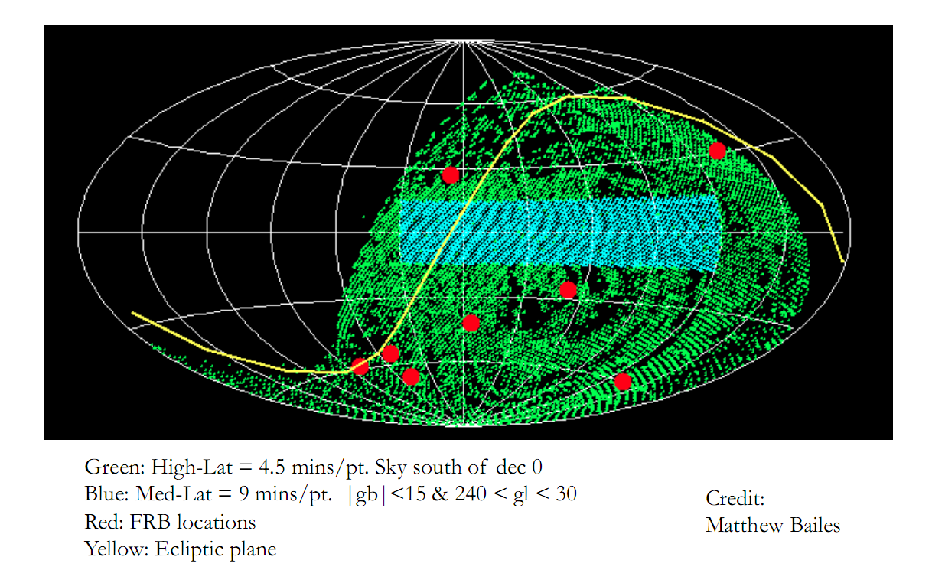
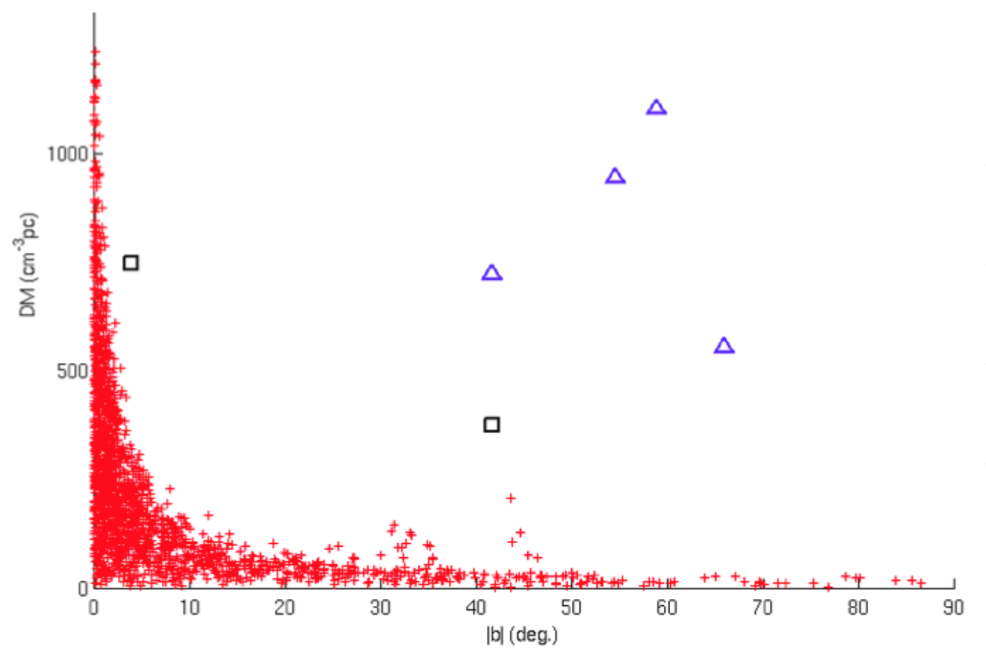
Extragalactic source ?
Possibilitiy,even cosmological
High galactic latitude ~|b| > 40°
High dispersion measure~300 - 1300 pc cm⁻³
Corresponding to redshifts in the range ~0.2 - 1
Champion et al.2015,MNRAS
Thornton D., Stappers B., et al.

Slide 7
Mechanism?
NS
• Collapsing neutron stars
• Coalescing neutron stars
• Binary NS mergers
……
BHs
• Evaporating black holes
• Kerr－Newman black holes
……
• Coalescing white dwarfs
• Magnetar giant flares
• Supernovae
• Giant pulses
• Cosmic strings
• Planetary companions around NSs...
Unknow!!!
We hope FAST can come out with a much larger sample!

Slide 8
No discussion
No conclusion
……
I am sorry .
Next time will be better and better.

Slide 9
Thanks for your attention !!!
Welcome to China!!!

