Slide 1
FLUKA Spoiler Study
T. Markiewicz
SLAC
2016-04-12 DASEL Meeting

Slide 2
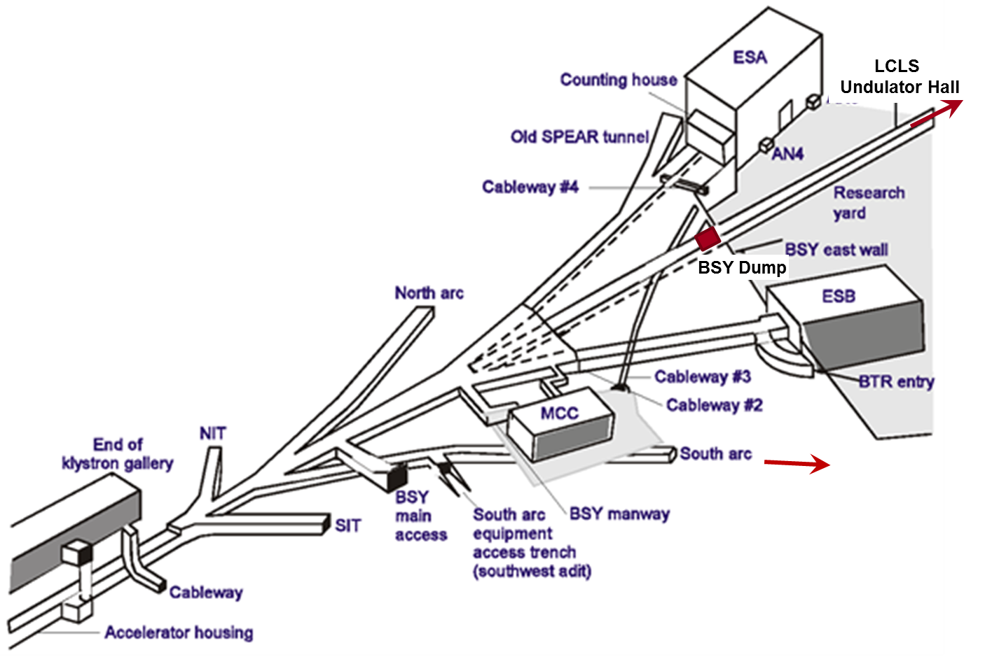
BSY Layout (2016-03-03;Nosochkov, Yuri)

Slide 3
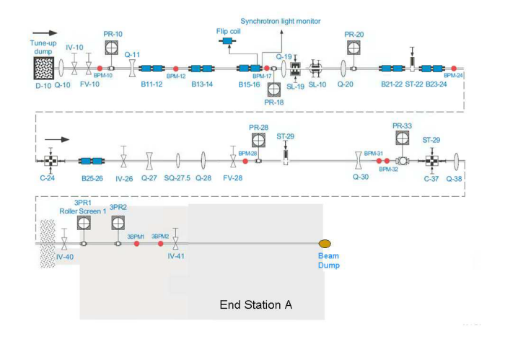
A-Line (2009 ESTB Proposal)

Slide 4
24 1°Bend and Collimator Locations
ID | AREA | KeyW | ELEMENT | L_EFF | ANGLE | APER | x | y | z | SUML | THETA | PHI | PSI | dL from SP1 | dL from IP
3300 | sc-A:e- | PROF | PR10 | 0 | 0.00E+00 | 0.00E+00 | 7.09E-01 | -6.34E-01 | 1.38E+02 | 7.50E+01 | 8.74E-03 | -4.54E-03 | 1.03E-02 | 0.000
3309 | sc-A:e- | SBEN | B11A | 1.512 | -1.74E-02 | 3.00E-02 | 7.76E-01 | -6.62E-01 | 1.44E+02 | 8.12E+01 | 2.62E-02 | -4.36E-03 | 1.04E-02 | Angle = 1 .0 degrees
3310 | sc-A:e- | SBEN | B11B | 1.512 | -1.74E-02 | 3.00E-02 | 8.29E-01 | -6.69E-01 | 1.46E+02 | 8.27E+01 | 4.36E-02 | -4.18E-03 | 1.05E-02 | C_B | 33.35641 | kG-m/GeV
3312 | sc-A:e- | SBEN | B12A | 1.512 | -1.74E-02 | 3.00E-02 | 9.42E-01 | -6.78E-01 | 1.48E+02 | 8.50E+01 | 6.11E-02 | -4.00E-03 | 1.06E-02 | E_beam | 4 | GeV
3313 | sc-A:e- | SBEN | B12B | 1.512 | -1.74E-02 | 3.00E-02 | 1.05E+00 | -6.84E-01 | 1.49E+02 | 8.65E+01 | 7.85E-02 | -3.81E-03 | 1.06E-02 | Rigidity | 133.4256 | kG-m
3319 | sc-A:e- | SBEN | B13A | 1.512 | -1.74E-02 | 3.00E-02 | 1.48E+00 | -7.04E-01 | 1.55E+02 | 9.19E+01 | 9.60E-02 | -3.62E-03 | 1.07E-02 | Angle | -1.74E-02 | radians
3320 | sc-A:e- | SBEN | B13B | 1.512 | -1.74E-02 | 3.00E-02 | 1.64E+00 | -7.09E-01 | 1.56E+02 | 9.34E+01 | 1.13E-01 | -3.44E-03 | 1.08E-02 | L_eff | 1.512 | m
3322 | sc-A:e- | SBEN | B14A | 1.512 | -1.74E-02 | 3.00E-02 | 1.91E+00 | -7.17E-01 | 1.59E+02 | 9.57E+01 | 1.31E-01 | -3.25E-03 | 1.08E-02 | B_poletip | -1.54E+00 | kG
3323 | sc-A:e- | SBEN | B14B | 1.512 | -1.74E-02 | 3.00E-02 | 2.12E+00 | -7.22E-01 | 1.60E+02 | 9.72E+01 | 1.48E-01 | -3.06E-03 | 1.09E-02
3327 | sc-A:e- | SBEN | B15A | 1.512 | -1.74E-02 | 3.00E-02 | 2.93E+00 | -7.38E-01 | 1.65E+02 | 1.03E+02 | 1.66E-01 | -2.87E-03 | 1.09E-02
3328 | sc-A:e- | SBEN | B15B | 1.512 | -1.74E-02 | 3.00E-02 | 3.19E+00 | -7.42E-01 | 1.67E+02 | 1.04E+02 | 1.83E-01 | -2.68E-03 | 1.10E-02
3330 | sc-A:e- | SBEN | B16A | 1.512 | -1.74E-02 | 3.00E-02 | 3.62E+00 | -7.48E-01 | 1.69E+02 | 1.06E+02 | 2.01E-01 | -2.49E-03 | 1.10E-02
3331 | sc-A:e- | SBEN | B16B | 1.512 | -1.74E-02 | 3.00E-02 | 3.93E+00 | -7.52E-01 | 1.71E+02 | 1.08E+02 | 2.18E-01 | -2.29E-03 | 1.11E-02
3348 | sc-A:e- | RCOL | SL19 | 0 | 0.00E+00 | 0.00E+00 | 8.06E+00 | -7.96E-01 | 1.89E+02 | 1.27E+02 | 2.18E-01 | -2.29E-03 | 1.11E-02
3350 | sc-A:e- | RCOL | SL10 | 0 | 0.00E+00 | 0.00E+00 | 8.49E+00 | -8.00E-01 | 1.91E+02 | 1.29E+02 | 2.18E-01 | -2.29E-03 | 1.11E-02 | 53.883
3359 | sc-A:e- | SBEN | B21A | 1.512 | -1.74E-02 | 3.00E-02 | 1.17E+01 | -8.34E-01 | 2.05E+02 | 1.43E+02 | 2.36E-01 | -2.10E-03 | 1.11E-02
3360 | sc-A:e- | SBEN | B21B | 1.512 | -1.74E-02 | 3.00E-02 | 1.20E+01 | -8.37E-01 | 2.07E+02 | 1.45E+02 | 2.53E-01 | -1.91E-03 | 1.11E-02
3362 | sc-A:e- | SBEN | B22A | 1.512 | -1.74E-02 | 3.00E-02 | 1.26E+01 | -8.41E-01 | 2.09E+02 | 1.47E+02 | 2.70E-01 | -1.71E-03 | 1.12E-02
3363 | sc-A:e- | SBEN | B22B | 1.512 | -1.74E-02 | 3.00E-02 | 1.30E+01 | -8.43E-01 | 2.11E+02 | 1.49E+02 | 2.88E-01 | -1.52E-03 | 1.12E-02
3367 | sc-A:e- | SBEN | B23A | 1.512 | -1.74E-02 | 3.00E-02 | 1.46E+01 | -8.51E-01 | 2.16E+02 | 1.54E+02 | 3.05E-01 | -1.32E-03 | 1.12E-02
3368 | sc-A:e- | SBEN | B23B | 1.512 | -1.74E-02 | 3.00E-02 | 1.50E+01 | -8.53E-01 | 2.17E+02 | 1.56E+02 | 3.23E-01 | -1.12E-03 | 1.12E-02
3370 | sc-A:e- | SBEN | B24A | 1.512 | -1.74E-02 | 3.00E-02 | 1.58E+01 | -8.55E-01 | 2.19E+02 | 1.58E+02 | 3.40E-01 | -9.28E-04 | 1.13E-02
3371 | sc-A:e- | SBEN | B24B | 1.512 | -1.74E-02 | 3.00E-02 | 1.63E+01 | -8.57E-01 | 2.21E+02 | 1.59E+02 | 3.58E-01 | -7.31E-04 | 1.13E-02
3379 | sc-A:e- | RCOL | C24 | 0 | 0.00E+00 | 0.00E+00 | 1.73E+01 | -8.59E-01 | 2.23E+02 | 1.62E+02 | 3.58E-01 | -7.31E-04 | 1.13E-02 | 87.427
3381 | sc-A:e- | SBEN | B25A | 1.512 | -1.74E-02 | 3.00E-02 | 1.82E+01 | -8.60E-01 | 2.26E+02 | 1.65E+02 | 3.75E-01 | -5.34E-04 | 1.13E-02
3382 | sc-A:e- | SBEN | B25B | 1.512 | -1.74E-02 | 3.00E-02 | 1.87E+01 | -8.61E-01 | 2.27E+02 | 1.66E+02 | 3.93E-01 | -3.37E-04 | 1.13E-02
3384 | sc-A:e- | SBEN | B26A | 1.512 | -1.74E-02 | 3.00E-02 | 1.96E+01 | -8.62E-01 | 2.29E+02 | 1.69E+02 | 4.10E-01 | -1.40E-04 | 1.13E-02
3385 | sc-A:e- | SBEN | B26B | 1.512 | -1.74E-02 | 3.00E-02 | 2.02E+01 | -8.62E-01 | 2.31E+02 | 1.70E+02 | 4.27E-01 | 5.70E-05 | 1.13E-02
3433 | sc-A:e- | RCOL | C37 | 0 | 0.00E+00 | 0.00E+00 | 4.91E+01 | -8.58E-01 | 2.94E+02 | 2.40E+02 | 4.27E-01 | 5.70E-05 | 1.13E-02 | 164.795
3438 | sc-A:e- | MARK | WALL | 0 | 0.00E+00 | 0.00E+00 | 5.27E+01 | -8.57E-01 | 3.02E+02 | 2.49E+02 | 4.27E-01 | 5.70E-05 | 1.13E-02
5m Al
?cm W
?cm Cu

Slide 5
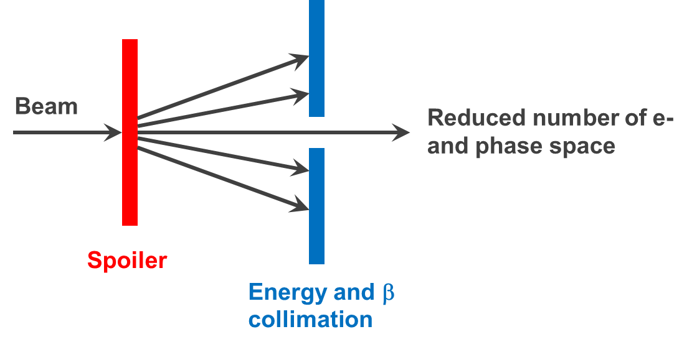
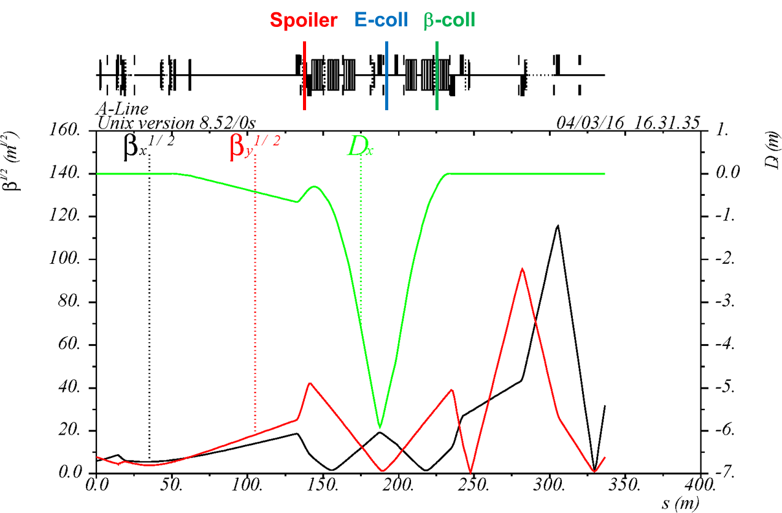
A-Line Spoiler and SLIT Optics
Y. Nosochkov (2016-03-04)

Slide 6
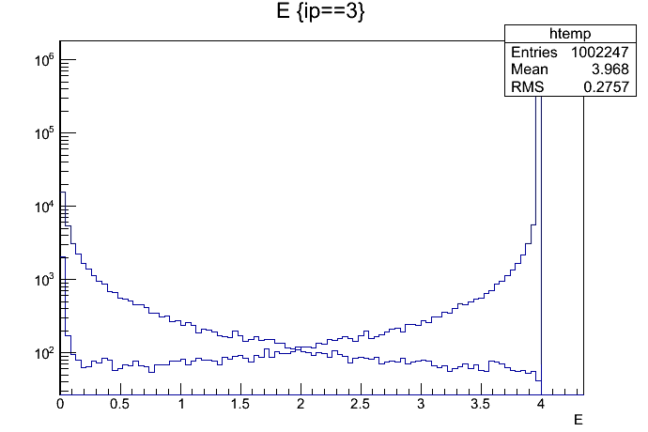
FLUKA: 4 GeV e- on 500um Al PR10
Electrons
Photons

Slide 7
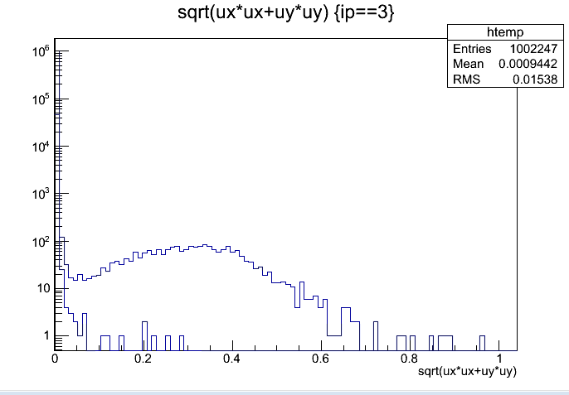
FLUKA: 4 GeV e- on 500um Al PR10
Electrons
Photons

Slide 8
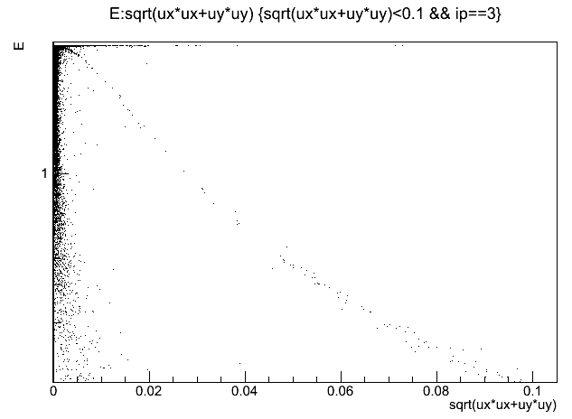
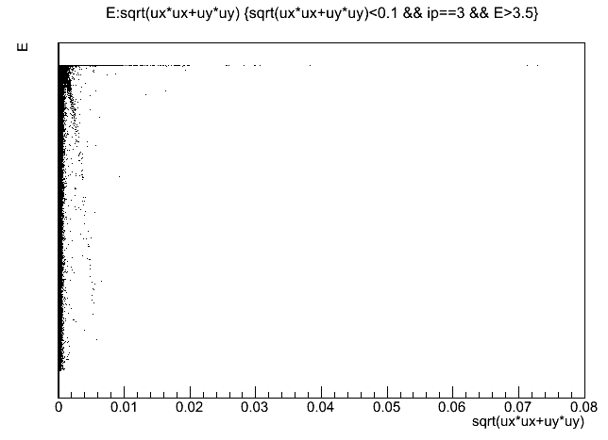
E vs. sin(theta)
All Electrons
Electrons > 3.5 GeV

Slide 9
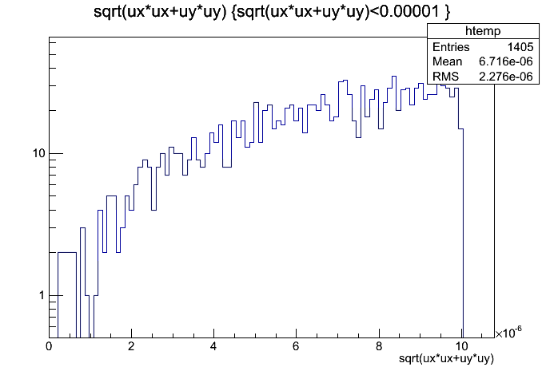
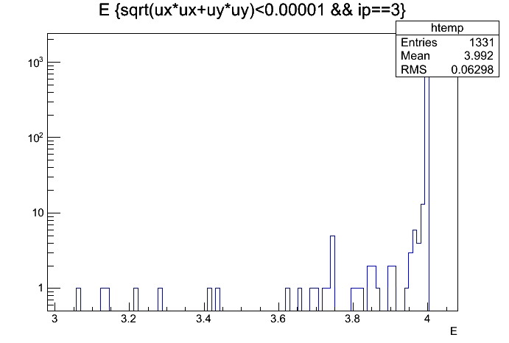
SL-10
Set slit to ±0.5mm in x and y at 54-59m
  In next iteration, slit will be in x only (my bad)
For the moment no bends
  Theta = ±8.5urad
  1.5E-3 of the energy makes it through slit

Slide 10
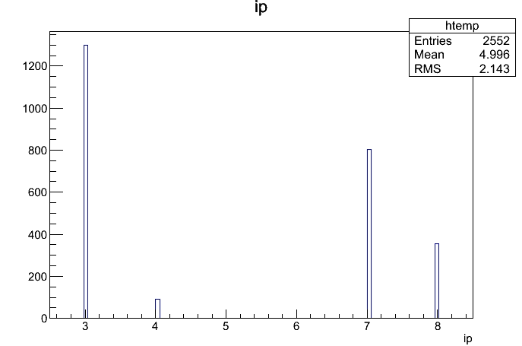
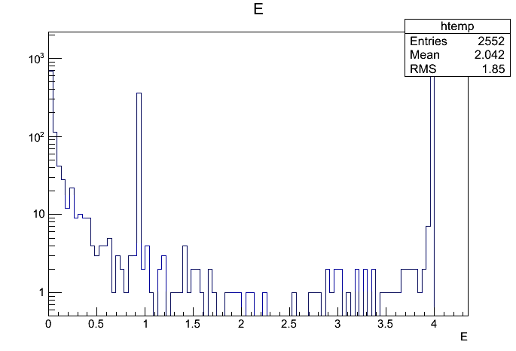
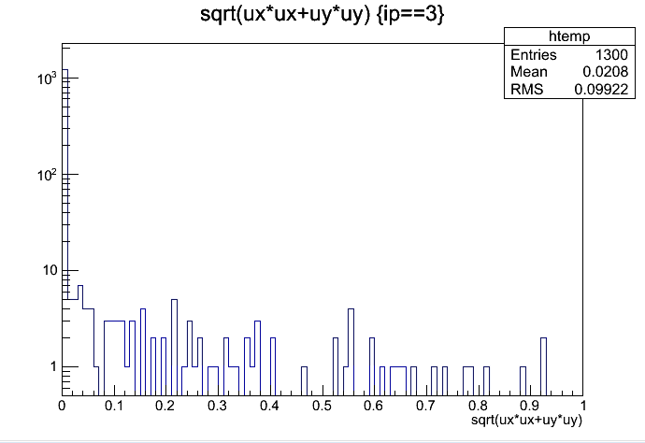
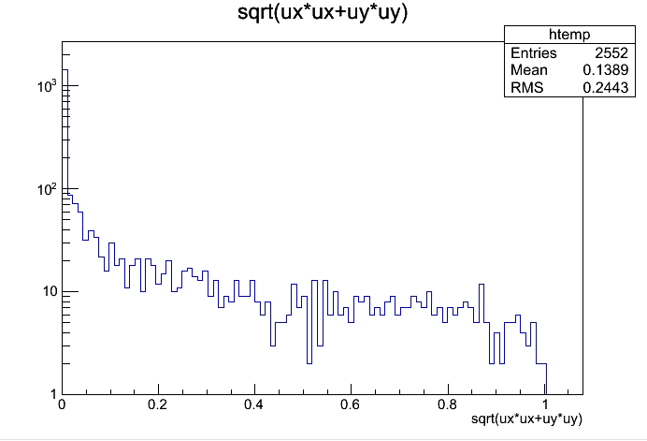
After SL-10
e-
n
γ
n
e+
e-

Slide 11
Status & Next Steps
Transport PR10 particles to SL-10 via transport matrix & interact in SL10 with FLUKA
Repeat procedure for C24 and C37
Vary
  PR10 material & thickness
  SL10, C24, C27 apertures
Get Glen White integrated GEANT4+optics code to work

