Slide 1
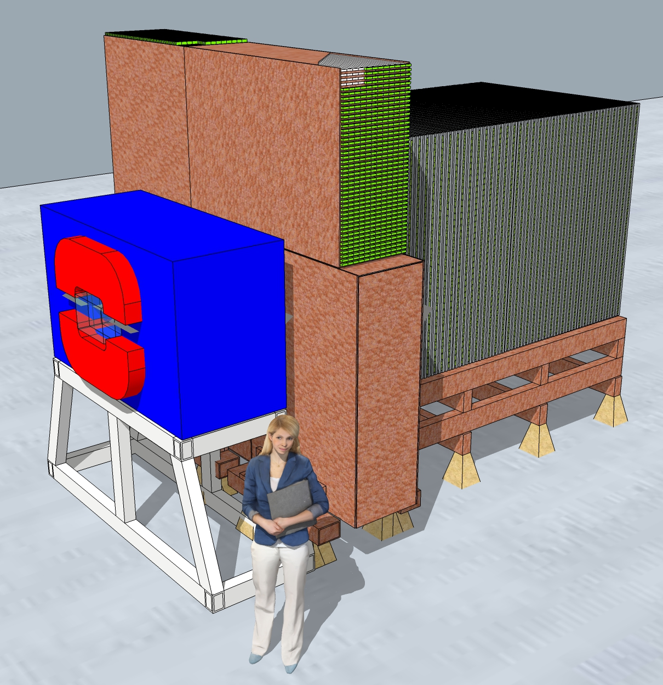
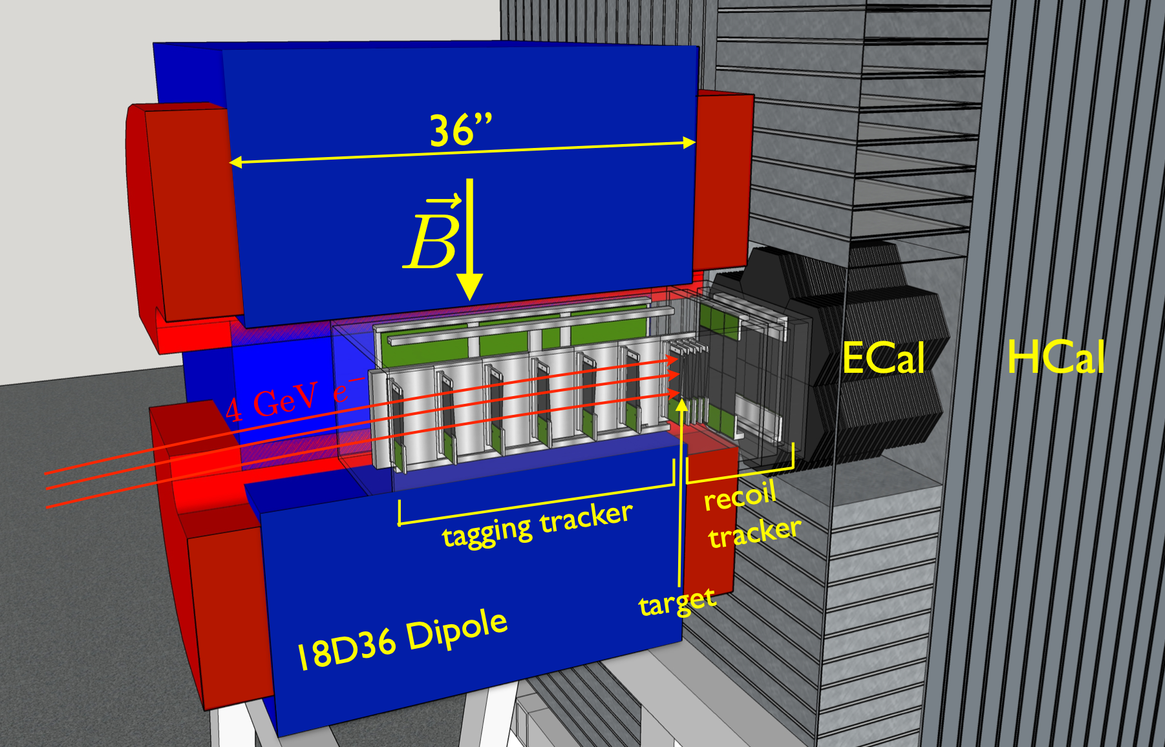
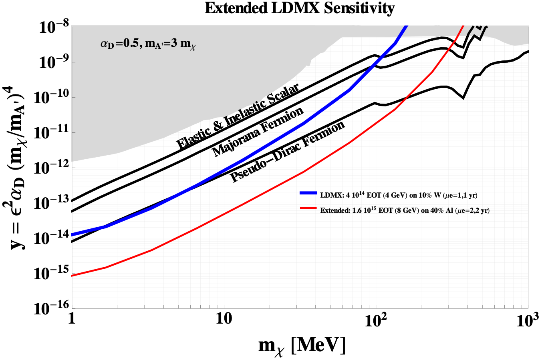
Light Dark Matter eXperiment (LDMX)
Overview
Missing momentum search for MeV-GeV Dark Matter
DOE-HEP experiment being developed for operation at SLAC LESA beamline by SLAC-led consortium with contributions by Sweden (Lund University)
uses 4/8 GeV LCLS-II electron beam and mature detector technologies to detect dark matter or other invisible dark sector states via missing momentum (or energy) in the production reaction
Prototyping and Technical Design: $1.5M, May 2020 through FY22
R&D: ongoing physics studies to optimize design (outside DMNI-scope: required scientific effort not supported through DMNI funds.)
arXiv:1808.05219 [hep-ex]

Slide 2
Light Dark Matter eXperiment (LDMX)
Comparison to Key Competitors
BELLE-II
NA64𝜇 2×10¹³ MOT
arXiv:1903.07899
NA64 5×10¹² EOT
NA64 10¹³ EOT

Slide 3
Light Dark Matter eXperiment (LDMX)
Organization and Management
The LDMX collaboration was formally founded in January 2019:
collaboration board
Jeremy Mans, UMN (chair)
J. Incandela, UCSB
D. Hitlin, Caltech
T. Åkesson, Lund
A. Whitbeck, TTU
C. Dukes, UVA
N. Tran, FNAL
P. Schuster, SLAC/Stanford
spokespersons
Torsten Åkesson
Tim Nelson
senior investigators committee
Joe Incandela (chair)
Bertrand Echenard (deputy)
all faculty and permanent staff from collaborating institutions:
UC Santa Barbara
Caltech
FNAL
Lund University
University of Minnesota
SLAC
Stanford University
Texas Tech University
University of Virginia
coordinators
technical - D. Hitlin (Caltech)
electronics - J. Mans (UMN)
physics - R. Pöttgen (Lund), P. Schuster (SLAC)
beamline/magnet - T. Nelson (SLAC)
tracking - T. Nelson (SLAC)
ECal - J. Incandela (UCSB)
HCal - B. Echenard (Caltech)
DAQ - N. Tran (FNAL)
trigger scintillator - A. Whitbeck (TTU)
software/computing - O. Moreno (SLAC)
DMNI PI, co-PIs, and co-investigators are the collaboration leadership. Institutions are largely DOE-funded, with a mix of IF and EF groups.
The collaboration has drafted a management plan for the DMNI project which includes internal milestones, progress monitoring, and technical reviews where appropriate.

Slide 4
Light Dark Matter eXperiment (LDMX)
DMNI Project Scope and High-level Milestones
preliminary design of LDMX project and development of baseline scope, cost, and schedule
Beamline, Magnet, and Tracker (SLAC)
  radiation studies and shielding design (Q3 FY21)
  designs and refurbishment plans (Q3 FY21) for magnet and magnet power supplies (Q3 FY22)
  mechanical design of tracker support system (Q4 FY21)
  electronics design, prototyping, and testing of tracker readout boards (Q3 FY22)
Target Scintillator Pad (TTU, Caltech, Stanford)
  design, prototyping, and testing of trigger scintillator pad and readout system (Q2 FY21)
  assembly of prototypes for test beam (Q3 FY21)
ECal (UCSB, UMN)
  mechanical design and prototypes of ECal layers and support structure (Q3 FY22)
  design, prototyping and firmware for ECal readout (Q2 FY22) and full system tests (Q4 FY22)
HCal (Caltech, UVA, FNAL, Lund)
  design and prototyping of HCal quad-bar assemblies (Q3 FY20), support structure (Q1 FY22), and readout electronics (Q1 FY22)
  assembly of a small scale prototype (Q2 FY21) and operation in test beam (Q1 FY22)
Trigger, DAQ and Slow Control (FNAL, SLAC, Stanford)
  development of Trigger, DAQ and Slow Control systems (Q1 FY22), integration tests (Q3 FY22)
Computing (SLAC)
  purchase of computing resources for optimization studies (Q2 FY21)
Management (SLAC)
  management of DMNI project (throughout FY21 and FY22)
  development of project plan for LDMX (Q4 FY22)
Software and Optimization Studies (ALL – Scientific Effort)
  development of software and computing required for operations and analysis (ongoing)
  optimization studies for baseline design (ongoing)
non-DMNI scope

Slide 5
Light Dark Matter eXperiment (LDMX)
Recent and Upcoming Milestones
Q3/Q4 FY20 Milestones
Target Scintillator Pad (TTU, Caltech)
  conceptual design for LYSO active target
  light yield study for LYSO active target
  preliminary technical design and assembly development for plastic scintillator bars
  design SiPM mounting board
  design control system (non-DMNI – Stanford)
HCal (Caltech, UVA, FNAL)
  finalize quad-bar and manifold (counter readout electronics) design
  start quad-bar production for HCal prototype
Trigger, DAQ and Slow Control (FNAL, SLAC)
    define interface specifications (slow control, clock/fast control, DAQ, trigger) with upstream subsystems (tracker, trigger scintillator, ECal, HCal) and LCLS- II/S30XL
    V0 version of trigger primitives added to ldmx-sw (non-DMNI – scientific effort)
Q1 FY21 Milestones
Target Scintillator Pad (TTU, Caltech)
  build prototype plastic scintillator array (scintillator assembly + SiPM unit)
  establish a test stand for frontend readout
  build prototype control system
  complete LYSO target prototype for beam test
HCal (Caltech, UVA, FNAL)
  initial design of HGCROC and Backplane boards
  test prototype quad-bar readout electronics
  design Hcal prototype test stand

Slide 6
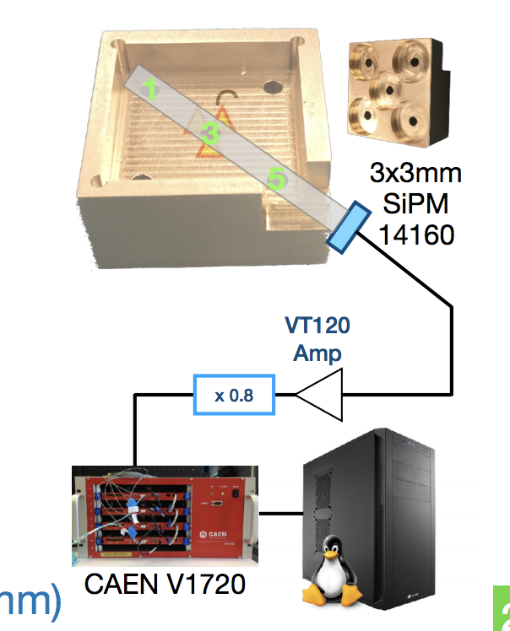
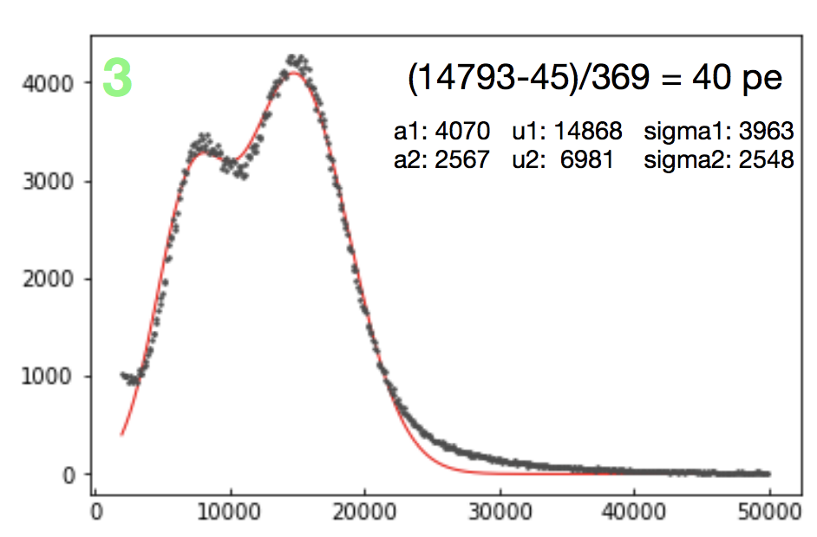
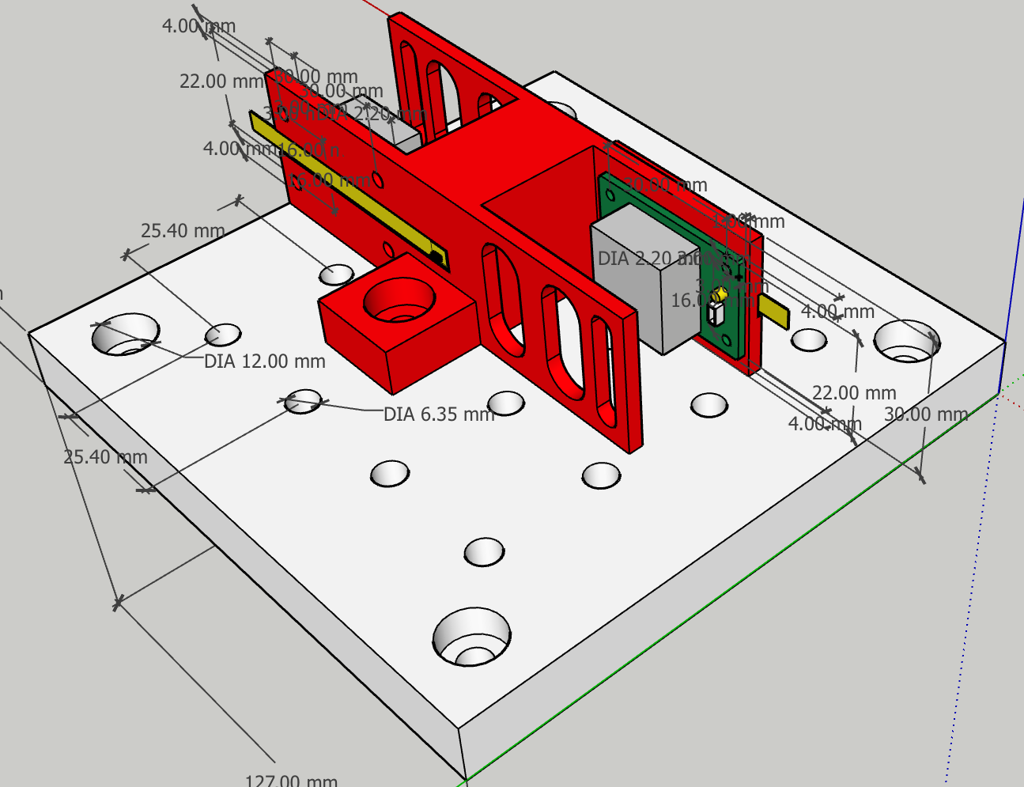
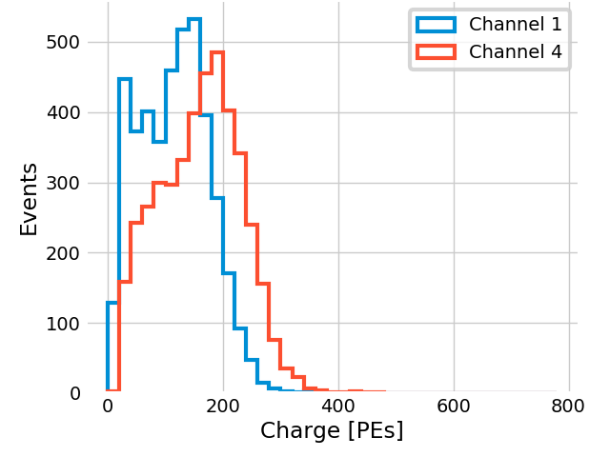
Light Dark Matter eXperiment (LDMX)
Recent Highlights: Target Scintillator Pad
Institutions Involved:
Texas Tech: mechanics and SiPM electronics, simulation studies, detector characterization
Caltech: LYSO active target studies, alternate designs
Stanford (non-DMNI – unsupported): control system electronics, simulation studies
Recent Highlights:
light yield measurements with plastic scintillator bars, scintillating fibers, and LYSO bars for active target
preliminary mechanical design underway
readout electronics design underway
control specifications and design (non-DMNI – Stanford)
Simulation studies (non-DMNI - scientific effort)
simulation and trigger algorithm development
studies of active target for background veto
Issues/Concerns:
SiPM mounting board design behind (personnel availability at TTU)
Caltech LYSO
characterization setup
Response to Co⁵⁷ source
0.6 x 2.1 x 30 mm
LYSO bar
TTU plastic scintillator
characterization test stand
Response to Sr⁹⁰ source
2x2x40 PVT bar
read out on both
front: blue
back: orange

Slide 7
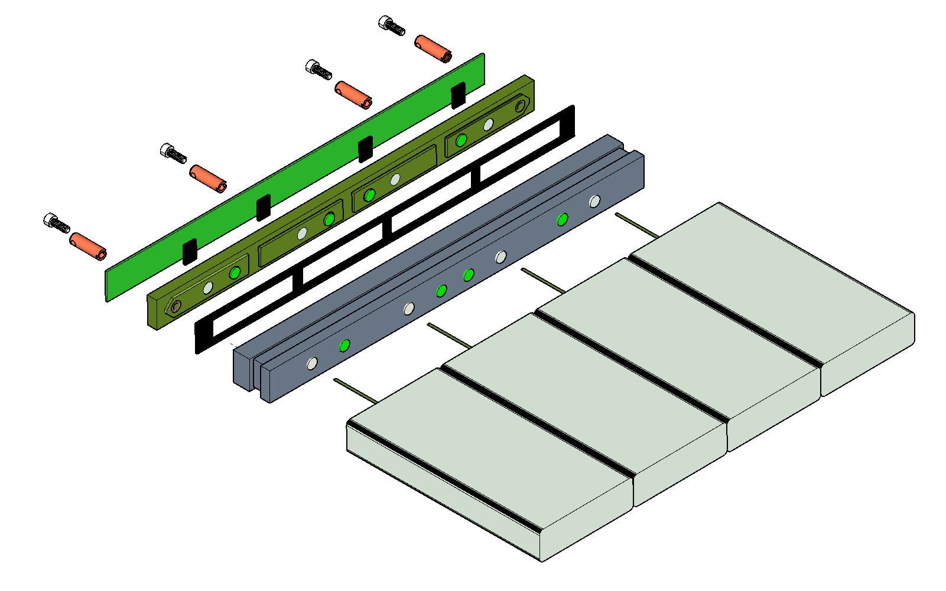
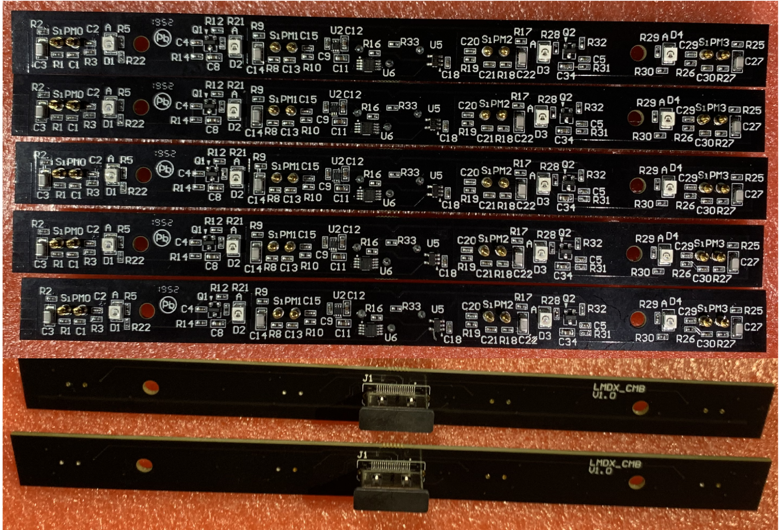
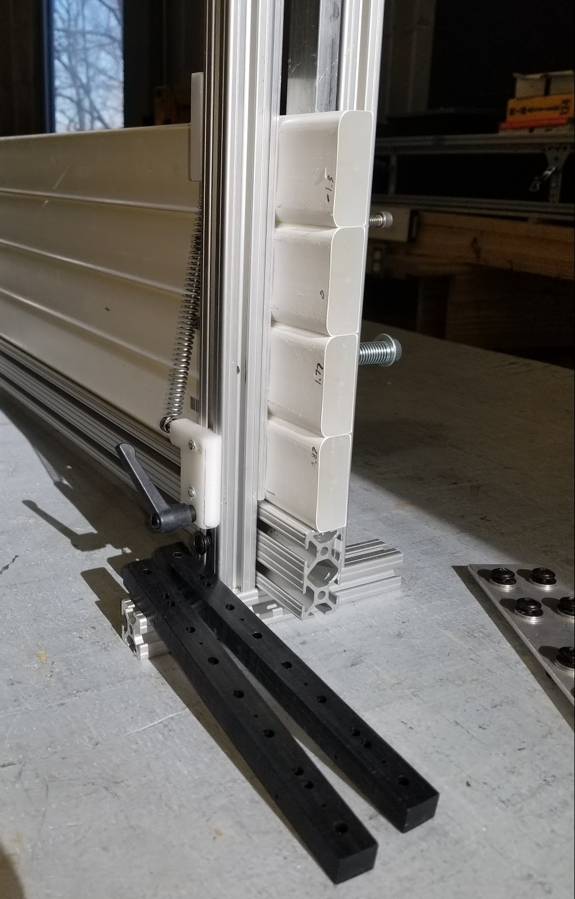
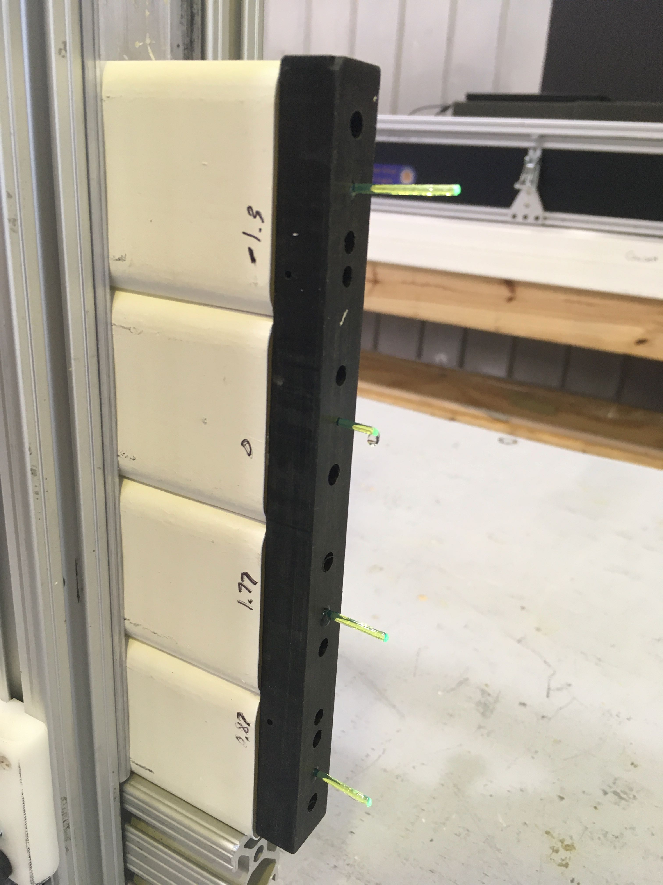
Light Dark Matter eXperiment (LDMX)
Recent Highlights: HCal
Institutions Involved:
Caltech: Counter readout electronics (counter motherboard and SiPM carrier board) design and prototyping, fiber performance studies
UVA: development of quad-bar assembly procedure (scintillating bars, fibers and fiber guide bar) and QC, quad-bar prototype production
FNAL: electronics design
Lund: electronics design, components and raw materials for HCal prototype (non-DMNI – Sweden)
Recent Highlights:
HCal quad-bar design (Caltech, UVA)
              studies of readout fiber diameter
              developed quad-bar (unit of 4 scintillating bars) assembly procedure
              finalized quad-bar electronics readout design, pre-production prototypes received
              counter motherboard fabrication and test stand design
HCal electronics (FNAL, Lund)
defined interface specs for HGCROC and backplane boards and TDAQ
Started design of HGCROC board (Lund)
started design of backplane board (FNAL)
HCal test beam (All)
started design of Hcal prototype & MC simulation, investigating test beam site capabilities (FNAL, CERN)
HCal simulation (Caltech, UMN, SLAC, FNAL: non-DMNI – scientific)
improvement of HCal digitization in progress
on-going studies to optimize overall HCal design
Quad-bar readout
SiPM mounting block
Fiber guide bar
SCB
CMB
Seal
fiber
scintillator
Counter Mother Board pre-prototypes
Quad-bar prototype assembly

Slide 8
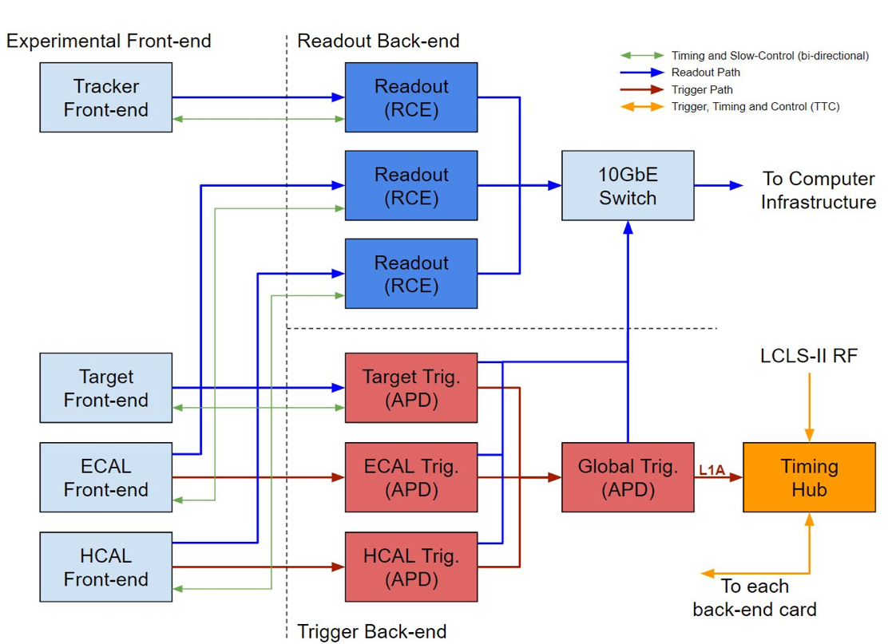
Light Dark Matter eXperiment (LDMX)
Recent Highlights: Trigger, DAQ and Slow Control
Institutions Involved:
FNAL: Trigger and DAQ coordination, trigger algorithms, firmware, infrastructure
SLAC: Central DAQ, fast/slow controls, and LCLS-II/LESA accelerator interface
Stanford (non-DMNI – unsupported): Fast/slow controls, trigger algorithms, firmware, infrastructure
Recent Highlights:
              interface specifications between Trigger/DAQ and the rest of the subsystems
              draft of fast control specification: flags, protocols and interfaces, common firmware block definition
              DAQ architecture definition in progress

Slide 9
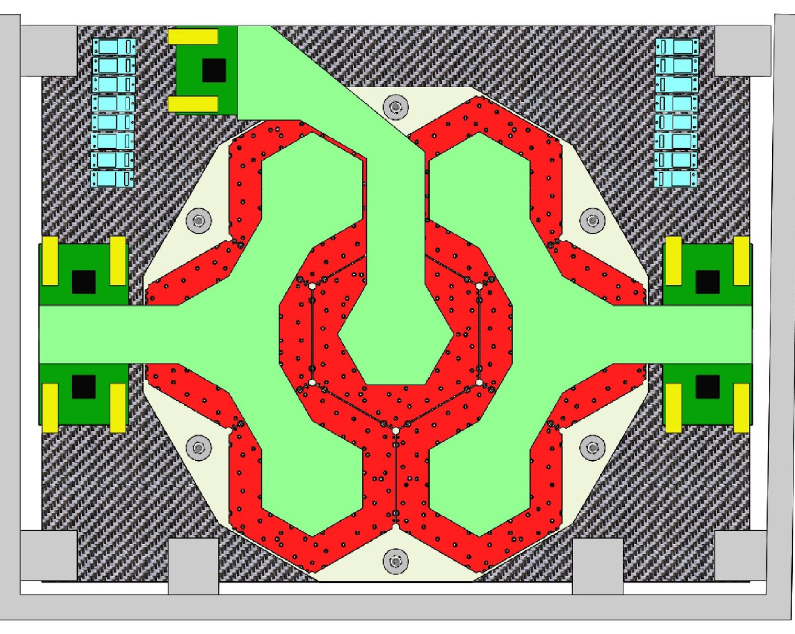
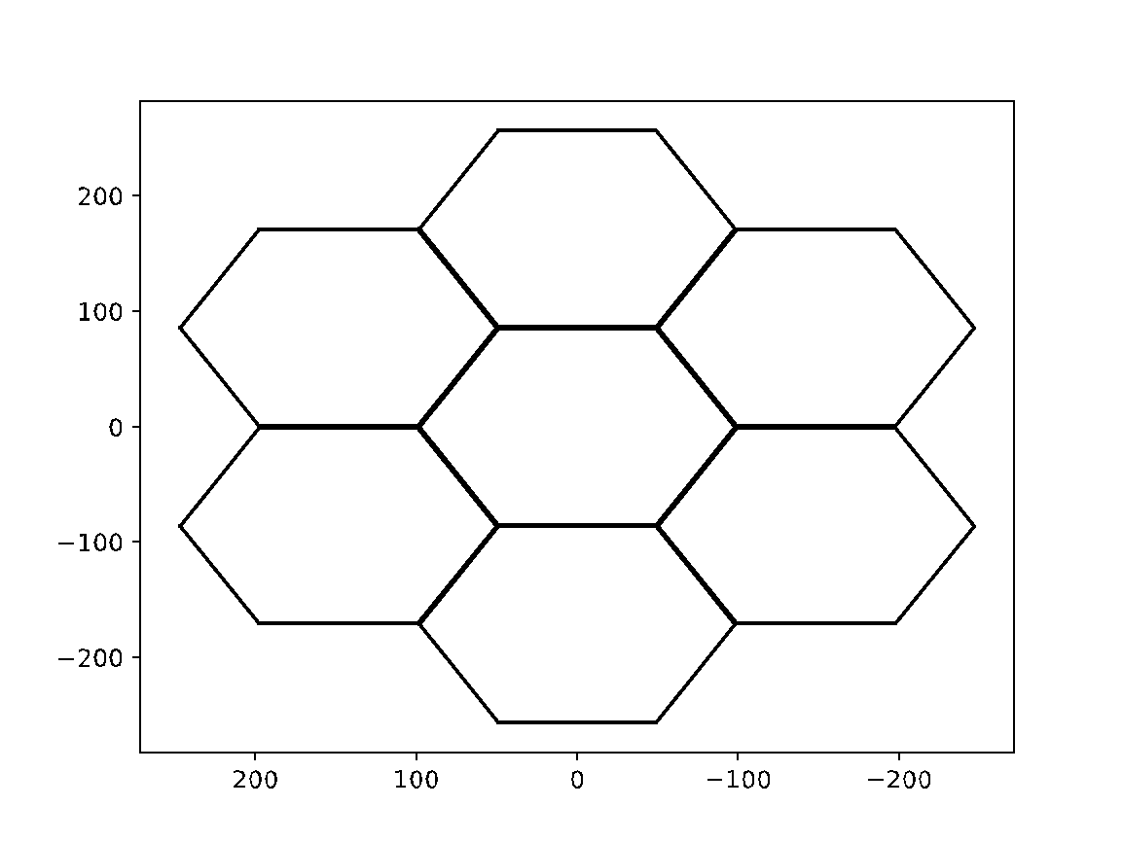
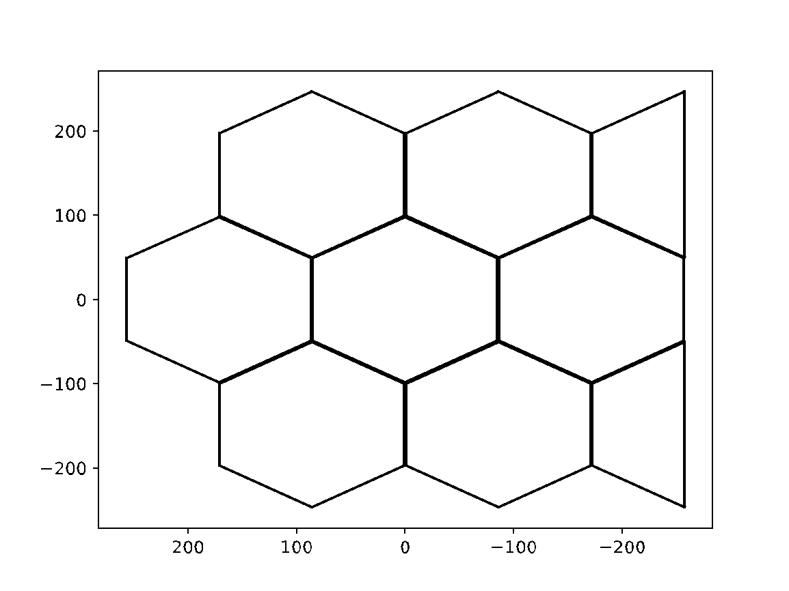
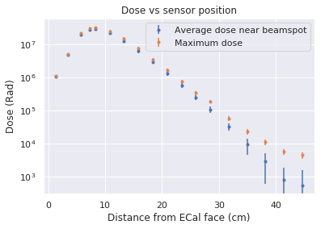
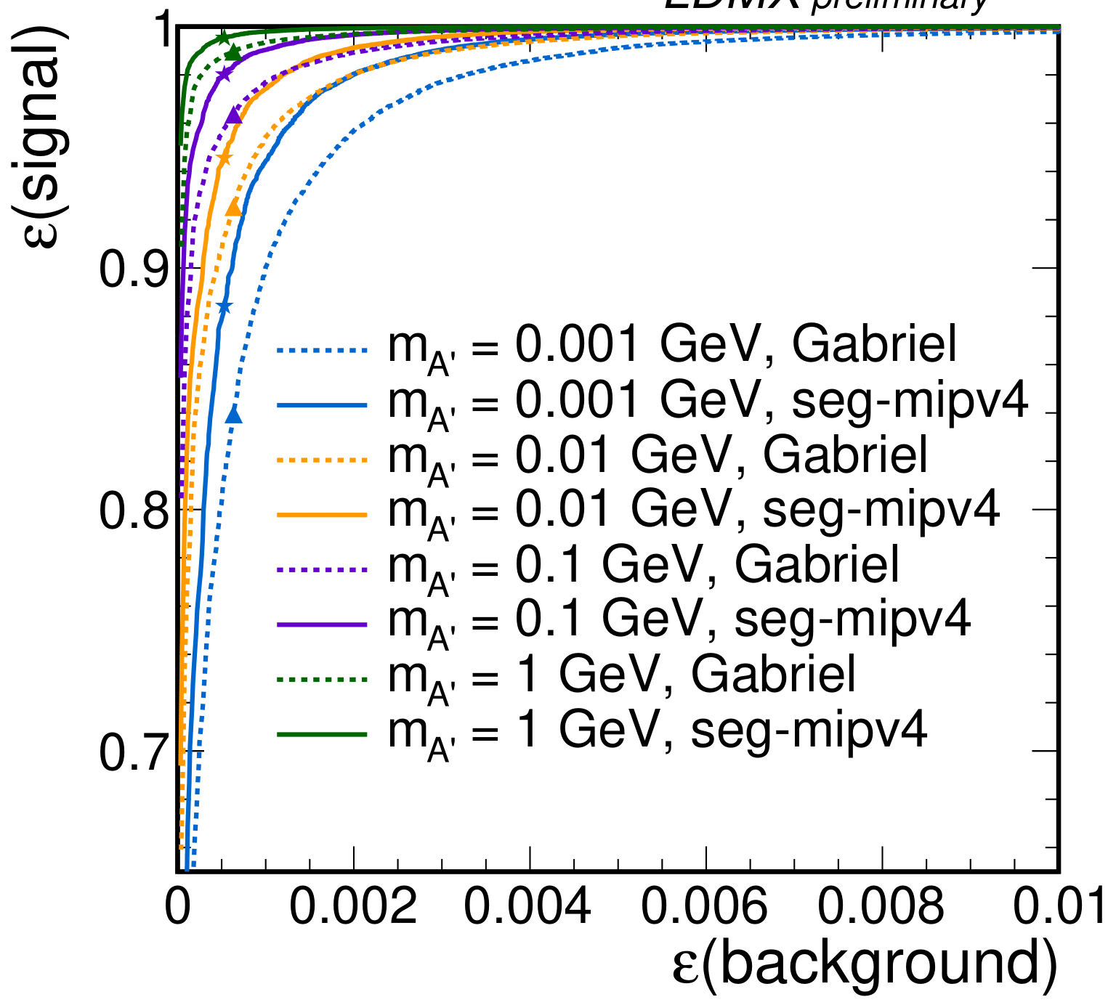
Light Dark Matter eXperiment (LDMX)
Recent Highlights: ECal
Institutions Involved:
UCSB: ECal layout, module design and assembly, support design and assembly
UMN: ECal readout and DAQ development
ECAL double-layer layout option: front view
90° rotation + added sections for wide-angle coverage
of recoil electrons deflected by the magnetic field
Default module orientation
Recent Highlights:
Work on finalizing ECAL layout (UCSB)
engineering of layout and thermal modeling
including DAQ electronics, cables, and fibers
optimizing final orientation of single-layer layout, looking at addition of small silicon sections for higher acceptance (non-DMNI – scientific)
optimizing relative orientations and shifts between consecutive layers to avoid dead regions between modules (non-DMNI – scientific)
Work on ECAL trigger and readout (UMN)
established stable optical link (3 Gbps/6 Gbps) and communications protocol for Ecal control and DAQ using Polarfire FPGA
developed event building FW from the HGCROC to the optical link
developed bit-level emulation for HGCROC trigger processing
block-level design underway for Polarfire mezzanine hardware
FLUKA simulation of integrated dose vs depth: 1e15 EoT
Simulation Studies (UCSB: non-DMNI – scientific)
studies to understand radiation damage of silicon and determine cooling needs
improved BDT-based veto
optimization of DNN veto using ParticleNet¹ to exploit imaging capabilities
dedicated studies of most challenging O(1-10) backgrounds underway
Improvements to BDT veto: 10-20% higher signal efficiency
m_{A’} = 1 MeV, Default
m_{A’} = 1 MeV, New variables
m_{A’} = 10 MeV, Default
m_{A’} = 10 MeV, New variables
m_{A’} = 100 MeV, Default
m_{A’} = 100 MeV, New variables
m_{A’} = 1 GeV, Default
m_{A’} = 1 GeV, New variables
1arXiv:1902.08570

Slide 10
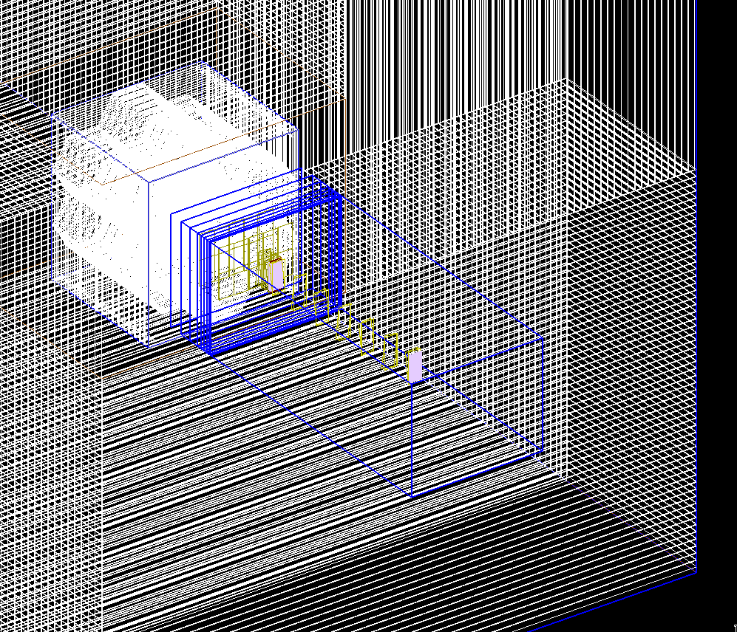
Light Dark Matter eXperiment (LDMX)
Software and Physics (non-DMNI Scope)
Highlights:
Simulation and reconstruction framework (ldmx-sw) is mature,
billions of background events generated to study the LDMX concept
Two papers focused on baseline single-electron performance for phase I:
initial design study (arXiv 1808.05219)
high efficiency photon veto (arXiv 1912.05535, JHEP 04 (2020) 003)
Two papers focused on the extended LDMX physics program:
sensitivity to several DM models (arXiv 1807.01730, Phys. Rev. D 99, 075001 (2019))
use of nominal LDMX setup to measure both inclusive and (semi) exclusive cross-sections relevant to DUNE (arXiv 1912.06140, Phys. Rev. D 101, 053004 (2020))
Planned Work:
continue improving performance of simulation and reconstruction
begin building up computing infrastructure needed for operation and analysis of LDMX data
ongoing studies that should be completed before the baseline design is finalized
  2+ electron studies (efficient beam utilization)
  8 GeV studies (LCLS-II HE operation)
  ECal as a target study (missing energy channel has greater reach with early data)
  wide angle background study (improved background rejection)
Issues/Concerns:
With current research support, it will take >1 year to finish the above, even at a preliminary level.
Additional full time scientific effort is needed on physics studies, simulation, and reconstruction.

Slide 11
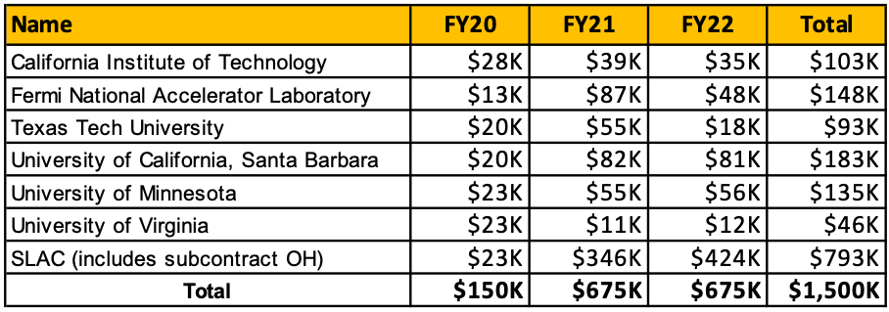
Light Dark Matter eXperiment (LDMX)
DMNI Budget
LDMX DMNI Proposal Budget: $1960K
DOE planned budget profile: $150K FY20
            $675K FY21
            $675K FY22
          $1500K Total
some work moved out of DOE scope to Lund and Stanford
some technical design tasks descoped
some additional risks to completion
FY20 funds allocated to start critical path work on HCal, ECal, and Target Scintillator Pad with a small amount to define critical DAQ interfaces
COVID is impacting lab overheads.
COVID impacts efficiency of lab work, preparation and operation of test beam

Slide 12
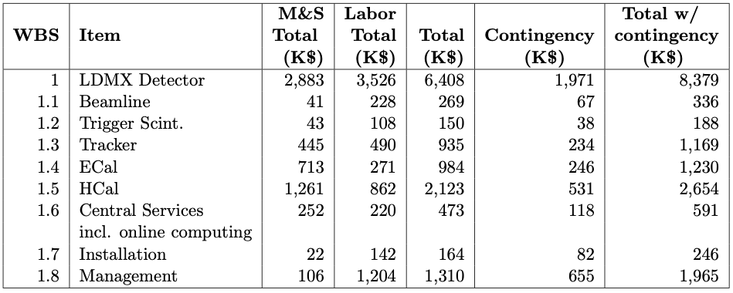
Light Dark Matter eXperiment (LDMX)
Project Management and Planning
Project management and planning is administered by LDMX technical coordination.
developed project plan, budget and schedule for DMNI award
compiled list of BOE documents required for LDMX project
defined a preliminary WBS for LDMX project
developed preliminary cost estimate for construction project for DMNI (assumed full funding of proposal)
developing RLS for LDMX project, expect roughly two years for construction
plan to have cost, schedule and project execution plan for baseline scope ready alongside preliminary design of LDMX ready for review by Q4 FY22
would like to have a detector on LESA beamline when completed to stay ahead of NA64
operations costs still relatively uncertain. magnet power will be significant, along with travel support for staffing the experiment during operations
DMNI support for PM at SLAC begins in FY21 (0.25 FTE). Project engineer expected to start Oct. 1 to take on formal project management and augment technical coordination.

Slide 13
Light Dark Matter eXperiment (LDMX)
Project Management and Planning
Extras

Slide 14
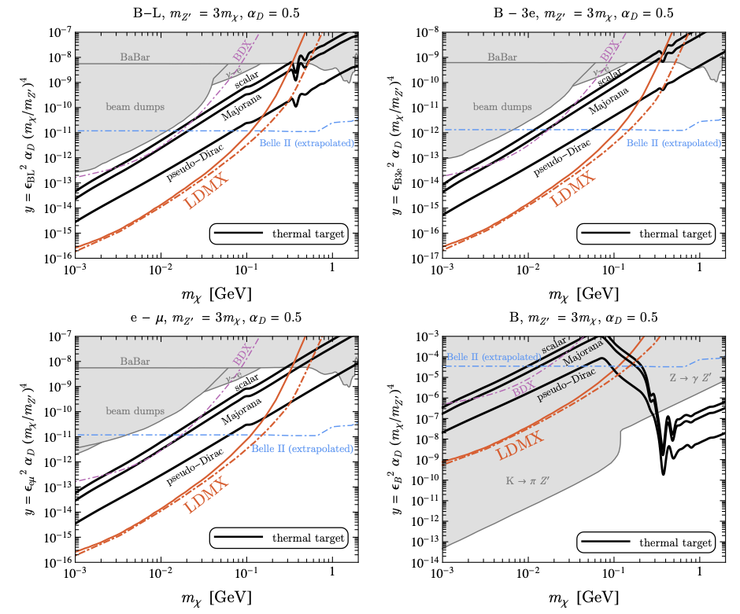
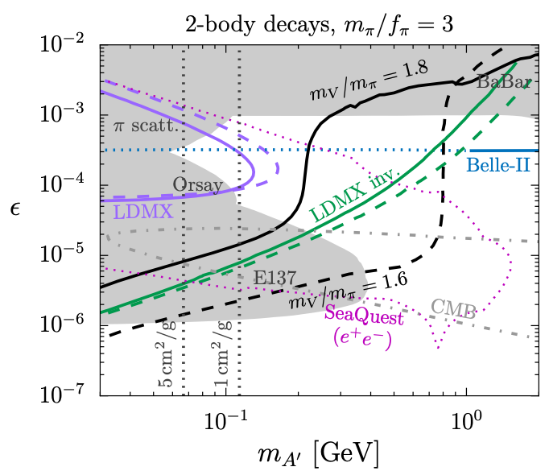
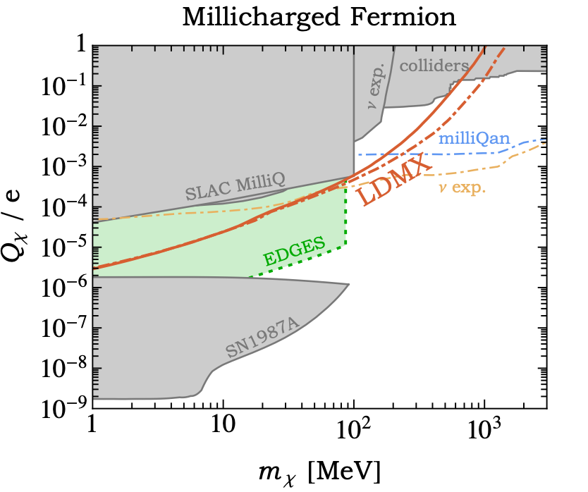
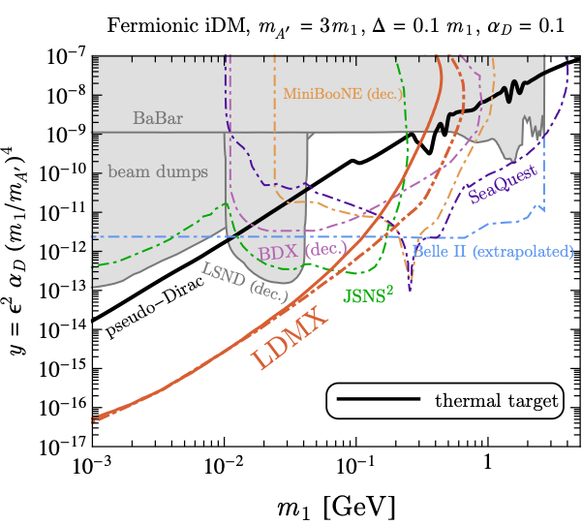
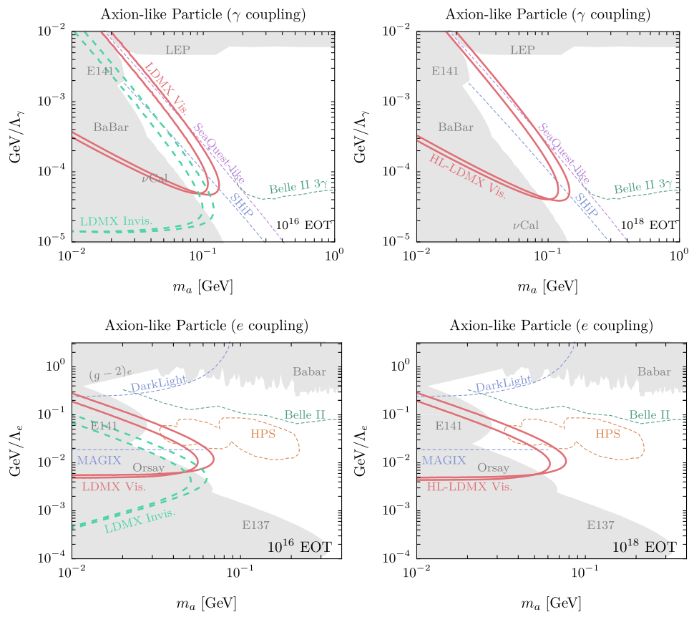
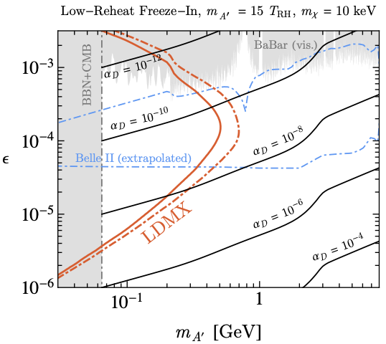
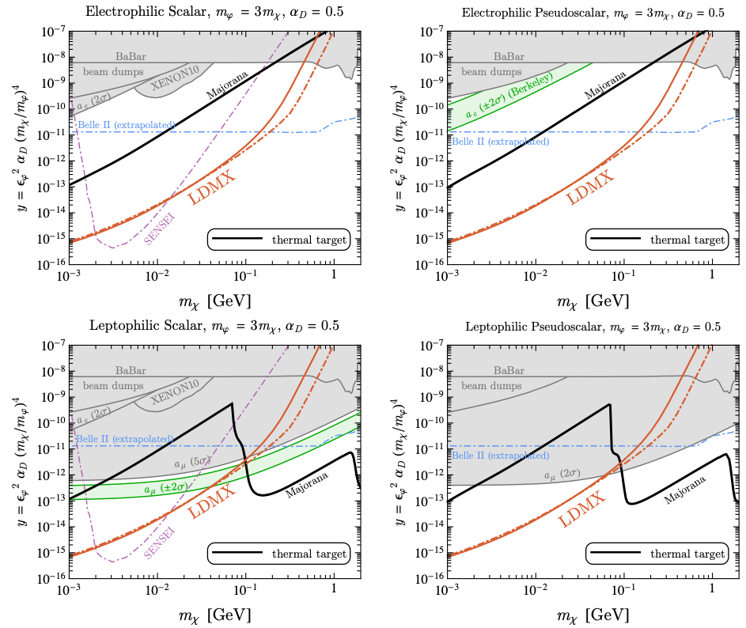
Light Dark Matter eXperiment (LDMX)
Beyond A′-mediated Freeze-out DM
Sensitive to a broader set of scenarios:
other mediators:
Strongly Interacting Massive Particles (SIMPs):
a confining interaction in the dark sector
millicharged particles:
arise from ~massless dark photons and
thrust into spotlight by EDGES anomaly
Axion-like particles (ALPs):
new pseudo-scalars can have either/both
photon and electron couplings
inelastic Dark Matter (iDM):
large mass-splittings in dark states, both visible
and invisible signatures
freeze-in DM, etc… new ideas?
arXiv:1807.01730 [hep-ph]
HPS

