Slide 1
Lcls-ii and connection to south arc
Y. Nosochkov
T. Raubenheimer, R. Iverson, C. Iverson, M. Santana, M. Woodley
January 15, 2016

Slide 2
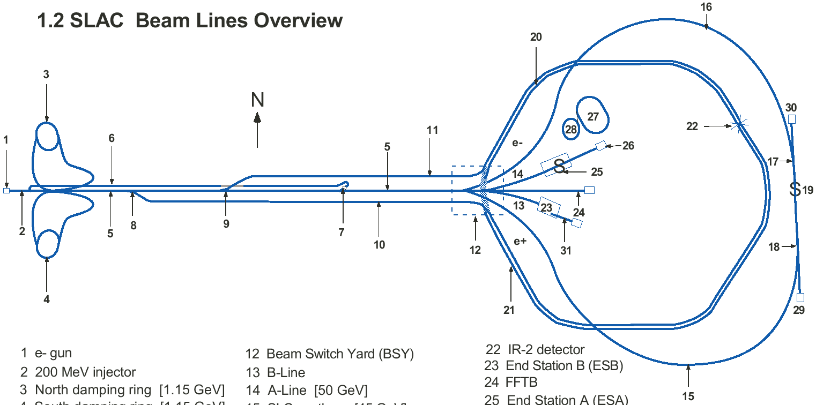
SLAC beam lines schematic
SARC Instrument Section

Slide 3
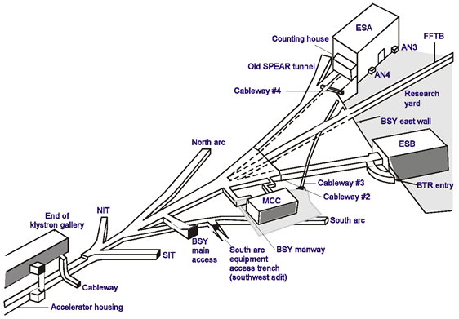
BSY schematic

Slide 4
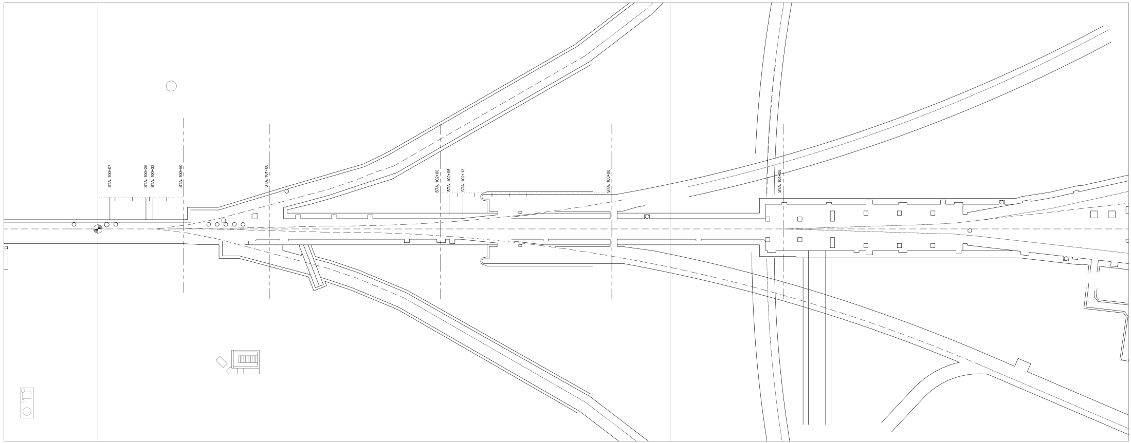
BSY to South arc – top view schematic
to South arc

Slide 5
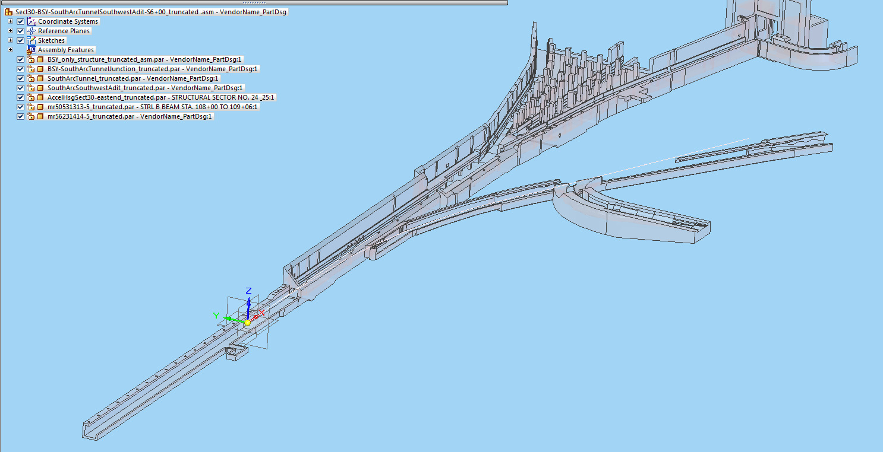
BSY – 3D schematic
to South arc

Slide 6
Original lines to N/S arcs starting from 50B1 dipole
to South arc

Slide 7
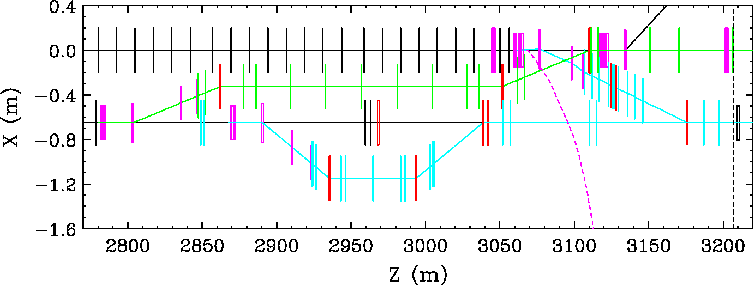
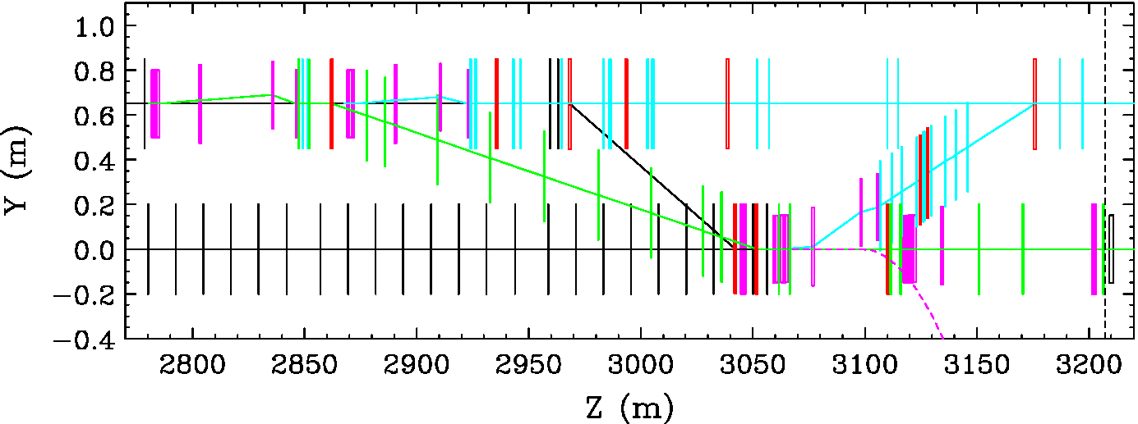
Spreader layout showing the original trajectory to South Arc
to A-line
Cu-linac
Quads:
SXR – cyan
HXR – green
Dump – black
CuRF – black
DC bends:
– red
Septa, kickers,
corrector bends:
– magenta
BSY dump:
– black
Face of muon
wall – dash
South Arc:
– magenta
dash line
HXR
SXR
LCLS2
dump
X-plane
to South Arc
LCLS2
Y-plane
SXR
Cu-linac
HXR

Slide 8
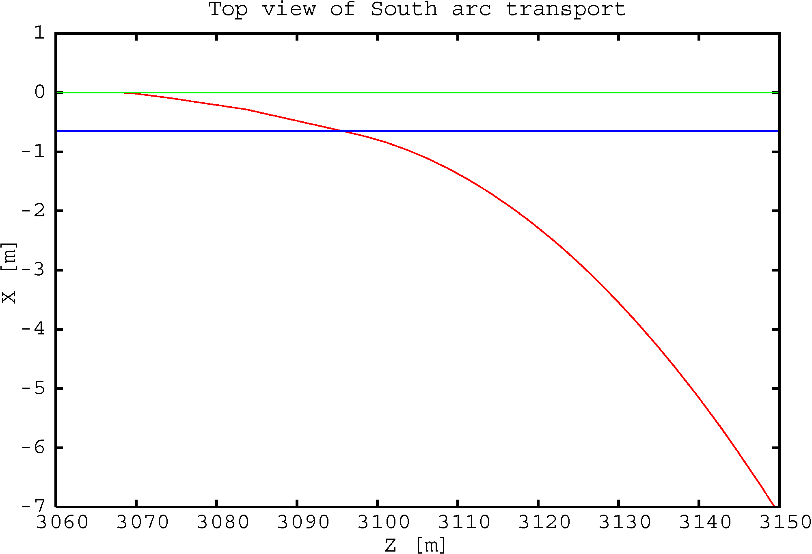
Cu-linac to HXR
LCLS-II to BSY dump
to South arc

Slide 9
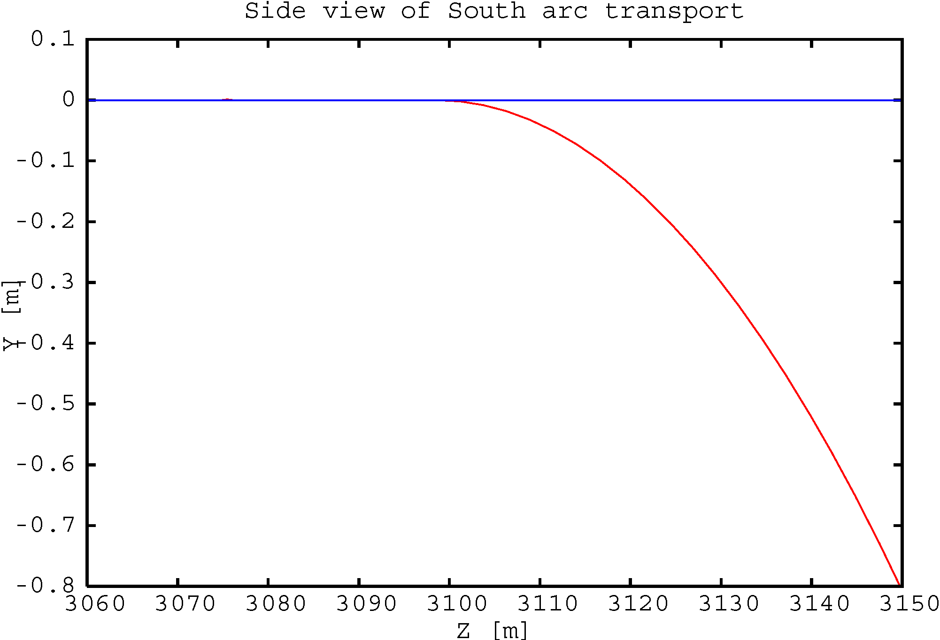
LCLS-II to BSY dump
to South arc

Slide 10
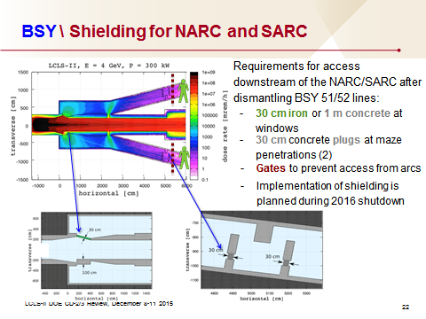
M. Santana

Slide 11
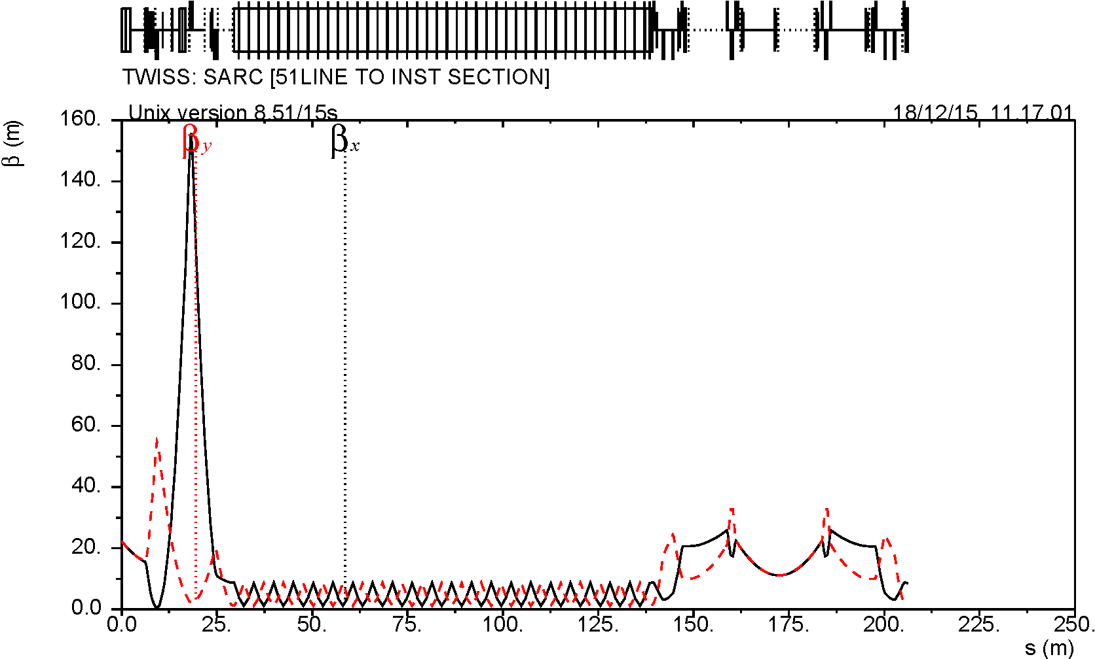
Original β functions from BSY to South arc instrument section

Slide 12
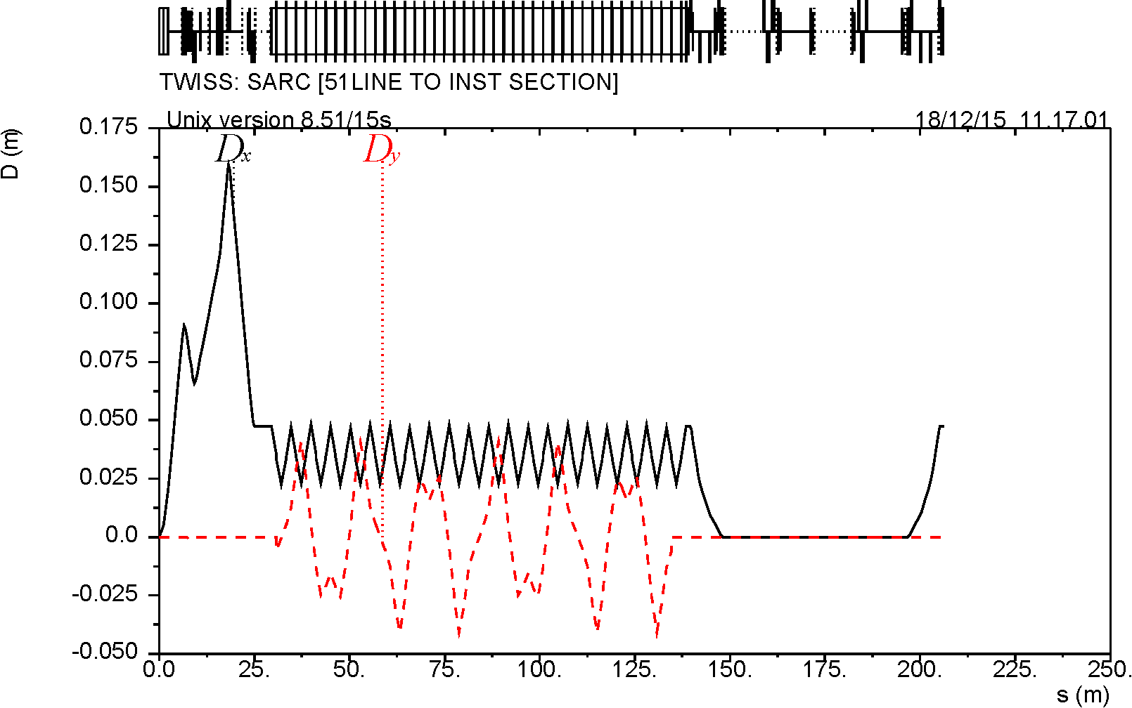
Original dispersion from BSY to South arc instrument section

Slide 13
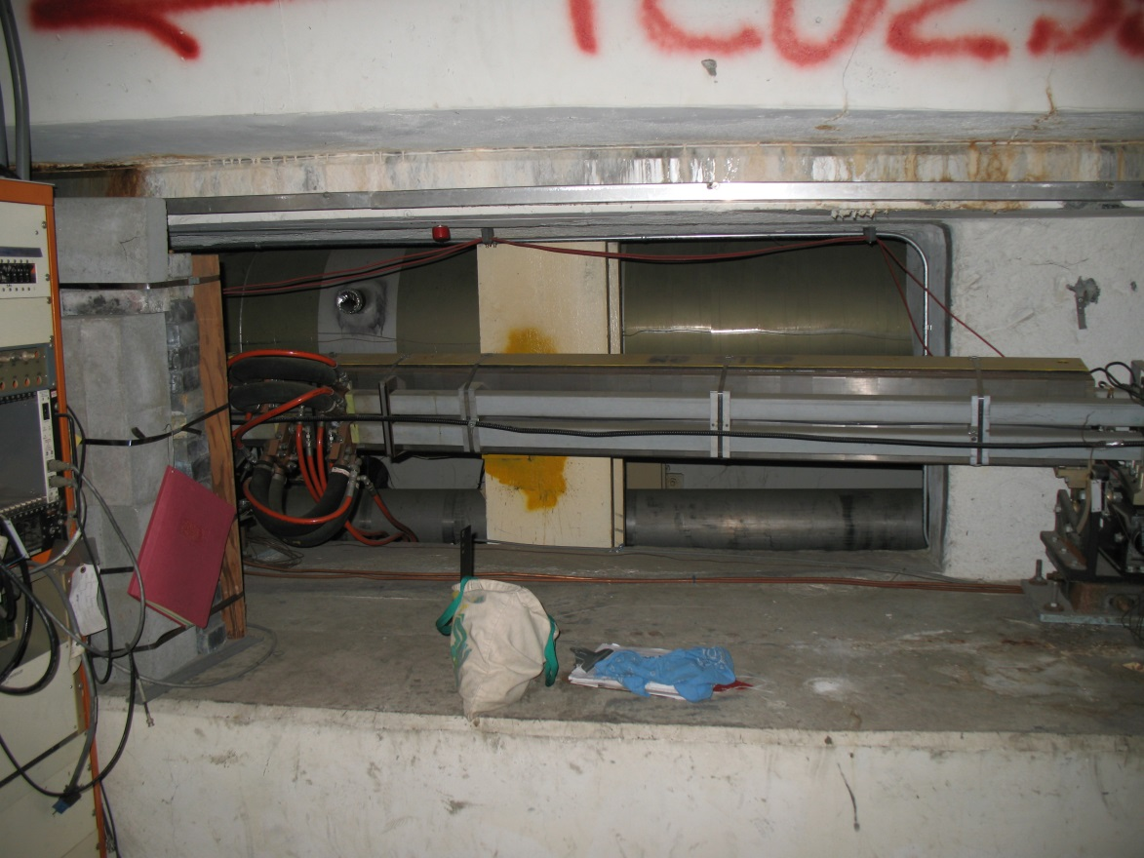
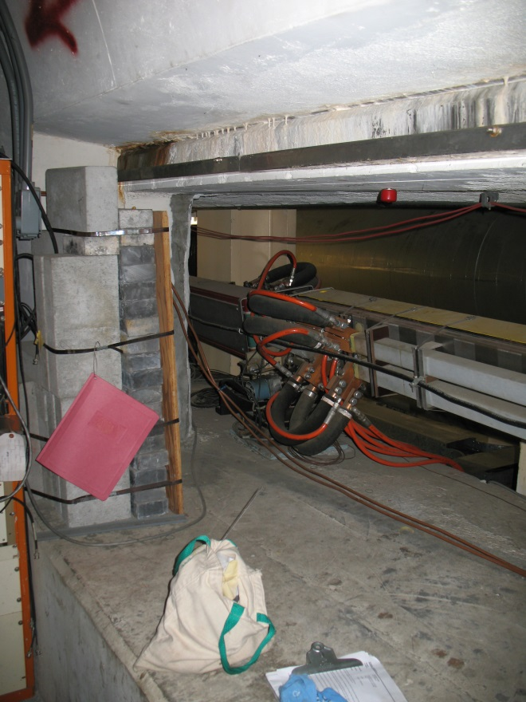
Window in the BSY wall for transport to South arc

Slide 14
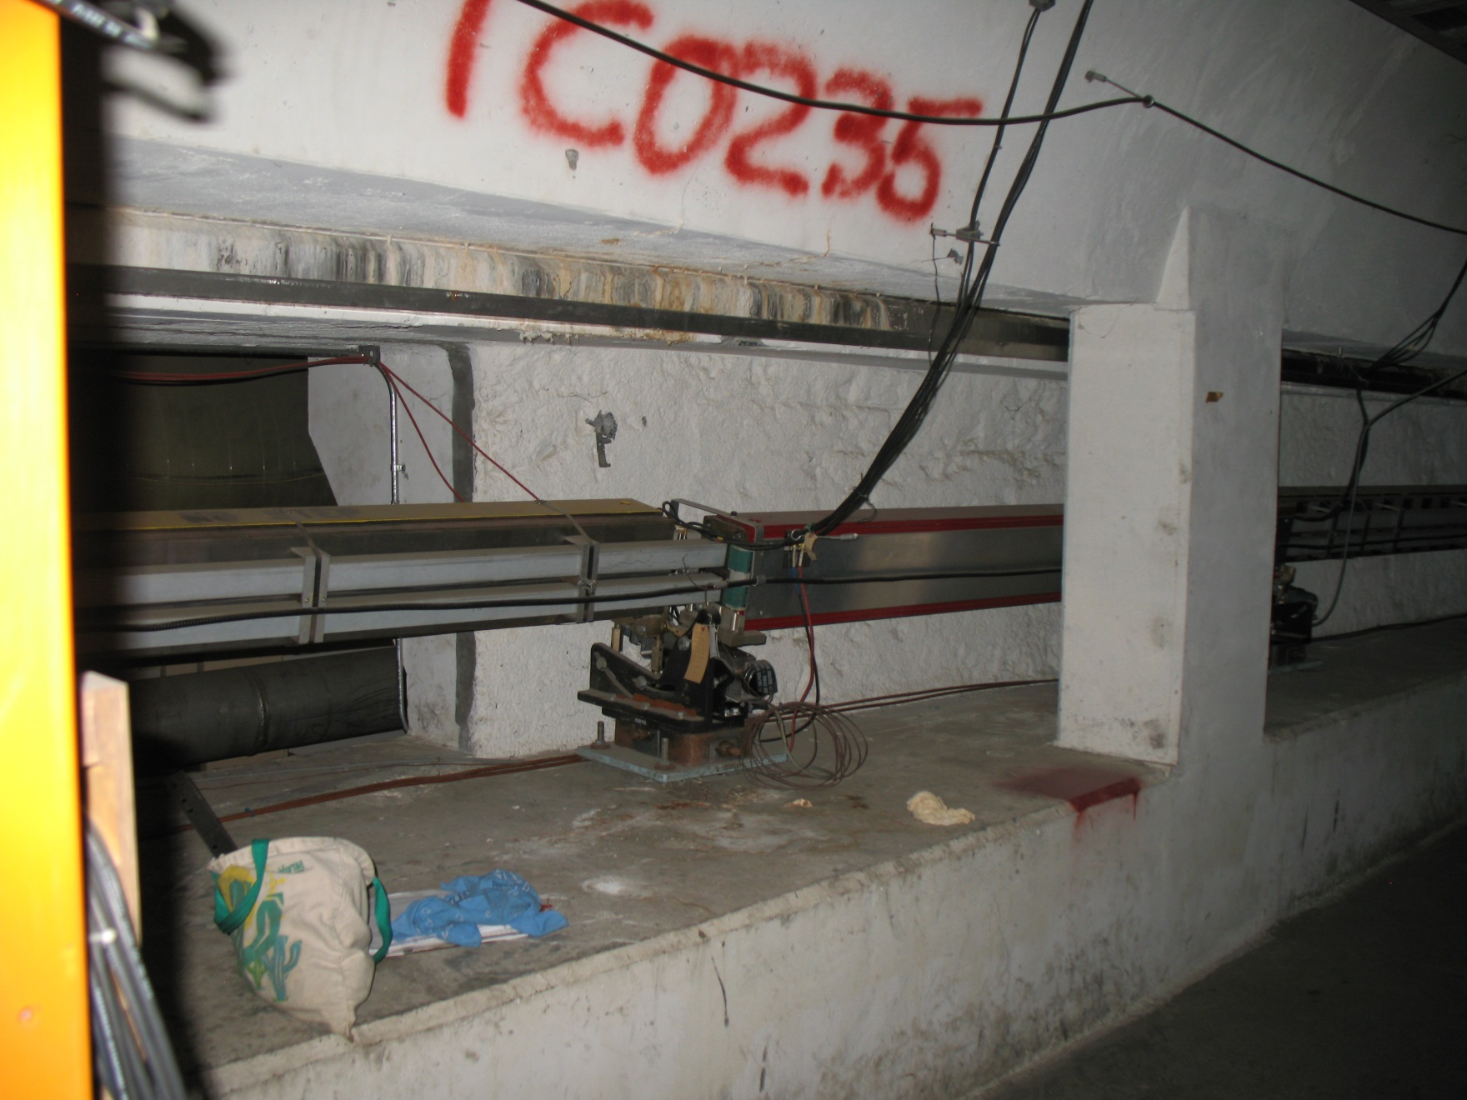
Downbeam of BSY wall window towards South arc

Slide 15
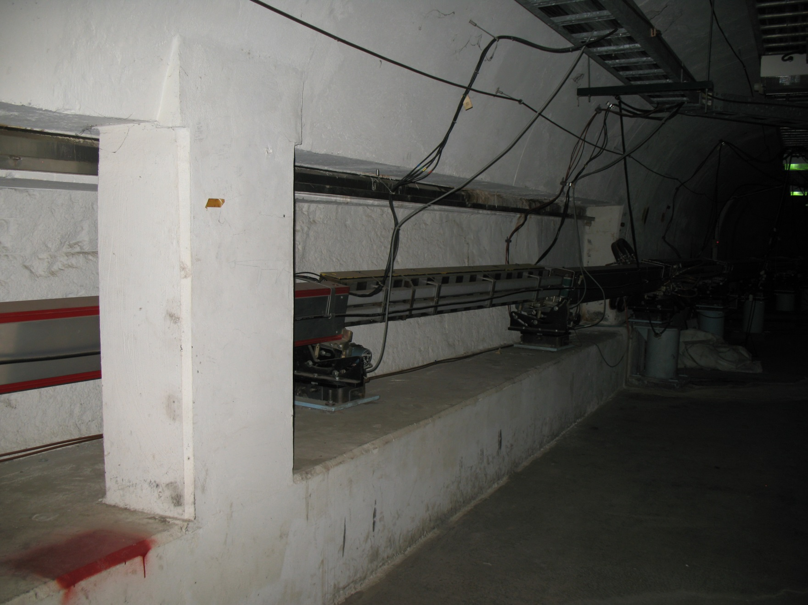
Further downbeam towards South arc

Slide 16
South arc instrument section

Slide 17
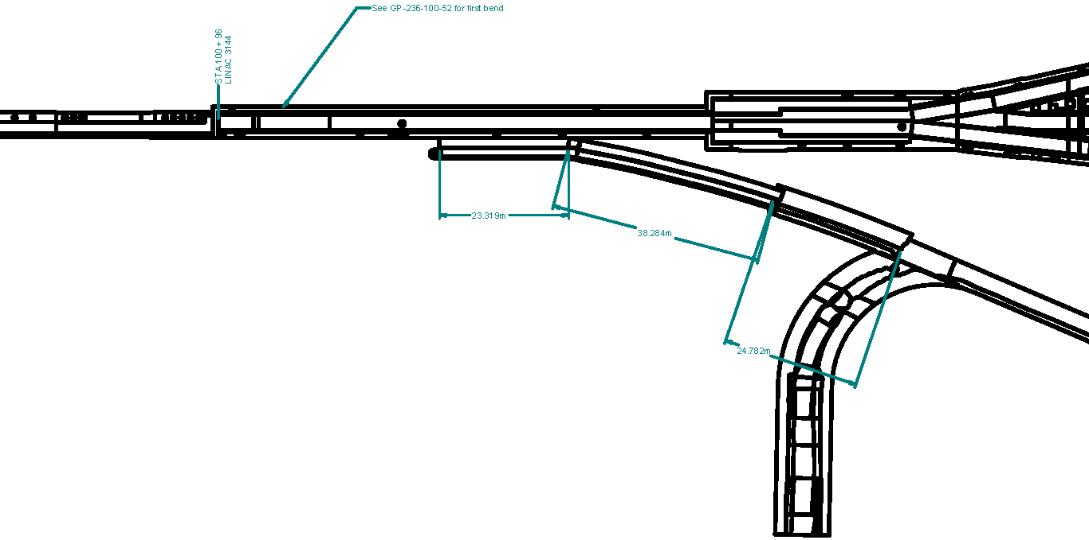
BSY top view with dimensions

Slide 18
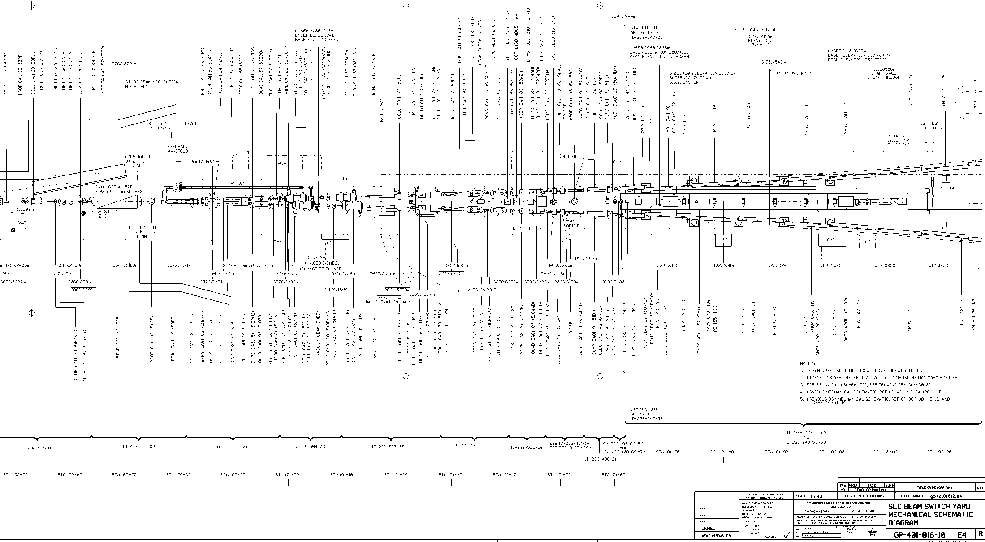
Detailed top view with original components
50B1

