Slide 1



sitka.triumf.ca to pinger.slac.stanford.edu
40ms
20ms
pinger-raspberry .slac.stanford.edu to sitka.triumf.ca
40ms
RTT milliseconds
20ms
pinger.slac.stanford.edu to sitka.triumf.ca
0.4%
Loss probability
40ms
0.3%
20ms
0.2%
22 Jun
29 Jun
6 Jun
13 Jul
loss
min
avg
max

Slide 2
pinger-raspberry .slac.stanford.edu to sitka.triumf.ca
40ms
RTT milliseconds
20ms
pinger.slac.stanford.edu to sitka.triumf.ca
0.4%
Loss probability
40ms
0.3%
20ms
0.2%
22 Jun
29 Jun
6 Jun
13 Jul
loss
min
avg
max

Slide 3
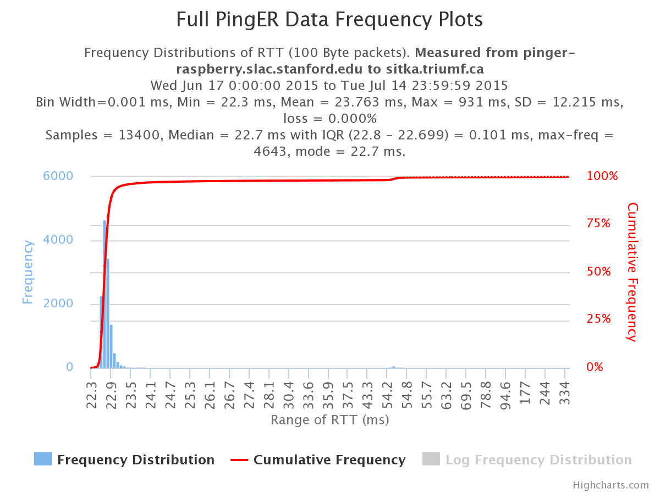

Slide 4
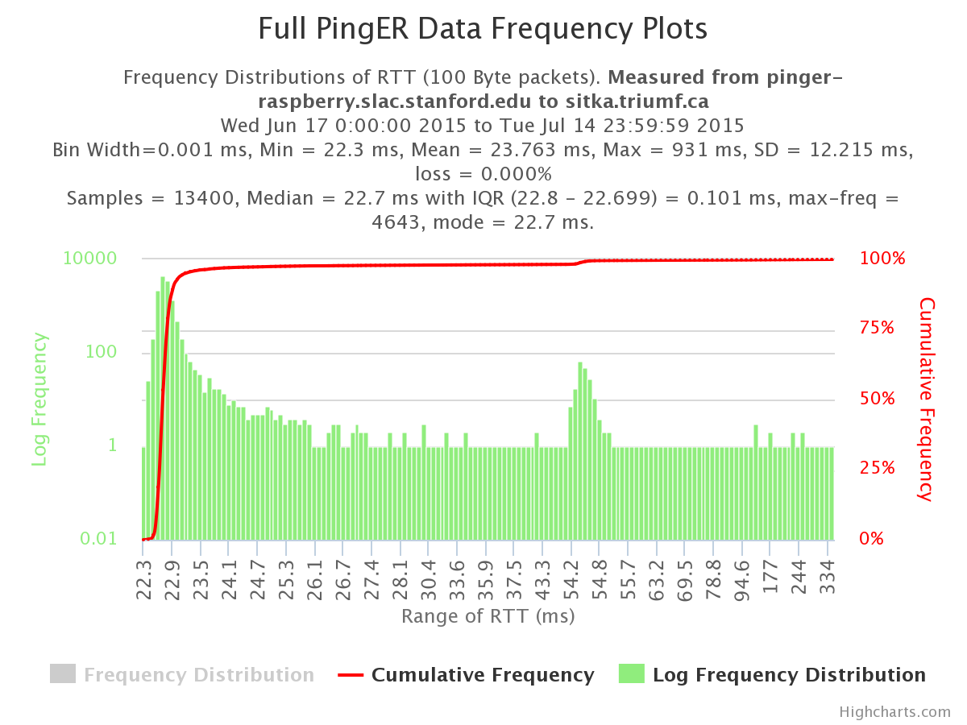

Slide 5
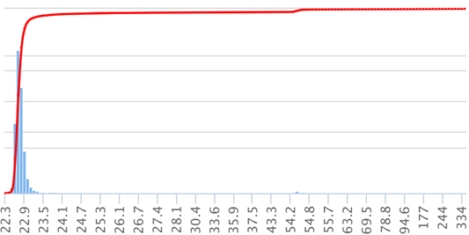
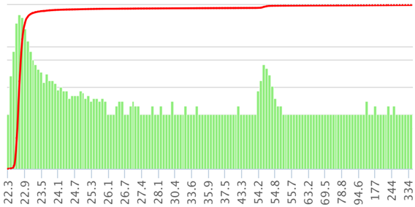
6000
100%
10000
100%
Ping RTT frequency distribution
From pinger-raspberry to TRIUMF
Log frequency scale
75%
Ping RTT frequency distribution
From pinger-raspberry to TRIUMF
Linear frequency scale
4000
100
50%
2000
25%
1
0
0.01
Range of RTT ms
Range of RTT ms

Slide 6
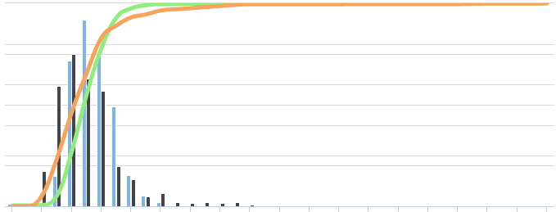
250
100%
Frequency distribution of Ping RTTs between
pinger.slac.. & pinger-raspberry.slac..
200
75%
150
From Pinger
Frequency
Cumulative Frequency
From Raspberry
50%
100
From Pinger%
50
25%
From Raspberry%
0
0%
0.64
0.72
0.8
0.88
0.96
1.04
1.12
1.2
1.28
1.36
1.44
1.52
1.6
1.68
1.76
1.84
1.92
2
2.08
RTT msec.

Slide 7
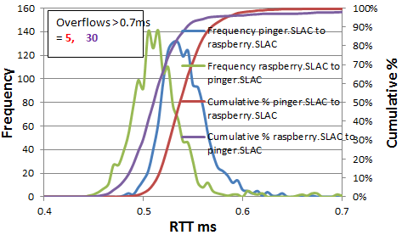
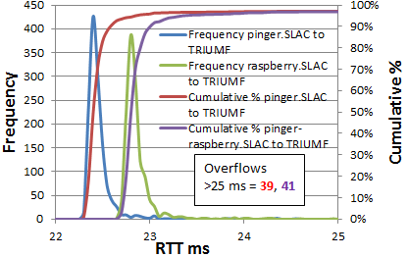
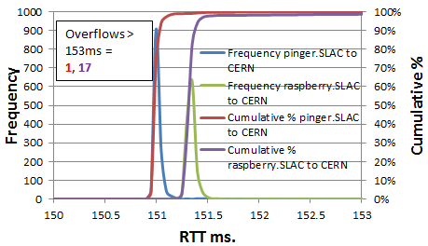
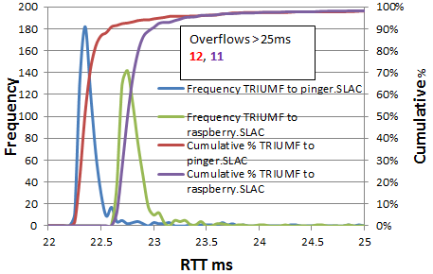
A
B
C
D

Slide 8
Average RTTs from pinger.SLAC and pinger-raspberry.slac to TRIUMF. The plot cuts off at about the cumulative 98%. The number of overflows not plotted are indicated.
For original see
https://confluence.slac.stanford.edu/download/attachments/192190786/ipdv-errors.xlsx
Tab hist-pinger-sitka

Slide 9
See mtr-localhost.xlsx tab diff mtr

Slide 10
See https://confluence.slac.stanford.edu/download/attachments/192190786/prob.xlsx
Tab hist-ipdpinger-sitka
Plot of the an IPD distribution. The plot is cut off below the 2% threshold
and above the 98% threshold. The number outliers is shown as are the minimum
and maximum values of IPD.

