Slide 1



sitka.triumf.ca to pinger.slac.stanford.edu
40ms
20ms
pinger-raspberry .slac.stanford.edu to sitka.triumf.ca
40ms
RTT milliseconds
20ms
pinger.slac.stanford.edu to sitka.triumf.ca
0.4%
Loss probability
40ms
0.3%
20ms
0.2%
22 Jun
29 Jun
6 Jun
13 Jul
loss
min
avg
max

Slide 2
pinger-raspberry .slac.stanford.edu to sitka.triumf.ca
40ms
RTT milliseconds
20ms
pinger.slac.stanford.edu to sitka.triumf.ca
0.4%
Loss probability
40ms
0.3%
20ms
0.2%
22 Jun
29 Jun
6 Jun
13 Jul
loss
min
avg
max

Slide 3
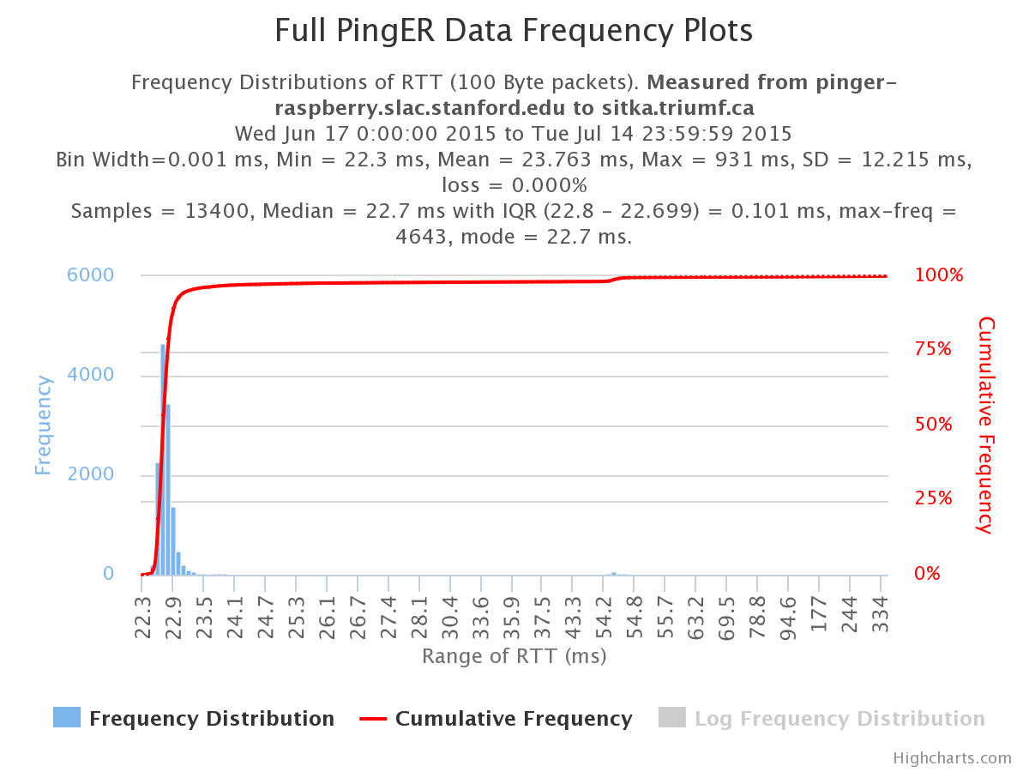

Slide 4
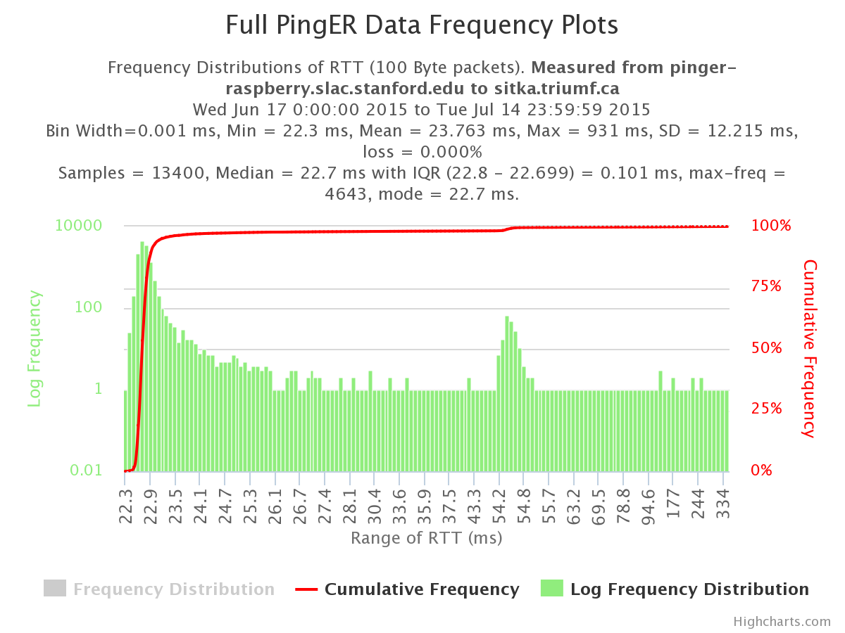

Slide 5
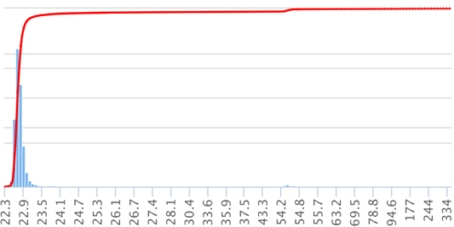
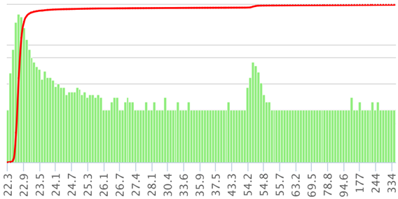
6000
100%
10000
100%
Ping RTT frequency distribution
From pinger-raspberry to TRIUMF
Log frequency scale
75%
Ping RTT frequency distribution
From pinger-raspberry to TRIUMF
Linear frequency scale
4000
100
50%
2000
25%
1
0
0.01
Range of RTT ms
Range of RTT ms

Slide 6
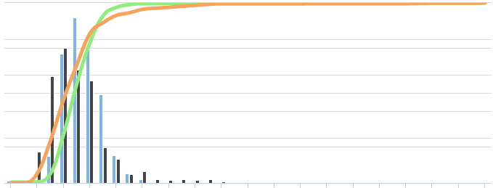
250
100%
Frequency distribution of Ping RTTs between
pinger.slac.. & pinger-raspberry.slac..
200
75%
150
From Pinger
Frequency
Cumulative Frequency
From Raspberry
50%
100
From Pinger%
50
25%
From Raspberry%
0
0%
0.64
0.72
0.8
0.88
0.96
1.04
1.12
1.2
1.28
1.36
1.44
1.52
1.6
1.68
1.76
1.84
1.92
2
2.08
RTT msec.

Slide 7
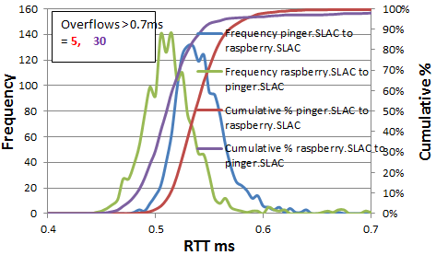
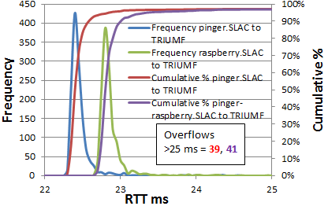
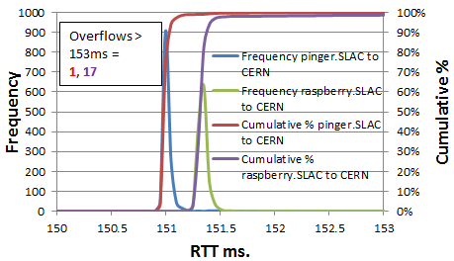
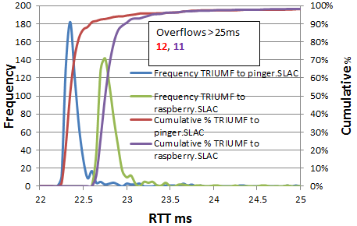
A
B
C
D

