Slide 1



sitka.triumf.ca to pinger.slac.stanford.edu
40ms
20ms
pinger-raspberry .slac.stanford.edu to sitka.triumf.ca
40ms
RTT milliseconds
20ms
pinger.slac.stanford.edu to sitka.triumf.ca
0.4%
Loss probability
40ms
0.3%
20ms
0.2%
22 Jun
29 Jun
6 Jun
13 Jul
loss
min
avg
max

Slide 2
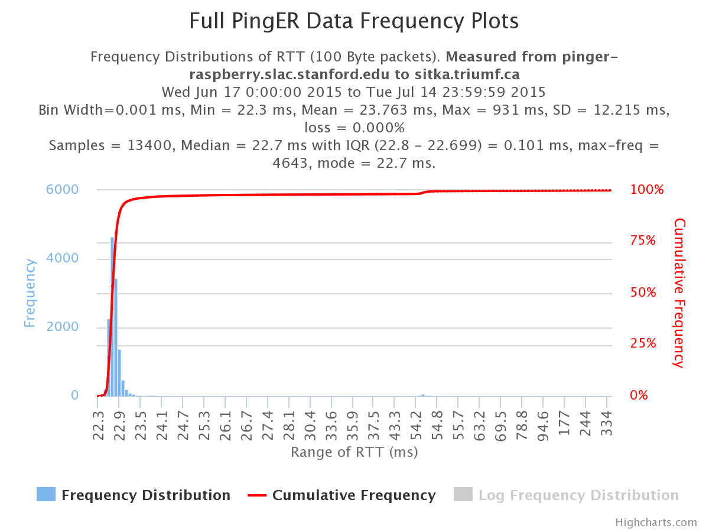

Slide 3
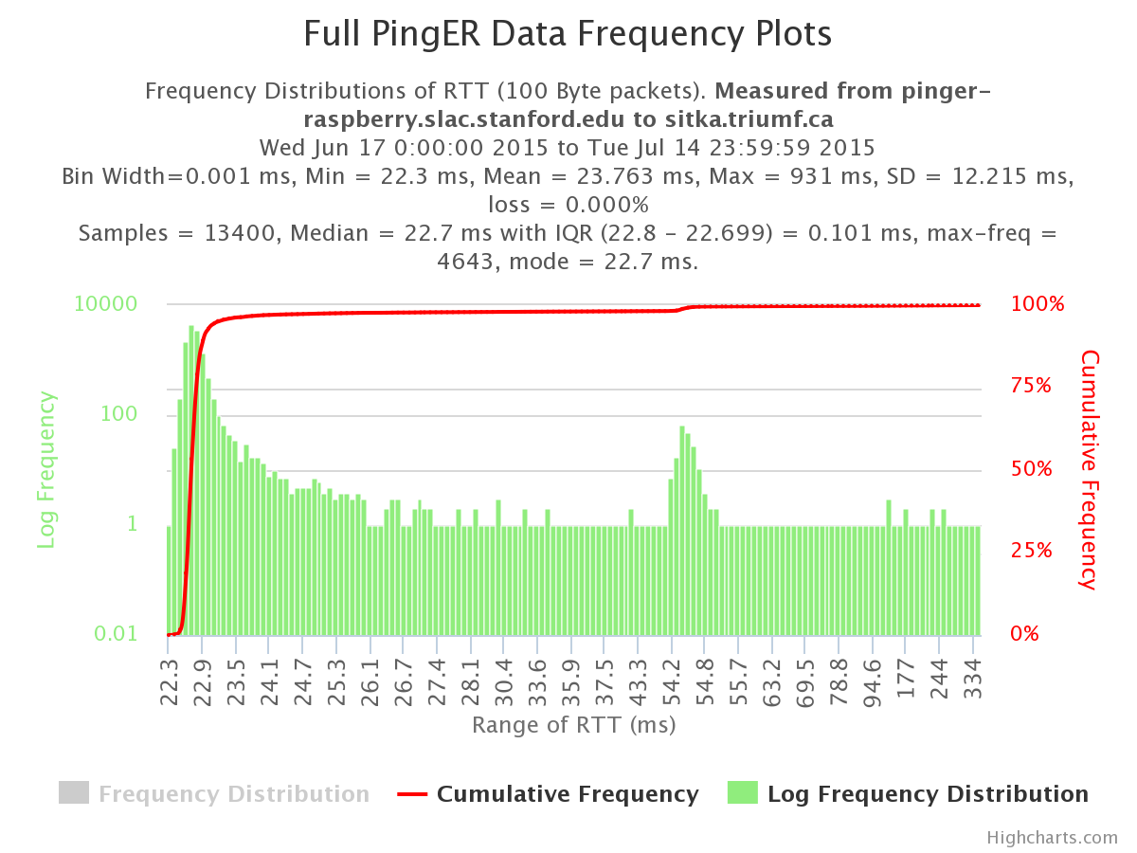

Slide 4
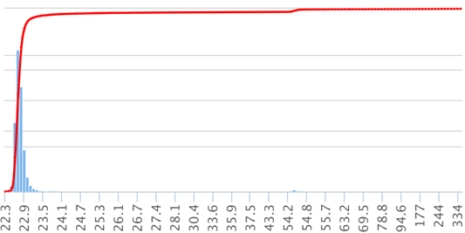
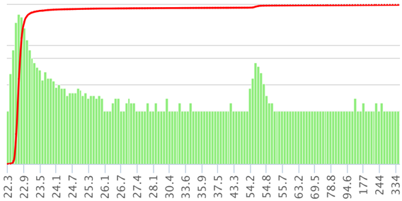
6000
100%
10000
100%
Ping RTT frequency distribution
From pinger-raspberry to TRIUMF
Log frequency scale
75%
Ping RTT frequency distribution
From pinger-raspberry to TRIUMF
Linear frequency scale
4000
100
50%
2000
25%
1
0
0.01
Range of RTT ms
Range of RTT ms

