Slide 1

Update on Accelerator Commissioning Plan
Todd Satogata
Accelerator Physics Group Head
Center for Advanced Studies of Accelerators
Accelerator Readiness Review
August 26, 2014

Slide 2
Outline
Fall 2014 Beam Parameters
Fall 2014 Beam Schedule
  Overview
  Details
Accelerator Procedures and Plans
  Cold Start
  12 GeV Beam Commissioning
  Optics Restoration and Finalization (ORFP)
  New Test Plans
Organizational and Meeting Structure
Summary

Slide 3
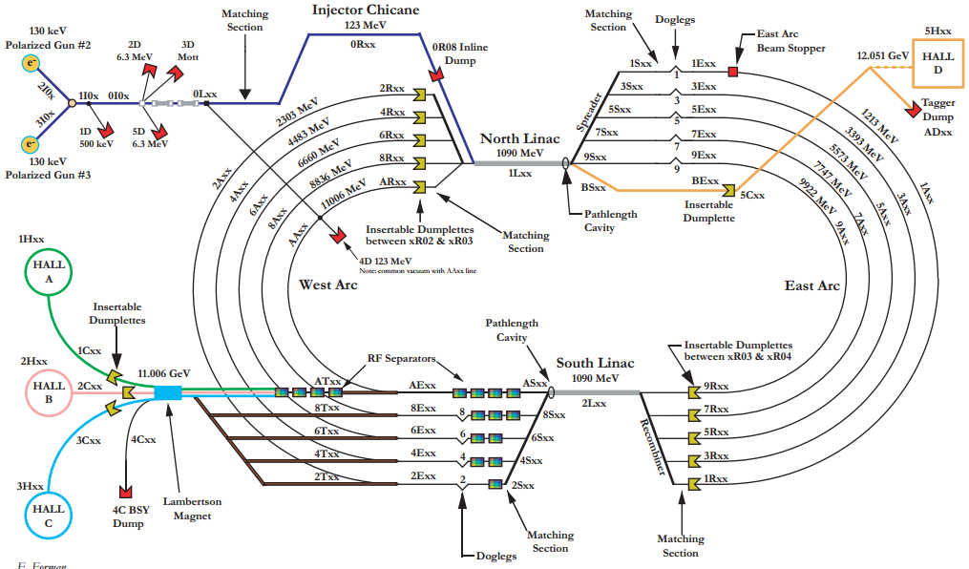

Accelerator Overview

Slide 4
Fall 2014 Beam Parameters
909 MeV/linac, 102 MeV injector: E_{tot}=10102 MeV
Repetition rate: 499 MHz (standard laser frequency)
Beam modes
  Viewer limited, tune, CW and “expert” modes
Beams passes/energies for halls
  Hall D: 5.5 pass, ~10 GeV
  Hall A: 4 pass, ~7.3 GeV (polarized; ran 3 pass beam Apr 2014)
  Hall B: 1 pass, ~1.8 GeV
Beam currents for halls
  Hall D: 50 nA to 200 nA (preferably as low as achievable)
  Hall A: 20 uA (short duration to dump power limit for target boiling test)
  Hall B: 1 nA to 200 nA

Slide 5
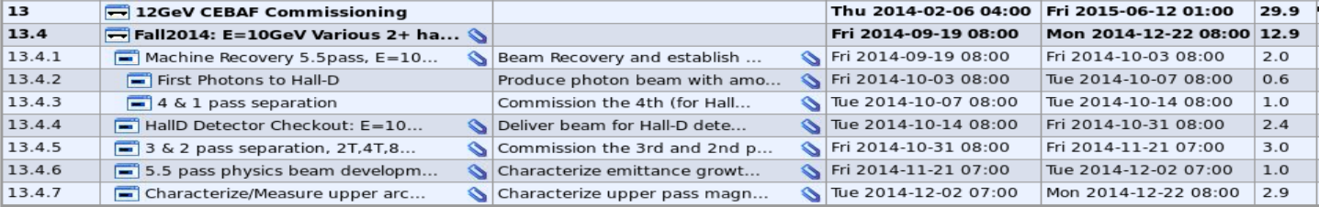
Fall 2014 Beam Schedule
Present schedule has ~90 days of beam operations
Section numbers from FY13-16 task tracking
Fall 2014 major deliverables:
  12 GeV Project Level 2 Milestone
    Hall D Beam Commissioning Complete (Dec 31 2014)
  Push towards multi-hall beam development
    Commission transfer lines, (some) beam separation
  Push energy; characterize higher pass optics

Slide 6
13.4.1: Recovery, 5.5 pass, E=10 GeV
Fri Sep 19-Fri Oct 3
Beam recovery and establish CW beam to Hall D tagger
  Reestablish tune-mode 5.5pass E>10GeV beam to hall D tagger beam dump.
  Establish pathlength control throughout all 5.5 passes
    Dogleg magnet upgrade completed summer 2014; no new ps
  Commission synchrotron compensation coils
  ORFP and beam matching as needed to achieve physics quality setup
  Establish CW beam to tagger vault
8.1 Radcon: Radiation measurements at the Tagger truck ramp, service buildings, above berm and other locations during low power operational beam loss events in the tagger magnet

Slide 7
13.4.2: First Photons to Hall D
Fri Oct 3-Tue Oct 7
Produce photon beam with amorphous radiator
  Active collimator readout needed in MCC for this effort
  No hall target operations (other than air)
Hall D initial detector checkout (see Wednesday presentations)
Start CD4B-III Project deliverable (Hall D detector operational)
8.2 Radcon: Radiation measurements at the around Hall D,
Hall D truck ramp and potentially occupied areas preceding first photon beam delivery to Hall D.
8.3 Radcon: Radiation measurements around Hall D, Hall D truck ramp and potentially occupied areas during first photon beam delivery to Hall D.

Slide 8
13.4.3: 4-Pass, 1-Pass Separation
Tue Oct 7 – Tue Oct 14
Commission the 4th pass separator (Hall A)
Commission the 1st pass separator (Hall B)
Hall D will be down for detector installation
  Beam stoppers, dipole ps lockouts will prevent Hall D beam
If time is available, establish beams to Halls A (4th pass) and B (1st pass)
Hall A magnetic transport on 3rd pass was established very quickly (less than one day) in March 2014
Hall B transport line has not yet seen beam in 12 GeV era

Slide 9
13.4.4: Hall D Detector Checkout
Tue Oct 14 – Fri Oct 31
E_{tot} > 10 GeV
Deliver beam for Hall D detector checkout
Complete CD4B Project deliverable
If beam RF separators are commissioned and beam to A or B is truly parasitic then beam to A or B possible during this activity
8.3 Radcon: Radiation measurements around Hall D, Hall D truck ramp and potentially occupied areas during first photon beam delivery to Hall D. Thickest photon amorphous radiator in position, highest expected Fall 2014 CW beam current.

Slide 10
13.4.5: 3/2 Pass Separation, 2T/4T/8T
Fri Oct 31 – Fri Nov 21
Commission the 3rd and 2nd pass separators
Complete commissioning of beam transport lines (2T, 4T, 8T, AR)
Beam to Hall D (5.5 passes) when possible
Establish separated beam to Hall A (4th pass) and, if parasitic, Hall B (1st pass)

Slide 11
13.4.6: 5.5 Pass Physics Beam Development
Fri Nov 21-Tue Dec 2
Characterize emittance growth and beam properties in upper arcs during 5.5 pass 10 GeV beam operations
Perform configuration change to E_{tot}=11 GeV
Beam optics studies with 5.5 pass E_{tot}=11 GeV beam
  Matching and optics optimization
  Emittance evaluation
When possible, deliver beam to users
No beam over Thanksgiving weekend

Slide 12
13.4.7: Upper Arc Beam Properties
Tue Dec 2 – Mon Dec 22
Continue energy change to E_{tot}=11 GeV if necessary
Characterize upper pass magnetic elements to establish operational procedures for efficient CEBAF out-year operations.
Beam studies performed during weekdays
Owl shifts and weekends: physics operation to Halls D, A, B if not needed to acquire beam physics deliverables

Slide 13
Procedures and Tools
The Commissioning Plan continues to provide a framework for restarting CEBAF.
  It relies on standard operating procedures and tools that were developed over the course of 6 GeV operations and have been updated for 12 GeV commissioning and operations.
Primary documents include:
  Injector Procedures
  Accelerator Cold Start Procedure
  Optics Restoration and Finalization Procedure
  Hall Delivery Procedures
Primary tools include:
  30 Hz. differential orbit tuning
  Pathlength measurement system
  Beam energy monitor
  New steering and quad centering applications

Slide 14
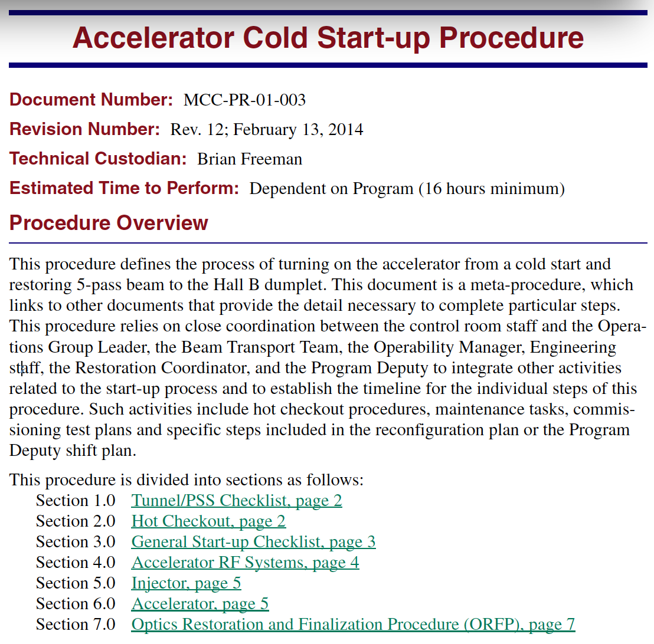
Cold Start Procedure
Contains references and configuration checklists for restart after shutdown
  Includes startup checklists for all major subsystems
Identifies specific roles and communication responsibilities related to coordination of startup activities
Updated in Feb 2014 with references to 12 GeV procedures and controls

Slide 15
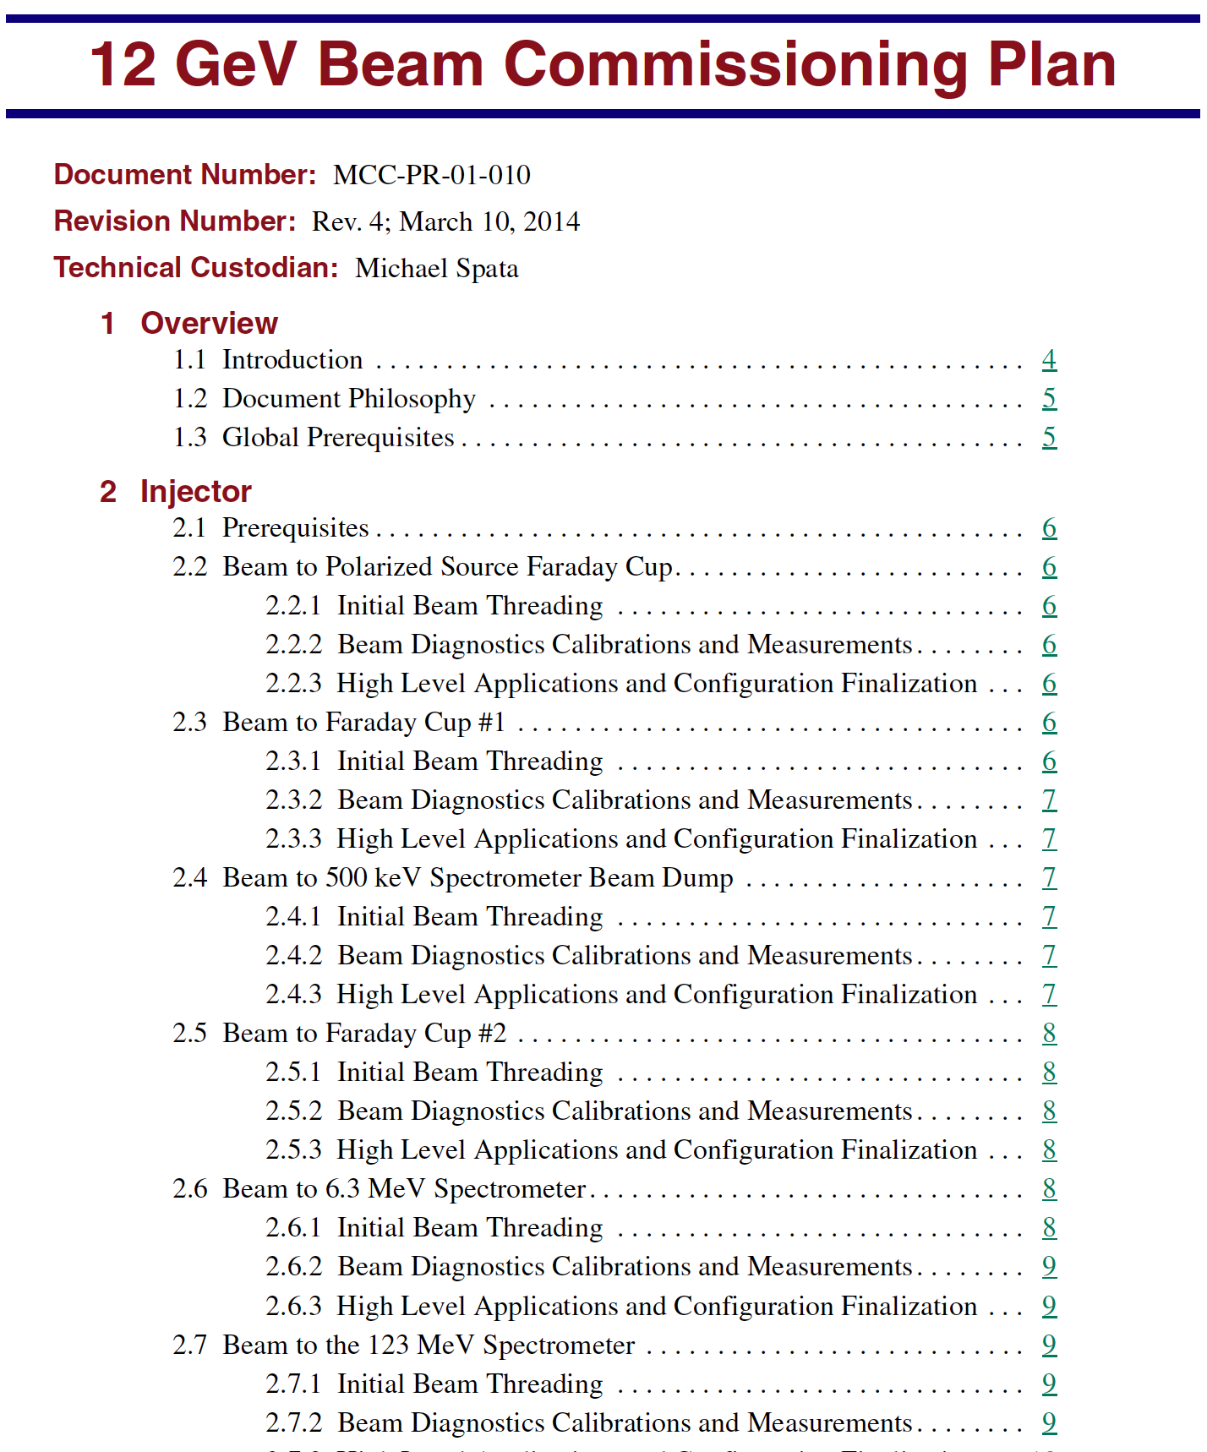
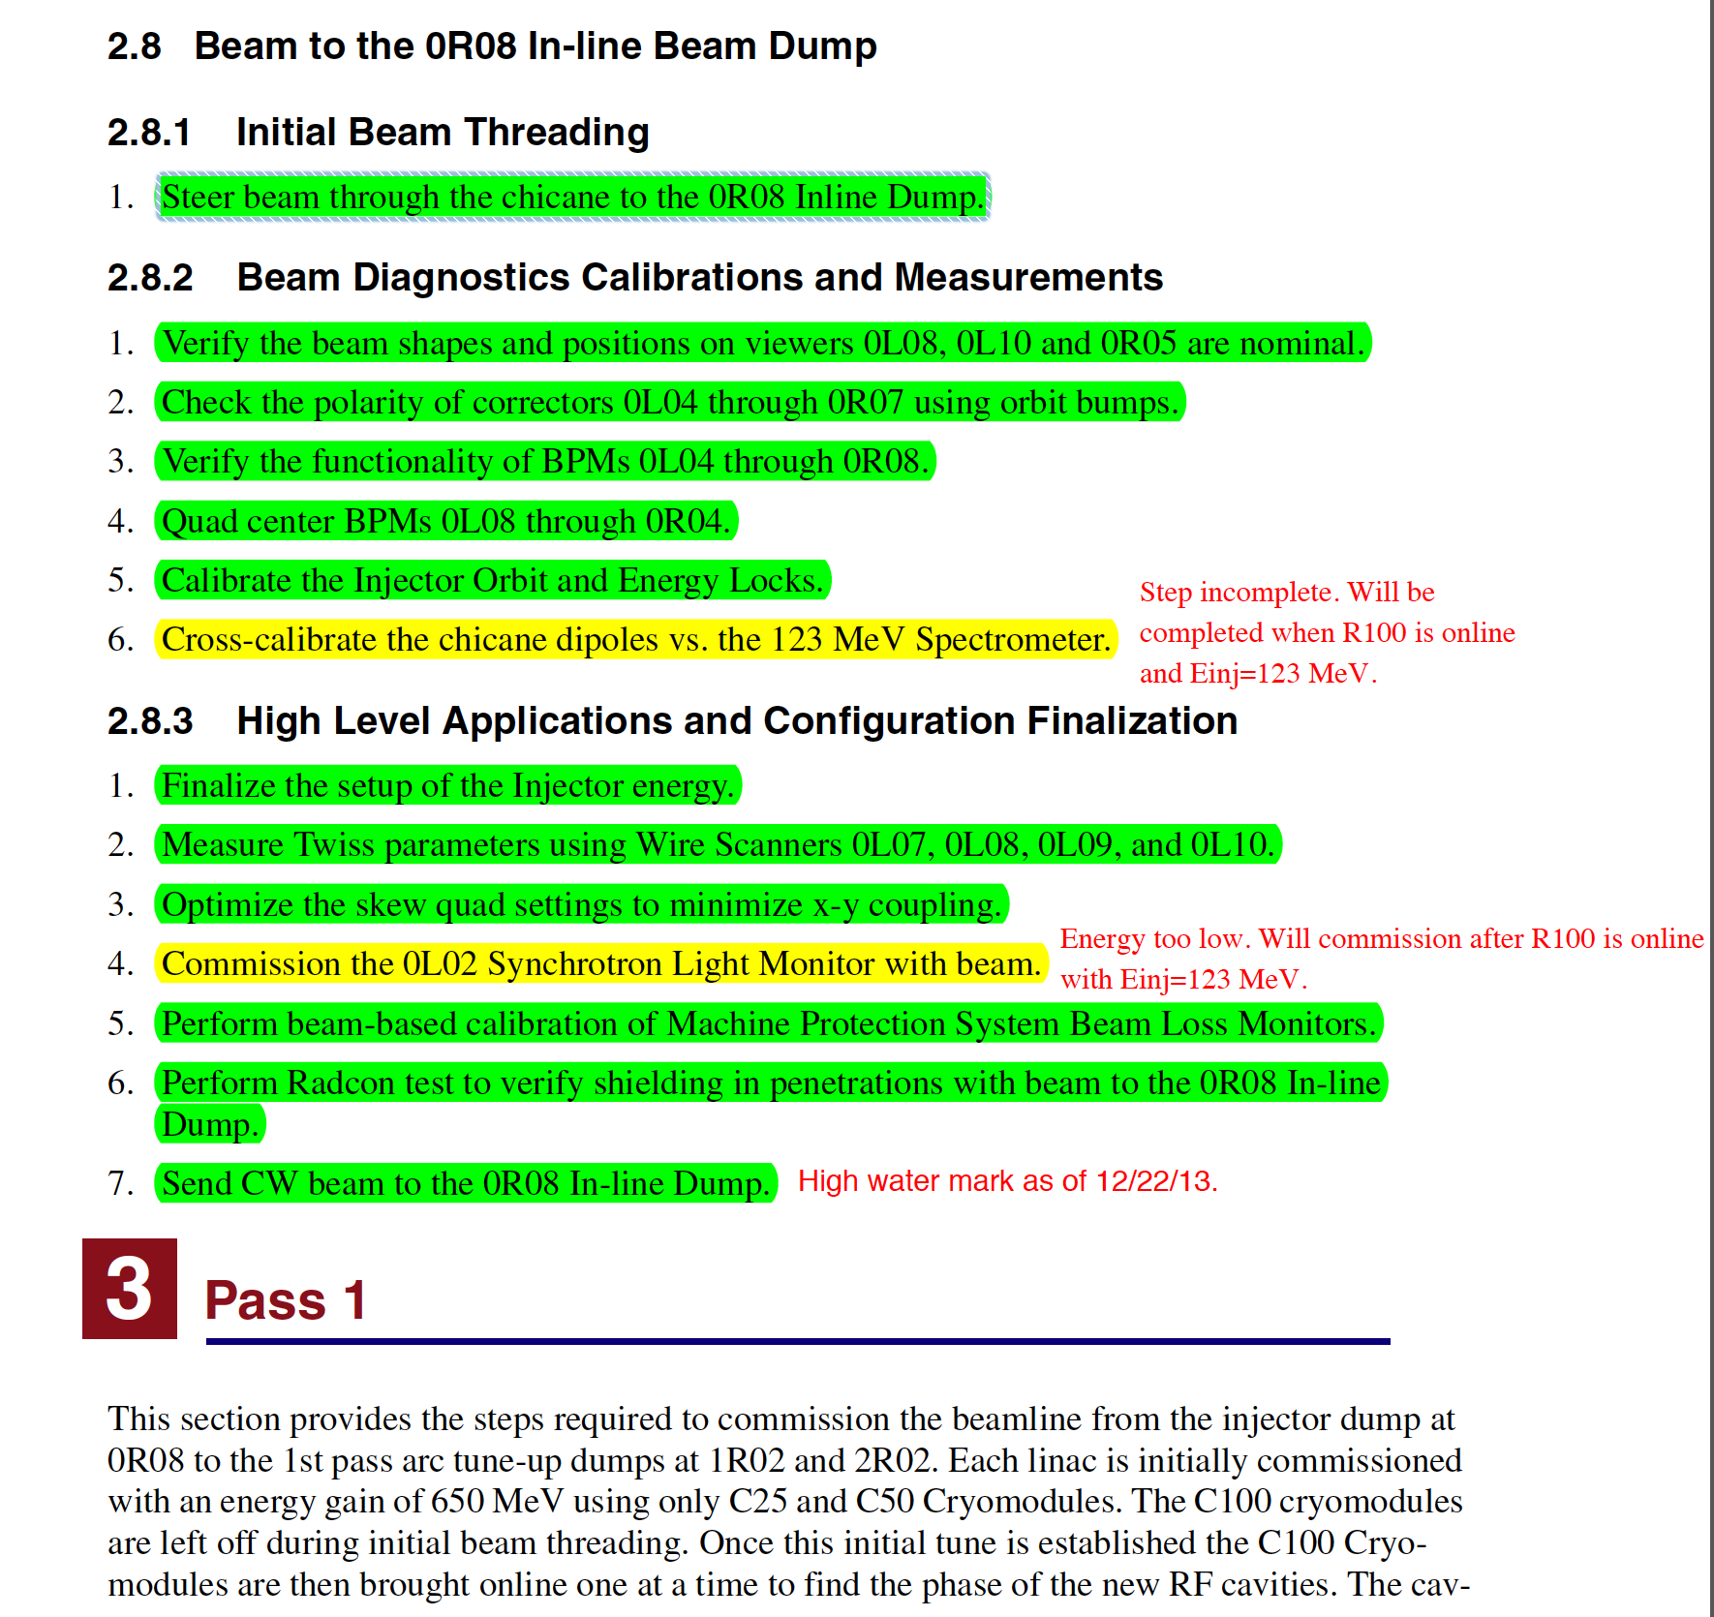
Beam Commissioning Procedure
Defines how 12 GeV CEBAF will be commissioned and tuned for physics quality beam through CD4 DOE milestones
Builds on, and calls out, relevant updated 6 GeV era procedures, new hall/beamline procedures
Annotated weekly to document completed and deferred steps, and achievements
Most steps completed as of ARR3, but will be used to guide and document physics-quality Fall 2014 5.5-pass startup

Slide 16
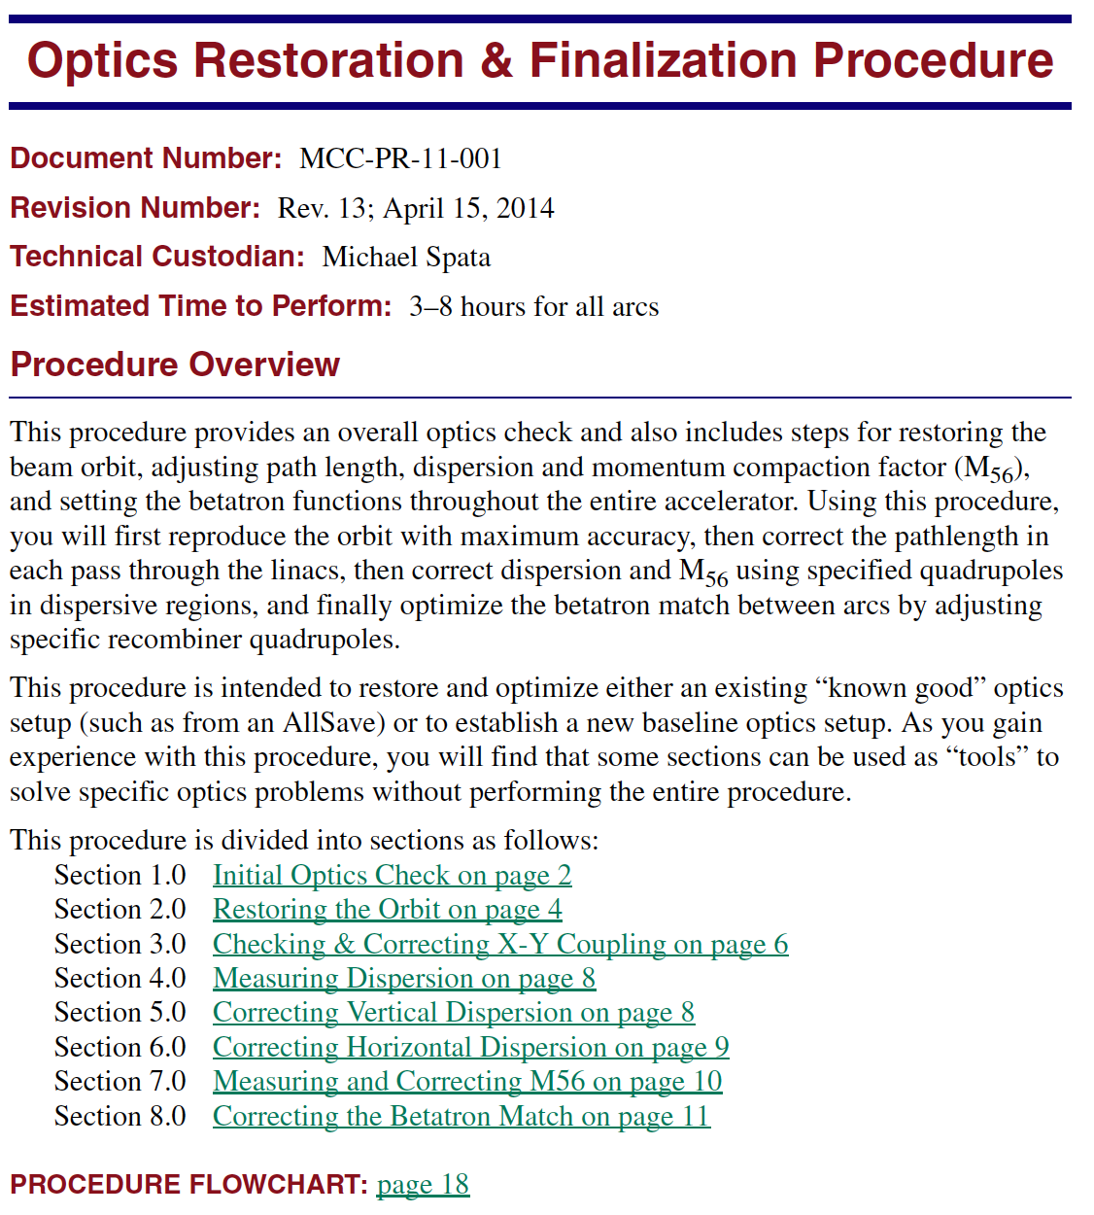
Optics Restoration and Finalization
Contains steps for producing physics-quality beam steering, matching, decoupling, and longitudinal compression
A live procedure, evolving from 6 GeV era procedure
  Updated with best optics control points based on model-based tuning
  Optics on call beam physicists available to help ensure that iterative procedure converges
  Lattice improvements in development to improve convergence, orthogonality of tuning knobs

Slide 17
New Test Plans
Beam Test Plans to refine setup and/or develop tools
  AutoQuad (set BPM zero reading to nearest quad center; new algorithm)
  ArcSteer (automated beam steering; new algorithm)
  Pathlength management system (new tools)
  Spreader/recombiner balancing (new algorithm)
  Effect of linac energy profile on arc match (new algorithm)
  Synchrotron coil commissioning (new system)
  Emittance measurements and optimization
  Gradient calibration (C25s/C50s)
  Linac energy management (new optimization)

Slide 18
Organization and Communication
Program Deputy: 2-week strategic operations organization
Daily 07:45 / 08:00 Operations meetings
  Daily review, tactical input to next 24 hours of PD plans
Commissioning Planning Team (Monday PM)
  Review week-long progress, tactical input to BTeam
BTeam (Tuesday PM)
  Tactical brainstorming, beam studies planning/reporting
Weekly Operations Meeting (Wednesday PM)
  Weekly strategic scheduling, priorities, guidance
Consistent with proven success during CEBAF 6 GeV era

Slide 19
Summary
We have a well-developed plan and schedule for Fall 2014
  Moving from 12 GeV commissioning towards 12 GeV ops
  Includes 12 GeV Project Level 2 Milestone (Hall D commissioning)
  Includes separator commissioning and potentially beam delivery to Halls D, A, B
Continue to follow 12 GeV commissioning plan and associated procedures
  Procedures are documented, controls/reviews established
  Demonstrated successful commissioning approach in early 2014
New test plans and systems identified and tracked
  Prioritized and scheduled as needed during tactical meetings
  Tactical and strategic aspects of transition from commissioning to early physics operations addressed

Slide 20
Spare Slides

Slide 21
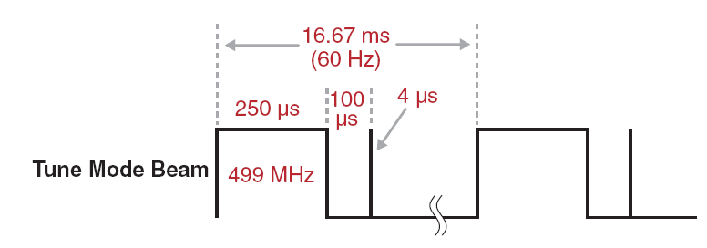
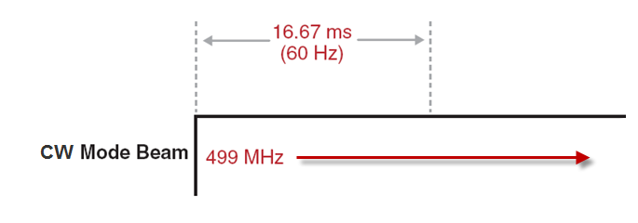
Minimizing Beam Power
Mike Spata: ARR2
Low average power “Tune Mode” beam is used to initially commission beamlines.
The 250 μs pulse width at 60 Hz provides a 1.5% duty cycle.
A nominal pulse height of 4 μA at 12 GeV provides only 720 W of beam power.
CW Beam provides a 100% Duty Cycle

Slide 22
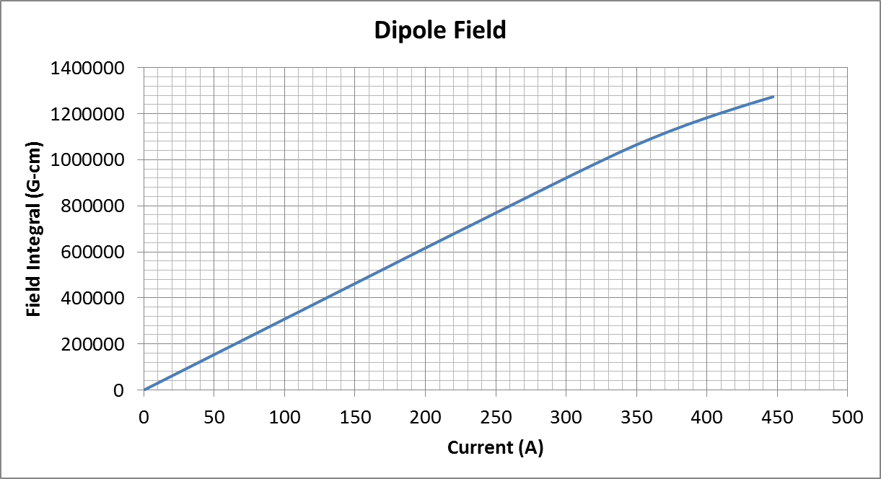
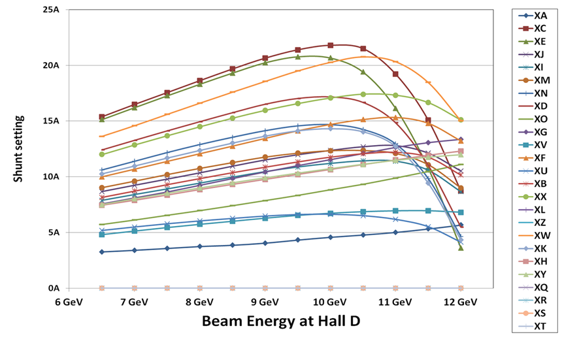
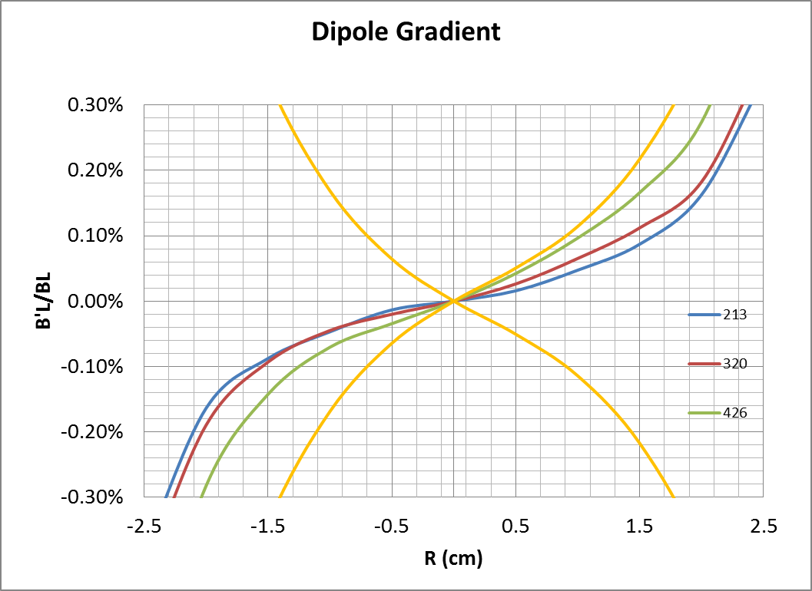
Magnet Field Quality
Mike Spata: ARR2
Magnet Measurement Facility Data
  All dipole and septa magnets measured for field quality.
  All quad families measured for field quality.
  Formal release process ensures that the installed system will meet specifications.
  Data entered into the CEBAF Element Database (CED).
  Control system gets information from the database.

Slide 23
Diagnostics
Mike Spata: ARR2
Bunch Length Monitors
  6 GHz pill box cavities for optimizing longitudinal beam profile in the Injector.
Beam Viewers
  Insertable flag for monitoring general beam quality. Located in all beamlines for measuring spot evolution. Also used in dispersive locations to phase cavities.
Beam Position Monitors
  4-wire M15 and M20 style in all existing beamlines and the new Arc 10. Additional BPMs added to new Spreaders and Recombiners.
  Stripline style BPMs newly developed for the Hall D beamline.
Pathlength Monitors
  499 MHz pill box cavities located at the end of the linacs to measure arrival time of the beam for each pass.
Beam Profile Monitors
  Wire Scanners used for matching in the injector, at the entrance of each Arc and in front of the 2 kW beam dumps for Halls A, B, C and D.
  Synchrotron Light Monitors in Injector, Arc 1, Arc 2, Arc 10, and Hall beamlines.

Slide 24
High Level Applications Software
Mike Spata: ARR2
RF Gradient Calibration
  Calibrates the gradients of the SRF cavities relative to a standard using the down beam Arc to measure the energy.
CMPQ (“Compare Quads”)
  Tool for comparing and managing the online quadrupole settings relative to the elegant model.
qsUtility
  Used for taking multi-harp emittance data.
QTSnyder
  Tool for tuning the optics in the main accelerator. Used to minimize errors in the Courant-Snyder invariant.
Orbit Locks
  Used to stabilize the beam position and angle at key points around the machine. Two correctors in each plane are used to maintain the orbit.
Energy Locks
  Used to stabilize the beam energy in the North and South Linacs using Arc 1 and Arc 2 as a spectrometer.

Slide 25
High Level Applications Software
Mike Spata: ARR2
elegant Download Tool (new)
  Determines machine settings from required energies and prepares them for download to the accelerator.
Injector Energy Management
  Sets cavity gradients and quadrupole settings for the Injector cryomodules.
Linac Energy Management
  Sets cavity gradients and quadrupole settings for the linac cryomodules.
Autosteer
  Minimizes transverse orbit errors for a beamline segment.
AutoQuad (new algorithm)
  Determines the magnetic center of a quad relative to the electrical center of an adjacent BPM.
Krest
  Maintains the optimal phase of the SRF cavities in the accelerator.

