Slide 1
Network Highlights
Antonio Ceseracciu, Yee Ting Li, Les Cottrell

Slide 2
IP Address Management (IPAM)
Goal:
replace aging and deficient IP Address Management system for 27,000 IP addresses at SLAC
cleanup of stale and incorrect data
NetDB Provides:
comprehensive roles based access control
  enable delegation of access and control to users
support for DHCP
  Simplify setting and changing of IP addresses for users
  Enable IPv6 for the next gen Internet with huge increase in address space
ongoing support from Stanford (opensource software)
advanced search capabilities

Slide 3
Testing, Reach Out and go live
Testing
Migrated data from old to new system
Careful comparison of information in old and new systems
Review of assets for lack of usage for many months
Working with admins, owners to improve asset information
Training:
5 training sessions have been provided to over 60 users of the IP address management system
open door sessions for ongoing training
Dates:
originally planned for 29th October 2014; delayed due to rescheduling of MCC downtime
system will be frozen 10th November 2010.
cutover now 11th November 2014

Slide 4
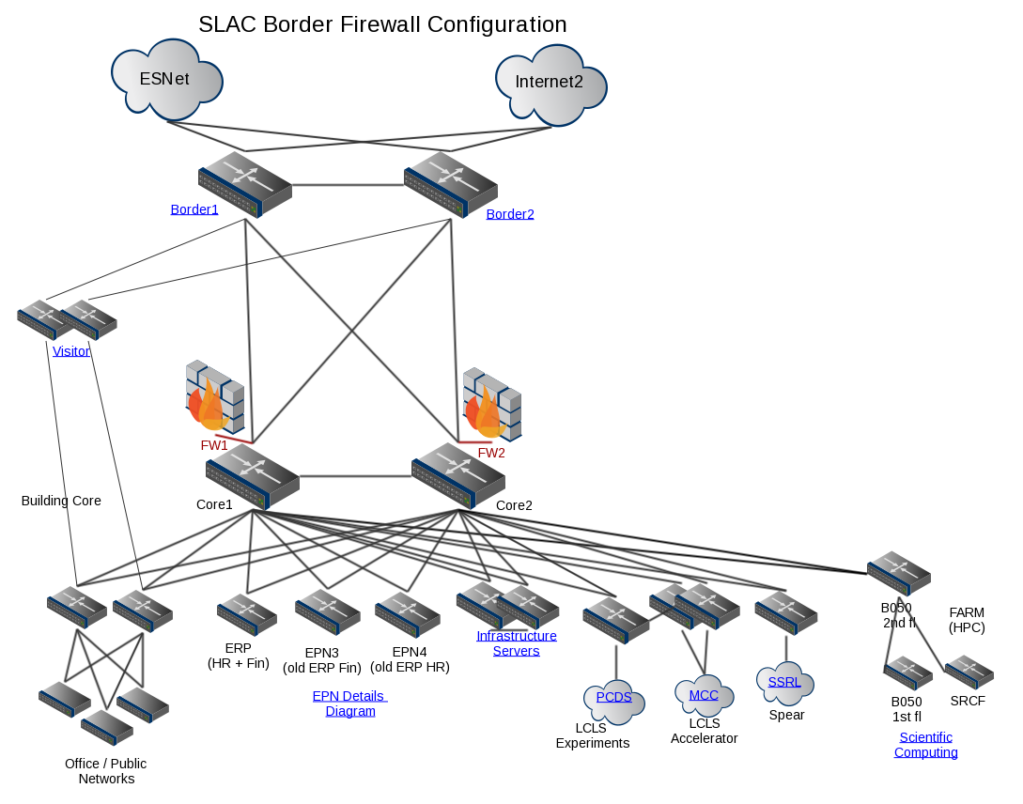
Network Security
4
The Border Firewalls – pair of Palo Alto Networks 5060s - are installed and connected to the two SLAC core routers
Policy Based Routing is used to selectively
steer traffic in/out the firewalls,
for ScienceDMZ bypass
The Visitor network is
now also protected by
the PANs.
The old Blue Coat web
proxy is decommissioned.
BRO IDS is used to monitor
the bypass links.

Slide 5
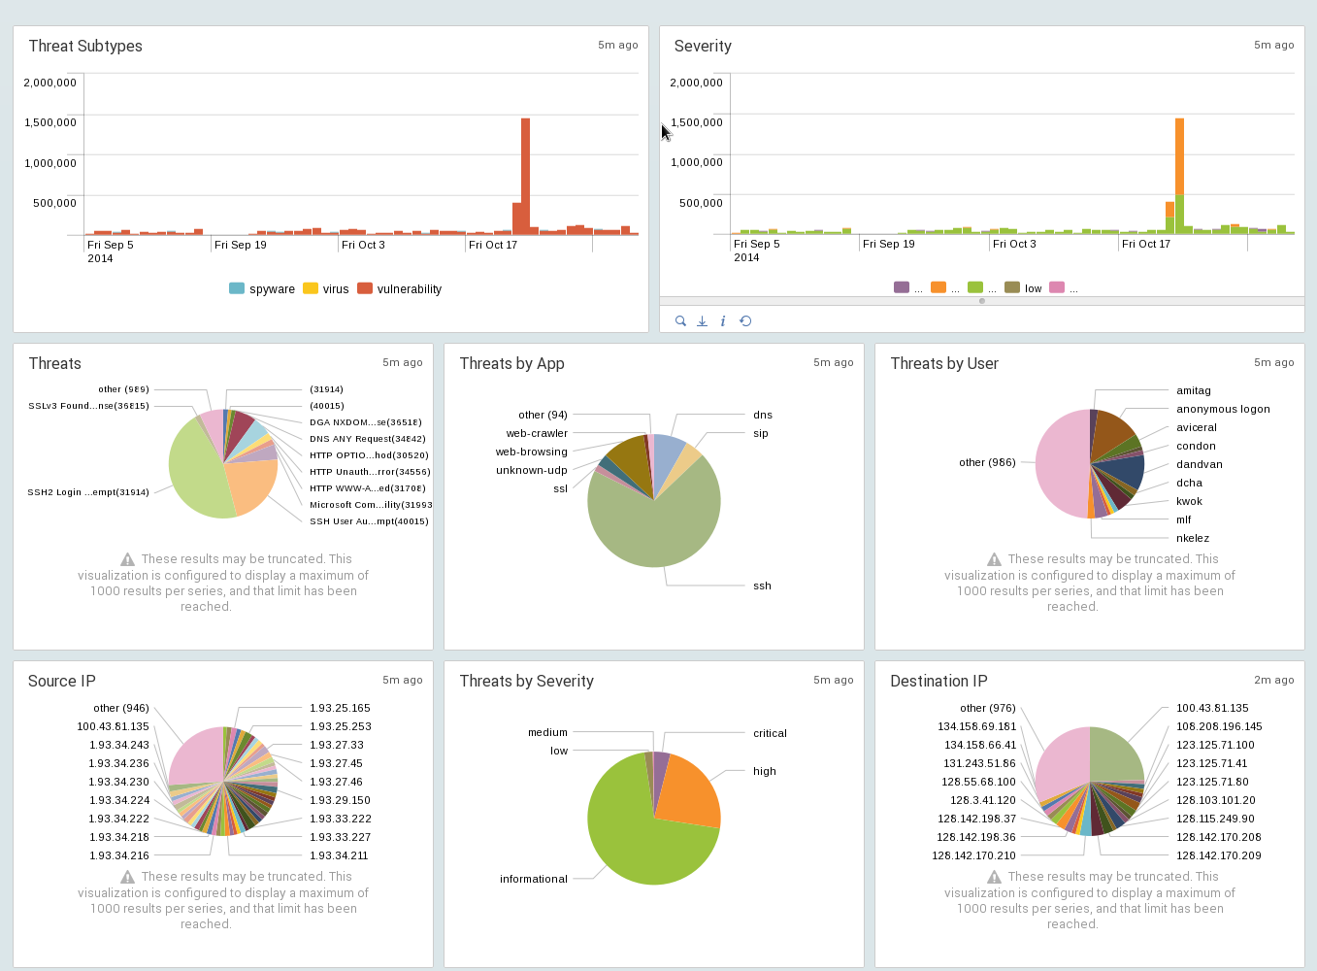
Firewall detection reports
5

Slide 6
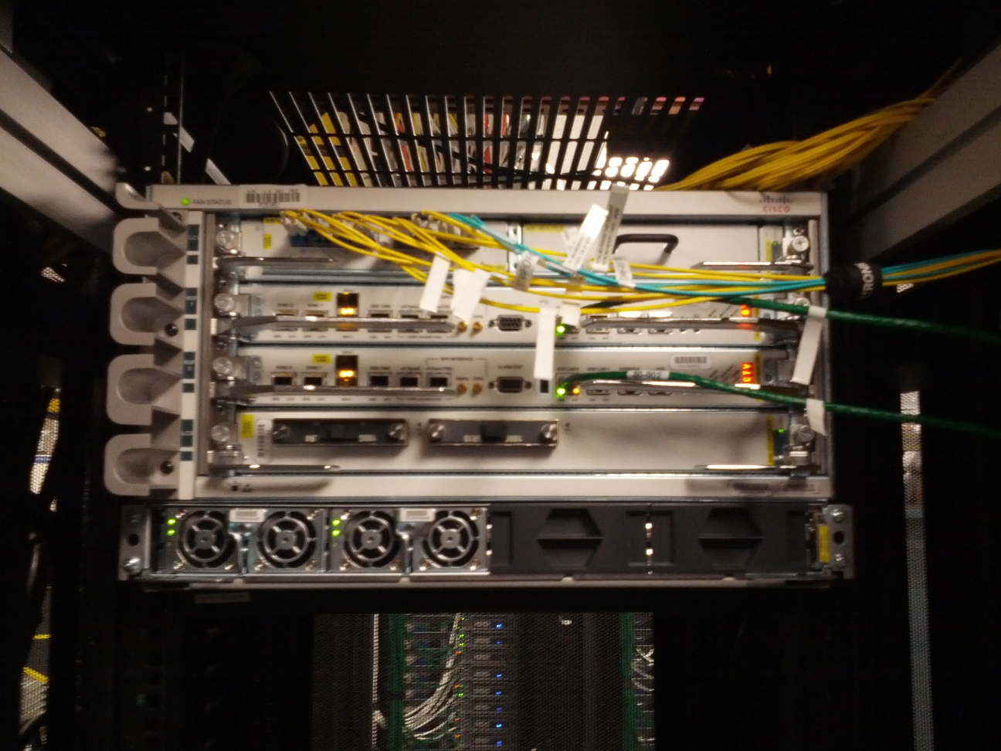
Technical developments - HPC
6
Stanford Research Computing Center located at SLAC
  2x40G HPC connectivity to main SLAC data center
Phased 100G network upgrade
  Phase 1 funded: single 100G border router for HPC
  Cisco ASR 9904 acquired and installed
  Later phases will enable core
  network to support 100G
    This will eliminate need
    for HPC bypass
  See diagrams next page

Slide 7
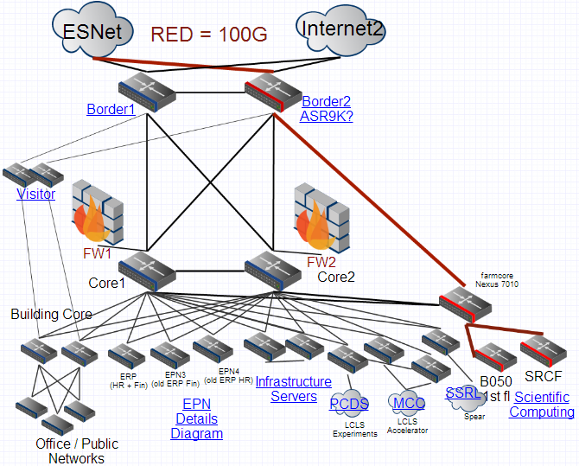
Single Modern Router replaces one side of Border between SLAC and the Internet
Science today has big data requirements: LHC, LCLS, KIPAC + to come LSST, LCLS-2…
Outstripping today’s 10Gbps
It is a bottleneck
Single 100G router to
connect science to
Internet
By pass core & FW
Only for Internet traffic
Failover to 10Gbps
Farm
core
Notes:
Bro provides passive Intrusion Detection System (IDS) for scientific network without impacting performance

Slide 8
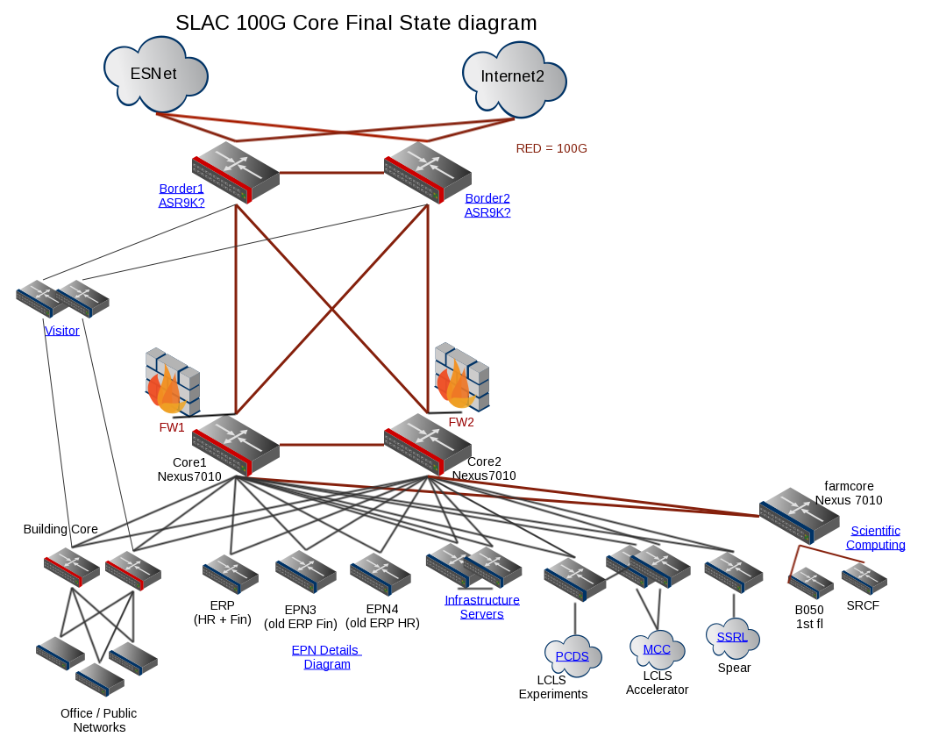
Technical developments – 100G phase 1 vs final state
8
Existing 9 year old core network replaced
All red links
are 100Gbps
No single point of failure for science
FY15

Slide 9

The end: Questions?
Contacts:
Associate CIO IT-operations
chrisken@slac.stanford.edu
Network manager:
cottrell@slac.stanford.edu,
Network Engineer
antony@slac.stanford.edu

Slide 10
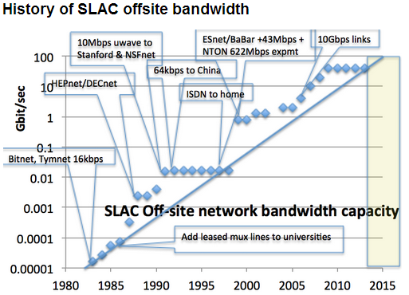
Evolution
Ethernet standard recent growth (technology leaps each 6 years)
10G Ethernet delivered 2005,
100G Ethernet delivered 2011,
400G Ethernet standards work began 2013 with expected delivery by 2017
Usage of high speed Ethernet
100G for net aggregation
40G for data center hosts
  2014: Costs per Gbit fall about 25% when networks shift from 10 to 40G. (Cisco)
Core beyond end of life:
8 years old as of March 2014
Industry recommendation for core
5-7 year life cycle (Gartner)
  Stanford does every 5 years
Robust, hardened network critical for:
Science, business, mobility, clouds, SaaS …
Notes:
Work quickly grinds to a halt if network dies.

Slide 11
Schedule
Date | Item | Comple tion
2014-08-20 | Submit purchase order | 100%
2014-09-30 | Receive equipment | 100%
2014-09-29 | Obtain change management approval for rtr-border2 replace | 100%
2014-10-7 | Install 100G card and optics on rtr- Farm04* | 0%
2014-10-7 | Pre-requisite: upgrade visitor network Switch* | 0%
2014-10-7 | Pre-requisite: upgrade external network Router* | 0%
2014-10-10 | Replace rtr-border2 with new hardware | 0%
2014-12-10 | Activate 100G link with Farm network | 0%
2014-12-15 | Activate 100G link with ESnet | 0%
* Change submitted, minimal impact since redundancy, immediate backout if prob
Notes:
Green has happened, Yellow this week, orange tentative December/Jan. We are working with Esnet and Stanford to activate the link to the outside world for the orange.There is a small risk when inserting a card that the switch will misbehave, in which case it would need to be rebooted, causing a 20 minutes outage for HPC. This has never happened at SLAC with this platform.

Slide 12
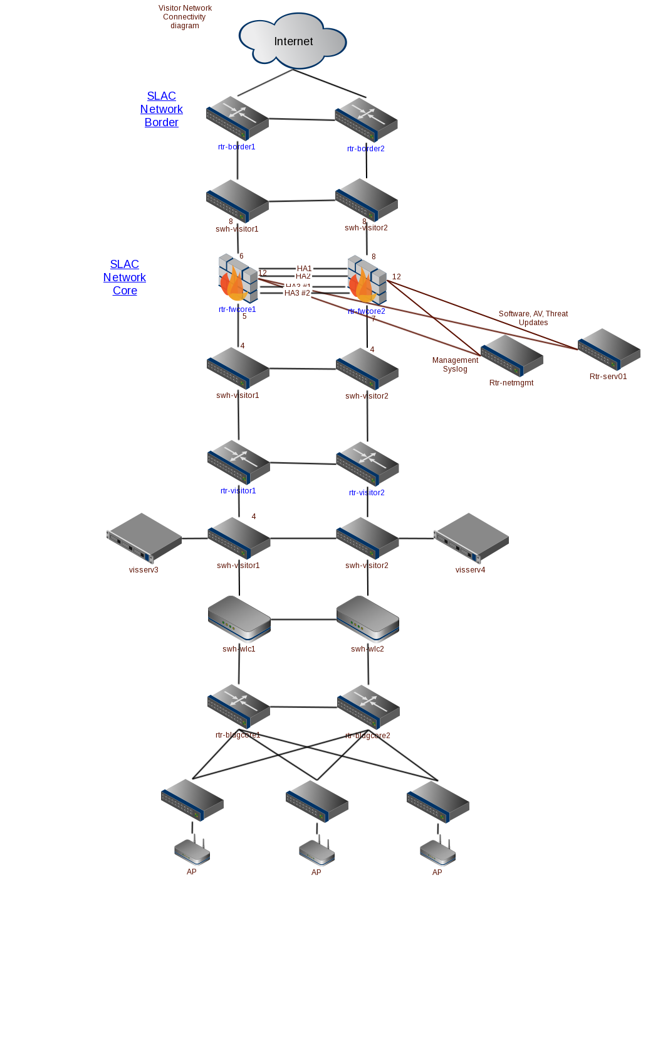
Technical developments - Security
12
The Visitor network is now also protected by the PANs.
The old Blue Coat web proxy is completely decommissioned.

