Slide 1
Efficiently Transferring Petabytes at ~70Gbps
ESCC meeting LBNL,
Chin Fang Zettar, Les Cottrell SLAC, May 5, 2017

Slide 2
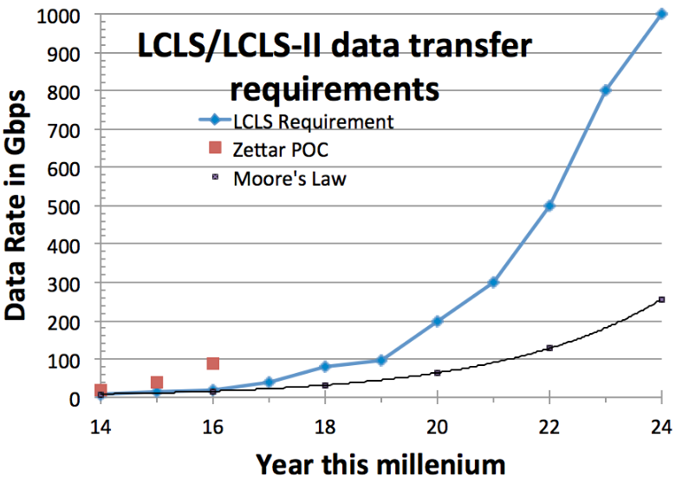
Requirements for LCLS-II
Beam Pulse rate 120HZ=> 1 MHz i.e. factor 10,000
Data rate increase by factor 1000 to Tbps by 2024
Plus
LHC/ATLAS
LSST
The rest
Notes:
Who else needs it:
Science:
Square Kilometer Array
Climate/weather
BIO/Genomics
Oil industry/seismic data
Defense
HPC
Clouds

Slide 3
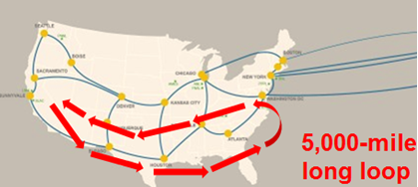




Overview
Transfer files over the 5000-mile OSCARS SLAC link
  Shared in the SLAC production 100Gbps border network
  Need to keep ~ 20Gbps for other production traffic
0.1PB in 3.4 hours at ~70Gbps, 1PB in 34 hours
Using the following testbed:
  Two 2 x1U storage tiers with 8 x Intel DC P3700 U.2 1.6TB NVMe SSDs (each 1U server has 4 x NVMe SSDs)
  Connected by InfiniBand
  Two 2-1U DTN clusters (one sending, one receiving), running Zettar zx.
  Each DTN has 4x10G Ethernet ports, i.e. 2 x 4 x 10Gbps = 80Gbps
All ports are connected to 2 x Arista 7280SE-68 10/100G switches.
One of the Aristas connects to the SLAC Cisco 100GBps border router & thence to ESnet
Note that due to the testbed hardware configuration, the max speed the testbed can attain is ~ 80Gbps.
Storage
DTN

Slide 4
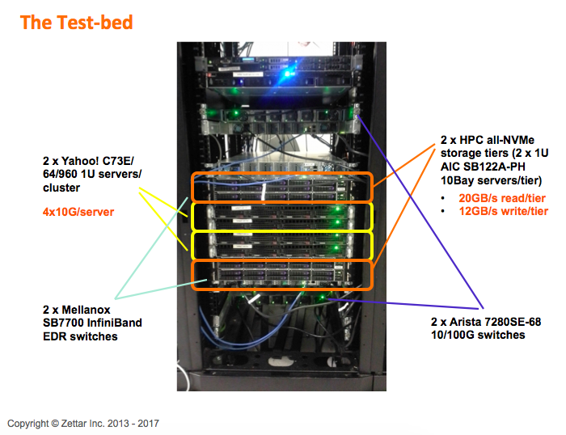
The test bed collocated at SLAC
Storage tiers
DTNs
OSCARS

Slide 5
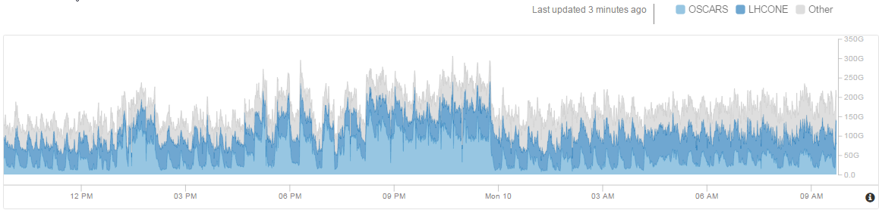
Impact on all ESnet traffic
When running data transfer contributes ~ 1/3 of total ESnet traffic
OSCARS
LHCONE
Other
200G
100G
12pm
3pm
6pm
9pm
Mon 10
3am
6am
9am

Slide 6
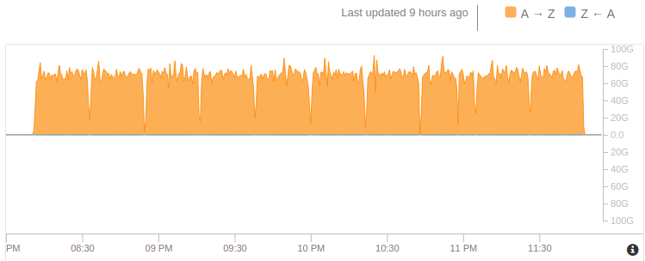
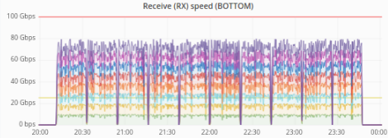
100TiBytes in 3.4 hours Testing
My.es.net
100Gbps
100Gbps
4/9/2017
Zettar Zx monitoring
80
60
40
20
0
20:00
20:30
21:00
21:30
22:00
22:30
23:00
23:30
00:00
10 runs of 10 TiB each = 100TiB took 3.4 hours
~ 1PiB in 34 hours
LCLS-II need to transfer 20PB SLAC => NERSC takes ~1 month with our testbed

Slide 7
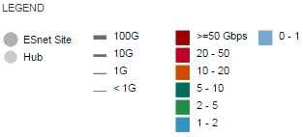
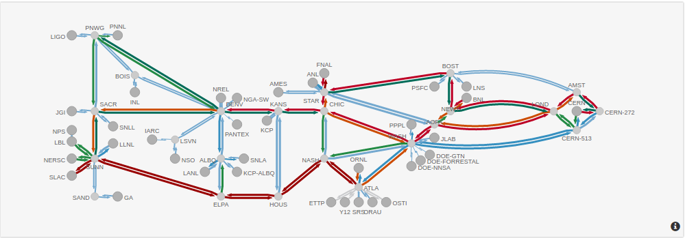

Weathermap of ESnet during PB transfer
The 5000-mile SLAC loop
100*10TiByte transfers
100G
80G
60G
40G
20G
4/12/2017
12:12:33
1 PebiByte in < 1.5days
34hrs 16 mins 51 seconds
4/13/2017
22:29:24

Slide 8
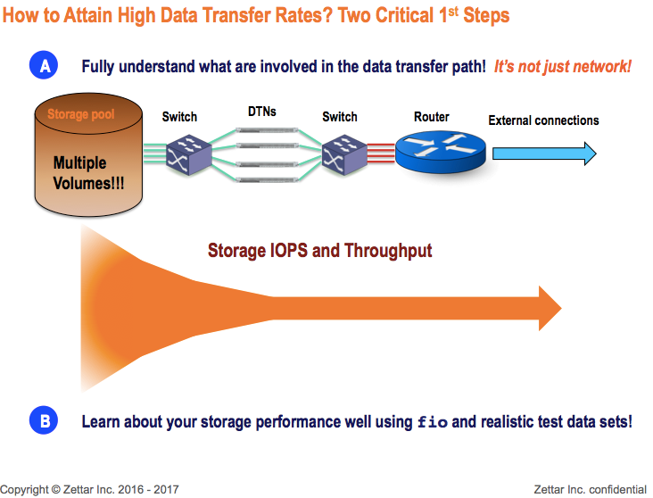
Not just the network
Bottle neck today is the IOPS needed for write

Slide 9
Conclusions
Demonstrated sustained 70Gbps over long distances.
Today’s challenge is writing the data to the files (IOPS)
  Network not a problem using standard TCP
We have been beating the 16 Intel DC P3700 NVMe SSDs since 2015 much harder and longer than most people in the world. But Intel DC P3700 NVMe SSD performance has been consistent
The four AIC SB122A-PH 10Bay NVMe 1U storage servers have proven to be highly cost-effective choices as well. Do not need to spend big $$$ on the proprietary all-flash storage systems from NetApp, Dell/EMC, Hitachi etc.
InfiniBand just works. The use of a Mellanox EDR (100Gbps) in each of the AIC SB122A-PH 10Bay NVMe 1U storage server, and a Mellanox FDR (56Gbps) HCA in each of the Yahoo! 1U C73E/64/960 DTN, together with the two Mellanox SB7700 IB switches has proven to be a quite cost-effective and reliable combination.

Slide 10
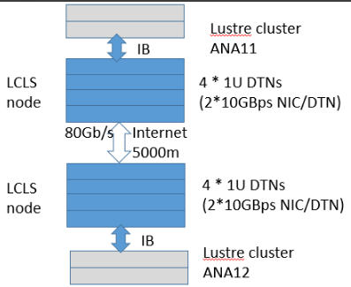
Future
Thinking about using test data sets with different file size distribution patterns, also even bigger test data sets (> 10TiB each, e.g. 50TiB each would be good)
Upgrade 200Gbps border at SLAC to two *100Gbps
Discuss with Intel about testing different CPU models.
  On the LCLS side, the modern (Broadwell)
  but low-end Intel E5-2620v4 8 core @
  2.1 Ghz CPU is used on all five LCLS DTNs
  NERSC DTNs use the older (Ivy Bridge)
  E5-2680 v2 20 cores @ 2.80GHz
  How do the CPU choices on DTNs affect
  the transfer performance,
Look at impact of LCLS Lustre file system
on performance
Then onto NERSC
Notes:
LCLS: <http://ark.intel.com/products/92986/Intel-Xeon-Processor-E5-2620-v4-20M-Cache-2_10-GHz>
NERSC: <http://ark.intel.com/products/75277/Intel-Xeon-Processor-E5-2680-v2-25M-Cache-2_80-GHz>

Slide 11
Summary
What is special:
Scalable. Add more NICs, more DTNs, more storage servers, links as needed/available…
Power, & space efficient; low cost
HA tolerant to loss of components
Storage tiering friendly
Reference designs
Easy to use, production-ready software
Proposed Future PetaByte Club
A member of the Petabyte Club MUST be an organization that is capable of using a shared production point-to-point WAN link to attain a production data transfer rate >= 150PiB-mile/hour

Slide 12

Other information, questions
Who needs it
LCLS Exascale requirements, Thayer and Perazzo, Tbit/s 2014
  https://confluence.slac.stanford.edu/download/attachments/178521813/ExascaleRequirementsLCLSCaseStudy.docx
Focus more on data migration when moving to the cloud,
  http://www.ciodive.com/news/focus-more-on-data-migration-when-moving-to-the-cloud-expert-says/439871/
Amazon, ship a PByte in a week (168hours). They manually ship appliances around to get the data from A to B.
Progress
186 Gbps Data Transfer Sets New Record, 2011
  SC11 Seattle <> U Victoria, 97Gbps/direction, 2 racks at SC11
  http://www.huffingtonpost.com/2011/12/16/worlds-fastest-internet_n_1154065.html
LCLS SLAC->NERSC 2013, 116TB in 5 days
  http://es.net/science-engagement/case-studies/
  multi-facility-workflow-case-study/
The Petascale project, Eli Dart, ESCC Winter 2016
  Goal Pbyte/week using Cosmology data
Moving a Petabyte of data June 13, 2015, identifies why it is difficult.
  http://inside.igneous.io/moving-a-petabyte-of-data,

