Slide 1
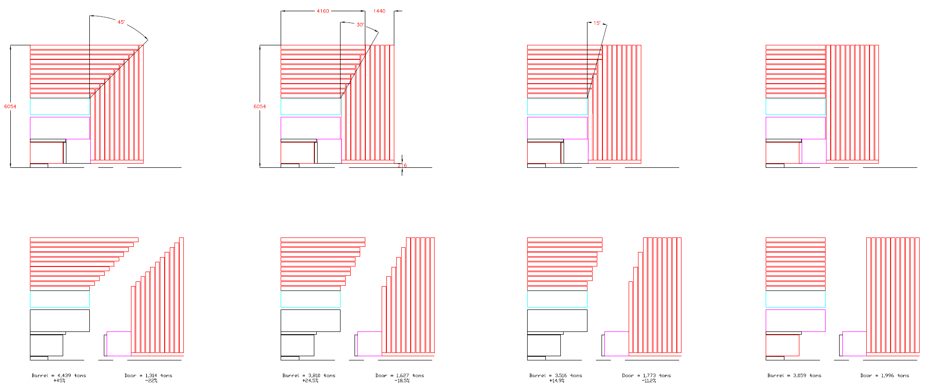
Barrel-Door partitions

Slide 2
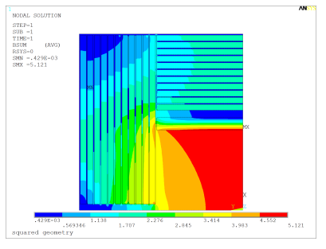
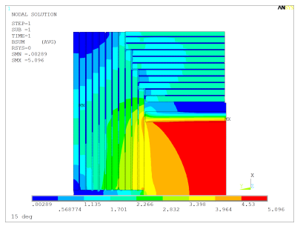
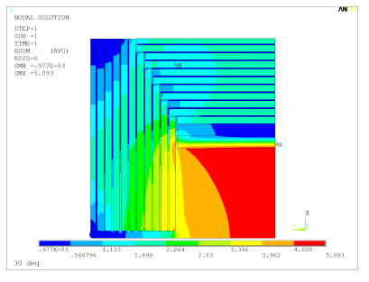
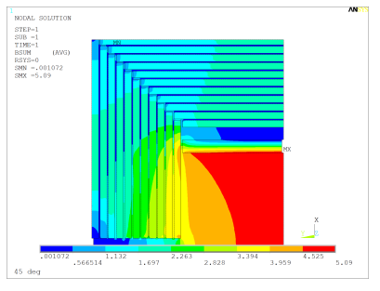
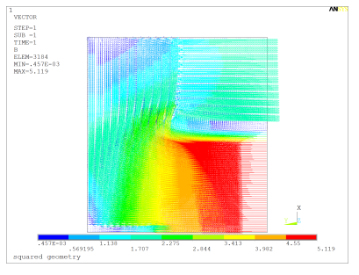
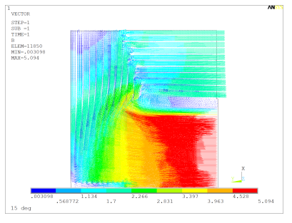
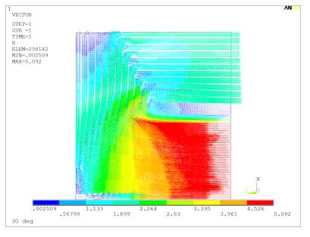
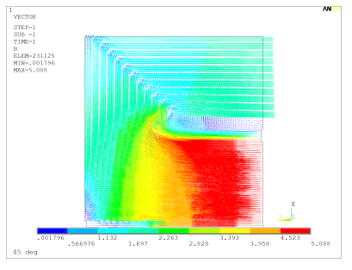
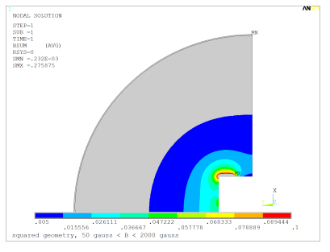
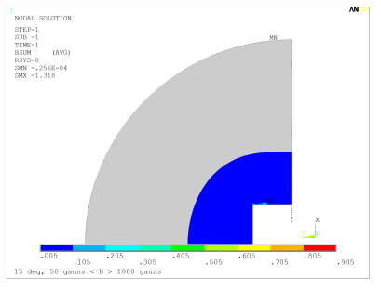
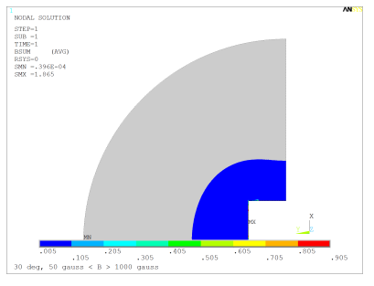
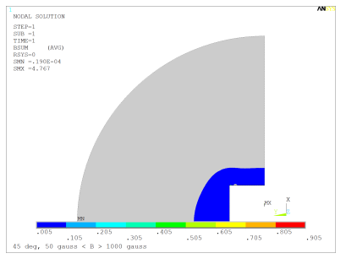
B field – 11 plates, 200mm

Slide 3
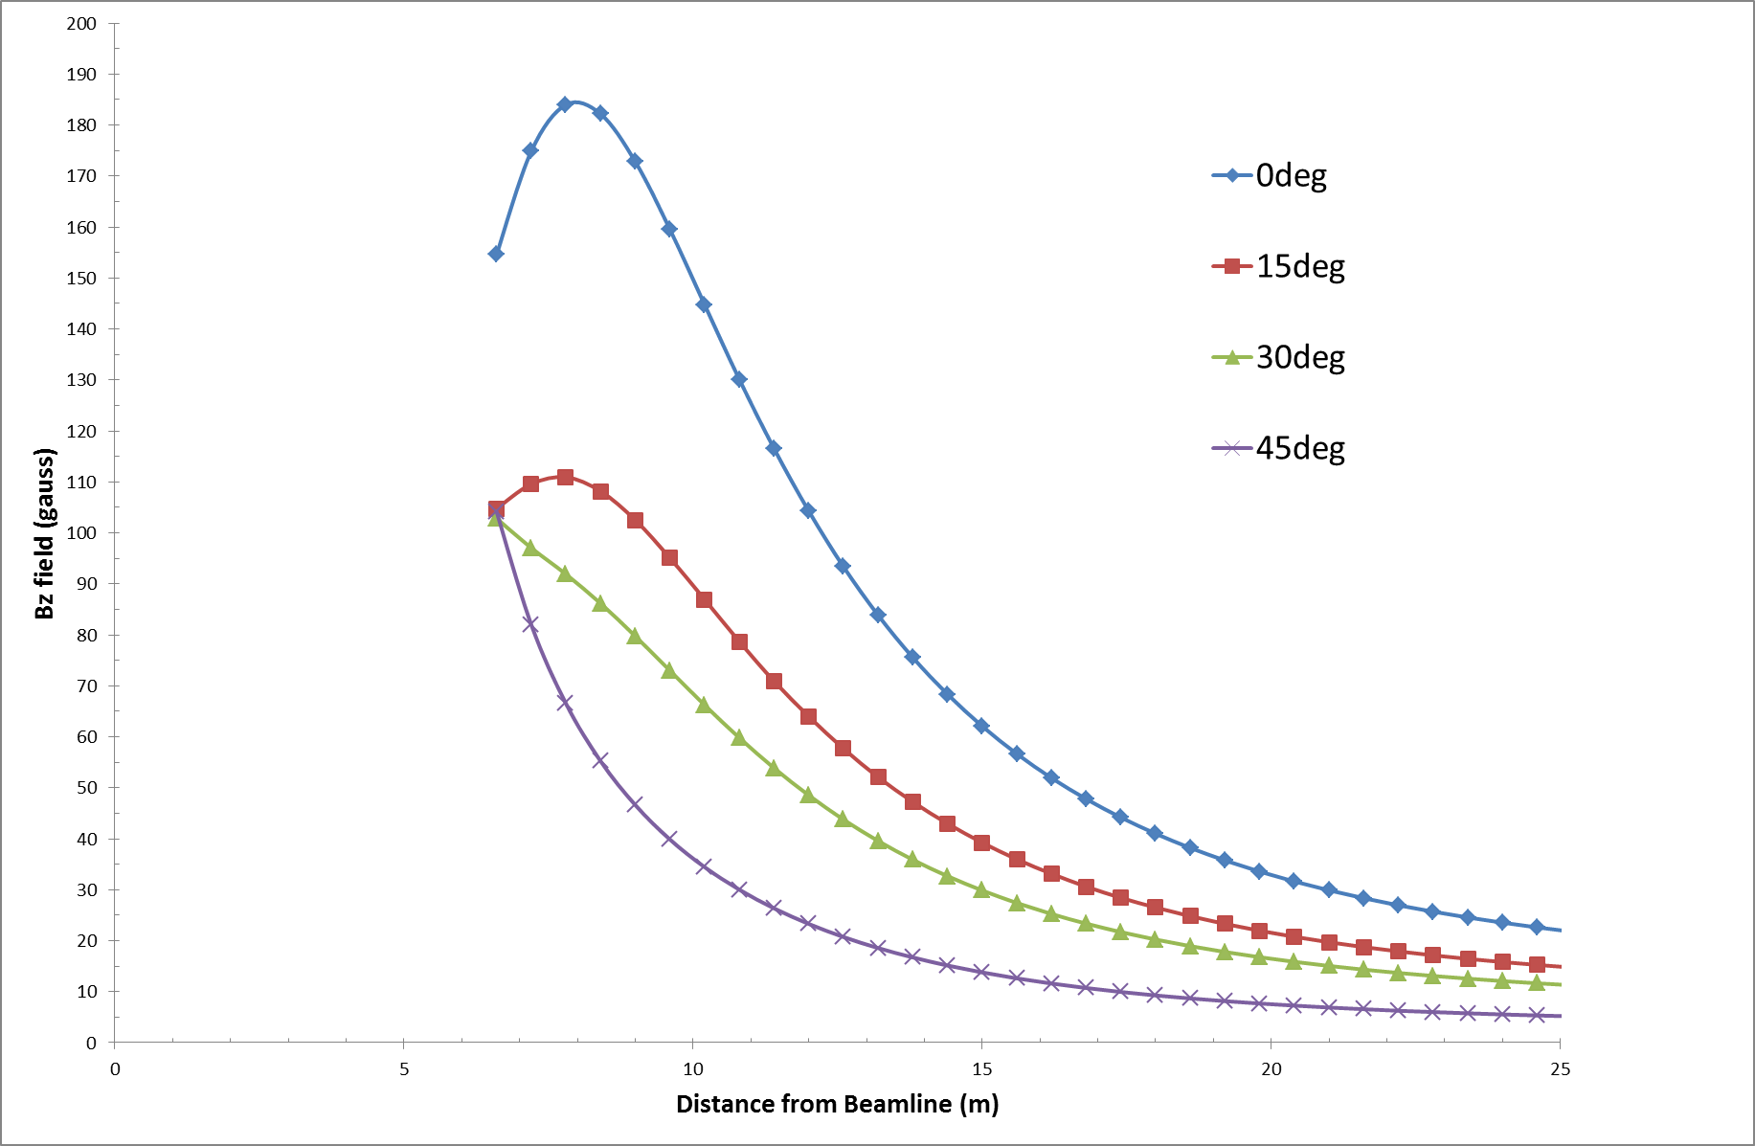
Bx field Far Region – 11 plates

Slide 4
Mass Distribution
Barrel | 00deg |  |  |  | Barrel | 15deg |  |  |  | Barrel | 30deg |  |  |  | Barrel | 45deg
Plate # | Radius (mm) | Length (mm) | Mass (tons) |  | Plate # | Radius (mm) | Length (mm) | Mass (tons) |  | Plate # | Radius (mm) | Length (mm) | Mass (tons) |  | Plate # | Radius (mm) | Length (mm) | Mass (tons)
1 | 3554 | 5900 | 208 |  | 1 | 3554 | 5900 | 208 |  | 1 | 3554 | 5900 | 208 |  | 1 | 3554 | 5900 | 208
2 | 3794 | 5900 | 222 |  | 2 | 3794 | 5900 | 222 |  | 2 | 3794 | 6396 | 241 |  | 2 | 3794 | 6400 | 241
3 | 4034 | 5900 | 236 |  | 3 | 4034 | 6396 | 256 |  | 3 | 4034 | 6396 | 256 |  | 3 | 4034 | 6880 | 275
4 | 4274 | 5900 | 250 |  | 4 | 4274 | 6396 | 271 |  | 4 | 4274 | 6880 | 292 |  | 4 | 4274 | 7360 | 312
5 | 4514 | 5900 | 264 |  | 5 | 4514 | 6396 | 286 |  | 5 | 4514 | 6880 | 308 |  | 5 | 4514 | 7840 | 351
6 | 4754 | 5900 | 278 |  | 6 | 4754 | 6880 | 324 |  | 6 | 4754 | 7360 | 347 |  | 6 | 4754 | 8320 | 392
7 | 4994 | 5900 | 292 |  | 7 | 4994 | 6880 | 341 |  | 7 | 4994 | 7360 | 364 |  | 7 | 4994 | 8800 | 436
8 | 5234 | 5900 | 306 |  | 8 | 5234 | 6880 | 357 |  | 8 | 5234 | 7840 | 407 |  | 8 | 5234 | 9280 | 482
9 | 5474 | 5900 | 320 |  | 9 | 5474 | 7360 | 399 |  | 9 | 5474 | 7840 | 426 |  | 9 | 5474 | 9760 | 530
10 | 5714 | 5900 | 334 |  | 10 | 5714 | 7360 | 417 |  | 10 | 5714 | 8320 | 471 |  | 10 | 5714 | 10240 | 580
11 | 5954 | 5900 | 348 |  | 11 | 5954 | 7360 | 434 |  | 11 | 5954 | 8320 | 491 |  | 11 | 5954 | 10720 | 633
 |  |  | 3059 |  |  |  |  | 3516 |  |  |  |  | 3810 |  |  |  |  | 4439
 |  |  |  |  |  |  |  | 14.9% |  |  |  |  | 24.5% |  |  |  |  | 45.1%
Door | 00deg |  |  |  | Door | 15deg |  |  |  | Door | 30deg |  |  |  | Door | 45deg
Plate # | R In (mm) | R out (mm) | Mass (tons) |  | Plate # | R In (mm) | R out (mm) | Mass (tons) |  | Plate # | R In (mm) | R out (mm) | Mass (tons) |  | Plate # | R In (mm) | R out (mm) | Mass (tons)
1 | 216 | 6054 | 181 |  | 1 | 216 | 3894 | 75 |  | 1 | 216 | 3654 | 66 |  | 1 | 216 | 3654 | 66
2 | 216 | 6054 | 181 |  | 2 | 216 | 4614 | 105 |  | 2 | 216 | 4134 | 84 |  | 2 | 216 | 3894 | 75
3 | 216 | 6054 | 181 |  | 3 | 216 | 5334 | 141 |  | 3 | 216 | 4614 | 105 |  | 3 | 216 | 4134 | 84
4 | 216 | 6054 | 181 |  | 4 | 216 | 6054 | 181 |  | 4 | 216 | 5094 | 128 |  | 4 | 216 | 4374 | 95
5 | 216 | 6054 | 181 |  | 5 | 216 | 6054 | 181 |  | 5 | 216 | 5574 | 154 |  | 5 | 216 | 4614 | 105
6 | 216 | 6054 | 181 |  | 6 | 216 | 6054 | 181 |  | 6 | 216 | 6054 | 181 |  | 6 | 216 | 4854 | 117
7 | 216 | 6054 | 181 |  | 7 | 216 | 6054 | 181 |  | 7 | 216 | 6054 | 181 |  | 7 | 216 | 5094 | 128
8 | 216 | 6054 | 181 |  | 8 | 216 | 6054 | 181 |  | 8 | 216 | 6054 | 181 |  | 8 | 216 | 5334 | 141
9 | 216 | 6054 | 181 |  | 9 | 216 | 6054 | 181 |  | 9 | 216 | 6054 | 181 |  | 9 | 216 | 5574 | 154
10 | 216 | 6054 | 181 |  | 10 | 216 | 6054 | 181 |  | 10 | 216 | 6054 | 181 |  | 10 | 216 | 5814 | 167
11 | 216 | 6054 | 181 |  | 11 | 216 | 6054 | 181 |  | 11 | 216 | 6054 | 181 |  | 11 | 216 | 6054 | 181
 |  |  | 1996 |  |  |  |  | 1773 |  |  |  |  | 1627 |  |  |  |  | 1314
 |  |  |  |  |  |  |  | -11.2% |  |  |  |  | -18.5% |  |  |  |  | -34.2%

Slide 5
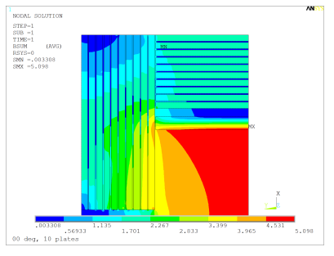
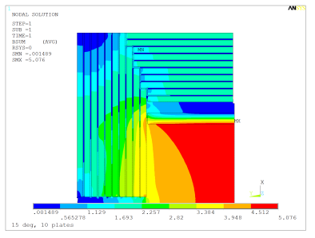
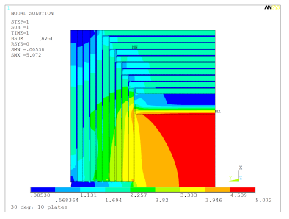
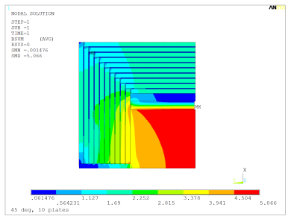
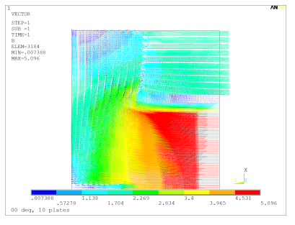
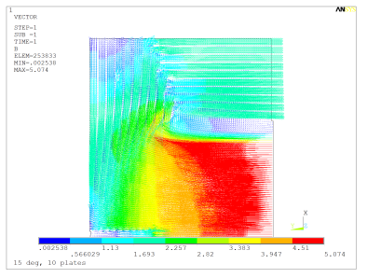
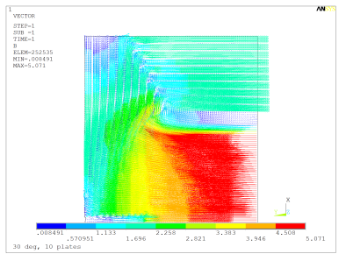
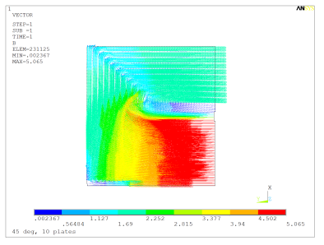
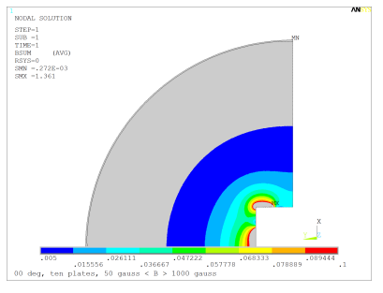
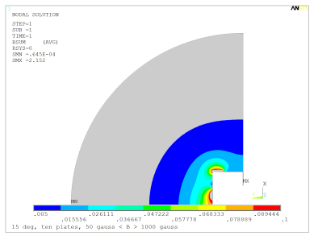
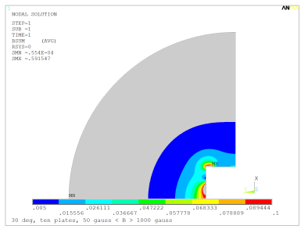
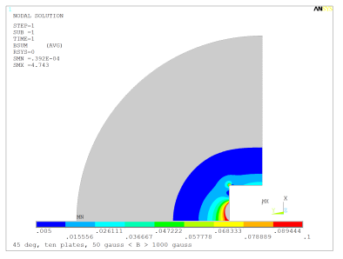
B field – 10 plates, 200mm

Slide 6
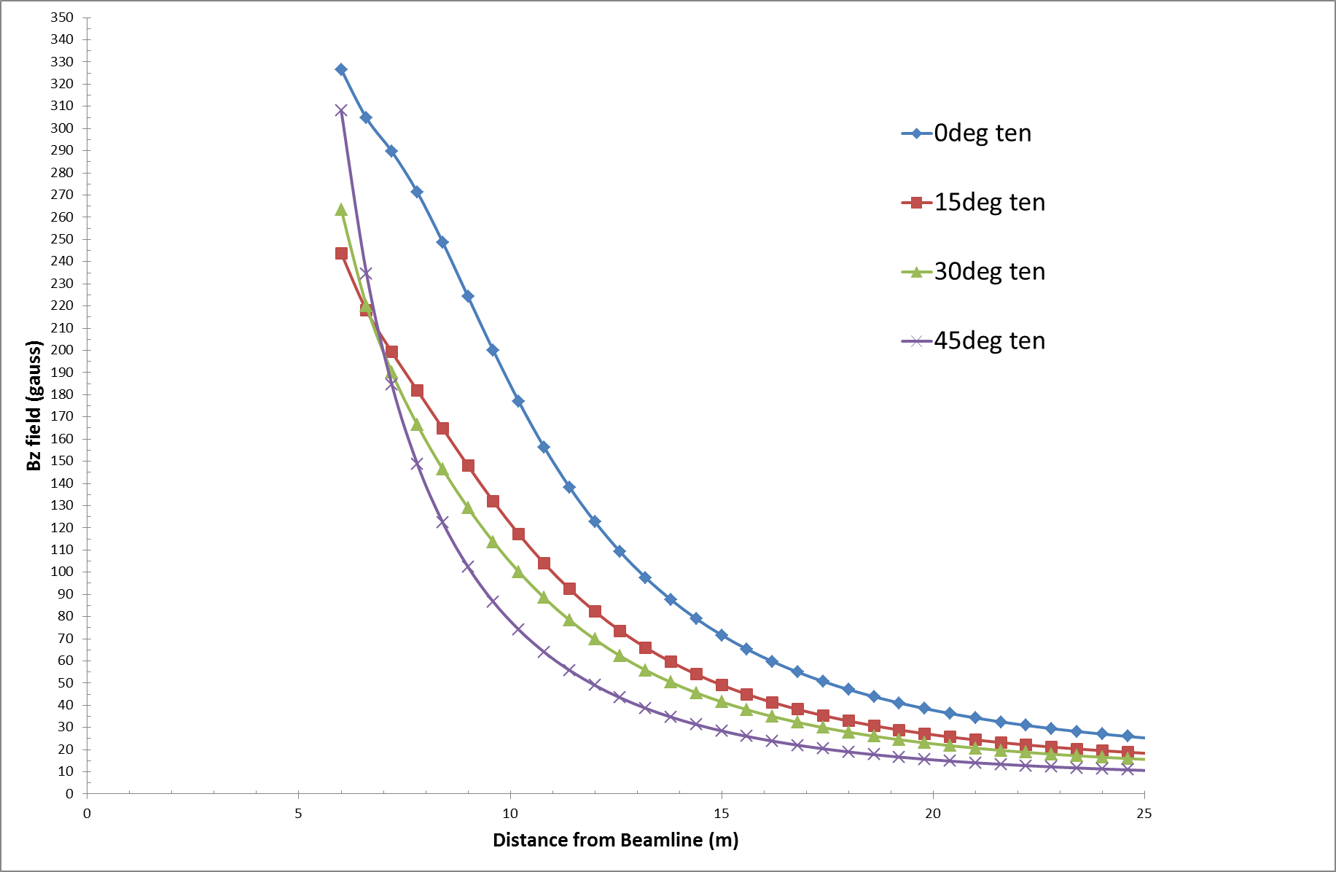
Bx field Far Region – 10 plates

Slide 7
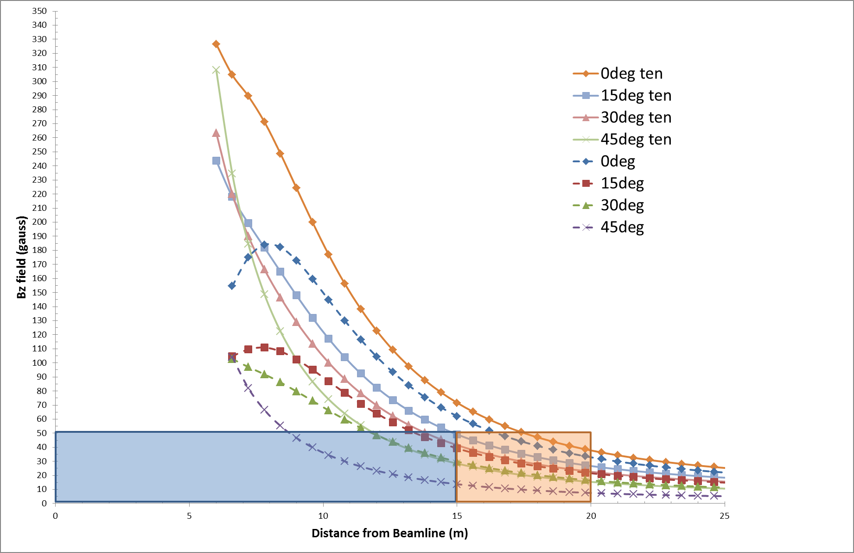
Bx field Far Region - All

Slide 8
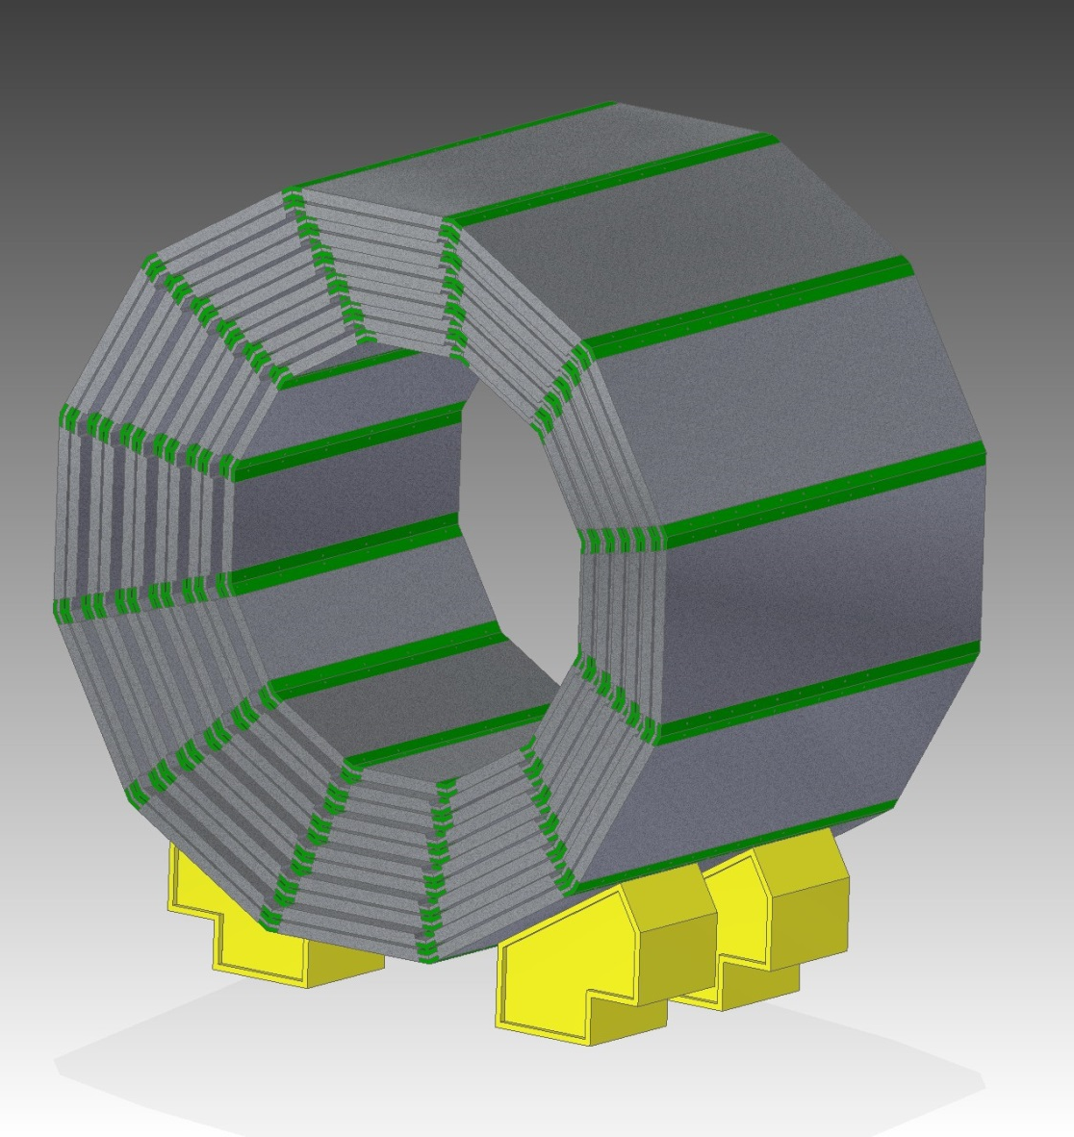
30 Deg cut

Slide 9
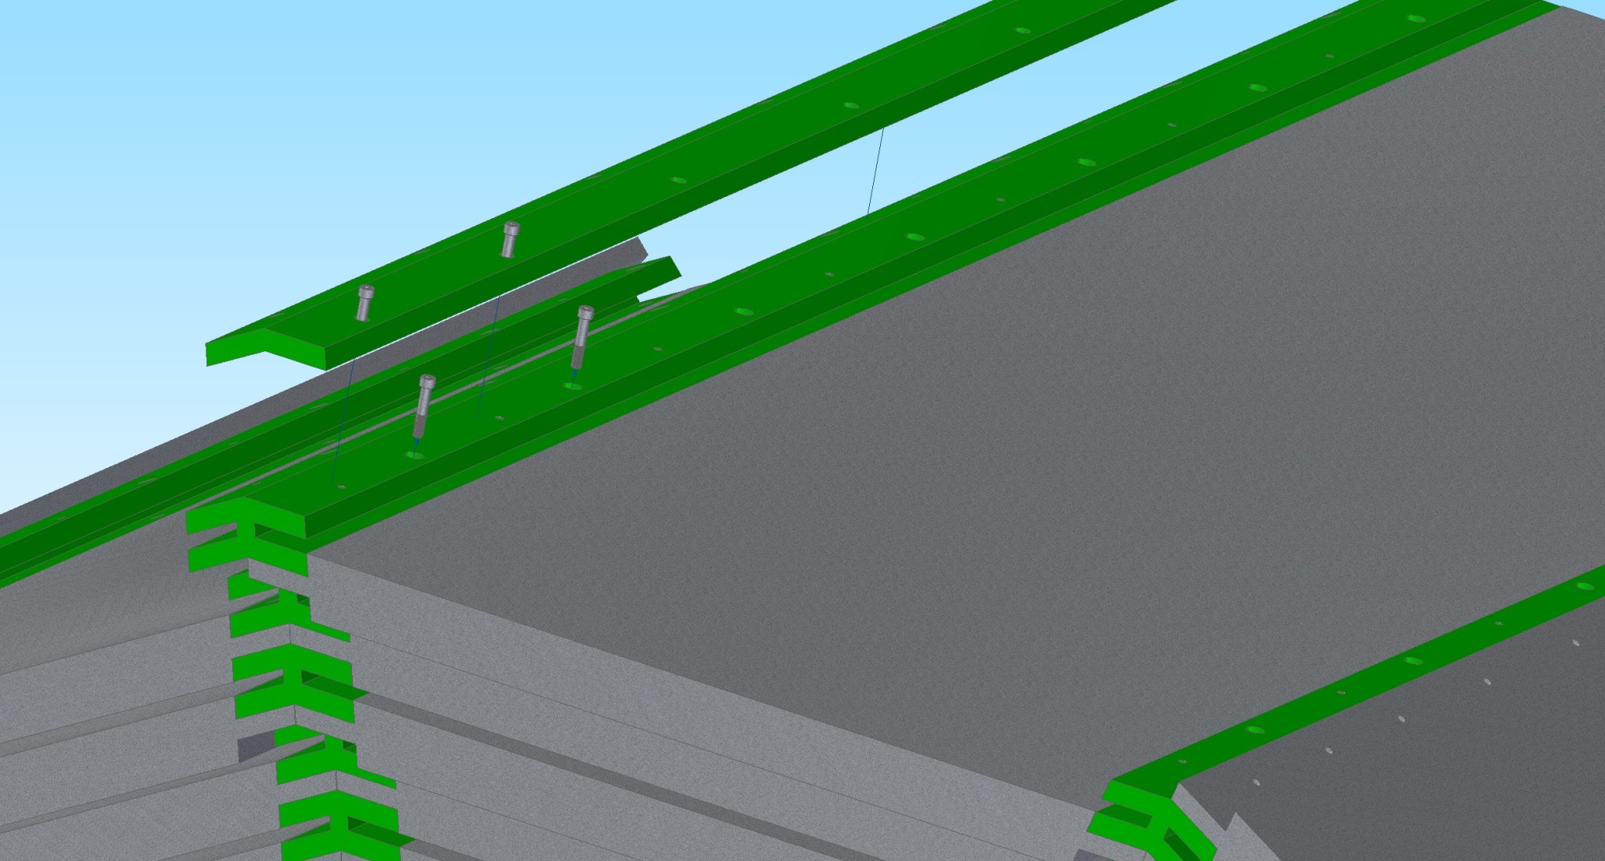

Slide 10
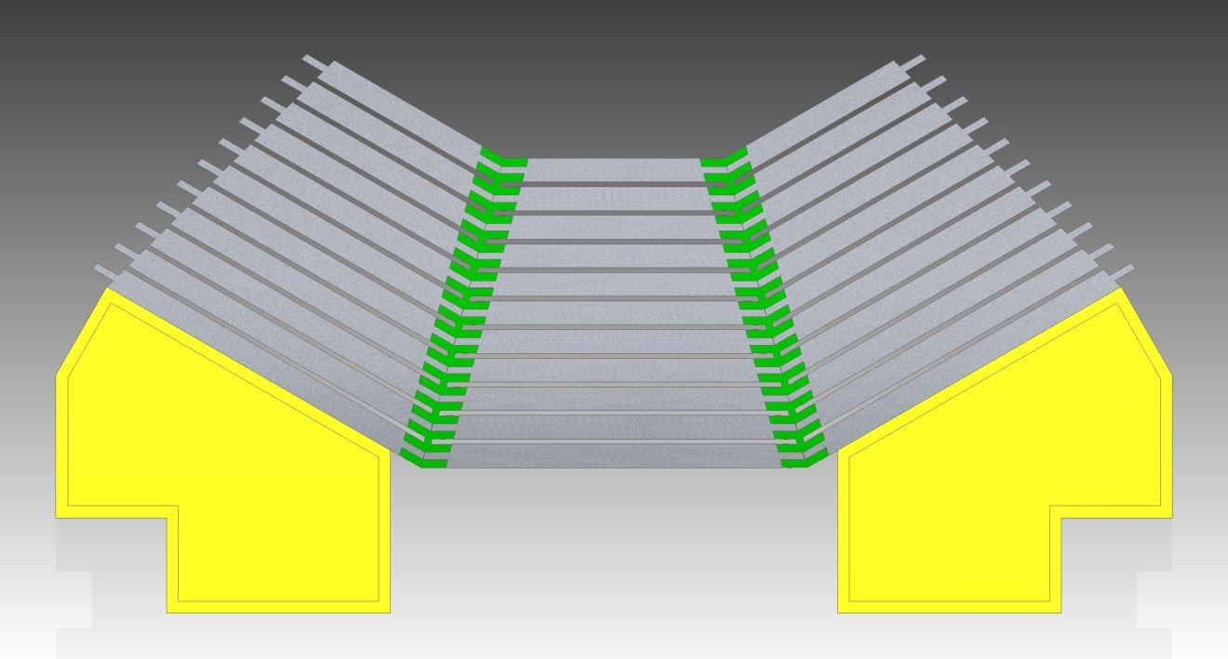
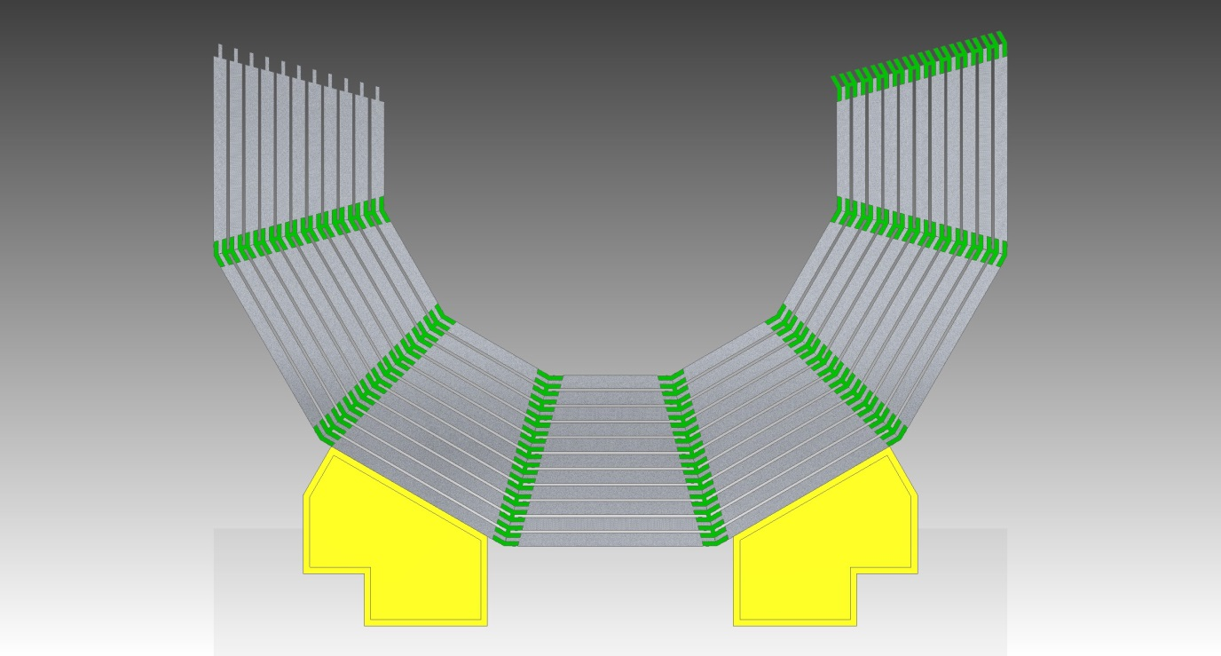

Slide 11
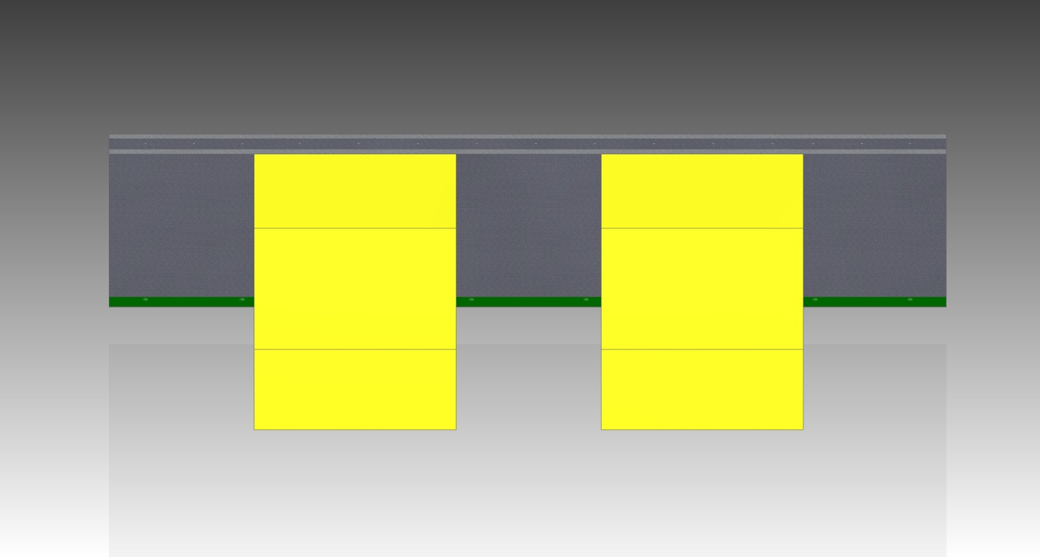
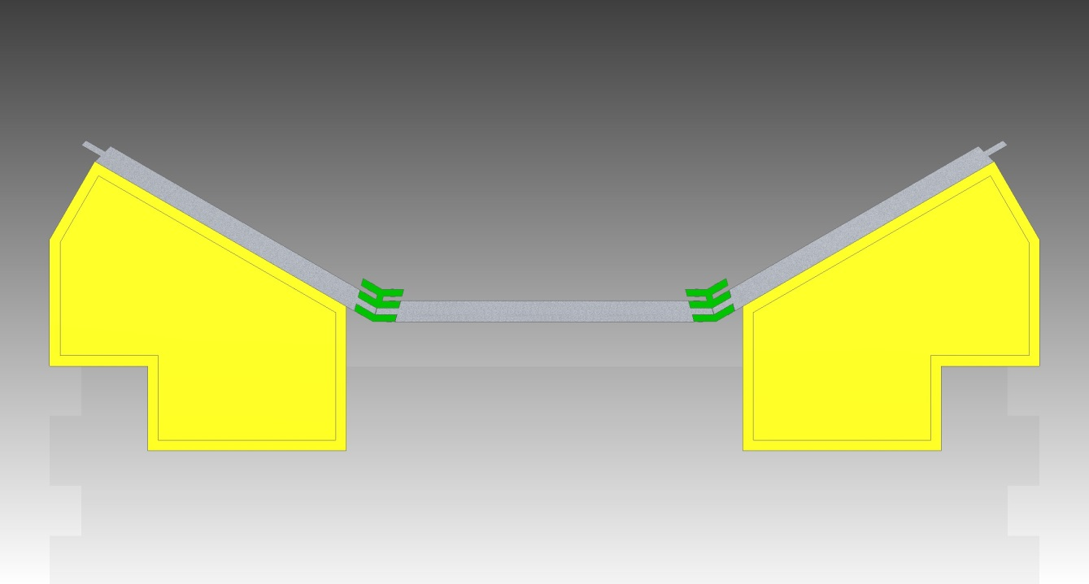

Slide 12
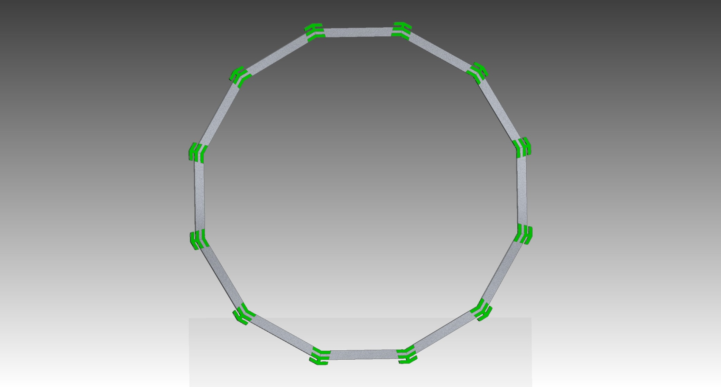

Slide 13
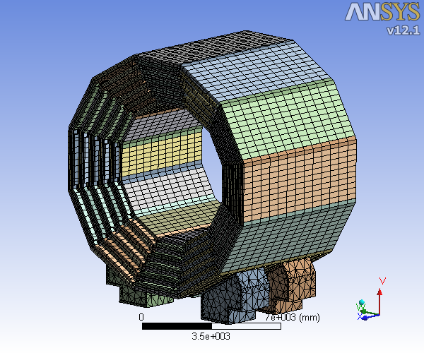

Slide 14
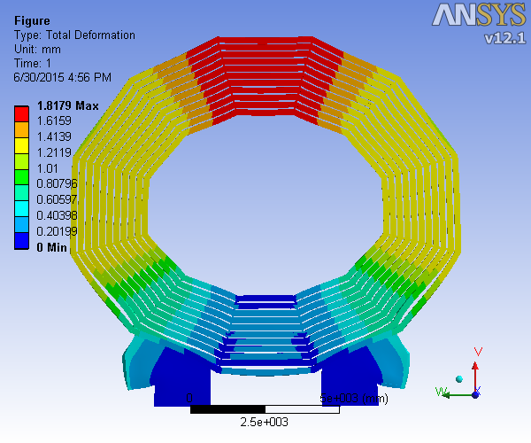

Slide 15
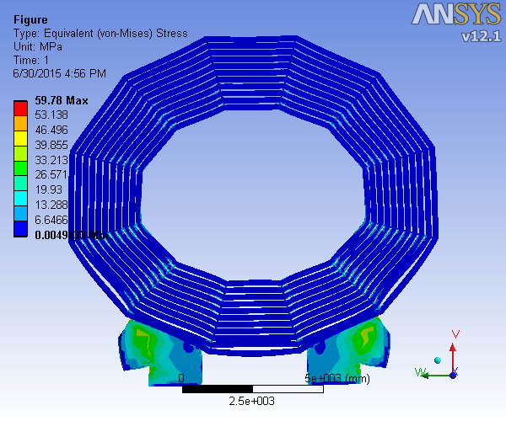

Slide 16
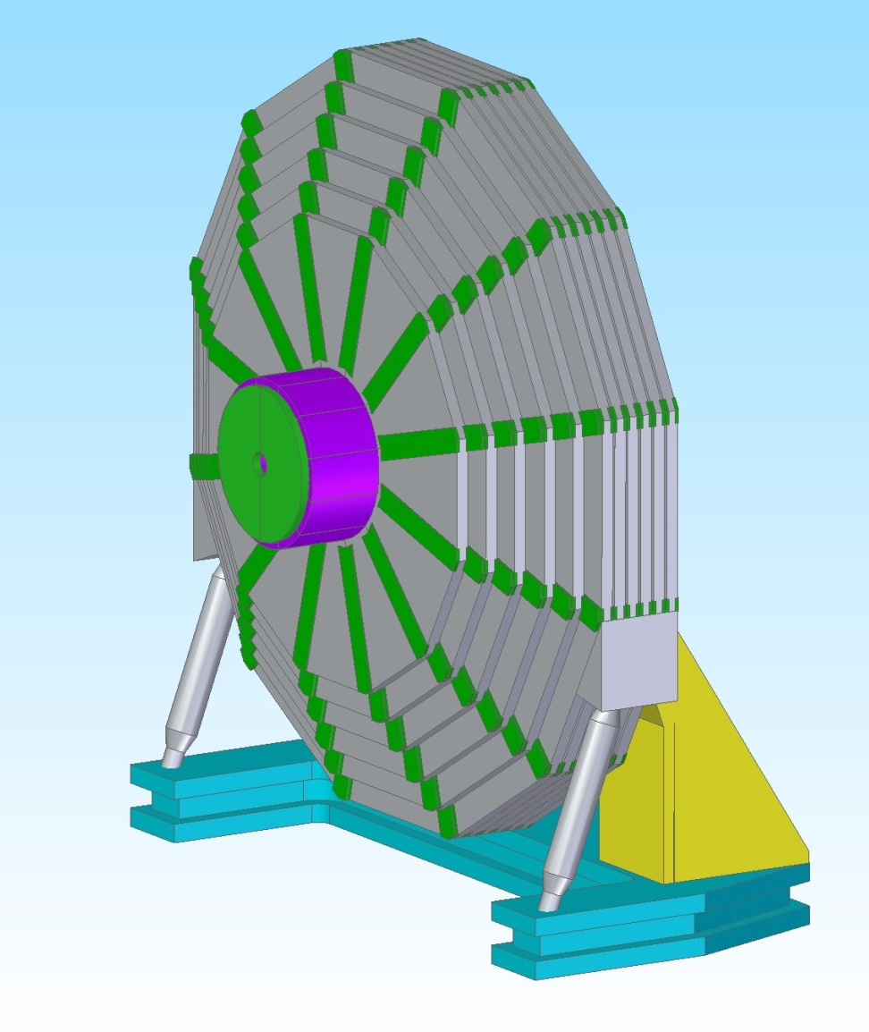
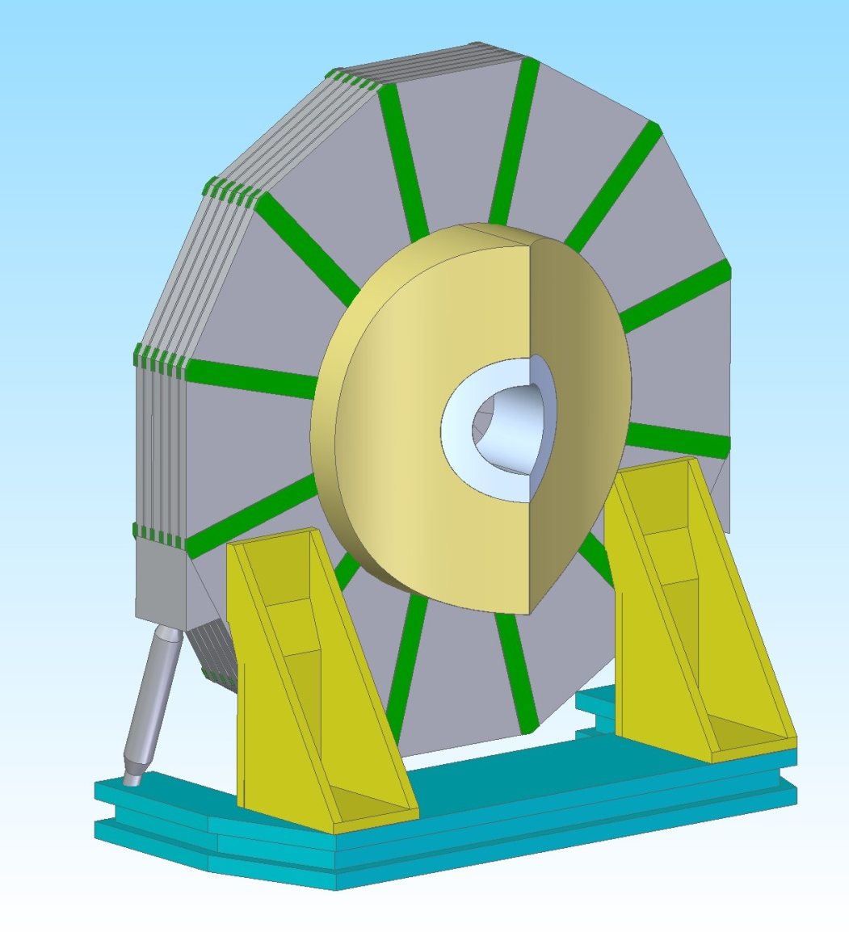

Slide 17
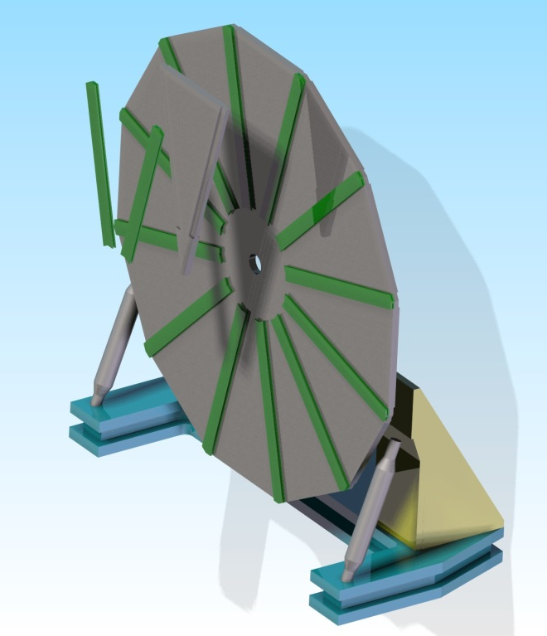
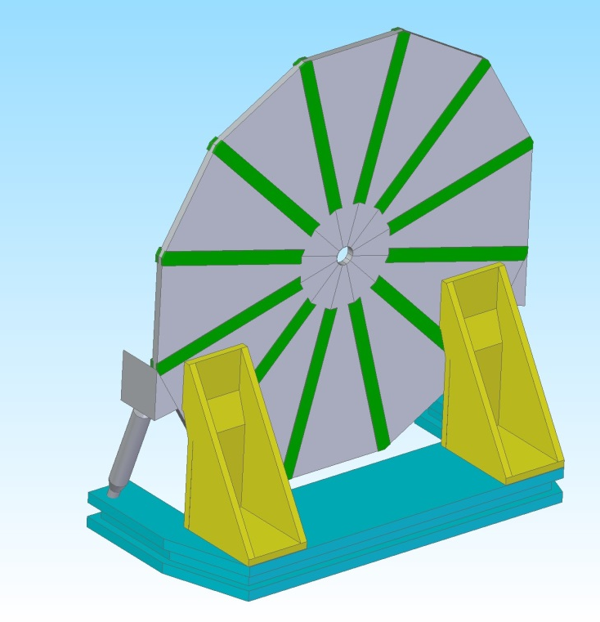


Slide 18
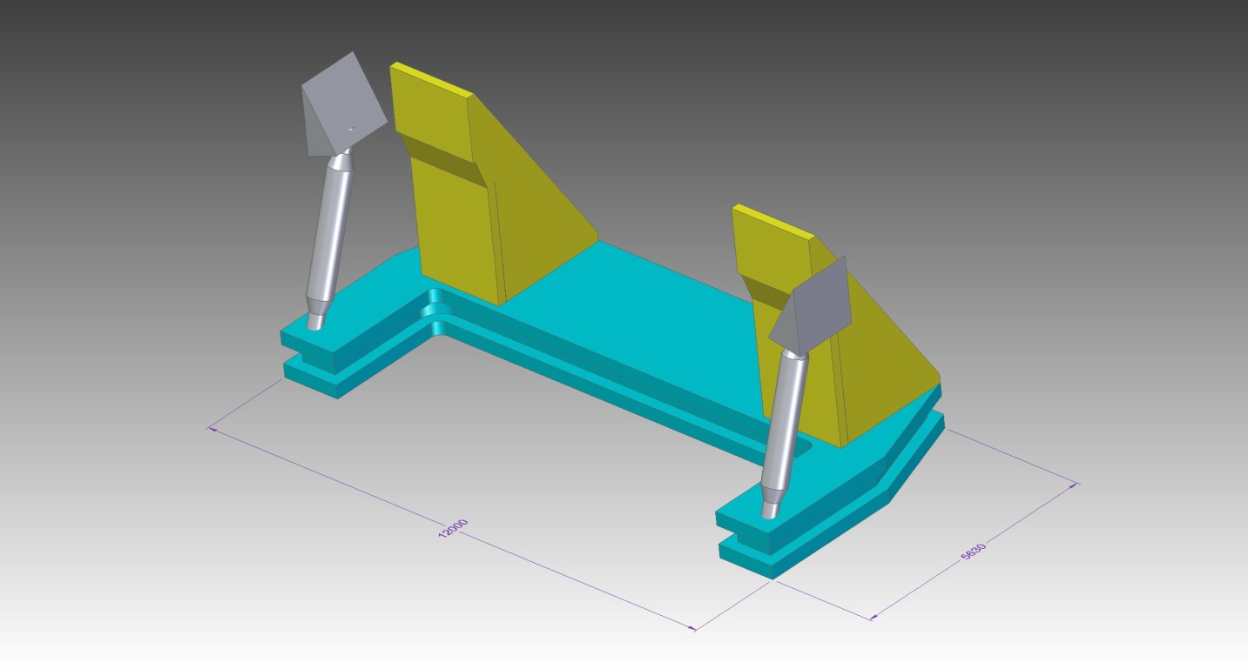
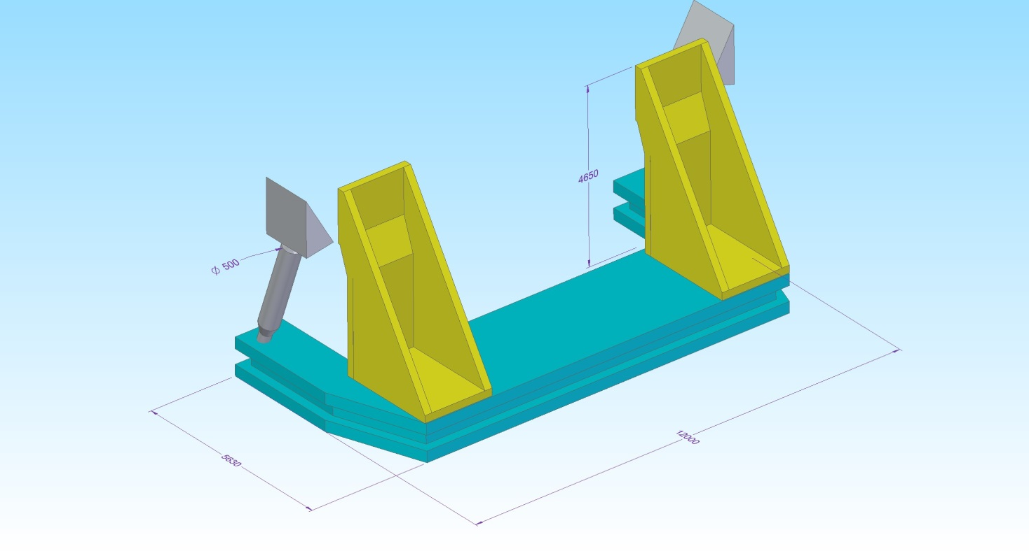

Slide 19
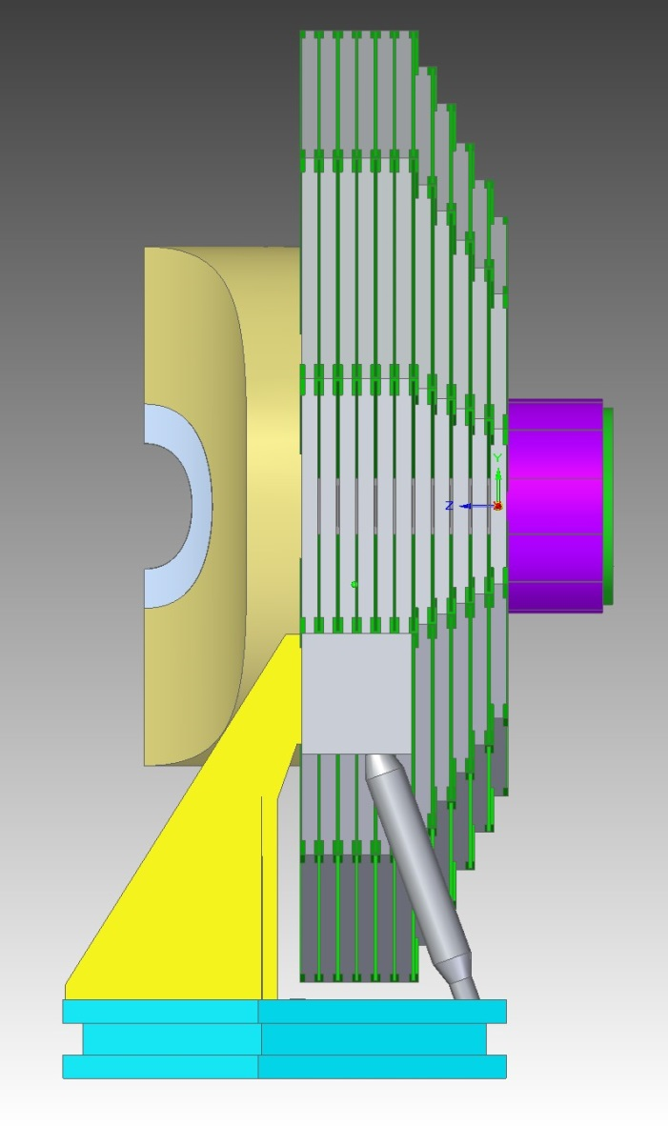
Total Mass 2,312 tons
Center of Gravoity
X = 0 mm
Y = -996 mm
Z = 1826 mm
C.G.

Slide 20
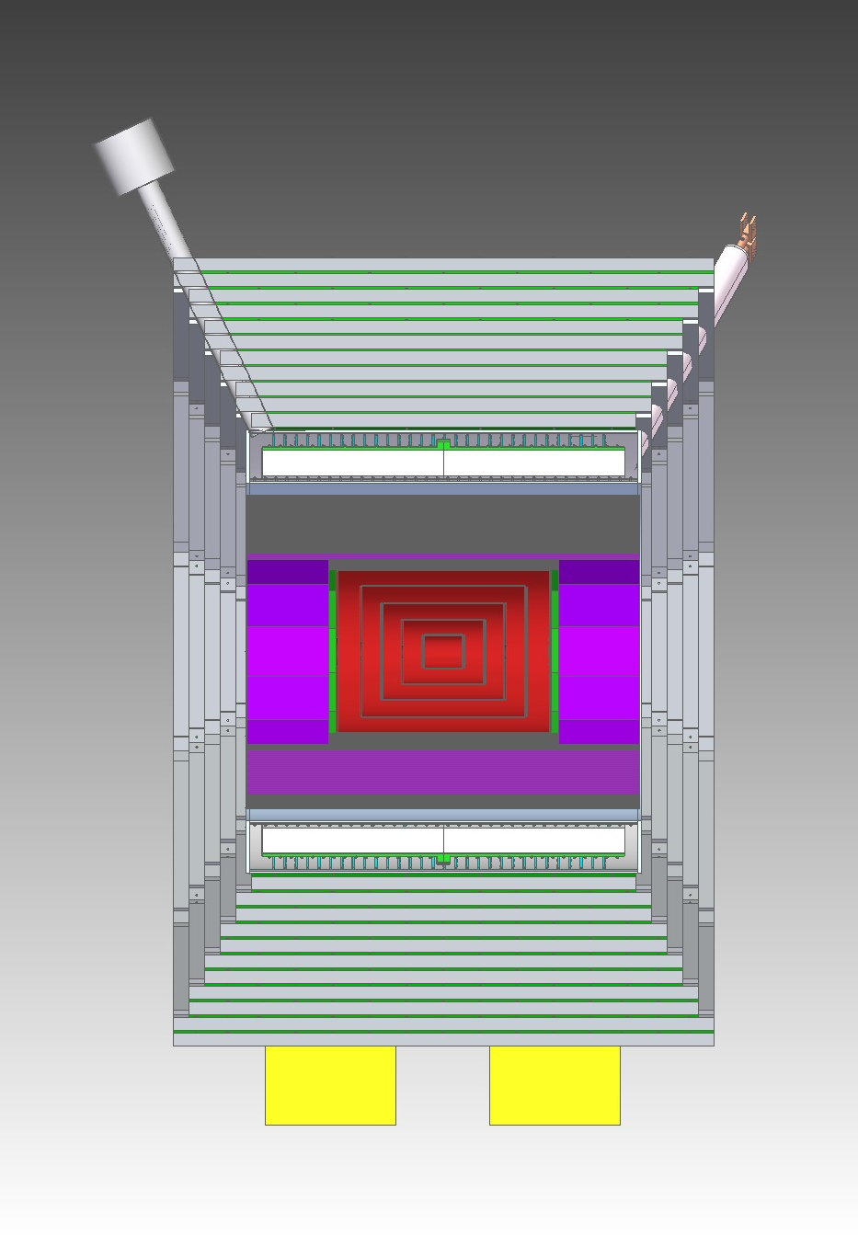
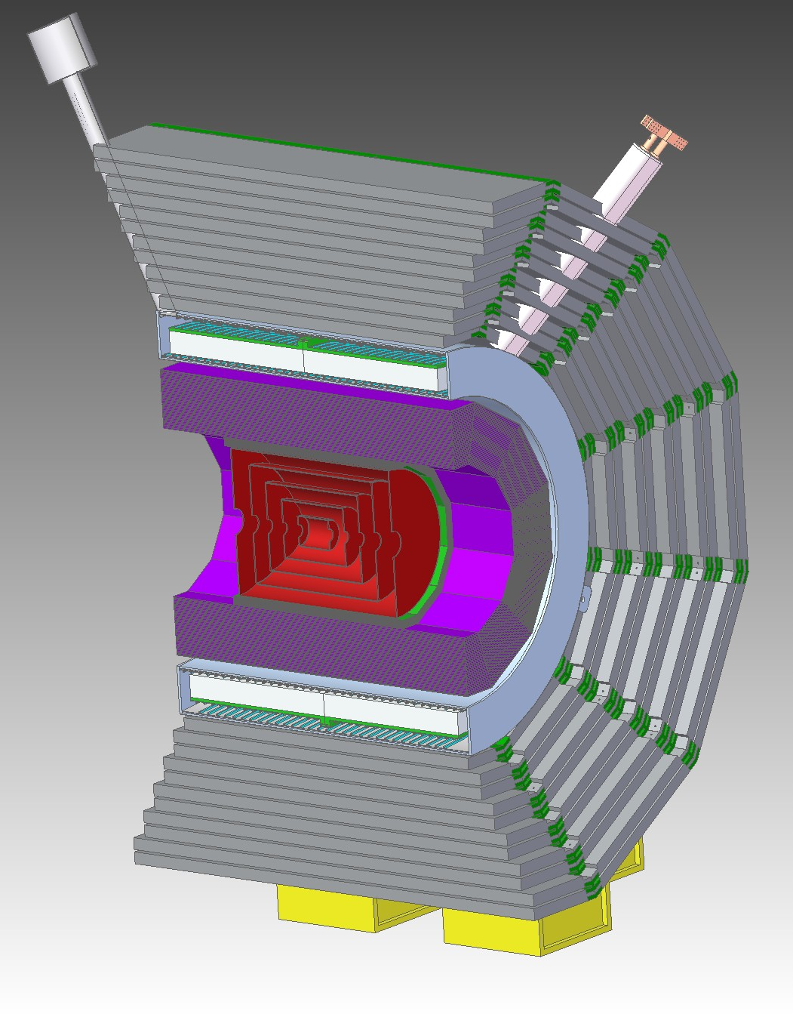
Total Barrel Mass 4,540 tons

Slide 21
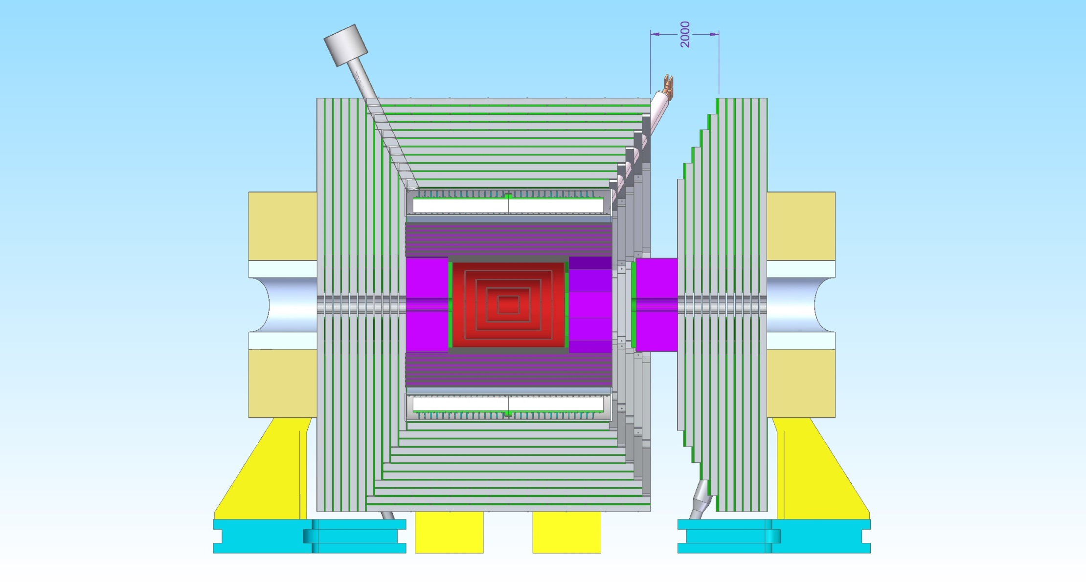
SID 30 deg cut

Slide 22
Item | Mass (tons)
Barrel Total | 4,540
Barrel Iron | 3,863
Feet | 80
Solenoid | 180
Hcal | 417
Door total | 2291
Door Iron | 1,655
Hcal | 55
Emcal | 12
Pacmen | 216
Brackets | 76
Cart | 277

Slide 23
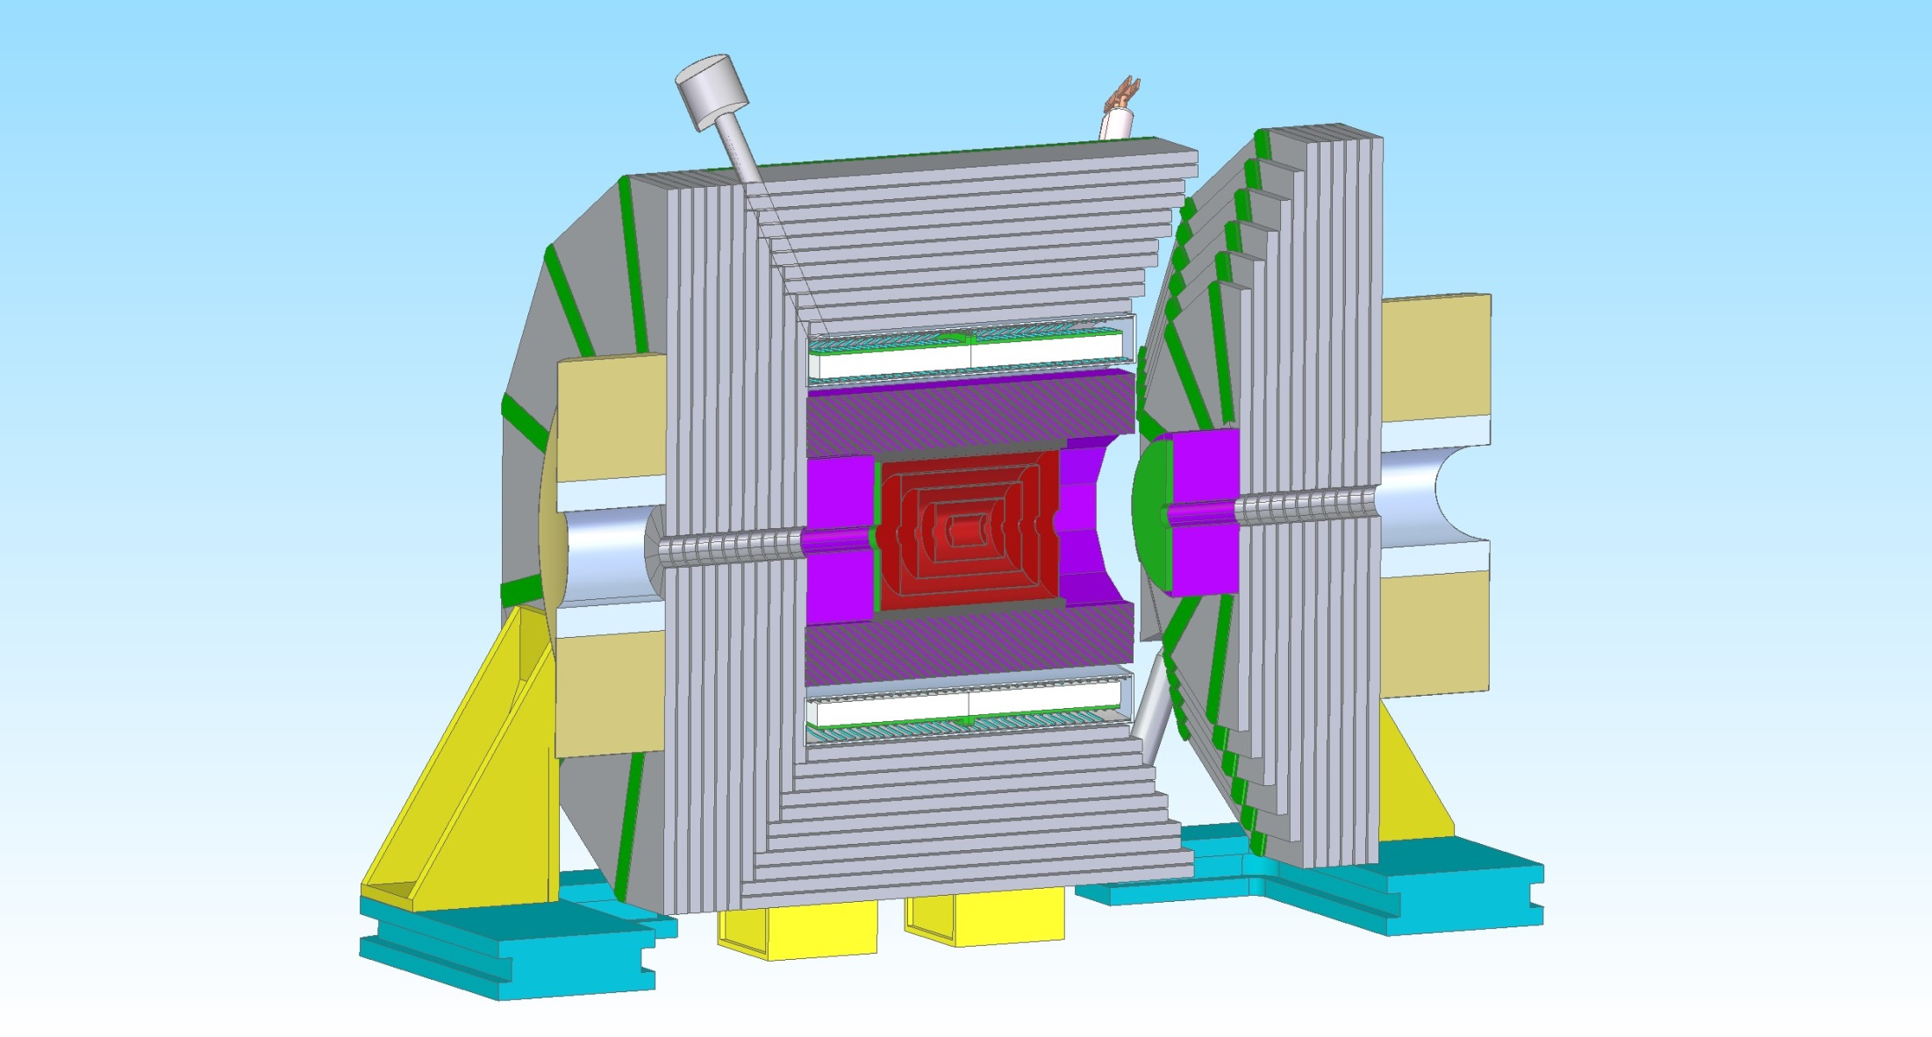

Slide 24
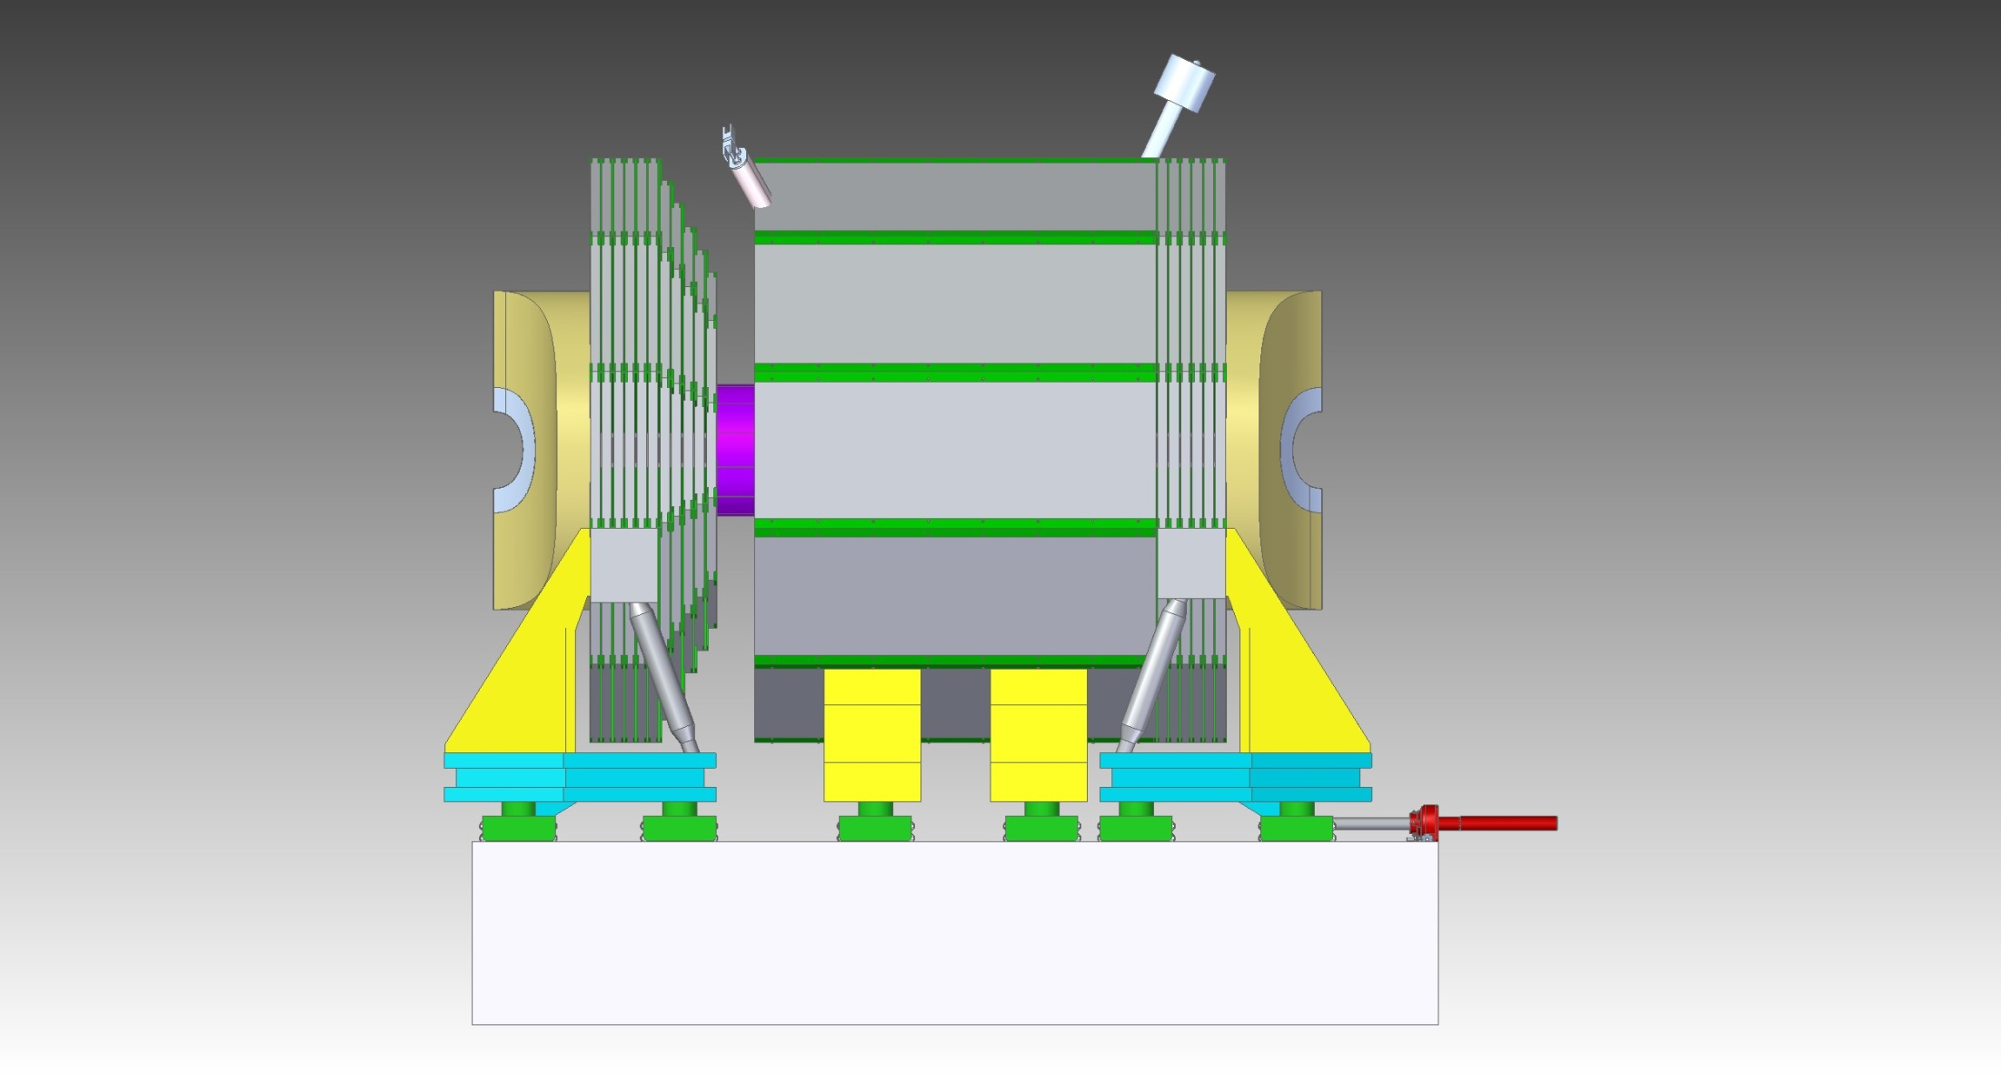

Slide 25


Slide 26


Slide 27


Slide 28


