Slide 1
Surface Assembly Workflow
Transport to the site
Assembly
Magnet Commissioning
Lowering
60 tons Max, Road Transport
Bridge Crane
200 tons
Gantry
3000 tons
18 m
shaft
Surface Hall

Slide 2
Underground Infrastructures
60-80 tons Max Road
200 tons on surface
50 tons bridge crane underground
N | 8 |  |  | R (m) | Width (mm) | Weight (tons) | Accrued Sector Weight | Accrued Barrel Weight
L | 5900 |  | Plate 1 | 3454 | 2861 | 26 | 26 | 211
Thickness | 200 |  | Plate 2 | 3694 | 3060 | 28 | 55 | 436
Gap | 40 |  | Plate 3 | 3934 | 3259 | 30 | 84 | 676
 |  |  | Plate 4 | 4174 | 3458 | 32 | 116 | 931
 |  |  | Plate 5 | 4414 | 3657 | 34 | 150 | 1200
 |  |  | Plate 6 | 4654 | 3855 | 35 | 185 | 1484
 |  |  | Plate 7 | 4894 | 4054 | 37 | 223 | 1782
 |  |  | Plate 8 | 5134 | 4253 | 39 | 262 | 2095
 |  |  | Plate 9 | 5374 | 4452 | 41 | 303 | 2423
 |  |  | Plate 10 | 5614 | 4651 | 43 | 346 | 2766
 |  |  | Plate 11 | 5854 | 4850 | 45 | 390 | 3123
N | 12 |  |  | R (m) | Width (mm) | Weight (tons) | Accrued Sector Weight | Accrued Barrel Weight
L | 5900 |  | Plate 1 | 3454 | 1851 | 17 | 17 | 204
Thickness | 200 |  | Plate 2 | 3694 | 1980 | 18 | 35 | 423
Gap | 40 |  | Plate 3 | 3934 | 2108 | 19 | 55 | 656
 |  |  | Plate 4 | 4174 | 2237 | 21 | 75 | 903
 |  |  | Plate 5 | 4414 | 2365 | 22 | 97 | 1164
 |  |  | Plate 6 | 4654 | 2494 | 23 | 120 | 1440
 |  |  | Plate 7 | 4894 | 2623 | 24 | 144 | 1729
 |  |  | Plate 8 | 5134 | 2751 | 25 | 169 | 2033
 |  |  | Plate 9 | 5374 | 2880 | 27 | 196 | 2351
 |  |  | Plate 10 | 5614 | 3009 | 28 | 224 | 2684
 |  |  | Plate 11 | 5854 | 3137 | 29 | 253 | 3030
50 pieces / 60 tons

Slide 3
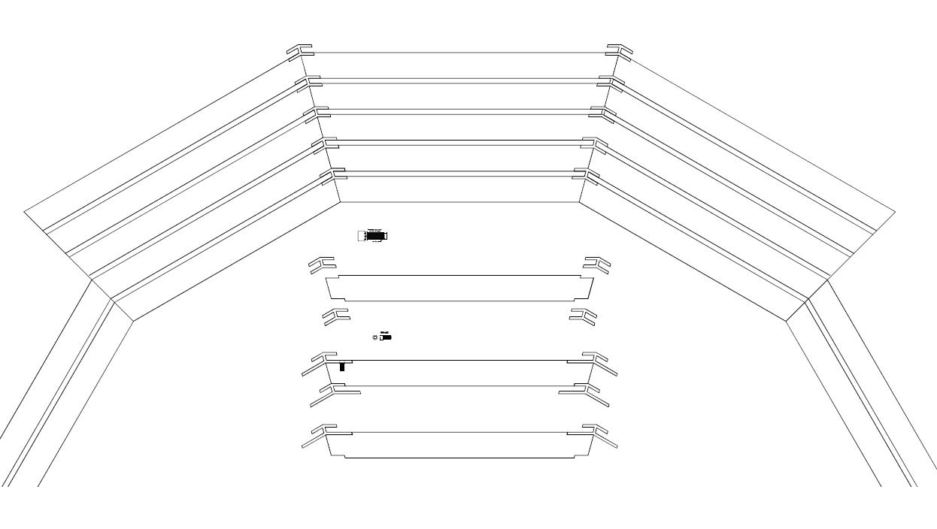
Magnet Barrel Design
30 tons Max per plate

Slide 4
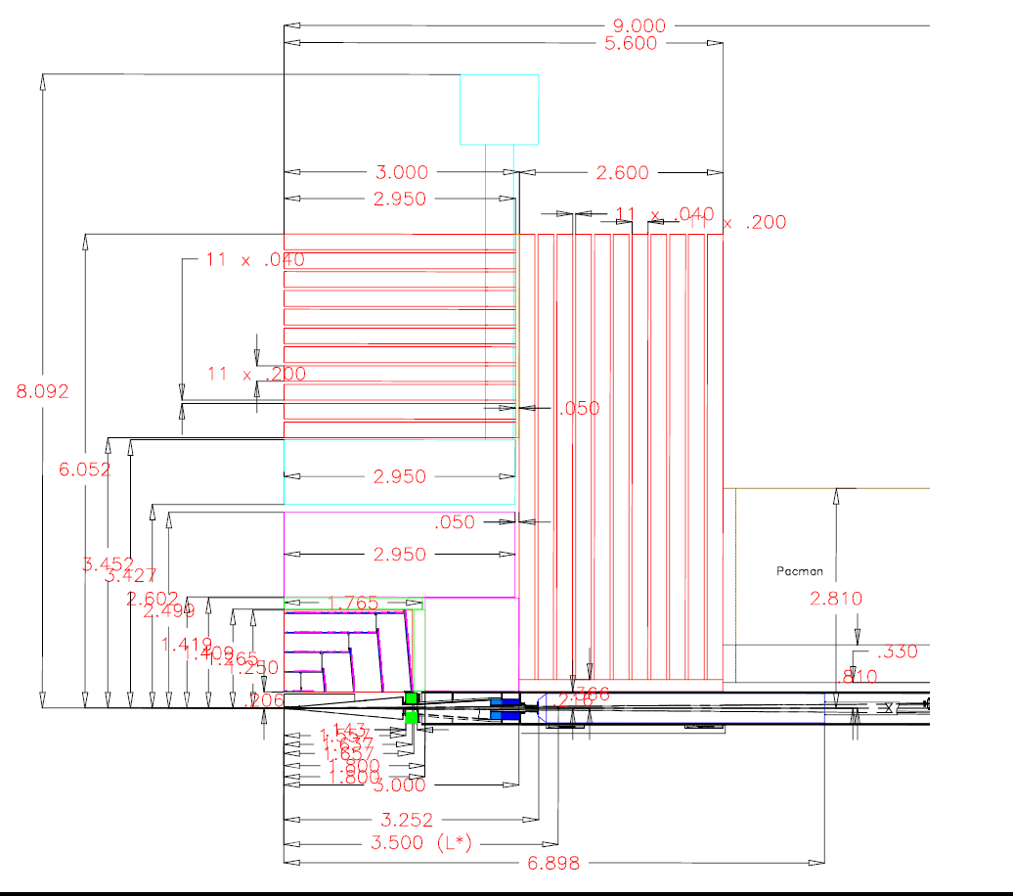

Slide 6
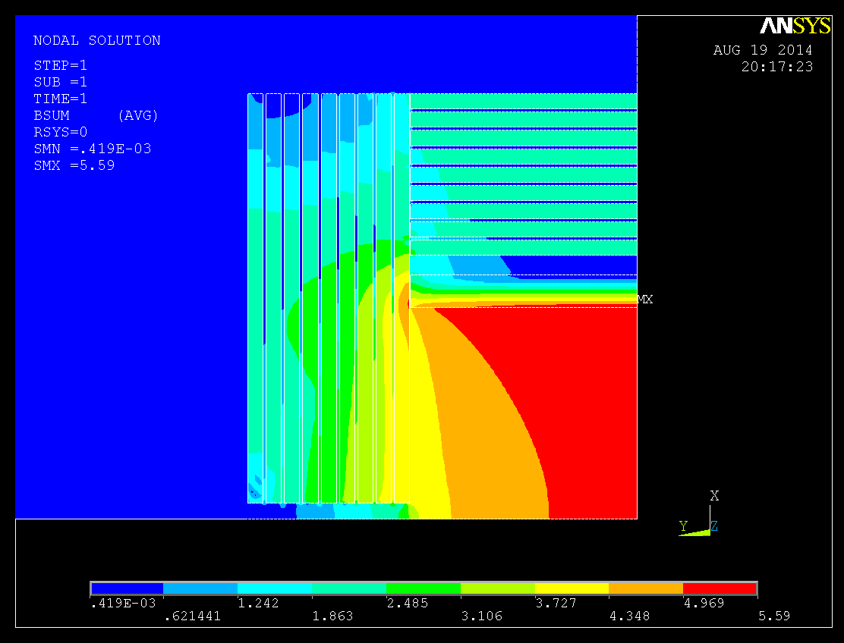
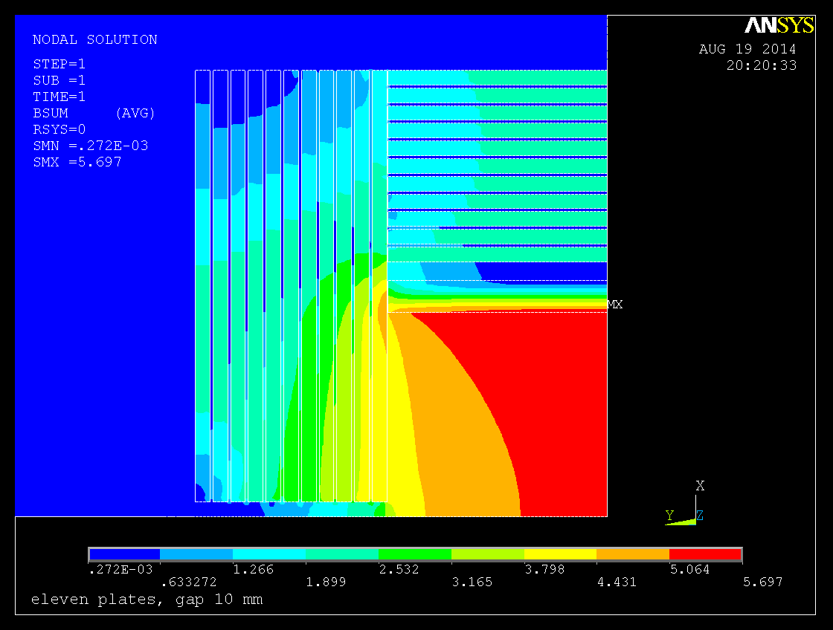
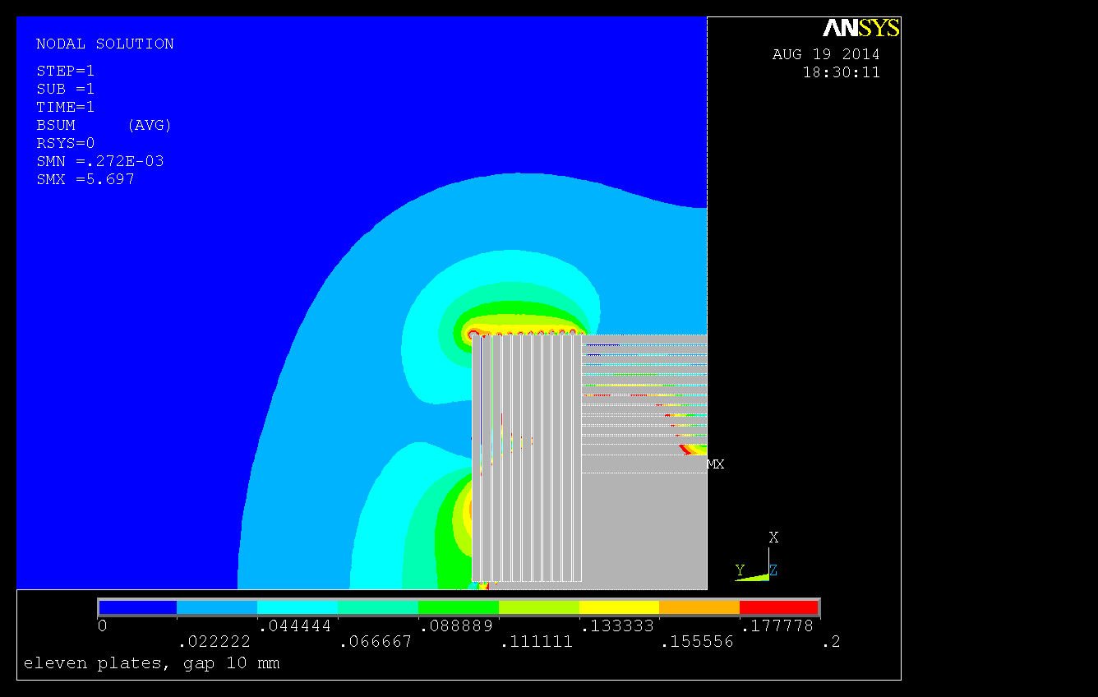
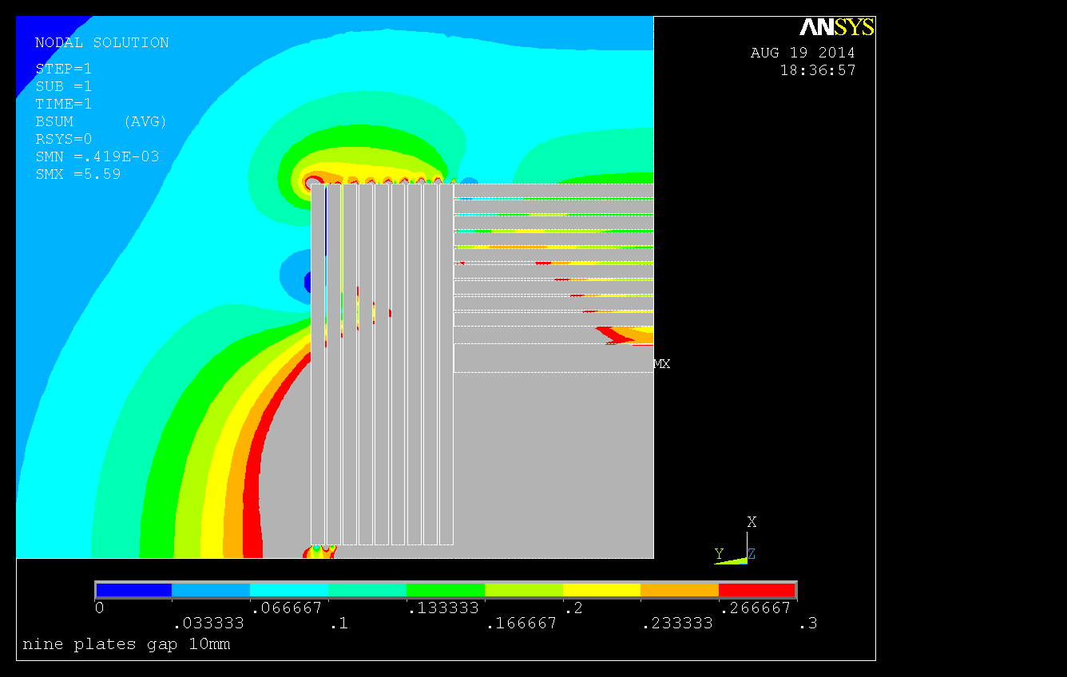
Nine Plates
Eleven Plates

Slide 7
B Field vs. Radius
Tesla
R

Slide 8
Solenoid
ITEM | QUANTITY | MASS | Diameter | Length
 |  | (metric T) | (O.D. meter) | (meter)
COMPLETED COIL MODULE | 2 | 64 | 6.578 | 2.793
CRYOSTAT OUTER VACUUM SHELL | 1 | 16.5 | 6.858 | 5.800
CRYOSTAT INNER VACUUM SHELL | 1 | 12.7 | 5.308 | 5.800
TOTAL CRYOSTAT WITH END FLANGES | 1 | 33.3 | 6.858 | 5.900
https://confluence.slac.stanford.edu/display/SiD/SiD+Solenoid+Weights+and+Dimensions+Relevant+to+Transportation

Slide 9
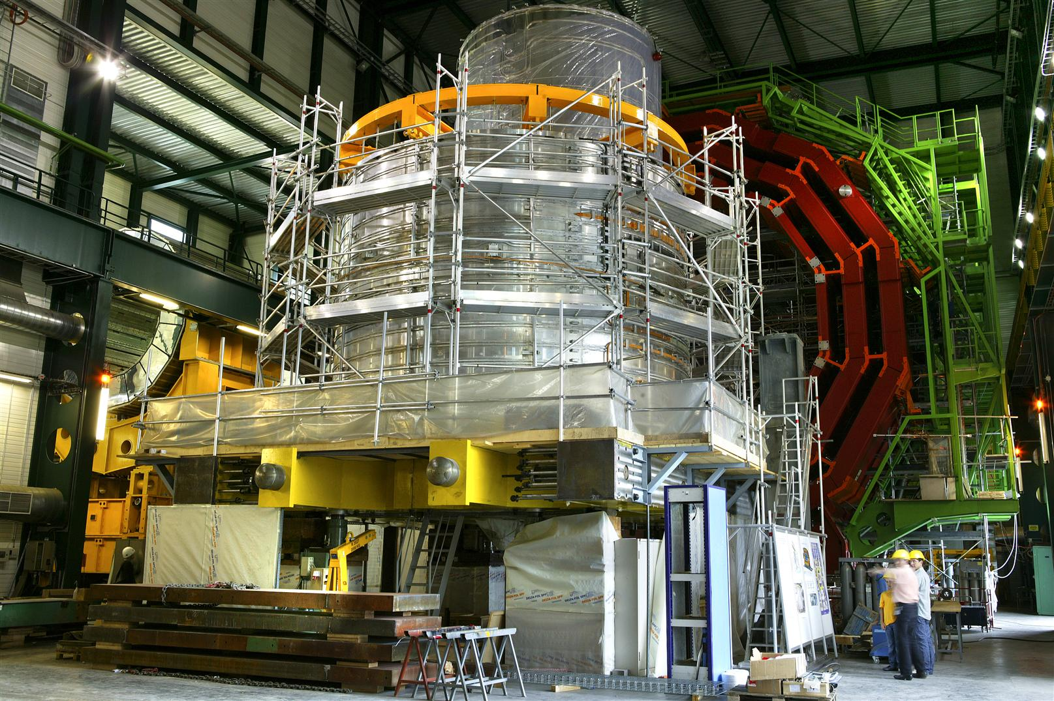
Solenoid Coil Module 64 tons Max.

Slide 10
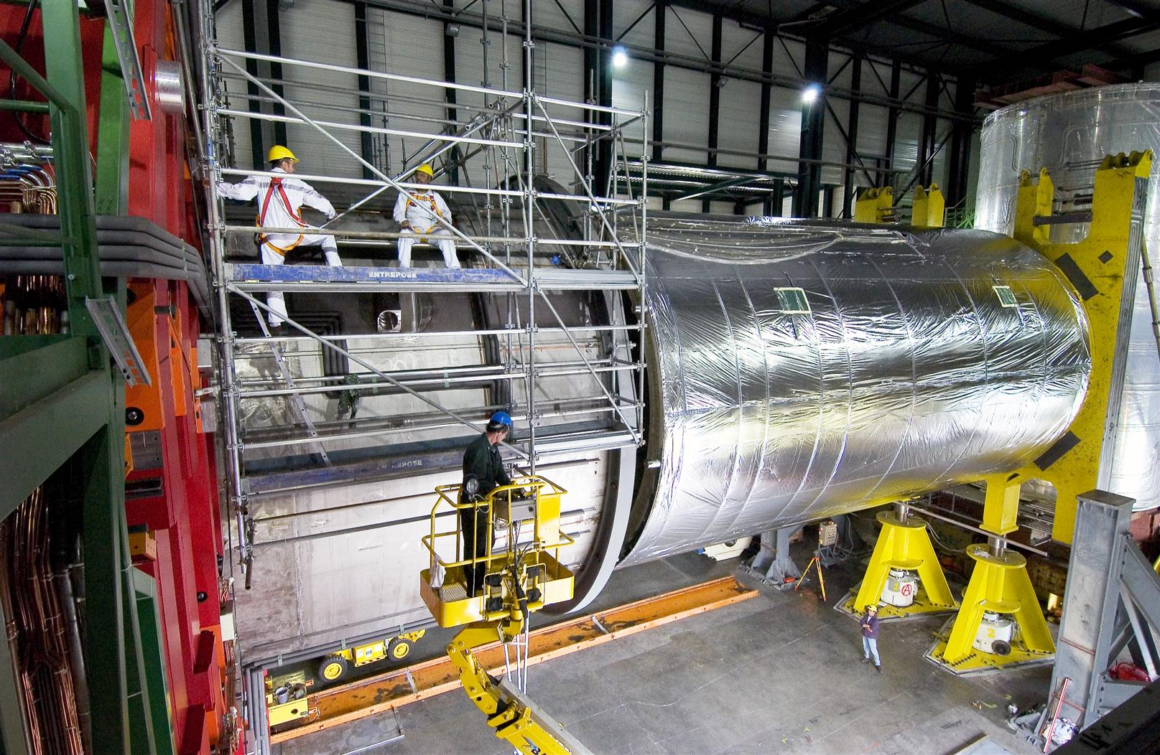
Swiveling

Slide 11
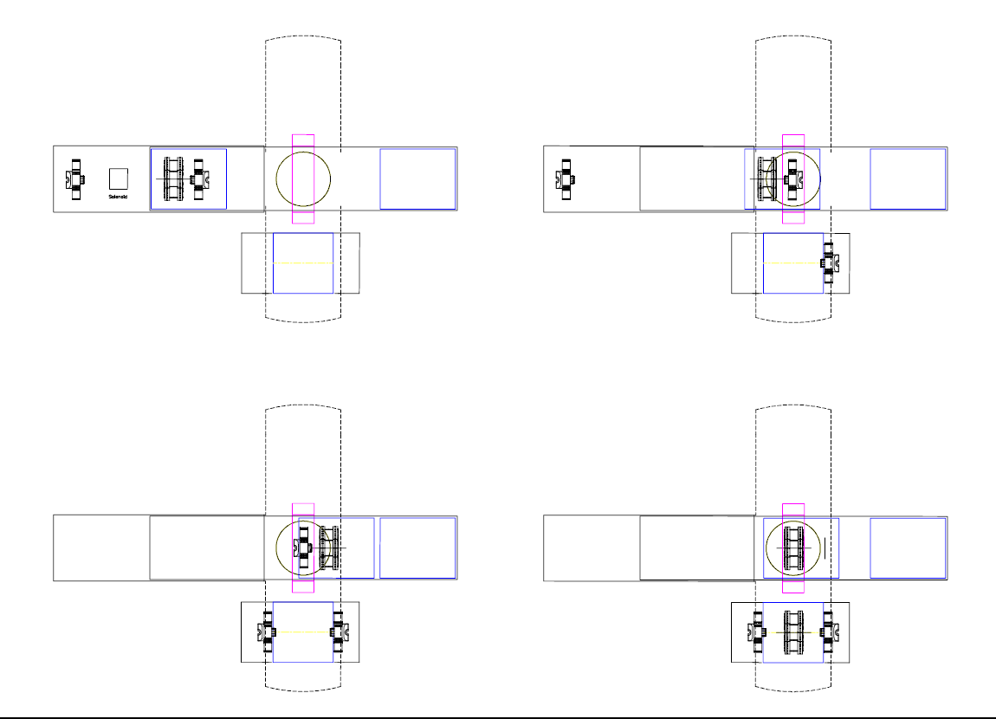
Lowering Sequence w/ platform

Slide 12
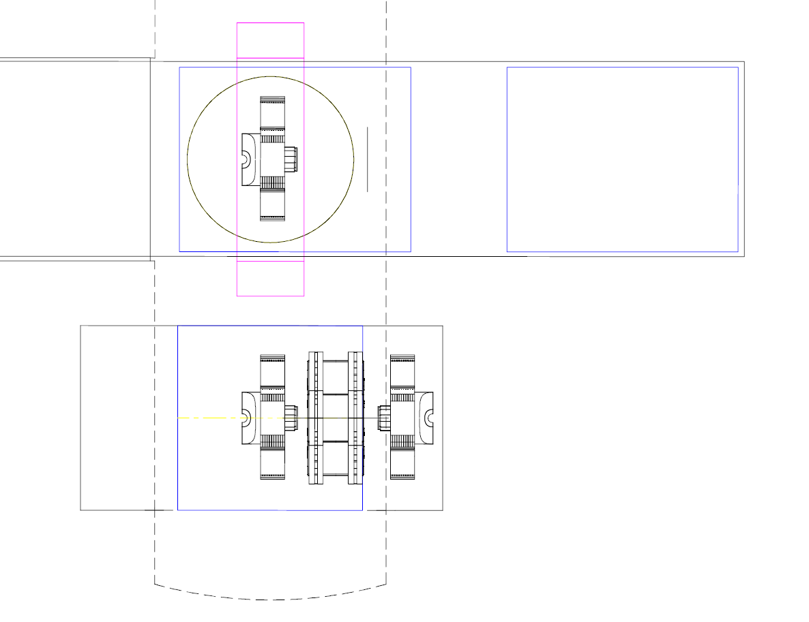
Lowering Sequence w/ rollers

