Slide 1
MDI & CFS :Detector Hall and Surface assembly
DH Scheme change
The total construction period can be reduced about 1y.
Accessibility to the underground is good and attractive.
The construction cost is also perspective cheaper than the baseline.
Above Ground facilities
The basic plan of the Assembly hall can be almost agreed.
Utility facilities will need more detailed study in near future.
More study about the necessary facility at IR is required.
Future Prospect and Problems
Basic planning is important activity toward the design stage.
Geological Survey is an important issue for the decision of DH location and structure

Slide 2
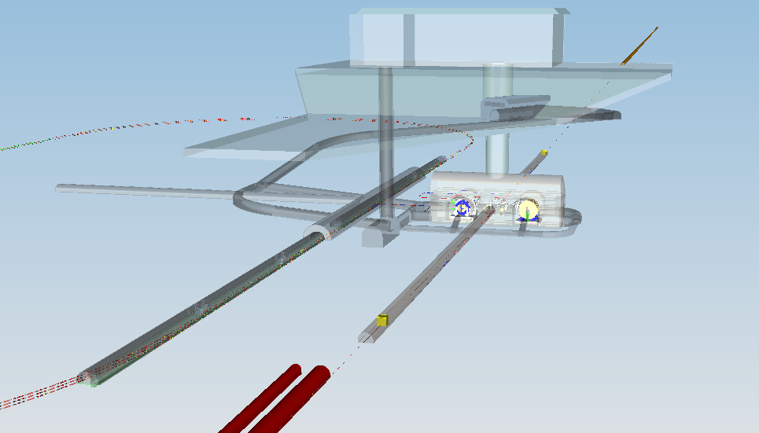
Overview of the DH scheme change
3D Model: New Baseline Proposal (Hybrid A’)
Assembly Hall
Utility Shaft
Access Portal
Access Tunnel
Main Shaft
Detector Hall
BDS
Damping Ring
3D Design Integration model:
Underground and Surface Facilities
From the EDMS Meeting @KEK 2.12.2014 Benno List

Slide 3
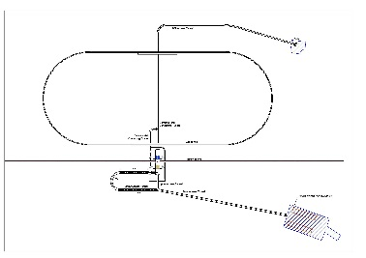
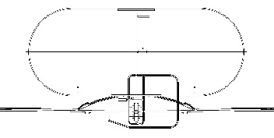
Outline of Baseline & New Baseline
TDR Baseline | New Baseline Proposed
Experimental hall (DH) is located below peak of Mt. HAYAMA. Transportation of the components: through the Horizontal tunnel Accelerator transportation(DR) : through the Horizontal tunnel(AT) | Experimental hall (DH) is located in the north side foot of Mt. HAYAMA. Transportation of large components: through the Vertical shaft (D18.0m) Security of the flat land for Detector assembly above the IR
Mt. HAYAMA
Mt. HAYAMA
Assembly
Yard
DR Surface
Yard
DR
Surface Yard
Assembly
Yard
DH/AT
W11m Grad7%
DR/ AT
W8m Grad10%
DR/ AT
W8m Grad10%
DH
DR
DH/AT
W8m Grad10%
DH
DR

Slide 4
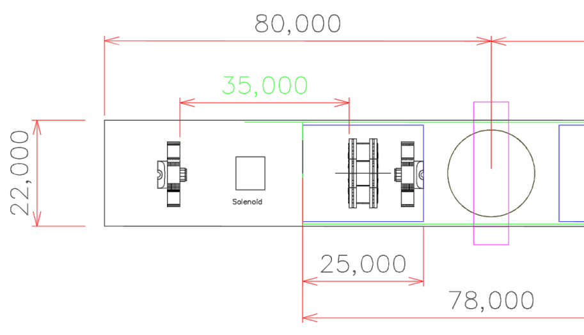
Required Space of Assembly Hall
ILD
SiD
62.0m
18.0m
181.0m
67.0 (65.0)m
50.0m
64.0 (62.0m)m
ILD
Common
SiD
52.5m
Platform
12.5m
Main
Shaft
Platform
25.0m
37.0m
27.0
(25.0)m
Assembly Area
Assembly Area
20.0m
(20.0m)
Shaft Construction
Area
Outer space
ILD: L67.0m x w27.0m
SiD: L64.0m x w27.0m
17.0(15.0)m

Slide 5
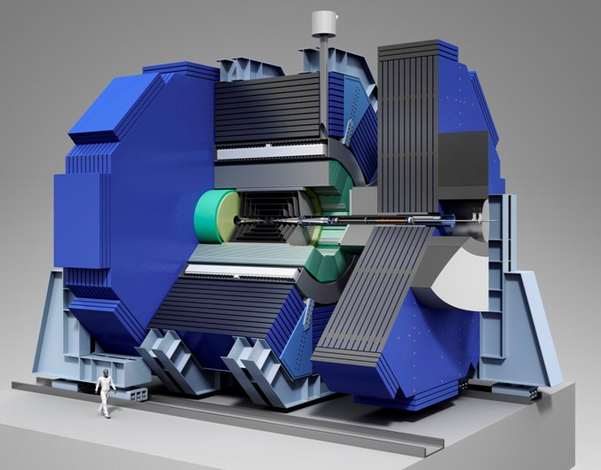
SID Assembly Assumptions
Maximum Permissible Load on Road, 60 ÷ 80 tons
Assembly on surface of Magnet, solenoid, Hcals
Weight | Metric Tons
Tracker | 1.5
Barrel Ecal | 60
Barrel Hcal | 450
Coil | 162
Barrel Iron | 3100
Total Barrel | 3773
Endcap Ecal | 10
Endcap Hcal | 38
Endcap Iron | 2100
Pacman | 100
BDS | 5
Total Door (x1) | 2253
Total SiD | 8278

Slide 6
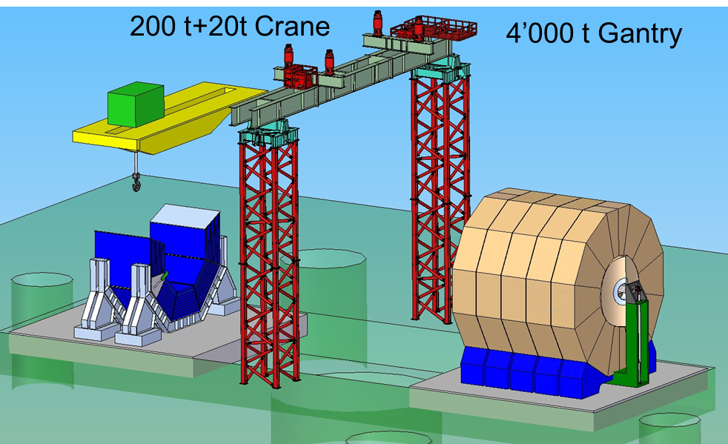
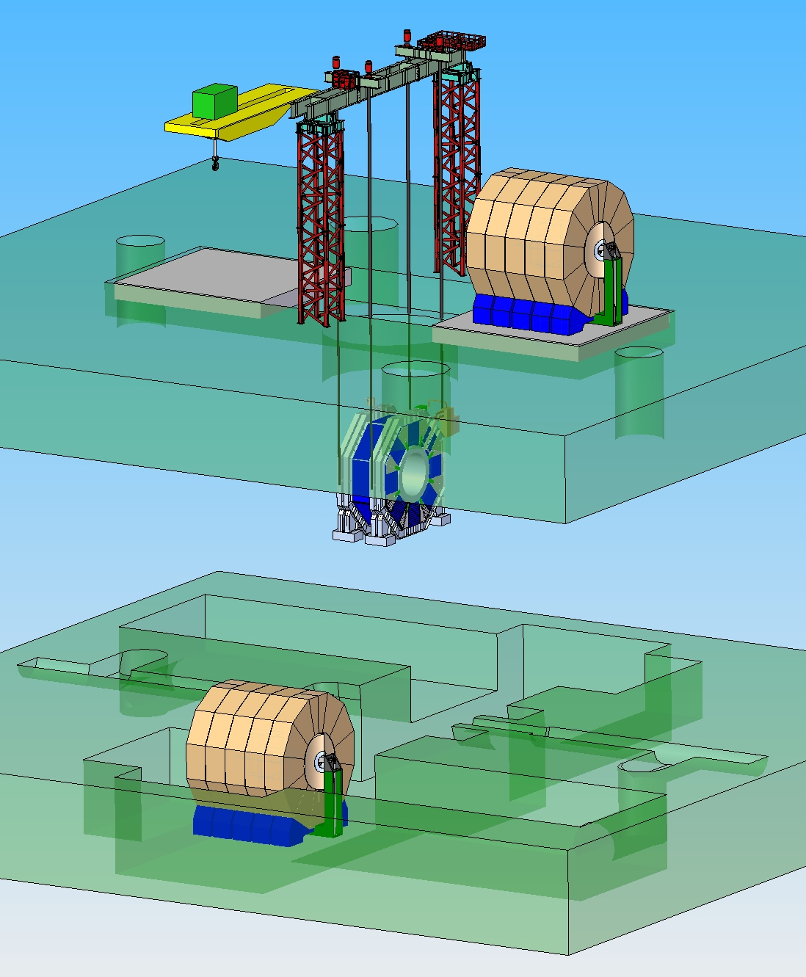
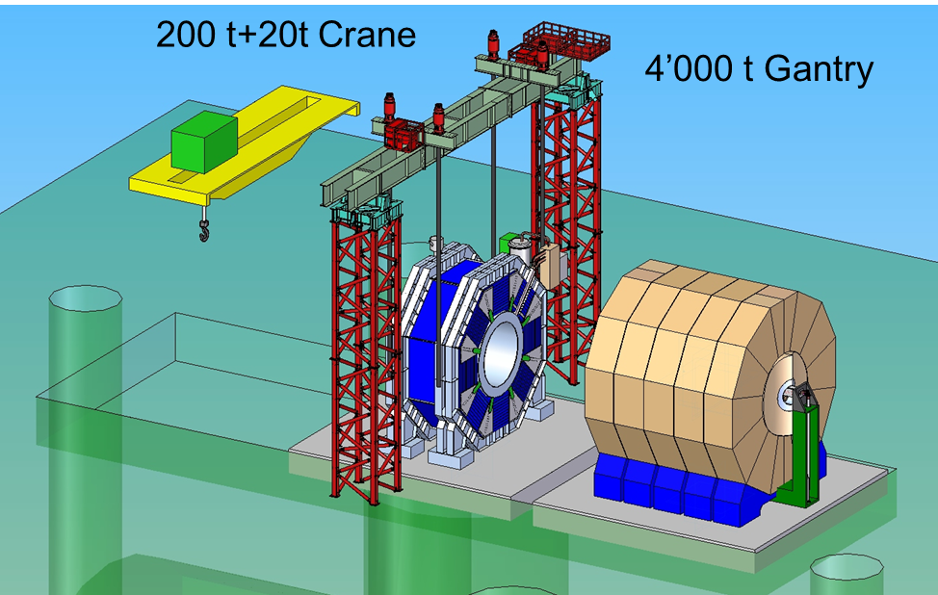
Vertical shaft Installation

Slide 7
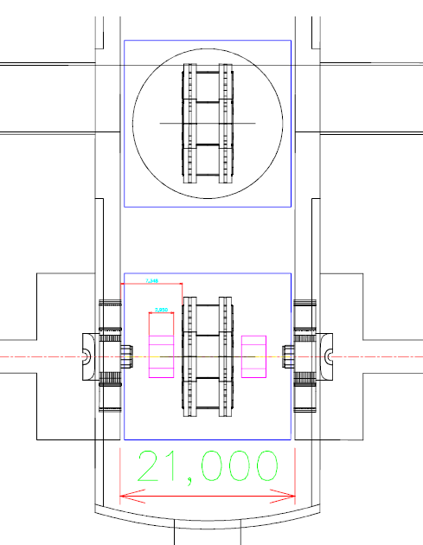
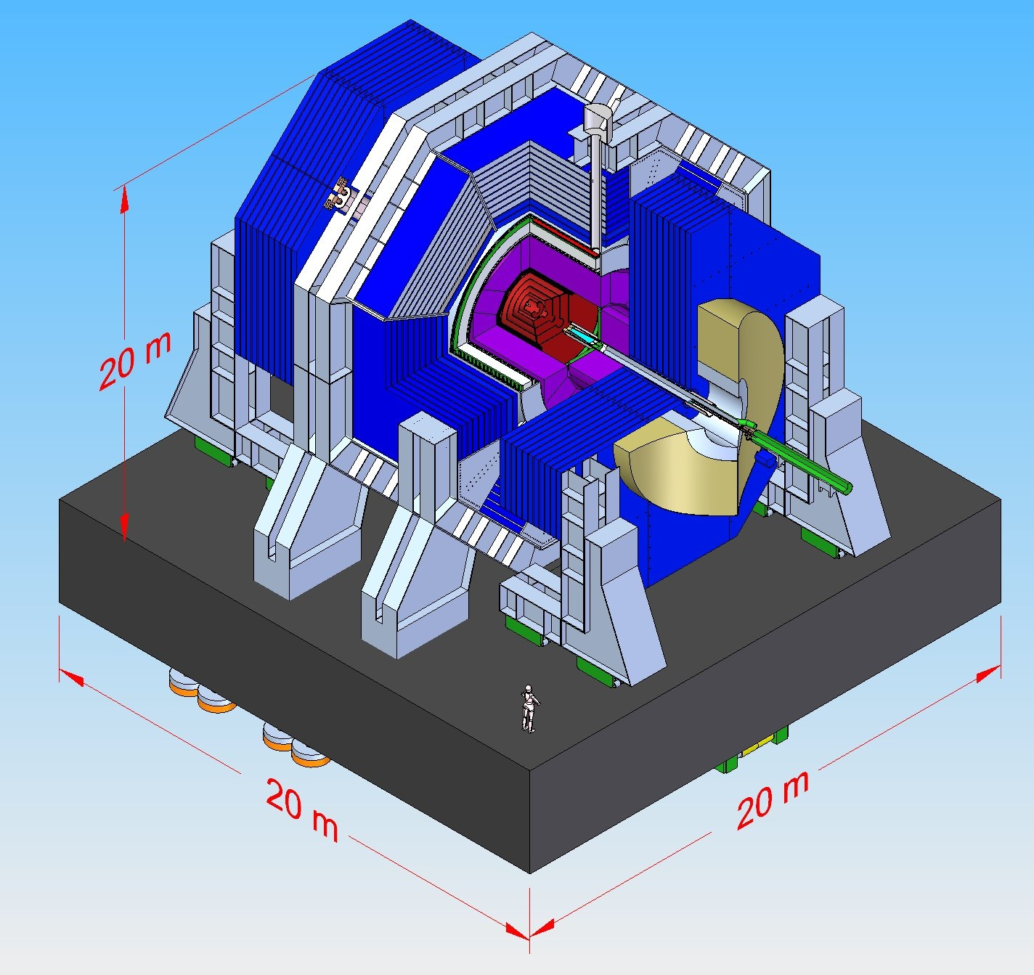
Cavern Width, at the floor level = 21 m
Set by the platform requirements
2 m opening on the beam
Space for Cryogenics and Infra.

Slide 8

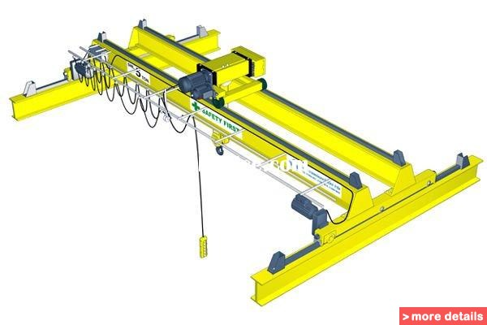
SID Assembly and Installation Workflow
Tasks
Transport from factories to the site
Assembly
Magnet Commissioning
Lowering
~ 60 tons Road Transport
Gantry
4,000 tons
Bridge Crane
~ 200 tons
~ 50 pieces / 60 tons

Slide 9
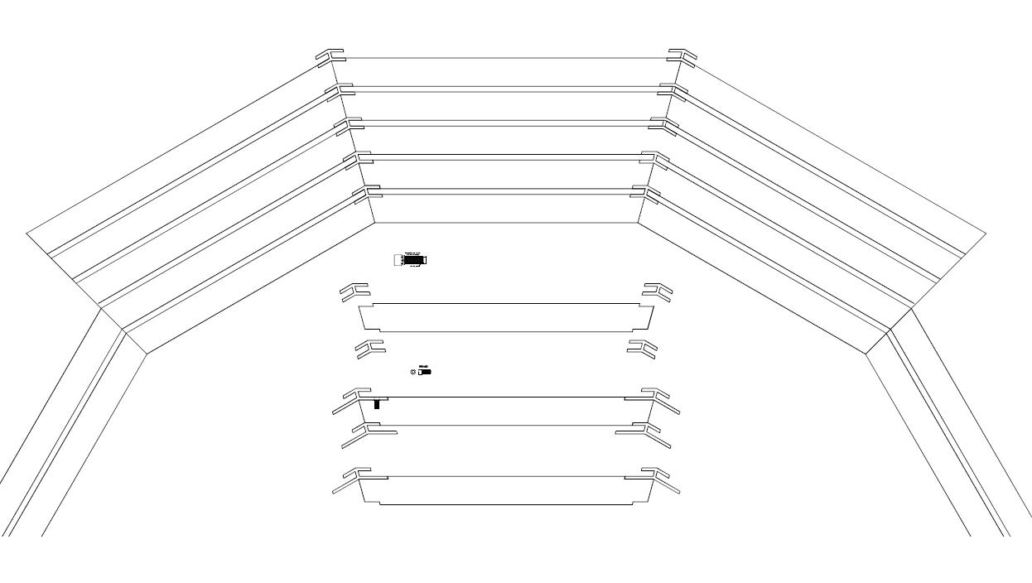
Magnet Barrel Design
30 tons Max per plate
Single plate: 17 tons through 29 tons

Slide 10
Barrel Construction

Slide 11
Magnet Assembly
60-80 tons assemblies delivered to the site and installed with 60-80 tons capacity cranes
33 tons vacuum tanks installed in the barrel
64 tons solenoid coils delivered to the site and vertically assembled in to a cold mass
Solenoid swiveled and inserted inside the vacuum cryostat
ITEM | QUANTITY | MASS | Diameter | Length
 |  | (metric T) | (O.D. meter) | (meter)
COMPLETED COIL MODULE | 2 | 64 | 6.578 | 2.793
CRYOSTAT OUTER VACUUM SHELL | 1 | 16.5 | 6.858 | 5.800
CRYOSTAT INNER VACUUM SHELL | 1 | 12.7 | 5.308 | 5.800
TOTAL CRYOSTAT WITH END FLANGES | 1 | 33.3 | 6.858 | 5.900

Slide 12
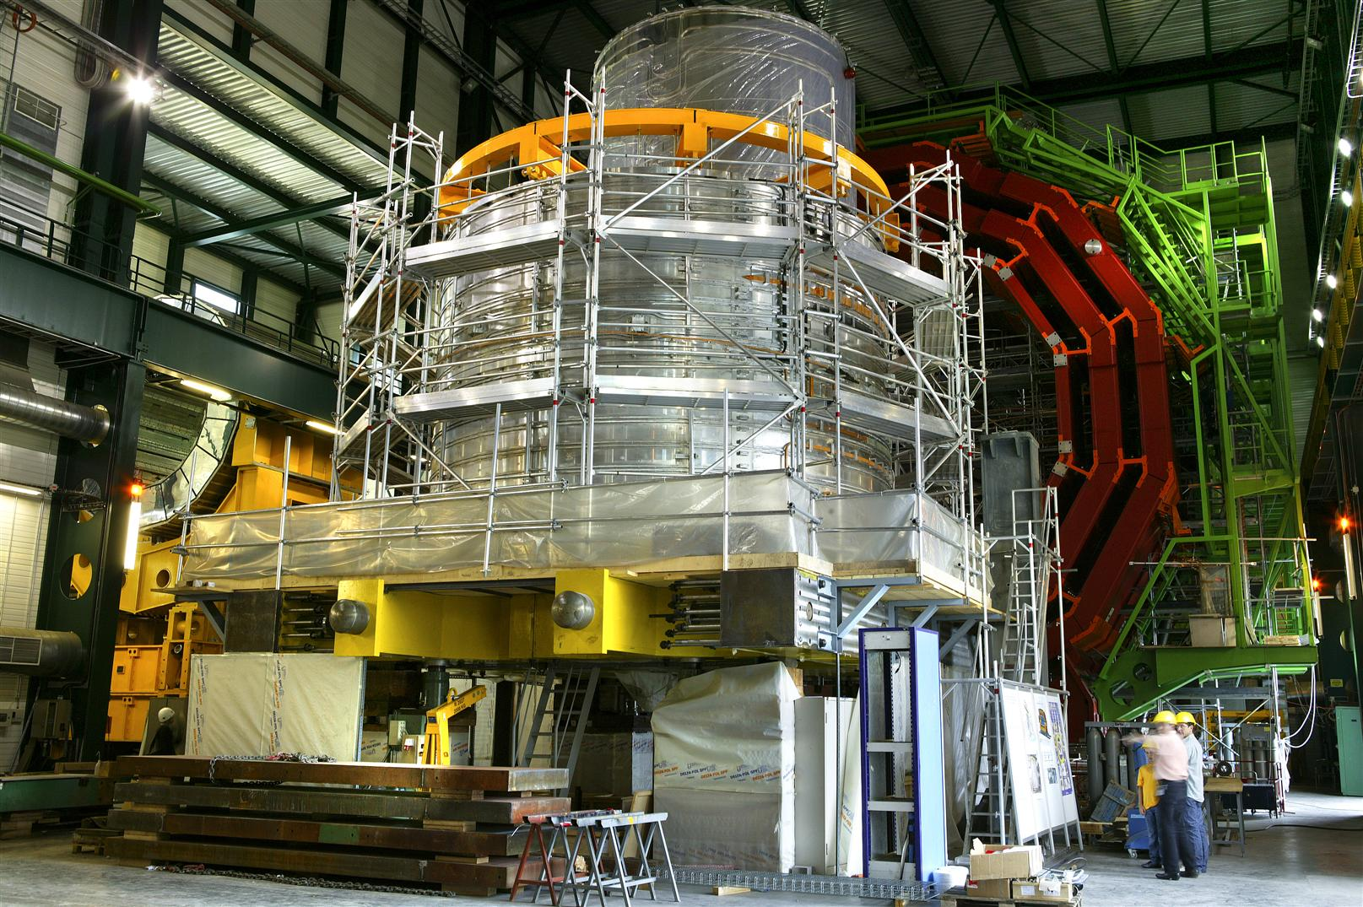
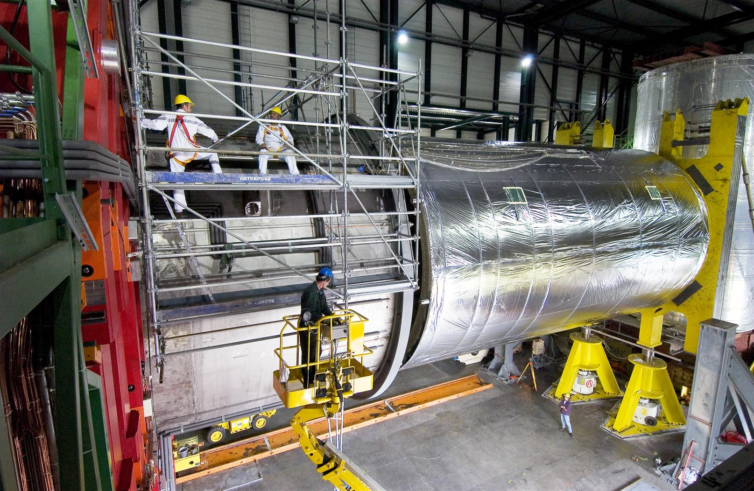
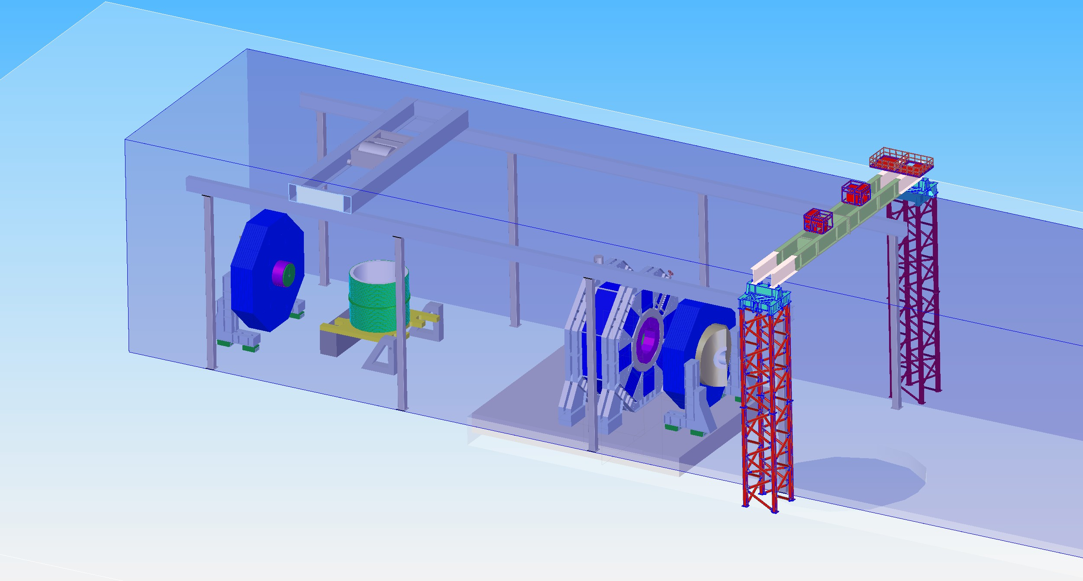
Solenoid Assembly and Installation
CMS
CMS
SID

Slide 13
Required Infrastructures on surface
~ 200 metric tons bridge crane with double trolley
~ 4,000 metric tons Gantry
One platform 25 m x 20 m with 50 m motion range
Motion system at floor for Doors and HCals
Cold box 4K for the commissioning of the Solenoid
Gas system for the commissioning of the muon detectors
Machine Shop
Adequate Storage for heavy tooling
Office space

Slide 14
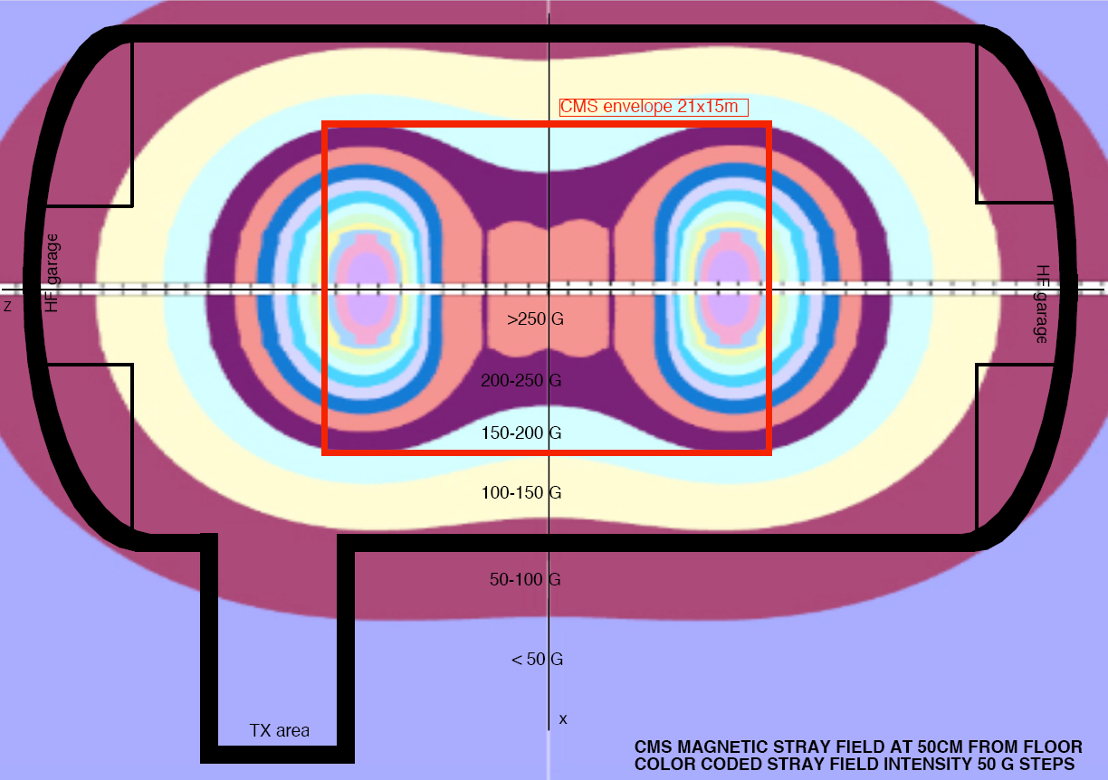
CMS Stray Field at 50cm from floor

Slide 15
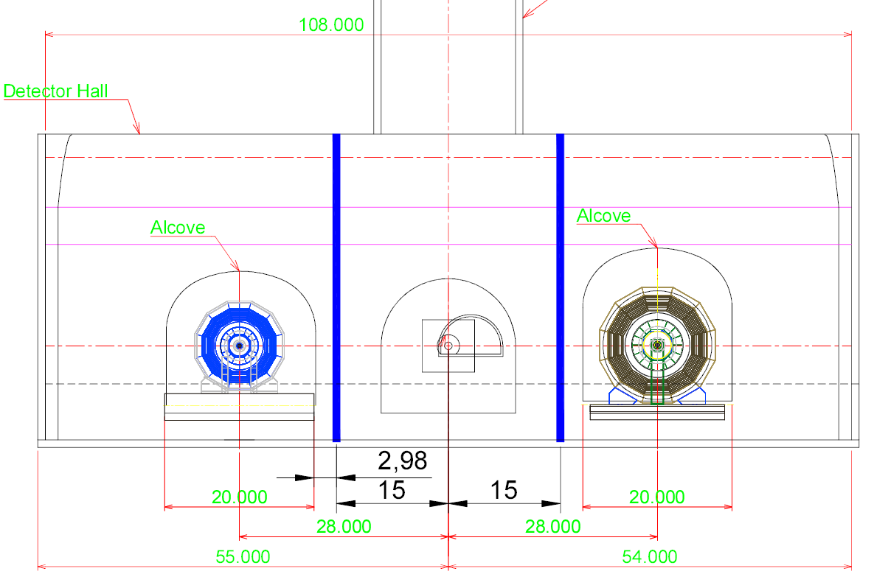
Detector Hall

Slide 16
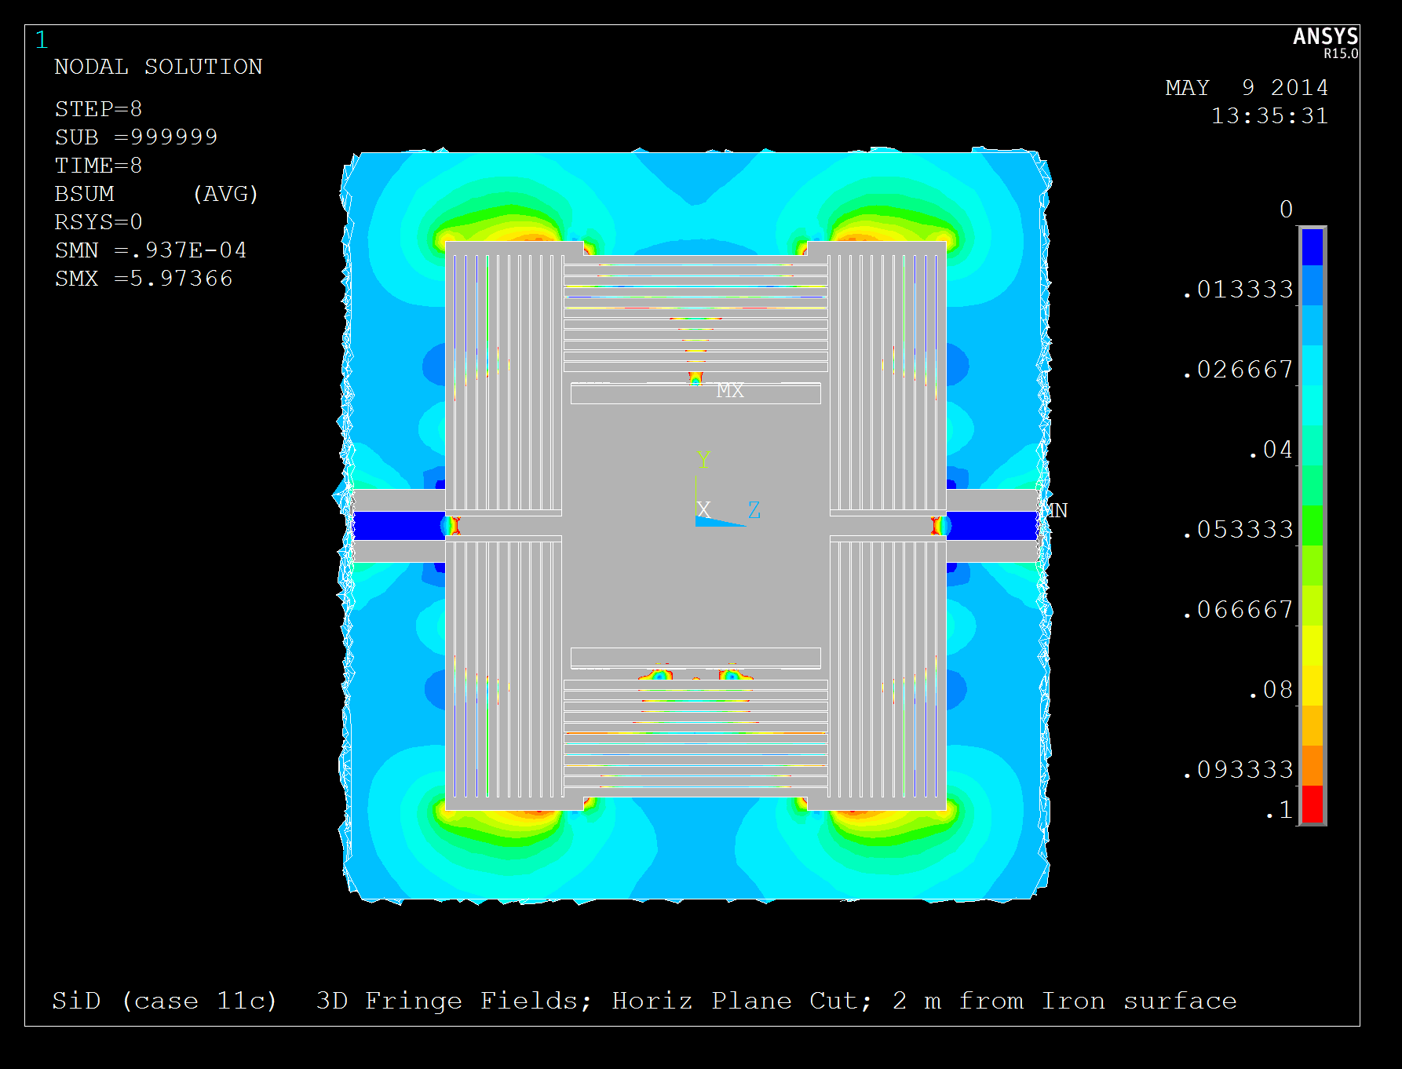
SID Fringe Fields
W. Craddock

Slide 17
Fringe field and Push-Pull
50 Gauss at the off-line detector area is safe number to consider and we should not change it.
No technical reason founded why this limit should be fulfilled at 15m.
It should be probably restated as “Maximum field at the edge of the platform”
If a concern, the additional cost of the iron should be traded of with a longer (+ 3m ) push-pull, i.e. a longer DH. Now it is the right time !
The 1,000 Gauss limit in the proximity of the beamline detector looks a safe value for components and personnel safety….and iron is needed !
I am afraid that the access of the personnel above/under an energized solenoid of 1.5 GJ class will be anyway very limited.
Field reduction with compensating magnets is doable but a passive solution is still preferable under many aspects.

