Slide 1
Progress of Hybrid Access Study
Contents
Review of the previous report (24th June.)
Baseline & Hybrid Option Case Study (P3~P5)
Status in progress and some issues
Revision of the Hybrid-A’ Option
Variations of Assembly Hall Shape
Some issues for the Cost Estimate under progress
Issues

Slide 2
Hybrid Access Study
Assembly Yard
Access Portal
Access Tunnel
DR Tunnel
BDS Tunnel
Image of Hybrid A´ Revision Plan

Slide 3
Baseline & Hybrid Option Case Study
Baseline； DH/AT(W11m x H11m)
  Detectors are transferred and installed only using Access Tunnel that is W11m x H11m, max. gradient 7%
Hybrid –A； VS(D18m) + DH/AT(W8.0m x H7.5m)
  Detectors are installed VS (D18m) and Detector parts can be transferred using AT.
  Detailed Schedule adjustments of VS (D18m) use is very important because both detector groups share the shaft.
Hybrid –A´； VS(D18m) + Common use AT(W8.0m x H7.5m)
  AT is used commonly for DH and DR.
  Detailed Schedule adjustments of AT use is necessary with machine team.
2-Vertical； VS(D18m) + VS(D8m）
  There is not DH/AT as an exclusive facility.
  But possible to use DR/AT during operation.

Slide 4
Baseline & Hybrid Option Case Study
Baseline (TDR) | Hybrid - A (ADI-CFS Joint Meeting)
DH/AT W11m x H11m Grad.7% DR/AT W8m x H7.5m Grad.10% | DH/AT W8m x H7.5m Grad. 7% DR/AT W8m x H7.5m Grad.10% Main shaft D18m UT shaft D10m
2 Vertical Shafts (SiD Proposal) | Hybrid - A’ (KEK-CFS Proposal)
DR/AT W8m x H7.5m Grad.10% Main shaft D18m Second shaft D8m UT shaft D10m | DH-DR common /AT W8m x H7.5m Grad.10% Main shaft D18m UT shaft D10m
Assembly
Yard
DR
Surface Yard
Assembly
Yard
DR Surface
Yard
UT Sht
Main Sht
DR/ AT
W8m Grad10%
DH/AT
W11m Grad7%
DR/ AT
W8m Grad10%
DH/AT
W8m Grad10%
DH
DR
DH
DR
Assembly
Yard
DR
Surface Yard
Assembly
Yard
DR
Surface Yard
UT Sht
UT Shaft
DR/AT
W8m Grad10%
Main Shaft
DR-DH Common AT
W8m Grad10%
Second Shaft
DH
DR
DH
DR

Slide 5
Hybrid – A´
One Vertical Shaft
One Access Tunnel
(for DH/DR)
DR/DH Access Tunnel
Main Shaft D18m
Main Shaft
Utility Shaft
DR/DH Access Tunnel

Slide 6
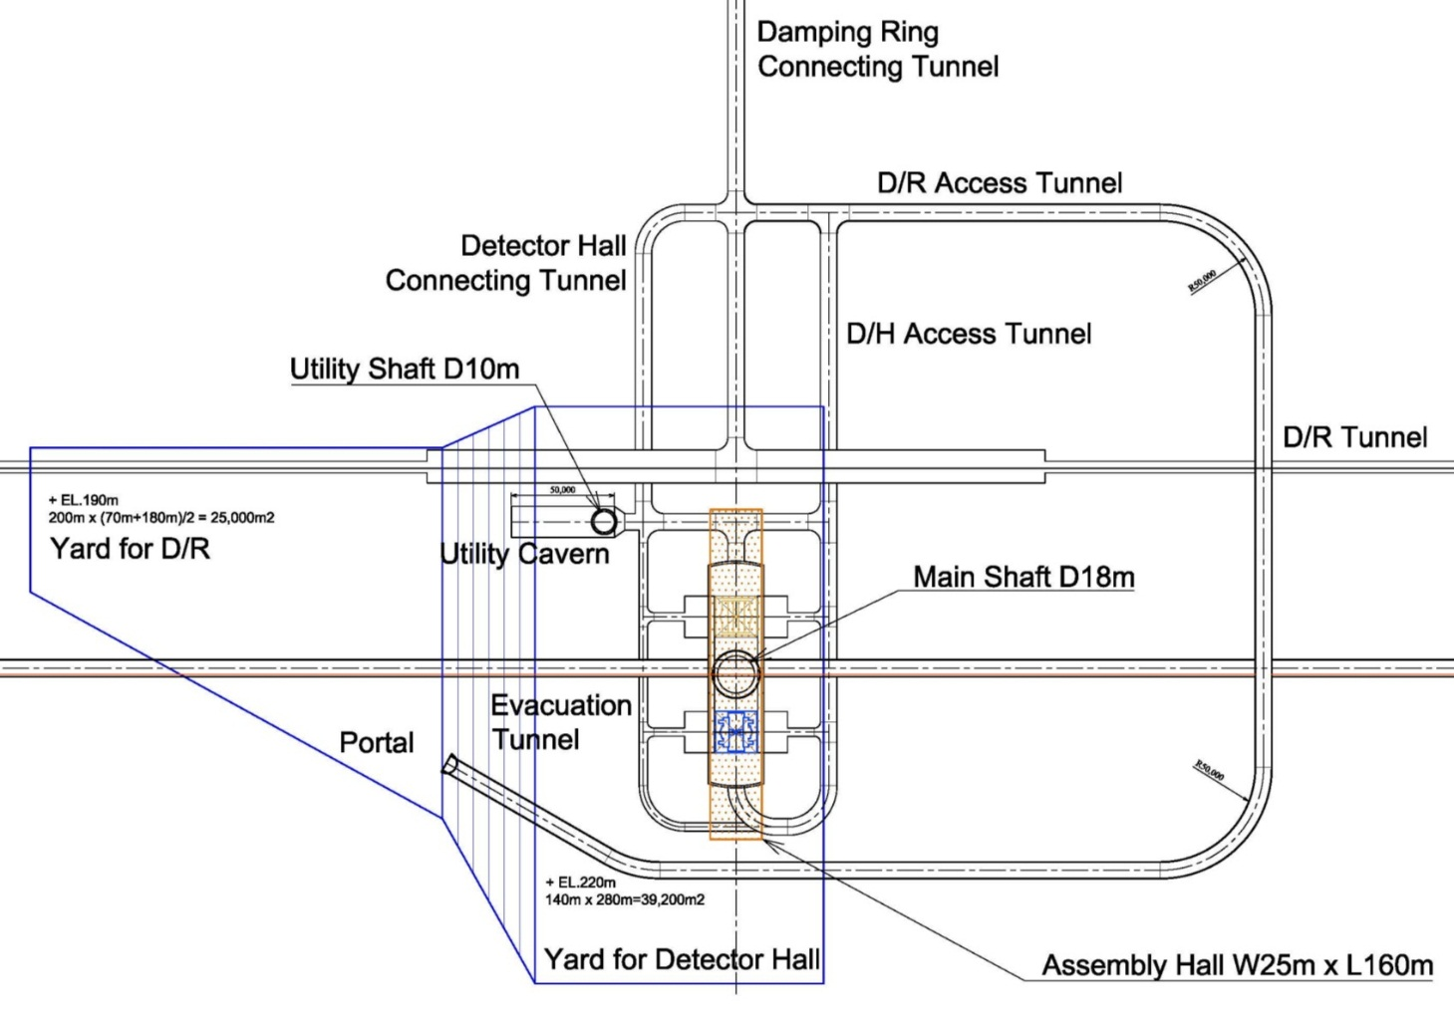
Hybrid – A´ Revision
One Vertical Shaft
One Access Tunnel
(for DH & DR)
DR-DH/Access Tunnel
DR-DH
Connecting T.
Under Construction
Main Shaft D18m
Evacuation
After Completion

Slide 7
Assembly Hall Layout Study
Current draft
Rotary 90 degrees plan
Assembly Hall
Beam line
Beam line
Z Shape
H Shape
C Shape
Beam line
Beam line
C-type or H-type is appropriate from land use conditions on the ground.

Slide 8
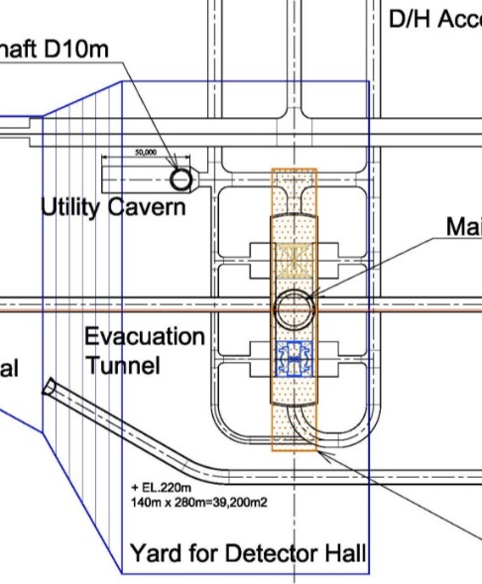
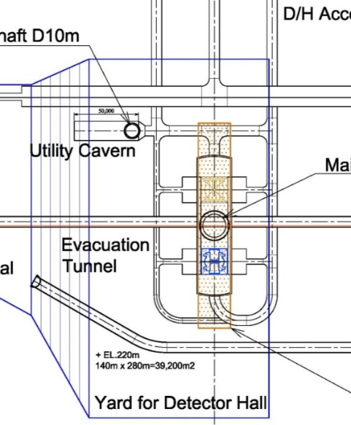
Assembly Hall Layout Option
Baseline
Orthogonal
Op.1
Parallel
Op.2
C-shape
Orthogonal
Op.3
C-shape
Parallel

Slide 9
Precondition for Cost Estimate
The matter list we want to confirm for cost study as soon as possible
Underground Facilities: Civil Work
Detector Hall Dimension/ L108m?*W25m*H42m (Minimum size)
Basic Dimensions of Alcove in DH (Possibility of change?)
Linear shape of the Access Tunnel for DH (no special trailer?)
<Minimum turning radius? of the Tunnel Inter-section>
Linear shape of the Access Tunnel for DR
<Transporting condition? of the long equipment to DR>
Surface Facilities: Architecture & Energy Plant
Assembly Hall Dimension/ Length, Width, Height.
Basic shape/ H-shape?, or C-shape? (CFS also will propose soon)
Other facilities and Functions are required
Specifications of crane equipment (DH & AH)

Slide 10
Precondition for Schedule Study
The matter list we want to confirm for Schedule study as soon as possible
Schedule for the Detector Assembly
Assembly period? in the surface building (ILD & SiD)
<For adjustment with the facility construction schedule>
Confirmation of heavy loading time to the underground
Assembly finishing period in the DH
Utility for the Cryogenics and Cooling Water System
Piping of Helium Gas & Liquid helium.
Cooling Water supply Plumbing.
Other matters
DH Pac-man: <design charge group?> <construction period?>
Design of the Platform in DH: <design charge group?> <construction period?>

Slide 11
Issues
Construction Cost and Schedule Study
- Civil Work for DH Cavern, Utility Cavern, AT, VS, and others.
- Surface Facilities for Cryogenics, Cooling Water, others.
- Mechanical & Electrical Facilities.
- Handling Equipment.
Surface Yard Study
- Land Area required for Assembly Yard
- Site Development and Environmental Impact issues.
Other Issues
- Installation Schedule adjustment between DR & DH.
- Geological Investigation in the main shaft point (IP).

