Slide 1

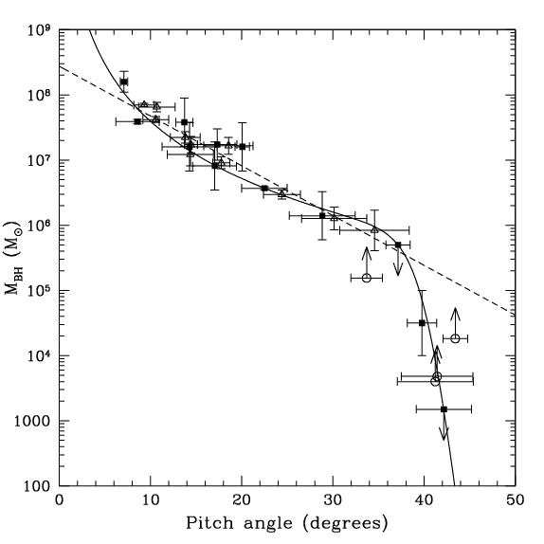
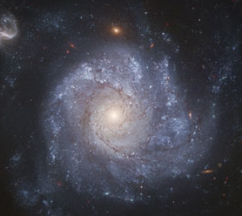
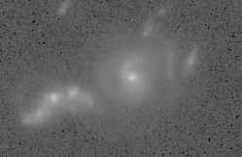

GOODS-North Field
Hubble Deep Field
Chandra Deep Field
Deep VLA 1.4 GHz & 8.5 GHz
z=0.47
Marc S. Seigar, Daniel Kennefick, Julia Kennefick, Claud H. S. Lacy 2008
z=1.9
FURTHER EVIDENCE FOR A SUPERMASSIVE BLACK HOLE MASS–PITCH ANGLE RELATION
Berrier et al. 2013 ApJ 769:132
Notes:
The Great Observatories Origins Deep Survey GOODS N and S – both cover 320 square arcmins of the sky. For galaxy evolution surveys across cosmic time.
Our correlation shows that galaxies which have more tightly wound spiral arms (the shape of whose arms are more nearly like a circle) have larger supermassive black holes. Galaxies with loosely wound arms have smaller central black holes. See the graph below.
Most the supermassive black holes we can measure the mass of are in quasars and other active galactic nuclei and most of the closer ones are smaller than the ones which are farther away. This is odd because farther away means that the objects are seen when the Universe was younger. The nearer objects are, in general, older. But we expect that black holes should never grow smaller, only bigger, as they swallow more matter without letting anything escape. Shouldn't the nearer ones, which are older, be generally bigger? As an aside for those who know about such things, it is true that Hawking Radiation does provide one mechanism by which black holes can lose mass, but we expect that supermassive black holes will be much too "cool," in terms of black hole thermodynamics, to lose any appreciable mass to Hawking Radiation. The explanation for cosmic downsizing is that the bigger black holes are more efficient at hoovering up matter in their neighborhoods, and so they become quiescent more quickly. Thus in our own epoch only the smaller supermassive black holes are still active. To prove this it would be nice to be able to find some way of estimating the masses of the central black holes for large numbers of galaxies in the more recent Universe. We should expect to able to locate those large black holes now sitting at the centers of their host galaxies doing nothing.

Slide 2
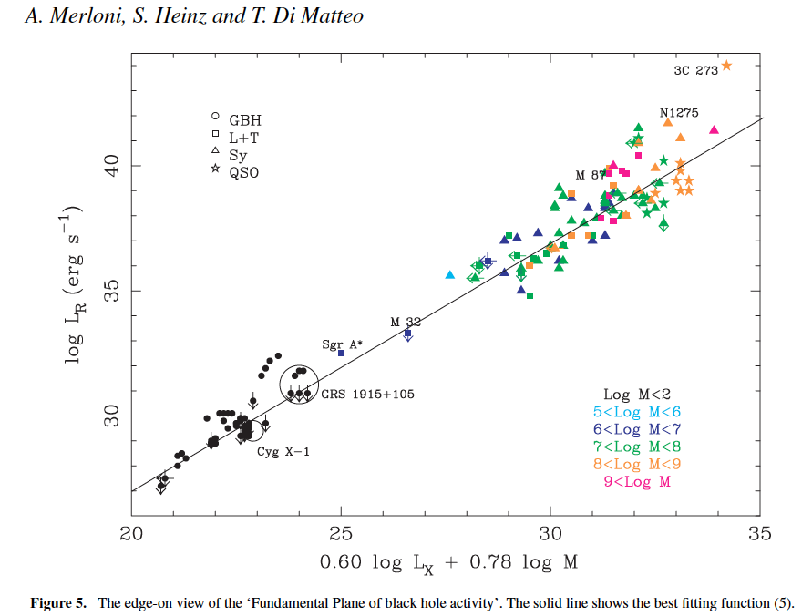
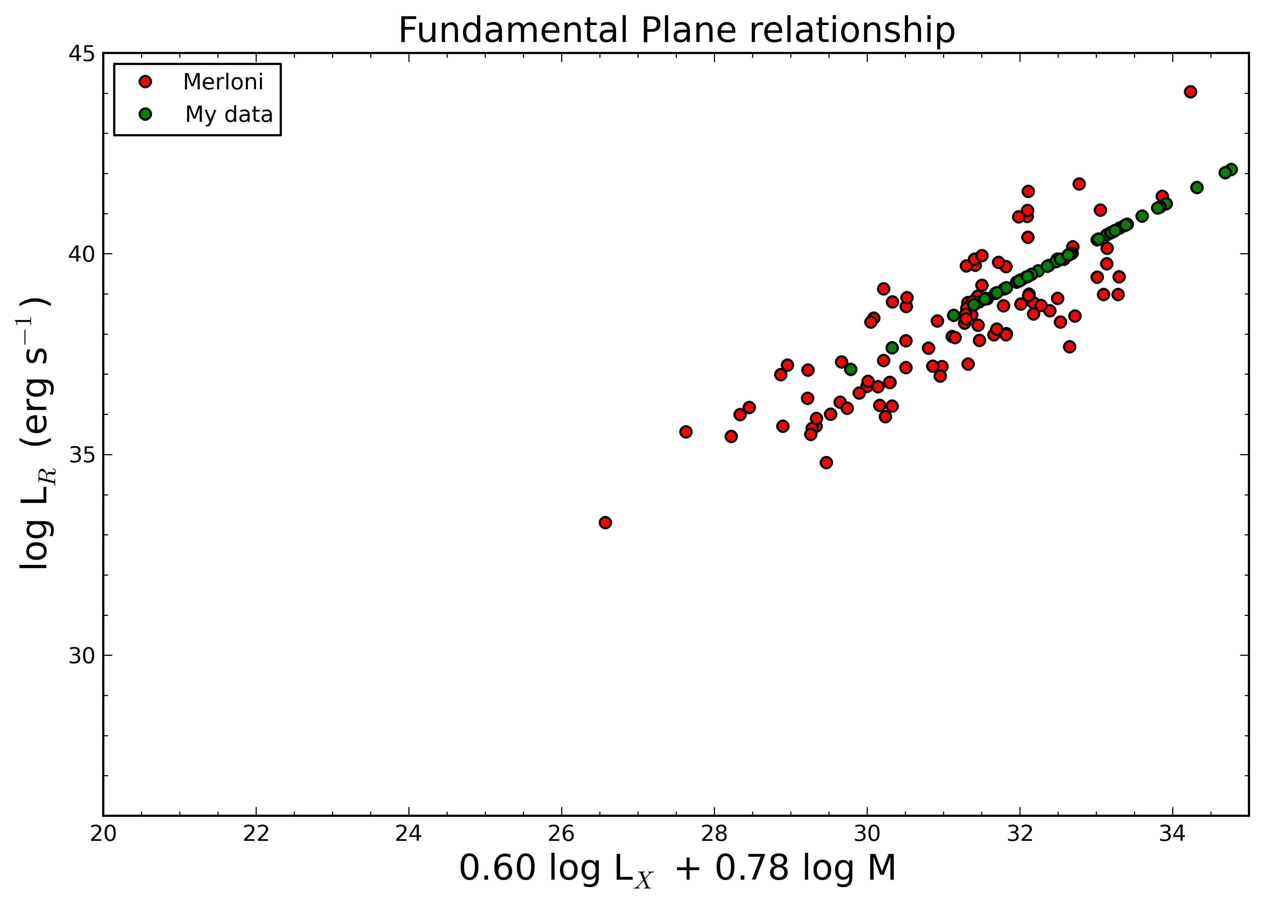
Merloni, Heinz, and Matteo 2003 data set from
‘A Fundamental Plane of black hole activity’
Radio Luminosity at 5 GHz
X-ray Luminosity 2-10 keV
Black Hole Mass

Slide 3
Fundamental Plane Relationship should not be used for calculating BH masses!!!
Only works well for LLAGNs with low Eddington ratios (λ < λ_{cr})
  Low Kinetic (radio loud)
  High Kinetic (radio loud Quasars)
  High Radiative (radio quiet Quasars)
My sample is bias toward higher accretion rates given higher luminosities.

Slide 4
My Results
Range of M_{BH}: 10^{7.6} – 10^{11.4}
Average M_{BH} ~ 10^{9.3}
30% of my BHs are > M87 BH mass
Using calculated radio spectral indices and photon indices.
Average M_{BH} for z < 0.96 ~ 10^{8.85}
Average M_{BH} for z > 0.96 ~ 10^{9.89}
Assuming α_{R} = 0.5 and Γ = 1.7
Average M_{BH} for z < 0.96 ~ 10^{8.79}
Average M_{BH} for z > 0.96 ~ 10^{9.60}
Differences in fluxes are negligible.
Notes:
Type 2 AGN suffer from heavier absorption of soft X-rays giving them a harder X-ray spectrum Γ ~ 1.4
I assumed a softer X-ray photon index expected more from a Type 1 AGN.

Slide 5
My problems
High Redshifts
  z ~ 0.08 – 4.4
  average z ~ 1.2
  Hard to distinguish AGN activity from SB activity (~ 70 % are SB)
No reliable AGN activity type
No reliable galaxy morphology
Can’t determine inclination angles

Slide 6
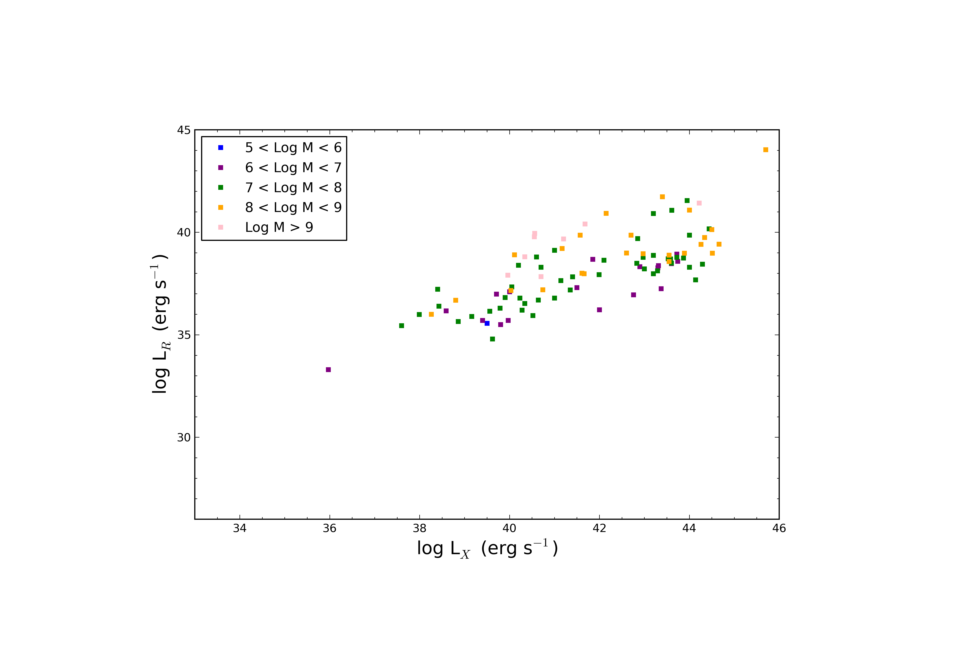
M03

Slide 7
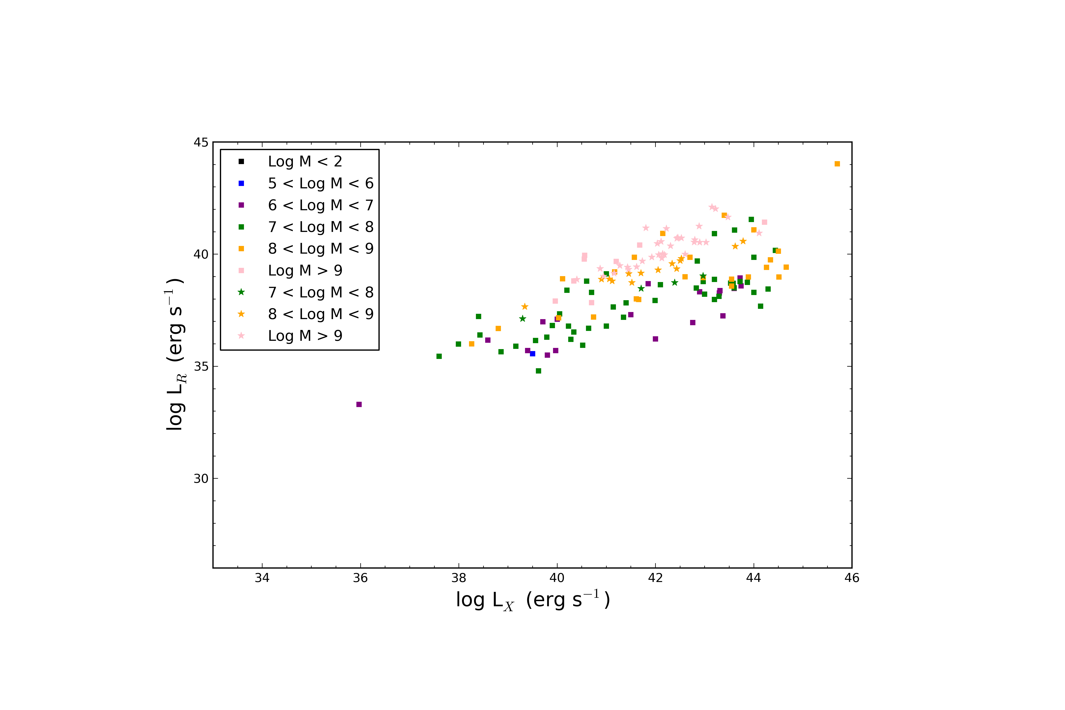
M03 + my data

Slide 8
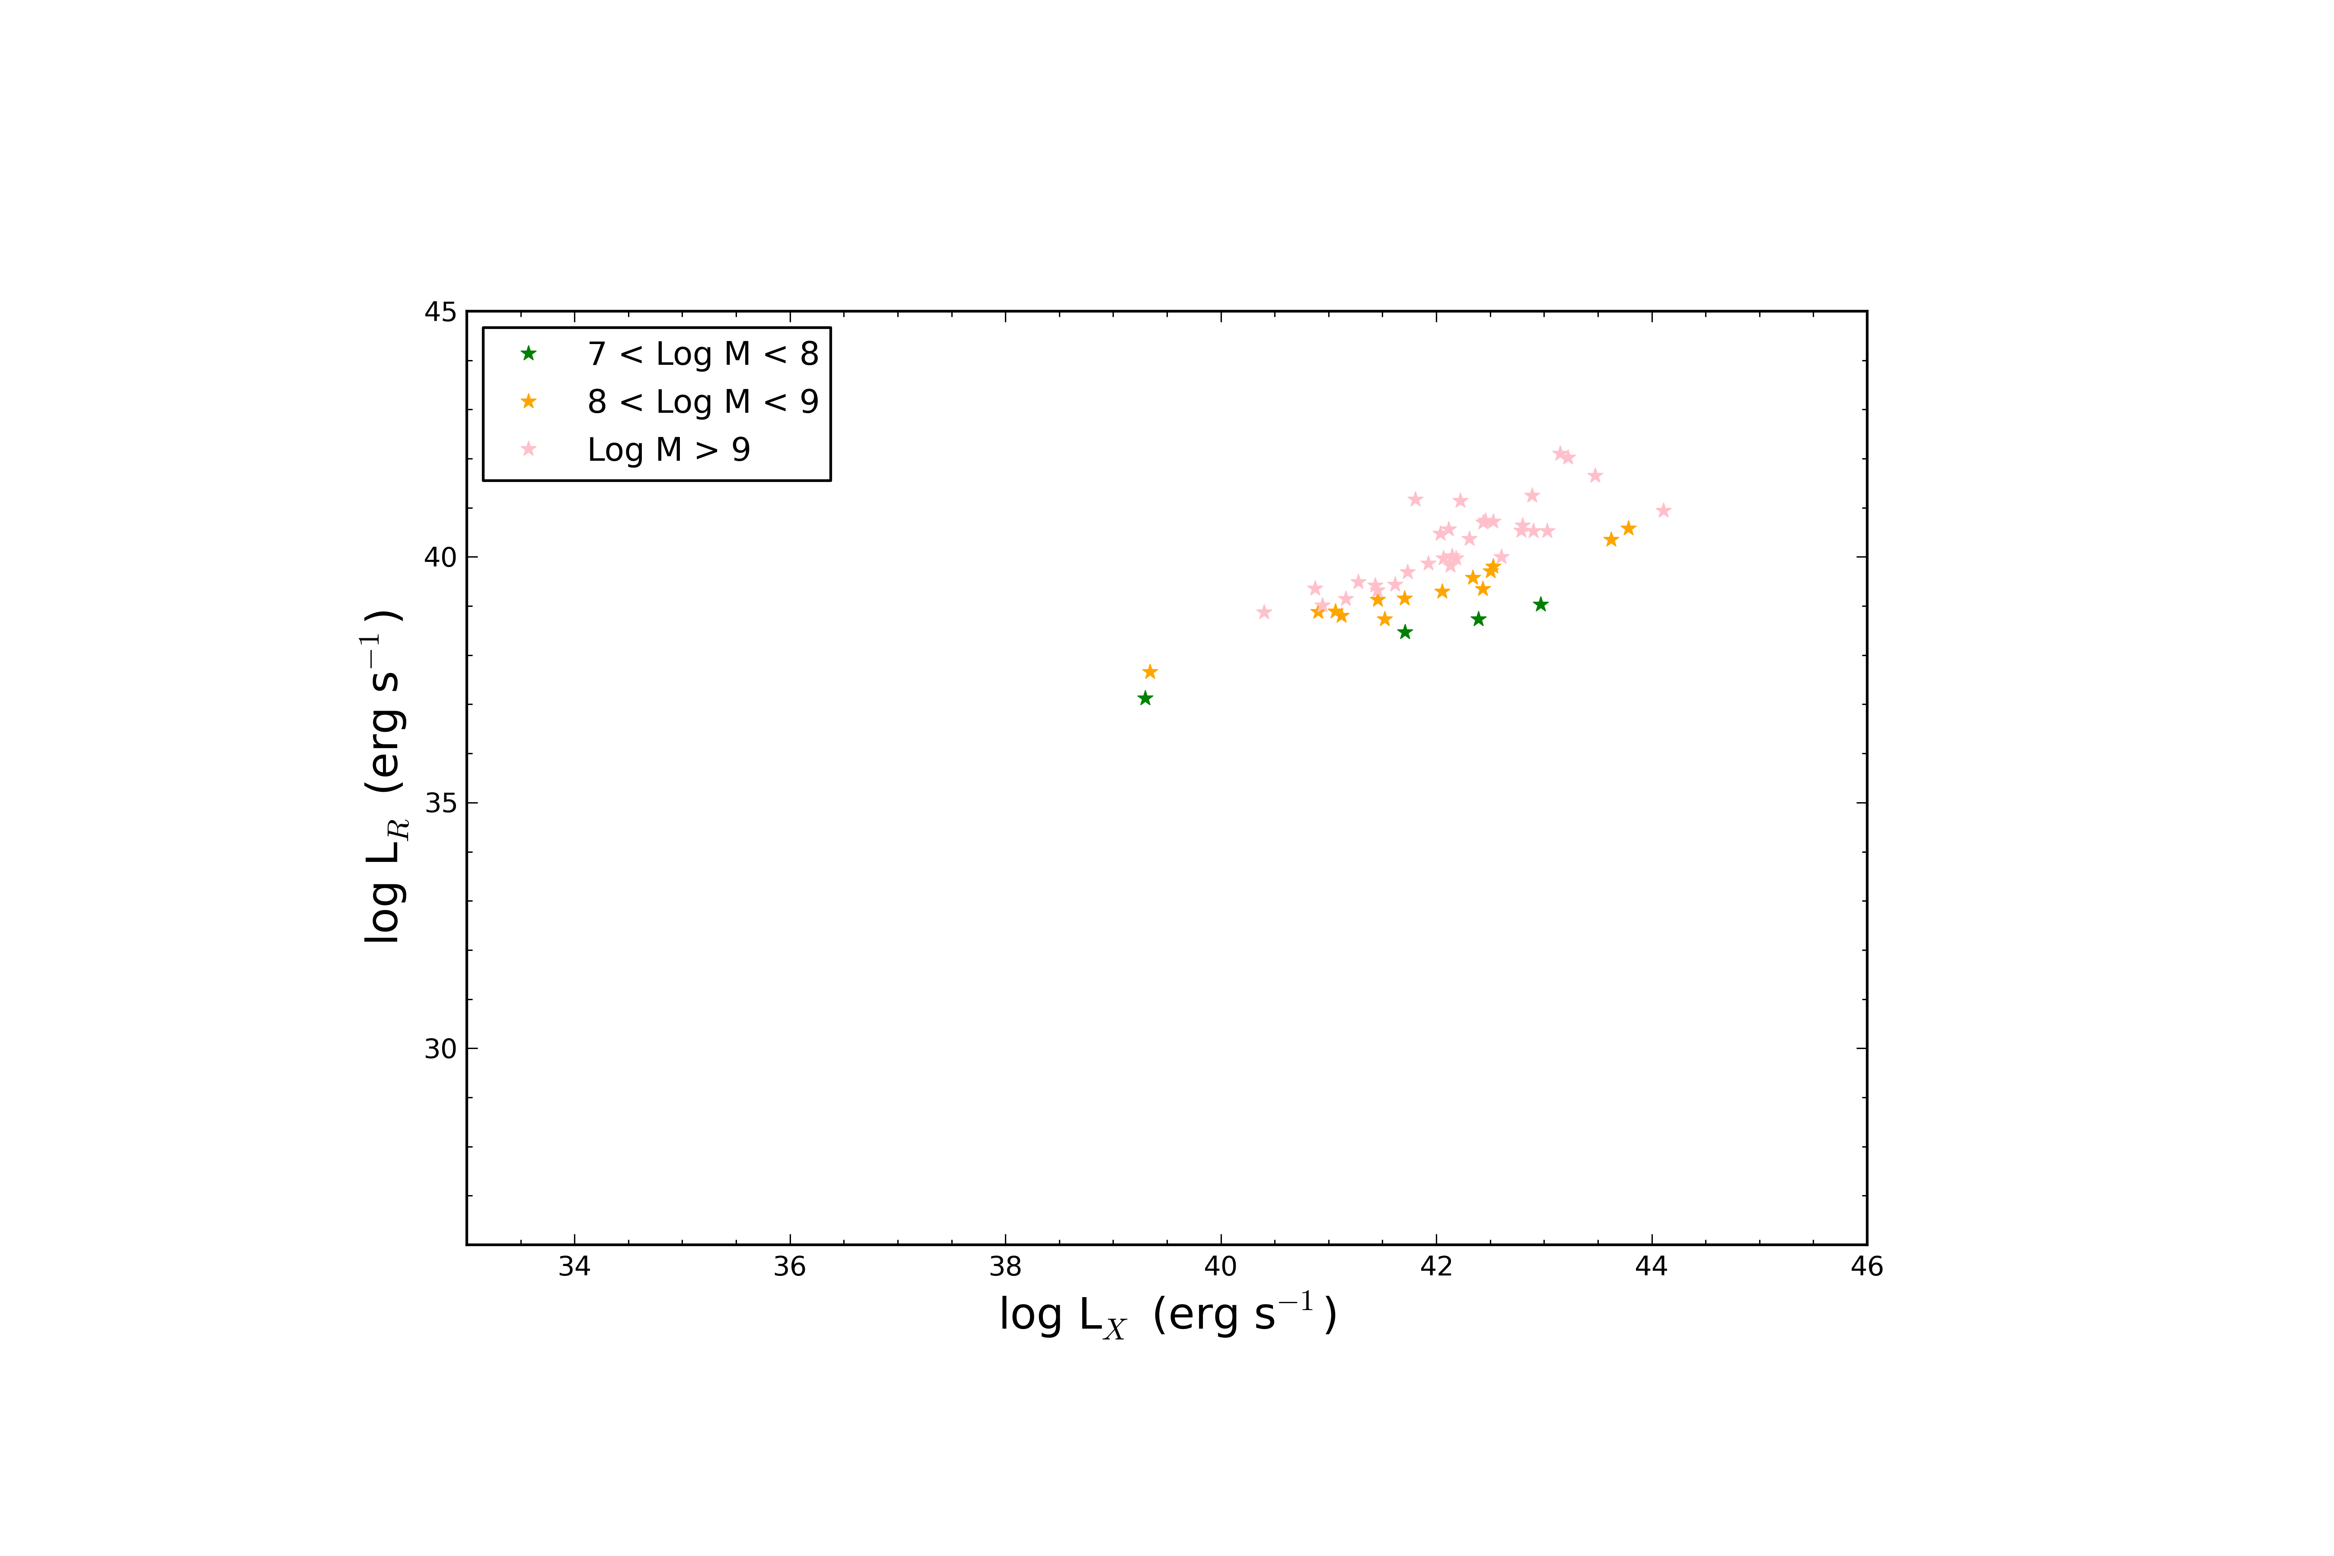
my data

Slide 9
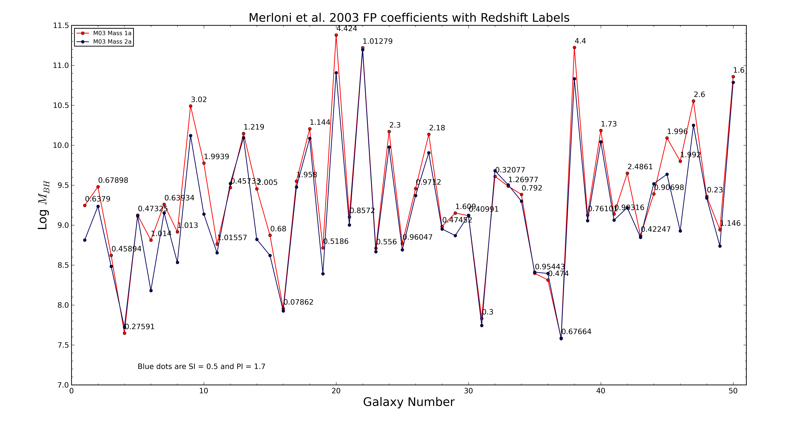
Notes:
The blue data are masses that were calculated by assuming all radio spectral indices (SI) were flat (α = 0.5) and effective photon indices (PI) were soft (Γ = 1.7).
Broad-line AGNs (typically type 1 AGNs) have X-ray power-law spectra with a softer photon index of Γ = 1.7 in the 2-10 keV band. Broad-line type 1 AGNs are your unabsorbed AGNs and Narrow-line type 2 AGNs are your absorbed AGNs. Absorbed AGNs are believed to be responsible for a significant portion of the harder X-rays observed in the Chandra X-ray Background (CXB) and have much harder photon indices in the range Γ = 1.4 ~ 1.5.
Masses that were calculated with these set spectral and photon indices (blue) tend to give lower masses than calculations done with photon indices from literature.
Calculations with the flat SI and soft PI give lower masses for 41 galaxies (82%), higher masses for 7 (14%) and 2 (4%) were consistent with the original calculations done using indices from the literature.

Slide 10
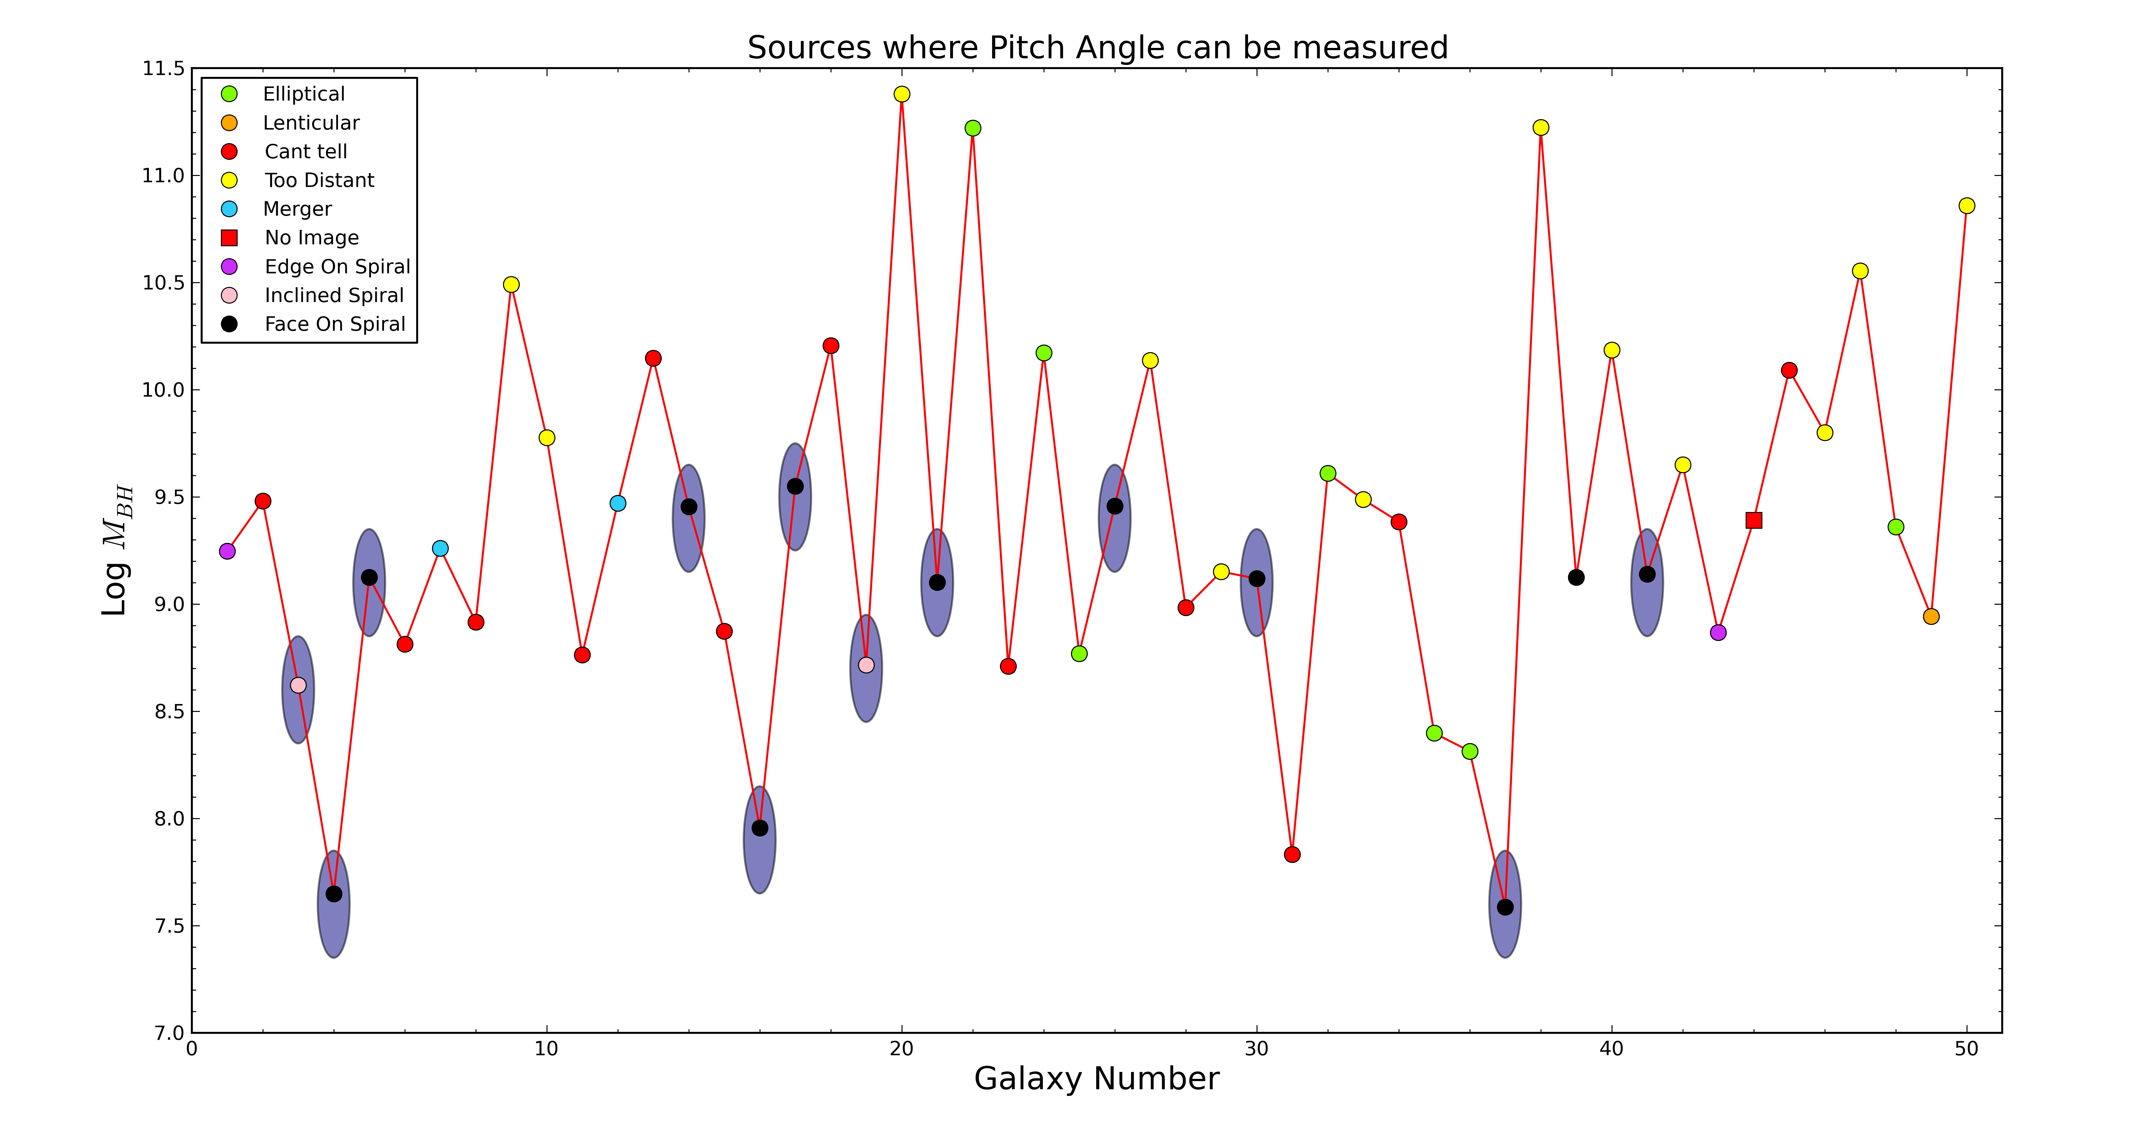

Slide 11
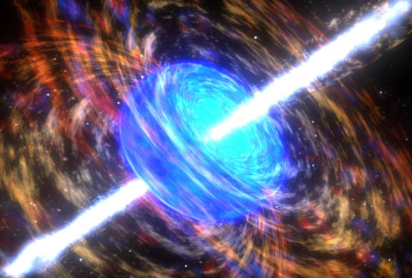
Summer Internship with Judy
Credit: NASA

