Slide 1

Gamma-ray Emission From Starburst Galaxies
NGC 253
Credit: ESO
Xilu Wang
Brian. D. Fields
University of Illinois
at Urbana and Champaign

Slide 2
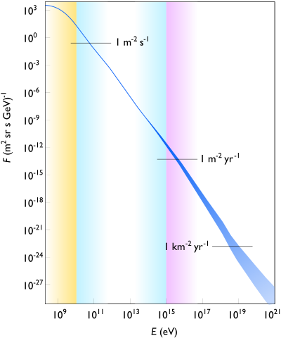
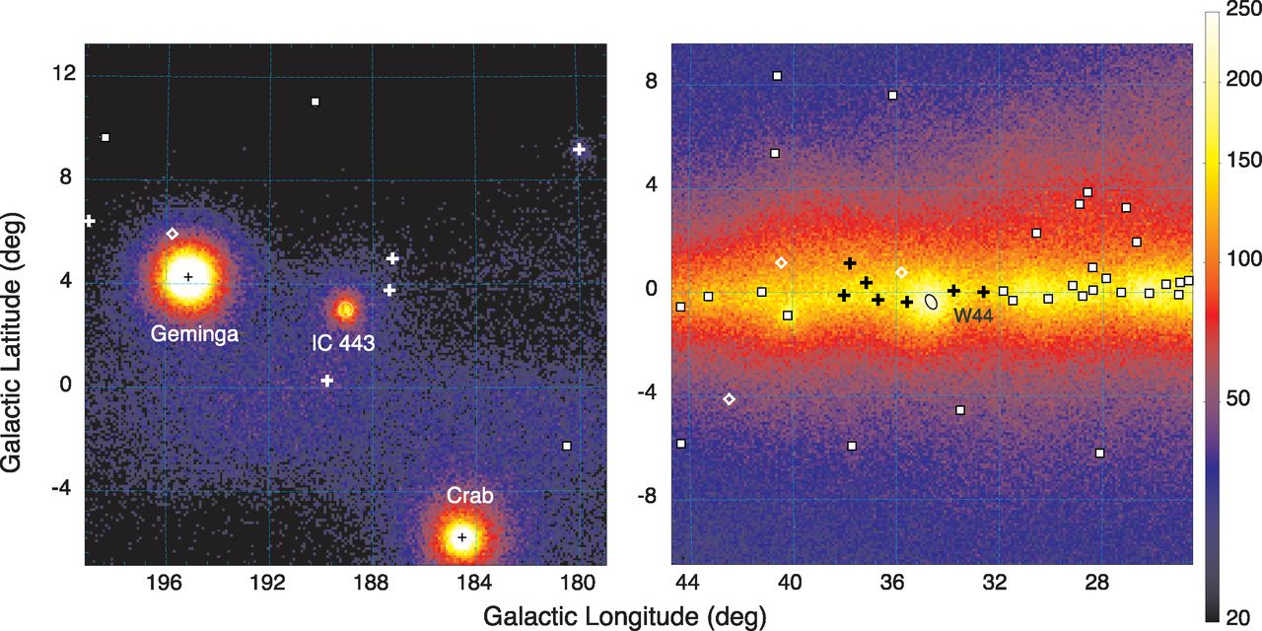
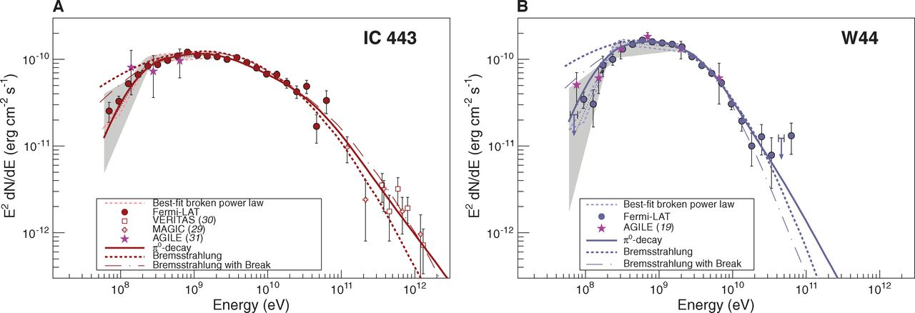
Cosmic Rays
Hays, Dermer, Castro, Wakely’s talks
Composition(charged particles):
  mostly protons (~90%)
Energetic (>1 MeV):
  Most energy is also in protons!
Hadronic Interactions between
CRs and ISM:
Nonthermal spectrum
Accelerators:
Supernovae
Credit: S.Lafebre(2007)
(Ackermann et al 2013)
(Ackermann et al 2013)
(Baade & Zwicky 1934; Ginzburg & Syrovatskii 1964)

Slide 3
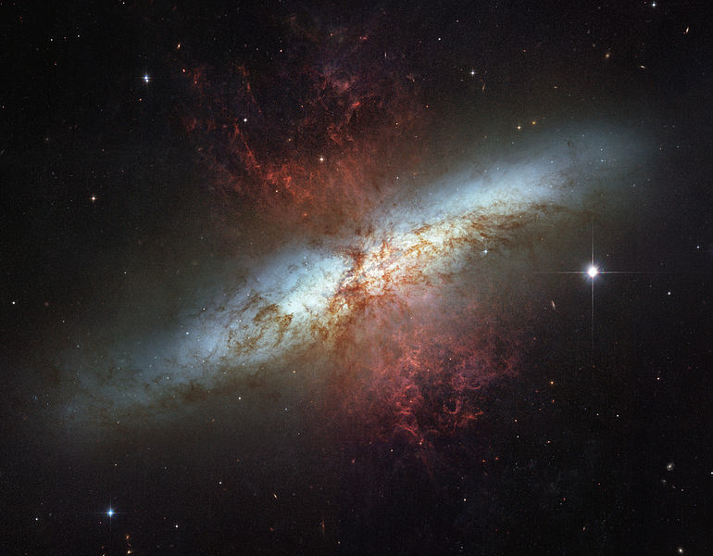
Starburst Galaxies
Properties:
Compared to normal star-forming galaxy:
Exceptionally high rate of star formation---high CR energy densities;
Very dense gas---enhance pionic gamma-ray emission.
most cosmic rays “die” in collision (Lacki et al., 2011).
MW: most escape!
Hubble picture of M82
Credit: NASA, ESA and the Hubble Heritage Team STScI/AURA)
learn about early universe: most galaxies are starbursts

Slide 4
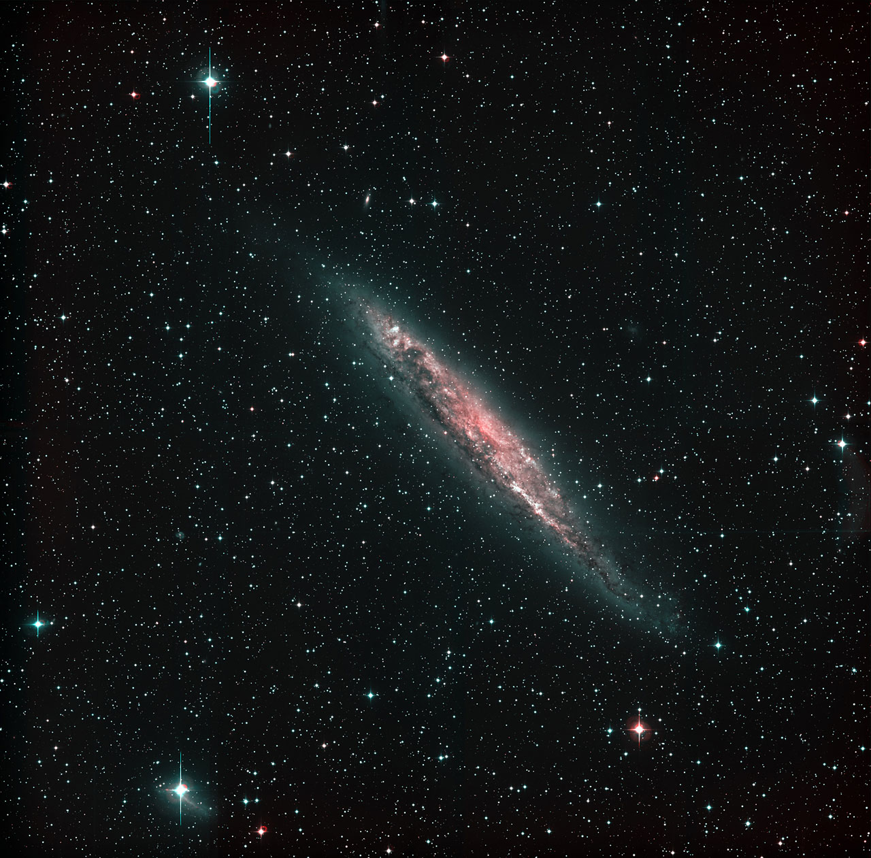
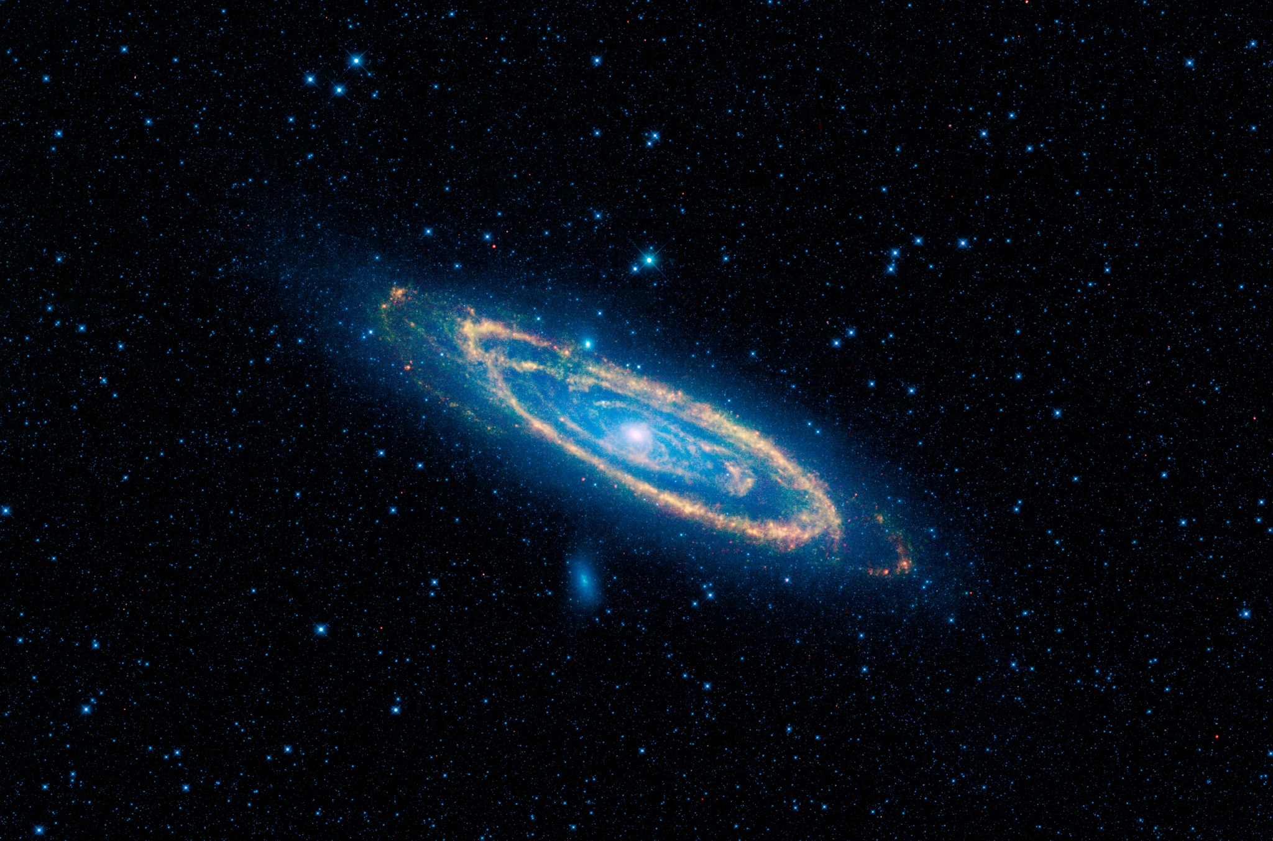
The “thick-target” model
Thick-target:
cosmic rays
SNR
NGC4945
Credit:ESO
Thin-target (opposite limit, like MW):
escape away
cosmic rays
SNR
M31
Credit: NASA / JPL-Caltech / UCLA

Slide 5
Equations
Calorimetry:
For a certain starburst galaxy, only 2 free parameters in the model:
CR source spectrum index s
CR acceleration energy per SN

Slide 6
Key features of the model
For the gamma-ray spectrum got from “Thick-target”:
Its value is proportional to injected energy luminosity from supernovae( );
Its shape only depend on injected proton spectrum (power law index s);
At high energies, photons have the same spectral index s as the injected proton’s, and thus is flatter than the spectrum from escape-dominated galaxies;
It has a “Pion-bump” feature peak at
for .

Slide 7
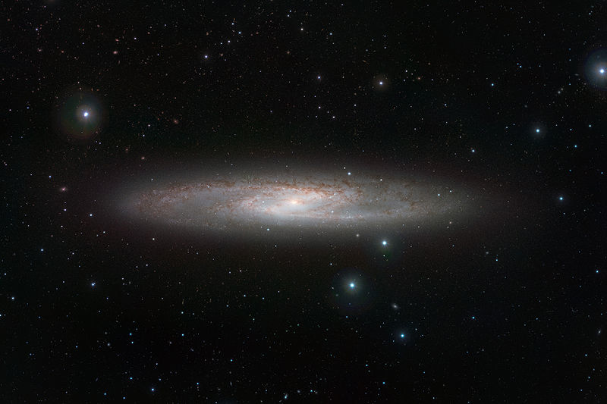
PRELIMINARY
Individual Starburst
NGC253(Credit: ESO/J. Emerson/VISTA)
E^2*Gamma -Flux
IC Fit: Charkraborty & Fields 2013
Photon Energy

Slide 8
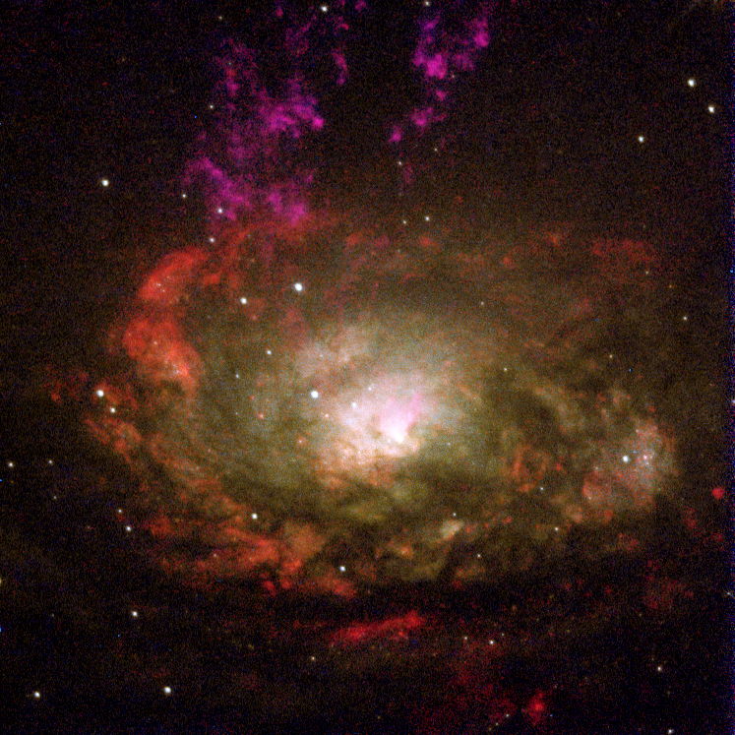
PRELIMINARY
Individual Starburst
Circinus (credit:HST/NASA/ESA.)
IC Fit: Charkraborty & Fields 2013

Slide 9
Calorimetric Limit
PRELIMINARY
Star Formation Rate
Gamma/IR Luminosity Ratio
IR Luminosity

Slide 10
Extragalactic Gamma-Ray
Background Emission(EGB)
The EGB intensity is:
Where is star-formation rate per individual galaxy and is cosmic star formation rate, in thick-target model, is independent of redshift z

Slide 11
A Calorimetric EGB?
PRELIMINARY

Slide 12
Summary
“Thick-target” actually gives an upper limit to the gamma-ray emission of starbursts: a good fit means proton calorimetry holds; starbursts are more efficient to produce gamma rays than normal galaxies;
Need more data to do further check: data in the lower energy range (~50-100 MeV) to check gamma-spectrum’s pionic turn-over feature; TeV data for NGC 1068, NGC 4945 and Circinus to constrain source CR index s as well as the energy parameter ;
When apply to EGB, we can get fair pionic upper limit with the thick-target model; s=2.4 gives unreasonably ‘perfect’ fit to the data, meaning at least some of the EGB signal must be from other sources, s=2.2 gives more physical upper limit and good fit to the shape of data at high-energy.

Slide 13
BACK-UP SLIDES

Slide 14
Model
Cosmic rays accelerated by supernovae:
Injection proton spectrum is a power law:
All CR interact with ISM inside a starburst/Escape timescale of CR is infinity:
Pionic process dominates gamma-ray production mechanisms:
Energy loss include hardronic elastic scattering, inelastic scattering and EM energy loss(ionization):

Slide 15
Equations
Propagation equation for CR:

Slide 16
Equations
(C.D.Dermer 1986)
For certain starburst galaxy, only 2 free parameters in the model:
CR source spectrum index s
CR acceleration energy per SN

Slide 17
Extragalactic Gamma-Ray
Background Emission(EGB)
The EGR intensity is:
Where is star-formation rate per individual galaxy and is cosmic star formation rate, in thick-target model, is independent of redshift z

