Slide 1
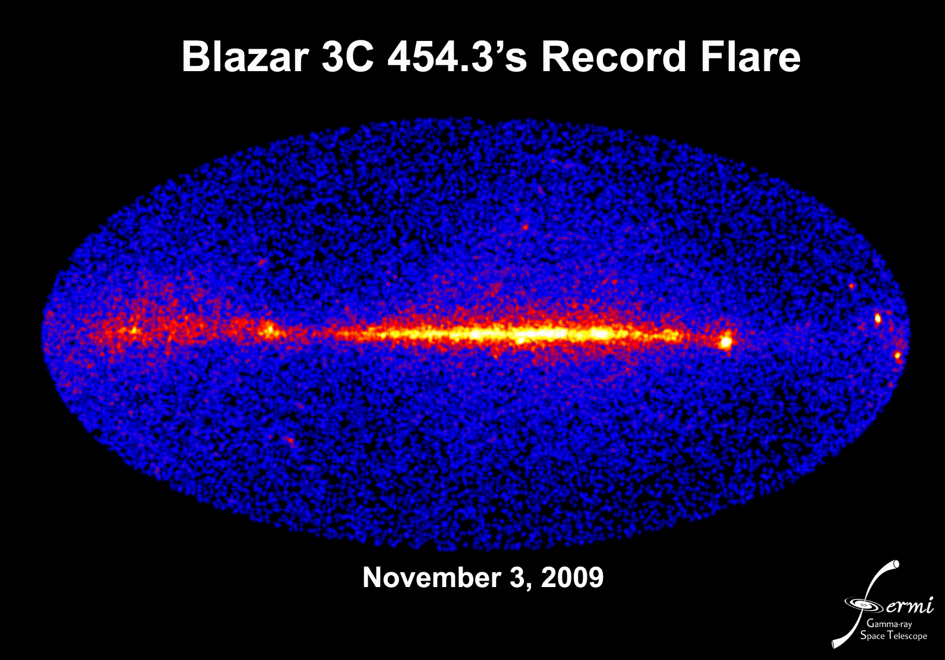

Slide 2
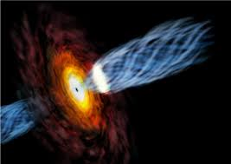


Fermi Blazar and AGN Science
Fermi Summer Science School
Lewes, Delaware
28 May 2014
Dr. Charles D. Dermer
Naval Research Lab, Code 7653
Washington, DC 20375 USA
202-767-2965
charles.dermer@nrl.navy.mil
Notes:
The standard blazar paradigm consists of a supermassive black hole that expels relativistic jets of magnetized plasma in our direction. This plasma entrains nonthermal synchrotron-emitting electrons that furthermore scatter internally-produced synchrotron photons as well as externally-produced photons from the accretion-disk, the broad-line region, and the infrared-emitting torus. This picture has been very successful in reproducing the two-humped blazar spectral energy distribution. Yet various discontents persist, including (1) ultra-short variability at TeV energies—shorter than the dynamical timescale across the black hole; (2) GeV spectral breaks in flat spectrum radio quasars and BL Lac objects with synchrotron peak frequencies < 1e14 Hz; (3) very-high energy (VHE; >100 GeV) radiation from FSRQs; (4) evidence for a hard spectral component in high-synchrotron peaked objects, found when deabsorbing the measured VHE spectrum using conventional extragalactic background light (EBL) models; (5) an unusual slowly varying class of BL Lac objects. Some of these problems can be resolved by introducing a hadronic component into the blazar paradigm, consistent with the hypothesis that blazars are sources of ultra-high energy cosmic rays. Gamma-ray observations with the Cherenkov Telescope Array and neutrino observations with IceCube will be important to test this hypothesis.

Slide 3
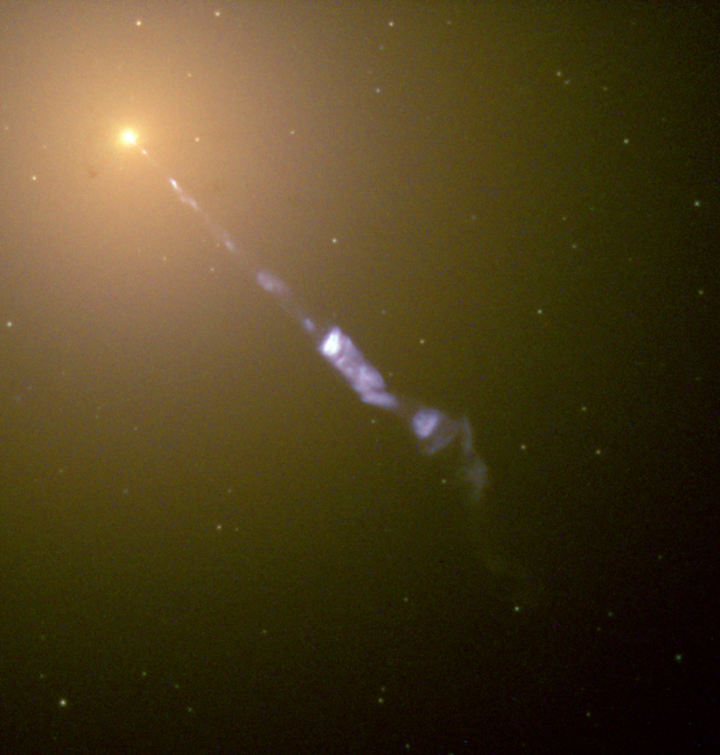
Outline
1. The Radio Galaxy/Blazar Paradigm
2. Problems with the Blazar Paradigm
3. Steps forward with Fermi
“…curious straight ray…apparently connected with
the nucleus by a thin line of matter.” H. E. Curtis, 1918
M87 discovered and cataloged by Charles Messier on March 18, 1781 (233 yrs ago)
Distance; 16.4 Mpc
Black hole mass: 6.6(±0.4) x10⁹ Solar masses
M87
Notes:
"curious straight ray ... apparently connected with the nucleus by a thin line of matter."[
MESSIER 087 12h30m49.4s +12d23m28s G 1284 0.004283
“Beauty has no obvious use; nor is there any clear cultural necessity for it. Yet civilization could not do without it.”
― Sigmund Freud, Civilization and Its Discontents

Slide 4
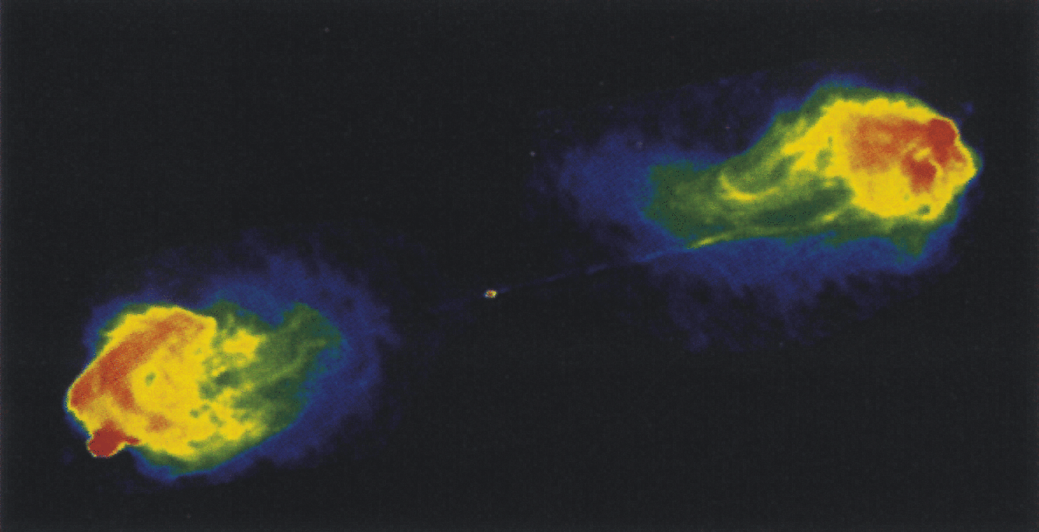
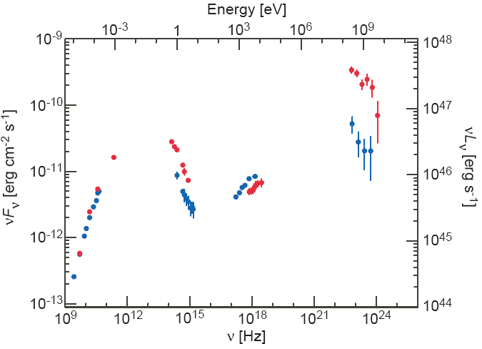
Blazars: Supermassive Black Holes with Relativistic Jets Pointed at Us
GeV
Cygnus A, z = 0.056
3C 279, z = 0.538
Causality argument for size of emission region
Abdo et al. 2010, Nature, 463, 920

Slide 5
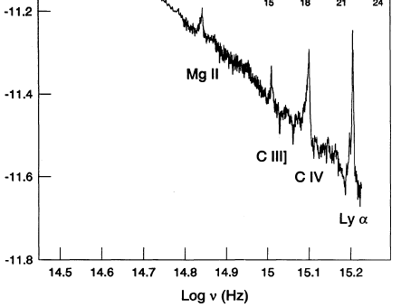
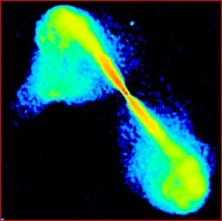
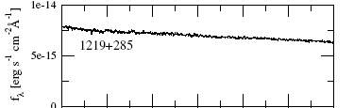
Radio Galaxies, Blazars, and Unification
L ~10⁴⁵ x (f/10⁻¹⁰ ergs cm⁻² s⁻¹) erg s⁻¹
FR2/FSRQ
Cygnus A
FR1/2: radio power/ morphology correlation; dividing line at ≅ 10⁴² erg s⁻¹ (2×10²⁵ W/Hz at 178 MHz)
3C 279
Mrk 421, z = 0.031
BL Lacs: optical emission line equivalent widths < 5 Å
3C 279, z = 0.538
FR1/BL Lac
W Comae
3C 296
Notes:
Fanaroff-Riley Classification:
Morphology correlates with radio power at 2x10²⁵ W/Hz at 178 MHz (≅ 4x10⁴⁰ ergs s⁻¹), or total radio power of ≅10⁴² ergs s⁻¹
Optical emission lines in FR IIs
brighter by an order of magnitude
than in FR Is for same galaxy
host brightness

Slide 6
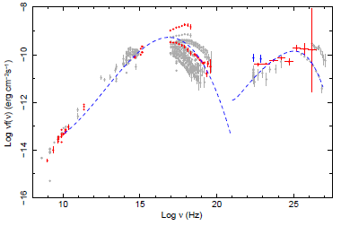
Classifying Fermi AGNs
Abdo et al. 2010, ApJ, 710, 1271
Radio: FR1 vs FR2
Optical: FSRQs vs. BL Lacs
SED; (“synchrotron-peaked”)
LSP (ν_{pk}^{syn} < 10¹⁴ Hz),
HSP (ν_{pk}^{syn} > 10¹⁵ Hz)
ISP
LSP
PKS 1510-089
Essentially all FSRQs are LSPs
HSP
Mrk 421
Notes:
Cen A, NGC 1275, M87, 3C 78, PKS 0625-35, NGC 6251, 3C 111 (FR2 at low galactic latitudes)

Slide 7
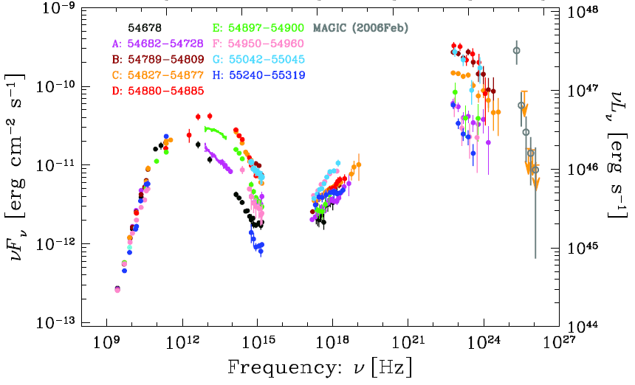
Blazar Spectral Energy Distributions
FSRQs: cutoffs at GeV with VHE episodes
BL Lacs: emission to VHE/TeV energies
3C 454.3
z = 0.859
Abdo et al. 2011a
Mrk 501
Abdo et al. 2009
z = 0.033
Abdo et al. 2011b
3C 279
Mrk 421
z = 0.031
3C 279
z = 0.538
z = 0.538
Hayashida et al. 2012
VHE (> 100 GeV)
LSP, ISP, HSP
Notes:
7

Slide 8
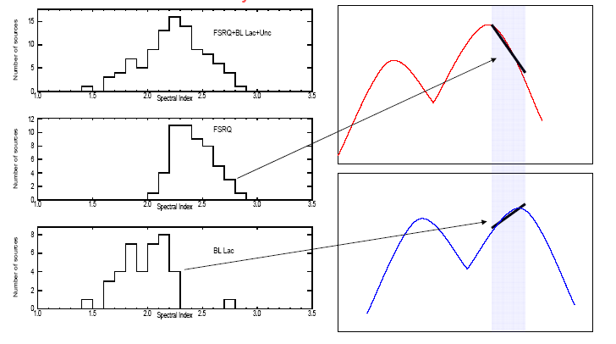
Spectral Energy Distribution and Spectral Index Distribution
PKS 1510-089
z = 0.361

Slide 9
γ-Ray Spectral Index vs. γ-Ray Galaxy Luminosity
Fermi blazar divide
(Ghisellini et al. 2009)
Misaligned AGNs
(host galaxies of blazars)
Star forming galaxies

Slide 10
Spectral Index vs. Peak Synchrotron Frequency
> 100 MeV γ-ray photon index vs. peak synchrotron frequency
2LAC; Ackermann et al. 2011

Slide 11
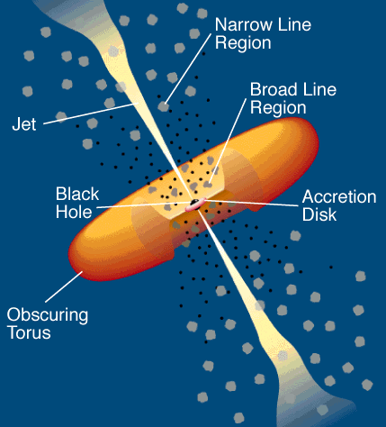
Standard AGN/Blazar Paradigm
AGN: active galactic nucleus
Accretion Disk
Molecular Torus
Shakura-Sunyaev Disk
Magneto Rotational Instability
Modified Accretion Disks
Hot Pair Plasma (T<10⁹ K)
Fe Lines
Broad Line Region/ Narrow Line Region
Nonthermal particle acceleration not evident in radio-quiet AGNs
Jets
Formation and Collimation
Relativistic Outflows
  Compton catastrophe
  Apparent superluminal motion
  γγ opacity arguments
Particle Acceleration Sites
  Within BLR
  Pc scale
  Knots and hot spots
  Lobes
Urry & Padovani (1995)

Slide 12

Leptonic Blazar Modeling
Observer
Leptonic jet model:
Nonthermal synchrotron paradigm
Associated SSC γ-ray component
(BL Lac objects)
and SSC/EC components (FSRQs)
Target photon sources:
Accretion-disk radiation
Broad-line region radiation
IR radiation from molecular torus
θ
BLR clouds
Γ
Relativistically
Collimated
Plasma Jet
Dusty Torus
Accretion
Disk
Ω
SMBH
Energy Sources:
1. Accretion Power
2. Rotation Power
Relativistic plasma outflows: Γ >> 1
Γ
Ambient
Radiation
Fields

Slide 13

Compactness
Puzzle: how to get γ rays out of compact region?
R < cΔt_{var}
γγ opacity
Threshold:
Compactness parameter:
superluminal motion in 3C 120

Slide 14
Solution: Relativistic Bulk Motion
Naively, emission size
Suppose relativistic spherical shell briefly illuminated, e.g., by shell collisions
Due to strong beaming, only see emission emitted within Doppler cone
Γ
R
Emission size ~ Γ² larger than values inferred for stationary region
Notes:
Comoving size ≈ Γαμμα larger
Two limits on variabiity time: off axis, and size of emission region

Slide 15
Relativistic Bulk Motion in Blazars
What is Γ, and why is it important?
After redshift z, Γ is the most important property to make the extreme behavior of blazars comprehensible
Doppler factor
To be optically thin to γγ absorption,
Γ > 10 in Blazars
Notes:
Maximum collimation (and reduction from apparent to absolute powers)
when jet opening angle

Slide 16
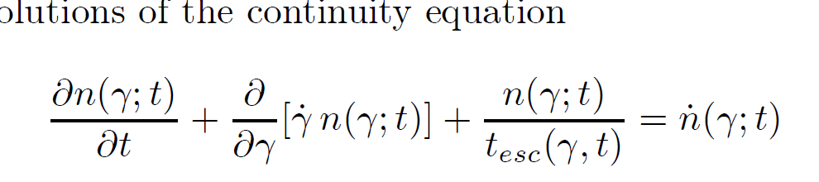

Particle Acceleration and Radiation in Leptonic Blazar Models
  Inject power laws and cool
  Separate acceleration and radiation zones
  Single zone; exclude radio
  Power law injection
  Nonlinear losses
  Adiabatic expansion
  Light travel time effects
  Cascading/γγ pair production
  Multizone/spine-sheath
  Anisotropic effects
  Reverberation/echo
EC
Boettcher & Chiang (2002)
Finke et al. (2008)
Dermer & Menon (2009)
Notes:
Power law injection
Nonlinear losses (SSC)
Adiabatic expansion
Light travel time effects
Cascading/γγ pair production
Multizone/spine-sheath
Anisotropic effects
Reverberation/echo
16

Slide 17
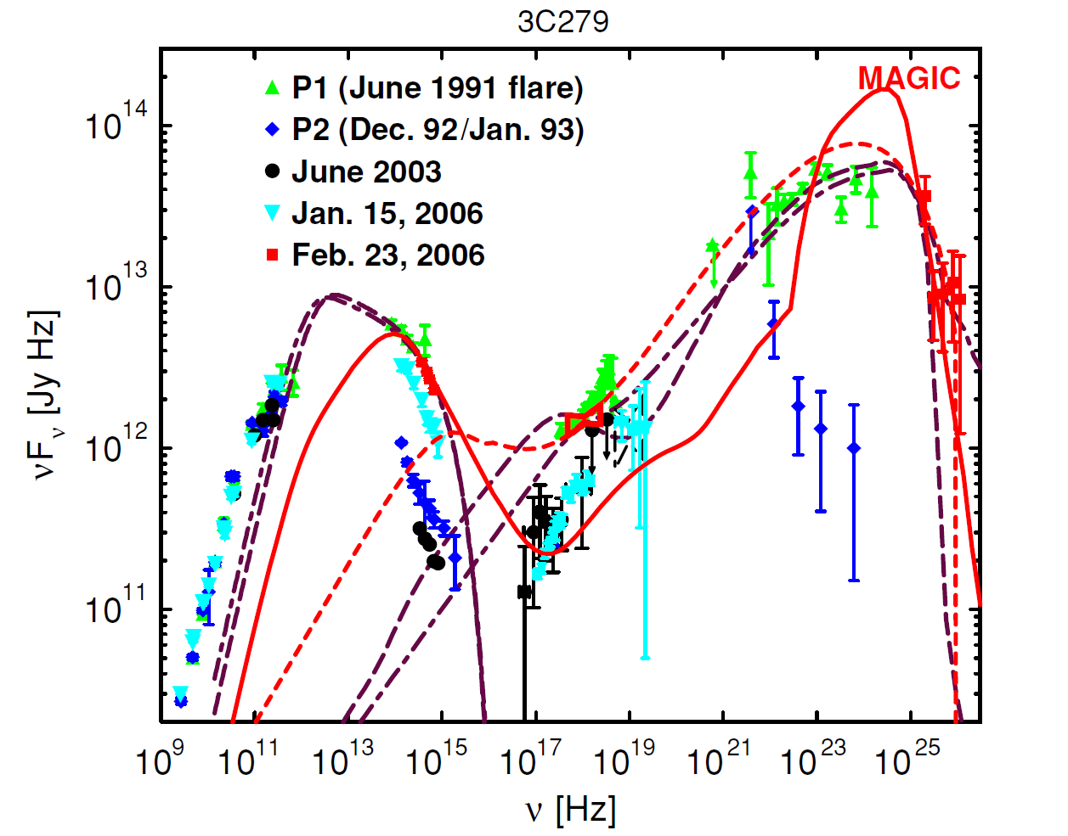
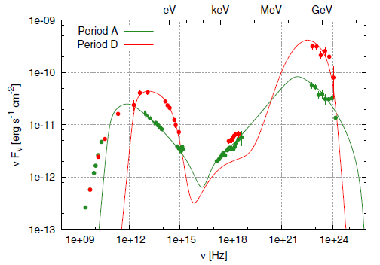
Spectrum and Jet Physics
FSRQs: synchrotron/SSC + EC
BL Lacs: synchrotron/SSC model fits
3C 454.3
Abdo et al. 2011a
Bonnoli et al. 2009
Mrk 501
Abdo et al. 2011b
3C 279
Mrk 421
Hayashida et al. 2012
Böttcher et al. 2009
Notes:
17

Slide 18
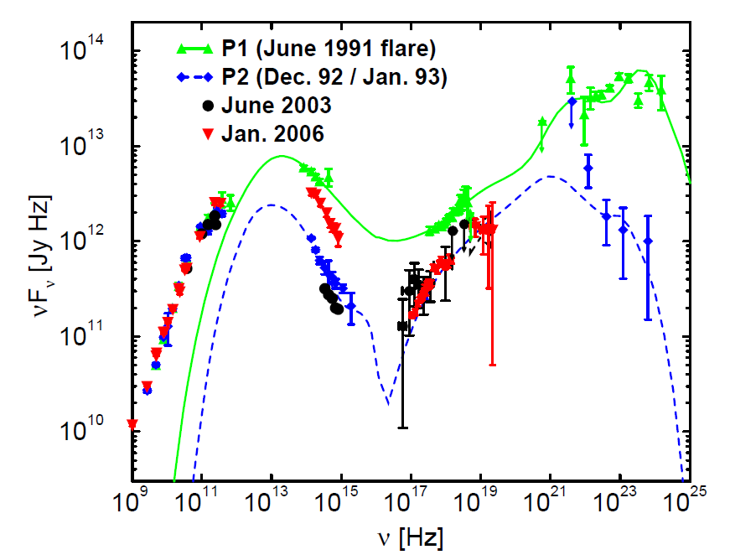
Blazar Spectral Modeling
Equipartition Approach
  Log-parabola electron distribution
  Equipartition between magnetic field and nonthermal electrons
Standard Approach
  synchrotron/SSC + external Compton
  Inject power laws + cooling
3C 279
3C 279
Böttcher et al. 2007
Dermer, Cerruti, Lott, Boisson, Zech 2014
Notes:
18

Slide 19
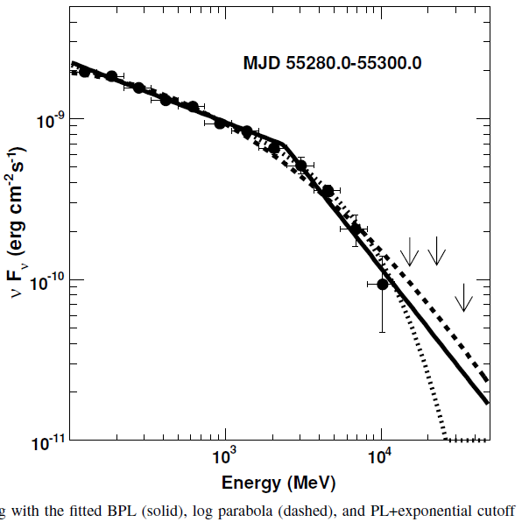
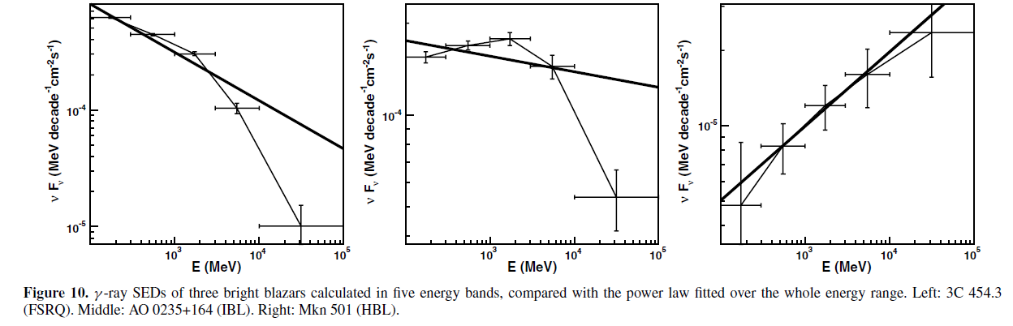
GeV spectral breaks in FSRQs, LSP/ISP blazars
Notes:
19

Slide 20
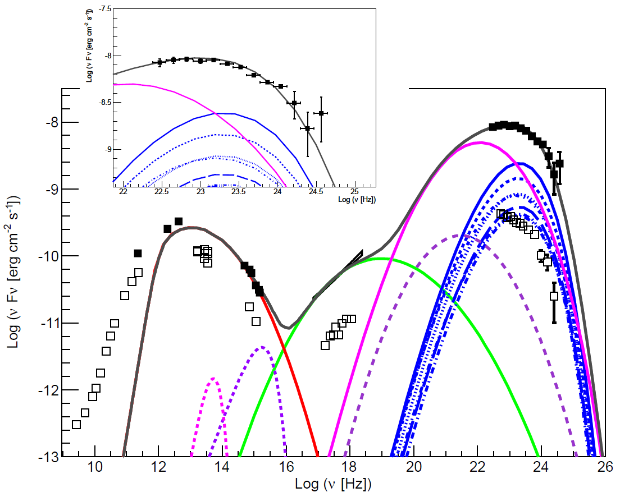
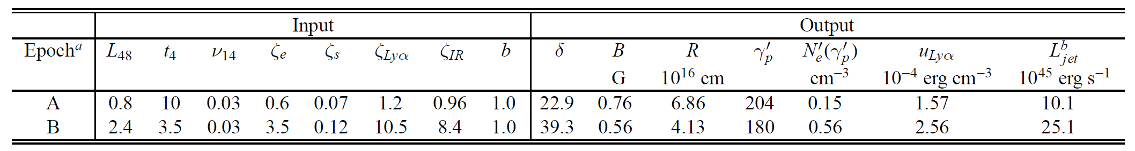
Spectral Fits to 3C 454.3
Epoch A: August 2008 low state (Abdo et al. 2009)
Epoch B: November 2010 high state (Abdo et al. 2011; Wehrle et al. 2012)
Cerruti, Dermer, Lott, Boisson, Zech 2012
Predicts no VHE emission: made by separate (hadronic?) process
Notes:
20

Slide 21
Extragalactic Background Light (EBL)
Infrared/optical EBL from past stellar activity and dust absorption and re-radiation (attenuates TeV radiation)
Difficult to directly measure
Provides a source of γγ opacity in intergalactic space through the process
Fermi spectrum extrapolated into TeV range bounded by deabsorbed TeV spectrum− constrains EBL model
Gould & Schrder 1966
Stecker, de Jager, Salamon 1992
Notes:
The Extragalactic Background Light (EBL) is dominated by the background radiation from all the stars which have ever existed, either directly (UV-optical) or through absorption and reradiation by dust (IR)
Why is it important?
Contains information about the evolution of matter in the universe: star formation history, dust extinction, light absorption and re-emission by dust, etc
Knowledge of the absorption effects due to EBL is necessary to infer the intrinsic spectra of extragalactic gamma-ray sources.

Slide 22
Blazars and the Extragalactic Background Light
Ajello/Fermi Collaboration 2012

Slide 23
Problems in Blazar Studies
Short variability times of luminous BL Lac objects
Unusual weakly variable BL Lac class
Distinct spectral components revealed by deabsorption of blazar VHE spectra
Flattening at moderate redshift in the Stecker-Scully relation showing the GeV - TeV spectral index difference versus redshift
Conflicting results for the location of the γ-ray emission site in blazars
VHE (> 100 GeV) emission from distant FSRQs γ rays formed by γγ → e⁺e⁻ with photons of ambient radiation fields
The Synchrotron Puzzle

Slide 24
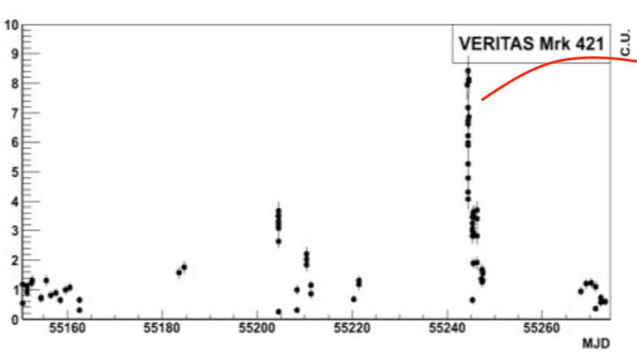
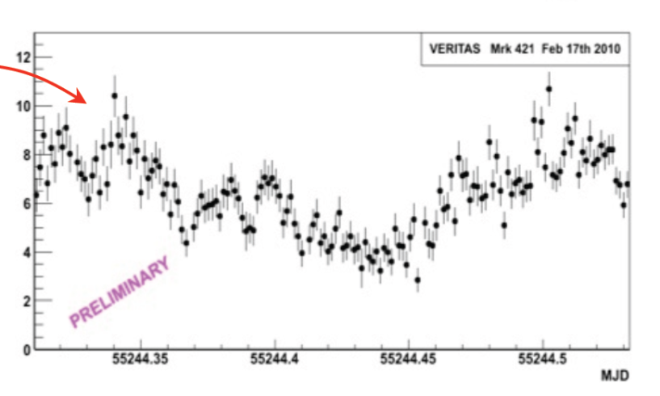
TeV BL Lac Objects
Strongly variable class
  Mrk 421, z = 0.03
  Mrk 501, z= 0.033
  PKS 2155-305, z = 0.116
  t_{var} < R_{S}/c, L > L_{EDD}
  Extreme sources
Aharonian et al. 2007
PKS 2155-304
28 July 2006 flare
Feb 2010 VERITAS OBS of MRK 421
Furniss 2011, Fortson 2012
R_{S}/c = 10⁴M₉ s
t_{var} ~ 5 min = 300 s
⇒(?) M << 10⁸ M₀
Notes:
24

Slide 25
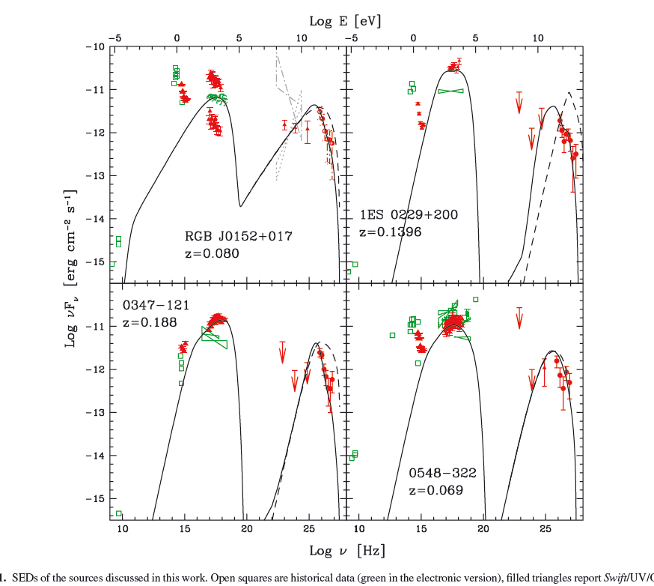
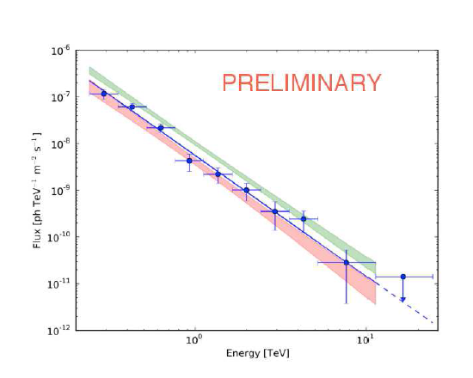
TeV BL Lac Objects
Weakly variable class
  Weak Fermi LAT fluxes
1ES 0229+200 z = 0.14
1ES 0347-121 z = 0.186
1ES 1101-232 z = 0.14
1ES 0548-322 z = 0.069
RGB J0152+0.17 z = 0.08
1ES 0229+200
Tavecchio et al. 2011
Compton-scattered CMBR from
extended jet/lobe
Cerruti et al. 2013
Böttcher et al. 2008
Notes:
25

Slide 26
Stecker-Scully Relation and
High-Redshift VHE Blazars
GeV-TeV Spectral index difference ΔΓ
Stecker & Scully (2006, 2010)
(cf. Sanchez et al. 2013)
γ
Mrk 421
γ
e⁺
2γ
e⁻
GeV
TeV
Mrk 421
λ_{γγ}
Notes:
26

Slide 27
Deabsorbed Blazar Spectra: Evidence for Extra Spectral Component?
z = 0.044
z = 0.047
z = 0.129
z = 0.139
z = 0.186
z = 0.188
z = 0.44
z = 0.538
Finke et al. 2010

Slide 28
Finke et al. 2010

Slide 29
Location of γ-Ray Emission Region
T. Savolainen
  Radio-γ correlations
  Optical polarization angle swings: 3C 279, PKS 1510-089, OJ 287
  Rapid variability, large luminosity implies inner jet origin of γ rays
4C +21.35
Notes:
29
Radio-optical-γ correlations PKS 1510-089, OJ 287
Optical polarization angle swings: 3C 279,
Rapid variability, large luminosity implies inner jet origin of γ rays
4C +21.35

Slide 30
The Synchrotron Puzzle
γ-ray photon index vs. peak synchrotron frequency
2LAC; Ackermann et al. 2011
In Fermi acceleration scenarios, acceleration timescale > Larmor timescale
Equating synchrotron energy loss time scale with Larmor timescale implies maximum synchrotron energy ~ 100Γ MeV
Many orders of magnitude greater than peak or maximum synchrotron frequency of blazars!
(de Jager & Harding 1992)

Slide 31
Steps Forward with Fermi
Acceleration Physics
Hadronic Component: UHECRs
New Physics--Axions

Slide 32
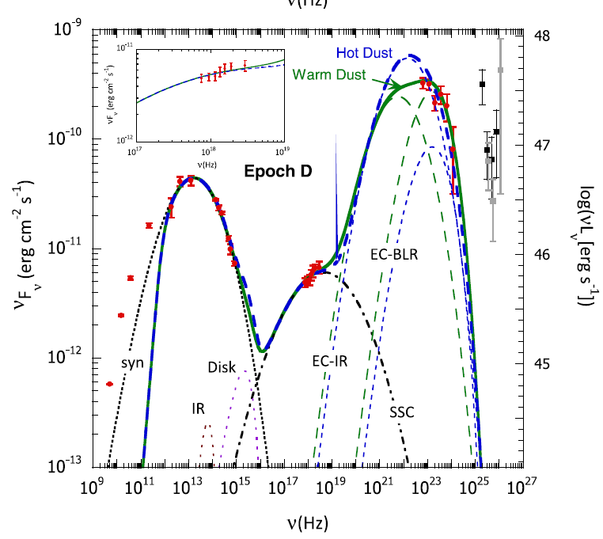
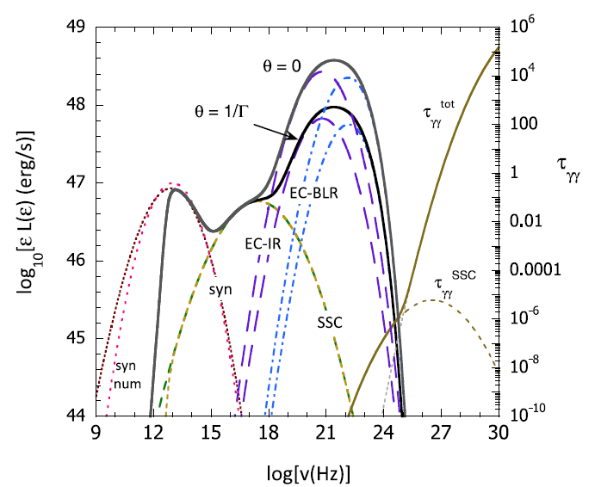
Acceleration Physics
First-Order Fermi Acceleration
Second-order Fermi Acceleration
Makes curved particle distribution
Turbulent particle acceleration scenario
(Lazarian et al.)
Magnetic Reconnection
Jets within Jets
Giannios, Narayan & Piran 2012
Dermer et al. 2014
Marscher

Slide 33
Gamma-ray and Cosmic-ray Induced TeV emissions from Jetted Sources
Mechanism for making
Weakly variable cascade radiation
Hard VHE component
Photon-induced cascade in IGM
γ
γ
γ
e⁺
γ
2γ
e⁻
λ_{γγ}
γ
γ
UHECR-induced cascade in IGM
π⁰, π±
ν,e⁺
p
e⁺
p
γ
ν,e⁻
2γ
e⁻
~100 Mpc
~ Gpc
UHECR protons with energies ~10¹⁹ eV make ~10¹⁶ eV e± that cascade in transit and Compton-scatter CMBR to TeV energies
Essey, Kalashev, Kusenko, Beacom (2010, 2011)

Slide 34
Limits on IGMF and Correlation Length
Origin of the Intergalactic Magnetic Field (B_{IGMF}):
Primordial
Early universe physics
Biermann battery (~10⁻³⁰ G on Mpc scale)
Galaxy dynamo
other
Recombination
inflation
IES 0229+200
Electroweak
QCD
IES 0347-121
Neronov & Vovk (2010)
34
Notes:
34
Light, medium,
and dark gray: known observational
bounds on the
strength and correlation
length of EGMF, summarized
in (25). The bound
from Big Bang nucleosynthesis
(BBN) is from (2).
The black hatched region
shows the lower bound
on the EGMF derived
from observations of 1ES
0347-121(cross-hatching)
and 1ES 0229+200 (single
diagonal hatching) in
this paper. Orange hatched
regions show the allowed
ranges of B and lB for
magnetic fields generated
at the epoch of inflation
(horizontal hatching), the
electroweak phase transition
(dense vertical hatching),
QCD phase transition
(medium vertical hatching),
and epoch of recombination (light vertical hatching) (25). White ellipses show the range of measured
magnetic field strengths and correlation lengths in galaxies and galaxy clusters.
74 2 APRIL 2010 VOL 328 SCIENCE www.sciencemag.org
REPORTS
Downloaded from www.sciencemag.org on August 31, 2010

Slide 35
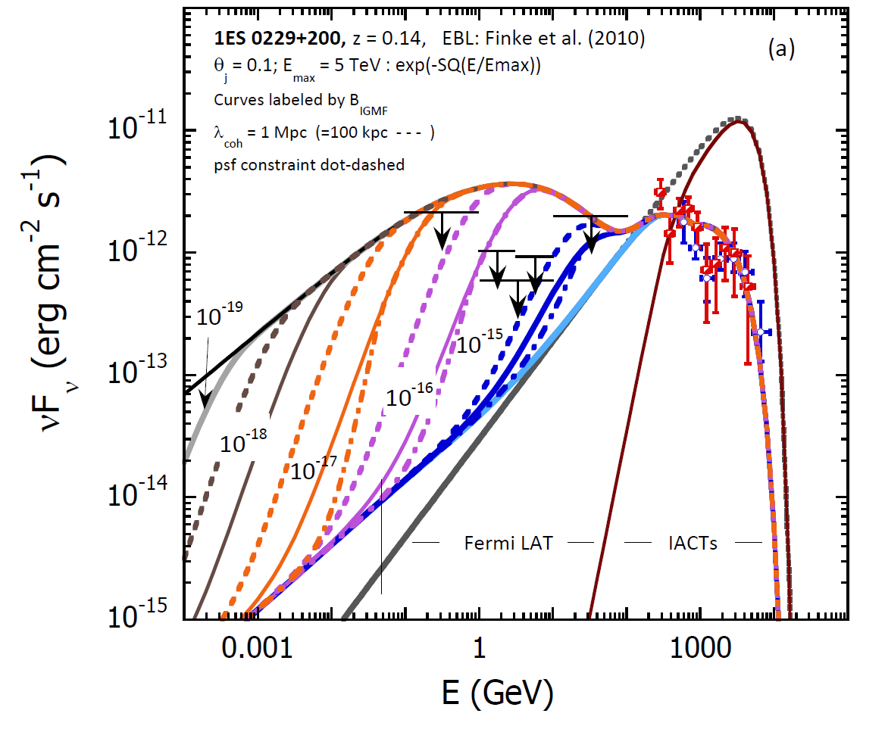
Lower Limits on the Intergalactic Magnetic Field
Use Fermi upper limits or detections at GeV energies to limit B_{IGMF} given TeV data and EBL model
e⁺
γ
e⁻
?
⇒ B_{IGMF} > 10⁻¹⁵ G
~
(Neronov & Vovk 2010; Tavecchio et al. 2010)
⇒ B_{IGMF} > 10⁻¹⁸ G
~
(relaxing assumption of
extended TeV emission)
(CD, Cavadini, Razzaque, Finke,
Chiang, Lott, 2011)

Slide 36
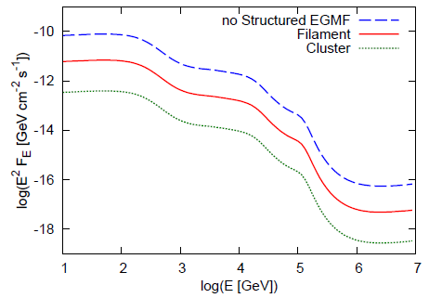
Electromagnetic Signatures of UHECRs
Photon-induced cascade in IGM
UHECR-induced cascade in IGM
Polisensky & Ricotti 2011
Murase et al. 2012

Slide 37
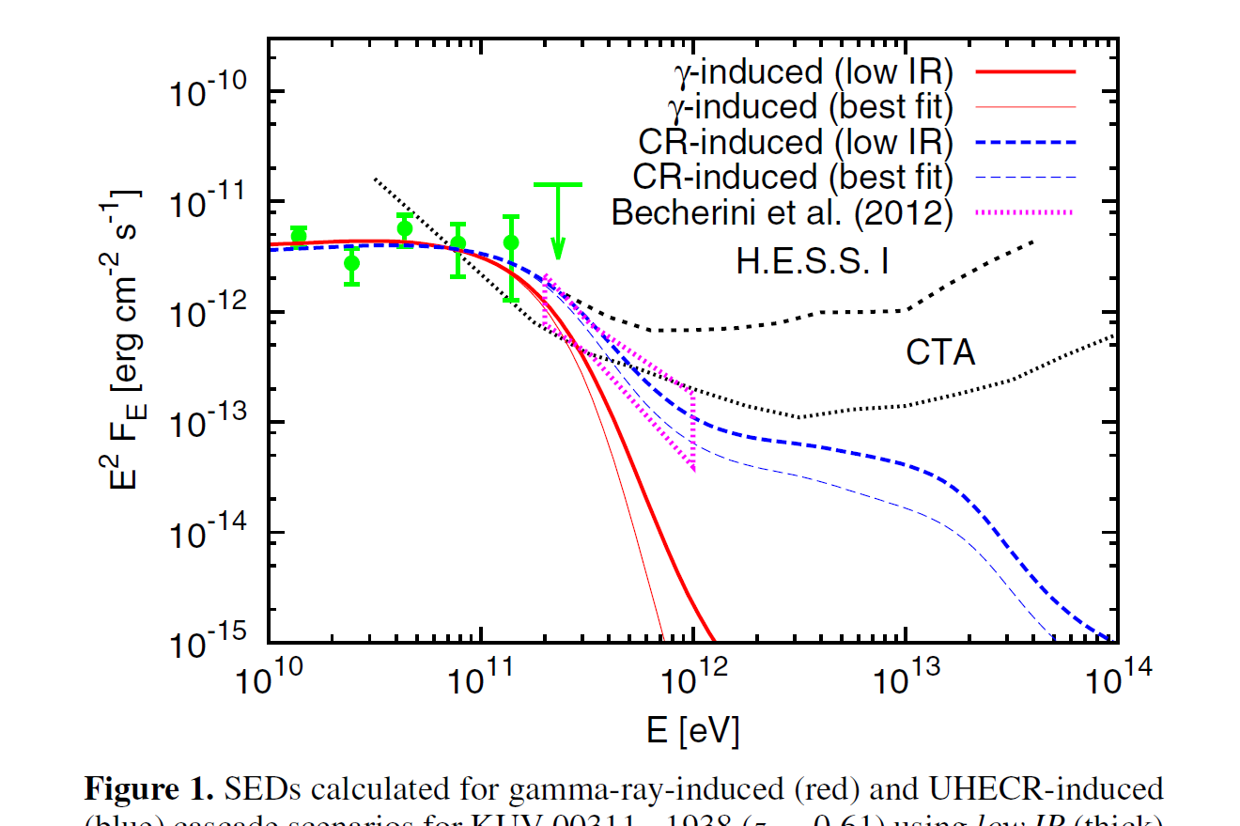
>10 GeV Sources Explained by Cascade Emission
GeV-TeV sources
  EBL effects greater on more distant blazars
Model >10 GeV Fermi-LAT emission by cascades
  γγ/Compton cascade
  Kneiske et al. (2004) EBL models
  Assume no suppression from IGMF (B_{IGMF} < 10⁻¹⁵ G)
  Intrinsic spectrum F(E_{γ}) ∝E_{γ}^{-1.76} , 5.6 GeV < E_{γ} < 100 TeV
UHECR-induced cascade
  Bethe-Heitler pair production
  Assume no suppression from IGMF (B_{IGMF} < 10⁻¹² G)
  UHECR proton spectrum:
  F(E_{p}) ∝ E_{p}^{-2.6}exp(- E_{p} /10¹⁹ eV)
Takami et al. 2013
KUV 00311-1938 (z = 0.61)
Normalization imposed to fit > 10 GeV Fermi-LAT spectrum from cascade emission
Definitive test of UHECR Hypothesis with CTA
Notes:
Find minimum required jet powers and predictions for CTA
37

Slide 38
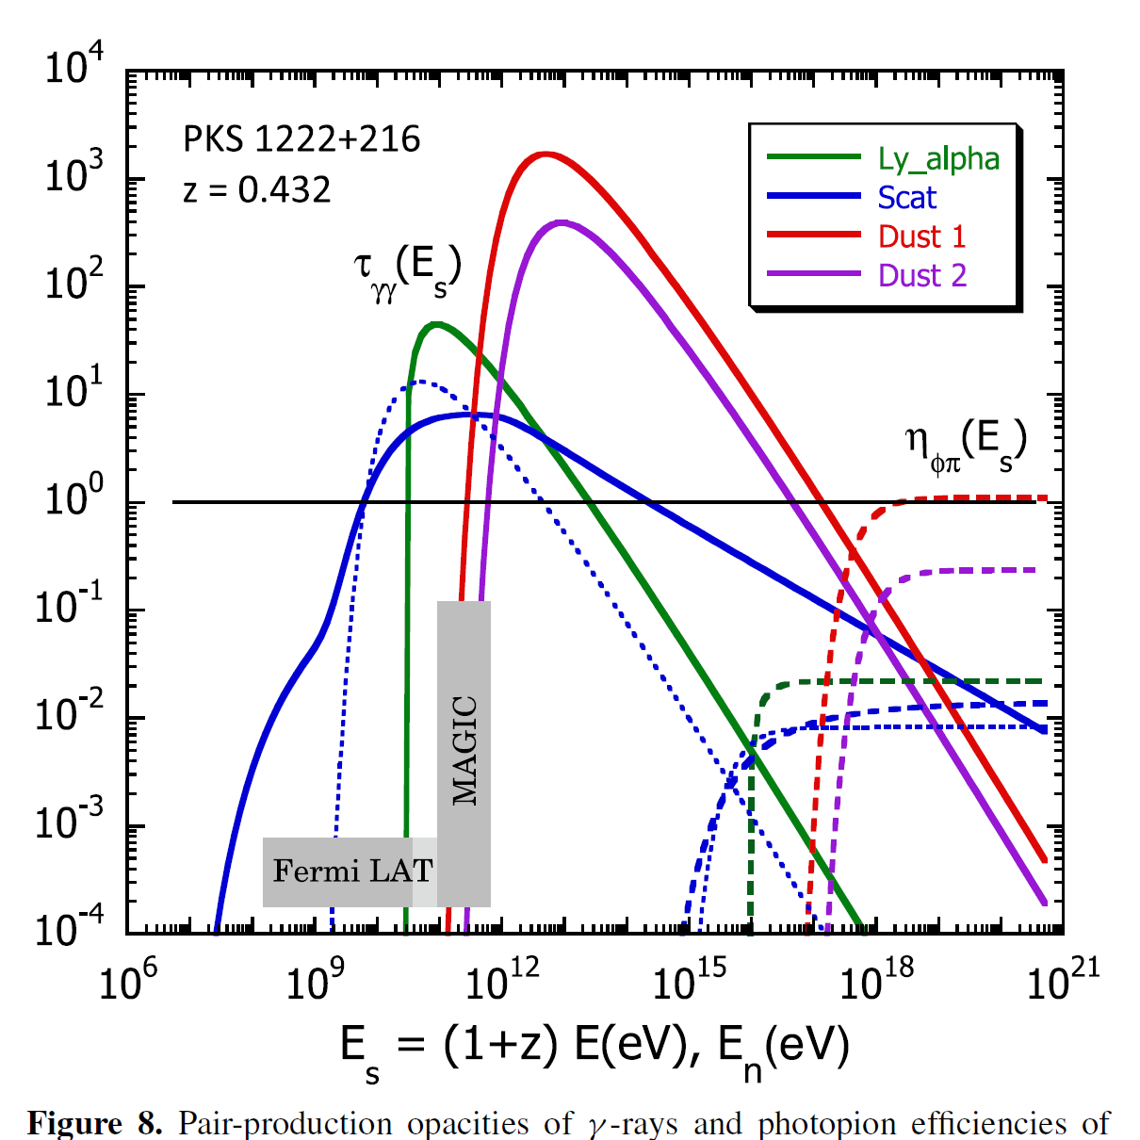
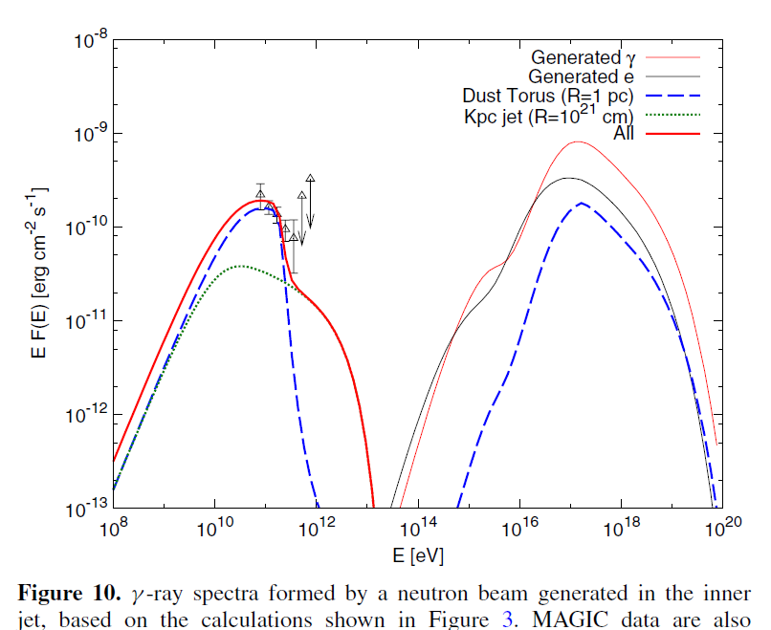
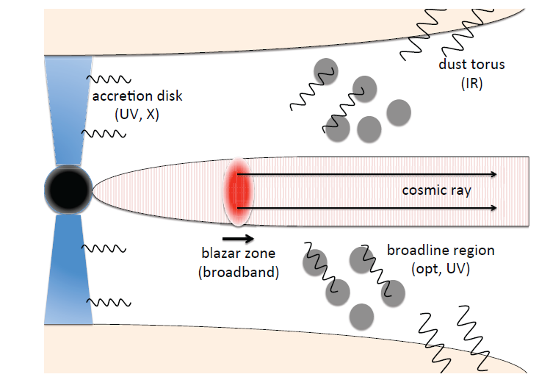
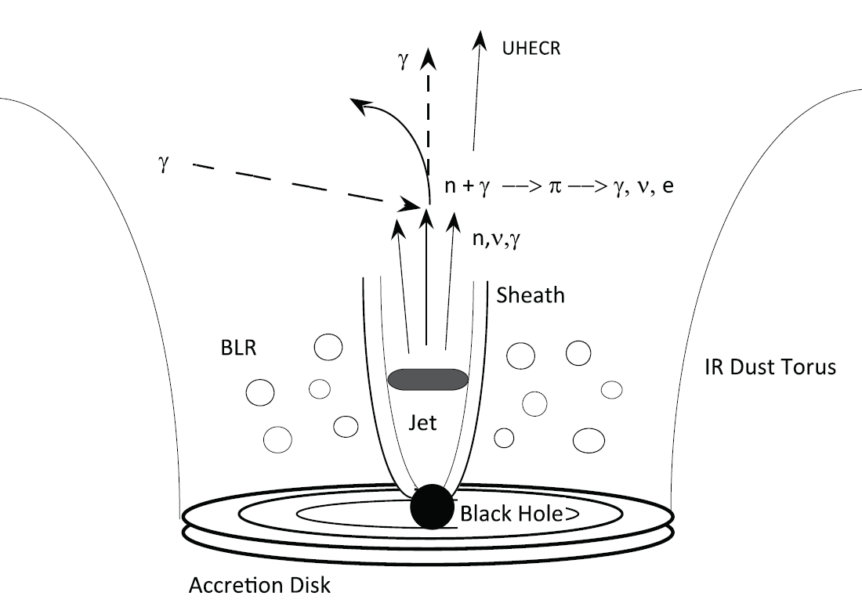
GeV-TeV Radiation in 4C +21.35 from Hadronic Processes
Ultra-relativistic leptons from UHECRs:
Dermer, Murase, Takami (2012)
Make synchrotron γ-rays
Detailed GeV and VHE studies with Fermi/CTA

Slide 39
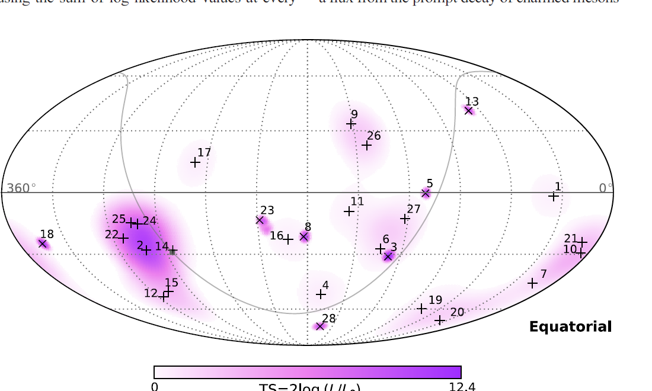
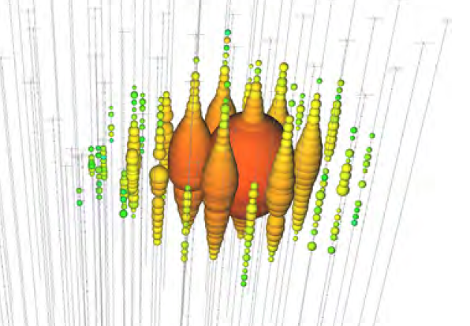
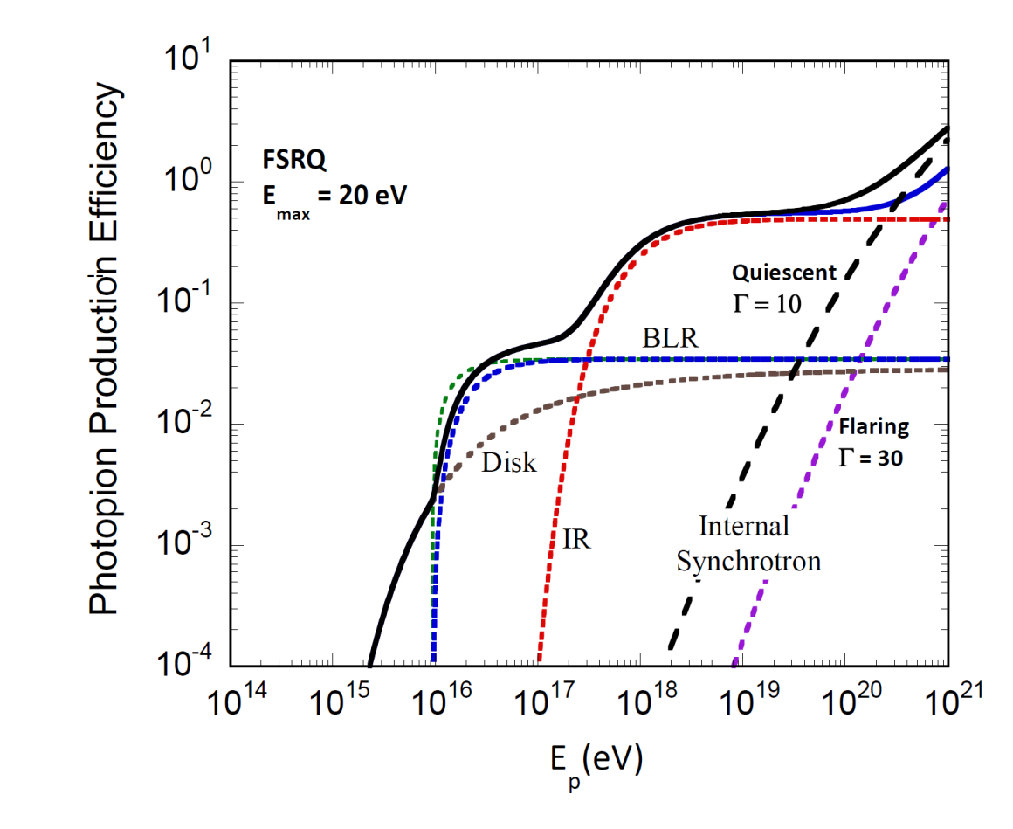
Neutrino Production in FSRQs
Evidence for High-Energy Extraterrestrial Neutrinos at the IceCube Detector Science, 342, Nov. 22, 2013
1041 TeV
Broad-line region (Ly α) radiation
Threshold γ_{p}ε₀ >~ 400, so most neutrinos are made with energy E_{ν} ~ 0.05 m_{p}c² γ_{p} >~ 0.05 x 10⁹ eV ≈ 400 /ε₀ ~ 10¹⁵ eV for ε₀ ~ 2 x 10⁻⁵ (Ly α)
Murase, Inoue, Dermer 2014

Slide 40
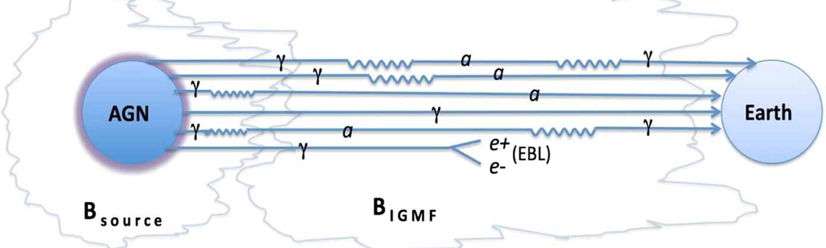
Axions
Axion: light DM particle introduced to solve the strong CP problem in QCD
Photon-axion conversion in presence of a magnetic field
Oscillation of photons to axion-like particles (and vice versa) can lead to an enhancement of the received flux from a distant source. Mixing near source and in intergalactic space
Sanchez-Conde et al. 2009
Spectral features/GeV cutoffs in FSRQs (Mena & Razzaque 2013)
Notes:
Pair secondaries of γ rays formed by γγ → e⁺e⁻ with photons of the extragalactic background light (EBL)

Slide 41
Fermi Blazar and AGN Science: Summary
Standard blazar paradigm: Supermassive black holes with jets explained by leptonic Compton-synchrotron processes in relativistic collimated plasma
Problems with the blazar paradigm
  Deabsorbed spectra of distant (z > 0.1) TeV blazars show unexplained hard emission component
  ΔΓ = Γ_{GeV} – Γ_{TeV} relation violated
  Location of γ-ray emitting regions in blazars
  Rapid variability in BL Lac objects
  Existence of a weakly variable BL Lac class
  VHE emission from FSRQs
  Synchrotron puzzle
Directions forward
  New thinking about particle acceleration
  UHECRs in blazar can potentially solve some of these problems
  New physics

Slide 42
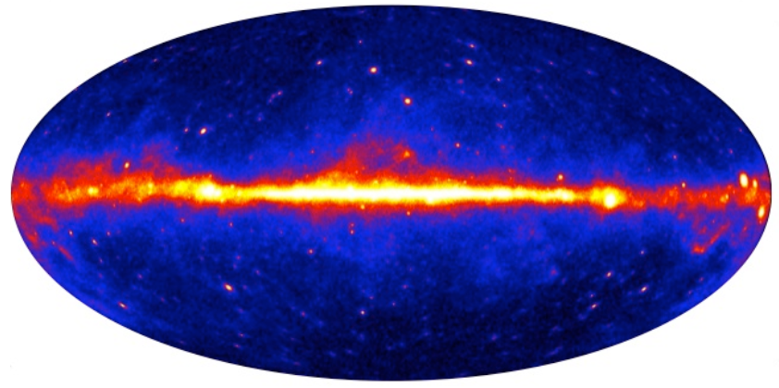
Fermi AGNs: All Radio-Loud
LAT Bright AGN Sample (LBAS); First year LAT AGN Catalog (1LAC)
LBAS: 3 month source list: 2008 Aug 4 – Oct 30
1LAC: 1 year catalog: 2008 Aug 4 – 2009 July 4
3EG (EGRET):
10 >10σ |b|>10° sources
66 >5σ blazars
LBAS: subset of 0FGL/Bright Source List
w/ 205 sources
TS >100 (>10σ)
106 |b|>10° sources
assc. w/ AGNs
1FGL TS >25
1451 sources
1043 |b|>10° sources
1LAC
TS >25 (> 4.1σ)
671 assc. w/ 709 AGN
(663 hi-conf. associations)
(300 BL Lacs, 296 FSRQ,
41 other AGN, 72 unknown)
2FGL TS >25
1888 sources 832 AGNs (+268 candidates)
114 Pulsars 60 SNR/PWNe
593 unaccounted 7 others
2LAC 360 FSRQs 420 BL Lacs (~60% with known z)
200 of unknown type ~20 other AGN
1 year Fermi GeV sky
2 year Fermi GeV sky
Small number of radio galaxies
Coming soon: 3FGL/3LAC
Notes:
31 > 10 sigma EGRET sources
41 other: 2 starburst, 6 RG, 2 SSRQs, 5 NLRGs
72 unknown either no optical spectrum or insufficient statistics to determine if FSRQ or BL Lac
Crab: 184.5 -5.8
Lines refer to z = 0.2, 0.5, 1

Slide 43
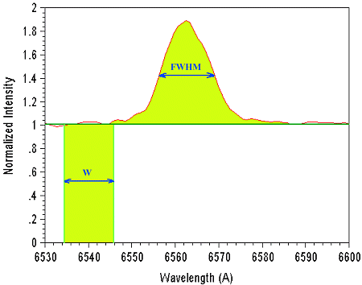
BL Lac and FSRQ: definition
classify an object as a BL Lac if the equivalent width (EW) of the strongest optical emission line is < 5 Å,
e.g., [O II] λ3727 and [O III] λ5007
classification of higher-redshift sources will preferentially use lines at shorter wavelengths (e.g., Lyα λ1216 and C IV λ1549) than for low-redshift sources (e.g., Mg II λ2798 and Hα λ6563).
a Ca II H/K break ratio C < 0.4,
Wavelength coverage satisfies (λ_{max} −λ_{min})/λ_{max} > 1.7 so that at least one strong emission line would have been detected if present
Sources for which no optical spectrum or of insufficient quality to determine the optical classification are listed as “unknown type”
3C 279

