Slide 1
HPS status report
12/17/2013
Stepan Stepanyan
JLAB

Slide 2
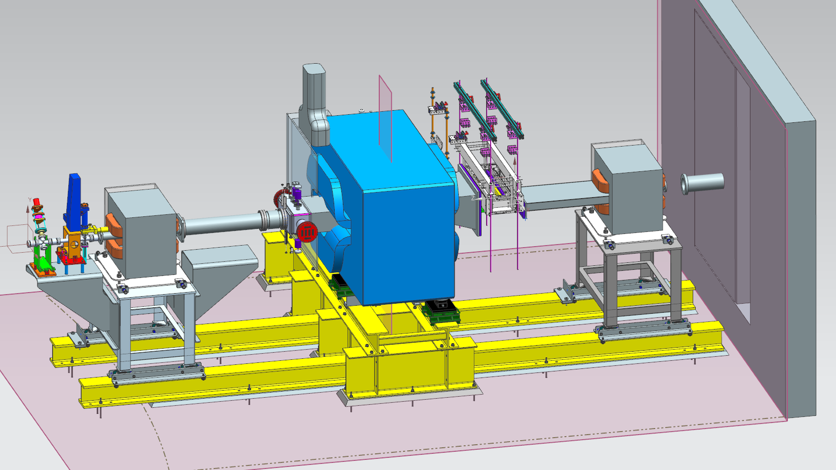
HPS chicane design status
Design of the alcove setup for chicane magnet supports has been complete
Currently drawings are reviewed for purchasing components
Critical milestone: magnets must be installed in alcove before June 2014 not to interfere with CLAS12 torus assembly

Slide 3
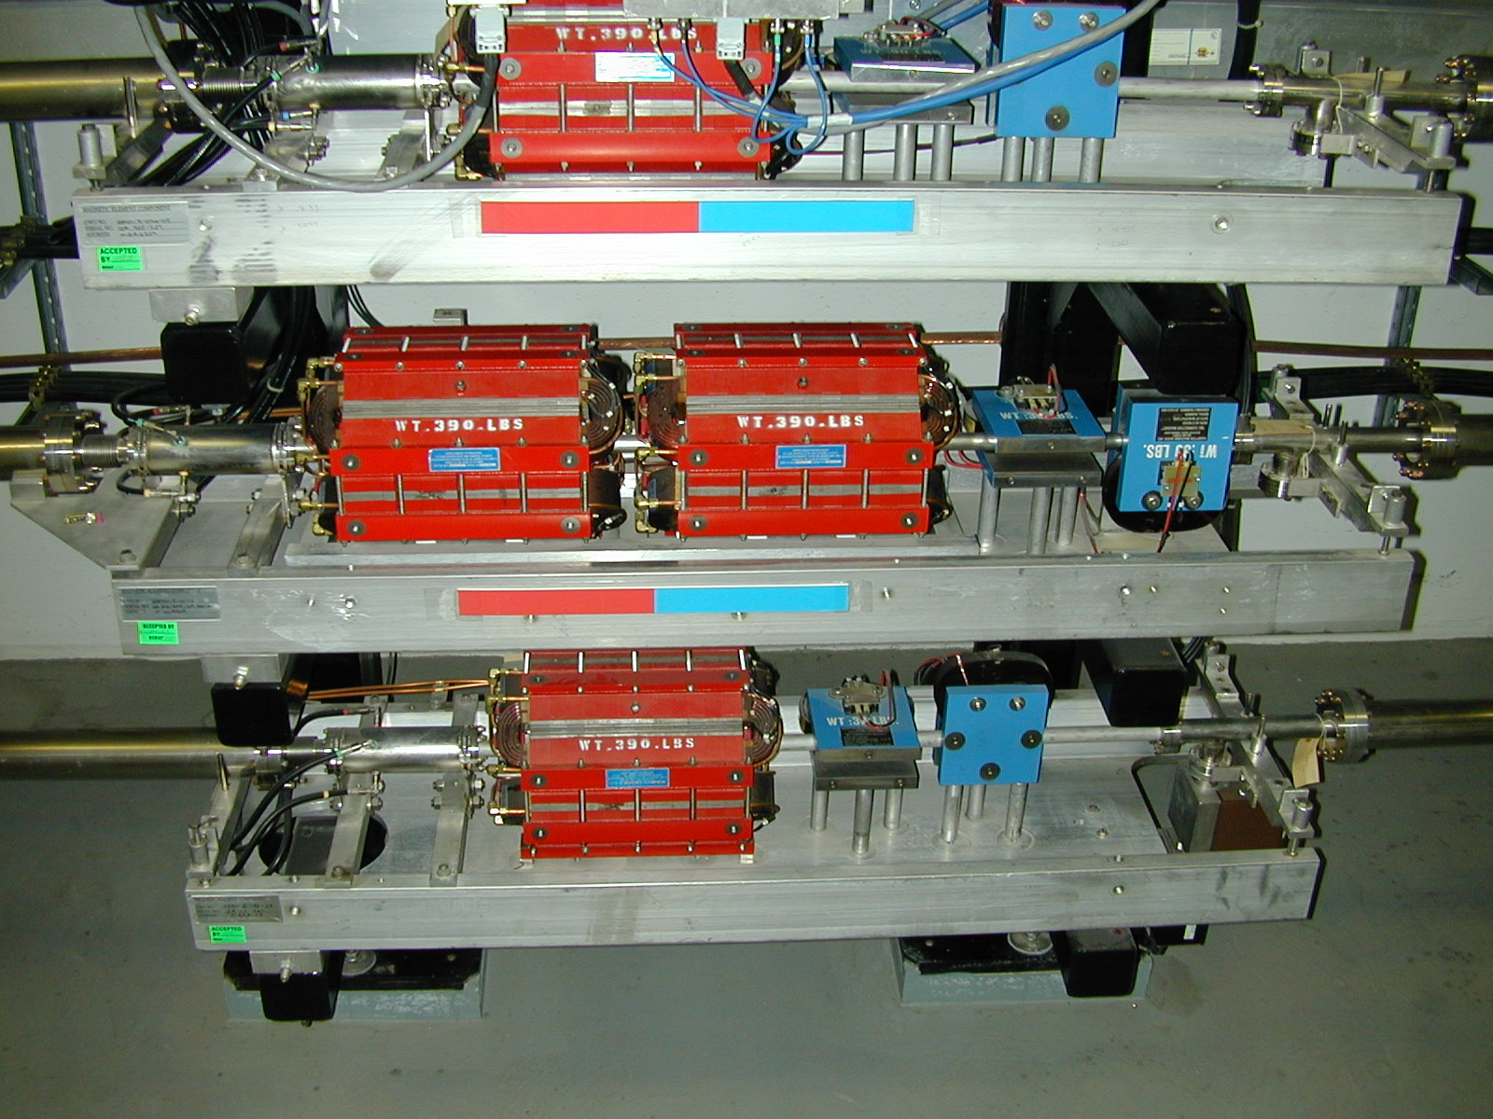
HPS beamline
Most of Hall-B beam line will be unchanged
Two new girders – one on the space frame, one on the forward carriage
BPM, 2-QA, and H-V-correctors
HPS
2H01 nA BPM
Shield wall
YAG viewer
H-V-correctors and BPMs
Vacuum valves

Slide 4
Beamline design status
Elements on B-deck are defined
Design of new girders started
A few elements can be barrowed some must be purchased (as was expected)
1.1 GeV
2.2GeV
6.6 GeV

Slide 5
“off-project” milestones
Regular meetings are held with accelerator and Hall-B engineering groups to track “off-project” milestones
 | Off-project milestones | Start date | Finish date | Responsibility | Comments
Beamline
 | Hall-B transport line |  | 8/29/14 | Accelerator | Quads and correctors are in place, not connected
 | Hall-B upstream beamline ready |  | 8/29/14 | Accelerator/Hall-B | Work is started
 | Commissioning of RF separator |  | 11/3/14 | Accelerator
 | 1/2/3 pass separaton and beam delivery |  | 11/10/14 | Accelerator
Hall-B work
 | CLAS12 PCAL and FTOF are mounted | 10/1/13 | 2/28/14 | Hall-B | PCALs and 15% of FTOF are installed
 | Preparing alcove | 10/1/13 | 3/7/14 | Hall-B | Work is started
 | Forward carriage move to upstream | 3/3/14 | 3/7/14 | Hall-B | Chicane Magnets can be installed after this is finished
CLAS12 Torus assembly
 | Start assembly of the Spit | 6/8/14 | 6/19/14 | Hall-B/Magnet | Magnets must be installed in alcove before this starts
 | Install Torus Coils | 7/21/14 | 1/7/15 | Hall-B/Magnet
 | Cold-to-worm supports | 3/16/15 | 3/28/15 | Hall-B/Magnet
 | Weld VJ | 2/28/15 | 4/11/15 | Hall-B/Magnet
 | Orient and secure Torus to Hall B floor | 4/11/15 | 4/28/15 | Hall-B/Magnet
 | Connect leads and piping | 4/28/15 | 5/19/15 | Hall-B/Magnet
 | Leak test and Pump VJ | 6/2/15 | 6/26/15 | Hall-B/Magnet

Slide 6
Progress on ECal
Funding for HPS has been received from INFN and IPN-ORSAY, ~500K EURO. This funding will be used for:
  purchase of new large area APDs (250K EURO) – POs from ORSAY and ONFN/Genova have been submitted, first delivery in 2.5 months
  rework amplifier boards - design is completed, some of components have been purchased
  new mother boards – motherboards have been purchased
  LED based LMS – design is progressing as planned
  a new mounting system - design is in progress
Both modules of ECal have been disassembled:
  Enclosures with amplifiers are ready for shipment to ORSAY for rework
  modules have been prepared for old APDs removal (will start in January)
INFN and Orsay groups will design and build APD test setup and APD gluing fixtures, and will provide part of manpower for ECal assembly

Slide 7
Running HPS during Accelerator Periods III and IV
During Acc. Period III and Period IV beam delivery to Hall-B will be possible after RF separators are commissioned, November 3rd, 2014
During the same period Hall-B will continue assembly of the CLAS12 Torus magnet and possibly other detectors
“Running would occur during evenings and weekends or during other periods when it would not conflict with the regularly scheduled assembly of the CLAS12 Torus coils” (from the HPS implementation plan document) and Accelerator commissioning plans (12 GeV has priority)
First meeting with physics division for scheduling HPS and preparing for the experiment readiness review took place on December 10
Follow-up meeting will be on January 8 with JLAB management. Will discuss coordination between HPS and 12 GeV work.
Experiment readiness review will take place in April, 2014.

Slide 8
Accelerator Period III and Period IV
Source: http://opsweb.acc.jlab.org/TJ3/12GeV_CEBAF/FY15.htm
Things to note:
Up-to 3 pass separation will be available after Nov. 3, 2015
Beam delivery to Hall-D is 1 week effort with 24-hour availability (total 168 hours)
Machine setting will be changed on Dec. 5, 2015
Availability of experts for beam tuning to Hall-B over night, after the two shifts of day time work

Slide 9
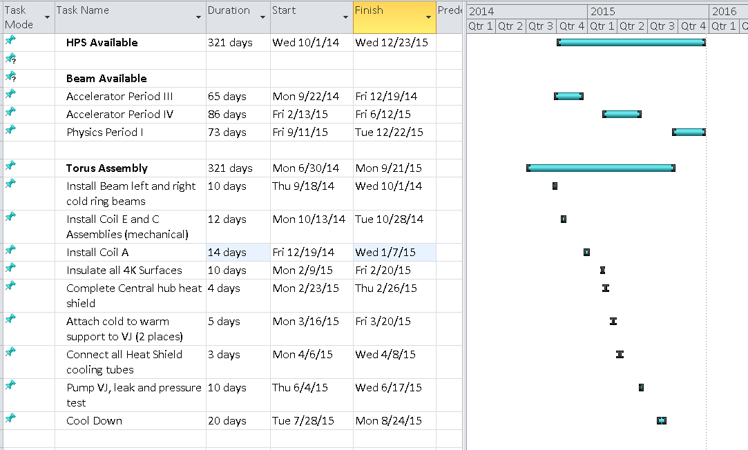
HPS / Accelerator / Torus Schedule

Slide 10
Time available in Hall-B - “on the floor with beam”
Run plan – evenings and weekends
CLAS12 Torus assembly involves Hall B access for 1 shift for 5 days per week. Hall should be in “Restricted access” at least 9-10 hours (Dave Kashy)
Sweeping the Hall to get from “Beam permit” to “Restricted access” and visa versa is 1 hour per sweep if ARM is available (6-GeV experience). Hall-B not been a priority, it may take longer (ARM may not be available for multiple locations)
Realistic scenario for work week – 12 hours split between “Beam permit” and “Restricted access”
From experience in Hall-B (Hall-B logbook 2009, experiments e1-DVCS, eg1-DVCS, and eg6) the average time for recovery after the accelerator maintenance is 6 hours (time between when shift personal asked to go to beam permit and when run started). This 6 hours have been with a fairly well understood machine, with moderate demands on the beam quality. In run periods under question we face with a new machine and with experiments that have very high demands for beam quality
  Realistic scenario for work week – 8 hours/day “on the floor with beam” or
  Total of 88 hours “on the floor with beam” per week
  This is about 50% of what normally would have been available per week -
  “on the floor with beam” / “on the floor” = 0.5

Slide 11
Beam time needed for HPS
A minimum of 21 “beam on target” days -
7 days of commissioning, and minimum 14 days of data taking at 1.1 GeV and 2.2 GeV
Nominal (from 6-GeV era) ratio for:
“beam on target” / “on the floor with beam” = 0.5
With availability of Hall-B during Accelerator periods III and IV this ratio is:
  “beam on target” / “on the floor” = 0.25
  For HPS “on the floor” time is 84 days
Reserving the time before December 5, 2014, for a general Hall-B beamline commissioning, the time available for the experiment is:
14 (Dec. 2014) + 119 (Feb. to June 2015) = 133 (with “restoration”* time – 10.5.1)
14 (Dec. 2014) + 70 (April to June 2015) = 84 (without “restoration”* time)
* 10.5.1 of Acc. period IV has “multiple beam characterization”, not clear if that will be suitable for physics running

