Slide 1

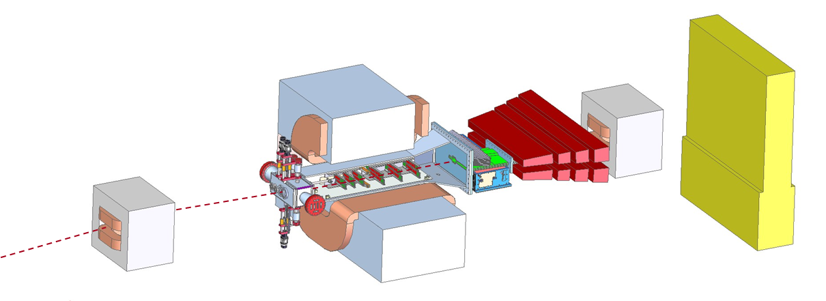
HPS Slow Control Review
Final Report
December 5, 2013

Slide 2
Review Panel
Marco Oriunno | SLAC | Chair
John Jaros | SLAC | Co-Chair
Stepan Stepanian | JLAB | Co-Chair
Hovanes Egiyan | JLAB | Link Person to the Slow Control Project
Mark Ito | JLAB | External Reviewer
Link to the Web Page of the Review :
https://confluence.slac.stanford.edu/display/hpsg/Slow+Control+Review+Dec.5%2C+2013

Slide 3
Charge
Thank you for agreeing to review the Slow Control Project. The window for the first physics opportunities at JLAB will be narrow and requires HPS to be ready on the floor by not later than October 1st 2014. In addition to monitoring the core functionalities of the SVT and ECAL detectors, the Slow Control provides monitoring and safety features and the fast interlocks for the Beamline. A flawless implementation of a robust Slow Control system in HPS is mandatory to start the commissioning of the HPS when the first beam will be available. In your review, please evaluate how ready the Project is to move forward to construction, in particular toward the installation and commissioning at JLAB by October 2014 .

Slide 4
General Remarks
The Review panel congratulates the project for the high quality of the talks presented, which addressed all the points in the Charge. The project is run by an experienced team, with day to day involvement in Slow Control design for Physics Experiments and Accelerators. They are very much in touch with all the key components of the HPS experiment, and the solutions they presented are technically very solid. Although some tasks can be labor intensive, the technological risks are low. The subsystem requirements collected to date are sufficient to start the development of the Slow Control System. Close collaboration with all the HPS subsystems in monitoring and assessing the progress is required for the success of the Project.

Slide 5
1. Does the project have a comprehensive list of requirements from all the HPS subsystems, which lets it finalize its plans and begin implementation?
Findings:
The list of requirements presented by the Sub-systems match very closely those presented by the SC Project, which proves the good collaboration between groups
Comments:
Although all the fundamental requirements have been captured to date and the development can start, some work is required to finalize the remaining small details.
Recommendations:
None

Slide 6
2. Are the interfaces with the other sub‐system sufficiently understood, e.g. SVT,
ECAL, Beamline, and TDAQ. Have liaisons with each system been established?
Findings:
The Project has good communication with all the HPS sub-systems and the link persons have been clearly identified. There are regular meetings reviewing progress.
Comments:
The interactions with the TDAQ system was not discussed. We understand that this work is minimal and anyway almost totally covered by the development of the tasks for the SVT and ECAL.
Recommendations:
None

Slide 7
3. Does the team have a resource‐loaded schedule for project execution that allows the installation and the commissioning in Hall‐B by October’14?
Findings:
An exhaustive list of the required manpower has been presented, with explicit names assigned to tasks.
Comments:
In same cases, the personnel belong to external institutions and it is not clear if these people have a firm commitment to participate in the Slow Control Project.
Recommendations:
The PL needs to verify as soon as possible the availability of all the people expecting to contribute to the Project , find replacements where required, and present an updated resource loaded schedule.

Slide 8
4. Does the schedule contain appropriate milestones for tracking progress and are they achievable?
Findings:
The project presented an exhaustive list of Milestones, which are considered detailed enough to start the work and monitor the progress.
Comments:
Some tasks have schedule risks because they depend on manpower associated with one HPS subsystem or another, which may themselves have manpower shortages and other priorities and so could impact progress on SC.
Recommendations:
The monitoring of the progress will require additional coordination with the HPS PM, at the Technical Board and other coordination meetings

Slide 9
5. Can the project adequately justify its costs; have the necessary funds secured?
Findings:
Costs of both Labor and M&S were presented with good detail.
Comments:
Some of the expenses related to the work of external contributors have been earmarked as Travel while they are instead Labor and, as such, part of the Capital Equipment.
Recommendations:
None

Slide 10
6. Is there a management team in place, have resources been identified, and has risk mitigation been adequately addressed?
Findings:
The manpower of SC project is essentially based at JLAB and the management is done locally by the PL, although with a small number of potential contributors visiting JLAB for long period.
Comments:
Although the project is considered technically sound with low a risk on the technology, a basic risk analysis of the most elaborated tasks was not presented. The review panel recognize the following tasks as potentially exposed to delays:
SVT DAQ channel-access server: this could be delayed by a steep learning curve and lack of documentation.
SVT interlocks: if there are dependencies among the conditions for shutdown then a design needs to be done. If not then this is straightforward.
SVT wire scan: in the traditional Hall B scheme, there is no active coordination of wire motion with scaler reading; you read the position and then read the scaler and assume simultaneity, a good assumption. If this assumption breaks down for the SVT scans ("latency problem") then then either the deployment of electronics needs to be examined or a different algorithmic approach to scans employed.
SVT motor system, shipping from JLab to SLAC: EPICS infrastructure would have to be installed at SLAC; this is certainly do-able, might be a non-trivial exercise.
Scalers from the JLab FADCs and discriminators: these are relatively new boards and the use of the built-in scalers is not something done before in a running experiment, thus associated schedule risk. Related to this is the development of the method for presenting scaler data to shift-takers. This may not be completely worked out.
RS-232 interface to chiller: the default plan is to get help from Accelerator Division at JLab. In that case, arrangements need to be made well in advance of desired delivery to make sure personnel are available to work on this.

Slide 11
6. Is there a management team in place, have resources been identified, and has risk mitigation been adequately addressed? (cont.)
Recommendations:
A closer monitoring of the these task is required and immediate action must be taken if necessary, in coordination with the sub-system involved.

