Slide 1

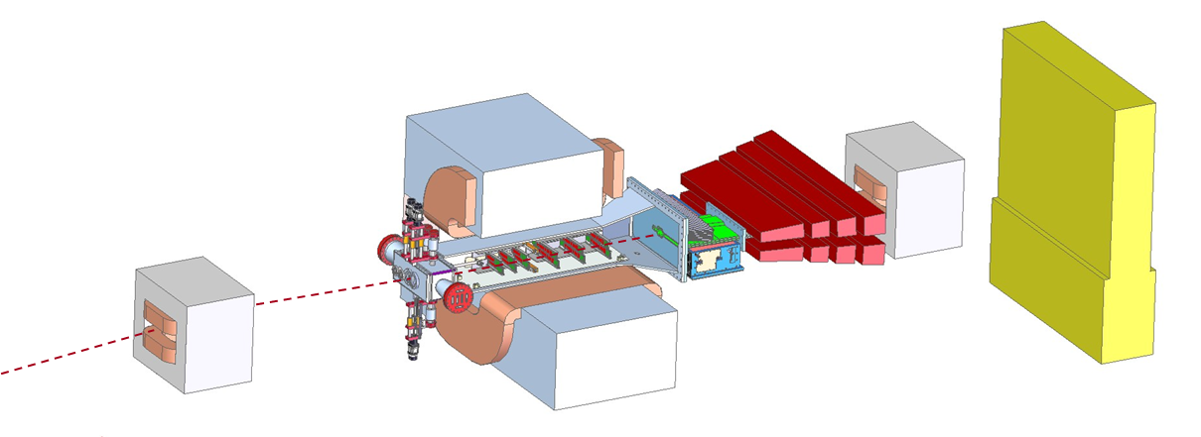
Budget, Schedule, Management
HPS DOE Review
Marco Oriunno, July 11, 2013

Slide 2
Outline
Organization
Schedule
Costs
Manpower
Risk Management
Project Monitoring

Slide 3
Organization Chart
DOE NP
DOE HEP
IPNO
INFN
JLAB
SLAC
Funding Agencies
Heavy Photon Search
Project Manager M. Oriunno
Project Scientists J. Jaros (SLAC)
S. Stepanyan (JLAB)
HPS Project
HPS Executive Committee
Beamline (K.Moffeit)
Slow Controls (H. Egiyan)
SVT (T.Nelson)
Software (M.Haltrop)
SVT DAQ (R.Herbst)
Analysis (M.Graham)
Ecal (R.Dupre)
Trigger/DAQ (S.Boyarinov)
The Project Manager holds the contingencies
Muon (K.Griffioen)

Slide 4
Matrix of Deliverables
 | SLAC | UCSC | JLAB | ORSAY | INFN
Beamline | ● |  | ●
SVT | ● | ●
SVT DAQ | ● | ●
ECAL |  |  | ● | ● | ●
TDAQ | ● |  | ● | ●
Slow Control |  |  | ●
Installation & Commissioning | ● | ● | ● | ● | ●
Project management | ● |  | ●

Slide 5
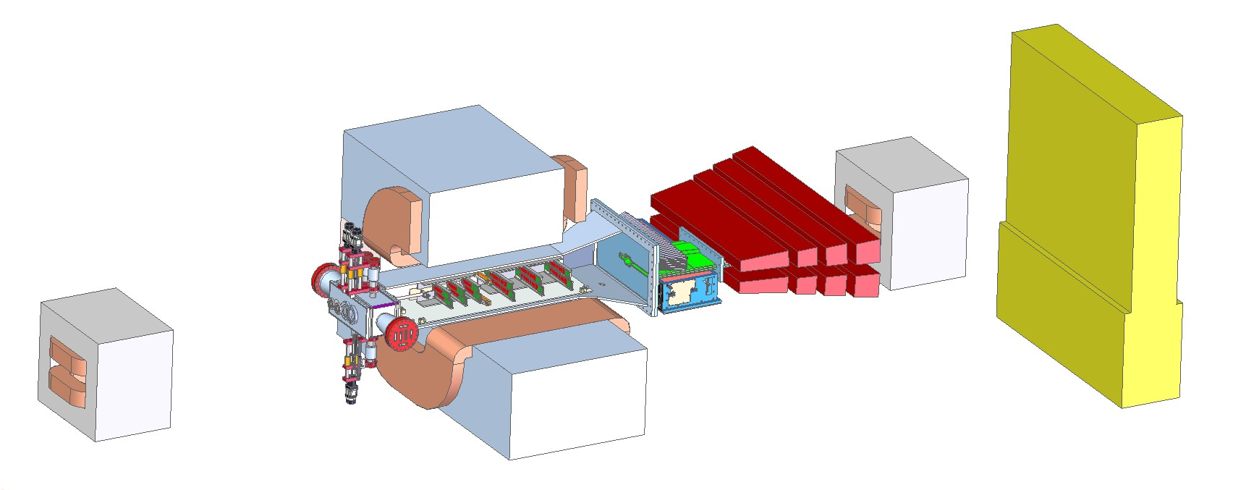
Work Breakdown Structure (WBS)
WBS | NAME
1.1 | Beamline
1.2 | SVT
1.3 | SVT DAQ
1.4 | ECAL
1.5 | TDAQ
1.6 | Slow Control
1.7 | Installation & Commissioning
1.8 | Electron running
1.9 | SLAC Travel and Meetings
1.10 | SLAC Travel for Data Run
1.11 | Project management
1.12 | UCSC (pass through)
Construction
Operations
Construction
Operations

Slide 6
Schedule Drivers – Staging Plan
Early Physics Window Opportunity
Funding
Mar.13
Oct.’14
May.’15
Sep.’16
HPS Construction
Data Runs
Analysis
FY13
FY14
FY15
FY16
Construction
Operations
Installation & Commissioning
Construction
Testing
I&C
Data Run
Analysis
Stage 1
Stage 2
Stage 4
Stage 3

Slide 7
Schedule Drivers – Endgame Milestones
Early Physics Window Opportunity
Funding
Mar.13
Oct.’14
May.’15
Sep.’16
HPS Construction
Data Runs
Analysis
FY13
FY14
FY15
FY16
Construction
Operations
End Milestone 1
End Milestone 2
End Construction: “Installation and the commissioning of HPS on the beamline, no beam”. September 30 ’14
End of Data Runs : Data Runs at 1.1, 2.2 and 6.6 GeV. March 31’15

Slide 8
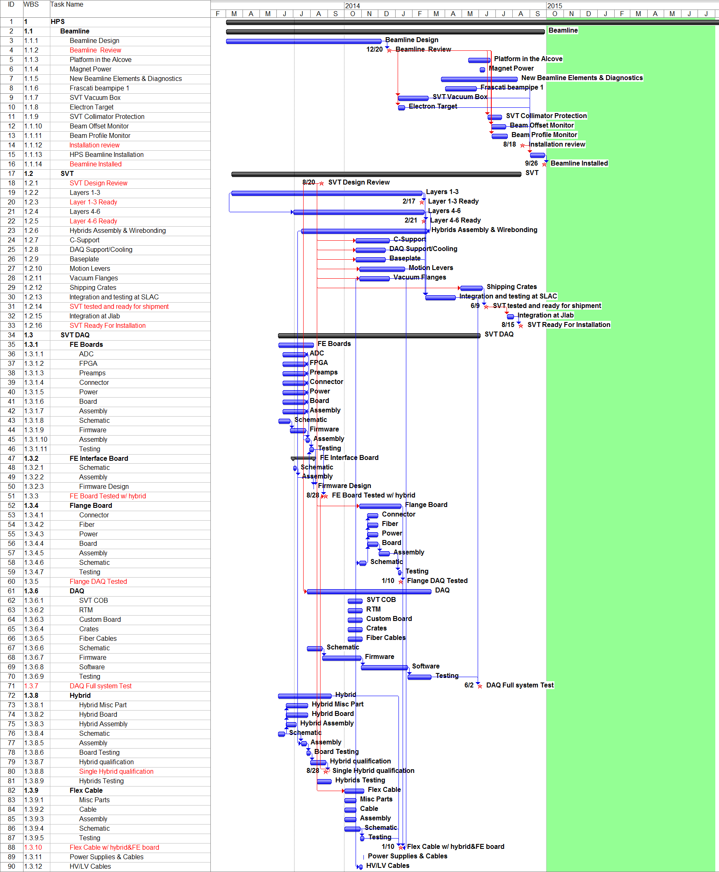
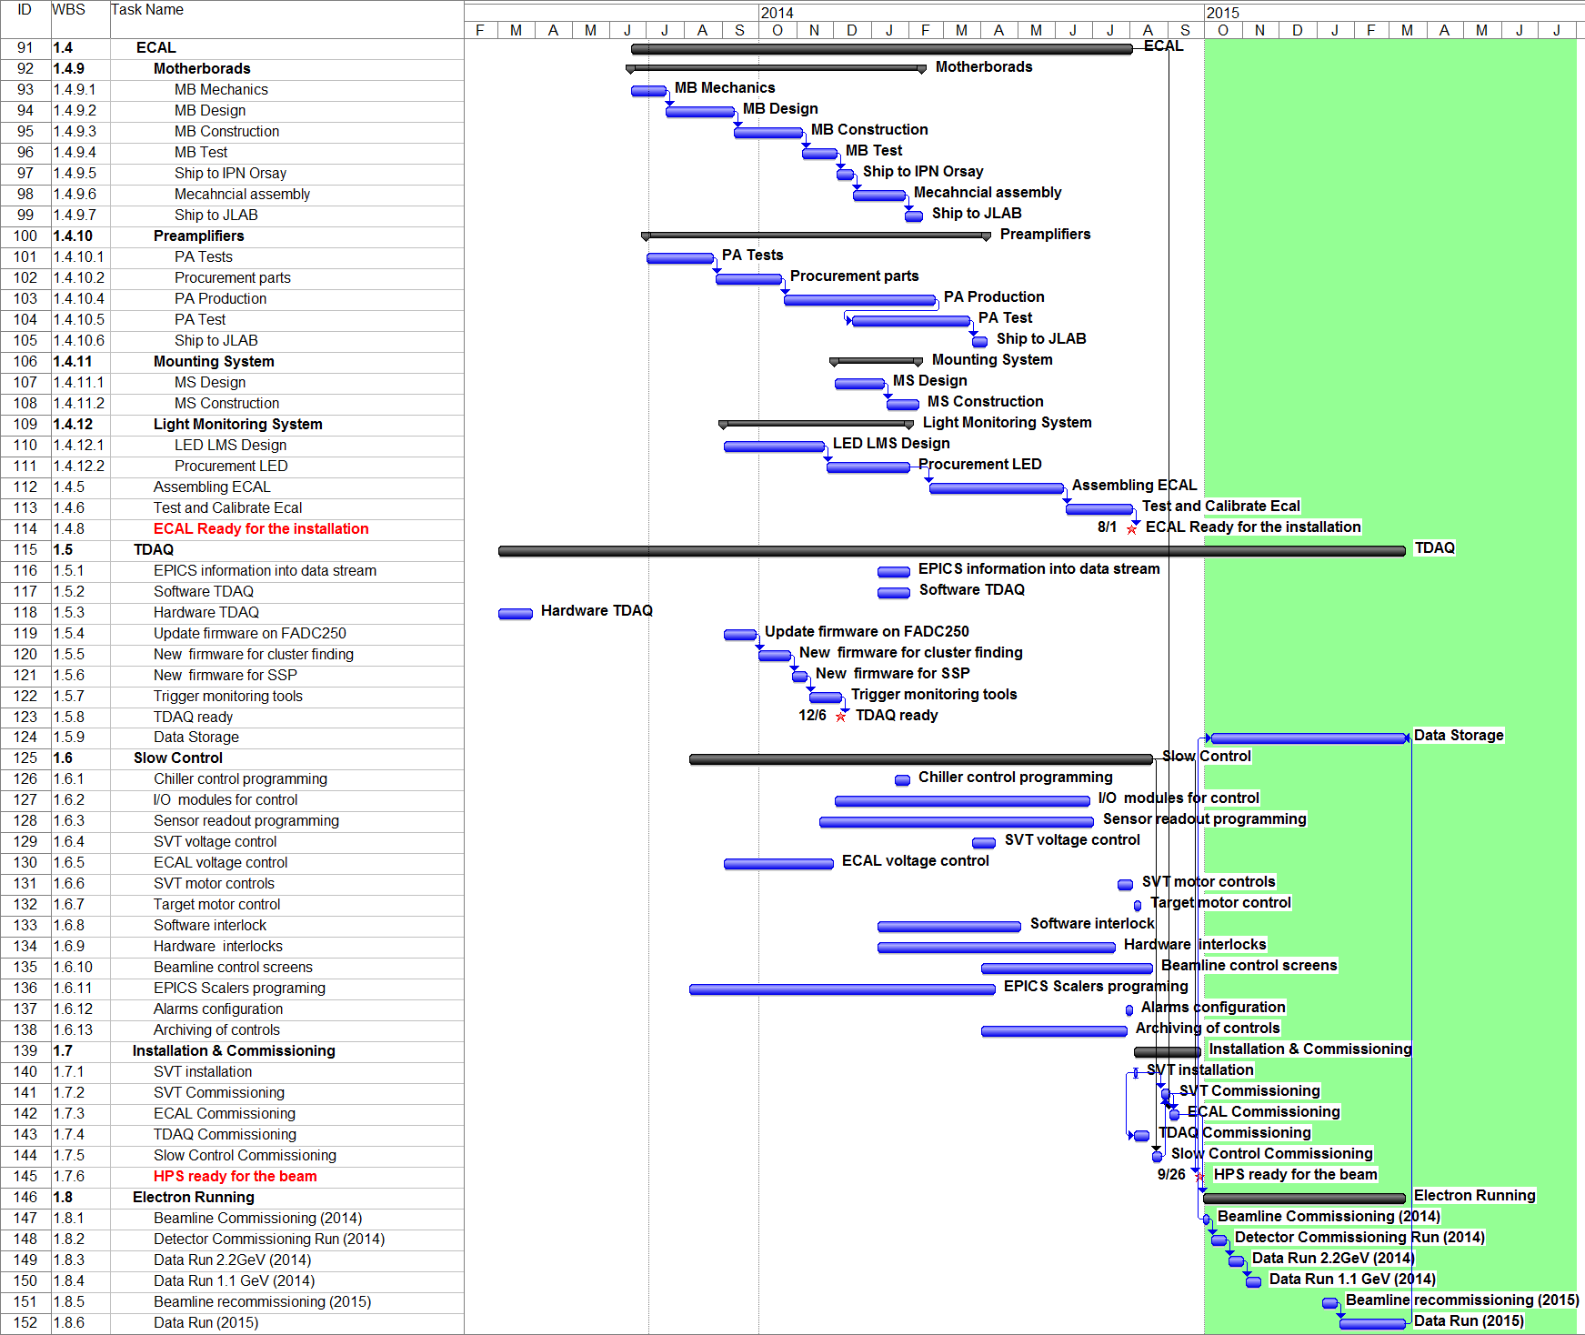
HPS Master Schedule – Staging Plan
Beamline
ECAL
SVT
TDAQ
SLOW Control
Early Physics Window Opportunity
Installation and Comm.
SVT DAQ
Data Run
Stage 1
Construction
Stage 2
Testing
Stage 3
Installation
Stage 4
Data Run

Slide 9
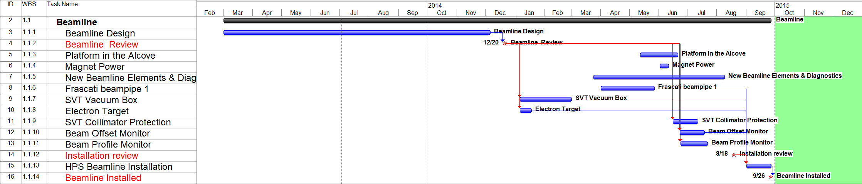
Schedule – Beamline (HPS downstream in the Alcove)
Milestones & Reviews
Beamline Design review 12 - Dec -2013
Installation review 18 - Aug - 2014
Beamline Installed 26 – Sep - 2014
Vacuum Box and Target works can start at SLAC > Jan. 2014
Work at JLAB can start only > March 2014 (Driven by Manpower Availability)

Slide 10
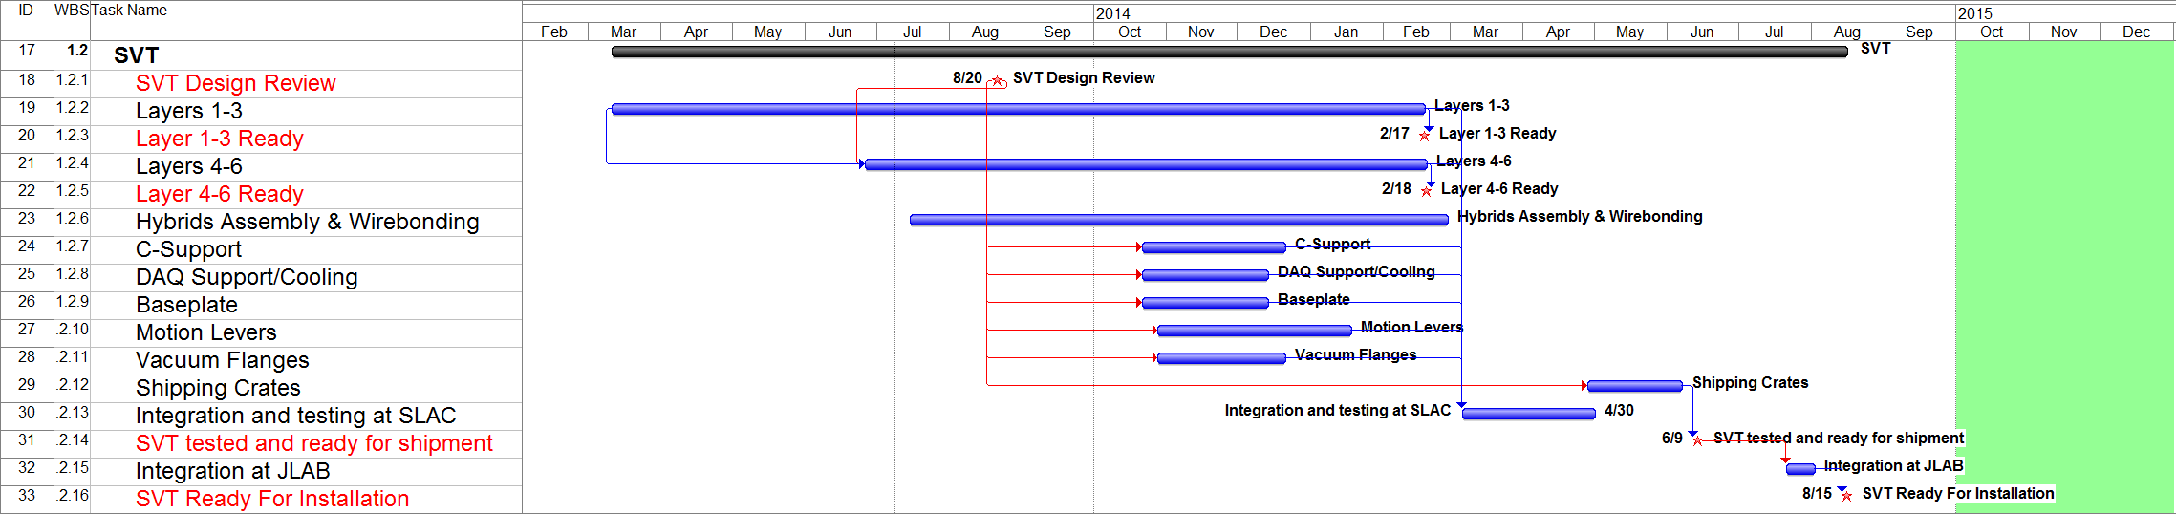
Schedule – SVT Mechanics
Milestones&Reviews
SVT+DAQ Engineering Design Review 20 – Aug- 2013
Layer 1-3 Ready 17 – Feb - 2014
Layer 4-6 Ready 18 – Feb - 2014
SVT Ready for Shipment (Tested with DAQ) 9 - June - 2014
SVT + DAQ Ready For Installation 15 – Aug - 2014
Work C-Supports, Baseplate…can start only > Oct’13
(Driven by Manpower Availability, not on the Critical Path)

Slide 11
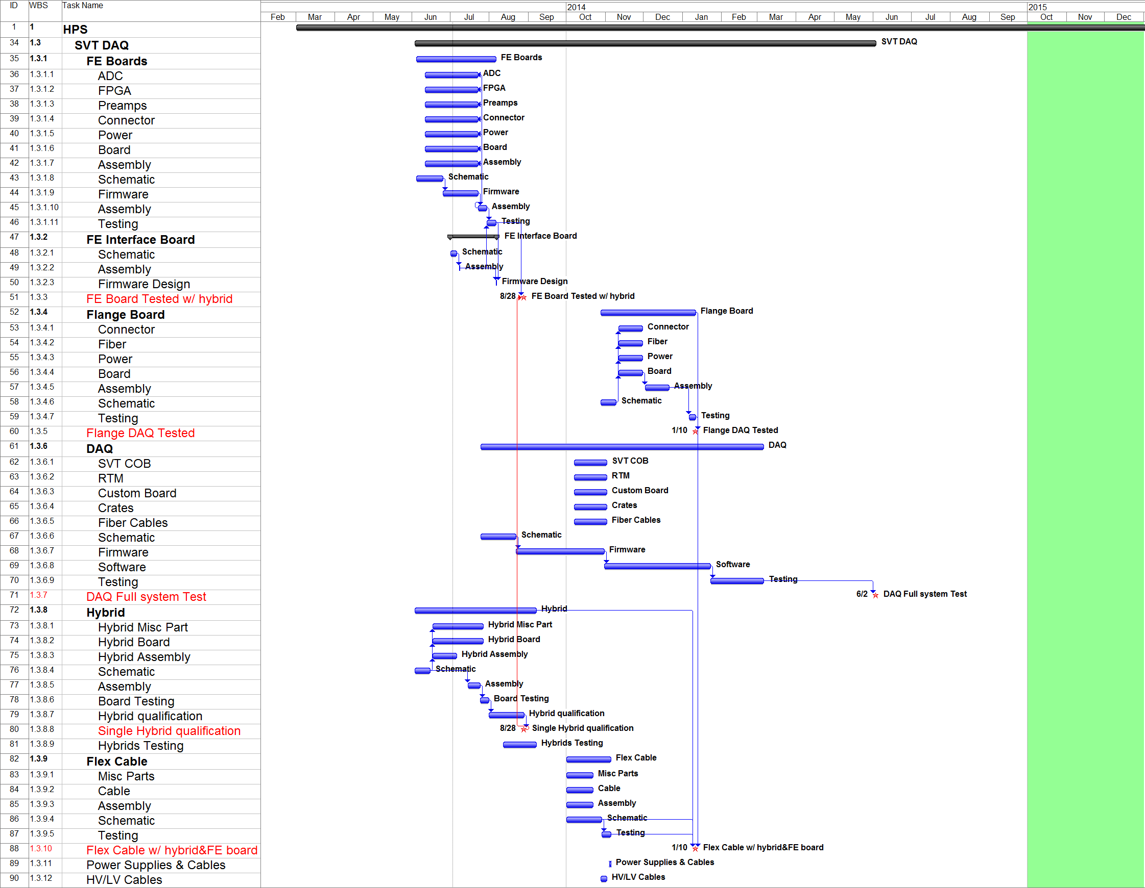
Schedule – SVT DAQ
Milestones&Reviews
Eng. Review (Combined SVT) 20-Aug-2013
FE board tested w/ hybrid 28-Aug-13
Flange DAQ Electrically tested 10-Jan-14
DAQ full system Test 2-Jun-14
FE Boards
Flange Boards
Start FY14, Driven by Funds availability
DAQ
Hybrids
Flex Cables
Start FY14, Driven by Funds availability

Slide 12
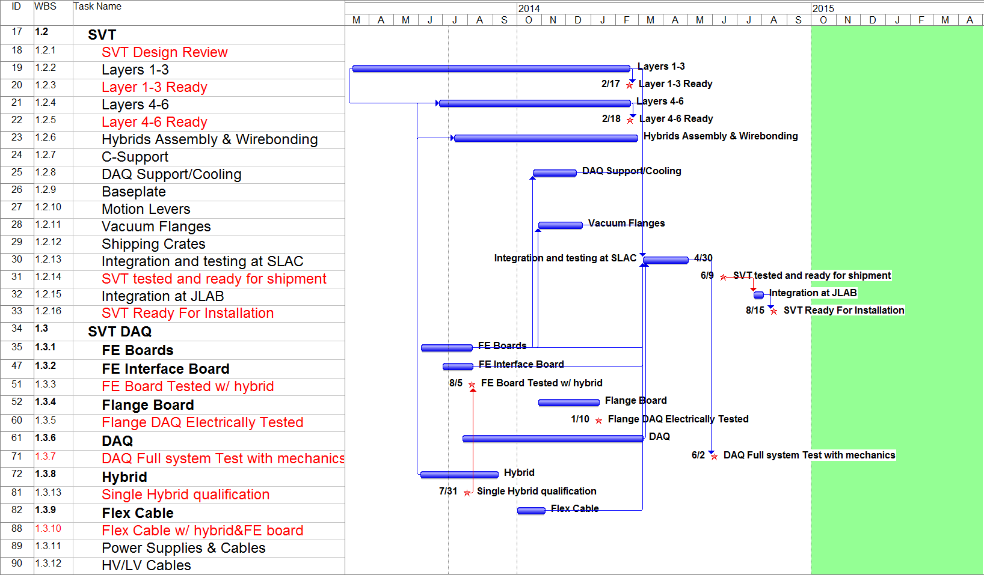
Schedule – SVT + DAQ Integration

Slide 13
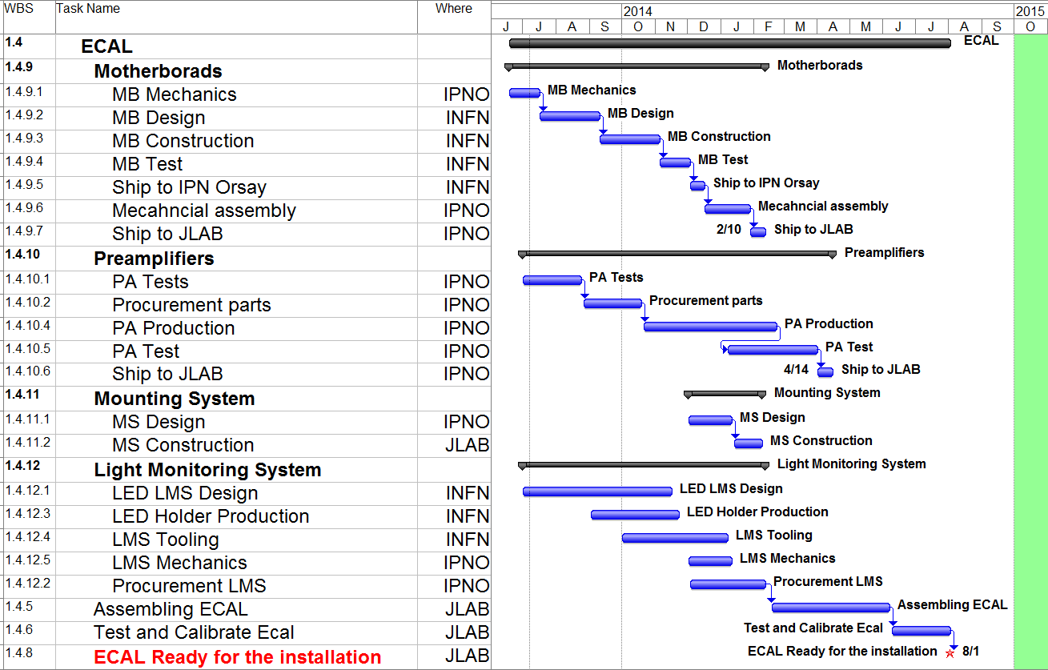
Schedule – ECAL
Milestones&Reviews
Motherboard Shipped at JLAB 10-Feb-14
Preamplifiers Shipped at JLAB 4-Apr-14
ECAL Ready for installation 1-Aug-14

Slide 14
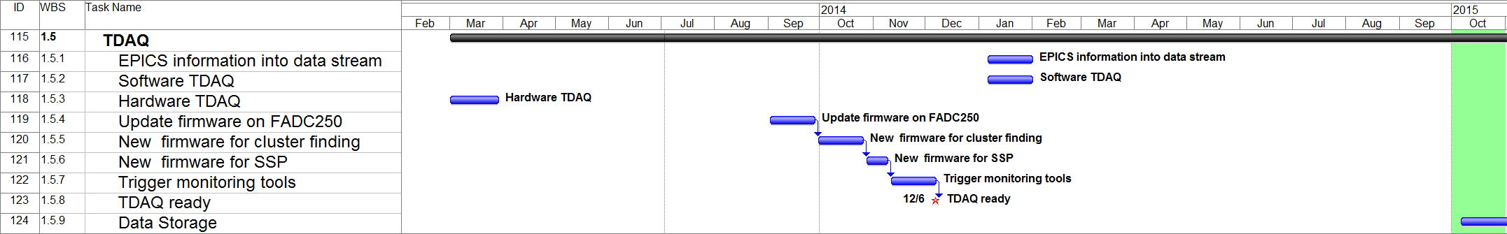
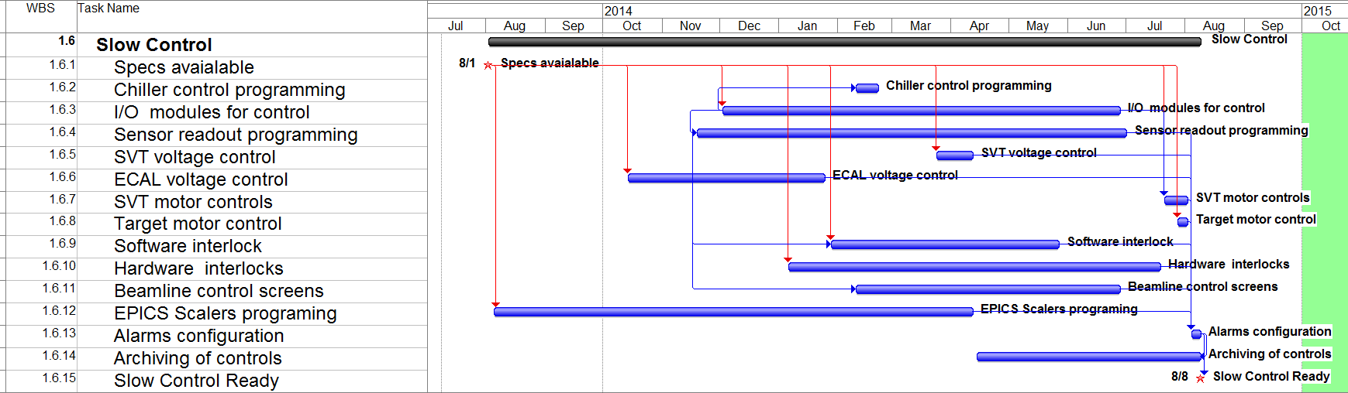
Schedule –TDAQ , Slow Control
TDAQ ready Dec.6, 2013 (Integration in the existing TDAQ of the Hall-B)
Slow Control Starts Aug’13 Ready Aug.8, 2014

Slide 15
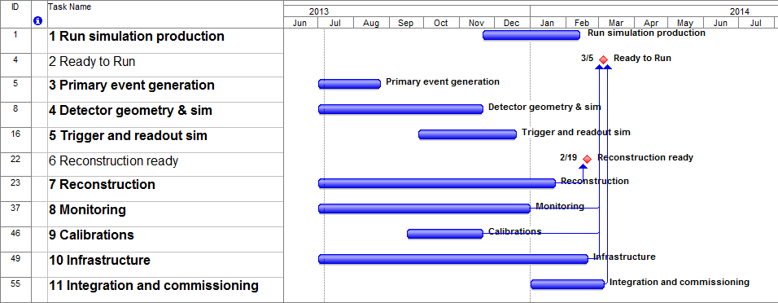
Schedule - Software
Milestones&Reviews
Reconstruction Ready 19-Feb-14
Ready to Run 5-Mar-14

Slide 16
Schedule – Installation, Commissioning and Data Runs
Installation in Hall-B ~2 wk at the end of August, done by the same crew of the Test Run
Commissioning and Data Run | Duration | Start | End
Beamline Commissioning (2014) | 1 wk | 29-Sep | 3-Oct
Detector Commissioning Run (2014) | 2 wks | 6-Oct | 17-Oct
Data Run 2.2GeV (2014) | 2 wks | 20-Oct | 31-Oct
Data Run 1.1 GeV (2014) | 2 wks | 3-Nov | 14-Nov
Beamline recommissioning (2015) | 2 wks | 5-Jan | 16-Jan
Data Run (2015) | 8 wks | 19-Jan | 13-Mar

Slide 17
Costs Methodology
Schedule and Costs are simultaneously managed with MSProject
Tasks are tracked down to WBS Level 3 Min.
Labor is added in hours by skills. M&S as number of required units
Only Engineering Labor + Overheads (SLAC = 53% , 7.65%, JLAB = 49% , 49%
Inflation 2.5% per year
Contingency :
  10% Catalogue Items
  20-25% Similar to previous design
  30-50% New design
Lab.
M&S

Slide 18
HPS Total Costs = $3,187k
Construction
k
k
k
k
k
Operations
k

Slide 19
HPS Budget vs. Test Run
Funded in July 2011 for installation in March 2012
First FWP $751k
Additional $200k for missing items, underestimating engineering and technicians
Slow response from external shops, recovered with an increase of Labor in-house
Installation done on April 18, ~ 7 weeks delay
Lesson learned : Better contingency, realistic engineering estimations, better planning of the purchasing process.

Slide 20
Capital Equipments vs. Operations (*)
 |  | Labor | Material | Total |  | Operations | Infrastractures | Capital Equipments
1 | HPS | $1,930 | $1,257 | $3,187 |  | $928 | $568 | $1,692
1.1 | Beamline | $285 | $184 | $469 |  | $0 | $325 | $143
1.2 | SVT | $452 | $204 | $656 |  | $75 | $43 | $539
1.3 | SVT DAQ | $431 | $352 | $782 |  | $80 | $162 | $540
1.4 | ECAL | $12 | $6 | $18 |  | $0 | $0 | $18
1.5 | TDAQ | $151 | $10 | $161 |  | $0 | $10 | $151
1.6 | Slow Control | $94 | $39 | $134 |  | $0 | $28 | $106
1.7 | Installation & Commissioning | $58 | $0 | $58 |  | $55 | $0 | $3
1.8 | Electron Running | $0 | $0 | $0 |  | $0 | $0 | $0
1.9 | SLAC Travel Meetings | $125 | $0 | $125 |  | $125 | $0 | $0
1.10 | SLAC Travel for Commissioning and Running | $156 | $0 | $156 |  | $130 | $0 | $26
1.11 | Project management | $167 | $0 | $167 |  | $0 | $0 | $167
1.12 | UCSC Funds | $0 | $463 | $463 |  | $463 | $0 | $0
< $2M
Capital Equipment (CE) | Labor and Material costs of the parts constituting the experimental apparatus, which is required to perform the physics. They do not include spares and prototyping
Infrastructures (INFRA) | Labor and Materials cost for general purpose infrastructures required by the apparatus, which can be reused for other experiments, e.g, Chiller, Power Supplies, PLC
Operation (OP) | Labor and Material Costs incurred for the commissioning and the operation of the experimental set up, as well as Spare Parts, Prototype and R&D activities. Travels.
* Thanks to H.Marsiske for the help with DOE Guidelines

Slide 21
Beamline Costs: Upstream vs. Downstream
With the recent CEBAF Re-Baselining Review, JLAB management has led the development of a realistic schedule for HPS in Hall B.
HPS can be installed in September, 2014, commissioned in early FY2015, and take data later in FY2015 if it is installed in the Hall B Downstream Alcove instead of the upstream location described in the proposal.
Alcove running is fully compatible with CLAS 12 assembly schedule in Hall B and ideal for future running when CLAS 12 is operational.
Beamline Downstream - ALCOVE | Labor | M&S | Total
Refurbishing of the Alcove | $202 | $118 | $320
Platform in the Alcove | $57 | $53 | $110
Magnet Power | $9 | $26 | $35
Beamline controls | $136 | $39 | $175
Increase $320k -
Beamline Upstream (Proposal) | Labor | M&S | Total
Items not required in the Alcove | $8 | $65 | $74
Vacuum beam line downstream of chicane | $0 | $19 | $19
Frascati Vacuum Chamber | $0 | $19 | $19
Photon Dump & Shielding | $8 | $27 | $35
Saving $74k =
Net Incr. $246k
The additional costs to refurbish the Alcove are considered HPS Infrastructures

Slide 22
Cost Breakdown by participants
SLAC Total=$2.473M
SLAC |  | Labor | Material | Total | Capital Equipments
1 | HPS | $1,400 | $1,074 | $2,473 | $1,332
1.1 | Beamline | $41 | $17 | $58 | $58
1.2 | SVT | $452 | $204 | $656 | $539
1.3 | SVT DAQ | $431 | $352 | $782 | $540
1.5 | TDAQ | $0 | $10 | $10 | $0
1.6 | Slow Control | $0 | $28 | $28 | $0
1.7 | Installation & Commissioning | $29 | $0 | $29 | $3
1.8 | Electron Running | $0 | $0 | $0 | $0
1.9 | SLAC Travel Meetings | $125 | $0 | $125 | $0
1.10 | SLAC Travel for Commissioning and Running | $156 | $0 | $156 | $26
1.11 | Project management | $167 | $0 | $167 | $167
1.12 | UCSC Funds | $0 | $463 | $463 | $0
JLAB |  | Labor | Material | Total | Capital Equipments
1 | HPS | $530 | $184 | $714 | $360
1.1 | Beamline | $244 | $167 | $411 | $86
1.4 | ECAL | $12 | $6 | $18 | $18
1.5 | TDAQ | $151 | $0 | $151 | $151
1.6 | Slow Control | $94 | $11 | $106 | $106
1.7 | Installation & Commissioning | $29 | $0 | $29 | $0
JLAB Total=$714k

Slide 23
Infrastructures, Total $568k
WBS | Name | Labor | Material | Total
1.1 | Beamline | $211 | $124 | $335
 | Platform in the Alcove | $57 | $53 | $110
 | Magnet Power | $9 | $26 | $35
 | New Beamline El. & Diagnostics | $136 | $39 | $175
 | Beam Offset Monitor | $10 | $6 | $16
1.2 | SVT | $0 | $43 | $43
 | Chiller | $0 | $39 | $39
 | Equipment for chiller Control | $0 | $4 | $4
1.3 | SVT DAQ | $0 | $162 | $162
 | SVT COB | $0 | 54 | $54
 | RTM | $0 | 23 | $23
 | Crates | $0 | 15 | $15
 | SVT LV Unit | $0 | $17 | $17
 | SVT HV Unit | $0 | $37 | $37
 | Wiener Crate | $0 | $16 | $16
1.6 | Slow Control | $0 | $28 | $28
 | PLCs Modules for controls | $0 | $28 | $28

Slide 24
Additional ECAL Funds - Orsay + INFN, € 223k
IPNO ORSAY, € 128k + € 38k (~30% contingency)
Young Researchers Grant awarded from Agence Nationale de la Recherche (ANR) for HPS. It will be used for new Preamplifiers, part of the LMS, Mechanics, Assembly
€ 34k M&S , € 64k Labor, € 30k Travels ,
Engineering provided as in-kind (ME, EE Design and Installation)
INFN*, € 95k + € 27k (~30% contingency)
Requesting funds to INFN in July for new Motherboards, the Light Monitoring System (€ 70k) and Travel (€ 25k). Decision expected by mid September. High chance to pass. € 40k already secured by INFN carry over funds of the Forward Tagger in Hall-B.
* Cagliari-Catania-Genova-Roma2-Torino

Slide 25
Spending Profile
Keep alive funds FY13
$414k
FY14 - FY15 - FY16
SVT Review
Beamline Review

Slide 26
Manpower – FTE Labor Breakdown
SLAC
Electrical Engineering
Ryan Herbst(EE)*, Ben Reese(EE)
Mechanical Engineering
Marco Oriunno(ME)*, Shawn Osier(ME), Matt McCulloch(MT)*, Matt Swift(MD)
 | FY13 | FY14 | FY15 | FY16
ME | 0.19 | 0.64 | 0.14 | 0.02
MD | 0.09 | 0.30 | 0.00 | 0.00
MT | 0.08 | 0.49 | 0.00 | 0.00
EE | 0.58 | 0.76 | 0.05 | 0.02
ET | 0.01 | 0.04 | 0.00 | 0.00
Electrical Engineering
Ben Raydo(EE)*, Scott Kaneta(EE)*, Chris Cuevas(EE)*, Nerses Gevorgyan(EE)*, Krister Bruhwel(ET)*
Mechanical Engineering
Hall-B Engineering Team*
JLAB
 | FY13 | FY14 | FY15 | FY16
ME# | 0.00 | 0.12 | 0 | 0
MD# | 0.05 | 0.54 | 0 | 0
MT# | 0.00 | 0.66 | 0 | 0
EE | 0.12 | 1.19 | 0 | 0
ET | 0.02 | 0.07 | 0 | 0
# Increase w.r.t. the Proposal, due to the Alcove
* Participated in the Test Run

Slide 27
Risk Management
Failure Mode | Consequence | Mitigation
Equipment
Beam damages silicon or ECAL in electron commissioning | Part or full sub detector not working | Beam Monitors and Interlocks. Spares modules for Layer 1-3
Failure of in-vacuum electronics (hybrid or front end board) | Part or full SVT not working. Need to break vacuum to repaire the failure with a prolonged Beamline shutdown | Extensive testing at SLAC in real conditions and at JLAB before installation. It can be repaired during a short access
Coolant leak in vacuum | Not possible to operate the SVT without cooling. SVT shutdown. Vacuum enviroment Pollution. Beamline shutdown | Minimize number of fittings. Only welded connections. Extensive test at SLAC and JLAB before installation. Pressure check before to close the vacuum chamber. It can be repaired during a short access
Failure to pump down adequately because of excessive SVT outgassing | High beam-gas background. Unable to perform the physics. It may need to break vacuum to repaire the failure with a prolonged Beamline shutdown | Exentsive qualification of the construction materials based on the experience with the Test Run.
CLAS 12 construction mishap breaks beam line vacuum | Hall-B is not able to provide beam to HPS | Careful check of the CLAS12 construction procedures. Mitigation plan shared with CEBAF Hall-B and Clas12.
SVT DAQ - Flange Board. New design, which requires more time than expected. | Schedule Delay and cost overrun | Design work shared woith other SLAC projects. High contingency (50%) in the WBS
Schedule and Budget
Late Funding beyond FY14 | Schedule delayed till funds available. Risk to miss the early physics window in FY15 | Absorbing delays of the critical task on the contingency carried over from the previous funding period on schedule and budget. Not Critical for Beamline, Ecal, TDAQ.
Partial Funding | Unable to deliver the project in time and with the declared performances. | Need to redefine the size, eventually the scope, of the project
SLAC manpower inadequate to complete SVT DAQ work on schedule | Delays on the SVT DAQ milestones | Current estimation based on what we learned from the Test Run. Same engineering team. WBS Contingency 30%
Ecal support (manpower or funding) inadequate at Orsay/INFN | Delays on the ECAL milestones | ECAL manpower is in-kind. 30% contingency included
Sufficient JLAB Engineering manpower not available for beamline | Delays on the beamline milestones. Inadequate beamline for the HPS phyisics runs. | Current estimation based on what we learned from the Test Run. WBS Contingency 30%. Redifine the schedule and the goals of the commissioning and the data run.
Running and commissioning is very spread out in time, killing the SLAC travel budget | Delay on the commissioning and Data Runs | Close contact with Jlab to track the progress toward the HallB beamline contruction, to implement procativ action to save budget.

Slide 28
Project Monitoring
Monthly meetings, PM (Chair) + Prj.Sci.s + Subgroup Leaders
Schedule Management Tracking of Schedule and Milestones
Financial Management Tracking WBS
Quality Management Consistency with Requirements (Reviews) Resource Management Manpower Leveling
Risk Management Risk Assessment and Mitigation
Procurement Management Purchase of Items > $15k

Slide 29
PM Executive Summary
HPS has deployed :
Experienced Team for the construction
Clear Organization with a Project Management team
Detailed Schedule with reasonable float
Detailed Budget with contingencies
Manpower uploaded and leveled with explicit names
Risk Mitigation Plan

Slide 30
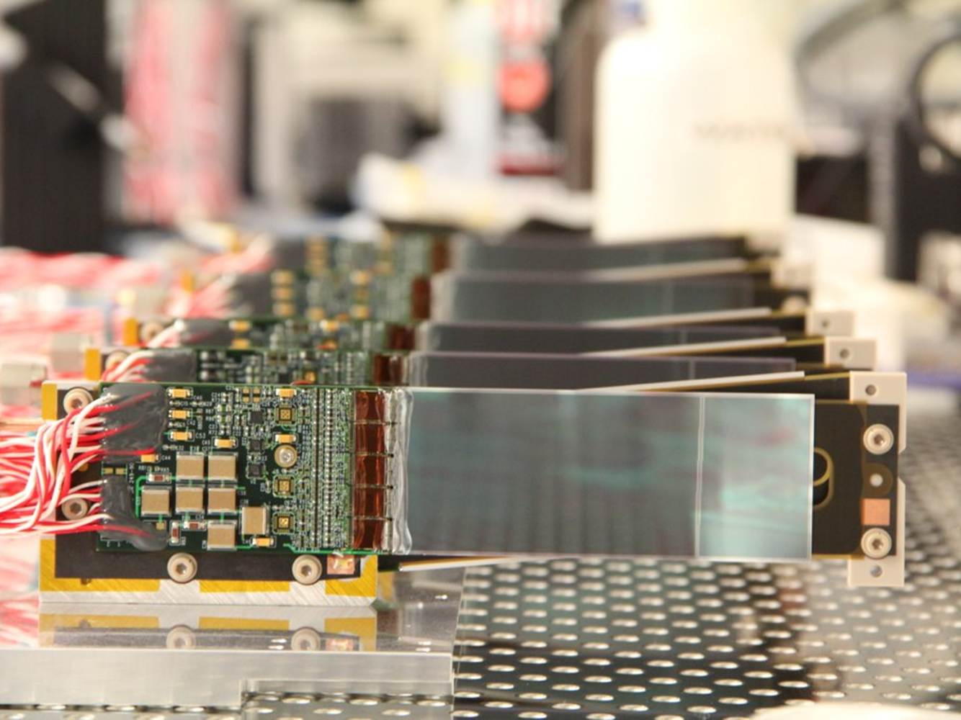
Back Up SLIDES

Slide 31
Beamline Costs: Upstream vs. Downstream
With the recent CEBAF Re-Baselining Review, JLAB management has led the development of a realistic schedule for HPS in Hall B.
HPS can be installed in September, 2014, commissioned in early FY2015, and take data later in FY2015 if it is installed in the Hall B Downstream Alcove instead of the upstream location described in the proposal.
Alcove running is fully compatible with CLAS 12 assembly schedule in Hall B and ideal for future running when CLAS 12 is operational.
Beamline Downstream - ALCOVE | Labor | M&S | Total
Refurbishing of the Alcove | $202 | $118 | $320
Platform in the Alcove | $57 | $53 | $110
Magnet Power | $9 | $26 | $35
Beamline controls | $136 | $39 | $175
Increase $320k -
Beamline Upstream (Proposal) | Labor | M&S | Total
Items not required in the Alcove | $8 | $65 | $74
Vacuum beam line downstream of chicane | $0 | $19 | $19
Frascati Vacuum Chamber | $0 | $19 | $19
Photon Dump & Shielding | $8 | $27 | $35
Saving $74k =
Net Incr. $246k
The additional costs to refurbish the Alcove are considered HPS Infrastructures

Slide 32
SVT Project Budget
SVT “upgrades” have been designed around scope we understand; scope of the Test SVT
Budget includes significant contingency beyond actual spending on similar items for Test SVT
 | Labor (w/ cont.) | Material (w/ cont.) | Total (w/ cont.) | Capital Eq.
Layers 1-3 | $66K | $37K | $103K | $103K
Layers 4-6 | $107K | $86K | $193K | $175K
Support, Cooling, Vacuum | $143K | $20K | $163K | $107K
Testing, Shipping, Integration | $136K | $61K | $197K | $154K
Total | $452K | $204K | $656K | $539K
Biggest items are completely new modules for Layers 4-6 and testing/integration at SLAC.

Slide 33
SVT DAQ - Budget
 | Labor w/ cont. | Material w/ cont. | Total | Capital Eq.
SVT DAQ | $431 | $352 | $782 | $540
FE Boards | $84 | $64 | $148 | $111
FE Interface Board | $10 | $0 | $10 | $0
Flange Board | $25 | $25 | $51 | $41
DAQ | $213 | $120 | $334 | $235
Hybrid | $48 | $26 | $74 | $65
Flex Cable | $41 | $13 | $54 | $54
PS & Cables | $0 | $70 | $70 | $0
HV/LV Cables | $9 | $33 | $42 | $34
Spending Profile in %
RCE platform components and power supplies

Slide 34
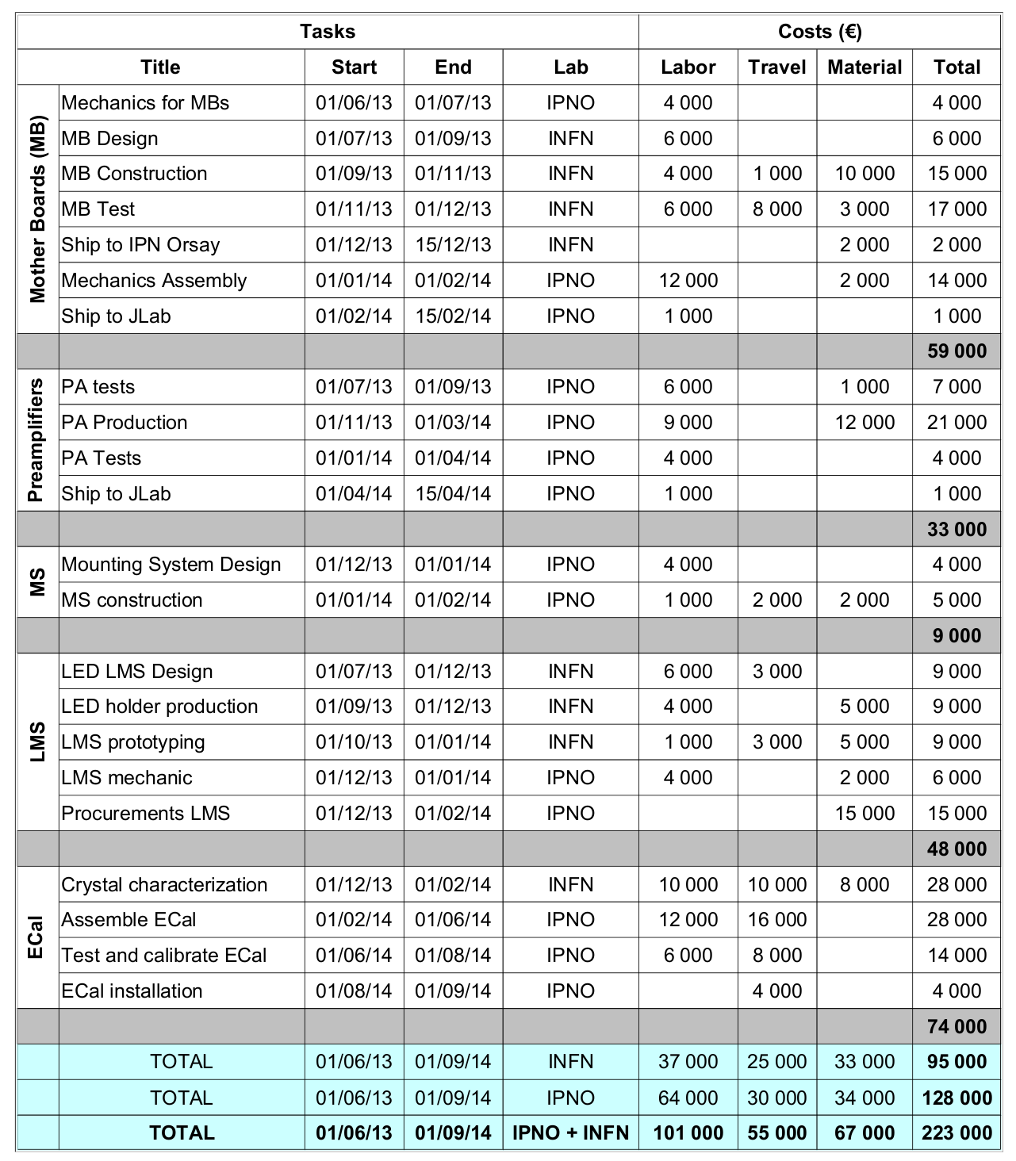
ECAL Budget
Emphasis here on European contribution
  INFN committed to
    MB Design and construction
    LMS Design
    Crystal characterization tooling & manpower
  IPNO committed to
    All mechanic design and most construction
    Preamplifier design and production
    LMS construction
    Manpower for ECal assembly
Total 223 k€ (290 k$)
+ contingency 65k€
Does not include physicist/postdoc salaries

Slide 35
Schedule and Budget –TDAQ
TDAQ ready Dec.6, 2013 (Integration in the existing TDAQ of the Hall-B)
TDAQ Budget
 | Labor | Material | Total | Capital Eq.
TDAQ | $151 | $10 | $161 | $151
Update firmware on FADC250 | $21 | $0 | $21 | $21
New firmware for cluster finding | $50 | $0 | $50 | $50
New firmware for SSP | $37 | $0 | $37 | $37
Trigger monitoring tools | $43 | $0 | $43 | $43
Data Storage | $0 | $10 | $10 | $0

Slide 36
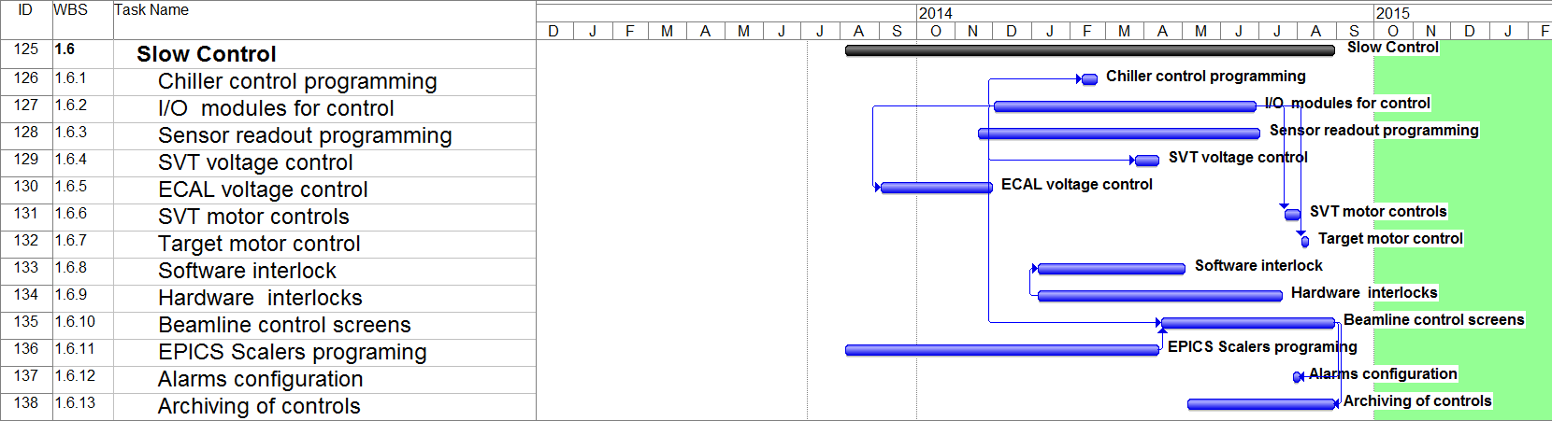
Schedule – Slow Control
Slow Control Starts July’13. Ready Aug.1, 2014
 | Labor w/ cont. | Material w/ cont. | Total | Capital Eq.
Slow Control | $94 | $39 | $134 | $106

Slide 37
HPS DOE Review 7/11/13 : Charges
The quality and the impact of the research by the HPS collaboration in the recent past
The scientific significance, merit and feasibility of the proposal research;
The competence and future premise of the HPS collaboration for carrying out the proposed research;
The adequacy of the resources for carrying out the proposed research and cost-effectiveness of the research investment;
The quality of the support and the infrastructure provided by the participating laboratories.
Did the HPS collaboration successfully demonstrates the technical feasibility of its detector design in its 2012 test run at JLAB ?
Has the HPS collaboration developed technical design and construction and commissioning plans for its components that are consistent with the readiness to begin taking data in FY15 in the low energy beam in Hall B at JLAB ?
Has the HPS collaboration identified and costed for the appropriate manpower and the other resources consistent with readiness to take data in FY15 ?
Has the HPS collaboration presented estimates of cost and schedule that are consistent with readiness to take data in FY15
Has the HPS collaboration developed a credible staging plan installation of detector components that will allow for data taking in FY15 ?

