Slide 1
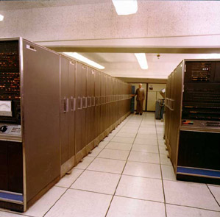
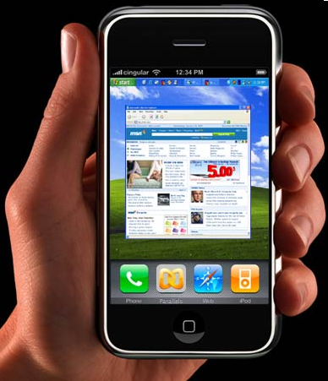
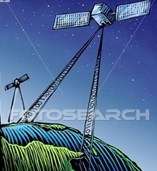
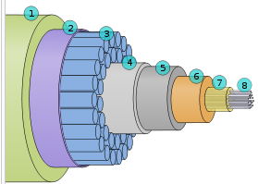

Networking Retrospective
R. Les Cottrell^{SLAC},
Presented at the 20 year HEPiX Anniversary Meeting,
Vancouver, Oct 24-28, 2011
Notes:
At the inauguration of HEPiX in 1991, mainframes (and HEPVM) were on their way out with their bus & tag cables, channels with 3270 emulators and channel attached Ethernets. DEC/VMS and DECnet were still a major player in the scientific world. Mainframes and to a lesser extent VMS hosts were being replaced by Unix hosts with native TCP stacks running on thin and thicknet shared media, the phone system was still a separate entity, wireless networking was very much a niche. The wide area network consisted of a multitude of networks and protocols such as DECnet, SNA, XNS, Color books, Bitnet/EARN and the emerging (soon to die off) OSI. All these were soon to "pass like tears in rain"* and be displaced by TCP/IP and what we know as the Internet today. We will look back at the evolution of the local area network, home networking and the wide area network over the last 30-40 years in particular noting the state and changes since HEPiX was formed 20 years ago.
* Blade Runner

Slide 2
Outline
Where were we in 1991 at the birth of HEPiX
  WAN, LAN, Home
What has happened since
  Brief history of Internet
  Convergence, bandwidth explosion
  Where its it going (mobile/wireless/smartphones, video, social networking …
Demo visualizing Internet performance growth

Slide 3

1991 birth of HEPiX

Slide 4
LAN 1991
Mainframes on way out,(so HEPVM => HEPiX)
  with their bus & tag cables, 3270 emulators, channel attached Ethernet, HiPPI, ESCON
  VAX/VMS still very big, Unix workstations taking hold (<=15MIPS)
  PCs, Macs, Amigas … desktops replace dumb terms
Network Data PBX (Micom, Gandalf, ...) & RS232, on way out
Multiple network protocols: Appletalk, XNS, SNA, DECnet, Color Books, MFEnet, TCP/IP (OSI) …
Token ring (going 4Mbps=>16Mbps), ATM -- RIP
FDDI 100Mbps big for core
Ethernet: yellow/fat cable & vampire taps, thinnet
  Shared media

Slide 5
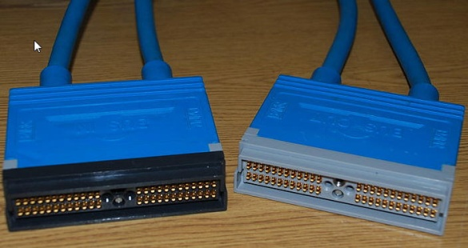
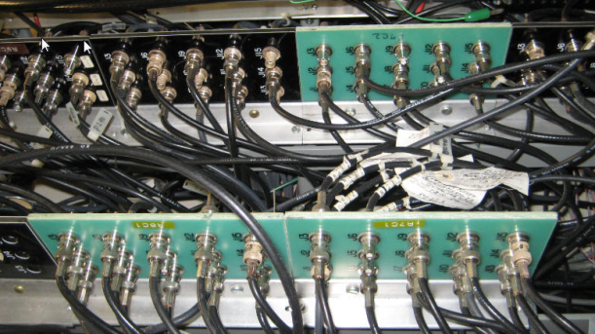
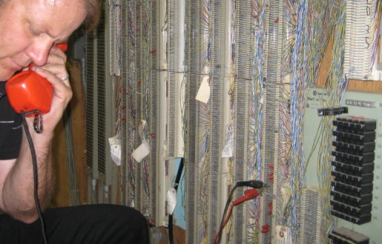
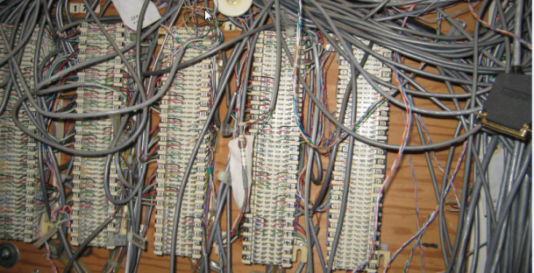
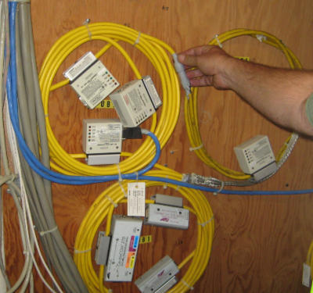
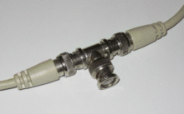
Cable history
(What you find in closets)
Mainframes
  bus & tag for channel connection of
  peripherals
  Coax for 3270 terminals
Phones twisted pair, 1 pair/phone
Data PBX followed suit
Ethernet:
  Thicknet + vampire taps
  Thinnet with coax

Slide 6
WAN: 1991
Point to point stat muxes/ 19.2kbps sync modems for terminal access still in use
BITnet/EARN (RSCS) 2600 nodes
Tymnet/Telenet via dialup
ESnet T1 backbone, supporting DECnet and TCP/IP with MFEnet phasing out
DECnet IV run out of address space, Digital developing DECnet phase V based on OSI
US mandated to move to GOSIP, dead by 1994
Packet switching vs ATM (cell/TDM) and X.25

Slide 7
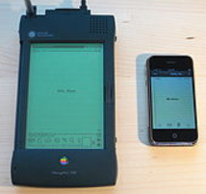
Mobile Computing: 1991
<= 14.4kbps analog modems, still some headroom
ISDN (128kbps) from the phone company been standardized but not deployed
Laptops such as Apple Powerbook introduced as well as color screens.
  Still to come as standard: touchpads, power management, less bulky, bigger memory and disks etc.
PDAs with mobile Internet access (e.g.
smartphone) did not exist yet.
Notes:
For analog modems see http://en.wikipedia.org/wiki/Modem
ISDN has long been known by several derogatory acronyms highlighting these issues, such as It Still Does Nothing, Innovations Subscribers Don't Need, and I Still Don't kNow.

Slide 8
Internet: 1991
1991: Internet about to go from NSF to public
  1M users, 1TByte/month (=10B packets), 600K hosts, nearly 5,000 separate nets
  NSFnet backbone upgraded to 43Mbps (T3)
Start of JANET IP service in UK
Gopher and Wide Area Information Service (WAIS)
  Later replaced by WWW
First WWW servers go online in Europe and US
    Mosaic & Netscape browsers still to come (& go)
      (see http://evolutionofweb.appspot.com/)

Slide 9
How have things changed (not your fathers Internet anymore):
Youth of today have very different expectations:
  what’s a wired phone, a payphone, a modem, typewriter, encyclopedia …
  => messaging, Google searches, Multimedia Internet, video communication (YouTube), Internet access everywhere, mobility, virtual worlds, social networking (Facebook, Twitter), video games, shared information (anyone can publish)
In 1998 75% of all Internet users were Americans, now < 15%.
2014 global IP traffic will exceed 767 Exabytes (10^18, ¾ zettabyte) was 1TByte in 1991, factor 10^5 growth
  CAGR 34% 2009-2014
  2014 avg monthly traffic = 32M people streaming Avatar movie in 3D continuously for whole month
Web pages quintupled in size since 2003, objects/page increase by 14%/year, response time bad for low bw users, for others bw kept pace

Slide 10
Internet: Design goals
Built as an experimental collaboration of global proportions, independent stand on own, self managed autonomous systems, decentralized (chaotic, no central control/mgmt cf. phone system),
best effort, no guarantees, recovery from losses, pipelining (TCP), host flow control, checksums
non-proprietary (c.f. SNA, DECnet, XNS …),
little focus on security (if had focused on this it might never have happened, no practical public key crypto at time),
simple black boxes (routers connect nets) that do not retain information about the individual flows,
packets inside envelopes, layering (independent of each other, i.e. middle layers don’t know if lower layers are wireless, satellite, copper, fibre, upper layer independent of applications cf. purpose designed TV broadcast networks, cable networks, telephone network, only end device knows what the contents mean).

Slide 11

Challenges

Slide 12
Challenges: Address space
IPv4 address space 32 bits ~ 4 billion addresses fine for initial usage but IANA ran out Feb 2011, APNIC Apr 2011
  Recognized in 1991: By-passes evolved: private addresses and NATs, CIDR blocks etc.
  Even with that its running out of addresses
Initially mainly a problem for later Internet deployment regions (China, India, Africa …)
IPv6 (production vsn –VC) not backward compatible,
  not as mature as IPv4 (target for crackers),
  will run both for many years so added complexity
  business case hard to make, however an example
    DR Congo Univ Kinshasa 24K students has 8 public IP addrs

Slide 13
Challenges: Mobility
Computers used to be big and did not move
As move need to change IP addresses
  This can look like a hi-jack so need trust mechanism
  Topology can change
Need persistence across links going up & down
  Delay & disruption tolerance (e.g. for space flights)
  No session layer in TCP/IP so left to application or just disconnect and start again
Mesh, sensor nets, self-organizing networks
  Bad guy may join, e.g. military position overrun, enemy gets device, pretends to be friend
Notes:
For OSI layers see: http://en.wikipedia.org/wiki/OSI_protocols

Slide 14
Challenges: Trust
Initial trust relationship badly broken
  Not everyone has everyone else’s best interest in mind
  Organized crime, state sponsored intelligence gathering, cyber-warfare
Naïve OS’, unpatched systems, browsers, users
Routing mistakes (e.g. black holes), DNS needs to have trust of others (DNSSEC)
Freedom of information vs privacy (e.g. wikileaks)
  Google (gmail has all your emails), Facebook have a good idea of who your friends are where you live, work, spend your free time, your health, love life, political leaning
  Branching out into your realtime GPS location
Lack of tools for strong authentication needed for Grids & cloud computing
Prevalence of spam, viruses, worms, malware, Trojan horses, DOS, DDOS
  Attack traffic ranking 1: Russia, 2: US, 3: China, 4 Brazil …
Notes:
Computer viruses are self-executing, replicating programs written specifically to change the way a machine works, without the knowledge (or permission) of the operator/owner. Viruses are so called because they behave in a similar way to biological viruses. Just as biological viruses pass from person to person, replicating themselves as they go, computer viruses pass from computer to computer. Unlike most biological viruses, however - computer viruses are entirely man made.
The first worm released November 2, 1988 disabled most of the Internet then existing. Robert Morris, a Computer Science graduate student at Cornell University and (embarrassingly) son of the Chief Scientist at the National Computer Security Center, wrote a 99 line program in the C language designed to self-replicate and propagate itself from machine to machine across the Internet. The worm performed the trick by combining a bug in the debugging mode of the sendmail program used to control email on almost all Internet computers, a bug in the finger program, and the Unix rexec and rsh commands.
The difference between a Computer Virus, Worm and Trojan Hose, see http://www.webopedia.com/DidYouKnow/Internet/2004/virus.asp

Slide 15
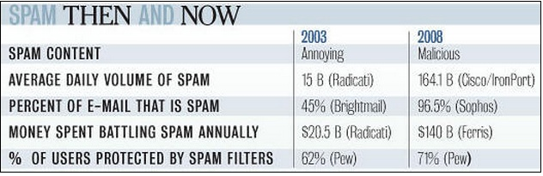
Challenges SPAM
2003: an estimated 15 B spam messages were sent over the Internet daily.
  45% of all e-mail messages = unsolicited pitches for things such as drugs and penny stocks.
2008: 164 B spam messages daily, =97% of email.

Slide 16
Challenges: others
Lack of effective broadcast and multicast, still mainly use unicast
How to redo a functioning production network critical to the global economy while it continues to run
  Happened once before when the Internet took over from phone network, so how does it happen next time?

Slide 17
What happened after

Slide 18
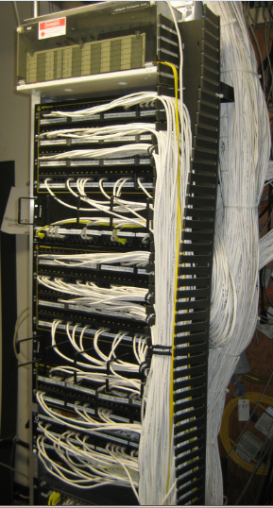
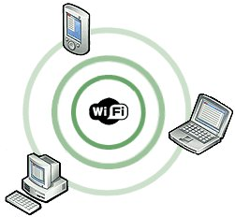
What happened: LAN
Structured wiring:
  CAT5 (100Mbps) twisted copper pairs for < 100m runs
    Continuous improve Cat5E (1Gbps)=>Cat6A(10Gbps)
  Fibre for longer runs (MM and SM) between buildings
Switched Ethernet replaced shared media
  10Mbps=>100Mbps(FE) killed token ring =>1Gbps(GE, 1999) killed FDDI=>10Gbps(10GE, 2007 2M ports shipped) killed ATM =>100Gbps(ratified 2010)
WiFi still shared medium
Notes:
As of November 2010, all manufacturers of active equipment have chosen to support the 8P8C for their 10 Gigabit Ethernet products on copper, and not the GG45 or TERA in order to function on Cat 6a. Due to lack of support for the 8P8C connector, Category 7 is not recognized in TIA/EIA-568

Slide 19
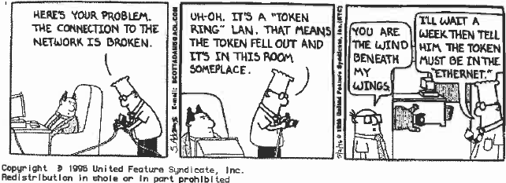
End of Tokens

Slide 20
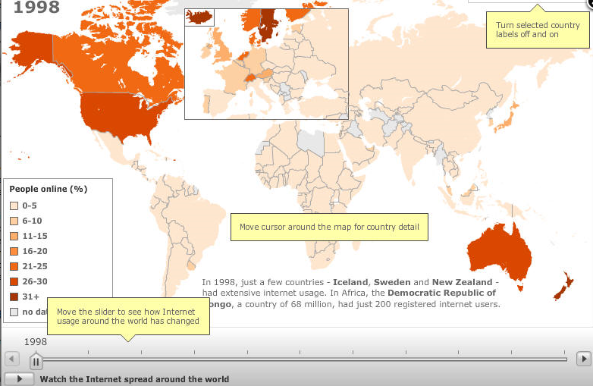
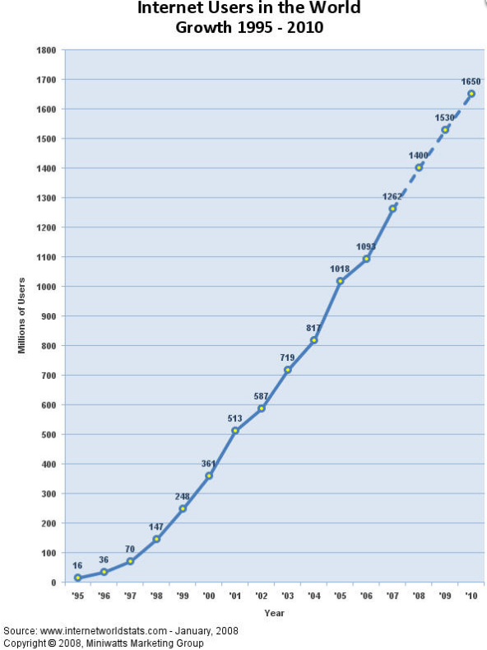
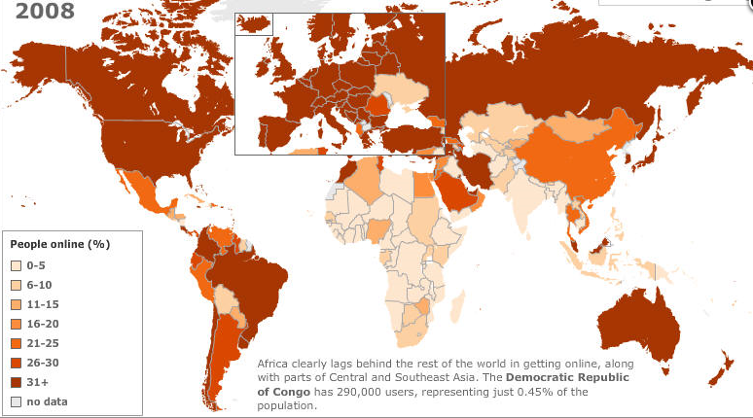
Internet Growth: users
2.09B Mar 2011
Most future growth from developing nations
  Maps from http://news.bbc.co.uk/2/hi/technology/8552410.stm

Slide 21
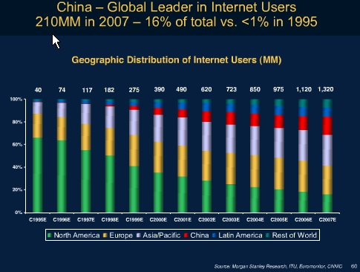
Example: China
China not connected to the Internet until May 1994
1st permanent IHEP/Beijing used satellite via SLAC
www.computerworld.com.au/article/128099/china_celebrates_10_years_being_connected_internet
Note relative decline
of US green
Jun 2011 China: 0.5B,
37% population red
  66% through mobile
  phones
  Avg ~ 18hr/wk/user
21
Notes:
See http://www.chinainternetwatch.com/whitepaper/china-internet-statistics/

Slide 22
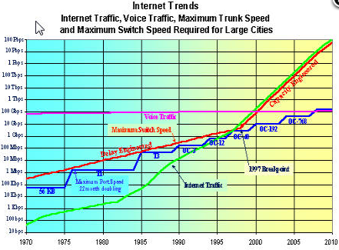
Growth: bandwidth
voice long ago overtaken by data,
trunk speeds roughly double every 22months (driven by Moore's law)
moved from 75bps in 1960 to 50kbps in 1970 to 10-100Gbps single stream today (1 billion times increase)
Dense Wave Division Multiplexing (DWDM) caused breaking point in 1998 then double every 6 months
  wavelength-division multiplexing (WDM) is a technology which multiplexes multiple (up to 160) optical carrier signals on a single optical fiber by using different wavelengths (colours) of laser light to carry different signals. This allows for a multiplication in capacity, e.g 1.6Tbps each channel 10Gbps

Slide 23
Satellite to terrestrial link
Geostationary satellite 24Kmiles above equator
  Round trip time 450ms minimum
  Bandwidth limited by power of satellite
  Great coverage, need earth station to xmt/rcv
  Expensive in $/Mbps
Being replaced by terrestrial links (fibre)
  Few countries remain without fibre international links
    Cuba, Afghanistan, a few African countries and several Island nations

Slide 24
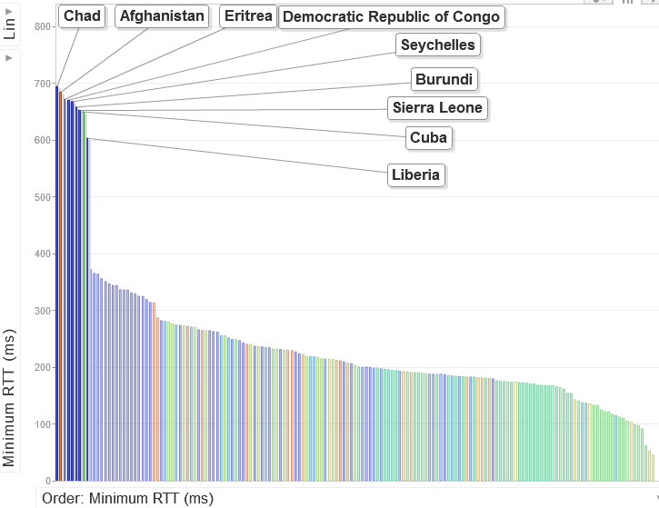

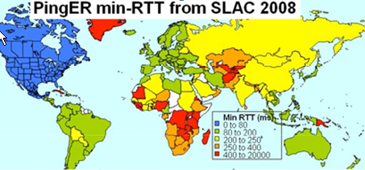
Who is still on Satellite 2008
GEOS
600
GEOS (Geostationary Earth Orbit Satellite)
  good coverage, but expensive in $/Mbps
    broadband costs 50 times that in US, >800% of monthly salary c.f. 20% in US
  AND long delays min RTT > 450ms, usually much larger due to congestion
400
Min RTT (ms)
Terrestrial
200
0
24
Easy to spot
Clear signature

Slide 25
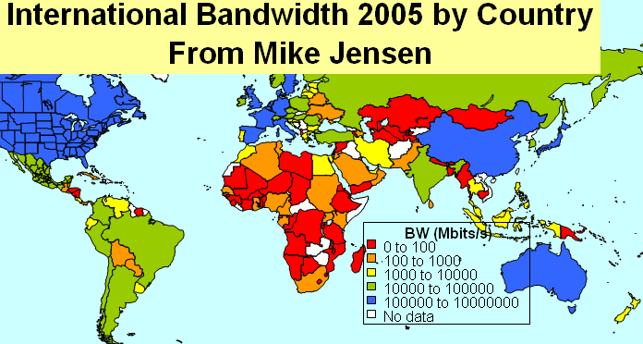
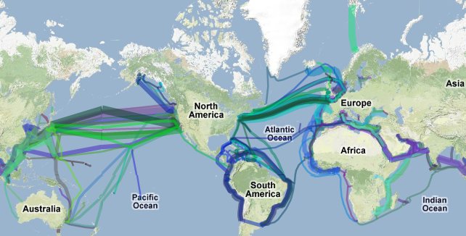
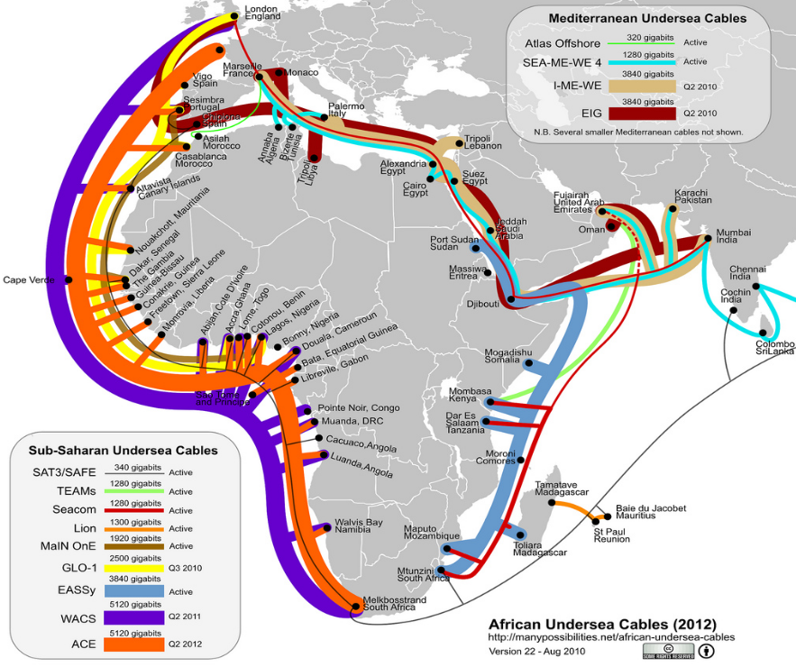
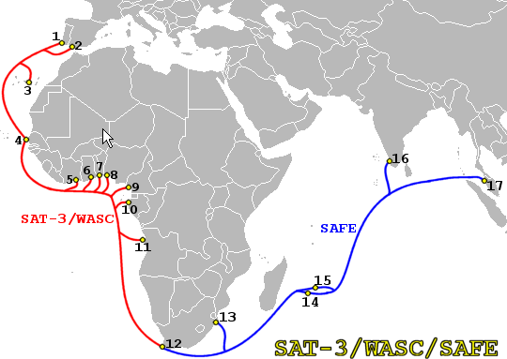
Capacity
Submarine Cables 2011
Capacity
2011
2008
http://manypossibilities.net/african-undersea-cables/

Slide 26
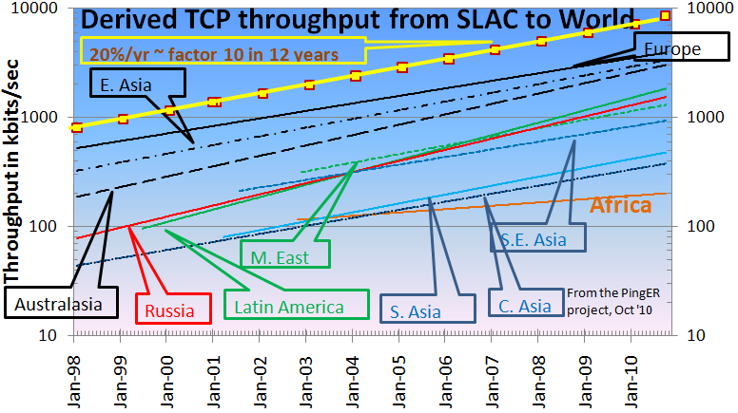
Growth Throughput Trends
Europe, E. Asia & Australasia merging
Behind Europe:
5-6 yrs: Russia, L America, M East
9 yrs: SE Asia
12-14 yrs: India, C. Asia
18 yrs: Africa
Derived throughput ~ 8 * 1460 /(RTT * sqrt(loss))
Mathis et. al
Feb 1992
Africa in danger of falling even further behind.
In 10 years at current rate Africa will be 70 times worse than Europe
Notes:
Using the Mathis formula for TCP/Reno throughput we can derive an estimate of the TCP throughput from our loss and RTT measurements. These estimates are only rough since the losses experienced by TCP[1] are different from those measured by ping, also PingER only sends about 14,400 pings a month between a monitoring host / remote host pair so one cannot see monthly losses of < 0.1% such as are often experienced on today’s high quality paths. In addition the RTTs on high quality paths are approaching the limits of the speed of light in a fiber, so further improvement is difficult. Finally the TCP/Reno congestion control is slowly being supplanted by more aggressive mechanisms. None-the-less, especially for poorer quality paths, combining loss and RTT into a single metric is very useful. Fig. 8 shows the derived TCP throughputs measured from SLAC to the world’s major regions, in some cases going back for the last 11 years. Similar plots (not shown here) are seen for the data measured from CERN in Geneva, Switzerland thus indicating that the effect is not just an anomaly associated with the measurements being from the U.S. The data for several of the developing countries only extends back for about five years and can vary greatly from month to month, so some care must be taken in interpreting the long term trends. With this caveat, it can be seen that links between the more developed regions including the U.S. and Canada, E. Asia and Europe are much better than elsewhere (3 - 10 times more throughput achievable). Regions such as Russia, S.E. Asia, S.E. Europe and Latin America appear to be 3-6 years behind. Russia and S.E. Asia are catching up slowly. However, Africa, S. Asia and C. Asia are 8-10 years behind and even worse appear to be falling further behind due to slow growth. Sites in many countries have less bandwidth than a residence in developed countries (typical residential DSL or cable bandwidths are of the order of a few hundred megabits/sec). Looking forward ten years to 2015, if the current rates of progress continue, then performance from N. America to Africa will be 1000 time worse than to Europe, to S. Asia and C. Asia will be 100 times worse than to Europe.
[1] TCP deliberately provokes loss as part of its congestion detection algorithm.
[2] The derivation is based on the TCP/Reno implementation of congestion control. These days more aggressive algorithms are often used. Still the formula is a useful way to combine metrics into a quality measure which is roughly based on throughput.

Slide 27
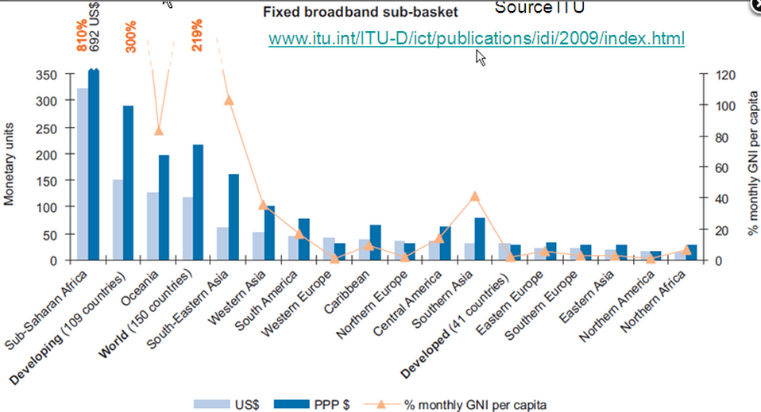
Cost of bandwidth
Then there is the cost

Slide 28
Demo: Explore Internet growth
Explain metrics, population, throughput, RTT
Growth in coverage and performance with time
Log scales
Population vs Internet users
Min RTT, linear scale, histogram
  Satellite signature, function of time
Map of min-RTT for Africa domain colored by Min RTT and bubble size by min-RTT, function of time
www-iepm.slac.stanford.edu/pinger/explorer.html

Slide 29
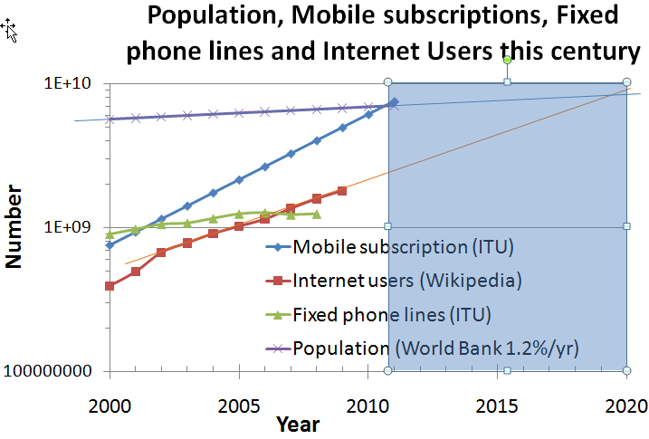
Phone/Internet convergence
Mobiles passed fixed in 2001, fixed stopped growing
Mobiles = population in 2011
Internet users = population in 2020 (slower growth)
Smartphones need Internet and at same time enable its spread

Slide 30
What’s next
Mobile computing and devices, clouds, virtuality …
40G (transAtlantic, US) & 100Gb backbones
On demand dynamic dedicated services (layers 1 & 2)
  Reserve a path at some bandwidth for some time
  Use QoS to deliver
  HEP, Radio Astronomy, climate research
IPv6
  See the other talks
Video, social networking …
30

Slide 31
Questions & more info
Internet history
  http://www.netvalley.com/archives/mirrors/davemarsh-timeline-1.htm
African undfersea cable

