Slide 1
Perspectives on Scientific Computing for PPA
D. MacFarlane
March 18, 2013

Slide 2
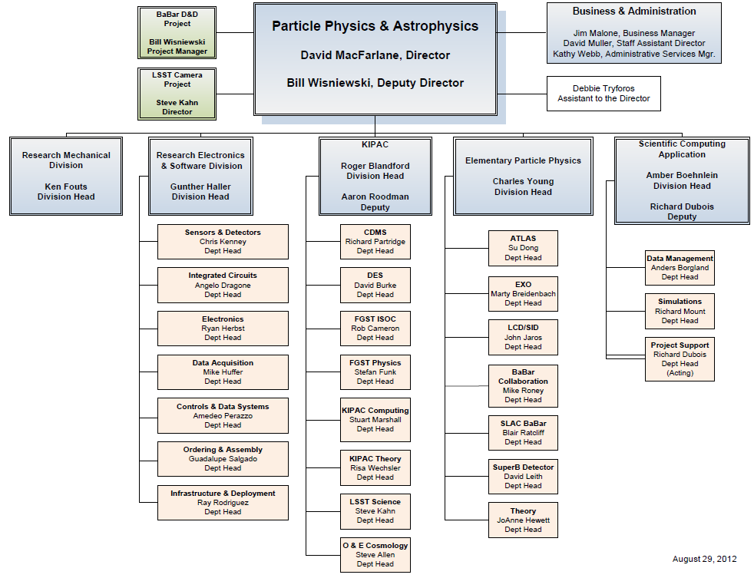

Slide 3
Scientific Computing Applications (SCA)
Supports common scientific computing efforts:
  Efficient solutions to data management for small experiments
  Specific community tools & their development
  Integrated planning for computing hardware & software needs of existing & future programs
SLAC leadership areas:
  Pipeline processing, data monitoring, visualization, collaborative tools applied to LSST, SCDMS, EXO, Fermi, LSST DESC
  xrootd: key element of cluster file access in LHC and many other experiments
  GEANT4: core development & programmatic deployment
  INSPIRES as a successor to SPIRES
  Pioneering Long-Term Data Access system for BABAR

Slide 4
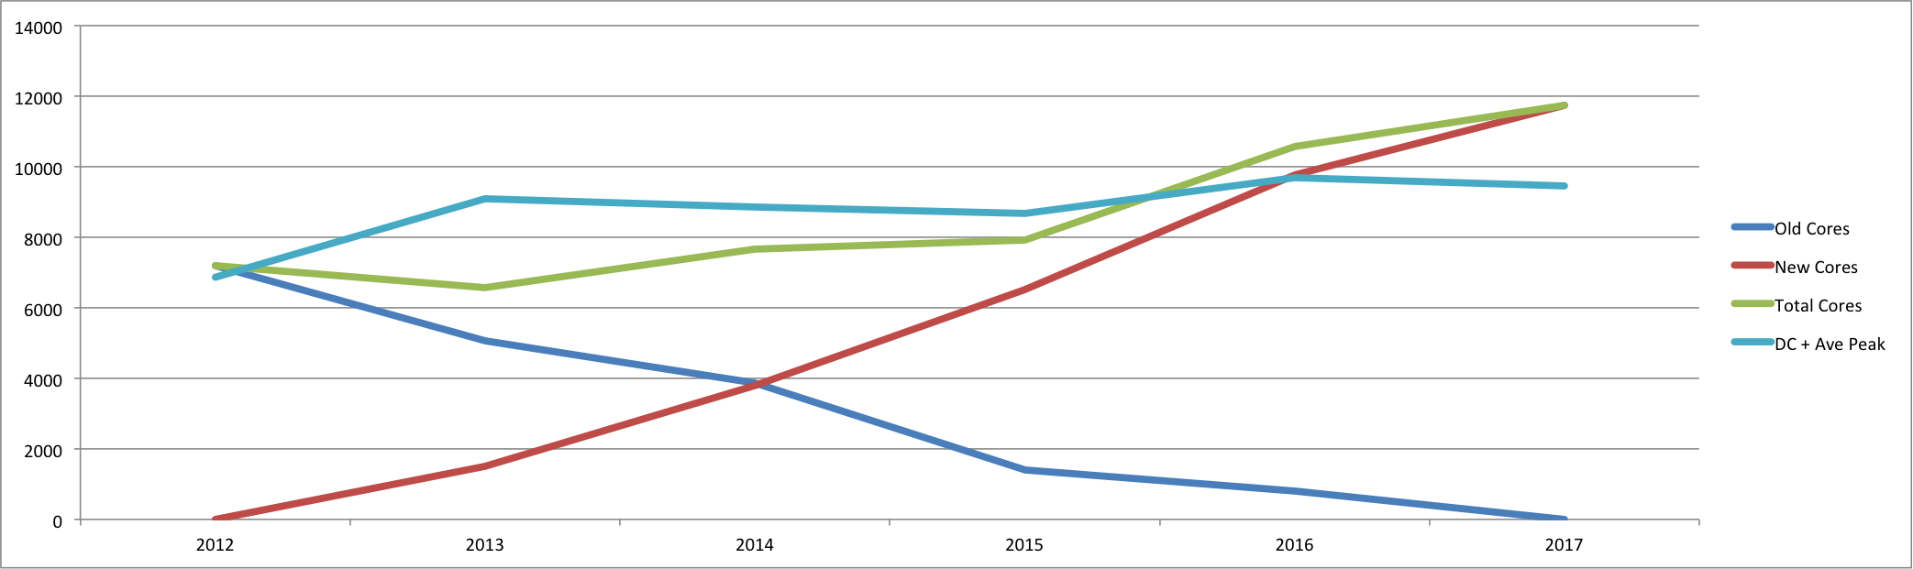
Computing Hardware Support
Submitted plan last summer to address future evolution of SLAC scientific computing hardware
  Hardware needs for large scientific programs continue to be program driven and funded (ATLAS, Fermi GST)
  Aggregated needs across remaining smaller programs and proposed an implementation plan
  Established a common set of hardware requirements and first procurement of 1500 cores now being commissioned
$300K/year investment
Year | Compute Nodes | Nodes Cost (k$) | Storage (TB) | Storage Cost (k$) | Recharge Cost (k$) | Total Cost (k$)
2012 | 75 | 525 | 160 | 100 | 200 | 825
2013 | 75 | 512 | 160 | 23 | 200 | 735
2014 | 75 | 503 | 160 | 42 | 200 | 745
2015 | 75 | 496 | 160 | 39 | 200 | 735
2016 | 70 | 459 | 160 | 39 | 200 | 698

Slide 5
Core funding for SCA
Established the principle of Core funding at OHEP COMP review, Feb 2011
Core funding is intended to facilitate
  Create incentives for product reuse by multiple projects
  Expertise to package the products for external use
  Expertise to use products created by others
  Enable innovation that is essential to adapt to modern times
Investigating a model with other labs to support ‘best in class’ tools
Mix of core funding and program (or project funds) ideal
Currently used as an internal concept to balance priorities and projects within the Cosmic Frontier
  Possible within Professional Center financial framework

Slide 6
Planning for Scientific Computing at SLAC
Assembling a multi-year plan that captures PPA needs for support for SCA
  Focus on needs rather than funding, but recognize that we are and will be under resourced
  Results in several scenarios currently under consideration
Work towards a well-rounded portfolio that supports the full PPA program
  Identify risks and areas of opportunities
SCA is small—weight priorities by scientific & intellectual impact
  Partner with others when possible to establish our niche
Ramp up & down according to need; reduce long-term assignment of people, but balanced by stability & commitment

Slide 7
Opportunities
Energy Frontier
  Future of LCSim as a community tool
Cosmic Frontier
  LSST: Data analysis model & resource planning, simulations, test data curation and analysis
  DM experiments: Together with Fermilab and DM collaborations work towards a common light framework for data management, frameworks, & collaboration tools
Intensity Frontier
  LBNE: Engage in development of LAr pattern recognition and reconstruction; evaluate simulation tools & possible G4 implementation
  LBNE: Work with Fermilab and LBNE collaboration towards a coordinated computing model

