Slide 1




Worldwide Internet performance measurements using a Raspberry Pi
Presented by Anjum Naveed^{UM}, on behalf of:
Les Cottrell^{SLAC,} Thiago Barbosa^{SLAC} , Bebo White^{SLAC}, Johari Abdullah^{UNIMAS}, Topher White ^{RainForest Connection}
NetApps Conference, Putrajaya, Malaysia
December 1-3, 2013
Notes:
Using PingER measurements going back to 1998 and covering 168 countries, this talk will illustrate Internet performance worldwide, with a particular focus on Africa, Pakistan and S. E Asia. After briefly introducing PingER, illustrating how the measurements are made and how widely PingER is deployed we will review the veritable wealth of information that is available from the simple ubiquitous Internet ping facility used by PingER. These include:
• Looking at identifying the general quality of links with metrics such as Round Trip Times (RTT), jitter, duplicate packets, out of order packets, losses and their patterns, and the unreachability.
• Deriving information on the expected throughput, quality of VoIP calls worldwide;
• Illustrating the evolution of the Internet worldwide;
• Identifying which countries are still using geostationary satellite links(as opposed to terrestrial links;
• Observing how directly hosts are connected;
We will then look in more detail at some case studies
For Africa we will illustrate the impact of the recently installed submarine fibre optic cables around the West and East Coasts of Africa, as they replace geostationary satellites. It will then look at what the near future may bring to Internet performance including the impact of: new submarine cables; intra Africa fibre optic cables; low earth orbiting satellites; the emergence of NRENs and connections to the rest of the world; and the demands of science.
For Pakistan we will show how PingER’s end-to-end measurements have helped uncover last mile problems, misrouting, the need for Internet International eXchange Points (IXPs), the feasability of international VoIP calls, and the need for reliable power sources. This in-turn has led to dramatic redesign and re-emphasis for next generation designs.
The coverage for Malaysia is in its nacsent stage starting in the last couple of months as UNIMAS and SLAC initiated monitoring of about 50 sites in S. E Asia (19 in Malaysia). Preliminary results of the analysis of these measurements will be presented
We will then look at case studies to see the impact on the Internet of some major events such as uprisings, cable cuts, and the Japanese earthquake/Tsumani on Internet performance as seen by PingER.
Finally we will discuss how the Internet helps development and how PingER results correlate with United Nations (UN) and International Telecommunication Union (ITU) development indices.

Slide 2
Agenda
Brief introduction to PingER
How does it make measurements
How is it useful
This study
Why do we want to use a Raspberry Pi?
Is it suitable for the role?

Slide 3
PingER Methodology
>ping remhost
Uses ubiquitous ping
Measurement
Agent (MA)
Internet
Remote
Host
(typically
a server)
10 ping request packets each 30 mins
Once a Day
Via web
Ping response packets
Data Repositories
@ SLAC/NUST
No software to install
Measure Round Trip Time & Loss
Notes:
Ping’s ubiquity and ease of use make it well suited to widespread Internet monitoring, particularly in underdeveloped regions such as Africa where more advanced applications may be impractical.

Slide 4






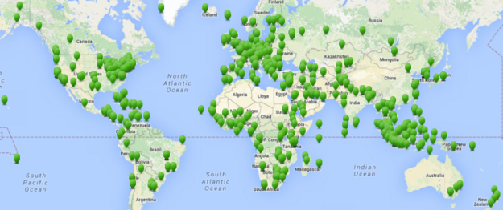
Topology
Users with web access
Ping’s ubiquity and ease of use make it well suited to widespread Internet monitoring, particularly in underdeveloped regions such as Africa where more advanced applications may be impractical.
http
http
Archive
Archive
2
Archiver
Analyzer
Presenters
SLAC
NUST
http
http
MA
MA
ping
~ 60 Measurement Agents/Monitors
ping
~ 700 Remote monitored hosts 165 nations containing > 99% of worlds populatrion
Notes:
Archive ~ 750GBytes

Slide 5

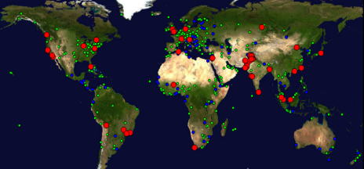





PingER Monitoring
Monitoring & Remote Nodes Jan 2015)
Measurements from 1995 on
  Reports link reliability & quality
700 remote sites monitored in
>165 nations; 60 active MAs;
  Strong Collaboration with NUST/SEECS (Pakistan) and 4 Malaysian universities
Countries: N. America (3), Latin America (19), Europe (31),
Balkans (10), Africa (49), Middle East (16), Central Asia (9),
South Asia (8), East Asia (4),SE Asia (10), Russia (1), Oceania (5)
Notes:
Uses:
Identifying sites that need upgrading (early Esnet)
Identifying last mile problems(Pakistan, Malaysia)
Choosing an ISP (for home connectivity)
Setting a collaborations expectations
Deciding where to site a software library effort
Choosing routes
Setting expectations for VoIP
Evaluating the impact of upgrades
Quantifying the Digital Divide
Comprehensive Nuclear-Test-Ban Treaty Organization
Hotmail
Internet History
Used in multiple reports and books

Slide 6
Uses
Internet performance history 1998…
Identifying problems
  Last mile problems
  Sites to upgrade
  Performance changes
Setting expectations
  Collaborations
  Email, VoIP, web …
  Data rates, reliability
Study Digital Divide
  Comparing countries, regions
Choosing between sites
Evaluate event impact
  Earthquake, tsunami
  Cable cuts
  Upgrades
  Social uphevals

Slide 7
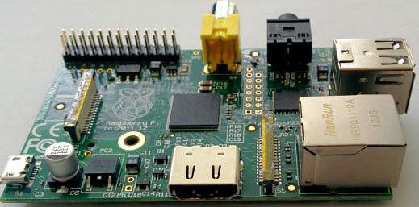
Goal of Study
Reduce PingER MA requirements
Enabling PingER in more remote regions
  E.g. Kelabit highlands, National Parks
Needs:
  Low cost
  Low power
Potential solution
  Raspberry Pi
    << $100
    Power 2.7W at 5V (1/7 of laptop, 1/30 desktop)
    Enables solar power with battery

Slide 8
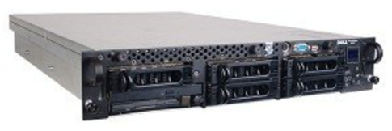

Requirement: Compare
3GHz Dell PowerEdge with 1000 Mbps Ethernet
0.7GHz Raspberry Pi with 100 Mbps Ethernet
Vs.
In terms of:
Reliability
  Run for months without interruption
  Auto recover after power outages
Important metrics should not be significantly different
Or difference needs to be understood &:
  Correctable or
  Irrelevant

Slide 9
Metrics
PingER measures or derives 16 metrics
The important ones for this study are:
  Minimum and Median RTT
  Jitter
  Loss
Can derive others
  TCP throughput,
  VoIP quality

Slide 10
Methodology
Four MAs selected in various locations
Made continuous measurements between them
Analysis based on first 2 months’ data
Abbrev-iation | Location | Great circle distance to SLAC | Min RTT
Raspberry | SLAC, Menlo Park, California, USA | 0 km | 0.0003 ms
Dell | SLAC, Menlo Park, California, USA | 0 km | 0.0003 ms
TRIUMF | TRIUMF, Vancouver, Canada | 1320 km | 22 ms
CERN | CERN, Geneva, Switzerland | 9391 km | 150 ms

Slide 11
Caveat
Measurements not synchronized in time
  E.g. Timestamps for Raspberry to TRIUMF are 8 mins different from Dell to TRIUMF
  So direct comparison not possible
  Have to check statistical differences
Calculated the statistical errors in the measurements
  So can use statistical tests for probability of differences when comparing results
  Used Inter Quartile Range (IQR) to derive errors
Notes:
Errors calculated using Inter Quartile Ranges

Slide 12
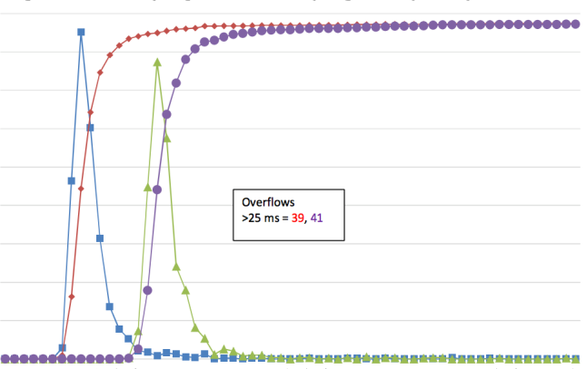


Average Round Trip Times (RTT)
Average RTT from Dell and Raspberry to TRIUMF
100%
400
Frequency Dell to TRIUMF
300
Cumulative % Dell to TRIUMF
Frequency
Cumulative Frequency
Frequency Raspberry to TRIUMF
50%
200
Cumulative % Raspberry to TRIUMF
100
0%
22
23
24
25
RTT ms.
Raspberry RTTs to TRIUMF (& CERN) 0.35ms > Dell to TRIUMF
The peak widths are similar

Slide 13
Localhost measurements
Measure from host to itself (eliminate network)
Raspberry median RTT 7 times > Dell
  0.2ms vs 0.03ms (or 0.17ms difference)
  Probably related to:
    Factor of 4 difference in cpu speeds
  Accounts for ~50% of difference in long distance RTTs noted above
The peak widths are similar
  0.25ms (Dell) vs 0.20ms (Raspberry)
  Dell runs lots of analysis cron jobs etc.= more interruptions

Slide 14
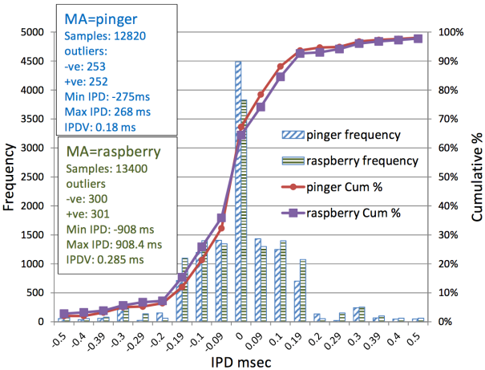
“Jitter”
We base this on RFC 3393 on one way IP Packet Delay (IPD) Variation (IPDV)
  modifying it for RTT
IPD from SLAC MAs to TRIUMF
dell
The distributions are similar.
They are not normal
Sharper and longer tails
TRIUMF:
Raspberry IPDV 50% > Dell (0.18 vs 0.28 ms)
CERN:
IPDV’s equal 0.01ms
dell
dell

Slide 15

Summary
RTT distributions differ markedly
  The main difference is the peak position (0.35ms)
  We could correct for ~50% of the difference by using localhost measurements
  The difference has a negligible effect since most MA to remote hosts are tens to hundreds of ms part
The jitter is similar
There is no noticeable difference in the losses
Reliability is promising,
  Raspberry Pi has run unattended for 5 months so far
The power draw is suitable for use with solar power
Looks very promising.
Next: package and simplify installation

Slide 16

Questions
More Information
PingER web home page
  http://www-iepm.slac.stanford.edu/pinger/
Tutorial on network monitoring & PingER
  http://www.slac.stanford.edu/comp/net/wan-mon/tutorial.html
PingER Annual Report Jan 2015
  http://www.slac.stanford.edu/xorg/icfa/icfa-net-paper-jan15/report-jan15.docx
Invitation to join
  www-iepm.slac.stanford.edu/pinger/letters/invite-monitor.doc

