Slide 1
Mobility:
Dr. Les Cottrell SLAC, Stanford University
School on Space Weather/GNSS-GIS-Intensive computing Basic theory and hands on experience
10-21 November 2014, Koudougou, Burkina Faso

Slide 2
Overview
Cell phones:
How they work
Cell phones components
Power
Coverage
Growth
Concerns
Benefits

Slide 3
Excludes
Cordless phones, CB radios, pagers, car phones, Bluetooth etc.
Iridium: catastrophes (Haiti), hard to reach places: expeditions, Arctic …
ATT Terrestar hybrid cell & satellite switches to satellite when out of range, covers US, looks like Blackberry, not cheap $799 + $25/month on top of regular voice & data. Calls are cell phone rates or $4.75/min using satellite. See http://www.pcworld.com/article/172944/terrestar_satellite_phone_coming_to_atandt.html

Slide 4
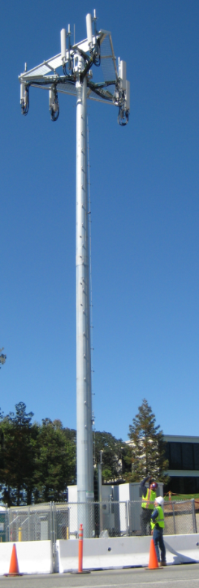
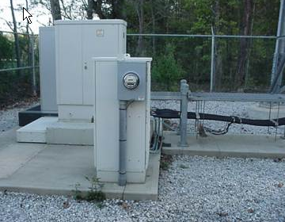
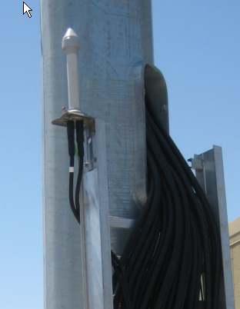

Base Stations
City divided up into cells size ~10 sq miles.
Each cell has a base station consisting of:
  a tower (sometimes disguised), with ladder, lightening arrester
  antennas, facing 3 sectors,
  a small building or pad (base station) containing radio equipment, UPS, cooling etc.
  Access to power
  a GPS antenna
  lots of cables
  An uplink to carry signals
What is the GPS antenna for?
For disguising towers see:
http://www.networkworld.com/slideshows/2009/092509-cell-tower.html

Slide 5
Architecture
Since cell-phones & base-stations use low power transmitters so the same frequency can be re-used in non-adjacent cells
  Cells typically 1-2 miles apart in urban areas, by reducing power
  Max distance: tall mast, flat terrain ~ 20miles, can reduce to 3miles
  _
Single cell uses 1/7 of frequencies allocated to carrier, blue cells can re-use same frequencies since no overlap
  Cells reserve part of available bandwidth for emergency calls
What are benefits of low frequencies (e.g. 850MHz vs 1800MHz)?
Tower cost with permits, construction etc. $150-800K, 9mos – 3years (with permits), but many providers can use a single tower so costs can be lower
Notes:
Towers: cost $120-500K, 9mos to 3 years (incl permits & construction), 80’-400’, 20 people to construct
Frequencies : low is good: potentially 2-3 times fewer cell towers for same coverage.
FCC to free more WiFi bandwidth using the no longer used analog TV channels now they moved to digital.
While the increased availability of WiFi in rural areas is one obvious application for this additional bandwidth, other possibilities include smart grids for electric distribution, remote patient management for hospitals, and larger corporate wireless networks.

Slide 6
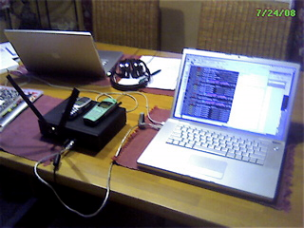
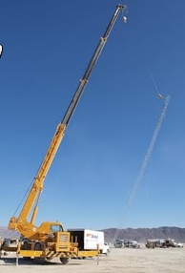
Cheaper
OpenBTS = open-source Unix application that presents a GSM air interface to standard GSM (G2) handset
  uses the Asterisk® software PBX to connect calls.
The combination of the ubiquitous GSM air interface with VoIP backhaul could form the basis of a new type of cellular network that could be deployed and operated at substantially lower cost than existing technologies in greenfields in the developing world.
  installed and operated at about 1/10 the cost of current technologies,
  compatible with most of the
  handsets that are already in
  the market.
  Range depends on antenna
Desert
http://openbts.sourceforge.net/
Few km. range

Slide 7
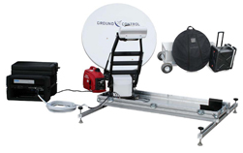
Portable tower
AT&T starts selling 'cell tower in a suitcase', see http://www.rdmag.com/New-To-Market/2011/04/Communications-AT-T-starts-selling-cell-tower-in-a-suitcase/, April 25, 2011.
Up to 14 simultaneous calls, $15K-45K, half mile coverage, for remote or disaster regions, can be truck mounted, needs outside power such as a generator to work
For emergencies, e.g. truck mounted
How to prevent others using?

Slide 8
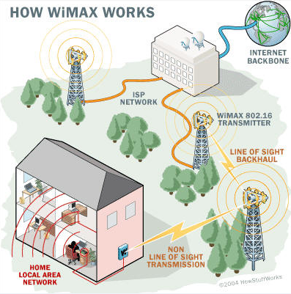
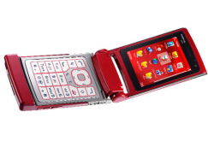
How they work
Each carrier in each city runs a Mobile Telephone Switching Office (MTSO) that controls Base Stations and handles phone connections
MTSO
BDA

Slide 9
Connecting
At power-on phone listens on the control channel for SID (5 digit number unique to each carrier)
Phone compares with SID in phone, transmits a registration request to MTSO which tracks phone location in a database
When MTSO gets calls looks in database to see which cell phone is in.
MTSO picks frequency pair & tells phone and base station over control channel
Base station & phone connect up on freq pair

Slide 10

Moving from Cell to Cell
MTSO

Slide 11
MTSO

Slide 12
MTSO

Slide 13
MTSO

Slide 14
MTSO

Slide 15
MTSO

Slide 16
Roaming
If the SID on the control channel does not match the SID on the phone then phone knows it is roaming
The MTSO of the cell you are roaming in contacts the MTSO of your home system
The home MTSO confirms the phone’s SID is OK
The home MTSO verifies SID is OK to roaming MTSO
All happens within seconds
Roaming can be expensive.
If roaming internationally may need phone with support for multiple technologies

Slide 17
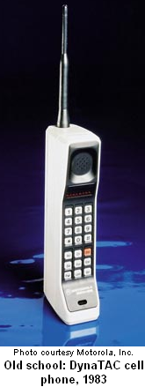
Analog phones (1st gen)
1983: Advanced Mobile Phone System (AMPS) by FCC and first used in Chicago
Use 824-894MHz frequency range
Each carrier is assigned 832 frequencies
  790 for voice and 42 for data
  Voice channel 30kHz wide (quality equivalent to wired voice)
  Each channel has 2 frequencies (xmt & rcv) separated by 45 MHz
    i.e. 395 voice channels and 21 control channels

Slide 18
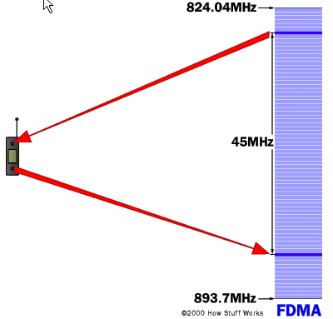
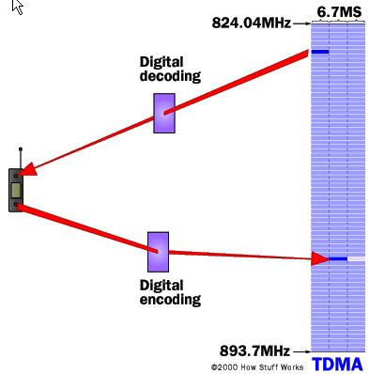
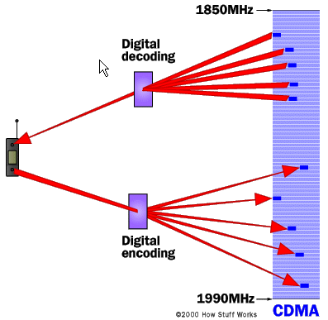
Digital 2G technology
Adds compression, fit more channels into given bandwidth (3-10 times more)
  Frequency division multiple access (FDMA)
    Each call uses a separate frequency, inefficient, mainly used in analog
  Time division multiple access (TDMA)
    Each call uses a certain portion of time on a given frequency, 3 times capacity of analog. This is used by GSM (see later).
  Code division multiple access (CDMA)
    Uses a unique code to each call and
    spreads it over the available frequencies, It uses GPS for timing

Slide 19

Global System for Mobile communications (GSM)
Implements TDMA
Has encryption for security
Uses 900MHz and 1800Mhz in Europe, Australia and much of Asia and Africa,
  In other countries switch SIM card
  Lower frequency=longer range, use in rural areas
Unfortunately uses 850MHz and 1900MHz in US
  Travel to Europe etc, need tri- or quad band phone
Some providers lock the phone to their service
  Unlocking requires a special key
  Data rates are typically modem (< 140kbits/sec(GPRS aka 2.5G), typically <=56kbps) based

Slide 20
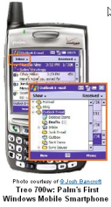
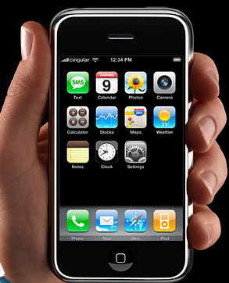
3G (Third Generation)
Meant for multimedia phones = Smartphones
Increased bandwidth and transfer rates, adds data
  Up to 3Mbps (15 sec for 3 min song) cf 144kbps for 2G
  Accommodate: web applications, audio & video files
Several cellular access protocols
  EDGE (Enhanced Data Rates for GSM Evolution aka 2.75G) 3*capacity & performance of GSM/GPRS, easy upgrade from 2G GSM, < 1 Mbps
  CDMA based on 2G Code Division Multiple Access
  WCDMA (UMTS) wideband CDMA < 21Mbit/s
  TD-SCDMA – Time-division Synchronous CDMA
  HSDPA (High Speed Downlink Packet Access – aka 3.5G) based on UMTS & backward compatible <21.0Mbits/s
  HSPA+ < 42Mbits/s

Slide 21
4G
4G mobile technology is the name given to the next generation of mobile devices such as cell phones. It became available from at least one provider in several parts of the US in 2009. There is not yet an agreed industry standard for what constitutes 4G mobile, so for now it is merely a marketing term.
Two contenders WiMAX and LTE (long term evolution)
  ~ 100Mbps down, 50Mbps up on 20MHz channel
  WiMax began testing in 2008 (Baltimore), 80 cities by end 2010, only 10Mbps
  LTE testing 14 Dec 2009 (Stockholm, Oslo)
Increases data speeds, enhanced security, HDTV, mobile TV, intended for Internet use on computers too, IP packet switching only, IPv6

Slide 22
LTE
IP only for data and voice
LTE provides high throughput, low latency, plug and play and is inter-operation with previous systems
LTE standard is defined as providing 100Mbps up to 300Mbps for mobile connections
  Carriers are announcing pre-LTE with lower speeds
  Some carriers are announcing 4G which are not LTE or WiMax
  LTE won compared to WiMax

Slide 23

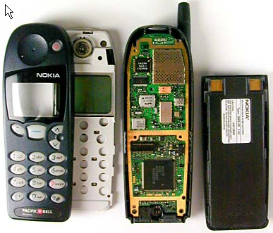
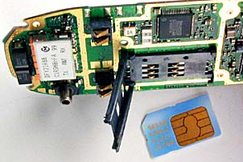
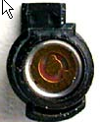
Inside a simple Digital cell phone
One of the most intricate devices used daily
  Compression take lot of compute power (MIPS), A-to-Ds, digital signal processor (DSP), radio (hundreds of channels), microprocessor, ROM, flash memory, power mgmt, clock
  Now smartphones
backup battery
for clock
Antenna
speaker
LCD display
battery
Flash memory removed
keyboard
microphone
microprocessor

Slide 24
Phone power
Many manufactures agreed on standard (micro-USB) for charging phones. No longer need a separate charger with each phone.
November 2008 the top five mobile phone manufacturers Nokia, Samsung, LG Electronics, Sony Ericsson and Motorola set up a star rating system to rate the efficiency of their chargers in the no-load condition.
Formerly, the most common form of mobile phone batteries were nickel metal-hydride, as they have a low size and weight.
  lithium ion batteries are sometimes used, as they are lighter and do not have the voltage depression that nickel metal-hydride batteries do.
  Many mobile phone manufacturers have now switched to using lithium-polymer batteries as opposed to the older Lithium-Ion, the main advantages of this being even lower weight and the possibility to make the battery a shape other than strict cuboid.
  Mobile phone manufacturers have been experimenting with alternative power sources, including solar cells.
The main requirements for the cpus is low power, the main contending designs are ARM/Eagle (Qualcom/Snapdragon, Apple/A4, Samsung/Hummingbird, TI) and Intel/ATOM.
Notes:
Processors see http://www.rethink-wireless.com/2010/08/10/ti-flies-ahead-arm-pack-eagle-deal.htm
ARM=Acorn RISC Machine => Advanced RISC Machine

Slide 25

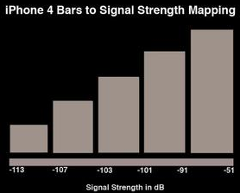
Coverage and bars etc.
BARS have a little to do with signal strength, there are no industry standards.
The main thing is the networks access level.
  Y (in dBm) = 10 *( log10(power (in mWatts))), 1milliwatt=0dBm, 1W=30dBm, 1 nanowatt= -60dBm etc.
  The –dBm can vary from minute to minute by -10dB or more. This may depend on trafffic, congestion, technology, moving bodies, how tightly it is held in the hand (24.6dB to 19dB) etc.
Record minimums with clear audio are:
-104dBm - Cingular (GSM)
-111dBm - Cingular (TDMA)
-109dBm - T-Mobile
With garbled or no audio, my record minimums while holding a call are:
(These calls did NOT drop but audio faded for a few seconds)
-113dBm - Cingular (GSM)
-113dBm - Cingular (TDMA)
-112dBm - T-Mobile
It really depends on the area, codec used, congestion, noise, interference, etc.
Minimum signal seen while registered to a tower (not in a call):
-117dBm - Cingular (GSM)
-113dBm - Cingular (TDMA)
-115dBm - T-Mobile
For most phones (not Apple) with 5 bars, each bar is worth 5dBm. So that means:
0 bars: No signal to -100dBm (<-113dBm)
1 bar: -100dBm to -95dBm (-113 dBm to -107 dBm)
2 bars: -95dBm to -90dBm (-107 dBm to -103 dBm)
3 bars: -90dBm to -85dBm (-103 dBm to -101 dBm)
4 bars: -85dBm to -80dBm (-101 dBm to -91 dBm)
5 bars: -80dBm or stronger (-91 dBm to -51 dBm)
Regardless of the max number of bars in the phone, usually the most bars is reached at around -80dBm, 10pW.
Notes:
See http://en.wikipedia.org/wiki/DBm for definition of -dBmW
Most of the information is from you can see the bars display freeze at 2 or 3 bars even if the signal is lost. This usually happens because the phone is scanning.
http://forums.wirelessadvisor.com/general-wireless-discussion/11301-signal-strength-db-vs-bars.html
It is important to know that the bars display doesn't get updated as quick as the dBm reading in the Test Field screens, so it doesn't always match.
Apple iPhone bars to –dB loss from http://www.boygeniusreport.com/2010/06/30/iphone-4-bars-to-signal-strength-mapped-antenna-issue-partially-explained/

Slide 26
Growth
Mobile telecommunications connections worldwide reached five billion in the first week of July 2010 on growth in India and China, and could triple by 2016, PRTM Management Consultants said.
Revenue will “probably grow 20 percent to 30 percent in the same time,” Ameet Shah, a consultant for PRTM, said from London in a telephone interview. The current revenue figure is about US$900 billion, according to researcher The Mobile World.
Operators must change their operating models and may need to merge to survive, Shah said. Instead of concentrating on “high value, high price and low volume” they must focus on “immense scale, low value and low prices,” he said. Some markets have grown to 150%-200% penetration relative to their populations. More penetration than Internet.
Notes:
Looks like AT&T will buy up T-Mobile.

Slide 27
Concerns - handset
Radiation
  Handset:
    Mainly from antenna, closer to head higher exposure
    So use ear phones and mike
    Measured metric is the Specific Absorption rate (SAR). An SAR of < 1.6 watts/kg of body weight is considered safe by the FCC. The SARs for manufactured phones vary from 0.1 to 1.59 watts/kilogram
Privacy
  Use multilateration based on RTT to towers to discover location of cell phone whether turned on or not
  Remotely turn on microphone of some cell phones and listen to conversations (see http://news.cnet.com/FBI-taps-cell-phone-mic-as-eavesdropping-tool/2100-1029_3-6140191.html)
Consideration
  Lack of attention when driving
  Interrupting others
Notes:
See http://www.seas.harvard.edu/courses/es96/spring1997/web_page/health/fccregs.htm
FCC guidelines for radiation emissions from radio frequency transmitters operating at a frequency range of 300KHz - 100GHz are based on ANSI/IEEE C95.1-1992. It includes Maximum Permissible Exposure (MPE) limits for the power density and magnetic and electric field strength from FCC regulated RF transmitters. The guideline also contains limits for the partial body absorption from portable transmitting devices.

Slide 28
Concerns - tower
Radiation
  Tower:
    Worst case ground level power density 1uW/cm2 or 0.01 W/sq m cf avg energy over entire earth ~ 250W/sq m/day ignoring clouds, i.e. electro magnetic energy from Sun 25K times that of cell phone tower.
Reliability
  Typically 8 hour battery backup, then portable generator
  However, recent Irene tropical hurricane on E coast US left 6500 cell sites out (44% in Vermont).
    Often power, unable to bring in portable generators due to flooding
    Antennas blown out of alignment, towers OK
    Flooding causes circuit disruptions
    No major wired central office knocked out, 911 & safety OK
    However 210,000 wired customers out, wires knocked down etc.

Slide 29
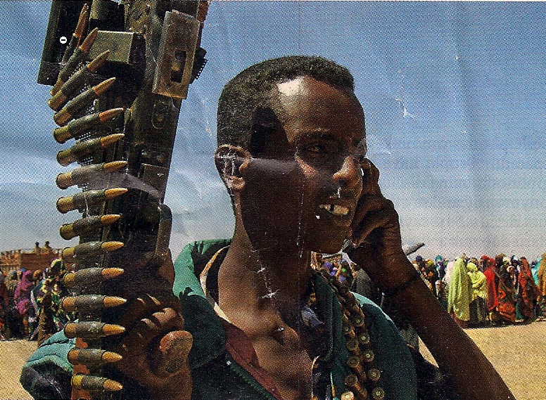
Some Benefits
Emergencies, reporting fires, accidents – alternate communication
Keeping in touch
  Market prices (fish, crops), weather, crop information
  Family, friends and co-workers etc
Given to victims of domestic violence
Emergencies, reporting fires, accidents
Keeping in touch
What no coverage!
Mobile computing (in future any micro-processor will have a wireless access):
Rent a car check in at the curb
Real time Bus schedules for students
Field workers, mobile workers
Push button access to nurse practitioners
Even warlords may need & protect
From the Economist
From the Economist, Sep 26, 2009

Slide 30
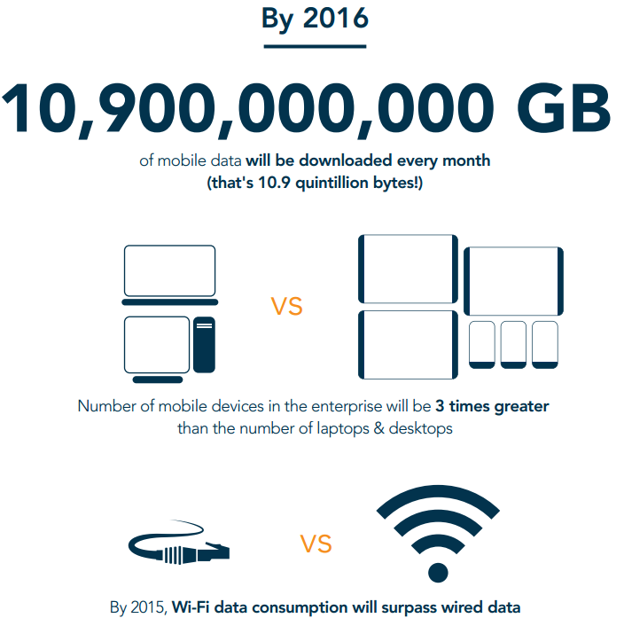
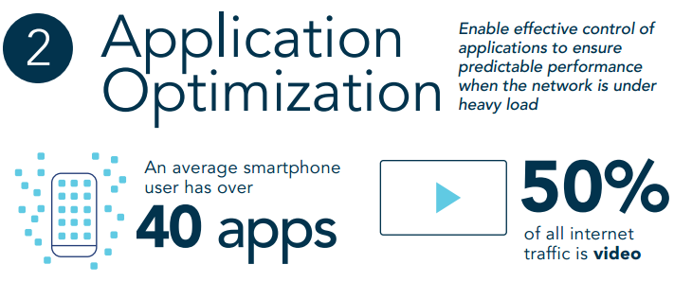
Directions

Slide 31
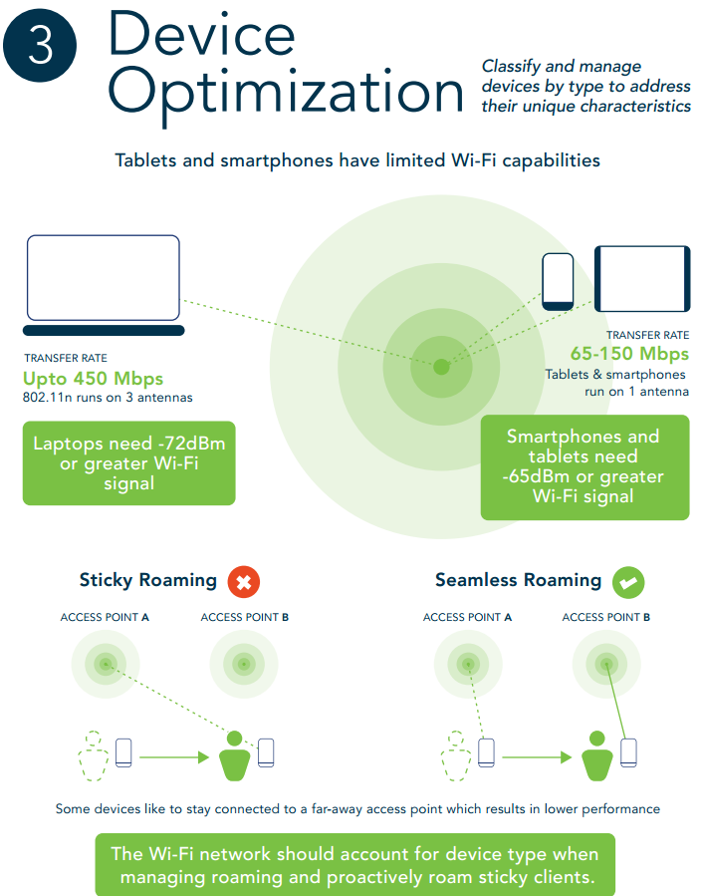

Slide 32

Blank divider page
INSERT PREFERRED IMAGE AS BACKGROUND – INSTRUCTIONS:
1: Click “Insert” from menu and choose “Picture” to select image
2: Once image is inserted, right-click image and choose ‘Send to Back’

