Slide 1
RTM Testing Issues
B-27 session discussion
PZ Takacs
22 March 2012

Slide 2
Common RTM test stand at BNL & SLAC
What metrology will be common to both BNL and SLAC?
Optical testing instrumentation required:
  Lamp, monochromator, integrating sphere, XYZ stage, dark box, cryostat, handling fixtures and cart, docking station.
  Tests required: QE, dark counts, flat field, Fe55, etc.
Requirements for BNL and SLAC cryostat for RTM testing. Make as similar as possible.
Design of a shipping container for completed RTM.
Handling device for loading RTM into cryostat and shipping container.
  Procedures for loading RTM into cryostat.
  Procedures for loading RTM into shipping container.
Cart for cryostat transport.

Slide 3
Test stand layout in RTM assembly lab

Slide 4
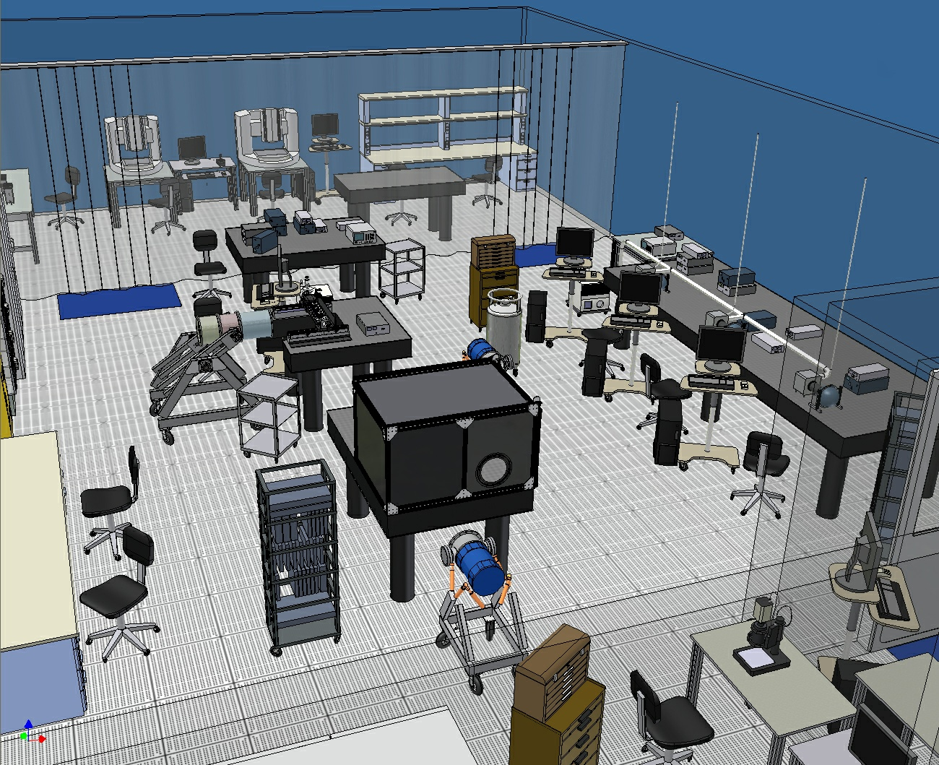
Raft integration cleanroom

Slide 5
WBS, SCOPE, & DELIVERABLES
Raft-Sensor
Assembly (RSA)
CCD Sensors(9)
Raft Baseplate
WBS 3.03.02
front
end
electronics
WBS 3.03.03
Sensor pigtails(18)
Tower Cage
deliverable
Science Raft Tower Module (RTM)
WBS 3.03.01
FEE-BEE pigtails(12)
Total Qty 28
ETU – 2
First Article – 2
Camera Integration & Test – 3
Production - 21
back
end
electronics
and
Raft Control Crate WBS 3.03.04

Slide 6
RTM REQUIREMENTS
Focal plane flatness of 0.0135 mm or better for each raft tower module (±0.00675 wrt nominal height of 42.810 above kinematic mount spheres)
Includes out-of-flatness of the individual CCDs as well as their mounts and the supporting raft surface
0.0135 mm tolerance zone
CCD
RAFT
42.810

Slide 7
Logic Path - II
Given that there must be a cold preamp to achieve the required noise performance, the next question is how much of the electronics chain should be cold and how much warm (i.e. inside vs. outside of the cryostat)?
One way to gauge that is to examine the size of the cabling plant at various points along the electronics chain – the numbers on the left show the raw number of conductors at each point along the RTM
9 CCDs
Raft-Sensor
Assembly (RSA)
189 x 74 = 13,986 ➔
FEC
Sensor Head Assembly (SHA)
Front End Cage (FEC)
Raft Tower Module (RTM)
21 x 120 x 6 = 15,120 ➔
RCC
Raft Control Crate (RCC)
21 x (4+24) = 588 ➔
Notes:
from Rick Van Berg 2011

Slide 8
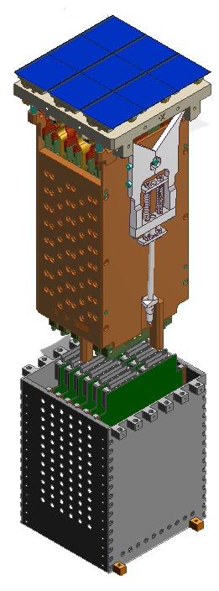
Raft key requirements
Complete 144-Mpixel imager
Support sensors mechanically to meet strict coplanarity and piston tolerances.
Thermal management of sensors and electronics.
Protect sensor surfaces from condensable contamination.
Provide bias, timing, and control signals for CCD operation.
Low noise analog signal processing.
Digitization, multiplexing of pixel data.
optical
Raft-Sensor Assembly (RSA)
Front End Cage (FEC)
Requirement | Value
Imaging surface location | 42.810 ± .00675mm above KM ball centerline
Sensor temperature | -100C
Electronics temperature | < -100C (FEC), -40C (RCC)
Heat removal (IR + electronics) | 50W ave
Read noise | 7 e- rms
Data rate | 288MByte/sec
Raft Control Crate (RCC)
power, control, cooling
pixel data
detail

Slide 9
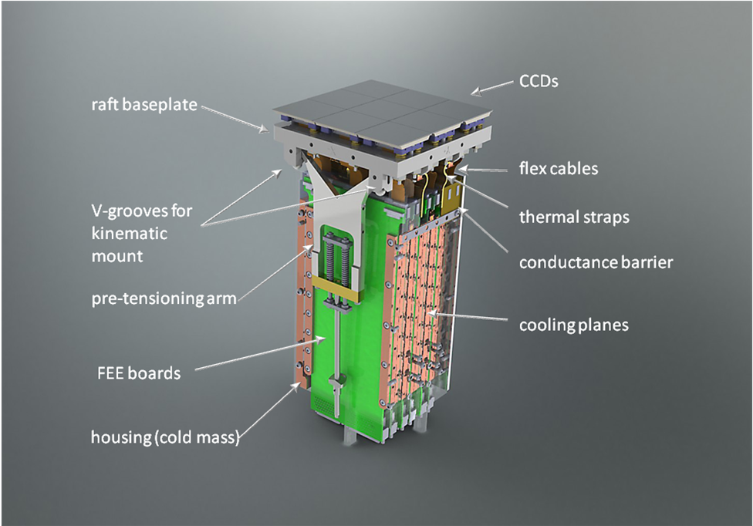
RSA + FEC elements

Slide 10
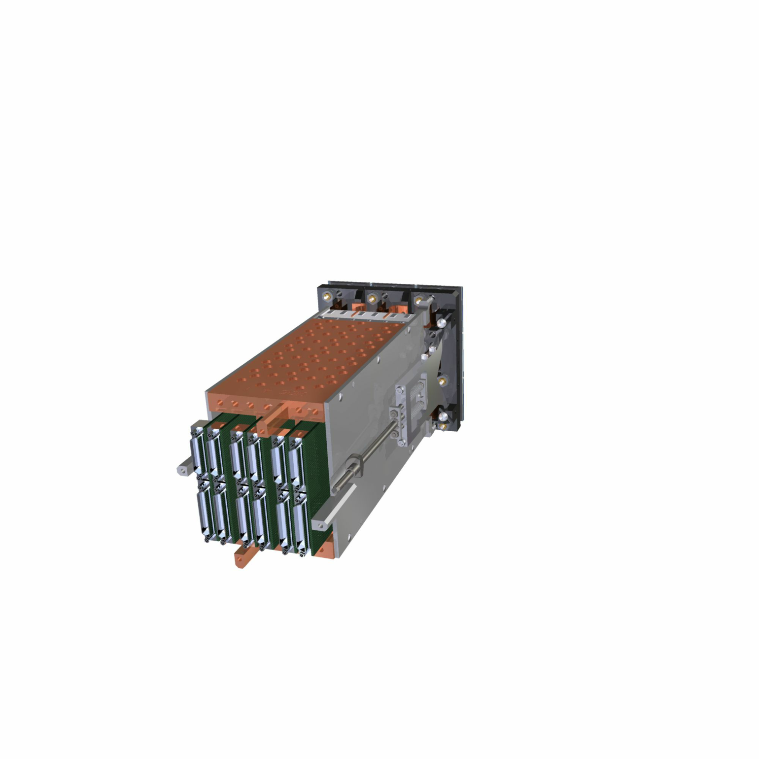
RSA + FEC
RSA
FEC
Ball-in-vee kinematic mount
FEC – RCC connectors

Slide 11
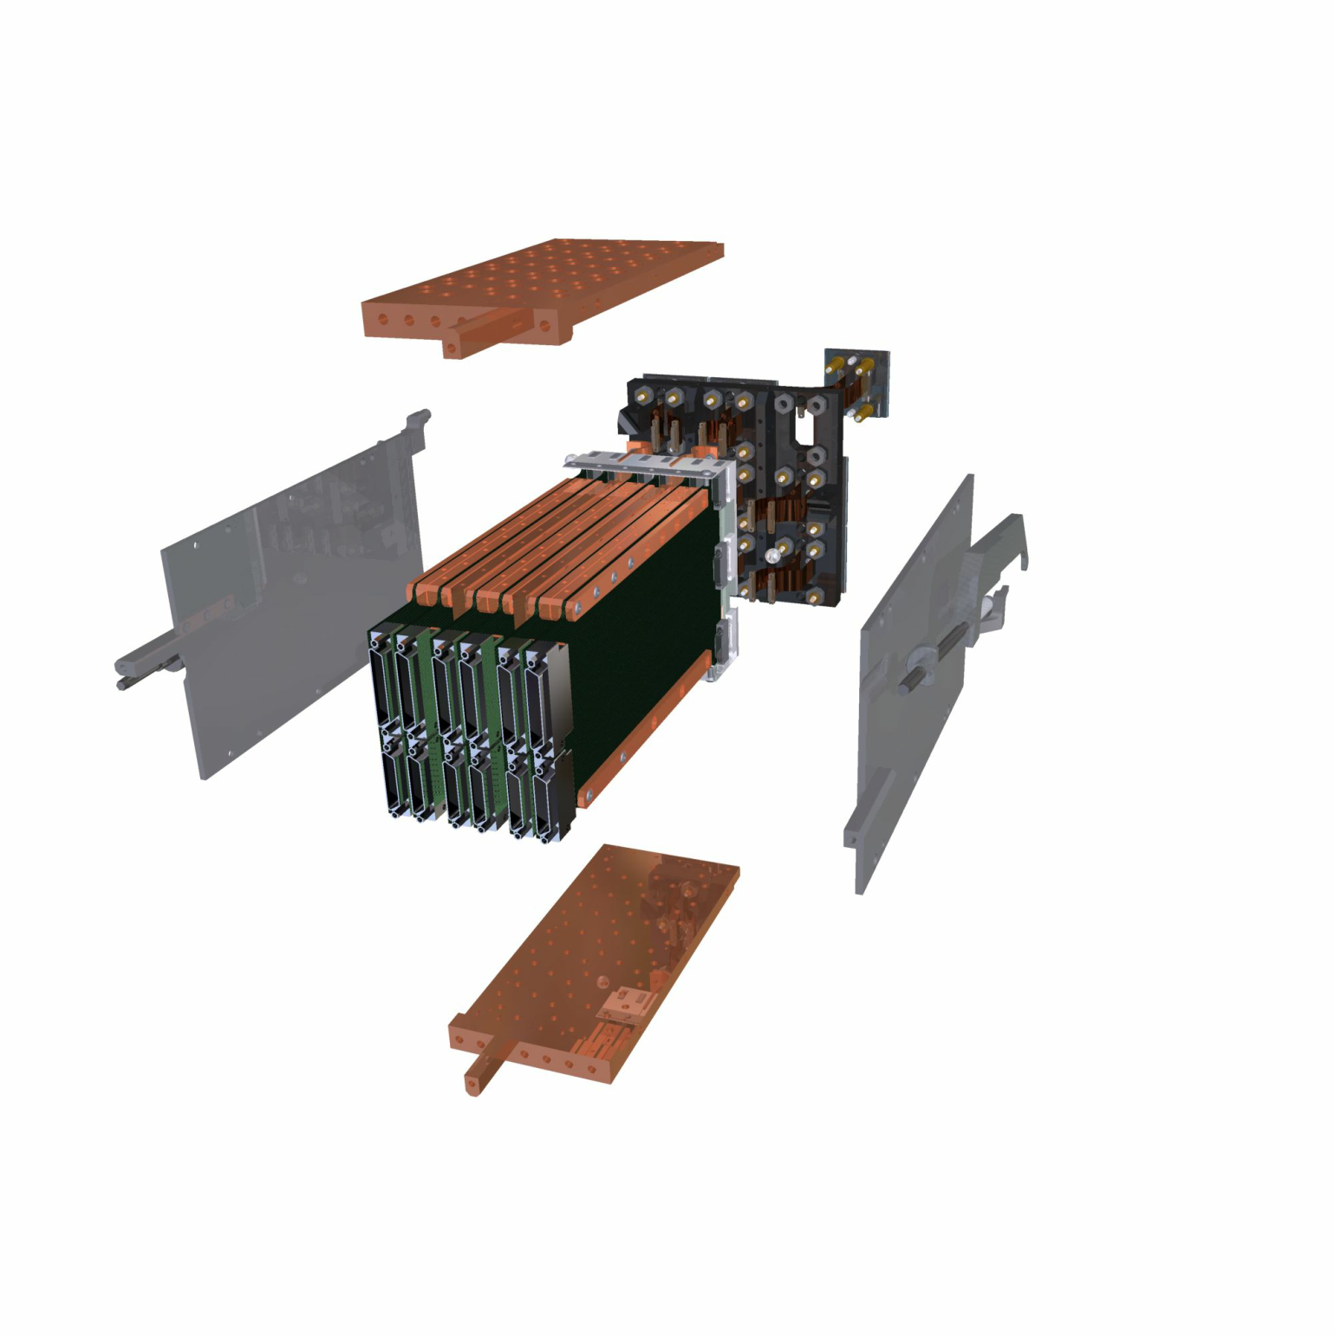
RSA + FEC: exploded
Copper cage sidewalls
CCDs
Conductance barriers
Raft baseplate
Thermal conduction planes
Pre-tensioning arm
Front end boards
Mounting feet

Slide 12
S6 - RTM Assembly
Assembly of RSA with FEB electronics and cage structure
Test Stand equipment: | Design | Procurement | Labor
Worktable 4’x8 |  | 3.03.01.02.02
ESD monitor |  | 3.03.01.02.02
ESD-safe chair |  | 3.03.01.02.02
Jigs and tools for assembly |  | 3.03.01.02.02

Slide 13
S7 - RTM Dewar Integration
Installation and removal of RTM into large cryostat
Design of large cryostat with front and rear access flanges.
Pack for shipping.
Test Stand equipment: | Design | Procurement | Labor
Worktable 4’x8 |  | 3.03.01.02.02
ESD monitor |  | 3.03.01.02.02
ESD-safe chair |  | 3.03.01.02.02
Jigs and tools for assembly
Large cryostat | 3.03.01.03.02.01 | 3.03.01.03.02.02
Fe55 source and actuator |  | 3.03.01.03.02.02
Vacuum gauges and valves |  | 3.03.01.03.02.02
Dry N2 backfill
CryoTiger units |  | 3.03.01.03.02.02
Vacuum pump |  | 3.03.01.03.02.02
Vacuum gauge |  | 3.03.01.03.02.02
Notes:
Move complete RTM assembly to staging table in Class100 area.
Prepare big dewar.
Install RTM into big dewar on large cart.
Make electrical connections.
Seal with window flange.
Move out of C100 to Keyence flatness station. Dock with Keyence machine.
Pumpdown and cooldown. Measure flatness.
Move to Final EO test stand. Dock with dark box. Connect electronics.
Perform final tests: QE, dark, CTE, Fe55, etc.
Move to C100 staging table.
Warm up and purge with dry N2. Open dewar, remove RTM. Package for shipment.

Slide 14
S8 - RTM EO Testing
Electro-optical testing of complete RTM system
Test Stand equipment: | Design | Procurement | Labor
Worktable 4’x8 |  | 3.03.01.02.02
ESD monitor |  | 3.03.01.02.02
ESD-safe chair |  | 3.03.01.02.02
Dark box | 3.03.01.03.02.01 | 3.03.01.03.02.02
Monochromator, Lamp, Shutter, Filters |  | 3.03.01.03.02.02
Integrating sphere, 12” |  | 3.03.01.03.02.02
Picoammeter |  | 3.03.01.03.02.02
XYZ stack |  | 3.03.01.03.02.02
Diode laser source |  | 3.03.01.03.02.02
Optical attenuator
Notes:
Move complete RTM assembly to staging table in Class100 area.
Prepare big dewar.
Install RTM into big dewar on large cart.
Make electrical connections.
Seal with window flange.
Move out of C100 to Keyence flatness station. Dock with Keyence machine.
Pumpdown and cooldown. Measure flatness.
Move to Final EO test stand. Dock with dark box. Connect electronics.
Perform final tests: QE, dark, CTE, Fe55, etc.
Move to C100 staging table.
Warm up and purge with dry N2. Open dewar, remove RTM. Package for shipment.

Slide 15
T8 - RTM assembly
Collect FEBs and cage parts from storage. Log in ID numbers. Assembly is done at S6 in C10K area.
Install thermal conductance strips to FEBs.
Install FEBs, conductance barriers, and heat sinks onto RSA.
Install tower sides.
Install hold-down arms and pretension.
Remove assembly tooling. RTM assembly is mounted in a handling fixture at this point.
Quick check of electronics functions.
Log in with serial number.
Move assembled RTM in handling fixture to dry storage with RSA covered.
RTM hardware and electronics parts will have been measured and tested earlier.
Requires tooling to cover RSA and hold it in place while tower is assembled.
Special tooling will be needed to assemble cage with boards onto RSA.
Requires a handling fixture to be attached at end of assembly.

Slide 16
T9 - RTM testing
1. Move assembled RTM to staging station, S7, in C100 area.
2. Prepare large cryostat for RTM installation on large cart.
3. Remove handling fixture from RTM and transfer to installation fixture.
4. Install RTM into cryostat.
5. Make all necessary electrical connections to back flange. Check continuity if necessary.
6. Attach back flange to back of cryostat.
7. Attach window flange to front of cryostat.
8. Make connections to vacuum pump and cryocooler.
9. Move RTM on large cart to flatness station, S5.
10. Measure flatness while warm at 1atm to see if any changes during assembly.
11. Pump down and cool down. Monitor flatness and vital signs.
12. Measure flatness when cold.
13. Move RTM on cart to EO test station S8 for final calibration tests.
14. Connect cryostat cables to CCS and RTS2 systems.
15. Perform QE, dark noise, flat field, CTE, etc. tests on full raft surface with actual electronics.
16. Thermal cycle the RTM and perform burn-in tests.
17. Move RTM and large cryostat into C100 area to S6.
18. Warm up and purge with dry N2.
19. Remove RTM assembly from cryostat and place in shipping container for storage.
Need large cryostat with 2-ended design. Install on large handling cart. Design to mate with flatness docking station at S5 and dark box on S8.
Cryostat contains Fe55 mechanism.
Cryocooler dual head connections through side wall of dewar.
Back flange contains all electrical connections to RTM.
RTM control by CCS software during testing. RTS2 interfaces to CCS?
Need to have flatness station and S8 components in working order. Calibrate QE equipment against NIST standard occasionally.
Need shipping container.

Slide 17
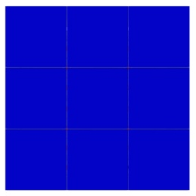
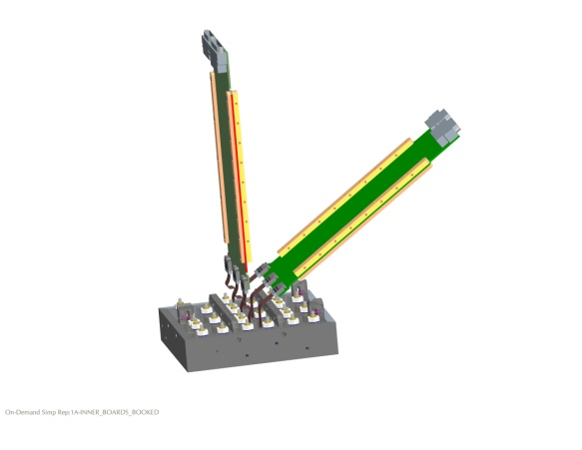
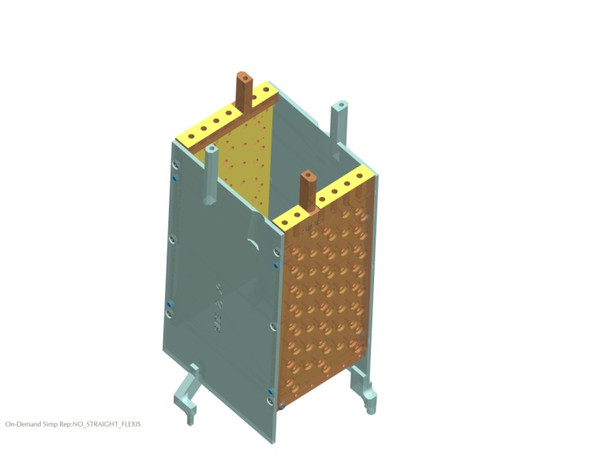
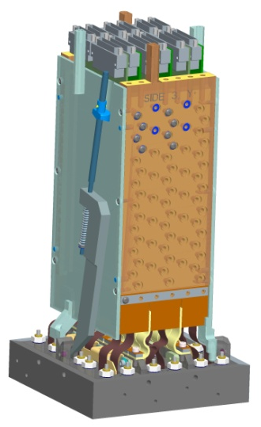
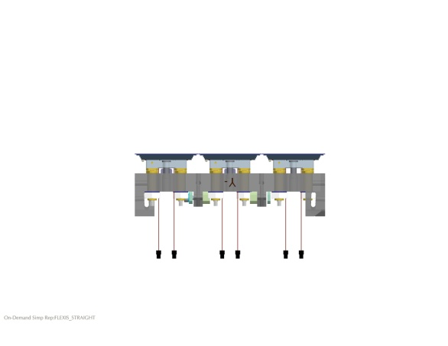
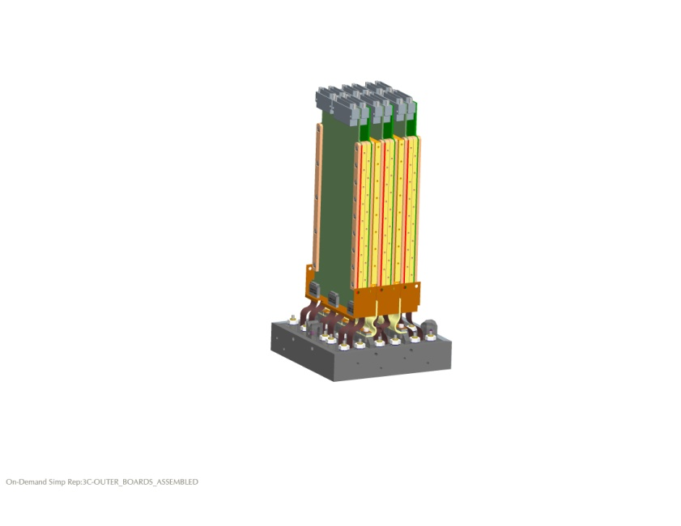
RTM Assembly - sequence summary
Planarize
(if Diff Screws are req’d)
Assemble, Machine, Disassemble
INSTALL BOARDS, HEATSINKS, CONDUCTANCE BARRIER
INSTALL HOLD-DOWNS, COMPLETE TESTING
Make surfaces coplanar
in instrument cleanroom
in machine shop
in assembly cleanroom
in assembly cleanroom

Slide 18
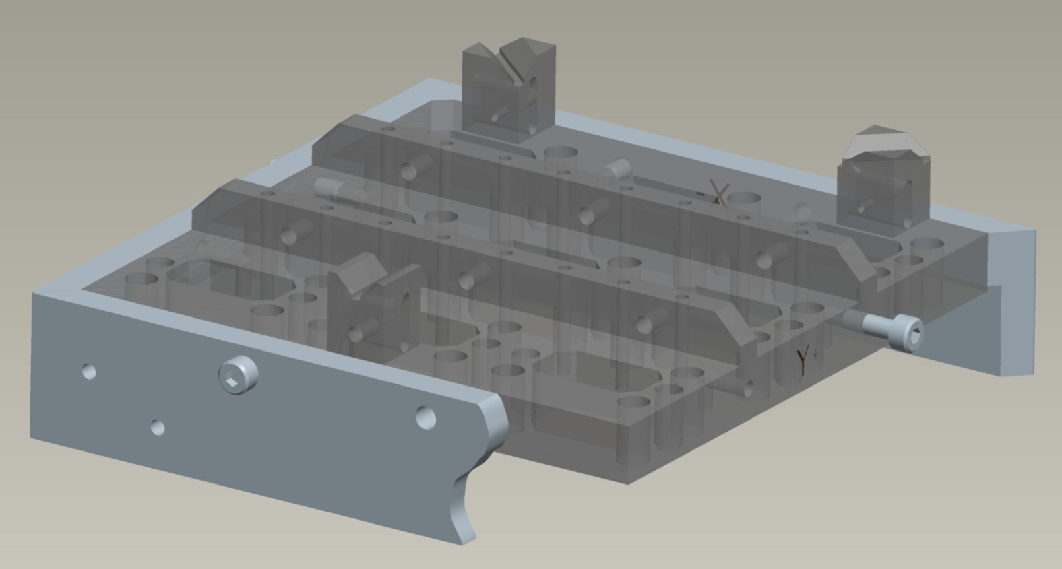
RTM Assembly Procedure – details
Protective 2-pc tooling sides added to Raft to prepare for sensor package installation
Two holes
each side
Clearance
undercut

Slide 19
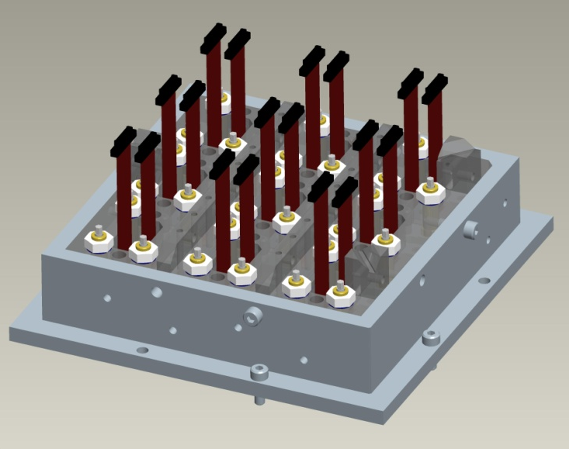
Build-up Raft Tower Module
Raft-Sensor assy is mounted to bench top

Slide 20
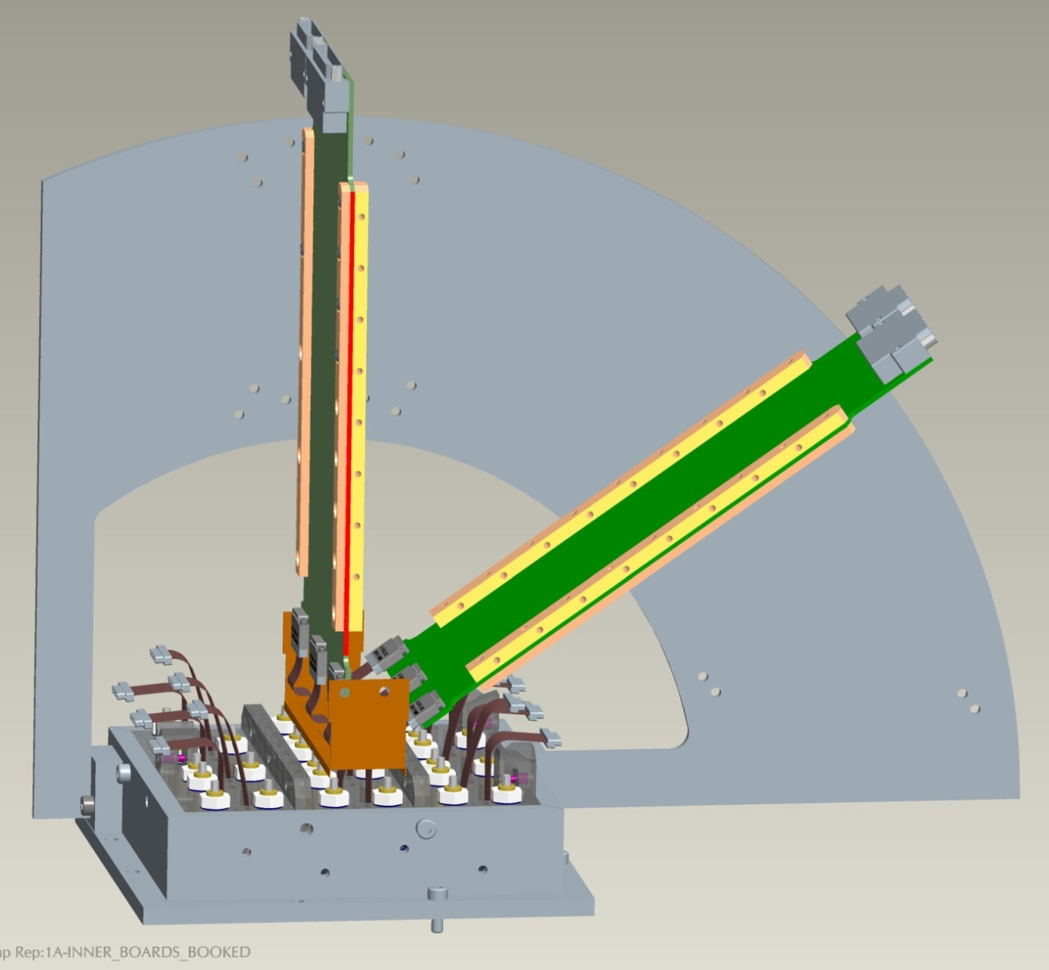
Begin FEB installation
micro-D
connectors
(2 sizes)
1/4–circle
multi-position
board holder
tooling
nano-D
connector
x3
Board with two thermal
conductance Cu strips

Slide 21
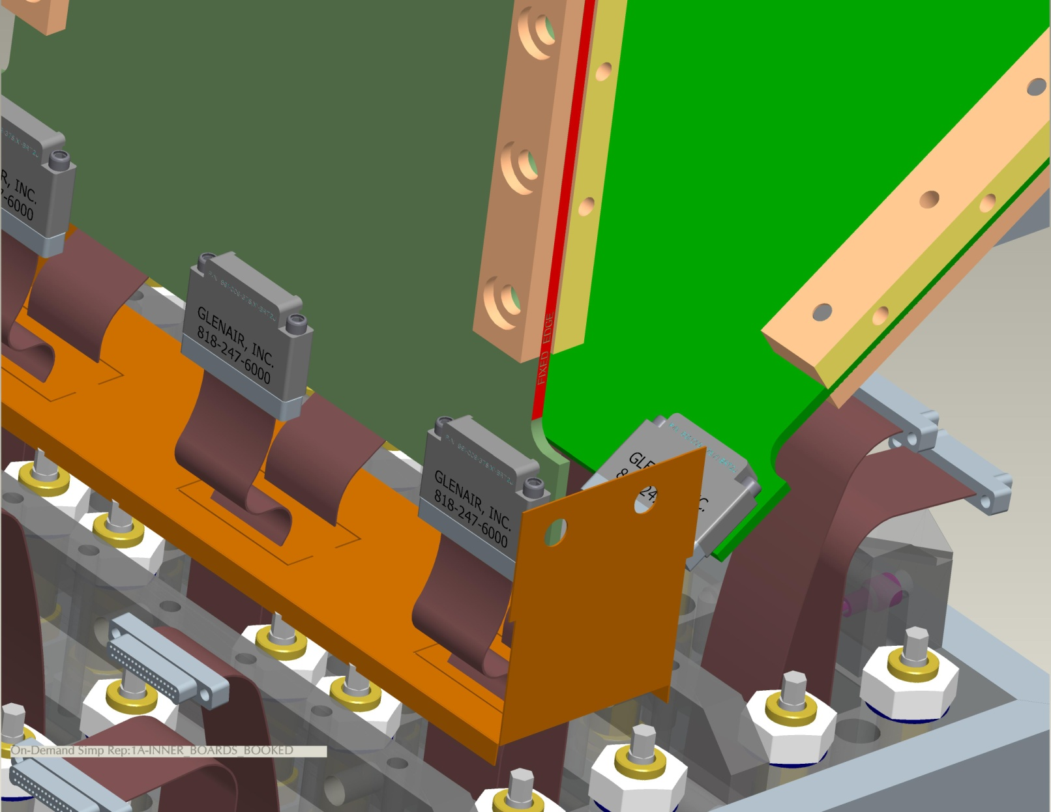
Connector mating detail
Nano-D connector
Creased Kapton
conductance barrier

Slide 22
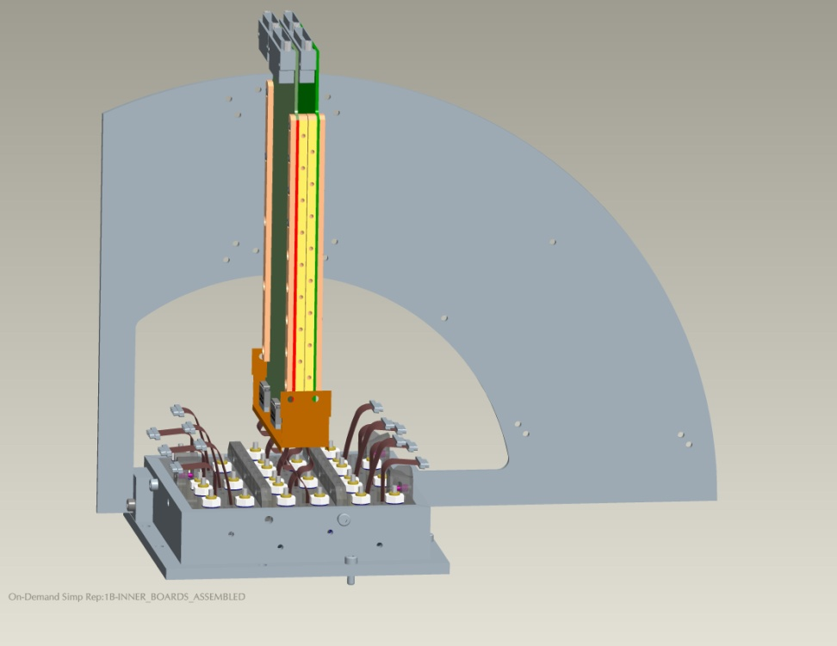
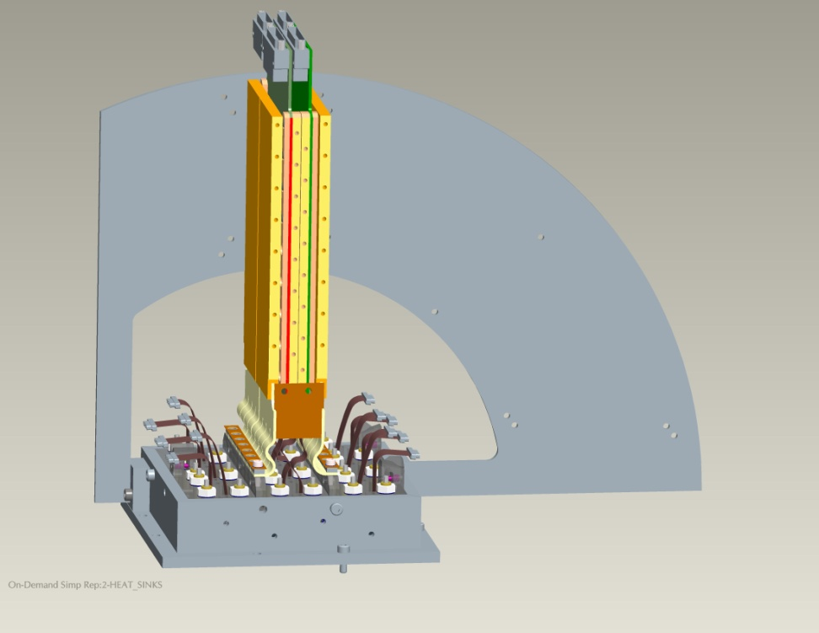
Add heatsinks
Stand up right-hand board
Add heat sinks (4 pieces)

Slide 23
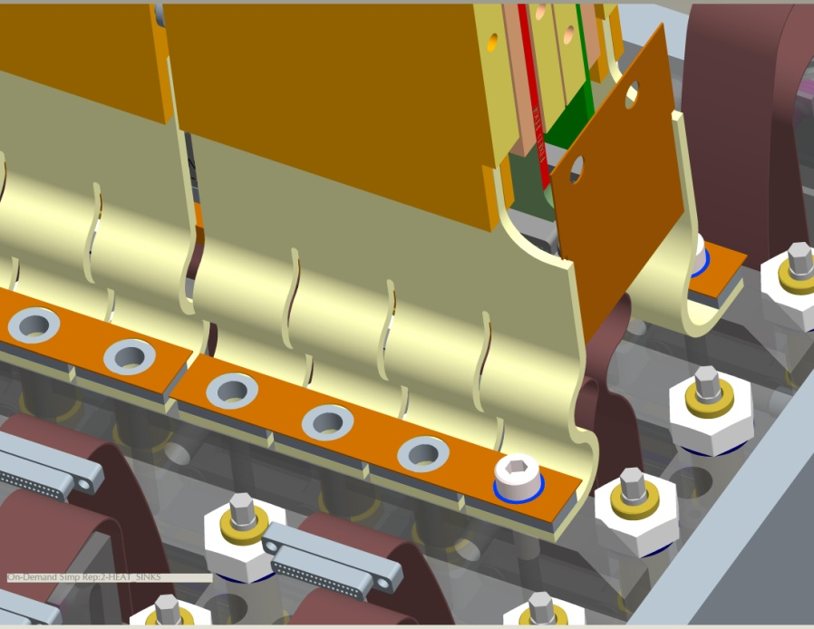
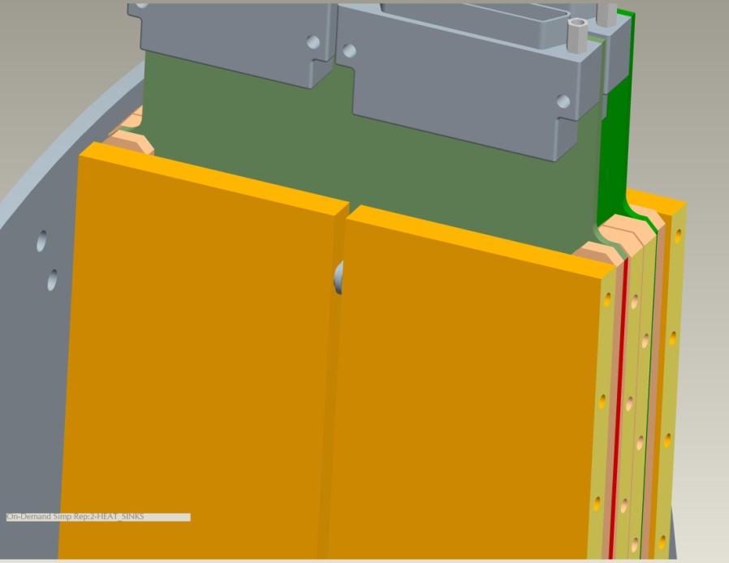
Heat sink details
soldered joint
Hanger Pin
Flexible Leaf assy (custom fabrication )
(12 leaves, 0.127 mm [.005 in] thk each)

Slide 24
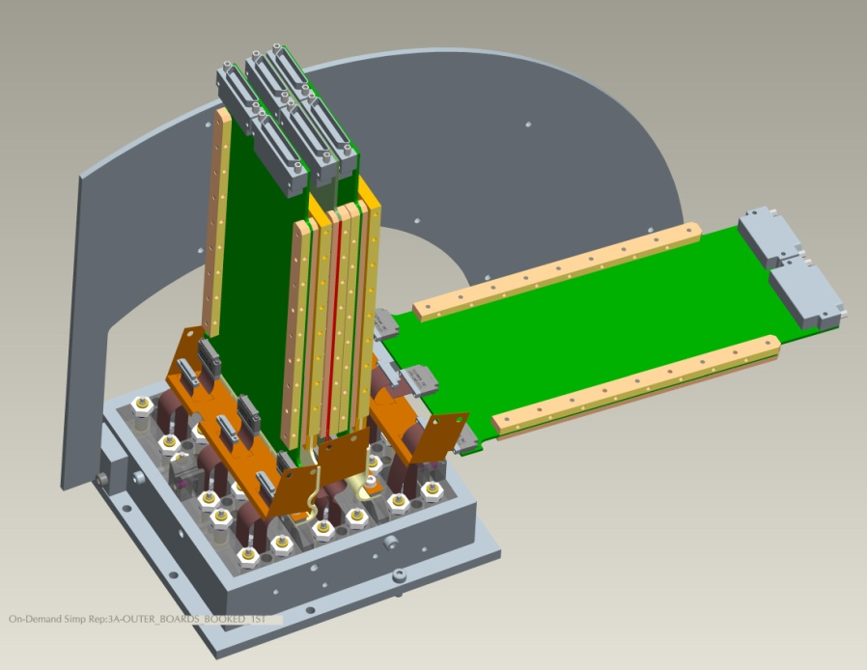
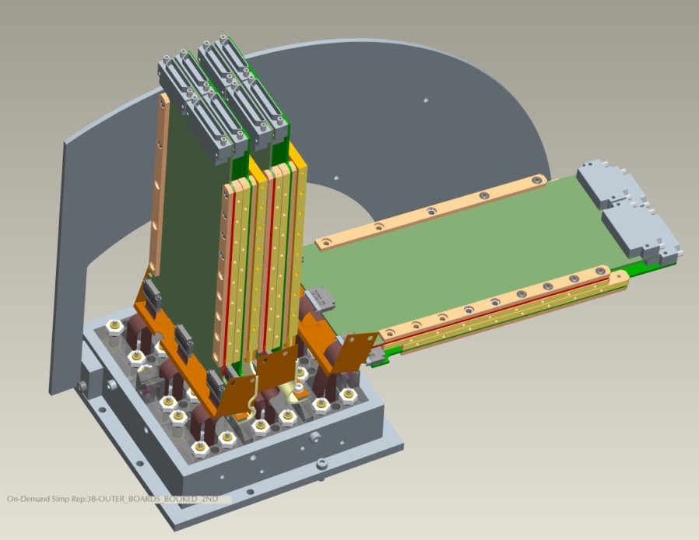
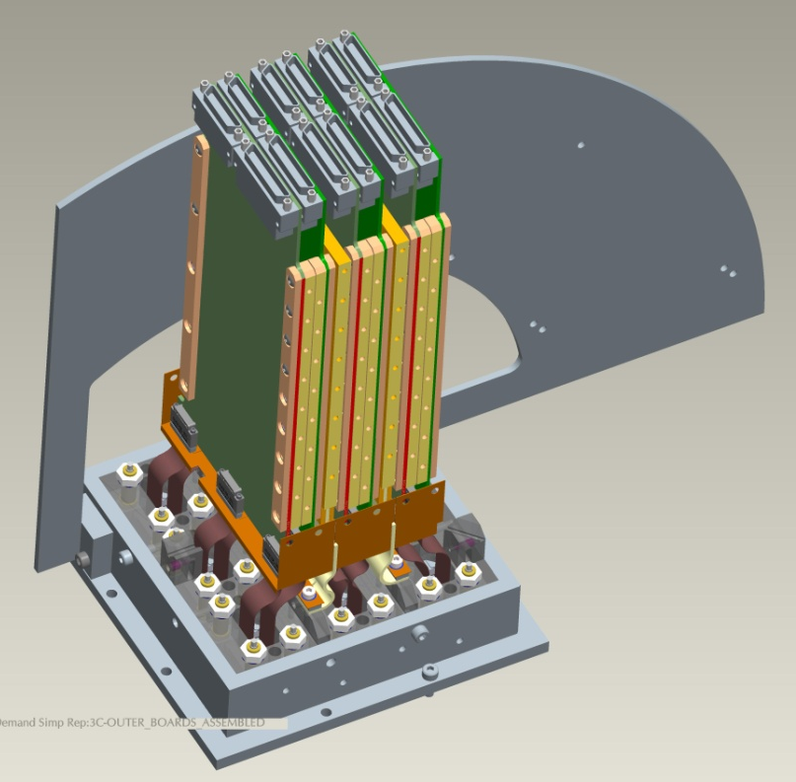
Continue board installations...
a
b
c

Slide 25
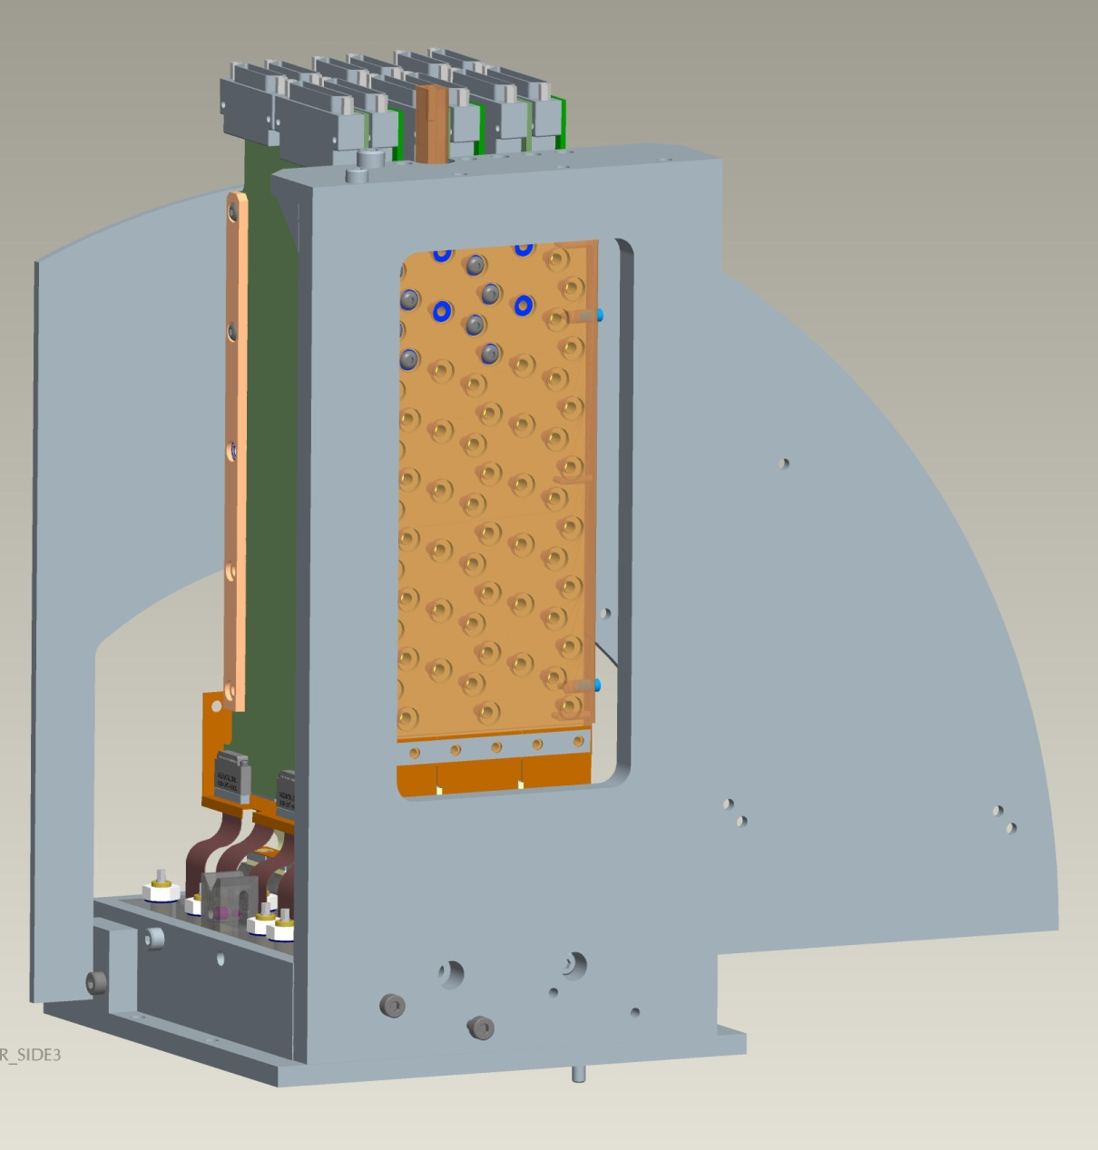
Install Tower Side 3 “Y+” (thermal path)
tool
Attach tower side to tool piece
Attach tool to existing tooling
Install hardware (attaches boards and heat sinks to Side 3)
Internal parts are now supported
Tower Side 3

Slide 26
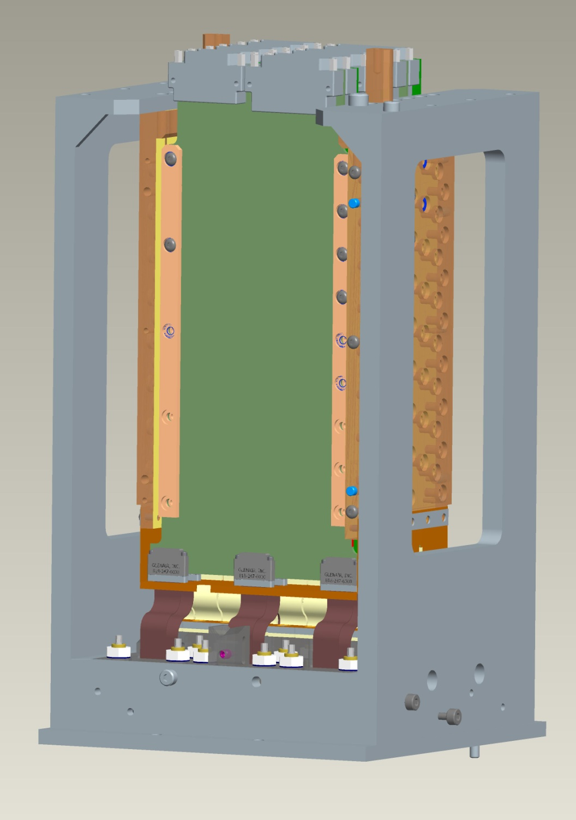
tool
Remove ¼-circle support plate
Replace with tool and Side 4 “Y-” (thermal path)
Install hardware
Install conductance barrier clamps
Side 4
conductance
barrier
clamp

Slide 27
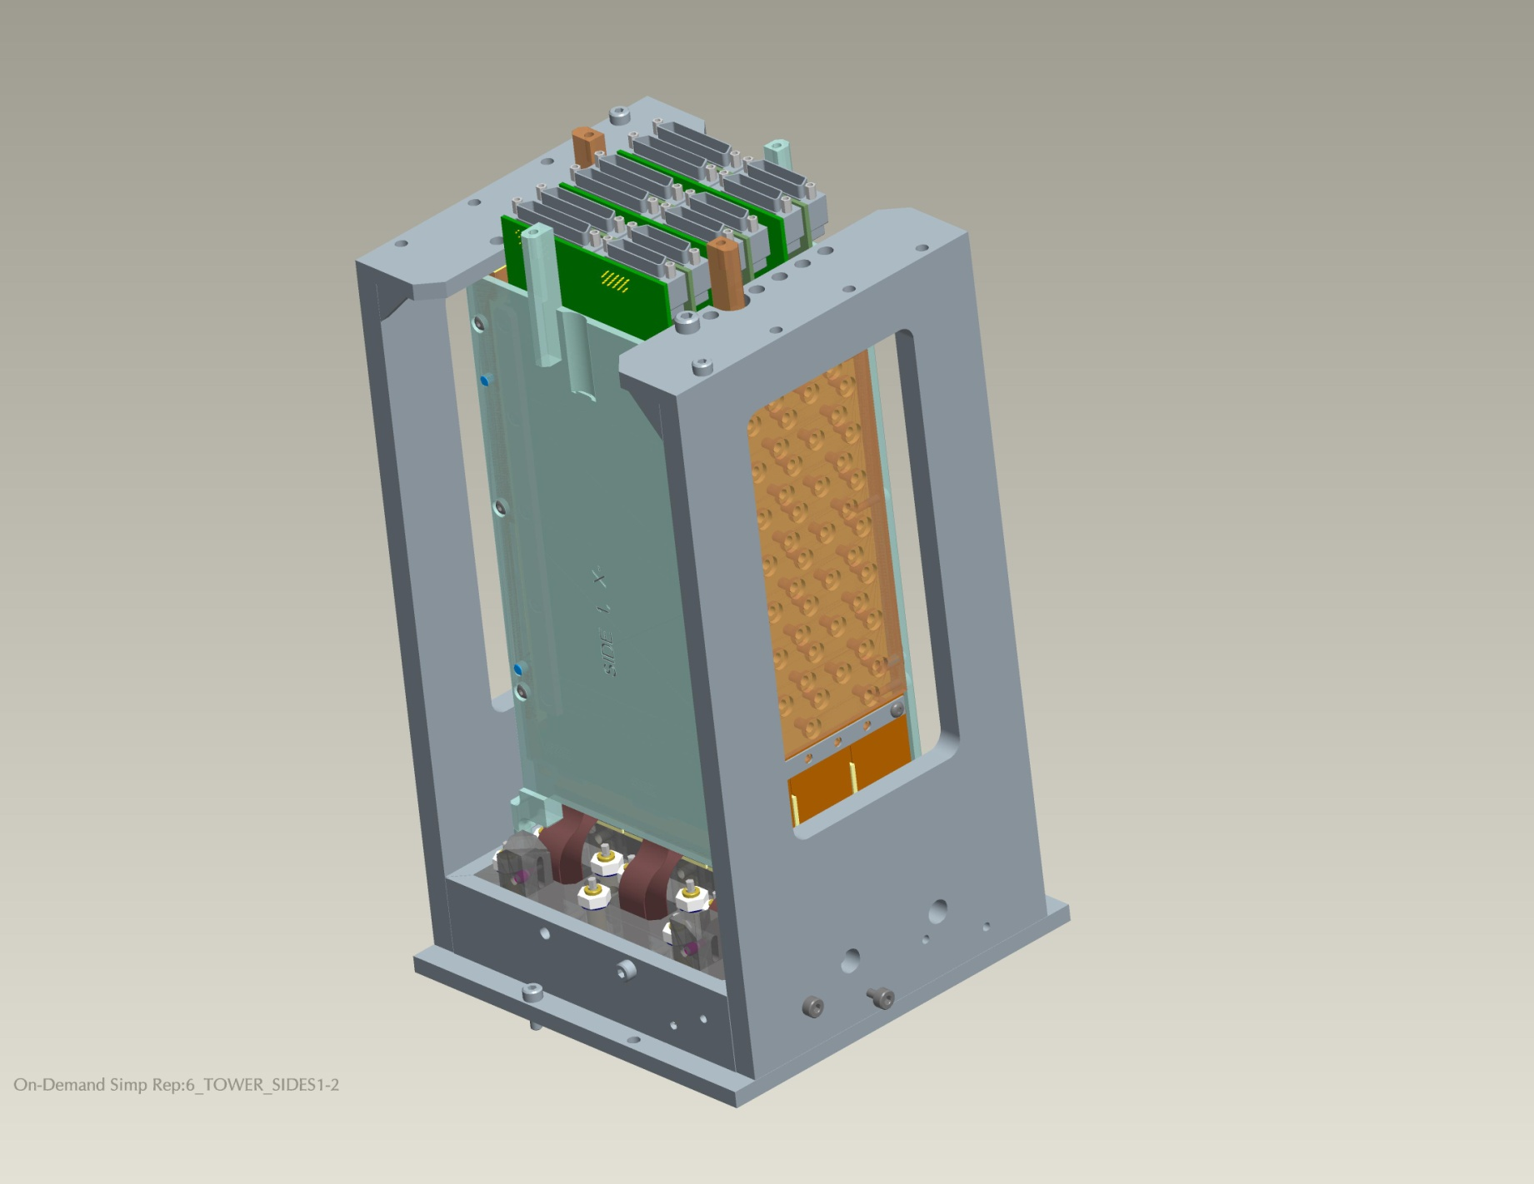
Install Sides 1 & 2 (mechanical)
Was pre-machined as matched set with thermal sides, then disassembled
Establishes coplanar thermal transfer surface to cryoplate
Pinned and keyed to impose identical re-assembly
Dowel
pins

Slide 28
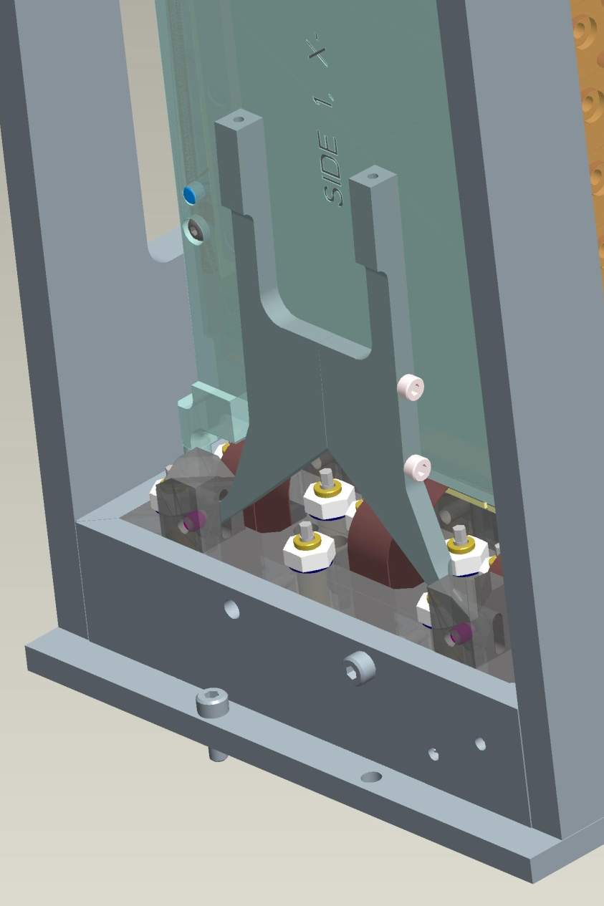
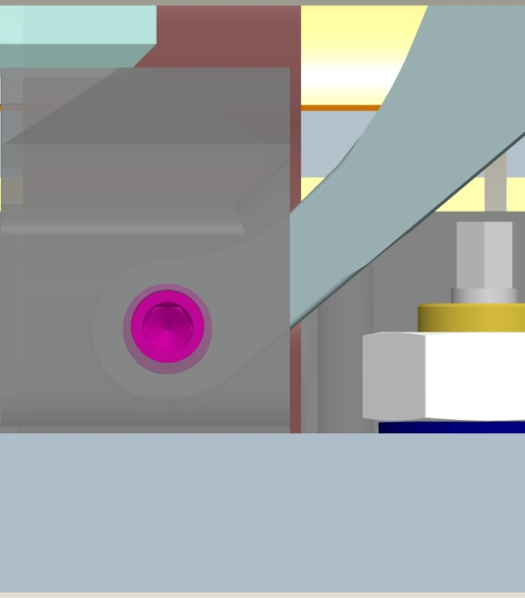
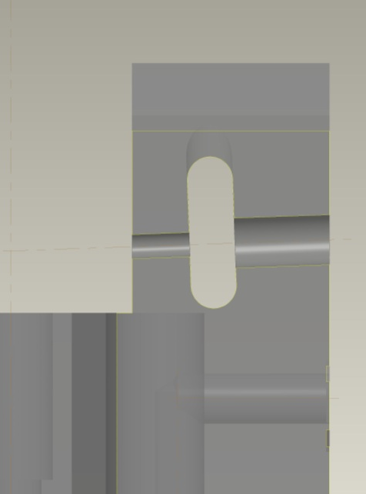
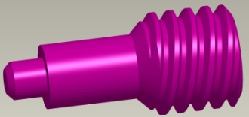
Install hold-down arms

Slide 29
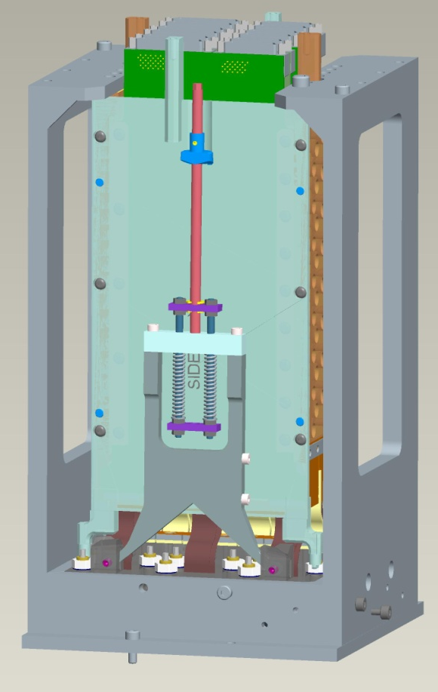
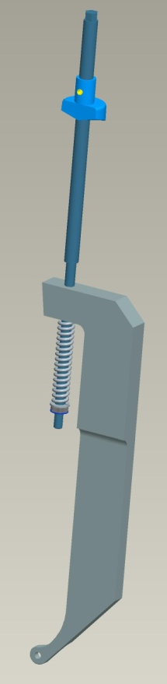
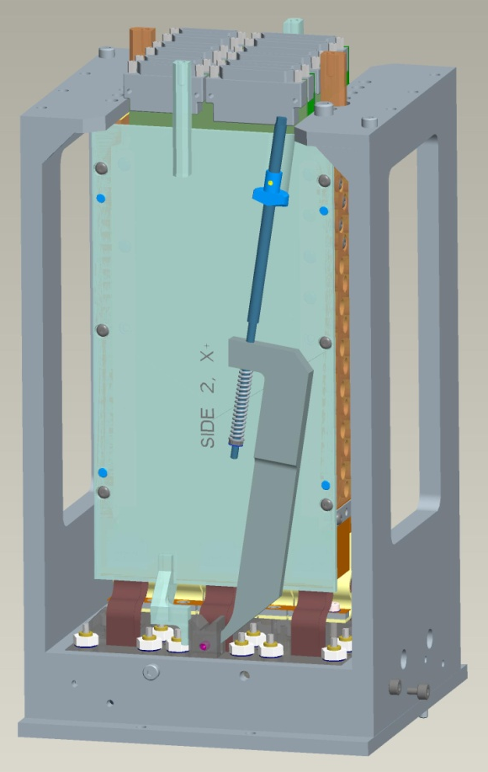
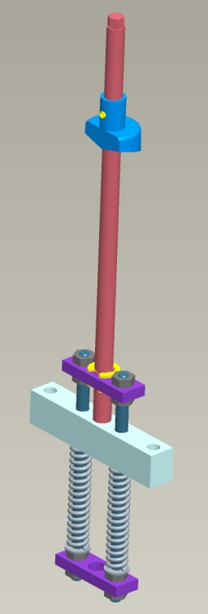
Complete hold-down assys

Slide 30
Tests and Inspection – incoming sensors
Flatness of image surface
Height of image surface wrt mount surface
Alignment pin diameters and location
  Dia 4.000 mm ±0.005
  Pin position held relative to silicon by mfgr
  pins prohibit neighbor collisions, during and after CCD installation on raft
Functional check in dewar (for first units)

Slide 31
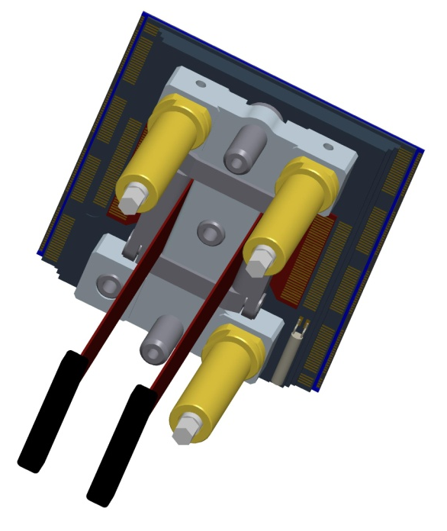
CCD Image Sensor (one mfg option)
ALIGNMENT
PINS
(Invar; Ø4.000 mm)
H-FRAME
(CeSiC)
FLEXI (Kapton)
with nano-connector
Studs or
diff. screws

Slide 32
Tests and Inspection - planarizing
Planarize sensors
  Use OGP Quest 300 laser
  REAL TIME measurement and adjustment
Place planarized Raft-Sensor assy in cold test dewar
Measure both warm and cold with Keyence measuring device to verify flatness and thermal stability; maybe first few assemblies only
Remove from dewar and re-install protective tooling around assy

Slide 33
Tests and Inspection – RTM performance
Remove protective tooling
Install RTM in dewar
  Check hold-down mechanism
Run cold tests
  Check electronics
  Check thermal response
Record results traceable to serialized RTM

Slide 34
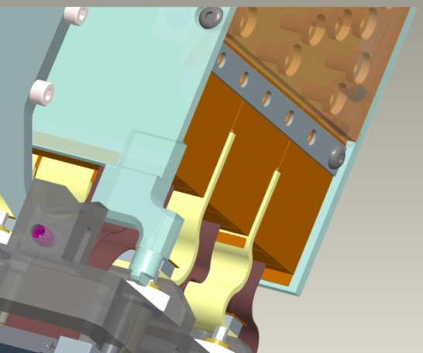
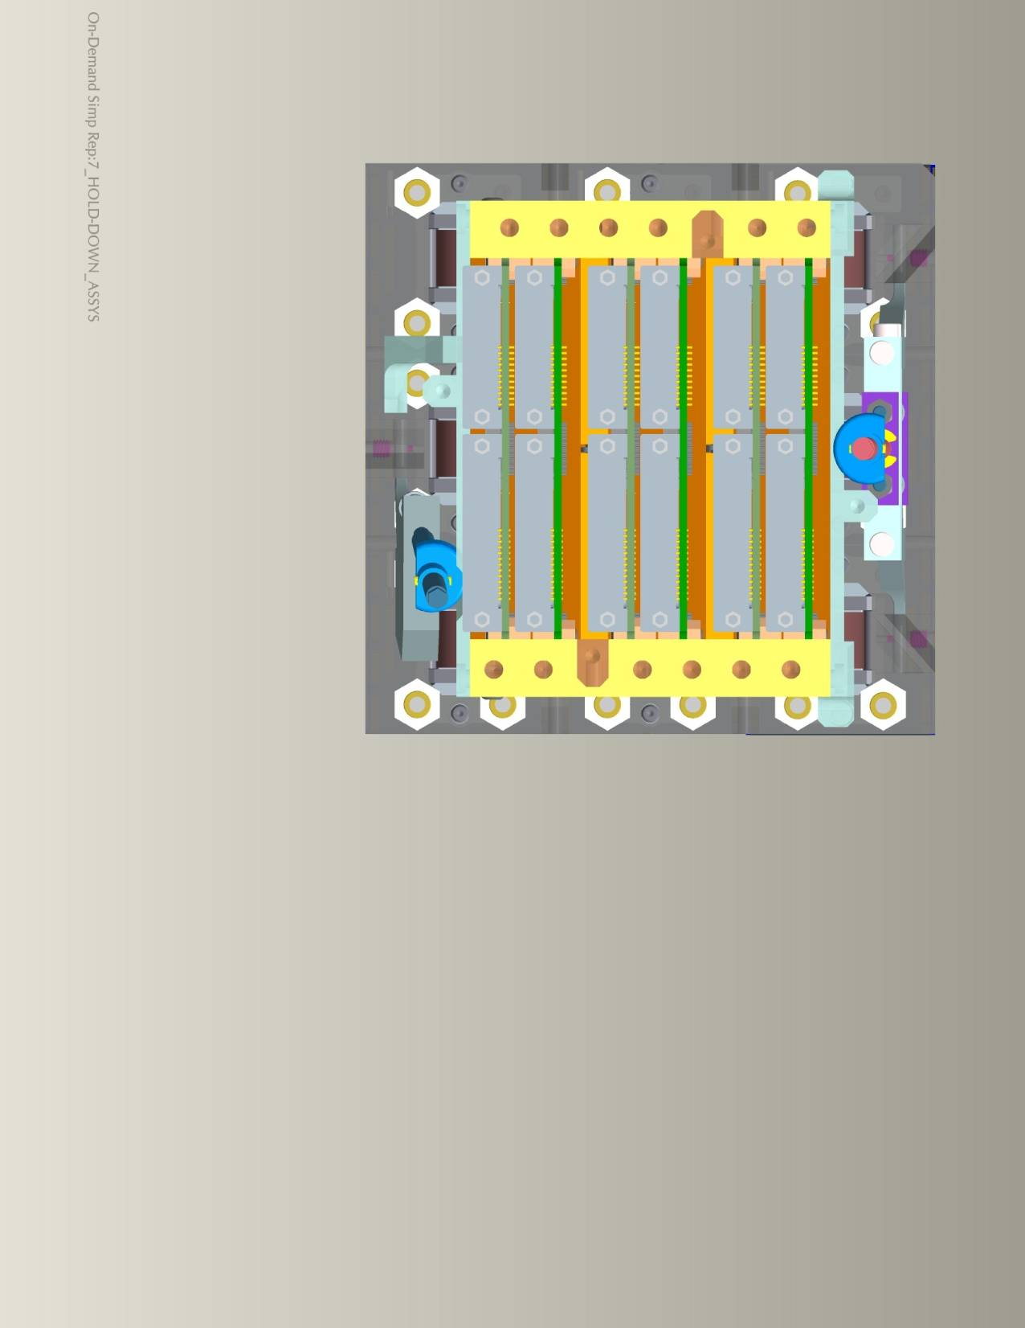
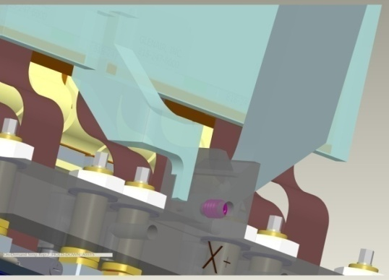
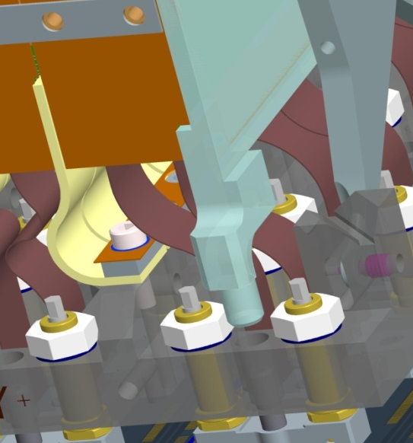
Registry of tower to raft

Slide 35
Extra slides

Slide 36
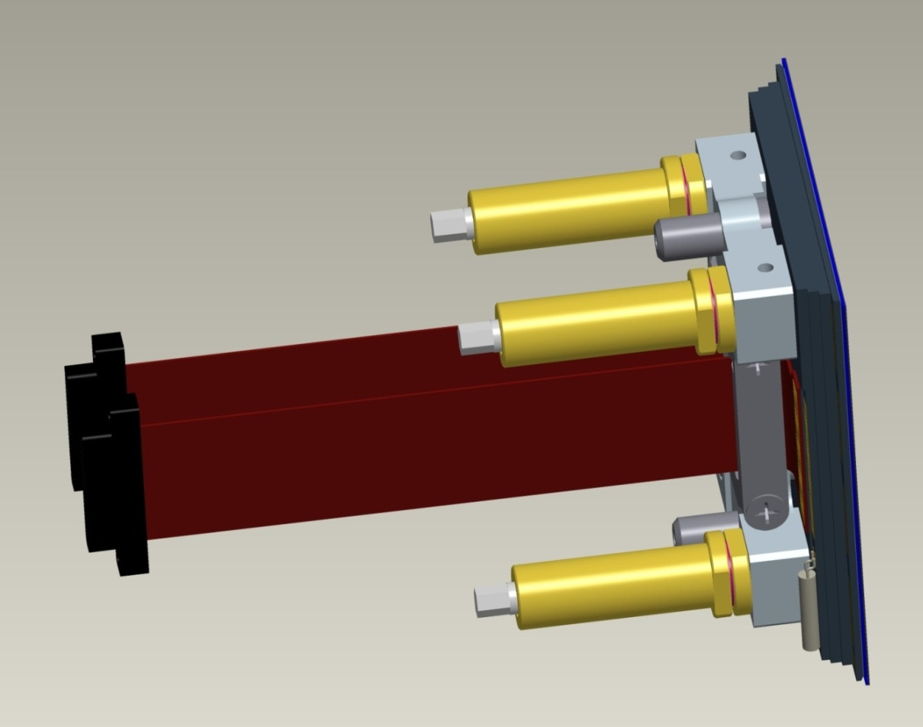
Add Diff Screws to Sensor Pkg – if used
100 & 80 thd/inch
Advance/retract 63.5 μm per turn
5.7 deg. per μm
Wave spring between head and stud eliminates hysteresis

Slide 37
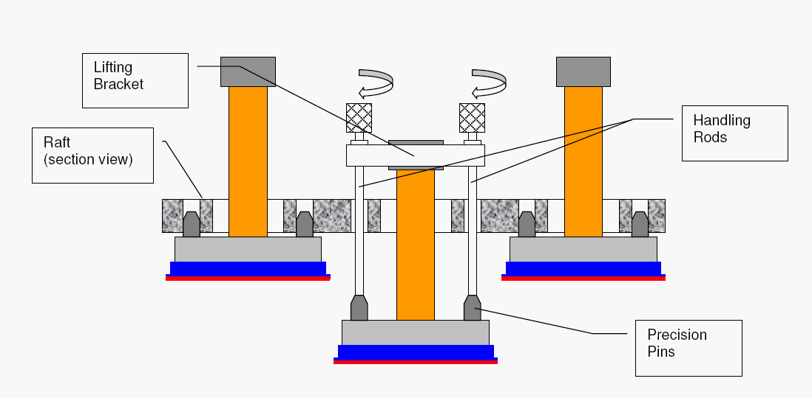
Sensor Package being withdrawn from handling jig onto Raft surface

Slide 38
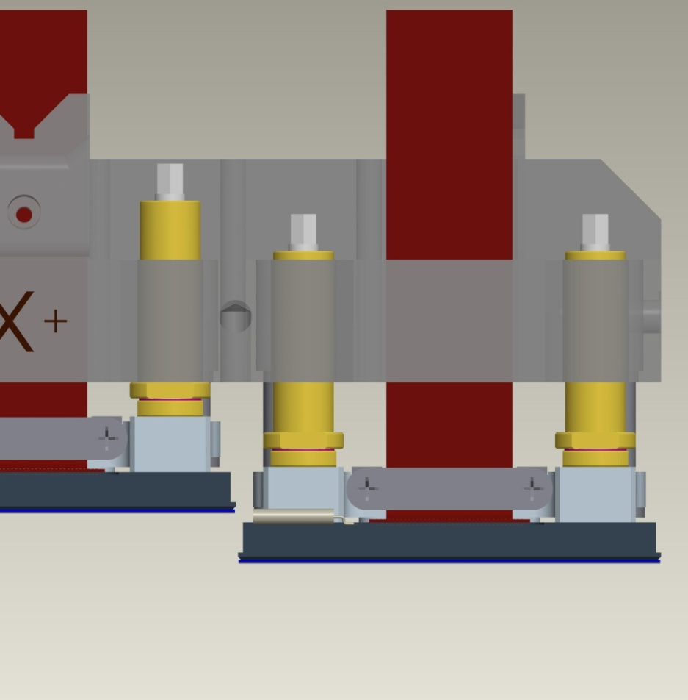
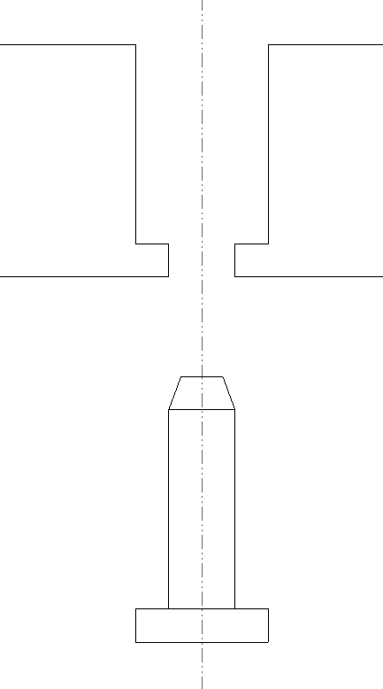
Alignment Pin Engagement
0.9 mm
5 mm

Slide 39
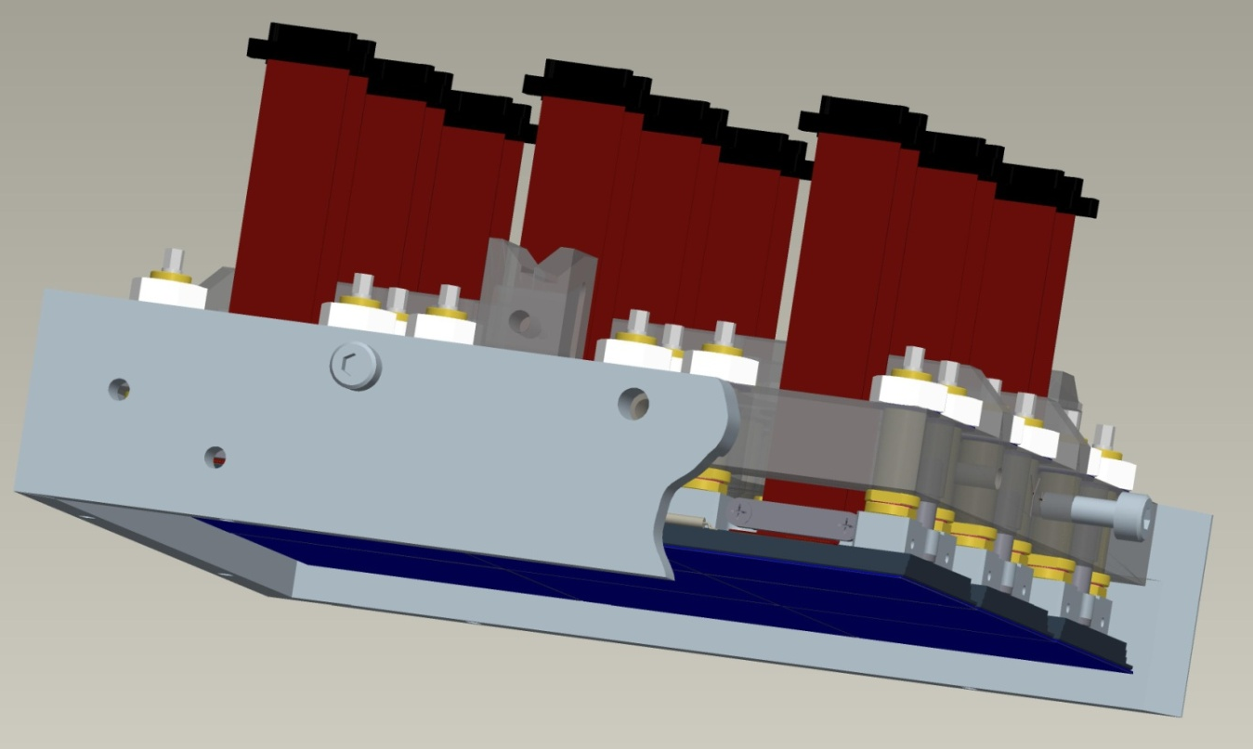
Raft Assy ready for planarization
Hardware (bellevilles and M6 nuts) added to screws
Ready for planarizing, if required

Slide 40
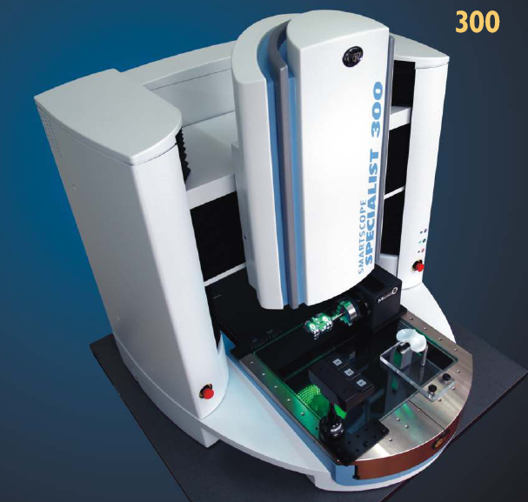
Quest 300 measuring machine
Measurement uncertainty:
  X,Y linear = (1.2+4L/1000) μm
  Z linear = (1.0+5L/1000) μm, using TTL laser
  (L measured in mm)
Can be improved using optical flat in field of view
Range (X, Y, Z, inches)
  Standard = 12,12,10
  Enhanced Z = 12,12,12

Slide 41
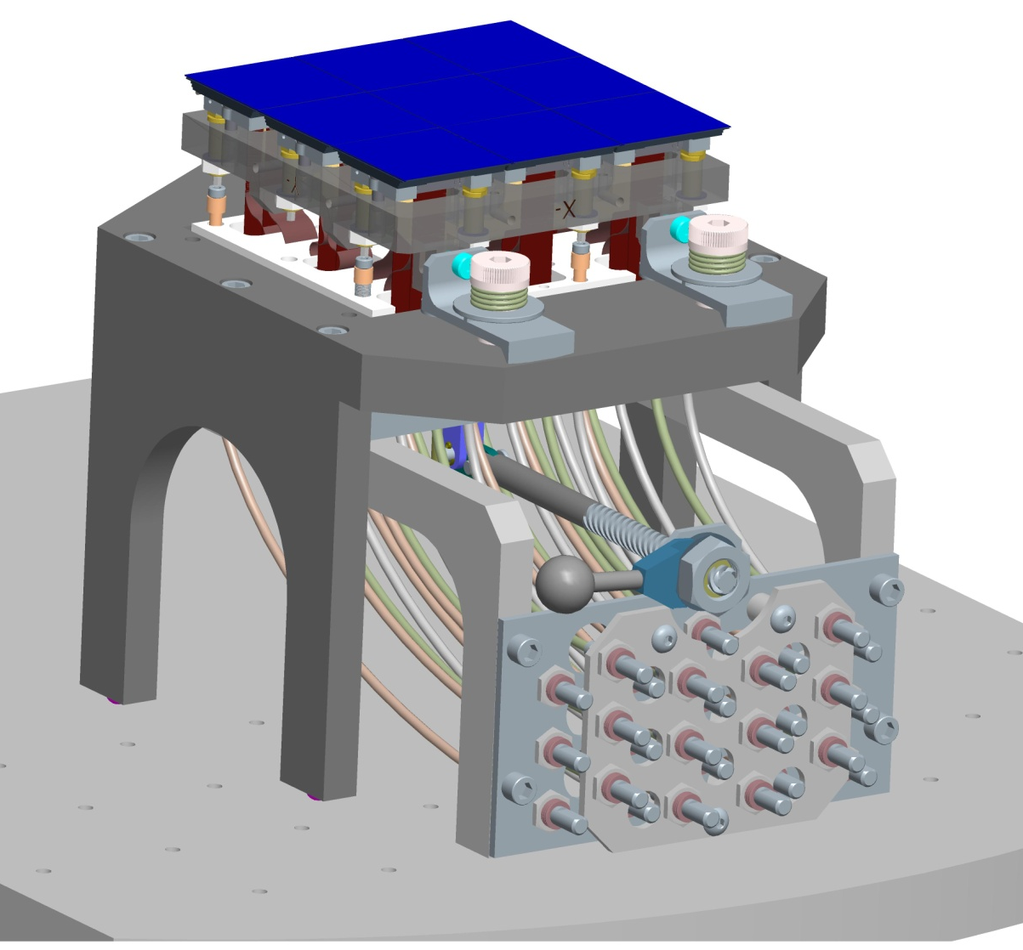
Multiple flexible shafts drive all differential screws
Simultaneous screw engagement with one lever
Once engaged, no Z-force imposed on screw
REAL TIME measurement

