Slide 1
Camera Overview
Nadine Kurita
Project Manager
LSST DOE CD-1 Review
November 1 - 3, 2011

Slide 2
Outline
Camera Project Overview
Camera Design Overview
Design Reviews & Project Risks
Cost & Schedule Summary
Notes:
2

Slide 3
Project Overview

Slide 4
A Broad-based Collaboration of Institutions Has Been Assembled to Deliver the Camera
SLAC National Accelerator Laboratory:
  Overall project management, camera body and mechanisms, cryostat subsystems, data acquisition and camera controls, integration and test
Brookhaven National Laboratory:
  Science sensors, electronics and raft assemblies
Lawrence Livermore National Laboratory:
  Optics, corner raft assemblies, wavefront sensing
Fermi National Laboratory:
  DAQ Analysis tools
Institut National de Physique Nucleaire and de Physique des Particules (IN2P3-Collection of multiple labs):
  Front-end electronics, sensor testing, filters, filter carousel, camera calibration, slow controls
University-based instrumentation groups:
  Harvard, U. of Pennsylvania, Purdue, Ohio State, U. of Illinois, UC Santa Cruz, U. of Arizona, U. of Tennessee, UC Davis
Notes:
4

Slide 5
Contributors – Camera Team
SLAC
  D. Arnett
  T. Azemoon
  G. Bowden
  C. Brackett
  D. Burke
  R. Claus
  S. Digel
  M. Foss
  K. Gilmore
  G. Guiffre
  P. Hascall
  J. Hodgson
  M. Huffer
  W. Innes
  T. Johnson
  S. Kahn
  J. Ku
  N. Kurita
  J. Langton
  H. Leung
  D. Marsh
  S. Marshall
  M. Nordby
  F. O’Neil
  E. Ortiz
  J. Panetta
  A. Rasmussen
  K. Reil
SLAC
  A. Roodman
  O. Saxton
  R. Schindler
  J. Singal
  S. Tether
  G. Thayer
  M. Turri
BNL
  J. Frank
  J. Fried
  J. Haupt
  I. Kotov
  P. O’Connor
  S. Plate
  V. Radeka
  J. Stewart
  P. Takacs
Purdue
  E. Alagoz
  K. Arndt
  A. Biccum
  B. Erny
  I. Shipsey
  B. Xin
  K. Ziegler
IN2P3
  B. Amade
  P. Antilogous
  E. Aubourg
  A. Barrau
  Y. Cargagno
  J. Colley
  G. Daubard
  C. DeLaTaille
  C. Evrard
  R. Flaminio
  J. Giraud
  L. Guglielmi
  C. Juramy
  P. Karst
  D. Labat
  H. Lebbolo
  D. Martin
  M. Migliore
  N. Morgado
  Y. Orain
  E. Perbet
  F. Riviere
  S. Russo
  D. Terront
  V. Tocut
  C. Vescovi
  F. Vezzu
  D. Vincent
  F. Virieux
LLNL
  B. Bauman
  D. Carter
  S. Olivier
  V. Riot
FNAL
  E. Gottschalk
  C. Green
  J. Kowalkowski
Harvard University
  S. Amato
  N. Felt
  P. Doherty
  J. Geary
  J. Oliver
U Penn
  N. Dressnandt
  G. Mayers
  M. Newcomber
  M. Reilly
  O. Rifki
  R. Van Berg
U of Arizona
  E. Cheu
  K. Johns
  D. Tompkins
Ohio State
  K. Honscheid
UC Santa Cruz
  T. Schalk
U Tenn/ORNL
  B. Blalock
  C. Britton
  N. Ericson
  P. Stankus
University of Illinois
  J. Hart
  J. Thaler
Inst. Physics Czech
  P Kubanek
  M. Prouza
UC Davis
  T. Tyson
  UC Berkley
  G. Jernigan
  Color Key
  Institution
  Manager
  Contributor
Notes:
5

Slide 6
Key Staff Identified and Management Structure is Well Understood
Key managers have been appointed in these areas:
  Project Office, System Engineering, Project Administration, Performance & Safety Assurance Managers
  Recent addition to lead Quality Assurance
Large sub-systems are led by:
  Sub-System Manager (physicist)
  Engineering Manager/Sub-system Architect

Slide 7
Product Oriented WBS is Well Defined and Used to Organize All Aspects of the Sub-systems Delivery
WBS | Title | Key Deliverables
3.1 | Management | Project Office, PMCS, performance safety & assurance
3.2 | Systems Integration | Requirements, risk, design integration, system analysis
3.3 | Science Raft System | Sensors, science raft mechanics and electronics
3.4 | Corner Raft System | Sensors, corner raft mechanics and electronics
3.5 | Optics | L1-L2, L3, filters
3.6 | Camera Body & Mechanisms | Camera body, shutter, exchange system, camera cooling
3.7 | Cryostat | Cryostat housing, grid, utility trunk, refrigeration system
3.8 | Control System, DAQ and System Electronics | Control system & DAQ software/hardware, power supplies, protection system
3.9 | Integration & Test | Integration and testing of the above deliverables
LCA-125, WBS Dictionary

Slide 8
Responsibility Assignment Matrix Defines the Accountability of WBS Deliverables
More detailed RACI (Responsibility, Accountability, Consulted, Informed) is being developed
Revision 1 |  |  | Responsibility Assignment Matrix | N. Kurita SLAC | M. Nordby SLAC | J. Langton SLAC | J. Ku SLAC | M. Huffer SLAC | J. Stewart BNL | R. Van Berg Upenn | V. Riot LLNL | J. Thaler U. Illinois
 |  |  | A = Accountable
 |  |  | WBS Name
3 | .01 |  | Management | A
3 | .02 |  | Systems Integration |  | A
3 | .03 |  | Science Raft System |  |  |  |  |  | A
3 | .04 |  | Corner Raft System |  |  |  |  |  |  |  | A
3 | .05 |  | Optics |  |  |  |  |  |  |  | A
3 | .06 |  | Camera Body & Mechanisms |  |  |  | A
3 | .07 |  | Cryostat |  |  | A
3 | .08 |  | Control System, DAQ and System Electronics |  |  |  |  |  |  |  |  | A
3 | .08 | .01 | Camera Control Core (CCC) |  |  |  |  |  |  |  |  | A
3 | .08 | .02 | DAQ |  |  |  |  | A
3 | .08 | .03 | Camera System Electronics |  |  |  |  |  |  | A
3 | .09 |  | Integration and Test |  | A

Slide 9
Camera Design Overview

Slide 10
Key Technical Challenges that Drive the Camera Design
3.2 Gigapixel camera, large focal plane (63.4-cm diameter) with small (10 micron) pixels
  189 sensors, 4 side buttable with 250 micron interchip gaps
  Deep, fully depleted CCDs with novel AR coating allow for broad spectral coverage
Fast readout (3.2 Gigapixels in 2 seconds) led to sensors with 16 segments
Low noise coupled with the large number of signal lines
  Analog and digitizing electronics in the cryostat
  Increased capacity needed for focal plane cooling system
Tight constraints on envelope, mass, and dissipation of heat to ambient
Tight alignment and flatness tolerances (13.5 micron p-to-v) on the sensor array
Large curved filters with broad spectral coverage and tight uniformity
As this is the only instrument for the observatory, it needs to provide 10 years of continuous operation (reliability and maintainability)

Slide 11
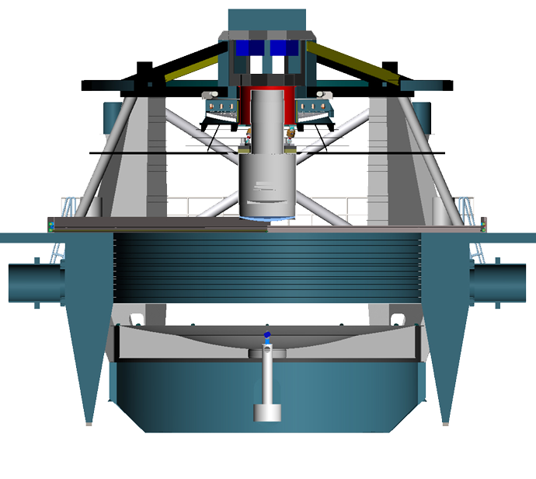
Designs Meet the Tight Constraints and All Subsystem Interfaces to Camera are Defined
M2 Mirror
Key interfaces:
Weight,
Size,
Heat,
Utilities,
Handling,
Controls.
Camera
M1M3 primary mirror
Cross section through telescope and camera

Slide 12
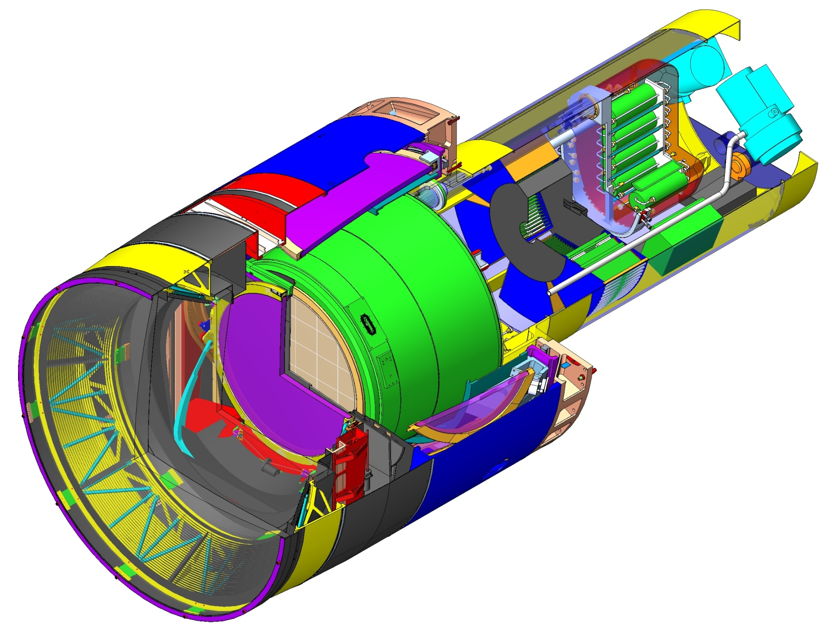

Camera Layout
System parsed into constituent elements
Understand their functionality and how they fit and work together
Focal plane
Utility Trunk—houses support electronics and utilities
Cryostat—contains focal plane & its electronics
Camera Parameters
Property | Value
Lifetime | 15 years
Incident half-angle in air | 14.2º-23.6º
Focal plane diameter | 634 mm
Maximum mass | 3000 kg
Maximum diameter | 1650 mm
Total length | 3732 mm
1.65 m
(5’-5”)
L3 Lens
Filter
L2 Lens
L1 Lens
Camera ¾ Section

Slide 13
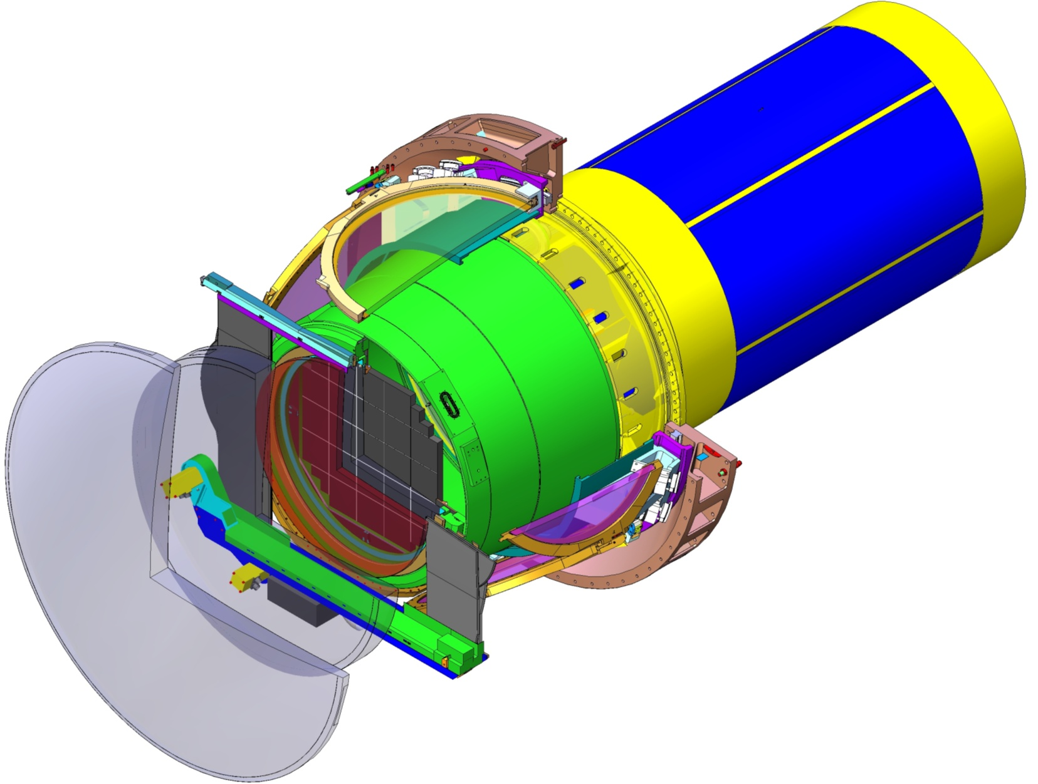
Layout of Camera Optics
Cryostat
Shutter
Detector plane
Utility Trunk
Camera Optical Parameters
Property | Value
L1 clear aperture diam | 1550 mm
L1-S1 spherical radius | 2824 mm
L1 center thickness | 82.23 mm
L2 clear aperture diam | 1102 mm
Filter clear aperture diam | 750 mm
Filter thickness range | 14.2-26.2 mm
L3 clear aperture diam | 722 mm
L3 center thickness | 60 mm
L3 Lens
Filter
L2 Lens
L1 Lens
Camera Optical Elements

Slide 14
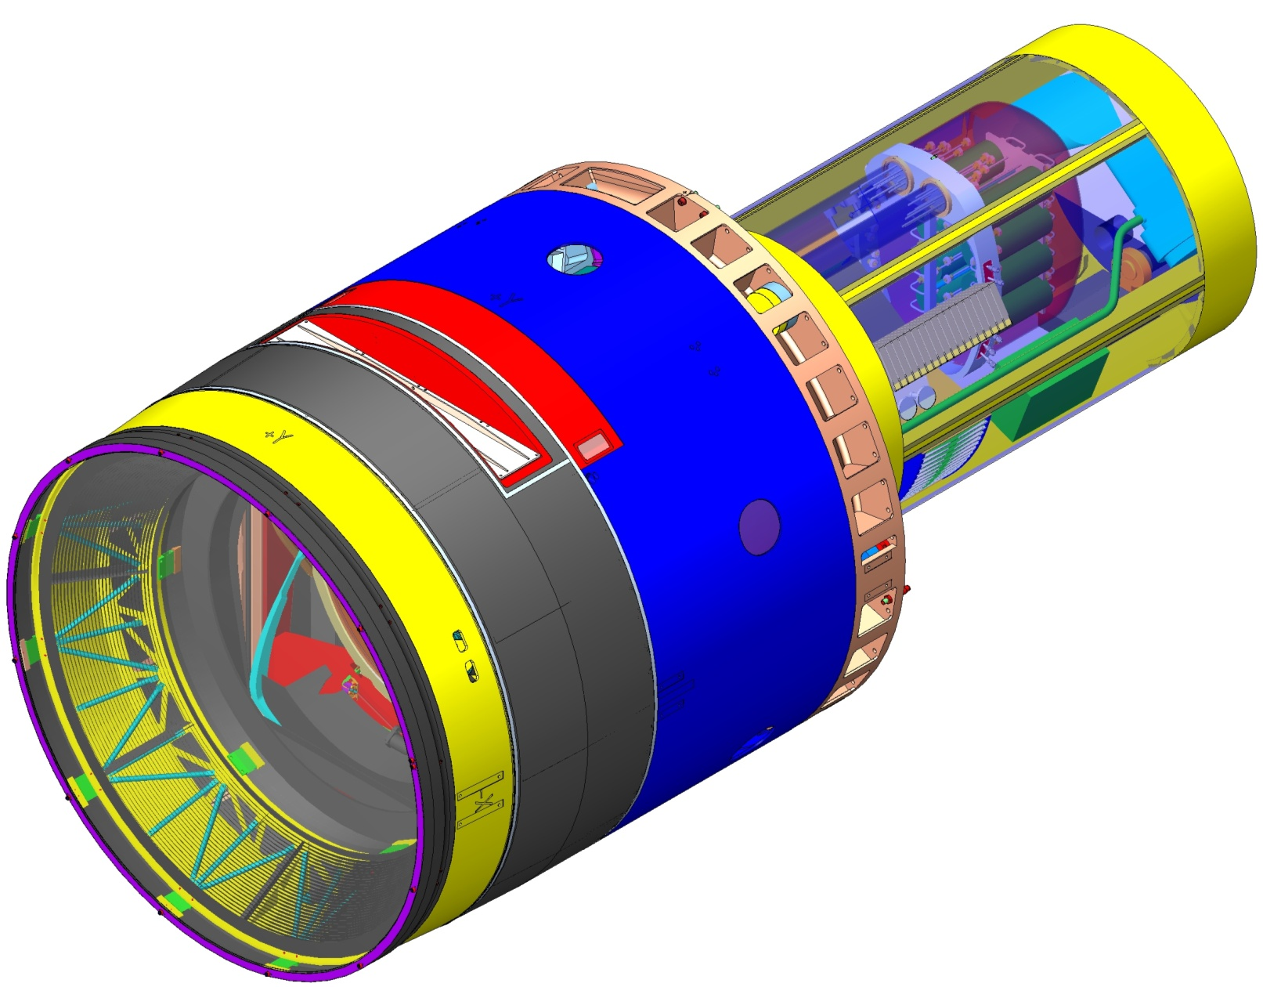
Fully-Integrated Camera
Camera Housing—supports the entire camera
Filter Loader access port—for swapping out a filter during daytime access
L1-L2 Assembly—pre-assembled structure holds both lenses
Utility Trunk—outer panels removed
Back Flange—mechanical interface to telescope
Camera Parameters
3.2 Gigapixels
0.2 arcsec pixels
9.6 square degree field-of-view
2 second read-out
f/1.2 beam = short depth-of-focus
Broad spectral coverage: 350–1040nm
Flexible Skirt—hermetically seals Camera housing
Fully Assembled Camera

Slide 15
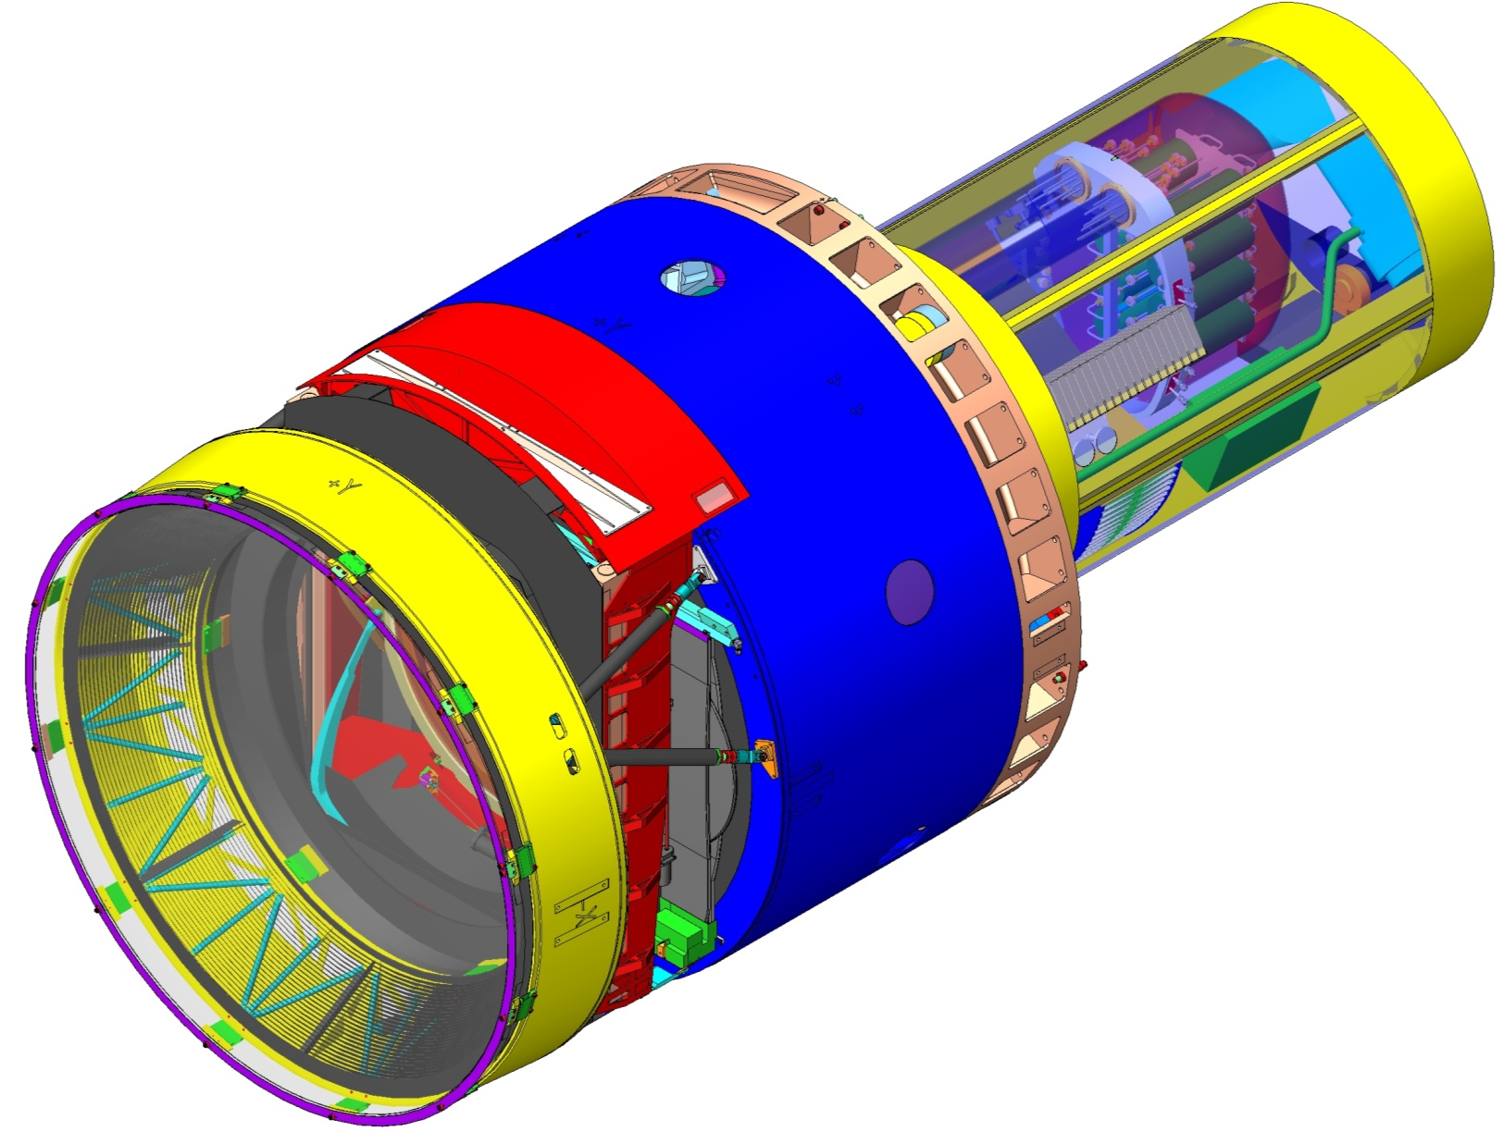
Skirt Removed: Standard Maintenance Configuration
Auto Changer frame
L1 support ring space frame
L1-L2 support struts
Light baffle rings
Region for access to mechanisms and lenses
Camera Opened for Access

Slide 16
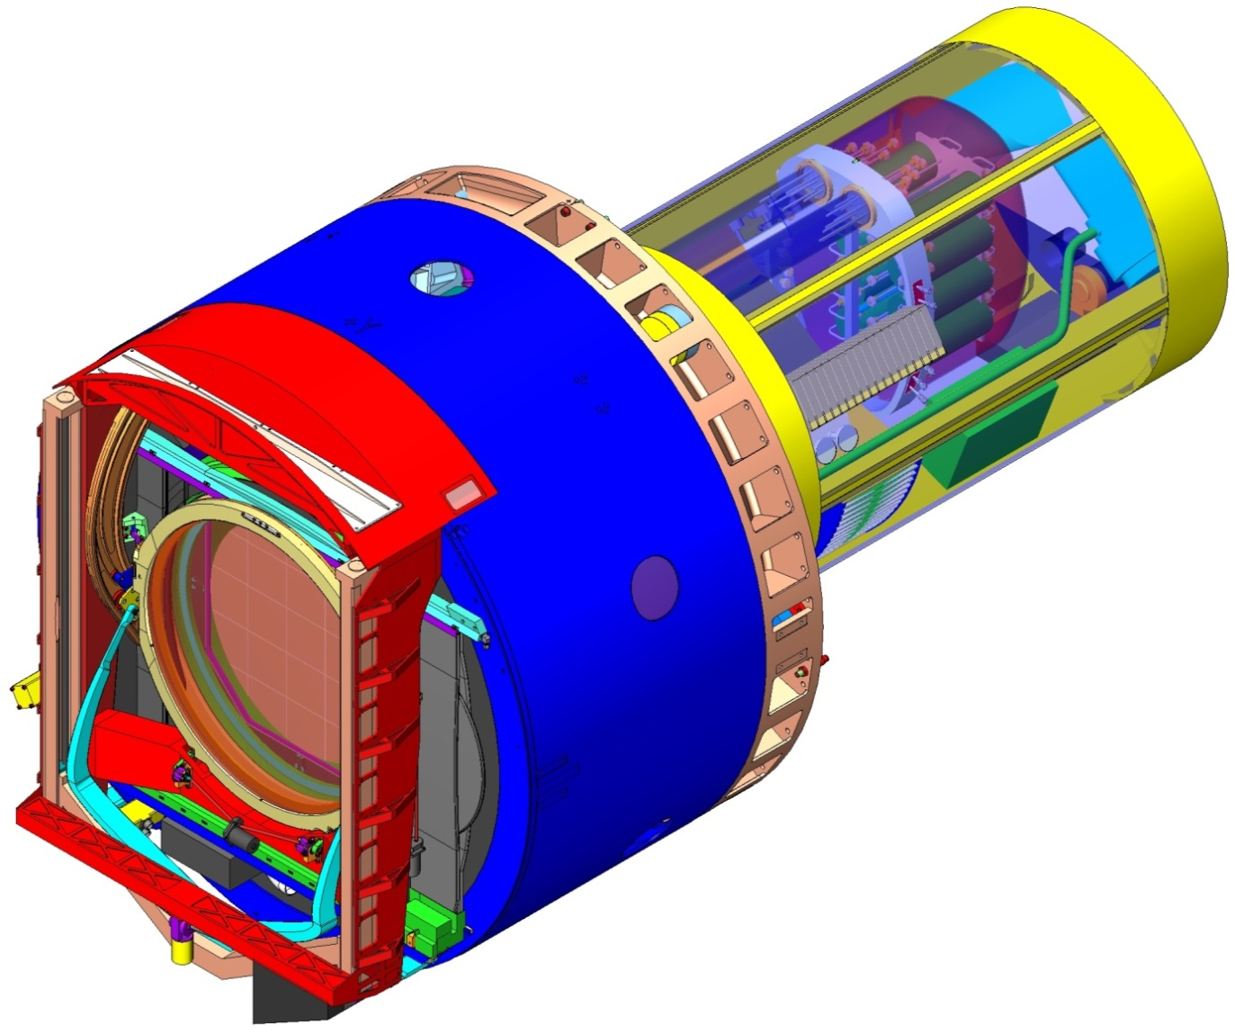
L1-L2 Assembly Removed: Exposing Auto Changer
Auto Changer structure mounts to Camera Body
Manual Changer access port aligns with Auto Changer rails
Auto Changer drive linear actuator
Auto Changer filter rail
Exchange System Primary Functions
Supports a filter in the field of view (a.k.a.: “on-line”) during observations
Stores filters in the clean environment of the Camera
Moves filter into the field of view by remote command during observations
Accommodates removal/replacement of filter(s) from/to the Camera
Filter
Shutter rail
L1-L2 Assembly Removed

Slide 17
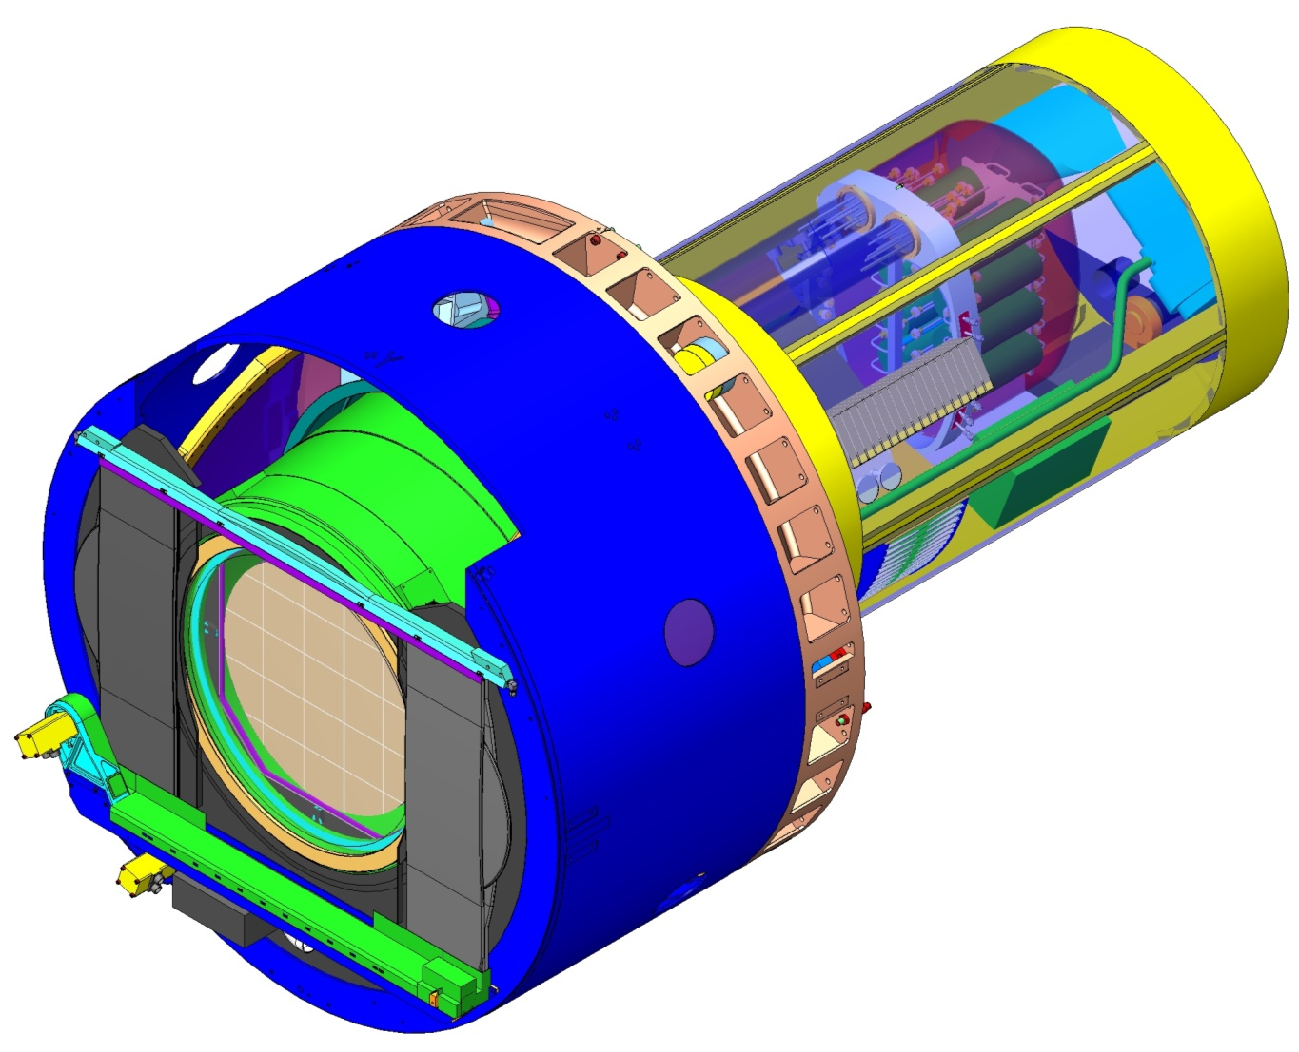
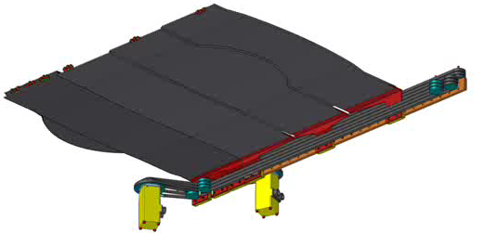
Auto Changer Removed: Showing Shutter
Guide rail supports blade tips
2 sets of 3 stacked blades
Drive rail housed in dust cover
Shutter Parameters
Property | Value
Activation time | 1 sec
Clear opening aperture | 734 mm
Min clearance to L3 lens | 10.8 mm
Auto Changer Removed
Shutter Animation

Slide 18
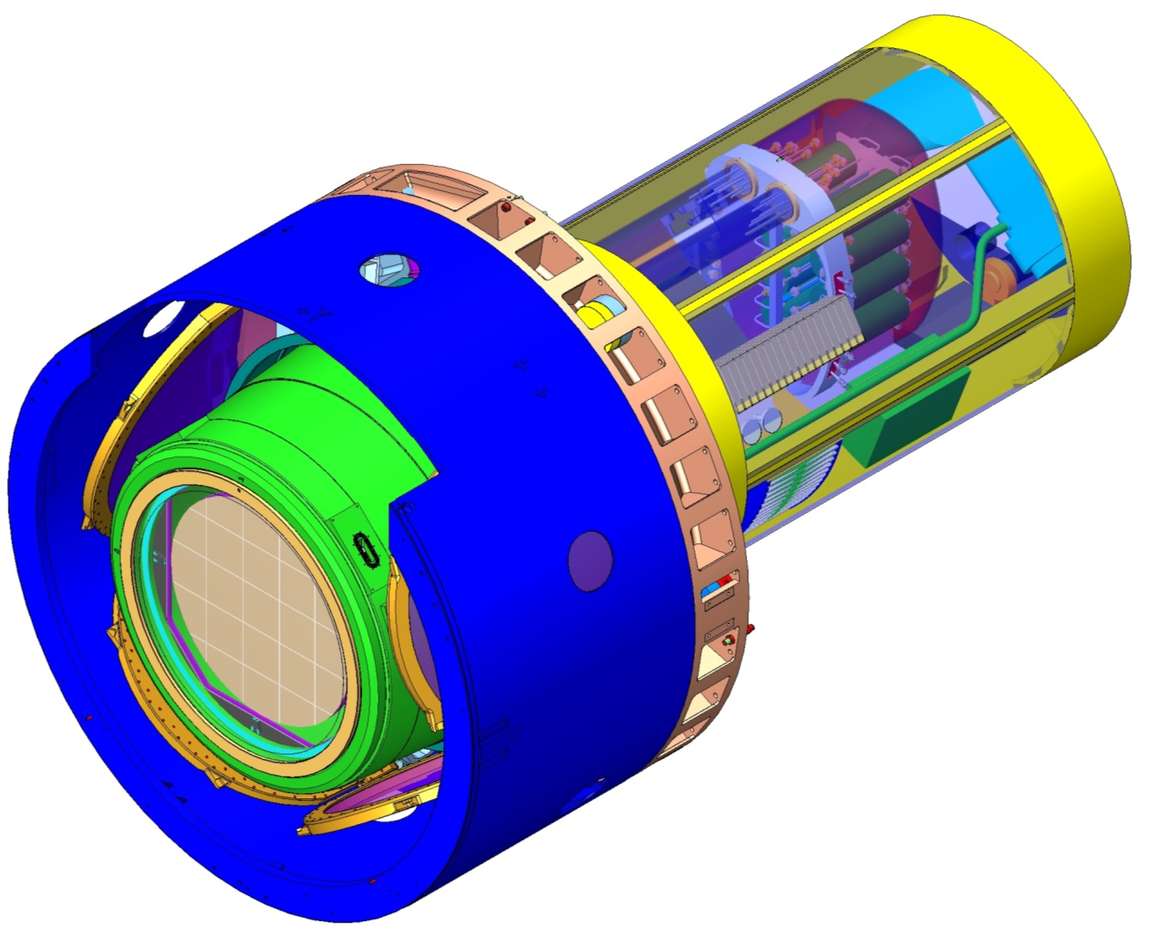
Shutter Removed: Exposing L3 Lens and Front of Cryostat
Gusseted back flange
Outer housing and front stiffening flange
Cryostat outer housing
1—Camera Body Integrating Structure
Provides primary support for L1, L2 lenses, filters and exchange system
Maintains clean, hermetically sealed environment for all optics
Presents primary structural interface to telescope at back flange
Presents primary thermal interface to telescope at outer housing
Segmented detector plane CCD’s visible through L3 Lens
Shutter Removed

Slide 19
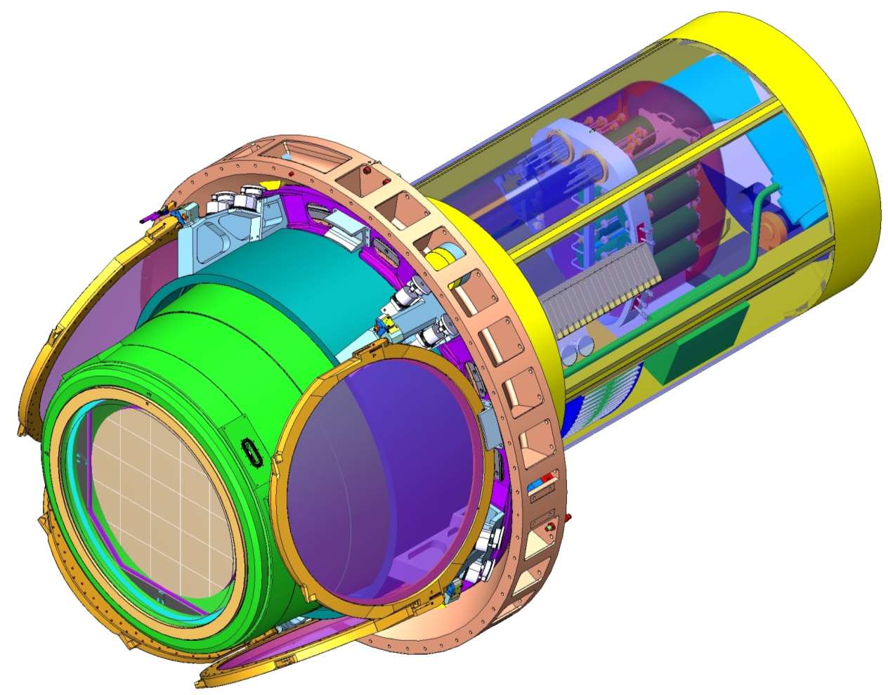
Camera Housing Removed: Showing Filters in Carousel
Filter clamp mechanism—holds filters in Carousel
Off-line Filters—stored in annular region surrounding Cryostat
L3 lens mounted to front of Cryostat
Carousel structure—rotates to position selected filter in position to bring on-line
Exchange System Parameters
Property | Value
Filter clear aperture diam | 756 mm
Max exchange time | 90 sec
Max filter mass | 35.5 kg
On-board filters | 5
Carousel and Cryostat Exposed

Slide 20
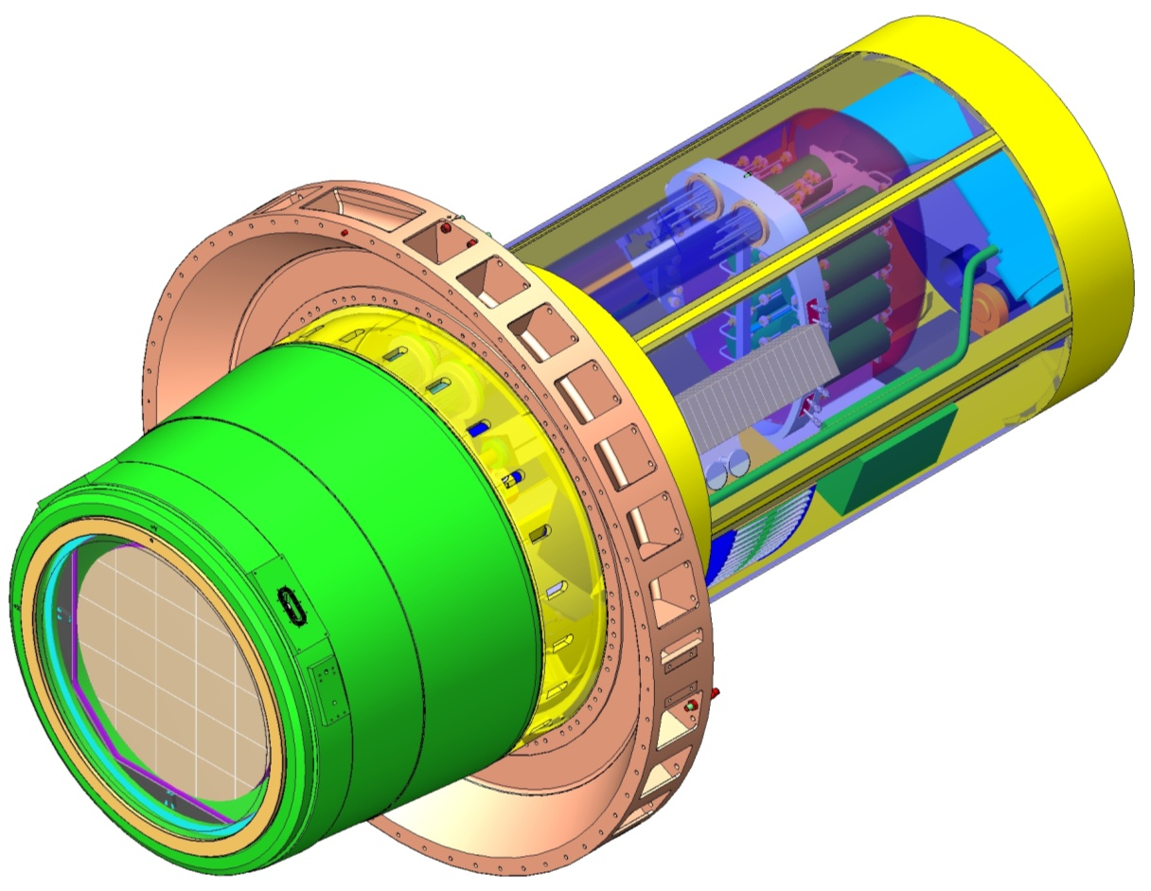
Carousel Removed: Showing Cryostat and Utility Trunk
Bulkhead panel for all camera services
Cryostat support cylinder—cantilevers off back flange
Cryostat housing
Utility Trunk structure
Back flange mounts to telescope rotator
L3 lens
Cryostat Cantilevered off Back Flange

Slide 21
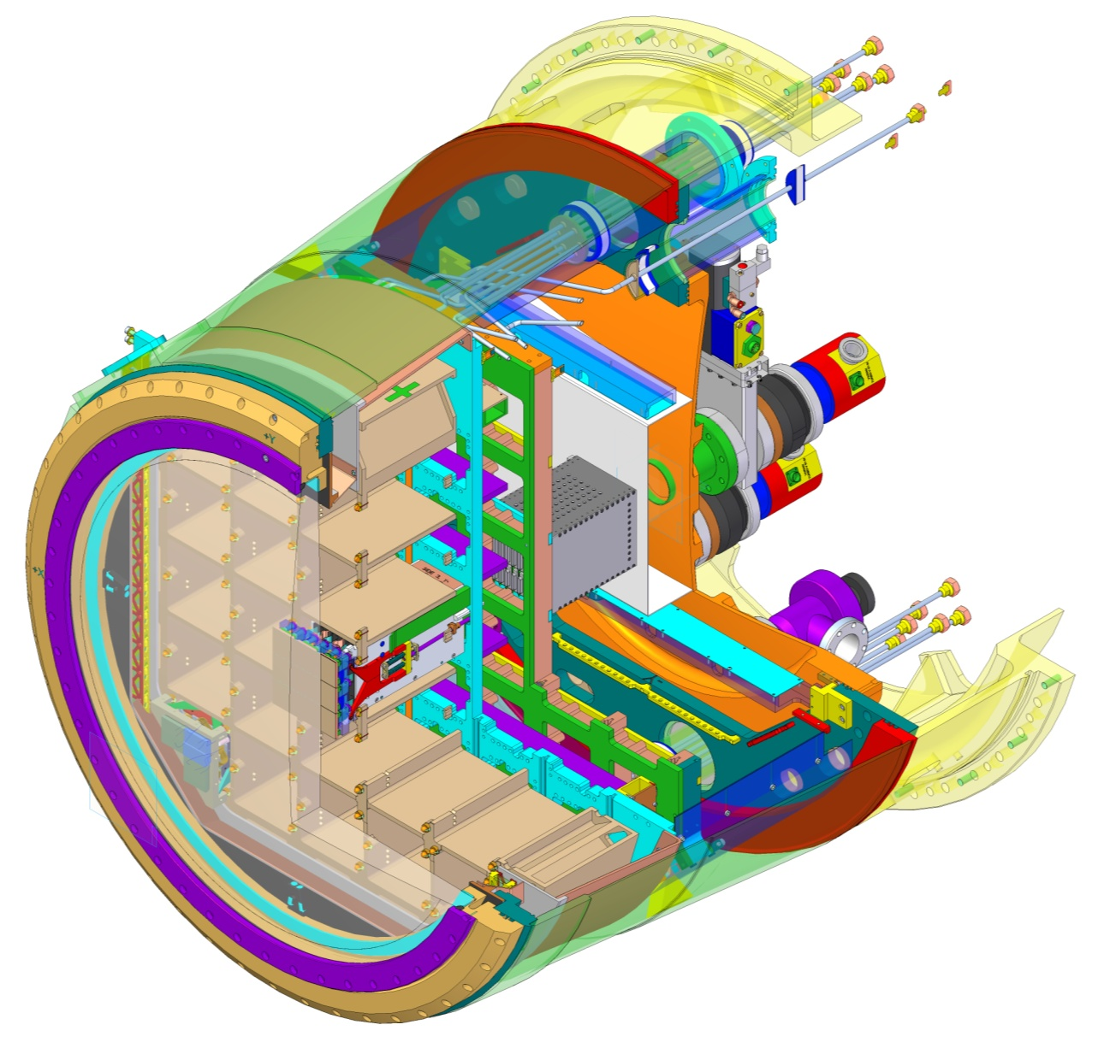
Cryostat Section: Showing Raft Towers
Raft Control Crate—digitizing electronics in copper structure
(-35 ºC)
Front End Crate—front end electronics in copper structure
(-120 ºC)
Raft Sensor Assembly—9 CCD’s on support plate with ball/groove mount to Grid
(-100 ºC)
Pump plate and vacuum system components
(~5 ºC)
L3 flange (~5 ºC)
L3 lens (~-5 ºC)
2—Cryostat Integrating Structure
Provides stable support for CCD detectors on focal plane
Provides stable thermal control of cold CCD’s and front end electronics
Removes all process and radiant heat
Maintains CCD’s in clean high-vacuum environment to prevent contamination
Cryostat housing—vacuum envelope, support structure
(~5 ºC)
Cold Plate—supports and cools Raft Control Crates
(-40 ºC)
Grid—supports Rafts
(-125 ºC)
Cryo Shroud—shields Grid from radiant heat
(-130 ºC)
Cryo Plate—supports and cools Front End Crates
(-130 ºC)
Cryostat Section

Slide 22
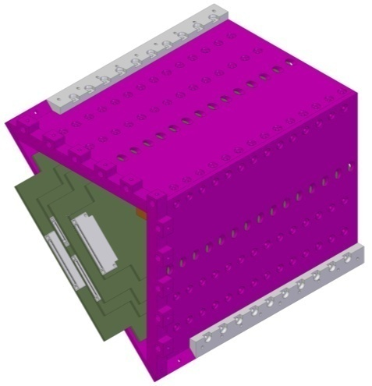
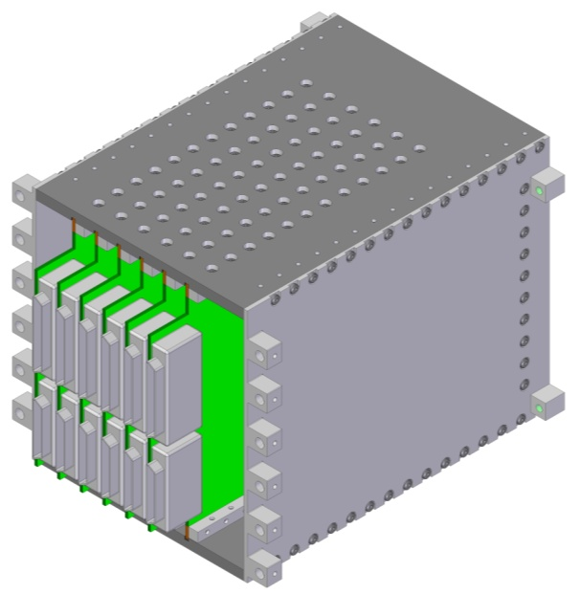
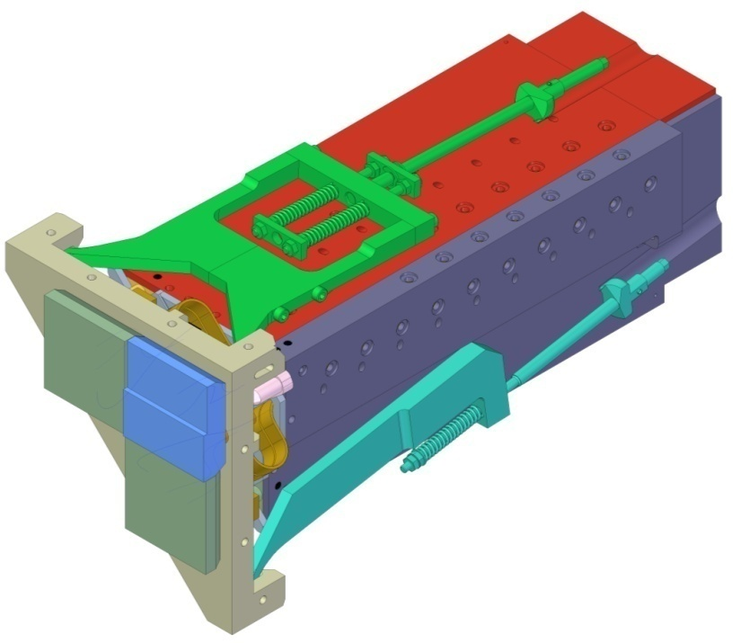
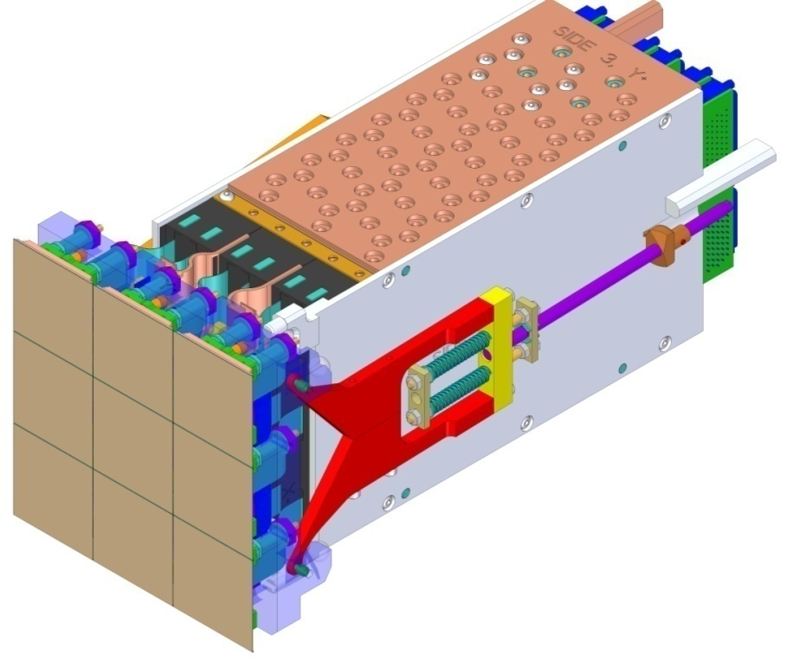
Science and Corner Raft Towers
Corner Raft Control Crate—mounts to Cold Plate
Front End Crate—triangular shape fits in Grid corner bays
Corner Raft Tower
4 towers, one in each corner
Split wavefront sensor
Guide sensors
Raft Control Crate—mounts to Cold Plate
Science Raft Tower
21 towers
Spring-loaded hold-down clamp—supports Raft off Grid

Slide 23
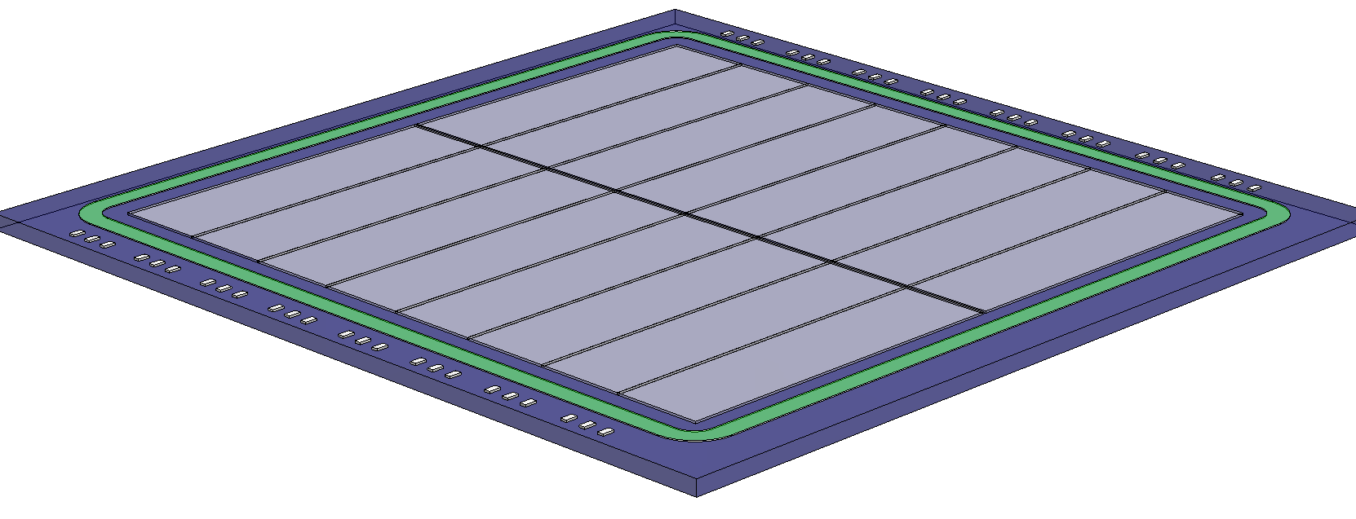
The LSST Focal Plane – 63.4 cm in diameter
Bonding Pads
Sixteen 1-Mpix segments 10mm pixels
100μm thick,
5kΩ-cm Si
Wavefront Sensors (4 locations)
Guide Sensors (8 locations)
42mm
3.5 degree Field of View (634 mm diameter)
Entrance Window on Back Side
Guard Ring
Wavefront Sensor Layout
2d
Focal plane
Sci CCD
40 mm
Curvature Sensor Side View Configuration

Slide 24
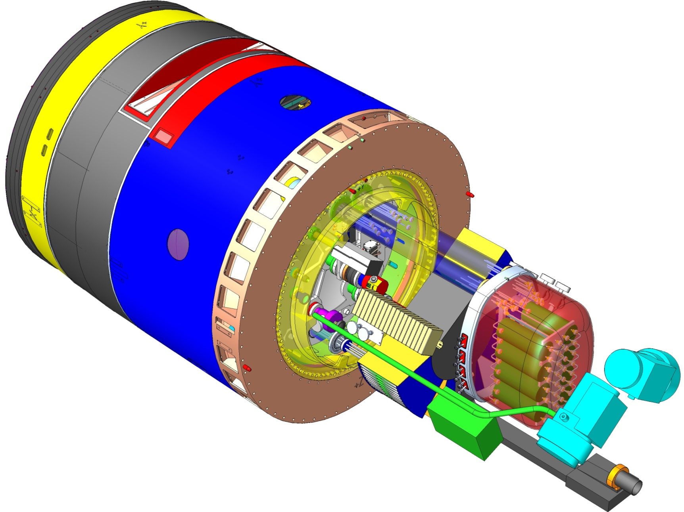
Reverse-Angle Camera View: Utility Trunk Contents
3—Utility Trunk Integrating Structure
Houses all on-telescope support utilities and services for the Camera
Provides a single location for disconnect of all lines to the Camera
Cools all support utilities using chilled air from telescope top-end plenum
Allows for access to electronics crates during camera servicing
Maintains clean, sealed environment for all utilities
Scroll pumps for vacuum systems
Utility Trunk structure (not shown) is cantilevered off the back of the Cryostat support tube
Utility Trunk cooling blower/filter unit
DIN rail for protection system controllers
Control crates for support electronics—timing module, power control, optical transition module, ethernet switch
Utility Trunk Contents
Heat Exchanger Canister for refrigeration system

Slide 25
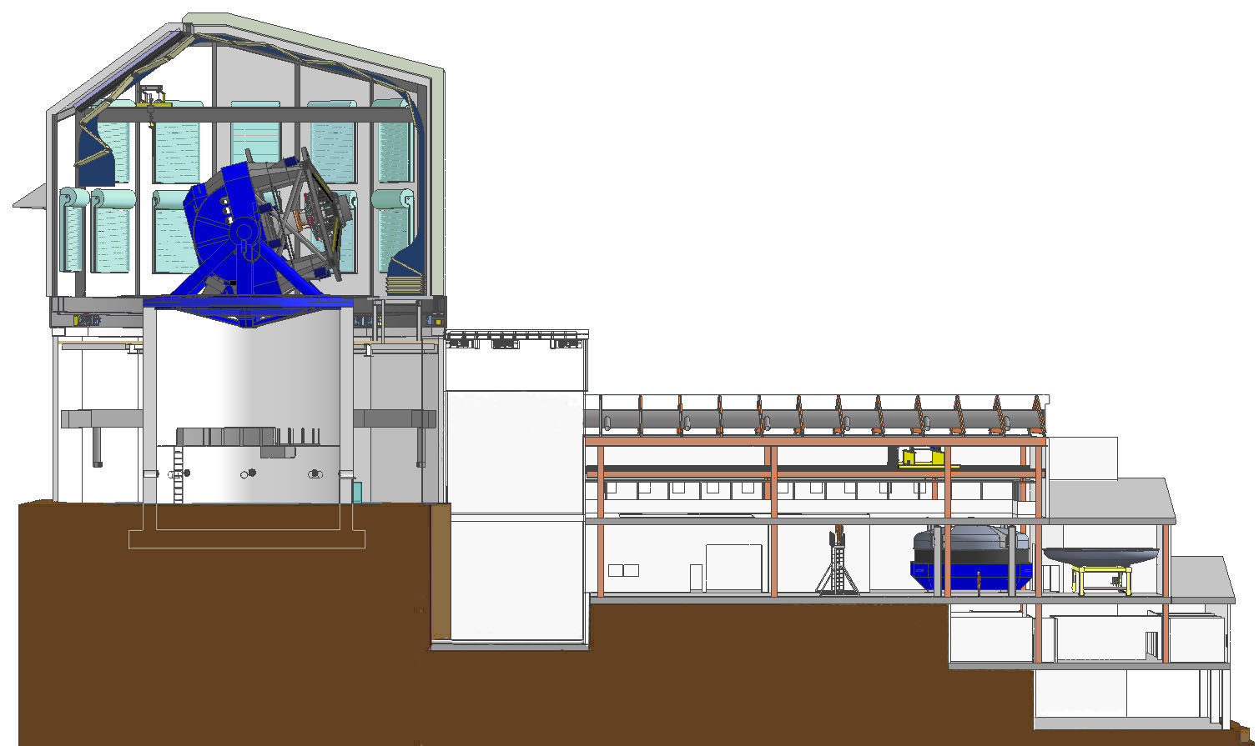
Camera Off-Telescope Components
Refrigeration system ground unit
Compressor chassis
Servicing and mixing equipment
Camera Control System
Computer rack
Camera Data Acquisition System DAQ computer
Data storage
Utility Room
Computer and
Control Rooms
Elevation View of Dome and Summit Facility

Slide 26
Design Reviews & Project Risks

Slide 27
Design reviews are required by the Project Office and well documented
LCA-98: Documents process and procedure
Project Office Required Reviews
  System Function Review/Requirement Review
  Development Review
  Conceptual Design Review (CoDR)
  Preliminary Design Review (PDR)
  Final Design Review (FDR)
  Manufacturing Readiness Review (MRR)
  Pre-ship or Integration Readiness Review (PSR/IRR)
  Safety Reviews

Slide 28
Successfully held System Requirement Review and Sub-System Conceptual Design Reviews
Oct 2010 – Preliminary System Function Review
Nov 2010 – Filter Exchange System Review Complete
Feb 2011 – Science Rafts & Electronics, CCS & DAQ Complete
May 2011 – Camera System Requirements, Camera System Design, Camera I&T, Shutter and Cryostat
Aug 2011 – Optics
Two “Request for Immediate Action” (RFA1) before moving to the next phase
  Filter Exchange System Requirements (closed)
  3rd Sensor vendor (working)
    Discussions with HEP to obtain additional funds to engage a third vendor have indicated that they will make a decision pending the outcome of the current prototype results.
      e2V has produced 2 working sensors and initial tests are promising.
      ITL will have produced sensors in early November and will provide testing results in December.
Sub-System Development Reviews Complete
  Internal reviews held in FY10
  On-going reviews by sub-systems to address their development plans and how they “burn down” their risks.
June 2011 – SLAC CD-1 Director’s Review
Notes:
“

Slide 29
Laboratory and Agency Reviews
Aug 2011 – NSF PDR
  “Camera team composition and organization is excellent and the project is being managed very well”
  “Although the Camera project is composed of one hundred and eleven persons (~30 FTEs) spread over four DOE laboratories, nine universities and one foreign organization, the team is cohesive and well--‐organized. The panel believes the good teamwork and high level of staff motivation is the result of the following.
    A clearly defined management structure, with well--‐defined roles and responsibilities.
    Strong and supportive project management.
    Open and frequent communication within the Camera project team and with the LSST project staff.”
October 2011 – SLAC CD-1 Director’s Review
  Successfully held and found “Ready for CD-1”

Slide 30
Project risk management process used to manage camera development, LCA-29
Camera risks documented in registry, LCA-30
Actively planning development work to burn down risks and monitor progress
  131 total risks identified
    Managing 74 active risks
    40 are closed
  5 top risks have detailed mitigation plans and key milestones to monitor progress
    Science CCD performance (17.3/25)
    Refrigeration Performance (14.7/25)
    Guide CCD performance (13.3/25)
    CCD Yield (13.3/25)
    Filter coating performance (13/25)
Others resolved through the normal development /engineering design process
Camera risks are well understood and development plans and funding is supporting their mitigations
  Development plans are documented & submitted by sub-systems.
  Development reviews were executed during the R&D phase by all sub-systems.
Notes:
30

Slide 31
CCD Performance Risk Mitigation Plan
(Risk ID CA1)
CD-3b- Review
CD-1 Review
CD-3a Review
CD-2 Review
Start Camera I&T
Camera Verification
PreShip Review
Technology study
Understand and model device characteristics
Study contract – 3 vendors
Receive working sensors
Technology choice
Establish test lab at BNL
IF the CCDs do not simultaneously meet k3bey requirements (flatness, read noise, crosstalk, diffusion PSF), THEN the camera will not meet the throughput and image quality allocations.
Critical
Full-Spec Sensor Prototype
Multivendor competition
Fabricate sensor meeting all LSST specifications
e2v funded to develop full-spec science sensor & mechanical package
  Mech samples received
  First operable test samples received Sep 2010
  Redesigned operable samples Nov 2011
  Operable samples with final AR coat Feb. 2012
ITL/STA delivered mech package and test device
  First fully tested operable samples Dec 2011
High
Risk Exposure
Moderate
Manufacturability/Yield Runs & Raft Integration
Prototype Raft
Demonstrate yield and quality control
Develop integration and QA test capability within LSST collaborating institutions
Minor
First Article Fabrication, Yield Runs & Raft Integration
Full Fabrication & Acceptance Process Finalization
Prototype Raft Tower with system electronics
Demonstrate yield and quality control
Full automation of QA test within LSST institutions
Assembly/test rate trials
Insignificant
Current Assessment
Fiscal Years
2007
2010
2011
2012
2013
2014
2015
2016
2017
2018
2019
Notes:
31

Slide 32
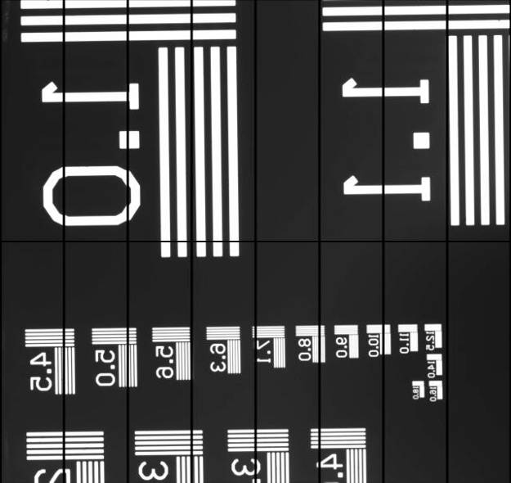
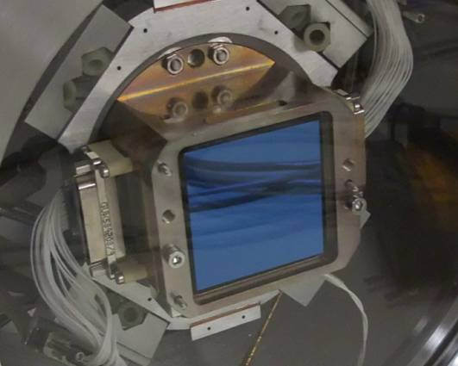
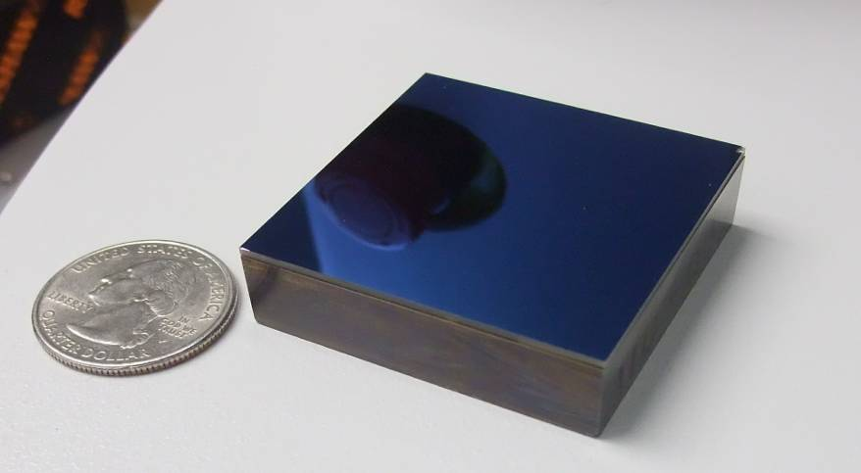
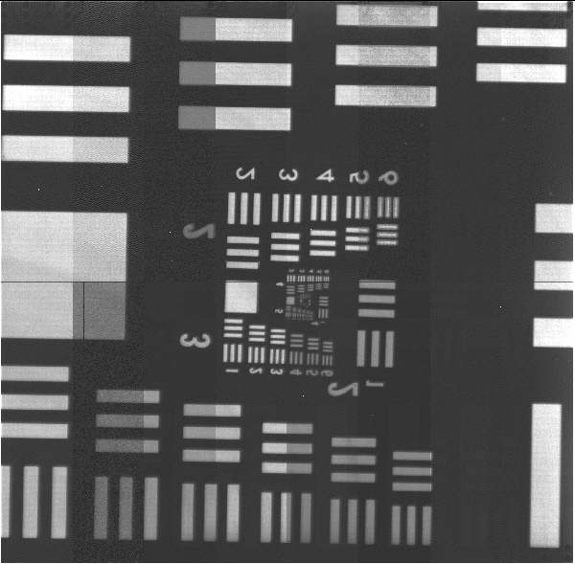
Sensors news: 2 vendors just recently fabricated prototypes
e2v CCD250 (operable)
STA3800 (mechanical sample)
(setup device, Oct. 28)

Slide 33
Performance on key specs based on the results of Phase 1 and Phase 2 programs with e2v and ITL
Key performance spec | CCD250 (e2v) | STA3800 (ITL)
QE (red bands) | ✓ | ✓
QE (blue bands) | Redesigned AR coat in development | ✓
Read noise @ 550kpix/s | ✓ | Not tested yet
PSF | ✓ | ✓
Flatness | ✓ | Process mod. In progress
Fill factor | ✓ | ✓
Phase 2 results are “hot off the press” and not final.
For details see Paul O’Connor’s breakout talk at 2PM

Slide 34
Cost & Schedule Summary

Slide 35
Level 2 Milestones – Key Milestones
Level I Baseline Milestones | Schedule
CD-0, Approve Mission Need | 6/20/2011
CD-1, Approve Alternative Selection and Cost Range | Q2FY2012
CD-3a, Approve Start of Long Lead Procurements | Q4FY2013
CD-2, Approve Performance Baseline | Q2FY2014
CD-3b, Approve Start of Construction | Q4FY2015
CD-4, Approve Project Completion | Q4FY2020
Level II Baseline Milestones | Schedule
Conceptual design complete (Ready for CD-1) | Q4FY2011
Prototype Science Sensors Received | Q2FY2012
Phase 1, Vertical Slice Test Complete - *before CD3a* | Q4FY2012
Sensor final design complete – *before CD3a* | Q3FY2013
Camera long lead designs complete (Ready for CD-3b) First Article Sensor Contract, options for additional production sensors | Q3FY2013
Camera preliminary design reviews complete & Performance Baseline established (Ready for CD-2) | Q1FY2014
Phase 2, Vertical Slice Test Complete - *before CD3b* | Q1FY2014
First article filter ready for coating | Q1FY2015
Cryostat Cryo-plate PO placed | Q3FY2015
Camera design complete (Ready for CD-3b) | Q1FY2016
Shutter Blade PO placed | Q2FY2016
Cryostat Assembly Ready for Integration | Q2FY2017
Filter exchange system fabrication complete (Accepted delivery) | Q3FY2017
Cryostat and sensor raft integration complete | Q4FY2018
Optical lens assembly, L1/L2 and L3 complete | Q4FY2018
Camera fully integrated | Q2FY2019
Camera Pre-Ship Review | Q3FY2019
Sensor Production Complete | Q3FY2020
Camera verification complete, KPPs achieved (Ready for CD-4) | Q4FY2020
L2 milestones – total of 19 –> 2/year.
1056 Milestones in the schedule or roughly 117 milestones per year
Milestone dictionary has been drafted

Slide 36
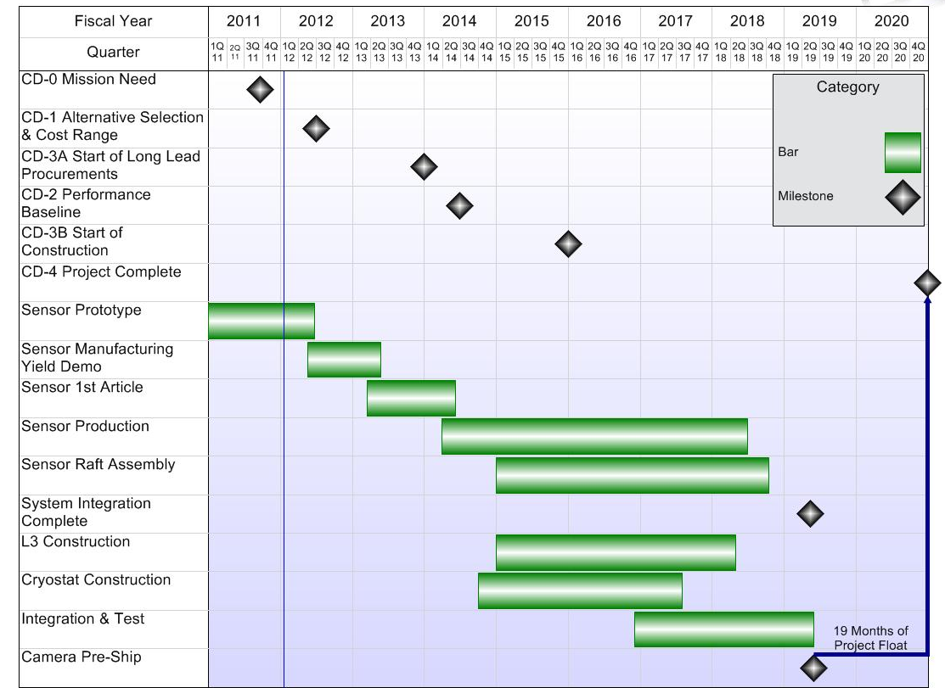
LSST Camera Summary Schedule

Slide 37
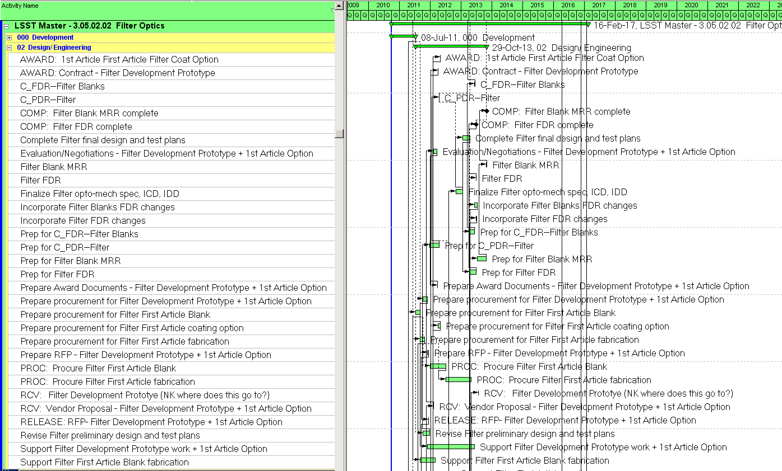
Detailed technical logic with only funding constraints
Sub-system milestones linked to management milestones
4735 activities including 1056 milestones
Most of the resources were imported from the Basis of Estimate Worksheets into P6

Slide 38
Cost Estimates Are Mature
Estimates are mature for this stage of the project
  Cost Books/Basis of Estimate contains,
    WBS Description
    3D models, drawings
    Detailed cost estimate
      Part number, drawing number, vendor, notes, weight, qty, cost, etc.
    Supporting quotations, drawings, catalogs, etc.
    Contingency/Risk Assessment
    Cross referenced to P6 activity ID’s
  High price materials are based on vendor quotations – recent updated quotes
    Sensors, CeSiC Grid, CeSiC Raft, Carbon Fiber Shutter Blades, Refrigeration System
  >43% material estimates are from catalogs or vendor quotations
  Most labor estimates came from detailed engineering experienced based on similar programs
40 % (45M) Contingency

Slide 39
Camera Level 2 Cost & Effort Summary
LSST Camera Total Project Cost | Escalated Total Cost ($K) | Cont. | Total Cost ($K)
3.01 Management | $ 9,467 | 12% | $ 10,603
3.02 Systems Integration | $ 6,489 | 40% | $ 9,085
3.03 Science Raft System | $ 36,844 | 42% | $ 52,318
3.04 Corner Raft System | $ 5,209 | 30% | $ 6,772
3.05 Optics | $ 21,304 | 31% | $ 27,908
3.06 Camera Body & Mechanisms | $ 3,732 | 30% | $ 4,852
3.07 Cryostat | $ 9,990 | 35% | $ 13,487
3.08 Control System, Data Acquisition System and System Electronics | $ 8,911 | 30% | $ 11,584
3.09 Integration and Test | $ 10,720 | 30% | $ 13,936
Residual Risk Contingency |  |  | $ 6,755
Total Project Cost ($K) | $112,666 | 40% | $157,300
Current data from P6 & Cobra
  NOTE: The cost data shown here is current, however, the sub-system talks reflect data results from June during our Director’s Review.
Residual Risk Contingency
  Additional management reserves to execute the project
  Monte Carlo Simulation used to evaluate if project has sufficient reserves to successfully execute the project

Slide 40
Preliminary Funding Profile
Fiscal Year | FY11 | FY12 | FY13 | FY14 | FY15 | FY16 | FY17 | Total ($M)
OPC | $1.9 | $5.5 | $3.0 |  |  |  |  | $10.4
TEC - Design |  |  | $6.0 | $9.0 | $9.0 | $9.0 |  | $39.0
TEC - Fabrication |  |  | $1.0 | $7.4 | $38.5 | $42.0 | $25.0 | $107.9
Total Project Cost ($M) | $1.9 | $5.5 | $10.0 | $ 16.4 | $47.5 | $51.0 | $25.0 | $157.3
Funding is for the MIE portion of the DOE LSST Program and covers the design, engineering, assembly and verification testing of the camera at SLAC.
DOE operations money is planned for FY18 and FY19 to cover camera shipment, preparing the camera summit facility, summit camera verification, and support to the effort for camera observatory integration and test.

Slide 41
4700 Activities have been leveled with funding constraints and are consistent with DOE funding
 | FY2012 | FY2013 | FY2014 | FY2015 | FY2016 | FY2017 | FY2018 | FY2019 | FY2020
Incremental Funding | 7.4 | 10.0 | 16.4 | 47.5 | 51.0 | 25.0 | 0.0 | 0.0 | 0.0

Slide 42
Commitment/Funding Profile – Consistent with “NSF Lowest Cost to the Government” Schedule
NSF has not provided a notional funding profile
NSF directed the project to produce a “Lowest Cost to the Government Schedule”
  This is defined as a front loaded schedule to achieve the lowest cost, but with a realistic labor/procurement ramp-up
The Camera project produced an accelerated schedule to meet the camera need date presented by the overall project at the NSF PDR. This schedule was the nearest solution to stay within the DOE funding guidance, however we will
  Need ~$47M of funding moved into the early years (FY2012 – FY2015)
  Deliver the camera with a partially filled focal plane that is sufficient for the “First Light” phase of the project
  Ship the balance of the focal plane science rafts to the summit before the completion of Observatory “Science Verification”

Slide 43
Commitment/Funding Profile – Consistent with “NSF Lowest Cost to the Government” Schedule

Slide 44
CD-1 Key Deliverables
All key deliverables have been completed
AQ & PPEP has been reviewed by DOE site office, OPA and HEP Program Office and ready for final signatures
CD-0 Approve Mission Need | ✓
Acquisition Strategy (AQ) | ✓
Preliminary Project Execution Plan (PPEP) | ✓
Appointment of the Federal Project Director (FPD) | ✓
Approve Integrated Project Team (IPT) | ✓
Develop a Risk Management Plan | ✓
Complete a Conceptual Design | ✓
Conduct a Conceptual Design Review | ✓
Complete a Conceptual Design Report | ✓
Prepare a Preliminary Hazard Analysis Report | ✓
Develop and Implement an Integrated Safety Management Plan | ✓
Establish Preliminary Quality Assurance Program (QAP) | ✓
Identify general Safeguards and Security requirements for the recommended alternative | ✓
Complete National Environmental Policy Act (NEPA)Strategy by issuing a determination (i.e., EIS, EA) | ✓
Conduct Independent Project Review or External Independent Review | ✓
Update PDS, or other funding documents for MIE and OE projects, and OMB 300s, if applicable. | ✓

Slide 45
CD-1 Readiness
All CD-1 criteria have been met
Camera designs are beyond or at conceptual design and technically meet the requirements
Baseline documents (functional, design, cost & schedule)
Programmatic
WBS Dictionary - scope of project defined | ✓
Risk Registry – risks defined and managed | ✓
Cost Estimate – detailed Basis of Estimates developed | ✓
Schedule – resource loaded approaching CD-2 maturity | ✓
Long lead procurements defined | ✓
Management plans drafted | ✓
Technical
Requirements & interfaces defined | ✓
System Function Review/Requirements Review | ✓
LSE-59, Camera Requirements Document | ✓
LCA-48, Camera Specification | ✓
External Interfaces Released | ✓
Internal Interfaces Drafted | ✓
Technical design maturity exceeds CD-1 requirement (Conceptual Design) & provides sufficient information to develop a solid cost estimate range | ✓
Camera Conceptual Design Reviews | ✓

Slide 46
Summary
Strong and experienced technical staff
The key personnel and management staff has been identified
Scope is well defined and organized. Deliverables by the DOE are clearly segregated, and interfaces are mature for this stage of the project
Designs are mature and have been successfully reviewed by external panels
Project risks are well defined and are actively being mitigated
Detailed cost estimates created a robust cost range
Resource loaded schedule has been developed and leveled
  Schedule is logically linked to support leveling per funding agency guidance
  Start EVMS early to help manage the collaboration
Major Upcoming Milestones & Events
  Receive operable sensors test results from 2 vendors in October and November
  Vertical Slice Test Phase 1 – Spring FY12
  Demonstration of kinematic mounting concept in FY12
  Demonstration of increased capacity of the refrigeration system in FY12

Slide 47
End of Presentation

Slide 48
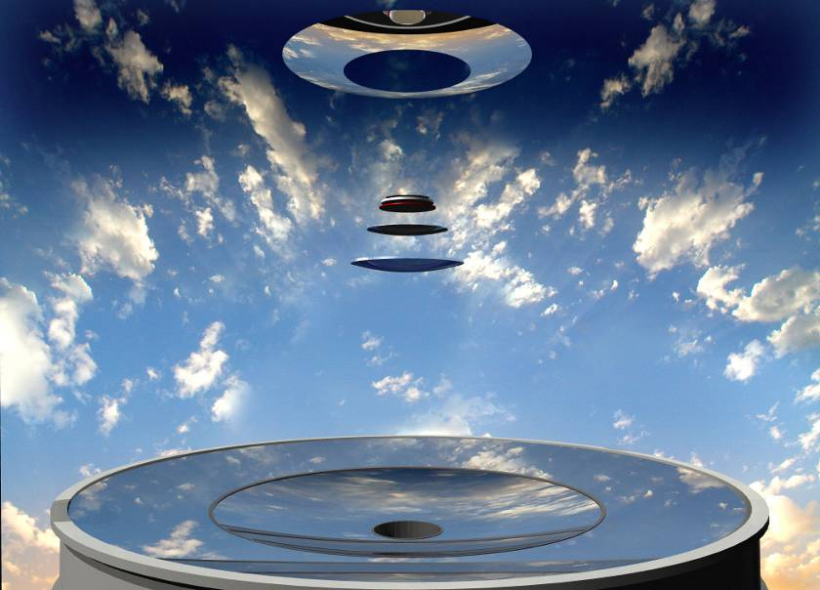
The LSST Optical System - Modified Paul-Baker Design
Secondary Mirror
Camera Lenses
Primary and Tertiary Mirrors

