Slide 1
Project Overview and
Science Requirements
Steven M. Kahn
LSST Deputy Project Director and Camera Lead Scientist
LSST DOE CD-1 Review
November 1 - 3, 2011

Slide 2
The Essence of LSST is Wide, Deep, Fast
The LSST will be a large, wide-field ground-based telescope designed to provide time-lapse digital imaging of faint astronomical objects across the entire visible sky every few nights.
As such, it will enable an enormous variety of complementary scientific investigations, utilizing a common database. These range from searches for small bodies in the solar system to precision astrometry of the outer regions of the galaxy to systematic monitoring for transient phenomena in the optical sky.
Of particular interest for cosmology and fundamental physics, LSST will provide strong constraints on models of dark matter and dark energy through statistical studies of the shapes and distributions of faint galaxies at moderate to high redshift, and the detection of large numbers of Type Ia supernovae.

Slide 3
The LSST Concept Highly Ranked by a Series of
National Advisory Committees
NAS/NRC: Astronomy and Astrophysics in the New Millennium (2001)
NAS/NRC: New Frontiers in the Solar System (2003)
NAS/NRC: Connecting Quarks with the Cosmos (2003)
HEPAP: Quantum Universe (2004)
OSTP: Physics of the Universe (2004)
HEPAP: Scientific Assessment Group for Experiments in Non-Accelerator Physics (2004)
NSF: Optical-Infrared Long Range Plan (2005)
AAAC/HEPAP: Dark Energy Task Force (2006)
HEPAP: Particle Physics Project Prioritization Panel (2006)
HEPAP: Particle Physics Project Prioritization Panel (2008)
HEPAP: Particle Astrophysics Scientific Assessment Group (2009)
NAS/NRC: New Worlds New Horizons (2010)

Slide 4
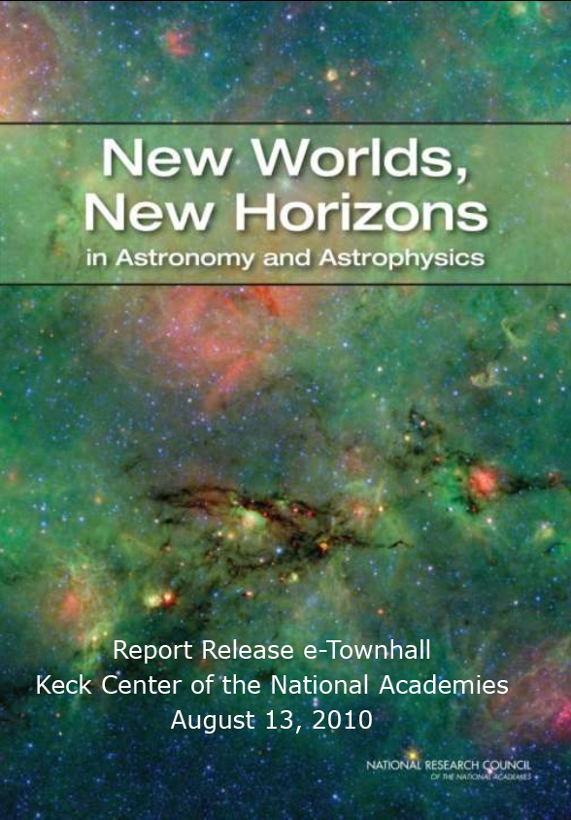
Recent Astro2010 Endorsement
LSST ranked as the highest priority large ground-based facility for the next decade.
“The top rank accorded to LSST is a result of (1) its compelling science case and capacity to address so many of the science goals of this survey and (2) its readiness for submission to the MREFC process as informed by its technical maturity, the survey’s assessment of risk, and appraised construction and operations costs. Having made considerable progress in terms of its readiness since the 2001 survey, the committee judged that LSST was the most ‘ready-to-go.’”

Slide 5
Overall Project Organization

Slide 6
LSST: Joint DOE/NSF Project
NSF
Lead agency
  Telescope and site
  Data Management
DOE
Deliver a camera that meets project requirements

Slide 7
Agency Coordination
NSF/DOE
MOU describing commitments will be developed by agencies
  Funding schedules must be coordinated
Joint Oversight Group (JOG) already established
Funding Flow
DOE funds to SLAC
NSF funds via AURA to LSST Project Office
Agency funds (including contingency) will not be co-mingled
  Management procedures will be appropriate to each agency
  Coordination of technical aspects of project established through system requirements and ICDs; shared management information; common document archive, etc.

Slide 8
The Project is Overseen by Board of Directors of the LSST Corporation
- The University of Arizona
- University of Washington
- National Optical Astronomy Observatory
- Research Corporation for Science Advancement
- Adler Planetarium
- Brookhaven National Laboratory
- California Institute of Technology
- Carnegie Mellon University
- Chile
- Cornell University
- Drexel University
- Fermi National Accelerator Laboratory
- George Mason University
- Google, Inc.
- Harvard-Smithsonian Center for Astrophysics
- Institut de Physique Nucléaire et de Physique des Particules
- Johns Hopkins University
- Kavli Institute for Particle Astrophysics and Cosmology - Stanford University
- Las Cumbres Observatory Global Telescope Network, Inc.
- Lawrence Livermore National Laboratory
- Los Alamos National Laboratory
- National Radio Astronomy Observatory
- Princeton University
- Purdue University
- Rutgers University
- SLAC National Accelerator Laboratory
- Space Telescope Science Institute
- Texas A & M University
- The Pennsylvania State University
- University of California at Davis
- University of California at Irvine
- University of Illinois at Urbana-Champaign
- University of Michigan
- University of Pennsylvania
- University of Pittsburgh
- Vanderbilt University

Slide 9
Organization Chart: 2011
NSF/DOE JOG
LSSTC President
Sidney Wolff
Project Manager
Donald Sweeney
Deputy Project Manager
Victor Krabbendam
Director
Tony Tyson
Deputy Director
Steve Kahn
Systems Scientist
Zeljko Ivezic
Systems Engineer
Chuck Claver
Science Council
Chair (SAC)
Ex Officio
Telescope & Site
Project Manager:
Victor Krabbendam
Project Scientist:
Open
Education & Public Outreach
Project Manager:
Suzanne Jacoby
Project Scientist:
Open
Data Management
Project Manager:
Jeff Kantor
Project Scientist:
Tim Axelrod
Camera
Project Manager:
Nadine Kurita
Project Scientist:
Kirk Gilmore

Slide 10
Anticipated Organization When Project Moves into Construction
Director
New Hire
Deputy Director
Steve Kahn
NSF/DOE JOG
Chief Scientist
Tony Tyson
Project Manager
New Hire
(Donald Sweeney, new position)
Deputy Project Manager
Victor Krabbendam
Project Scientist
Zeljko Ivezic
Science Council
Chair (SAC)
Ex Officio
Systems Engineer
New Hire
Systems Scientist
Chuck Claver
Telescope & Site
Project Manager:
Victor Krabbendam
Project Scientist:
Open
Education & Public Outreach
Project Manager:
Suzanne Jacoby
Project Scientist:
Open
Data Management
Project Manager:
Jeff Kantor
Project Scientist:
Mario Juric
Calibration: Tim Axelrod
Camera
Project Manager:
Nadine Kurita
Project Scientist:
Kirk Gilmore

Slide 11
Lead Organizations for Subsystems
SLAC is lead organization for camera
NOAO will provide telescope and site team
NCSA will construct and test archive and data access center
− Formal agreements define:
  Scope of work for the various partner organizations
  Compliance with system specifications and subsystem requirements flowing down from the Science Requirements Document
  Integrated schedule with common reporting
  Use of a common LSST document archive

Slide 12

NSF Preliminary Design Review
Held Aug 29 – Sep 2, 2011 in Tucson, AZ.
Reviewed all aspects of the technical system, including the camera.
“The Panel was very impressed by the strength of the project team (including both the DOE and the NSF funded teams). The presentations were well prepared and informative, and the team members responded promptly to all requests for additional information or documentation.
“The design is well advanced and the Panel had no design related issues. In particular, the Panel was impressed with the design of the camera. However, to ensure that all elements are examined in depth, the project would benefit from more formalized subsystem level design reviews with external reviewers included.
…
“The Panel considers that the LSST project has met the requirements for PDR.”

Slide 13
Science Requirements

Slide 14
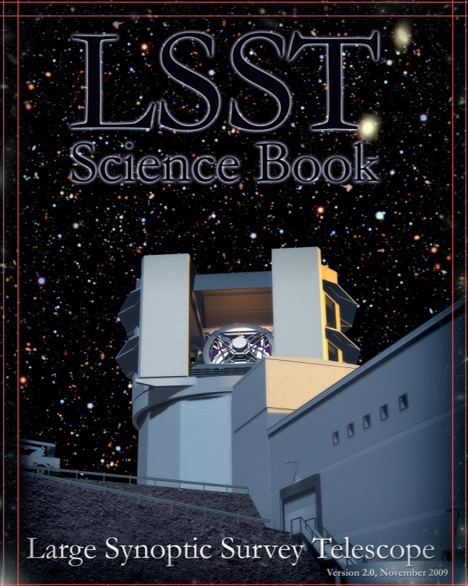
The Science Opportunities are Summarized in the LSST Science Book
Contents:
  Introduction
  LSST System Design
  System Performance
  Education and Public Outreach
  The Solar System
  Stellar Populations
  Milky Way and Local Volume Structure
  The Transient and Variable Universe
  Galaxies
  Active Galactic Nuclei
  Supernovae
  Strong Lenses
  Large-Scale Structure
  Weak Lensing
  Cosmological Physics
Dark Energy

Slide 15
The System Design is Driven by Four Primary Science Missions
Dark Energy and Dark Matter
  Weak Lensing Tomography for Cosmic Shear Correlations
  Baryon Acoustic Oscillations
  Type Ia supernovae
  Clusters of Galaxies as Cosmological Probes
Hazardous Asteroids and the Remote Solar System
  Earth crossing asteroids to 140m diameter
  Distant trans-Neptunian and Kuiper Belt objects
The Transient Optical Sky
  Open unexplored phase space
The Formation and Structure of the Milky Way
  Co-moving stellar streams in the Milky Way halo
  Census and properties of stars within 300pc of the sun
These four primary missions were chosen, because they push the system design in complementary ways that also enable many other parallel investigations.

Slide 16
Dark Energy/Dark Matter Science Drivers
Weak Lensing for Cosmic Shear:
  Optimal image quality for galaxy shape measurements
  Multi-color precision photometry for photometric redshifts determination with < 2-5% error
  Near full-sky coverage to reduce cosmic variance and galaxy shape noise
  Large number of distinct visits (~ 100 per color) for reduction and characterization of image systematics
  Faint co-added limiting magnitude (r ~ 27.5) for sufficient galaxy surface density (~ 40/sq. arcmin)
Baryon Acoustic Oscillations:
  Large area sky coverage to measure low order angular correlations
  Multi-color (ugrizy) precision photometry for photometric redshift determination
Type Ia supernovae:
  Multi-color temporal sampling to measure chromatic effects in light curve
  Multicolor photometry needed to determine k-corrections and supernova type
  Targeted deep areas with rapid cadence to probe high redshifts with well-sampled light curves
Clusters of Galaxies
  Image quality for strong and weak lensing
  Multi-color precision photometry for photometric redshift determination
  Large area sky coverage with uniform sampling
  Several day cadence for time delay measurements of variable backlighters (AGNs and Sne)

Slide 17
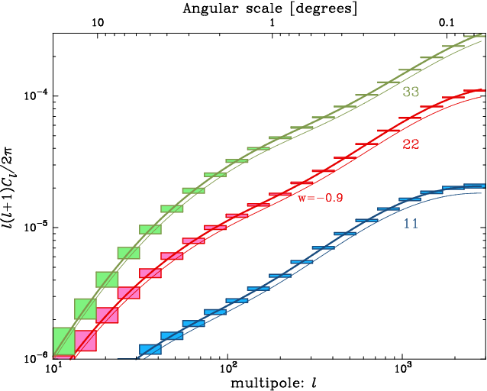
Cosmic Shear Auto-Power Spectra in Three
Redshift Bands

Slide 18
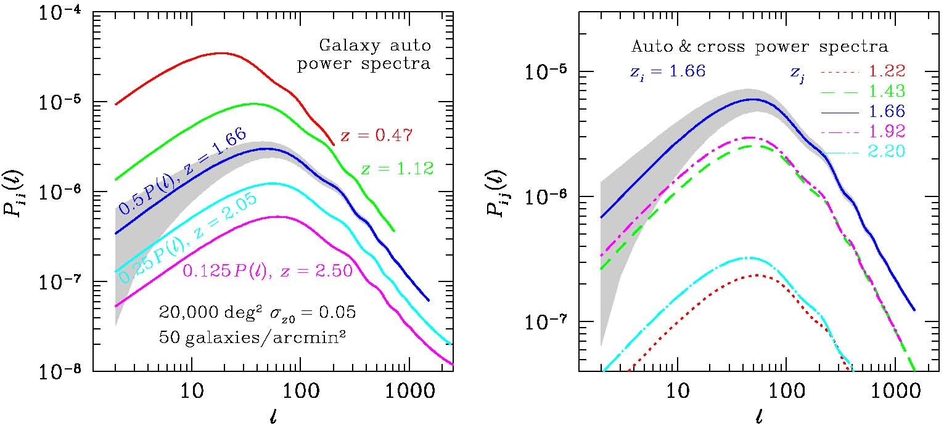
Galaxy Auto and Cross Power Spectra with Baryon Acoustic Oscillations

Slide 19
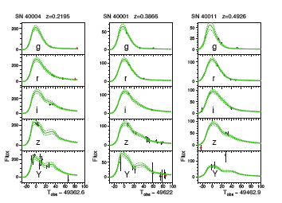
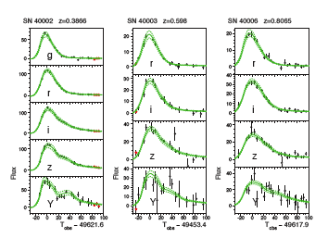
Type 1A Supernova Lightcurves
Main Survey
Deep Drilling Fields

Slide 20
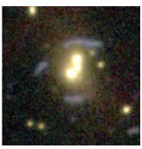
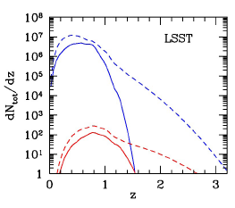
Strongly Lensed Supernovae

Slide 21
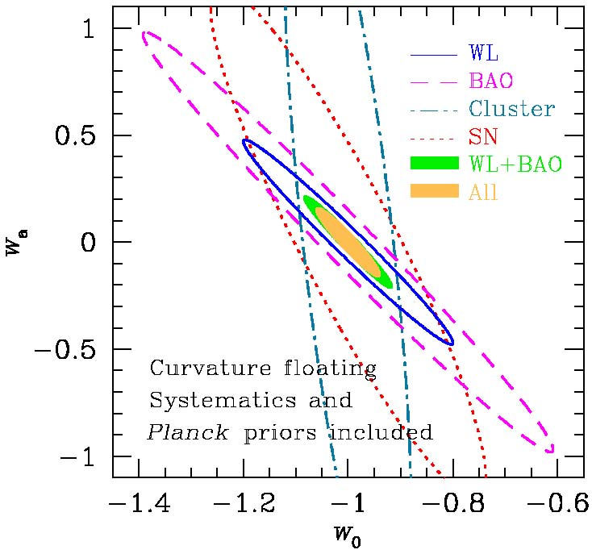
Separate and Joint Constraints on the Dark Energy Equation of State

Slide 22
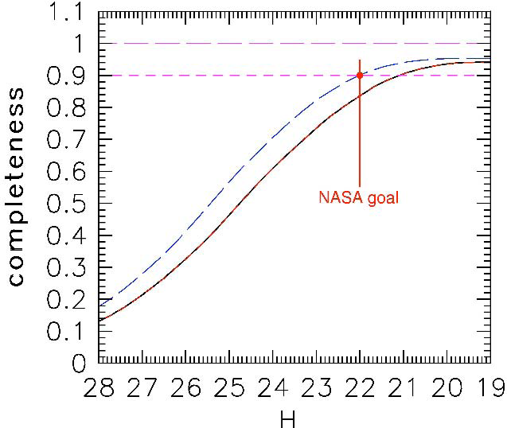
Asteroids and Solar System Drivers
  Earth crossing asteroids ≥ 140m diameter
  Short exposures (15 sec) to avoid trailing of fast moving objects
  Short and intermediate temporal sampling for object linking and orbit determination
  Faint single visit limiting magnitude (r ~ 24.5) to efficiently detect objects to 140 m in diameter
  Small bodies in the distant Solar System (trans-Neptunian and Kuiper Belt objects)
  Temporal sampling to link detections and determine orbits
  Faint visit detection limit – r ~ 24.5
  Small area with deep detection limit – r ~ 27
LSST completeness functions for Potentially Hazardous Asteroids as a function of absolute magnitude for a 10-year (lower) and 12-year (upper). H = 22 → ~ 140 m

Slide 23
Transient Time Domain and Milky Way Drivers
Primary objective is to fill in phase space
Desired survey properties include:
  Uniform data over extended time base
  Large area to detect rare events
  Dense temporal coverage to produces well sampled light curves
  Faint detection limits to probe unexplored phase space
  Good image quality to enable reliable image differencing in crowded fields
  Rapid data reduction and characterization to flag short timescale events
  Publish transient events within ~60sec to enable spectroscopic follow up
Probing the outer parts of the galaxy
  Multi-color photometry, including u-band, to estimate chemical abundance and spectral type
  Faint detection limits to measure the stellar main-sequence turnoff in the Milky Way halo
Stellar Kinematics
  Uniform data over a long time span for measuring stellar proper motions
Solar neighborhood census to 300 parsecs
  Good image quality enables precision relative position measurements
  Uniform sampling of the parallax factor is required
  Many measurements to reach statistical significance of 0.003 arcsec parallax

Slide 24
The Four Primary Drivers Can Be Fulfilled With A Single 10-Year Multicolor Imaging Survey
The LSST Science Requirements Document (LSST archive number: LPM-17) defines the required 10-year survey performance.
The SRD defines 2 sets of requirements:
  Full Survey Performance (after 10-years)
    Area Coverage
    Number of visits over the area defined
    Distribution of visits in time
    Astrometric Parallax
    PSF shape residuals
    Data processing and release
  Single Visit Performance
    Filter set
    Image depth
    Image Quality and Shape
    Photometric quality
    Astrometric quality

Slide 25
Requirements Flow Down for LSST
Science Requirements Document is the parent for all system flow down.
  Defines a range (min, design, stretch goal) of acceptable performance for the survey
LSST System Requirements defines specific survey performance requirements
  System Functional Capabilities
  Operational and Administrative Functions
Observatory System Specifications
  System Composition and Constraints
  Common System Functions & Performance
  Detailed System Specifications

Slide 26
Driving requirements from the SRD
6 spectral filters covering 320-1050nm
  ugriz (SDSS like) + y (~1μm)
The Main Survey Area
  18,000 square degrees with;
Total Visits per unit area and Visits per filter
  Single visit = Two 15 sec exposures separated by 4 sec.
  825 visits on each patch of sky;
  Median visit counts by filter u: 57, g: 80, r: 184, i: 184, z: 160, y: 160
Temporal Visit Distribution in Main Survey Area
  Revisit after 30-60 minutes
  Visit pairs every 4 nights
  3 pairs per lunation
Image Quality
  PSF FWHM < 0.4 arcsec (without atmospheric seeing).
  PSF Ellipticity < 0.04 (referenced to 0.6 arcsec FWHM circular Gaussian)
5-sigma single visit limiting magnitudes
  u: 23.9, g: 25.0, r: 24.7, i: 24.0, z: 23.3, y: 22.1
2.5 million visits, 5 million science images over 10 years

Slide 27
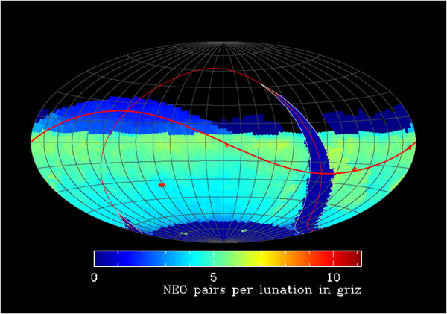
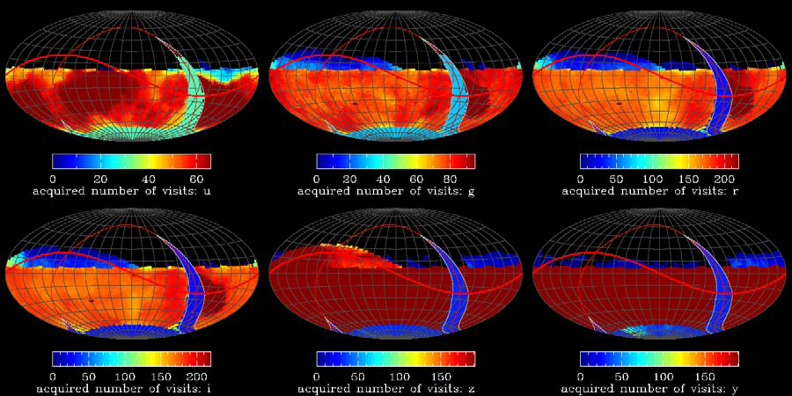
An Operations Simulator has been developed to validate the visit requirements
More than 18,000 square degrees with > 825 visits on each patch of sky;
  Median visit counts by filter u: 57, g: 80, r: 184, i: 184, z: 160, y: 160
For example more than 3 NEO pairs achieved per lunation
OpsSim output meets SRD Area and Visit requirements
Revisit requirements are also met

Slide 28
System requirements from OpsSim
Optical System Field of View = 3.5 degrees.
  Early OpsSim runs with 3 degree FOV did not produce sufficient coverage and visit count
Visit (2x15 sec exposure) duration = 34 seconds
“Dead time” between visits; median ≤ 5sec, mean ≤ 10sec
  Telescope mount accelerations and velocities
  System settle time
  Time to change internal filter = 120 sec

Slide 29
LSST System Design

Slide 30
Integrated Design Philosophy
System level design efforts for LSST began in the late 1990’s, but became coordinated and focused beginning ~ 2003.
From the start, the emphasis was on the development of an “integrated system”, including all aspects of the site facilities, the telescope, the camera, and the data management.
The design process started with the science requirements, but involved many iterations and trades studies balancing performance, cost, and technical risk between the different subsystems.

Slide 31
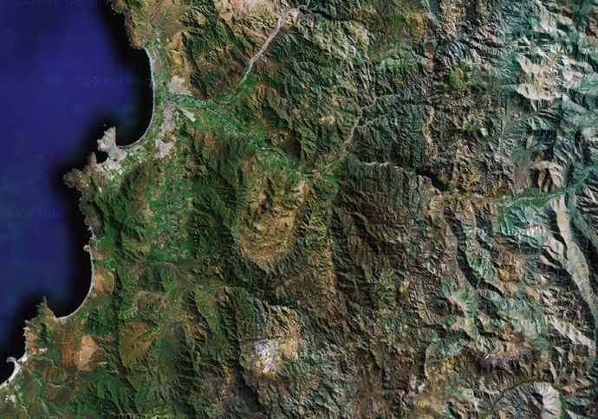

Site selection based on weather and seeing conditions, as well as programmatic considerations
Central Chile Location Map
Cerro Pachón chosen in 2006 after 2 year global evaluation by international committee.
La Serena
La Serena airport
port
50 km paved highway
LSST
Base Facility
Coquimbo
Puclaro
dam & tunnel
Vicuña
AURA
property
(Totoral)
CTIO
Pan-American Highway
40km dirt road
Gemini & SOAR
N
0
10
20 km
LSST SITE

Slide 32
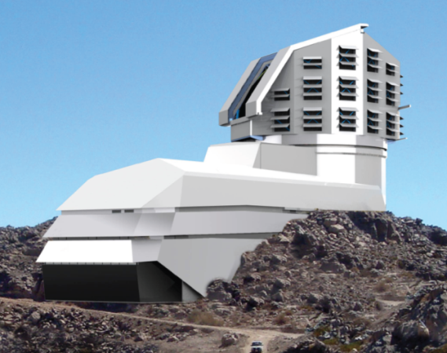
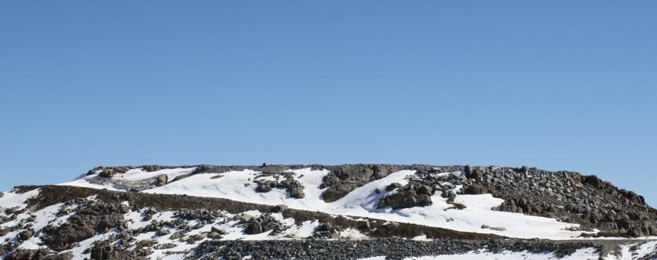
Site facility designed to minimalize atmospheric turbulence in the vicinity of the dome
Design is well advanced.
ARCADIS Chile has delivered the 50% package.
Internal and external reviews conducted.
90% package due this year.
One 3 month phase from a full procurement package.
After ~4,000 kg of explosives and ~12,500 m³ of rock removal, Stage I of the El Peñón summit leveling is completed.
Non-Federal funds.
5 month, $1.3 M effort to level the site “completed.”
No surprises!

Slide 33
Most of the design details of the telescope and camera flow from the constraints on the optical design
Median delivered seeing at the site is ~ 0.6 arcsec.
  Assuming 3X oversampling -> a plate scale of 0.2 arcsec per pixel.
Keep camera size as small as possible. Minimum pixel size is ~ 10 μm.
  Driven by charge diffusion in the CCD and full well capacity, given the 100 μm depletion depth necessary to achieve the desired spectral range.
Plate scale -> a focal length of 10.3 m.
Single visit depth requirements -> Minimum aperture diameter of 6.5 m.
  Assumes nominal throughput losses in the atmosphere, mirrors, lenses, and CCD detectors.
Implied focal ratio is < 1.5.
No. of required visits -> FOV > 3.5 degs.
  Implies 3.2 Gigapixels.
Implied focal plane diameter is 63 cm.
Fast slew and settling -> Keep telescope mount as compact as possible.

Slide 34
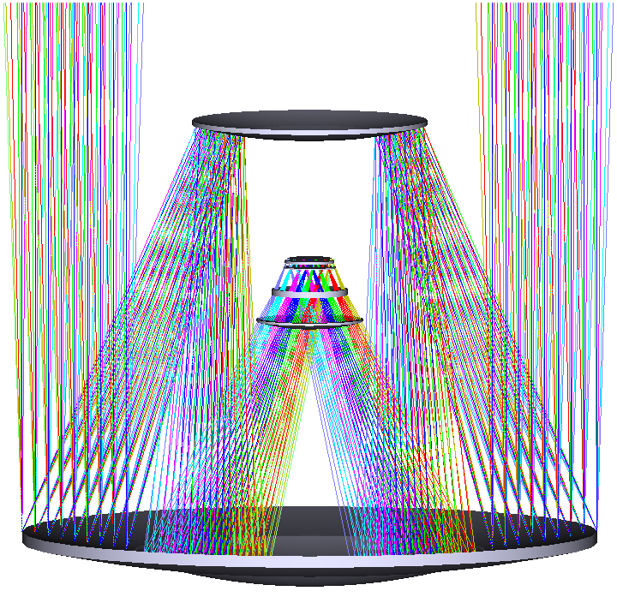
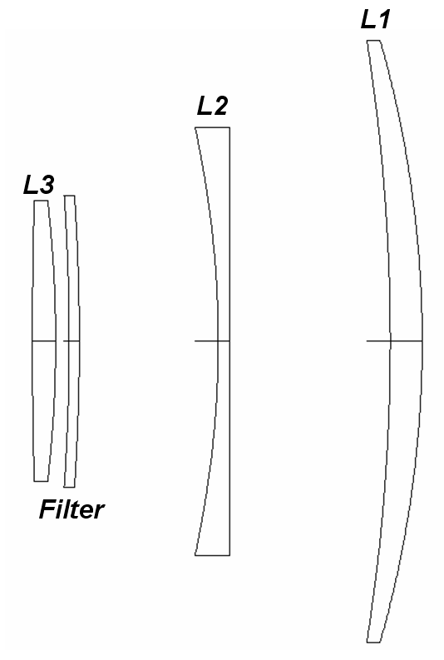
Resulting Optical Design
3 Mirror Modified Paul-Baker Design is the only feasible approach for achieving such a low focal ratio over such a large field. The camera optics correct for chromatic aberration introduced by the need to have a dewar window.

Slide 35
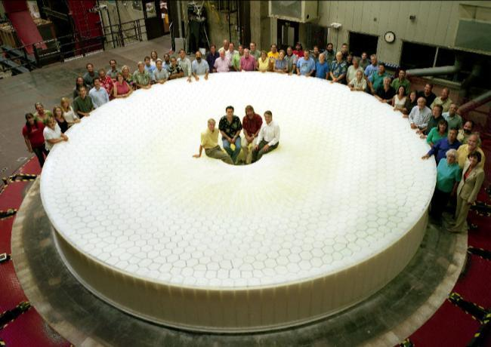
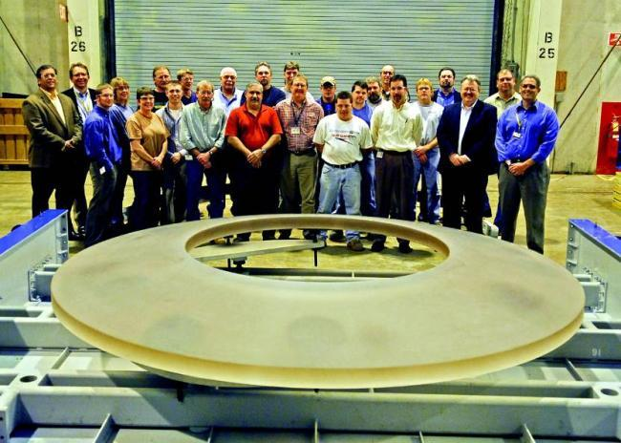
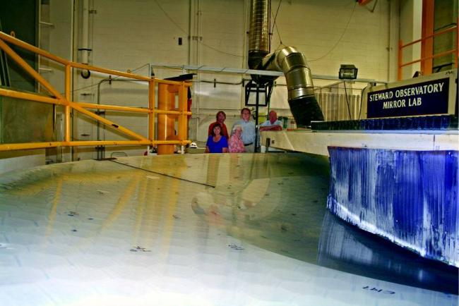
Primary/Tertiary cast from a single borosilicate blank. Secondary uses a thin meniscus technology
Primary-Tertiary was cast in the spring of 2008.
Fabrication underway at the Steward Observatory Mirror Lab - completion by the end of 2012.
MREFC effort focused on support hardware.
Secondary substrate fabricated by Corning in 2009.
Currently in storage waiting for construction.
MREFC effort has optical surface finishing and support hardware.

Slide 36
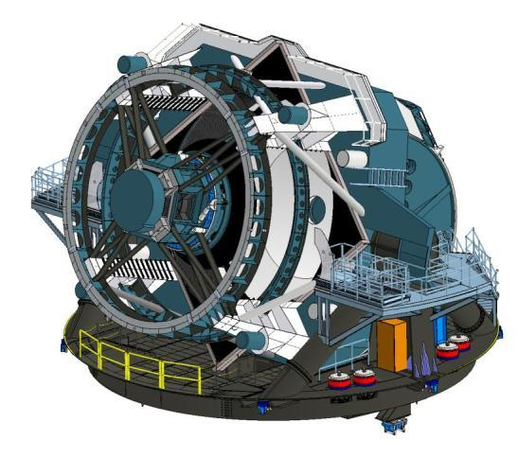
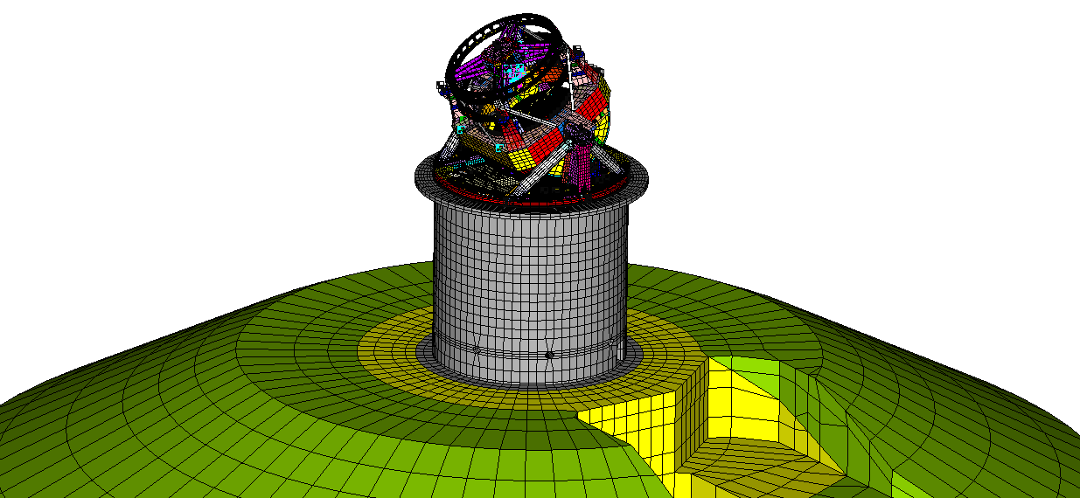
Telescope System Designed to Slew and Settle within 5 seconds
Demanding 3.5 degree cadence is met with stiff structure.
  Moving Structure 350 tons (60 tons optical systems).
  Pier design structured to maximize stiffness.
  First system frequencies at 7.5 Hz and 8.9 Hz.
Models reviewed with vendors.
  FEA and solid model.
  Two detailed vendor quotes.
FEA model is loaded structure on bearings, pier, and summit rock
Telescope model with system design details included

Slide 37
Unique Technical Challenges Drive the Basis of the Camera Design
Very large field of view implies a physically large focal plane (634-mm diameter) with small (10 micron) pixels.
Fast f/1.2 beam leads to short depth-of-focus.
Camera located in the telescope beam.
Broad spectral coverage.
Fast readout (3.2 Gigapixels in 2 seconds).
Large number of signal lines and large cryostat
Mosaicing a large number of sensors with narrow interchip gaps. Modular array to ease integration and test.
Tight alignment and flatness tolerances (13.5 micron p-to-v) on the sensor array.
Tight constraints on envelope, mass, and dissipation of heat to ambient.
Deep, fully depleted CCDs, but with minimal charge spreading.
Sensors must be highly segmented (16 readout ports).
Electronics through digitizing must be implemented in the cryostat.

Slide 38
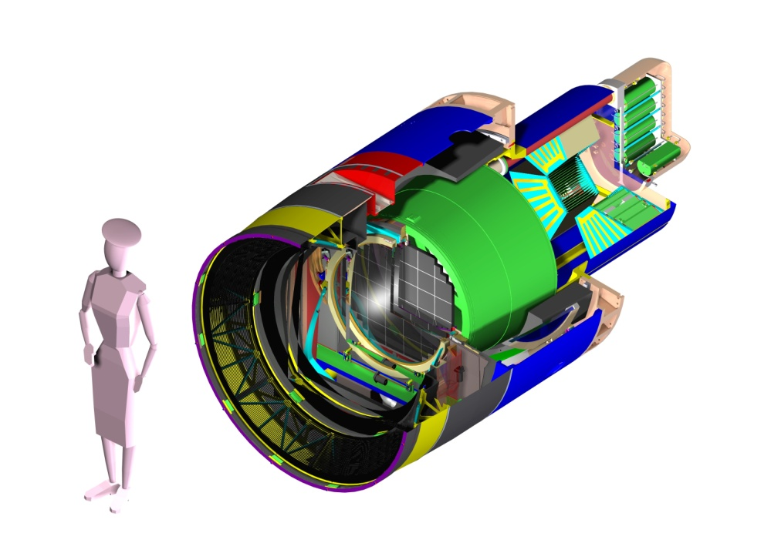
Camera Design
  3.2 Gigapixels
  0.2 arcsec pixels
  9.6 square degree FOV
  2 second readout
  6 filters
1.65 m
5’-5”
Parameter | Value
Diameter | 1.65 m
Length | 3.7 m
Weight | 3000 kg
F.P. Diam | 634 mm
Notes:
The current design of the camera is meeting its technical challenges. When completed it will be the largest astronomical camera. To put things into perspective this camera is just a little taller than I am, but thankfully it is heavier than I am at 3000 kg.
38

Slide 39
Data Management Faces Many Challenges
LSST Data Management system must deal with an unprecedented data volume.
  one 6-gigabyte image every 17 seconds
  15 terabytes of raw scientific image data / night
  100-petabyte final image data archive
  20-petabyte final database catalog
  2 million real time events per night every night for 10 years
The software, framework and database designs are in place for highly reliable open source system.
Infrastructure is identified and anticipates modest technical advancement consistent with trends.

Slide 40
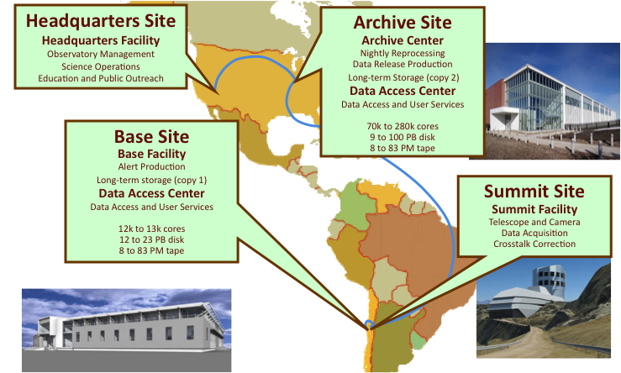
Cyber infrastructure is defined and capacity has been identified to handle data volume
Summit-Base network will be installed by the project.
Working with NSF funded network consortiums on capacity.
International protected network identified and quoted.

Slide 41
Summary
The LSST Project involves an interagency collaboration between NSF and DOE to deliver a versatile survey facility that will enable a wide variety of scientific investigations in astronomy and fundamental physics.
The science requirements have been flowed down in detail from four major scientific themes and are well-understood. Most of the requirements can be met with a single observing strategy, and will utilize a common database.
The overall system design has been developed by an integrated project team, with R&D funding from both agencies, as well as from private sources. The design has been optimized and is well-advanced in all areas.
The Project successfully passed an NSF Preliminary Design Review in September and is technically on track for an MREFC construction start in 2014.

Slide 42
End of Presentation

