Slide 1
Data Handling Group
Status and Plans
  People and Goals
  Major Experiments
    Fermi, EXO, LSST Camera Control System
  Cross Experiment Projects
    Pipeline + Data Catalog
    Developer Infrastructure
    User/Group manager
    Web Infrastructure
      Login/CAS/Crowd support
    Freehep/AIDA/WIRED/JAS
    Nagios
  Miscellaneous
    SSRL data access
    LCIO/lcsim support
  Stuff we are not working on
  Issues and Problems
  Roadmap Development

Slide 2
People
Karen Heidenreich
Chalotte Hee
Tony Johnson*
Dimitry Onoprienko
Max Turri
Brian Van Kleveren
* It is not clear what of the stuff I do should be included in the work of the DH group, so I made somewhat arbitrary decisions

Slide 3
Data Handling Group Goals
Critical Outcome:
  Well supported key software infrastructure components ready for adoption by experiments at SLAC and other universities and laboratories
Strategic:
  Invest in new technologies for future experiments like Cloud and Interactive Web Applications
  Continue to encourage software reuse between experiments at SLAC
  Build collaborations with the Computing Department, LCLS and other laboratories
Tactical:
  Continued support of Fermi, SiD, EXO, SuperCDMS
  Continue and expand support of LSST Camera Control System
  Evaluate future larger role in LSST and possible role in CTA
  Continue to advance lab-wide collaboration
    with CD (Confluence, JIRA, Forums, development tools...)
    with SSRL (SSRL data download)
    with Theory Group
    with others

Slide 4
Data Handling Strengths and Methods
Core Strengths
  Web Application Development
  Data Quality Monitoring
  Analysis and Visualization Tools (Web+GUI)
  Data Access
  Experiment and User Support
  Developer/Communication tools and techniques (especially Java related)
Design Methodology
  Design for experiment independence
  Small modular interoperable tools with well defined interfaces
    Allows adoption of individual components
    Modernization and replacement of individual components
  Adopt industry standard tools (e.g. J2EE) where possible
Library layers
  Experiment specific (e.g. Fermi, EXO)
  SRS = “SLAC” focused, experiment independent
  FreeHEP = experiment, lab independent

Slide 5
Experiment Support
Fermi

Slide 6
Fermi Large Area Telescope
Major Data Handling group contributions
  Web Infrastructure
  Web Applications
    Portal, Login, Group Manager, Shift System, Resource Monitoring, Data Processing, Speakers Bureau, Run Quality, System Tests …
    Data Quality Monitoring/Trending (time histories)
    Automated Science Processing
  Automated workflow engine (pipeline)
  Data Storage and Access
    Use of xrootd
    Data Catalog + Download Manager
    Astro Server and Skimmer (event filtering)
  WIRED Event Display

Slide 7
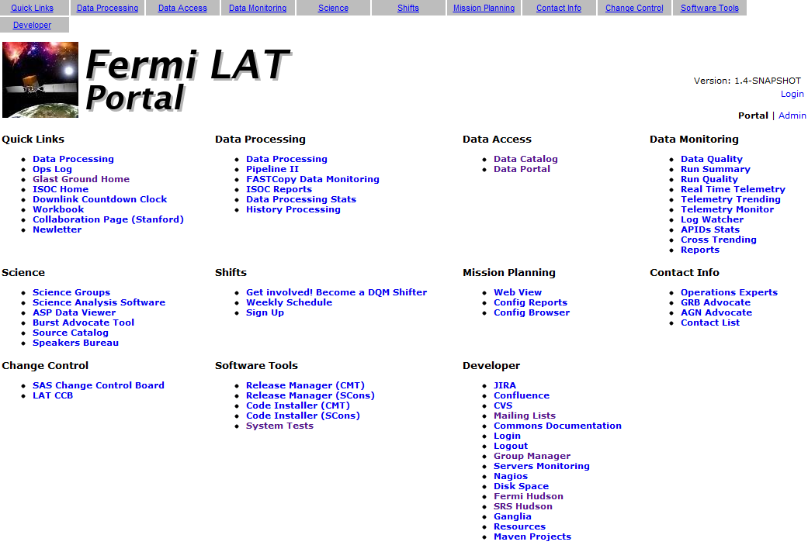
Fermi Data Portal
Many independent but interoperating web applications using same core technology and infrastructure
  Allows independent development
    by core data handling group and ISOC and collaborators
    but often we get left with maintenance

Slide 8
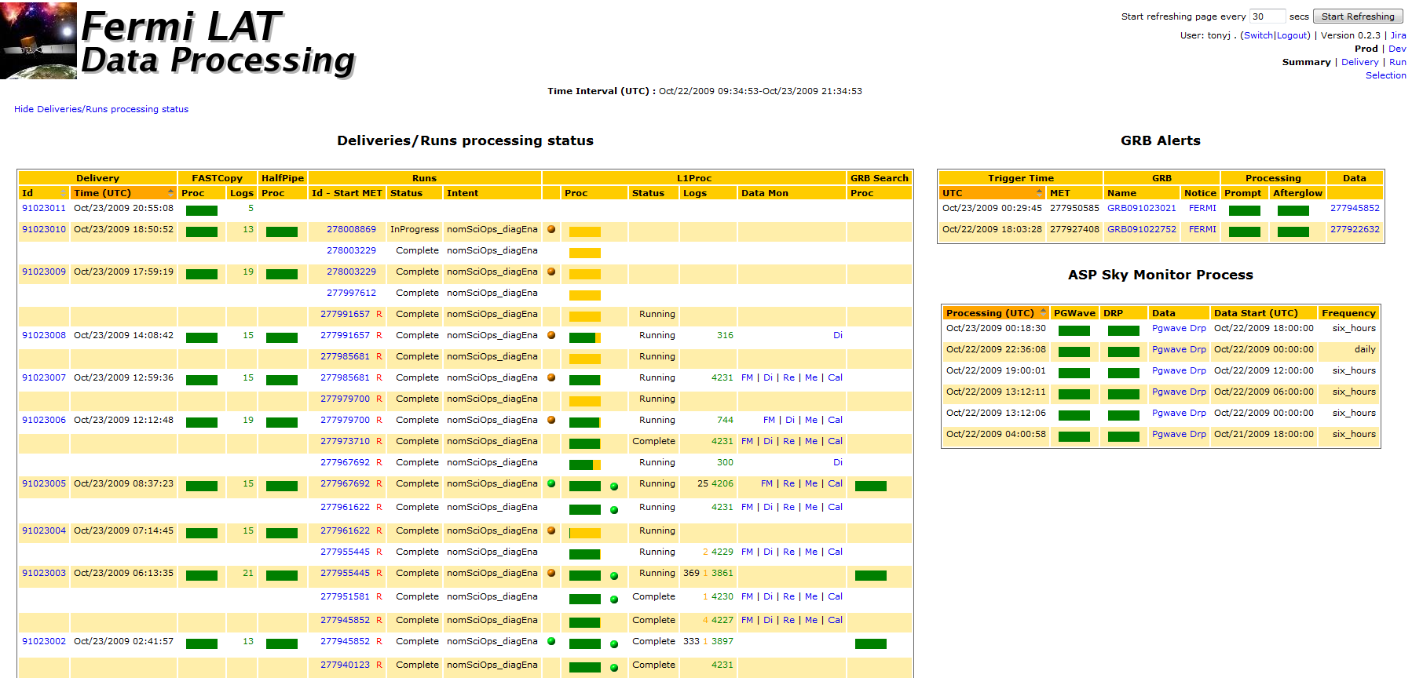
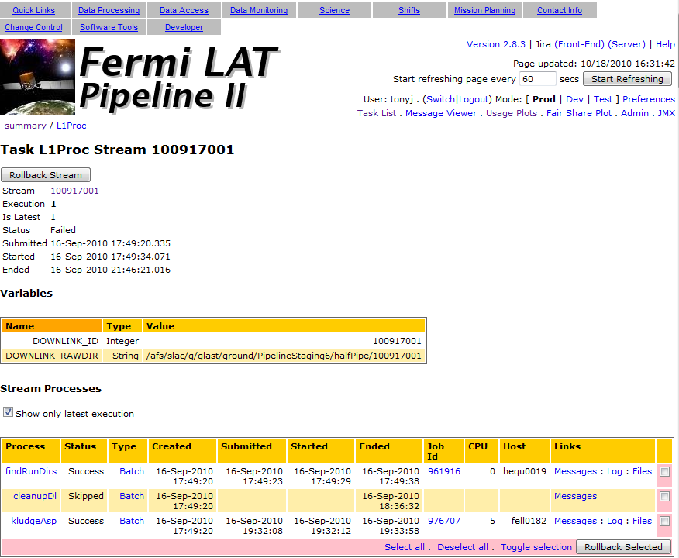
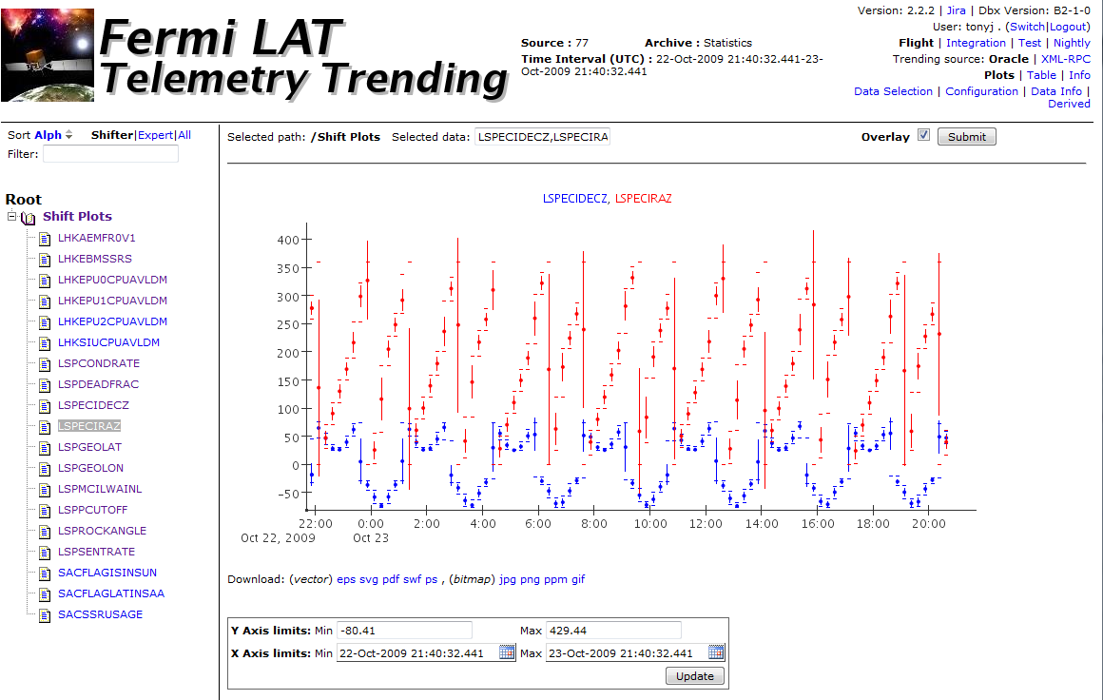
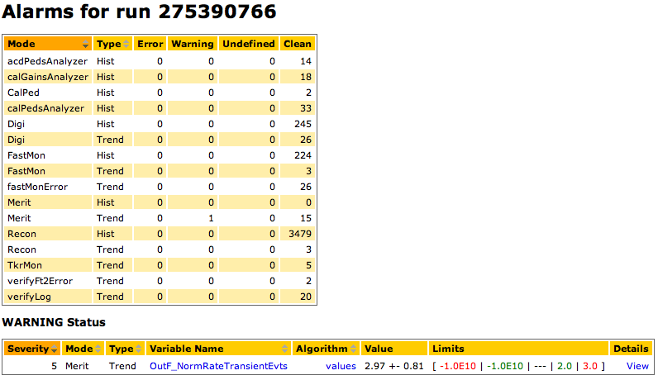
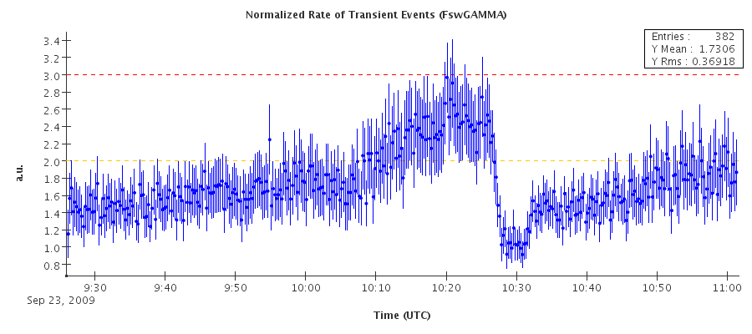
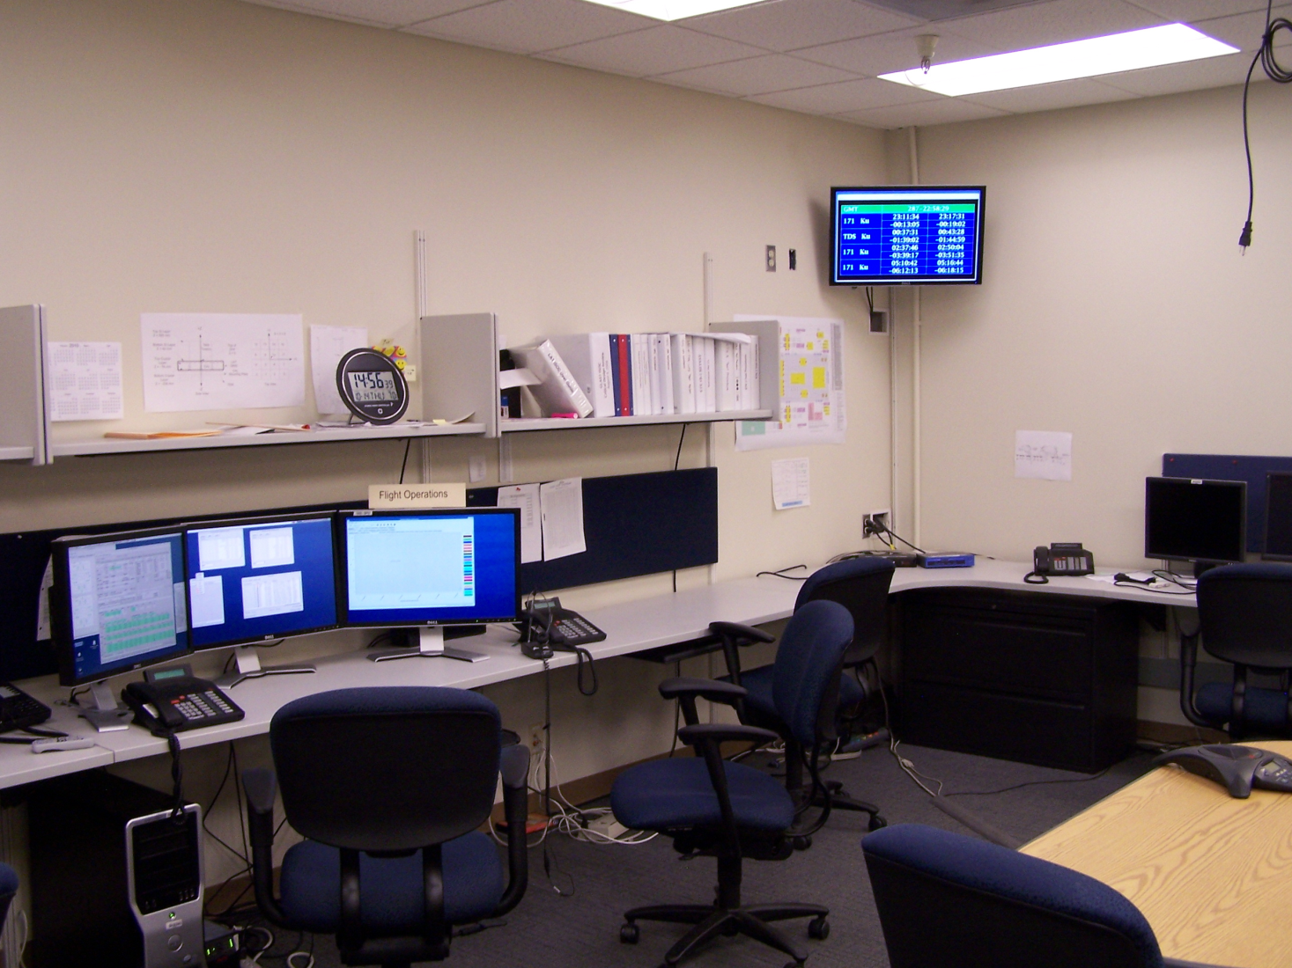
Fermi Web Applications
Error limit
Warning limit

Slide 9
Ongoing Fermi Projects
Maintenance of existing projects
  Upgrade from maven1 to maven2 (maven3 already released)
  Upgrade from tomcat5 to tomcat6 (tomcat7 already released)
  Upgrade Java 6 for security patches (Java 7 already released)
  Upgrade Oracle10 to Oracle11
  Slowly upgrading Fermi projects (including pipeline) to depend on srs infrastructure
    Very nearly completed (thanks to Max, Brian, and Charlotte)
Active Projects
  Astroserver upgrades/maintenance
  WIRED event display
  Pipeline extension to Grid, Mixed Mode
  Speakers Bureau
  Integration of campus web tools (?)

Slide 10
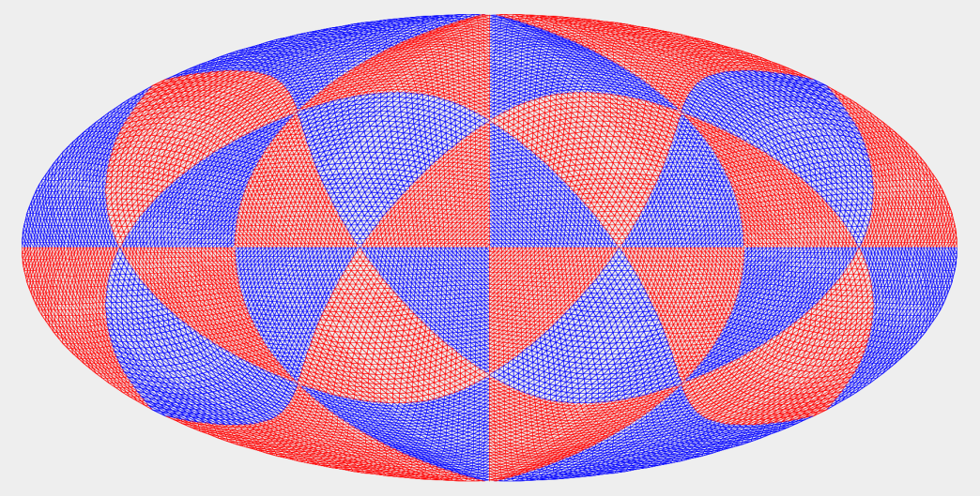
Fermi Astro Server
The Astro Server is both a portal to our events database and the software used to retrieve events (.fits, .root), consisting of:
  Several databases of events and event metadata, separated by reconstruction pass version
  Software for reading/writing events from various types of files, and loading them into the database
  Software for the retrieval of the metadata from the events, and a Pipeline task which constructs files based on searches
  A web interface for the previous pipeline task
User Request
Time/Energy Range
Position in Sky
Quality
Dedicated
Oracle
Database
~5 Billion Photons
Event List
Xroot File Server
Root Tuples
Fits Files

Slide 11
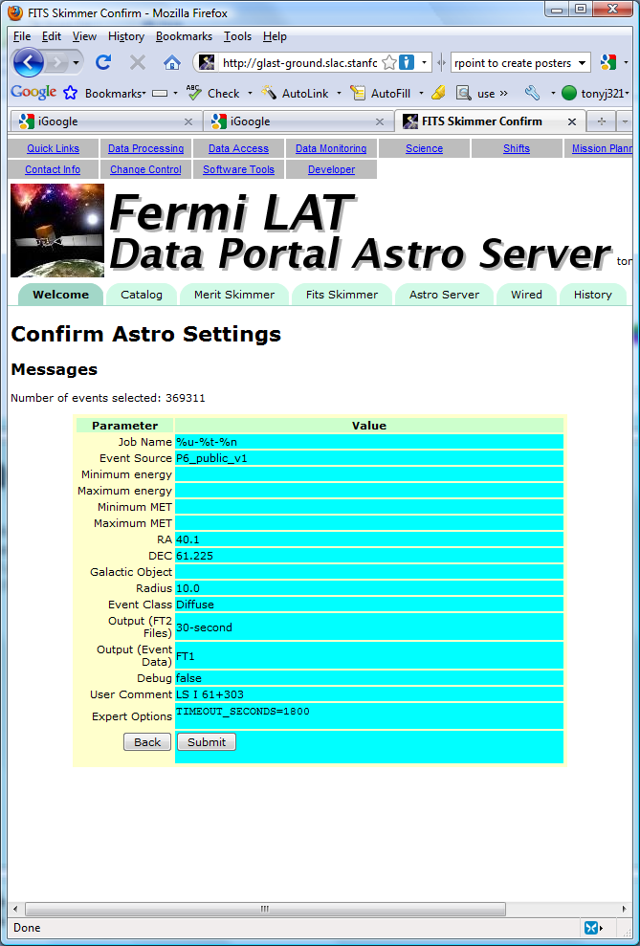
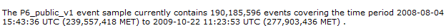
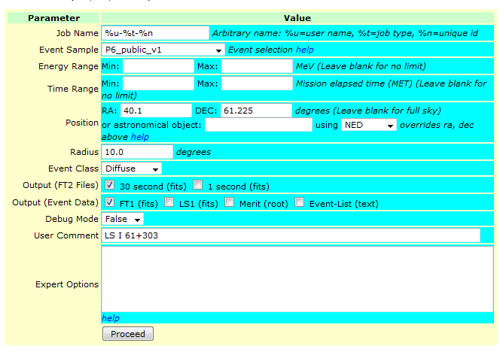
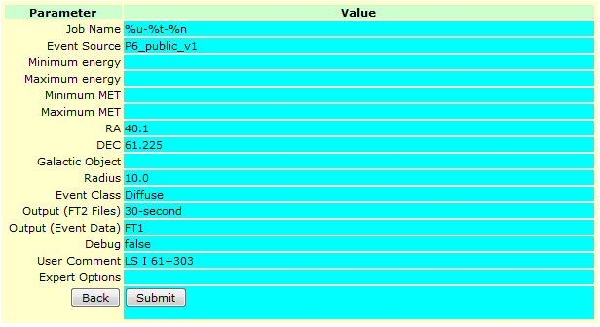
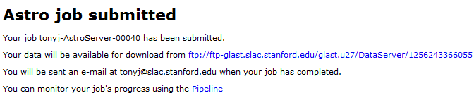
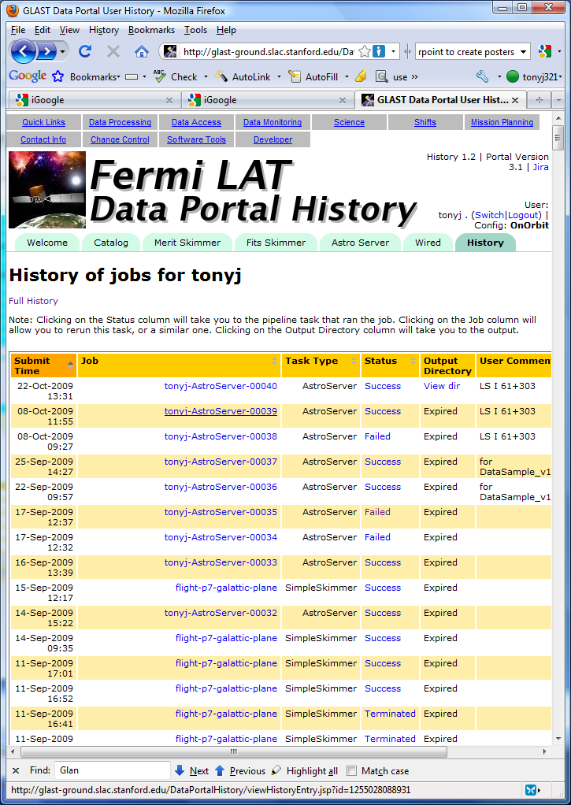
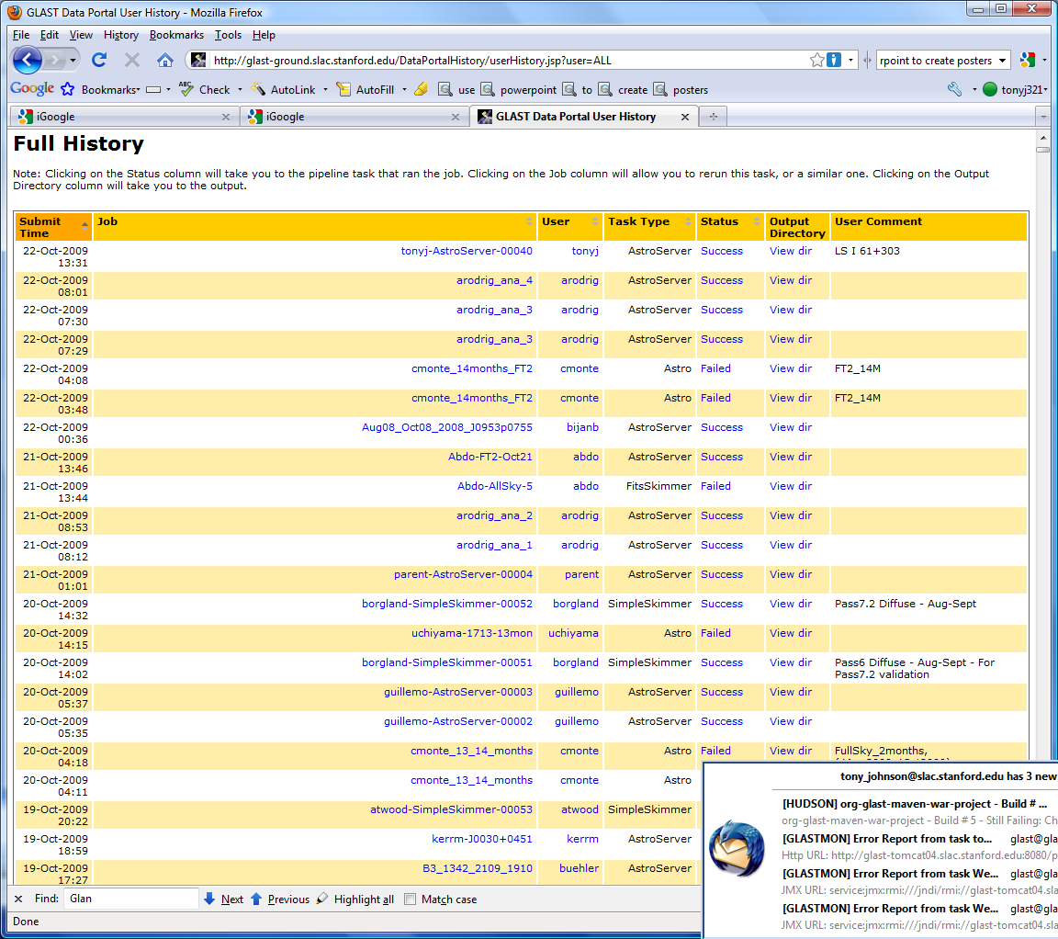
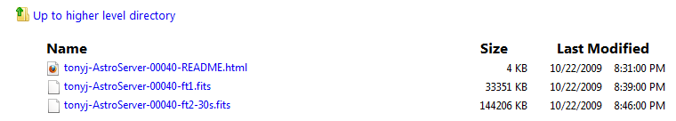
“Astro” Server Web Interface

Slide 12
“Astro” Server Improvements
Major work so far has been bugfixes, database optimization, and code maintenance issues as we've been migrating packages to SRS.
Support issues:
  Adding support for new passes (in code, database), such as:
    New filetypes (reading/loading and dumping/writing metadata)
    Metadata in the new passes/filetypes (event classes, event parameters, etc...)
  (Continued) work on query optimization and maintenance in Oracle
Working on:
  New (html5) web interface for the astroserver
  Further optimization of Oracle for our large tables (over 5 billion rows)
  Support for end-to-end processing ?
    Fermi analysis is fairly standardized. Some steps time consuming
    Currently users download data and run analysis apps themselves
    Astro server could perform some analysis
      Needs collaboration from science users

Slide 13
Fermi – WIRED Event Display
WIRED: Experiment independent event display
  Originally developed at CERN (by Mark Donszelmann)
  JAS+WIRED projects merged when Mark came to SLAC
  Has been used by BaBar, SiD/lcsim, LCIO, Fermi, Geant4
  Had been mostly un-owned since 2007
  Development renewed in 2011 by Dimitry Onoprienko
    Focusing on bugs/features from Fermi
Core Features
  3d “wire-frame” event display
  Easy to interface to different experiments
  Many standard features: projections, picking, attributes, cuts
  Fermi: Started from web, directly interfaced to data catalog
    Type in run/event number and event opens

Slide 14
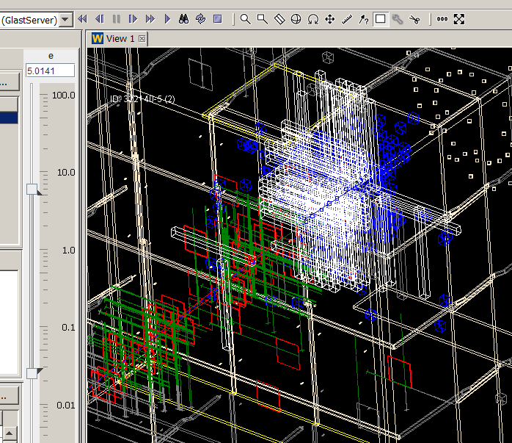
Fermi – WIRED Event Display
Most of the new features and bug fixes were requested by Fermi. Some by org.lcsim users and others.
Heavy re-factoring and re-coding was required to return the project to a maintainable and extendable state, and to enable new functionality requested by users.
Since WIRED is implemented as Jas3 plugin, many changes and additions to WIRED were in fact implemented as changes and improvements to Jas3 and FreeHEP libraries – will benefit other projects as well.
Very good progress made, Pass 8 developers seem satisfied
How much effort for future? Should we try to re-productize this and encourage other users?

Slide 15
Experiment Support
EXO

Slide 16
EXO
Data handling group made contributions to
  DAQ (web based GUI based on GWT)
  Online monitoring and Online Event Display
  Data Transport, Data Processing, MC Infrastructure (Pipeline)
  Monitoring (Nagios), Resource Monitoring
  Web Applications for
    Trending, Data Quality, Shifts, Portal, User/Group Manager, Login, Data Mover, Data Catalog
  Offline
    Build system (make)
    Subversion/Automated build (hudson)
    Documentation (confluence)
    Conditions system (with Joanne Bogart)
  Extensive reuse of Fermi/SRS/FreeHEP tools

Slide 17
DAQ/Online Architecture
anywhere (almost)
EXO DAQ GUI
Run History
Online/Trending
Live Event Display
(computer)
glastlnx09
SLAC
(name)
MySQL
database
(replica)
MySQL daemon
surface
(process)
exodata01
JBOD
NFS client
Online Monitoring
underground
(WEB application)
exouser
MySQL
database
(master)
MySQL daemon
NFS daemon
RAID (12TB)
exodaq
command flow
ExoData
EXO
ExoControl
data flow

Slide 18
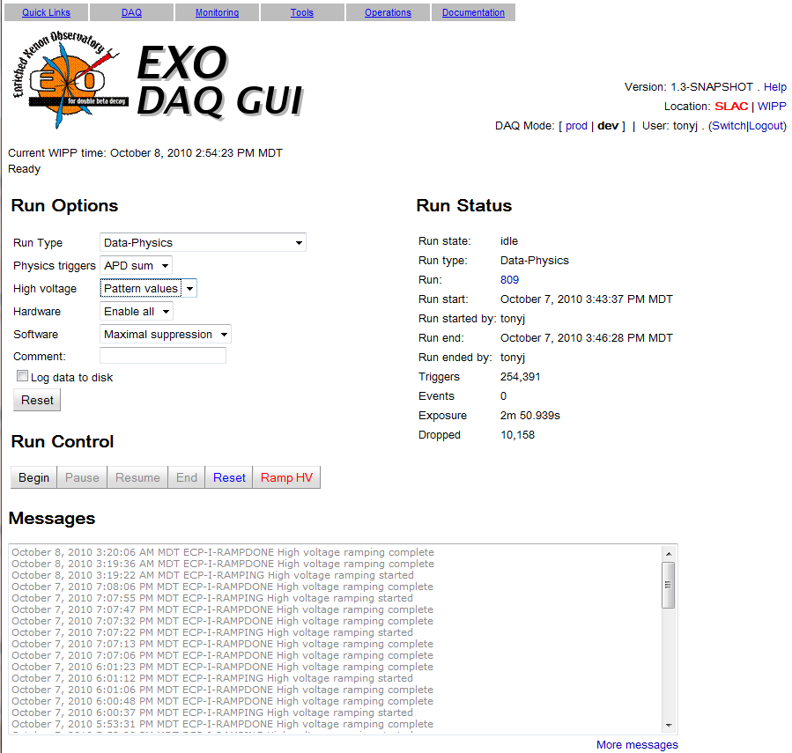
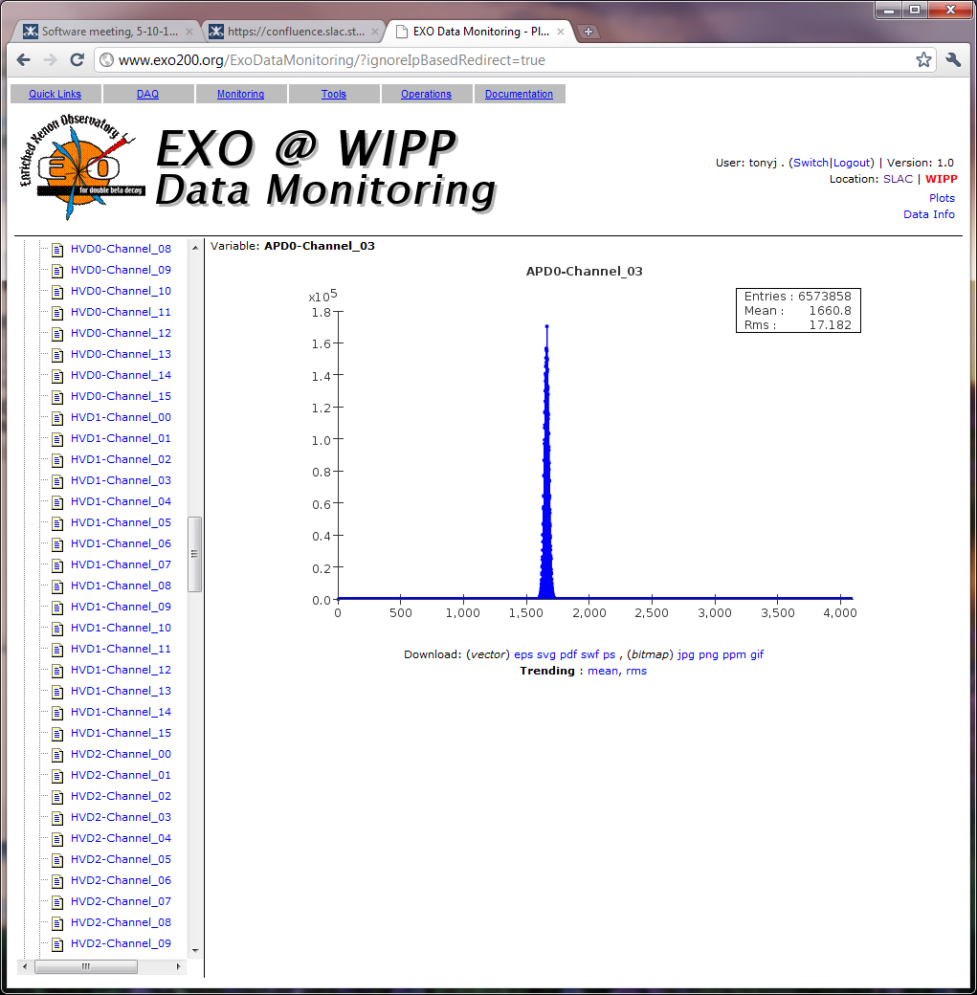
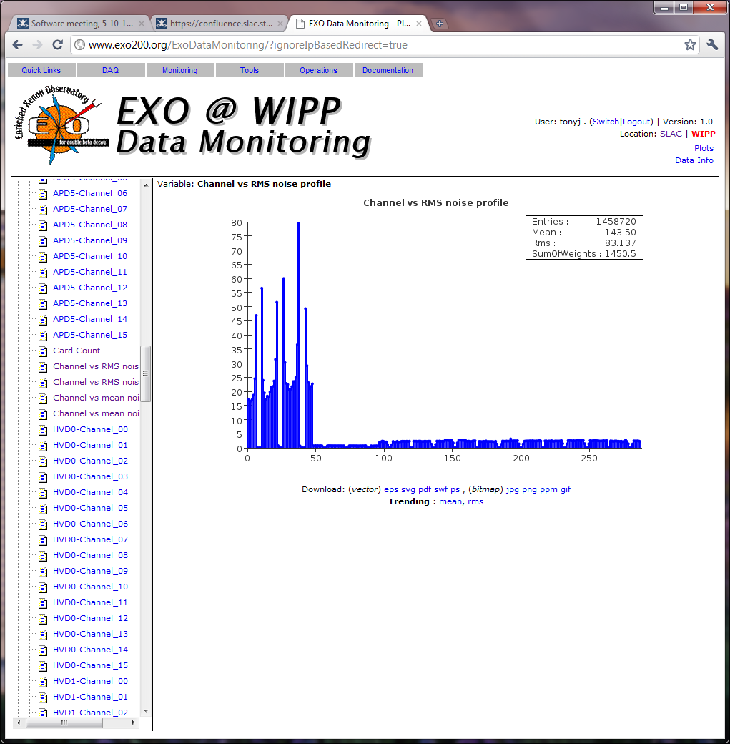
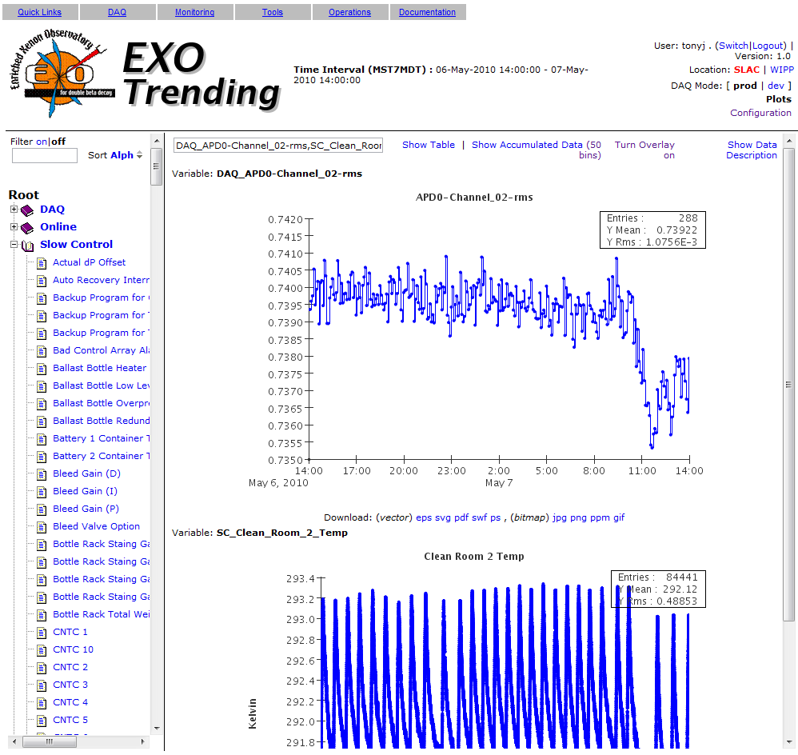
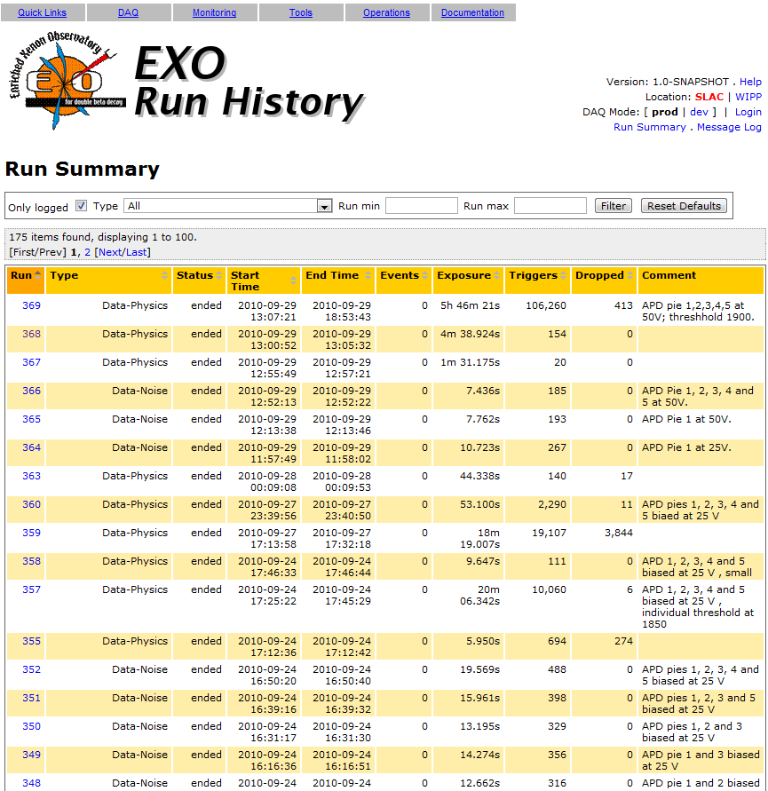
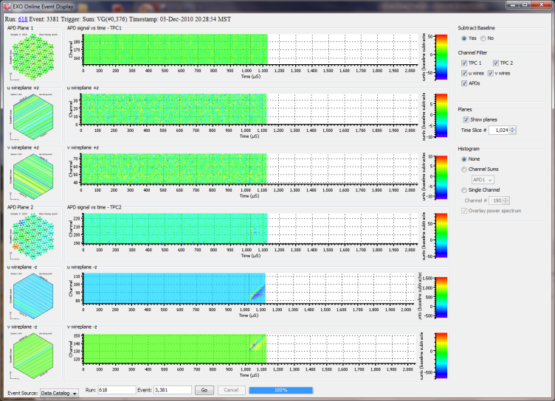
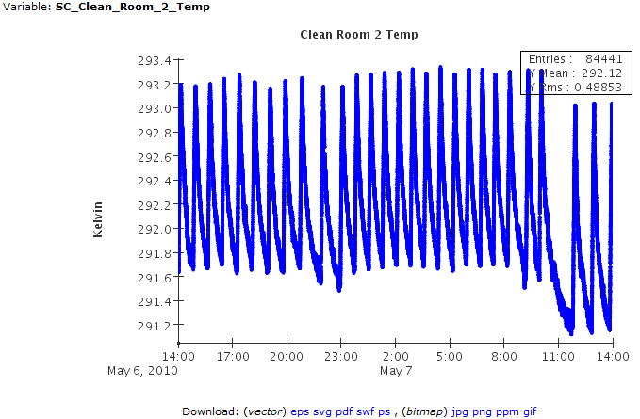
EXO Online Tools

Slide 19
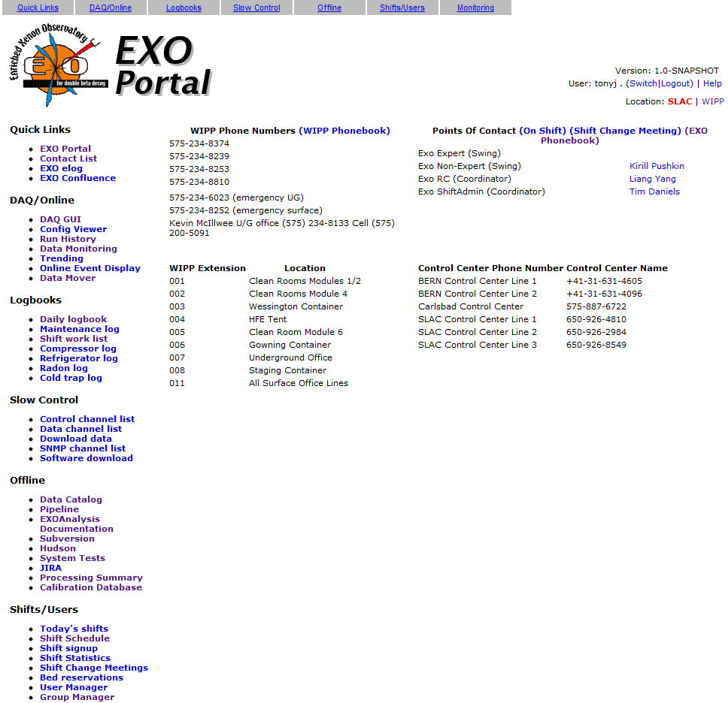
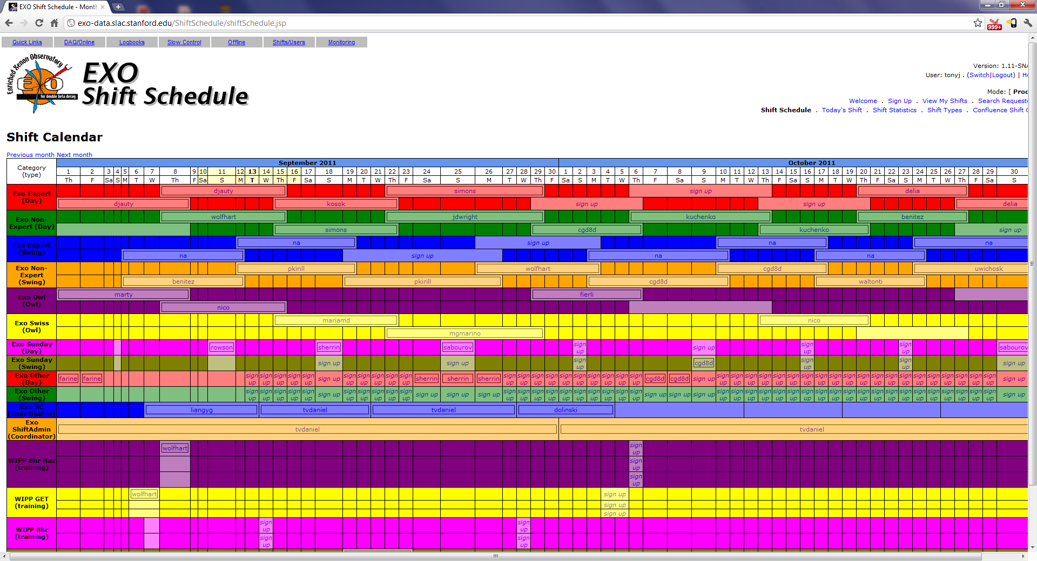
More EXO Web Applications

Slide 20
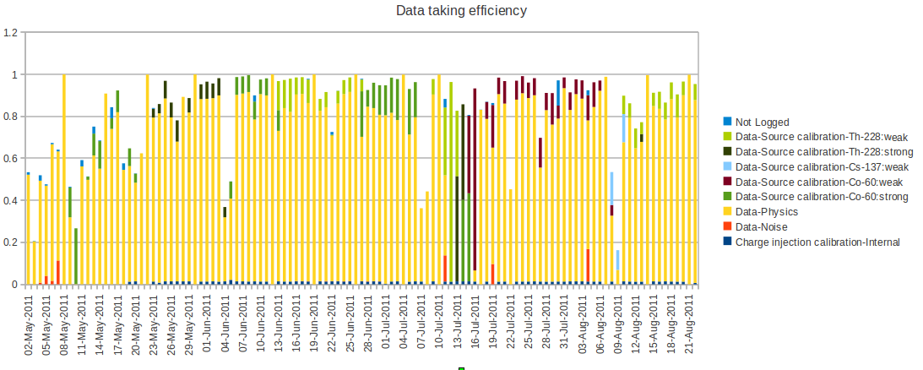
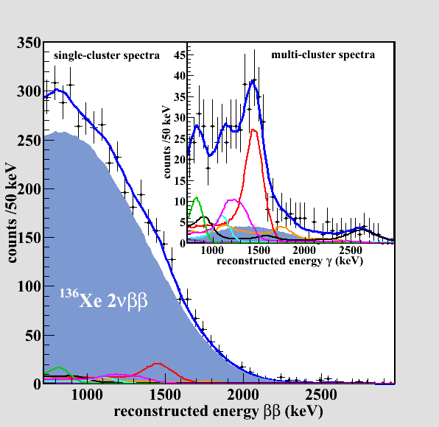
EXO Data Taking Ramp Up
Data taking efficiency
Data processed/reconstructed (x2) as it arrives at SLAC
  Fully automated using pipeline
  On demand reprocessing (24 hour turnaround)
  Remarkably few problems with software
Observation of Two-Neutrino Double-Beta Decay in Xe-136 with EXO-200

Slide 21
EXO
Reuse of many Fermi/FreeHEP projects very successful
  Shows that tools can be easily adapted/reused
    But for the most part we did it ourselves
      On EXO there was no one else to do it
      Not enough documentation that we could just hand it to others
What is left to do?
  For EXO 200 not much
    Adapt to new analysis group structure
    More effective use of monitoring to improve data quality
    More use of xrootd for managing data location and migration
      With Wilko, Andy
    Implement MC Infrastructure
      But need to ramp down (my) involvement in EXO
      Need to get some help with EXO support from somewhere
  Design work for EXO full
    Not until 2022 – so no hurry

Slide 22
Experiment Support
LSST Camera Control System

Slide 23
LSST Camera Control System
Developed in Paris by small group (~2-3 FTE)
  Basic Java control system written (but no users)
  Already interested in using our freehep/plotting/trending tools
At SLAC with Tofigh, Stuart, Owen Saxton
  Understand existing infrastructure
  Move to supportable build/management/test system
  Developed GUI's for shutter/carousel
  Demoed working system interfaced to prototype hardware
  Developing engineering console based on JAS
  Developing web interface/trending system built on web app
  Beginning to support first sets of users
    Established user support mailing list
  Developer/User workshop held at SLAC in October
    Developed roadmap for next 6 months
  Longer term involvement in LSST?
    Camera control system is a bit of a niche involvment

Slide 24
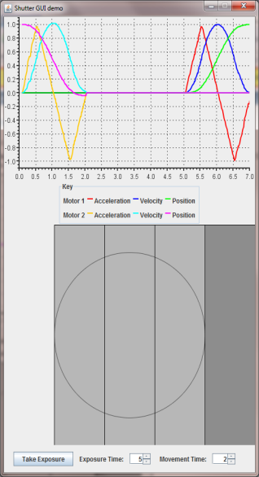
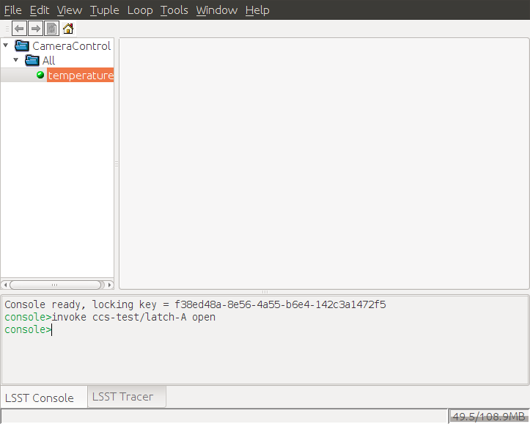
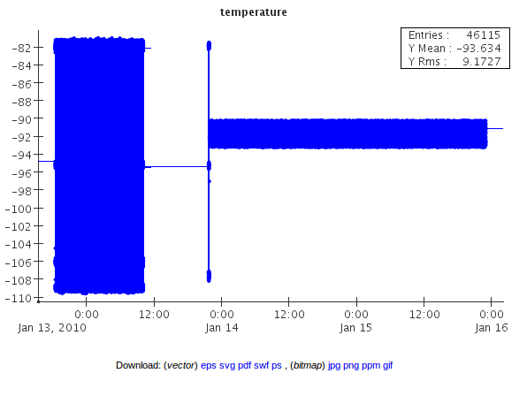
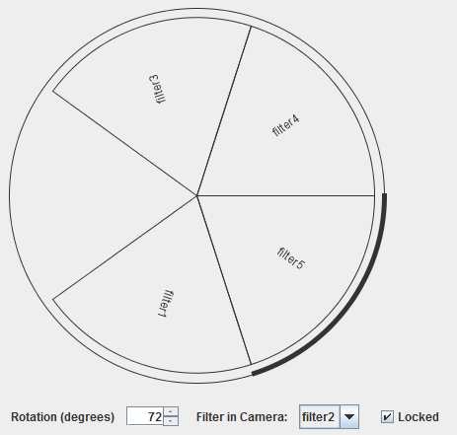
LSST Camera Control System

Slide 25
Multi-Experiment
Products

Slide 26
Pipeline + Data Catalog
Pipeline?
  Allows complex, parallel workflows to be defined
  Tracks all data-processing in database
  Allows jobs to be ”rolled back” manually or automatically
  Extensive web interface, plus command line interface
Data catalog?
  Heirachical database for keeeping track of data
    Storage independent, particularly useful with xrootd
    ”Crawler” which verifies data integrity
    Allows arbitrary meta-data to be associated with datasets
      At registration time, or extracted by crawler
  Web interface for browsing/selecting/fetching data
    Download manager, Skimmers, Event Displays
  Command line interface

Slide 27
Pipeline and Data Catalog Components
SLAC
Oracle
Command
Client
read-only
Data
Catalog
Client
Catalog Web
Interface
Client
Data
Portal
Client
Client
SLAC
SLAC
Batch
Farm
Client
Job Control
Line Mode
Client
Pipeline
Server
IN2P3
Client
Batch
Farm
Job Control
Client
Oracle
INFN / Grid?
Pipeline
Web Interface
Batch
Farm
read-only
Job Control

Slide 28
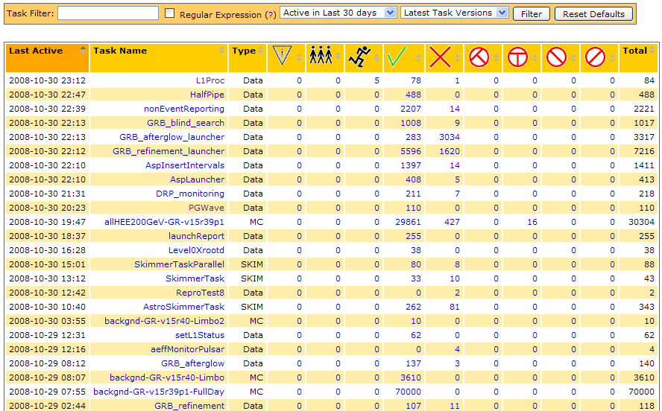
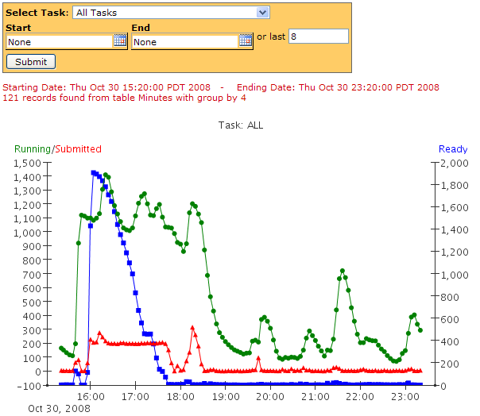
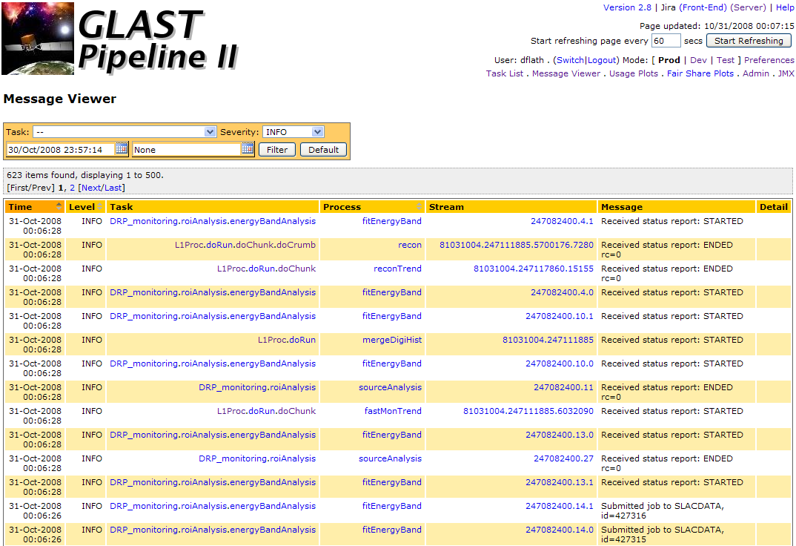
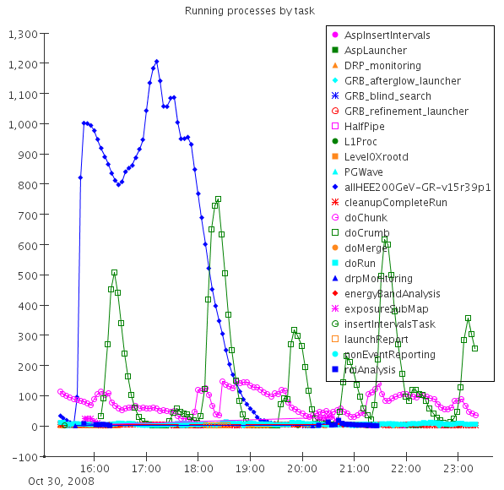
Pipeline Web Interface

Slide 29
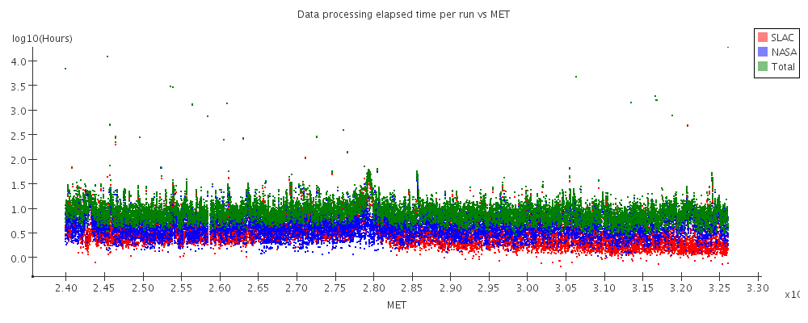
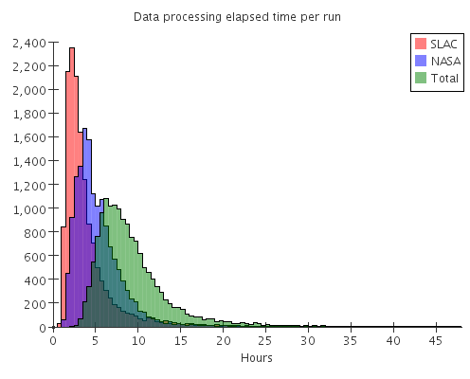
Pipeline Performance and Reliability
Pipeline reliability. AutoRetry allows failed jobs to be rerun without manual intervention.
CPU-years delivered by the pipeline per month.
x10⁸
Elapsed time between data being recorded on satellite and arriving at SLAC (red), and between arriving at SLAC and being totally processed (blue), and total elapsed time (green). Most data is fully processed <24 hours after being taken.

Slide 30
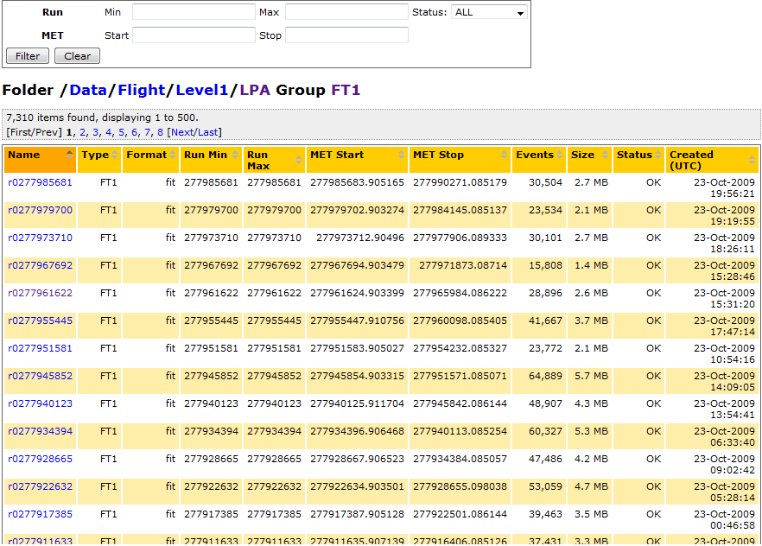
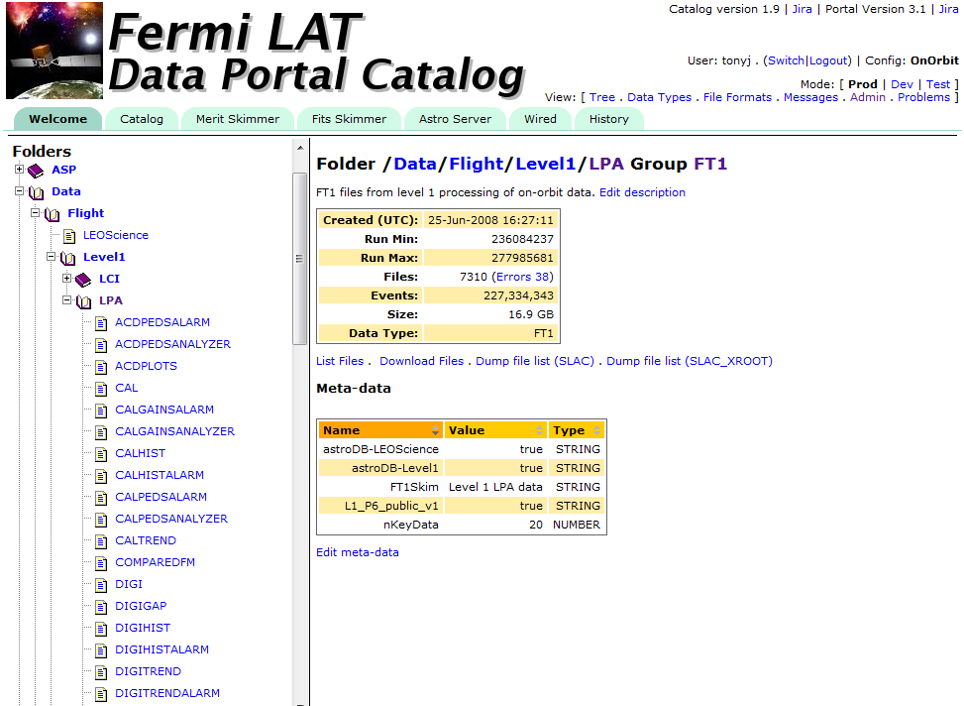
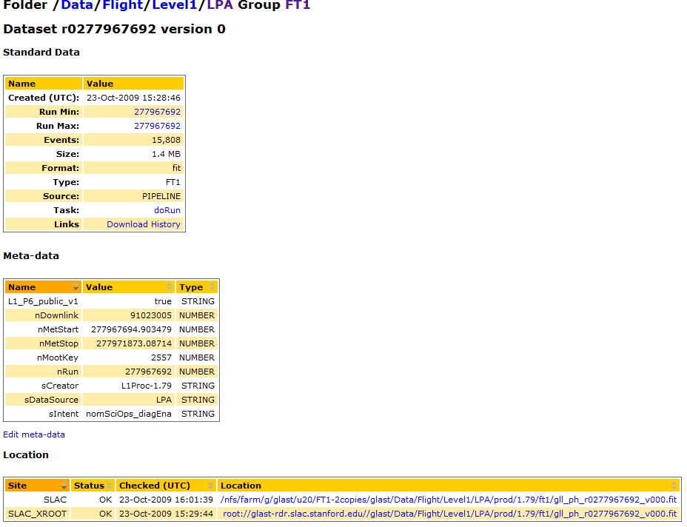
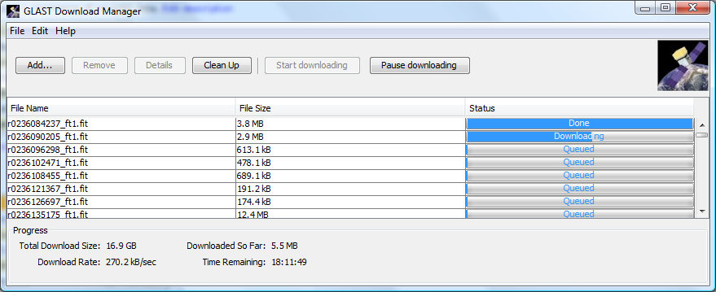
Data Catalog and Download Manager

Slide 31
Pipeline + Data Catalog
Recent and Ongoing Activity
Fermi dependencies removed
  Now used by EXO (MC, Data Processing), CDMS (MC), CTA (SLAC MC)
    EXO probably has more pipeline users that Fermi
Currently two versions of the pipeline
  SRS version – ported to subversion, generalized, misc improvements
  Fermi version – CVS, stable, some emergency patches
    Brian has been working on merge (almost complete)
    Slow, painstaking work, consquence of lack of manpower
Pipeline extended to work with
  Grid Engine (IN2P3)
  Condor (SMU)
  Work ongoing to make ”generic” Grid interface (EGEE/Dirac)
Interest expressed by others James Webb Space Telescope, CTA
  How much work should be put into extensions/improvements?
  But do we have manpower/interest in productizing this?
    Would need a lot more documentation, installation instructions
    It is currently tied to Oracle

Slide 32
Developer Infrastructure
Maven
  Java based project management/build system
Subversion
  svn.slac.stanford.edu, svn.freehep.org
  Web Interface to subversion (sventon)
  E-mail notificiation on checkin (svnspam)
  Integrated crowd login (in progress)
CVS
  cvsspam, cvs.freehep.org (lcio, hps, etc), web interface (currently dead)
Hudson
  Automated build system
JIRA/Confluence
  Support now handed to computing division
  But still help with user requests and configuration
  Also run bugs.freehep.org (currently dead)
Whole is greater than sum of parts
  All of these systems interoperate
Brian is looking at Atlassian Fisheye
  Works for CVS, Subversion, GIT, ….
  Would replace sventon+svnspam+cvsspam
  Crowd integration built in
  Need to decide if/how to support this
    Ideal would be collaboration with computing division c.f. confluence

Slide 33
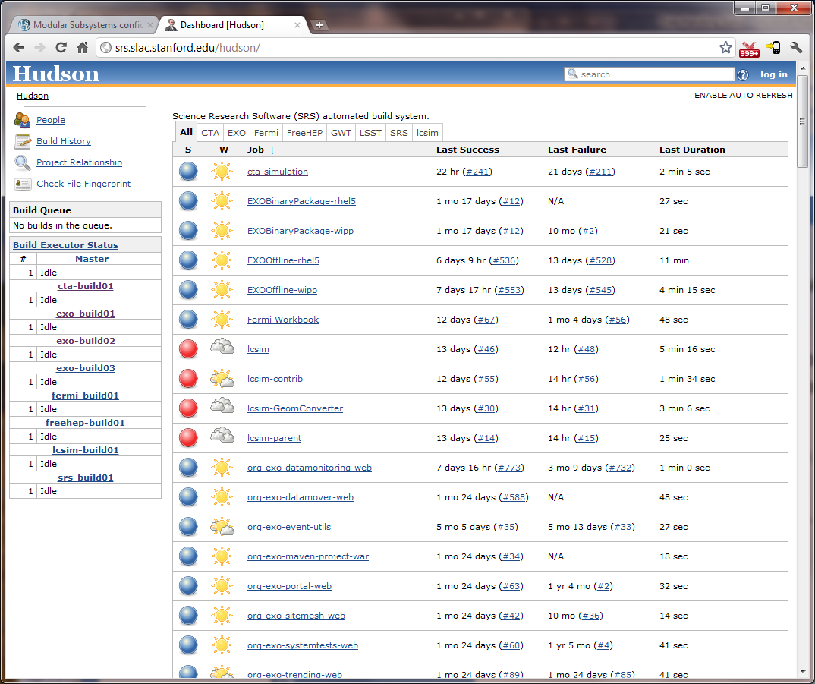
Developer Infrastructure
Used by, CTA, EXO, Fermi, FreeHEP, LSST CCS, lcsim, open to others …
We are trying to leverage our experience to benefit LSST observatory

Slide 34
User/Group Manager
Group Manager developed for Fermi
  Puts users (and groups) into groups
  Supports delegation of group administration
  User by web infrastructure for authentication
For Fermi user management done on Campus
  Looking at possibility to migrate some of this to SLAC
For other experiments (initally EXO) we needed our own user management
  Basic set of data on each user
  Any experiment can add arbitrary meta-data
  Flexible control over what data is visible/editable by who
    Some data editable by user, others only by certain groups
  Flexible reporting infrastructure
Available for use by other collaborations/experiments
  Charlotte has setup skeleton project for HPS
Should look at closer integration with SLAC/SLUO user management

Slide 35
Web Infrastucture + Login Framework
Web infrastructure is used by all of our web applications
  Used by Fermi, EXO, Pipeline, Data Catalog, LSST CCS, ...
  Uses AIDA/freehep for plotting, root access etc
Uses CAS for single sign-on
  Supports SLAC windows or unix ids (via kerberos)
Uses Group Manager for authentication
Future directions
  Integrate CAS with Crowd
    Will allow login with crowd/conflunce id as well as windows,unix id
    Will allow integration of tools like hudson, probe into login framework
  May consider closer integration of Crowd/Group Manager
    Similar but complementary functionality

Slide 36
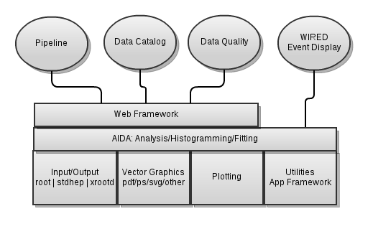
Freehep/JAIDA/JAS
FreeHEP underlies many of our tools
No work since 2007 except critical bug fixes
  Recently done small amount of work to
    Update JAS to use maven for integration with WIRED, LSST
    Plan to look at AIDA compressed XML support for EXO

Slide 37
LCIO/LCSIM
LCIO = joint project with DESY to define standard IO format for ILC detector studies
  Uses subversion, hudson, JIRA, confluence
lcsim = reconstruction and analysis framework
  Initially for ILC (primarily SiD)
  Now also potentially targeted at muon collider, small experiments (heavy photon, dark light)

Slide 38
Other products
Nagios (monitoring)
  Used by Fermi, EXO, CDMS
  Being merged with computer center nagios

Slide 39
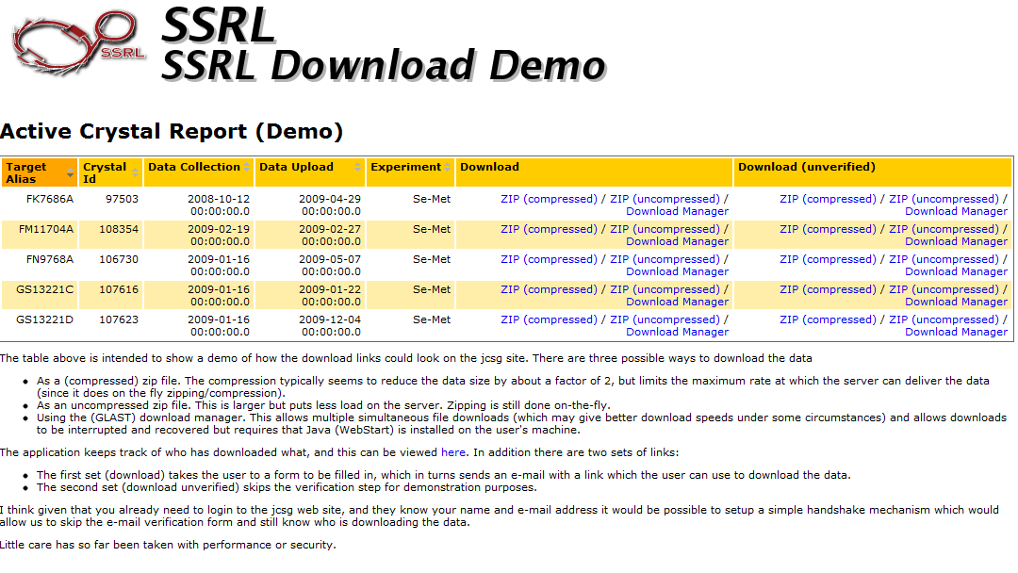
Outreach
SSRL, Theory group (Stephan)

Slide 40
What are we not working on
Freehep/AIDA infrastructure
FreeHEP web site
  Site not updated since 2007 (looks bad)
  Forum, bugs broken
Support for external users
  Collaboration with Geant4
    Use of WIRED, JAIDA
  Offers of collaboration with others
    Use of WIRED for LCIO (distinct from lcsim)
    Root team on web/visualization infrastructure
    Work with ANL on (Java) tools for Atlas analysis
    Work with CLIC on Dirac interface to data catalog

Slide 41
Problems
We are doing too much (or have too little manpower)
  Doing anything new and interesting becoming very hard
    Not enough of (Max+my) time dedicated to new projects, planning
  Supporting any products beyond SLAC has become impossible
  We work best when we can get at least 2-3 people working together actively on project
    E.g. Pipeline, AIDA, ...
    When we are fragmented working on different projects progress is slow
  Not staying on top of maintenance leads to wasted time/effort
    Allowing pipeline project to fork has taken a long time to undo
    Becoming lazy at using JIRA to manage projects
  Highly dependent on individual expertise
    Has taken year for Brian to take over pipeline+abstract
    Has taken year for Dima to take over WIRED
Need to develop more rational process for deciding on support
  Needs to take into account coupling of projects
  e.g. lcsim, freehep

Slide 42
Roadmap development...
We need to develop a roadmap for future developments
  Success on Fermi, EXO was because we had existing tools which we could deploy
  We should be leading adoption of new technologies
HTML5 Web infrastructure
  Takes advantage of existng skills/tools
  Will become primary way of interacting with large physics datasets
    ”Cloud based” backend
Accelerate development of advanced web apps
  Improve plotter, make web compatible
    Prototype already in use for EXO, LSST
    Brian has worked on GWT port
  Improved data catalog interface
    If there are new users
Target LSST projects, perhaps using Fermi as a testbed
  Ability to perform web based end-to-end analysis
  Virtual observatory interfaces
    Use of SAMP for web interfaces, GUI tools
Continue support for Fermi/EXO/LSST CCS
  Ramp down Fermi, EXO
  Ramp up CCS (for 1-2 years)
  Others? CDMS? HPS? Sid?
Freeze development for Pipeline
  Continue to support it ”as is”
    Except where we have specific offers of collaboration
Make decission about future support of freehep
  Document where support is needed for other projects
  Make decisions about support for individual projects
    Favour projects which can contribute to web infrastructure
  Clean up web interface
  Decide on future support of wired?
    Geant4? ILC?
More manpower?

