Slide 1
Fermi Gamma-Ray Space Telescope Processing Pipeline and Data Catalog and Online Monitoring
Tony Johnson
tonyj@slac.stanford.edu

Slide 2
Overview
Fermi infrastructure
  Automated data processing pipeline
    Also use for MC simulation
  Data quality monitoring
  Data access and data selection tools
  Future development
Explore potential for future use by CTA
  Reuse of any existing Fermi tools?
  Reuse of experience and lessons learned from Fermi?
  Development of future CTA tools?

Slide 3
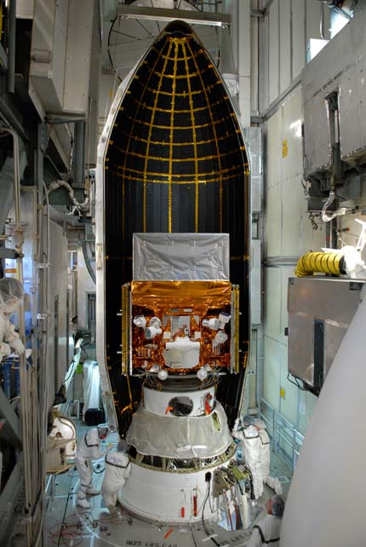
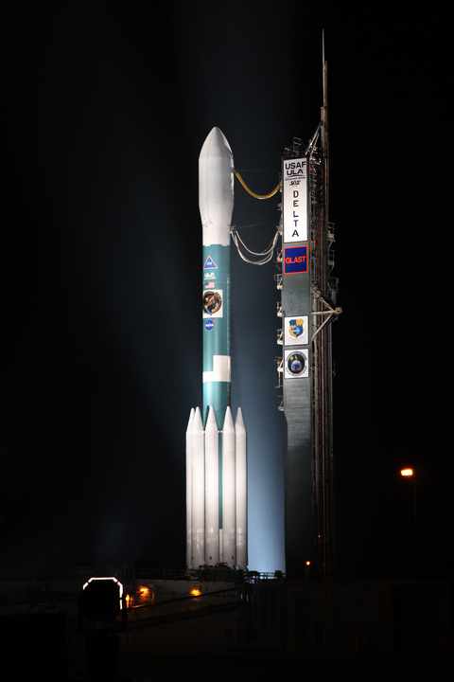
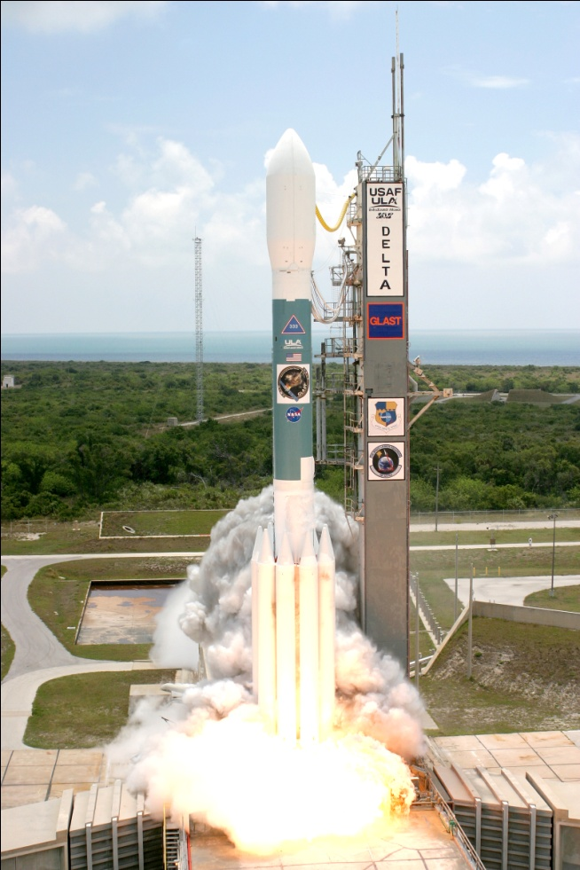
Launched 11 June 2008 – LAT activated 25 June

Slide 4
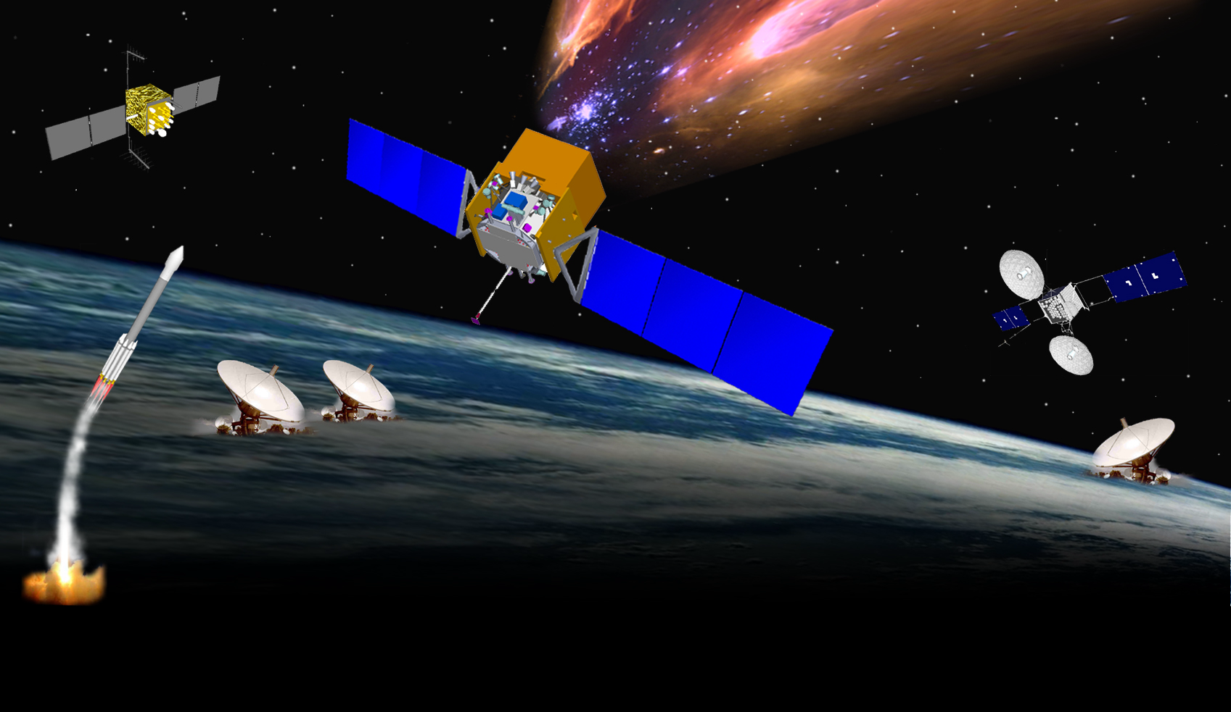
Fermi MISSION ELEMENTS
GPS
•
μ
sec
Large Area Telescope
& GBM
•
Fermi Spacecraft
•
Telemetry 1 kbps
-
•
TDRSS SN
S & Ku
DELTA
7920H
•
•
-
S
-
•
GN
•
LAT Instrument Science Operations Center (SLAC)
Schedules
White Sands
Mission Operations
Center (MOC)
Fermi Science
Support Center
HEASARC
GRB
Coordinates Network
Schedules
GBM Instrument
Operations Center
Alerts
Data, Command Loads

Slide 5
Data Processing Flow at SLAC
Downlink from Goddard Space Flight Center
  ~8 downloads per day
  15 GB total daily
Level 0 Processing
  Automatically launched as data arrives
  Decode & repackage incoming data
    Split science data from telemetry data
Level 1 Processing
  Full event reconstruction: 750 GB/day
  Data Quality Monitoring
  Transfer science summary files to Fermi Science Support Center - 200 MB/day
    Immediately available to the public
ASP (Automated Science Processing)
  GRB and Flare detection
  Spectral analysis
120,000 quantities continuously monitored
  Mixture of Oracle, Root, Fits data
Level 0
Trending Database
(Oracle)
Level 1
Data Quality
(Root)
ASP
ASP Results
(Fits)

Slide 6
Data Processing Pipeline
Allow completely automatic processing of Fermi data
  Reconstruction and initial analysis of incoming data
    Aim to completely process incoming data in 3 hours
      Requires massive parallelization (2000 jobs, 800 cores)
      Less than .01% of batch jobs require manual intervention
  Re-processing of data
  Monte-Carlo simulation of data
    Sufficient capacity to do MC simulations and reprocessing without impacting data processing
Full bookkeeping for maintaining provenance of data products
Ability to roll back failed (or successful) jobs
  Including automatic resubmission of all downstream jobs
Web interface to allow data processing to be monitored or controlled from anywhere

Slide 7
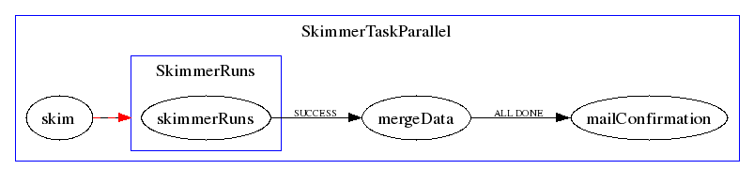
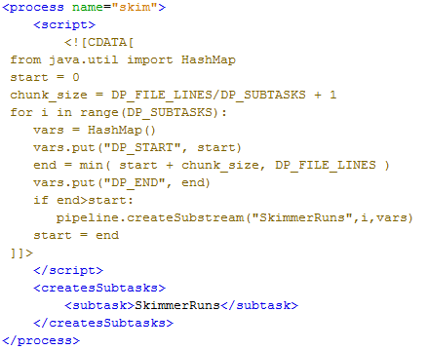
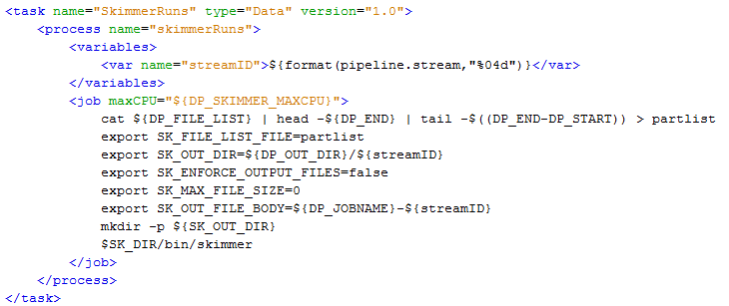
Anatomy of a Pipeline Task
    Tasks, Subtasks, Processes, Streams, specified in user written XML

Slide 8
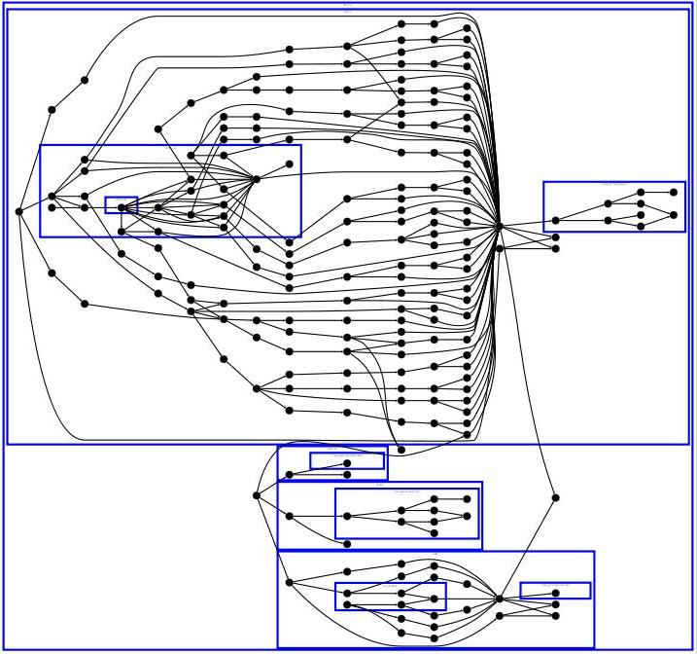
Level 1 Processing Task Example
Digitization
Reconstruction

Slide 9
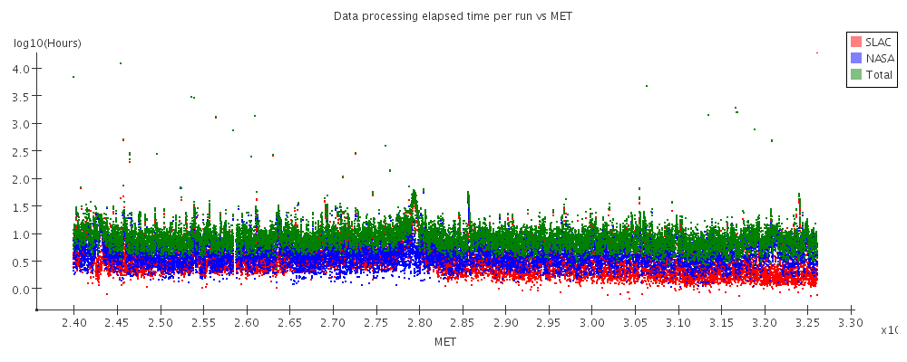
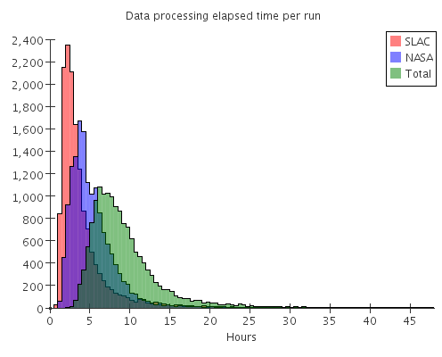
Pipeline Performance and Reliability
x10⁸
Elapsed time between data being recorded on satellite and arriving at SLAC (blue), and between arriving at SLAC and being totally processed (red), and total elapsed time (green). Almost all data is fully processed <24 hours after being recorded.

Slide 10
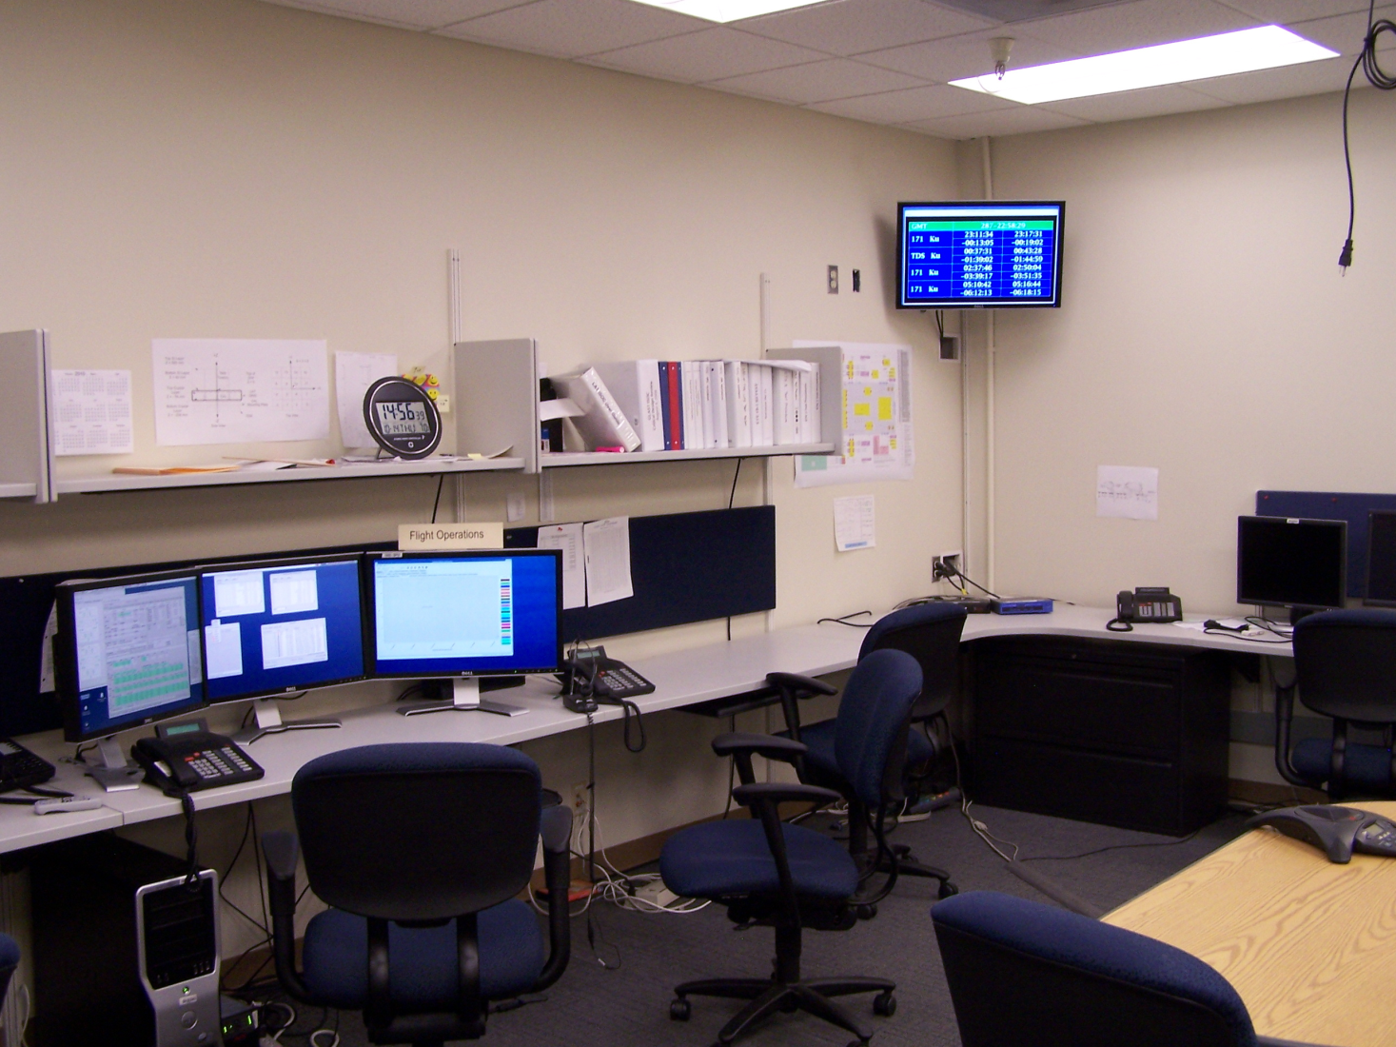
ISOC Control Room
“Duty Scientists” monitoring data quality daily
All of the data processing and data quality monitoring can be done from the web

Slide 11
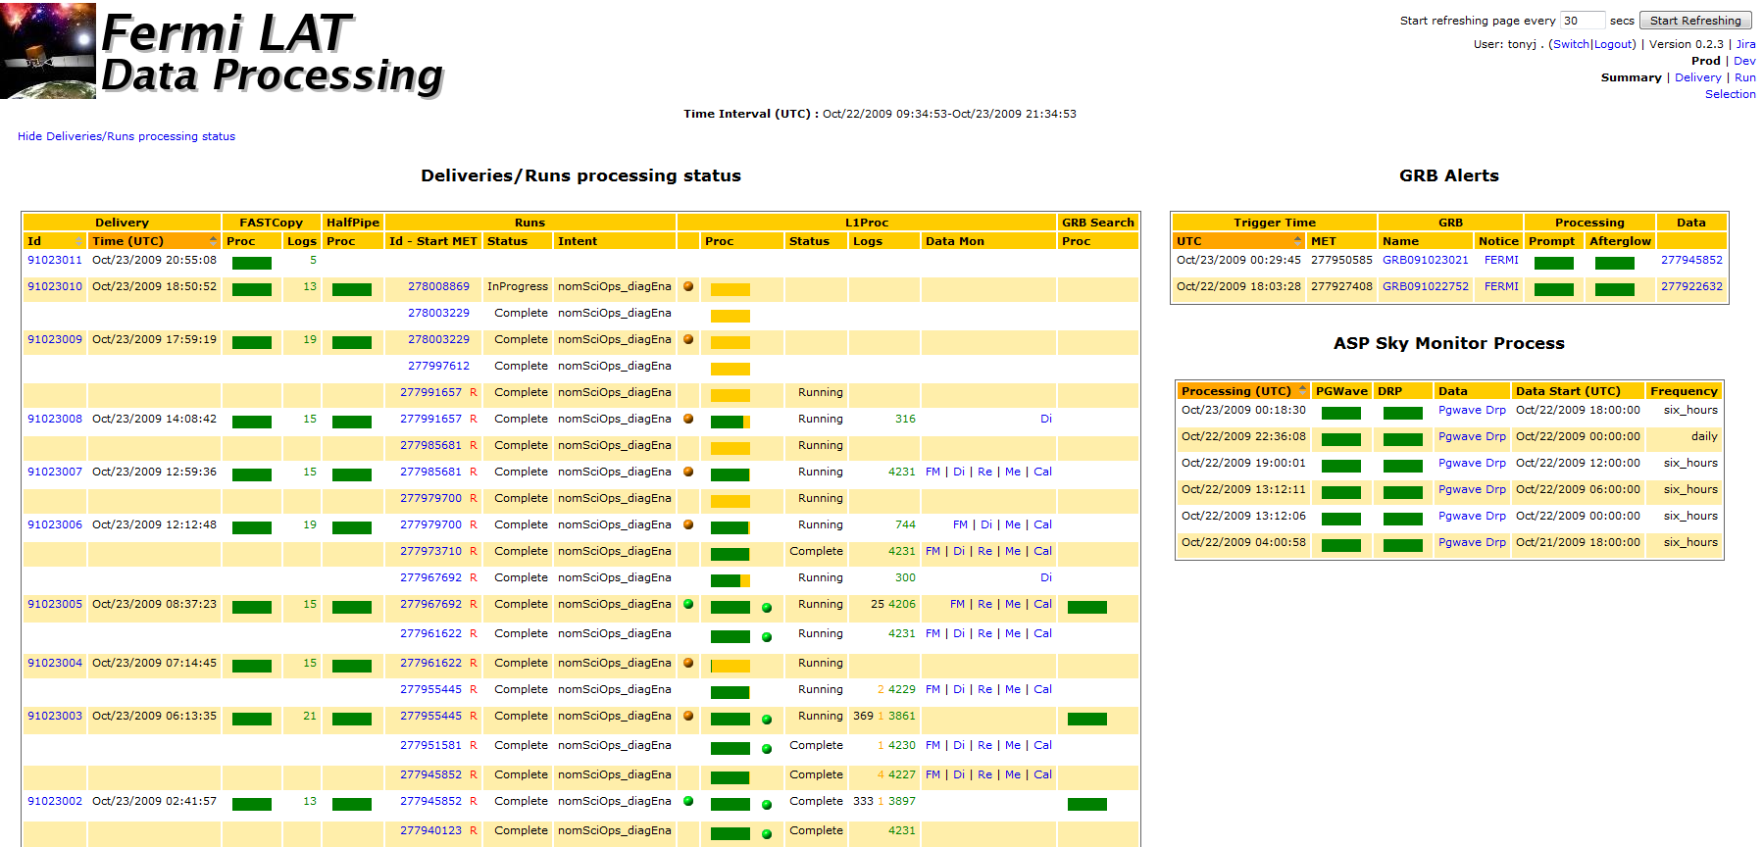
Monitoring Data Processing
Web interface allows
  Quick overview of data processing
  Flags runs requiring further attention
  Allows “drill-down” to isolate/identify problems

Slide 12
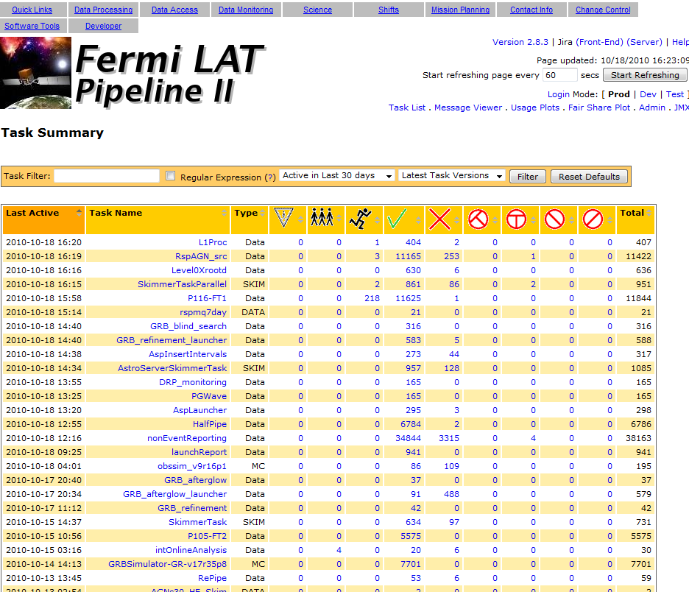
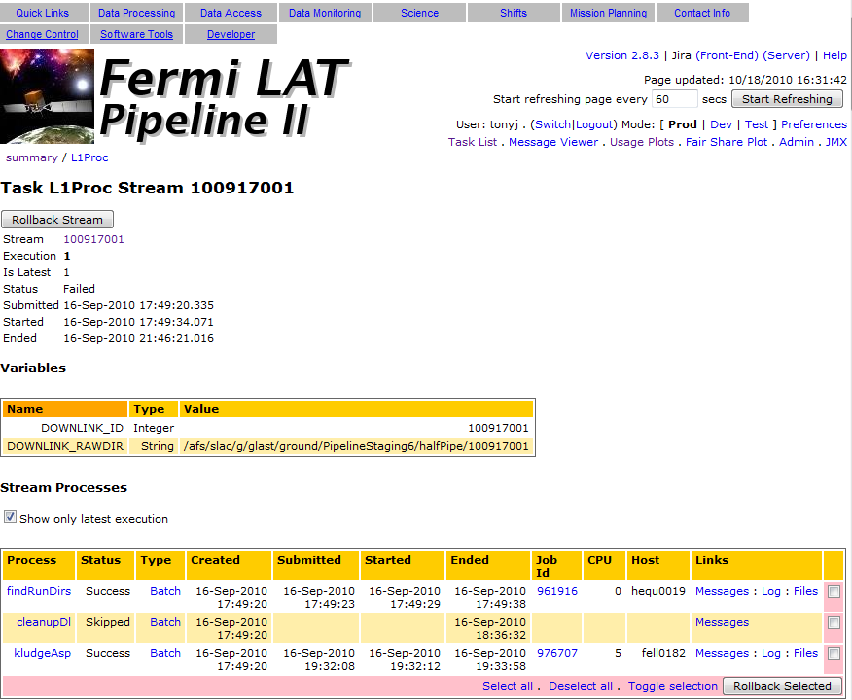
Processing Pipeline Web Interface
Pipeline web interface allows
  Many views of data processing, down to log files of individual jobs
  Job submission (but normally done from command line)
  If jobs do fail they can be “rolled back” directly from the web interface

Slide 13
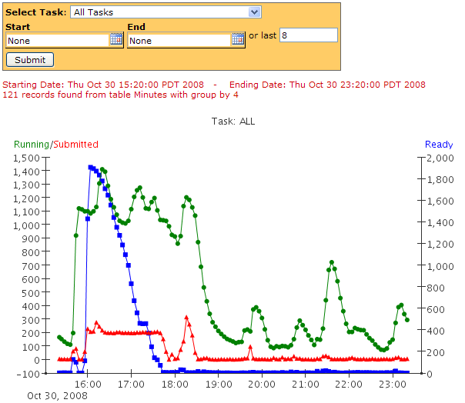
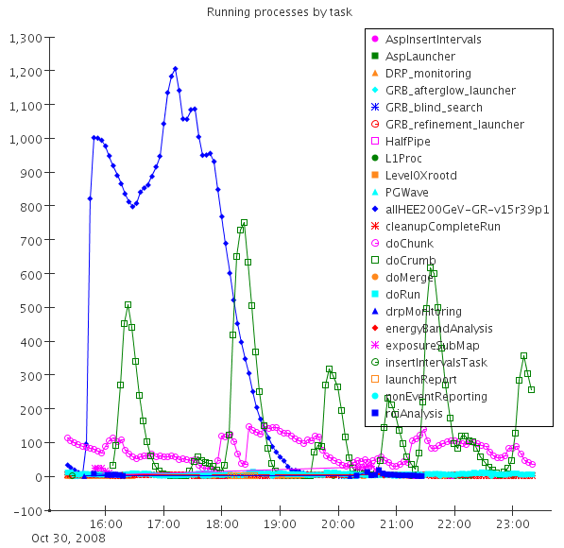
Front End: Activity Plots
Simulation
L1 Reconstruction
L1 Digitization

Slide 14
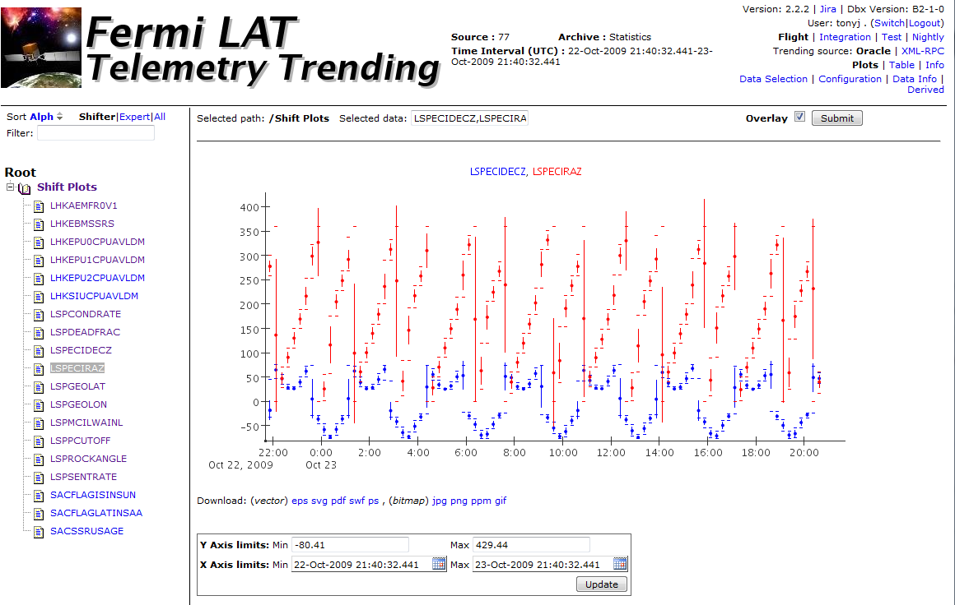
Telemetry Trending
Web interface allows
  Dynamic selection of time period
  Dynamic overlay of quantities
  Customized tree to draw attention to important plots
    Can be customized for individuals or groups
Cross trending of housekeeping and level 1 data

Slide 15
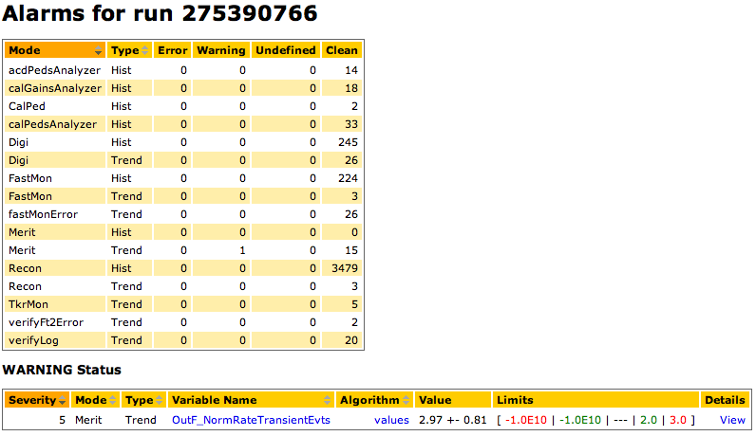
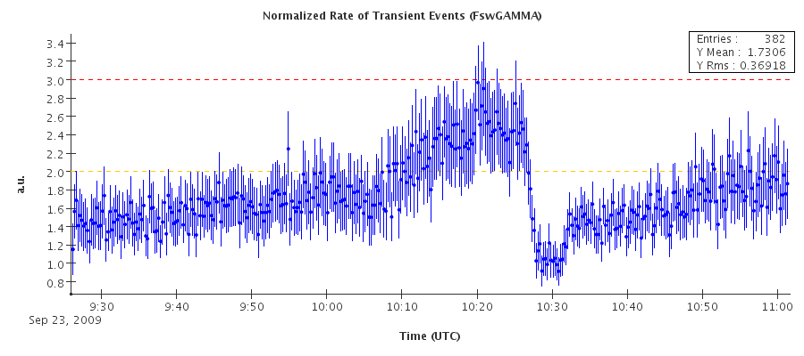
Automated Alarms
Error limit
Warning limit
Automated alarms are used to alert duty scientists to anomalies
Use fixed limits and reference histograms
Many quantities are highly orbit dependent, so particle fluxes, geomagnetic variables must be taken into account
  20 different alarm algorithms

Slide 16
Data Access
Fermi data is immediately available to the public
  Via Fermi Science Support Center
ISOC supports collaboration data servers which provide
  Full access to data via web based “data catalog”
    Access to public files plus extended event formats
    Search based on arbitrary “meta-data” associated with datasets
  Web based event display for looking at detailed reconstruction of individual events
  Web based data selection tools
    With support for producing Root and Fits files

Slide 17
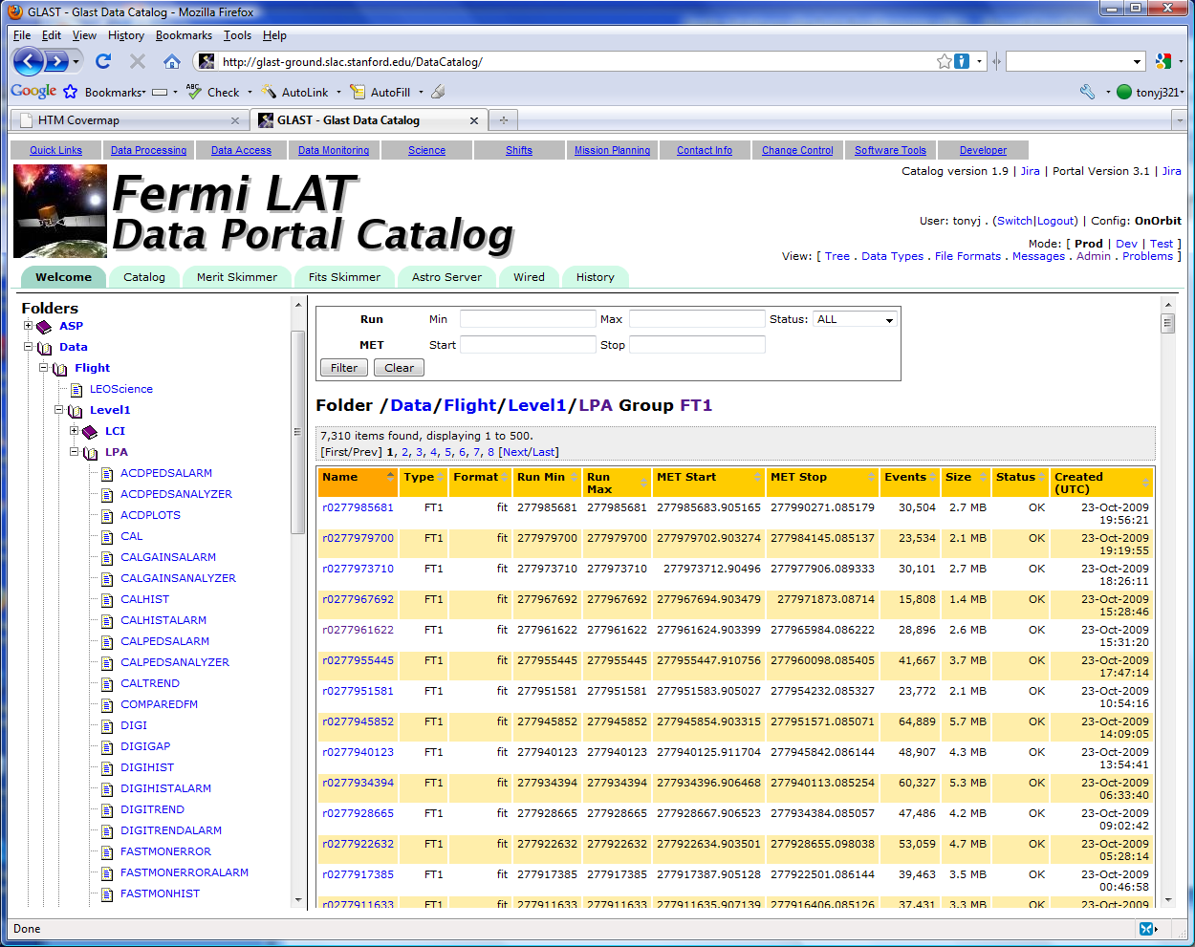
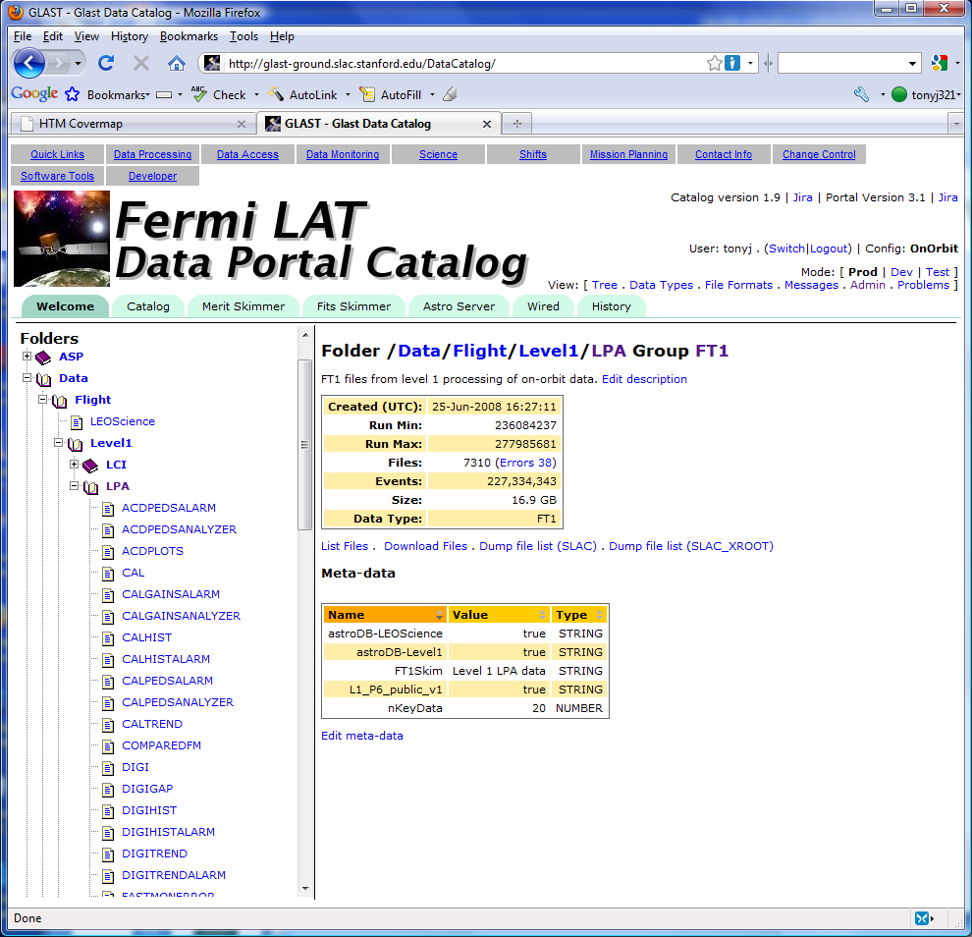
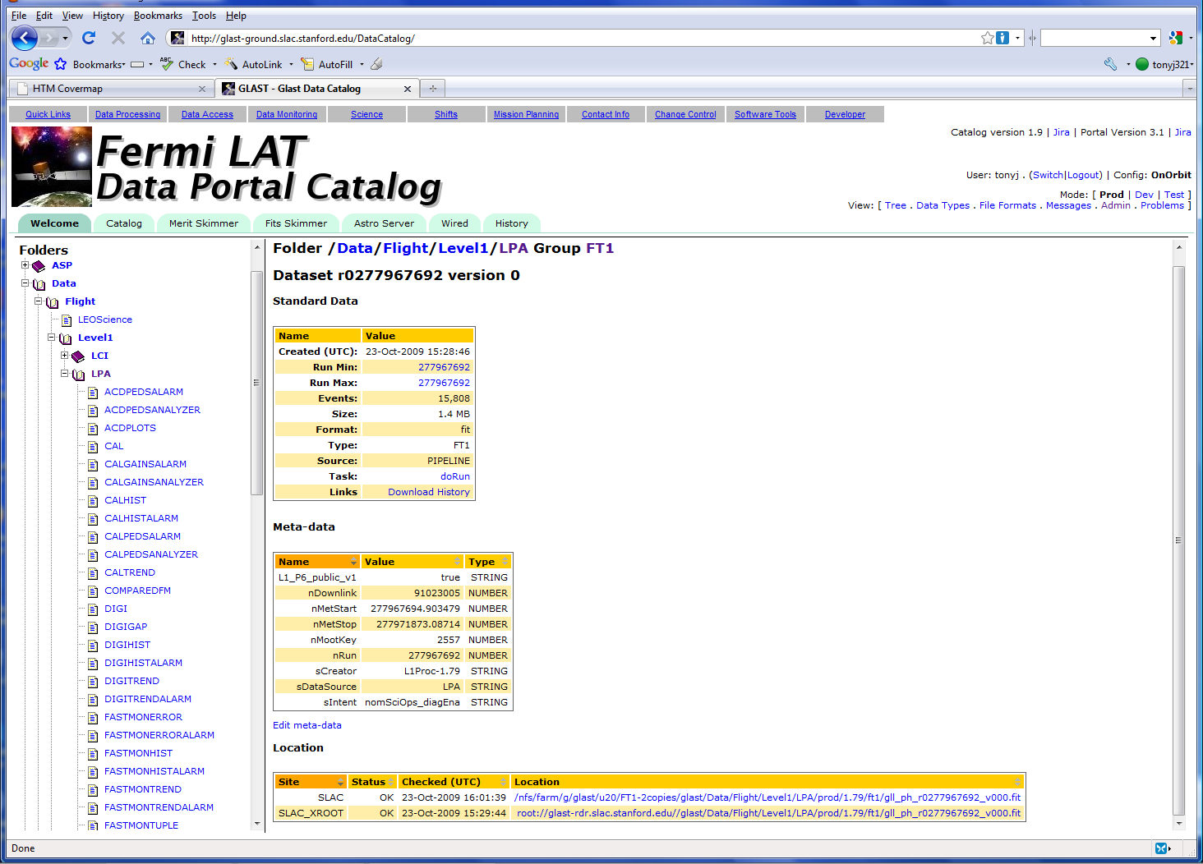
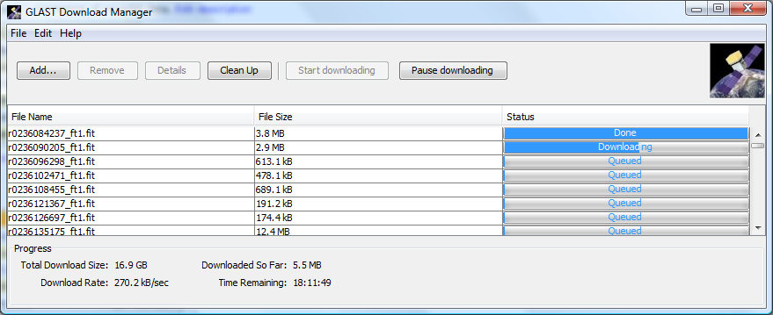
Data Catalog Web Interface
Drill down to get more details
Download manager, reliable download of multiple files

Slide 18
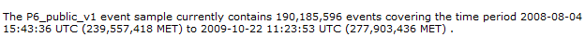
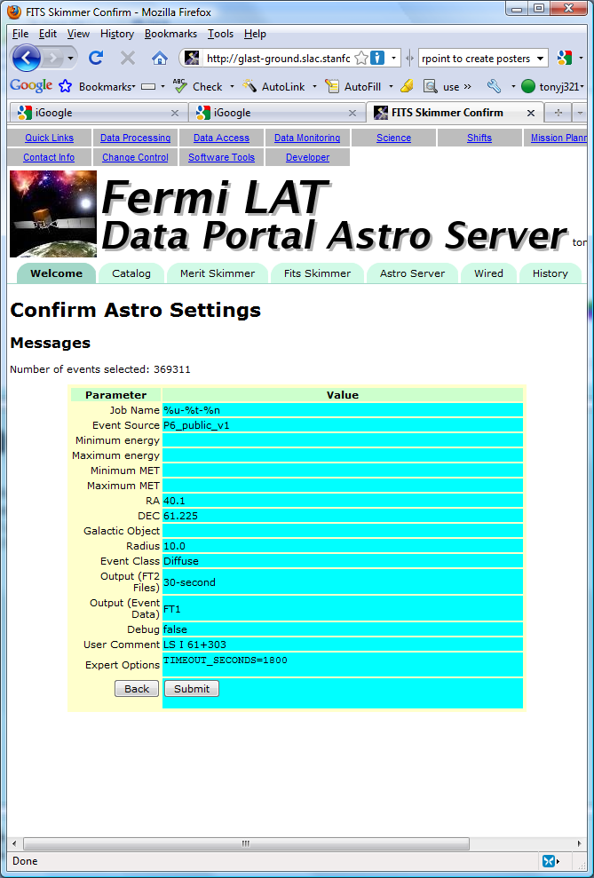
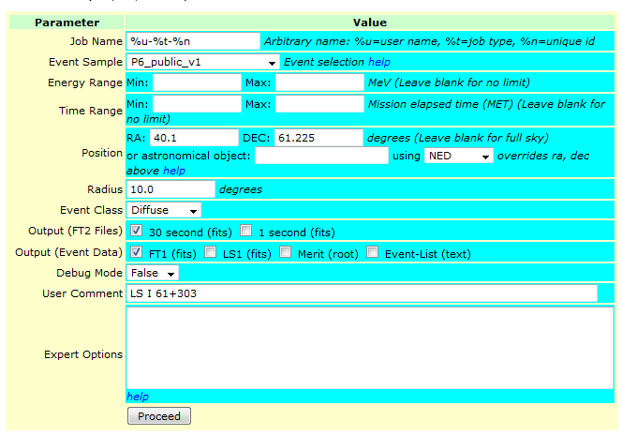
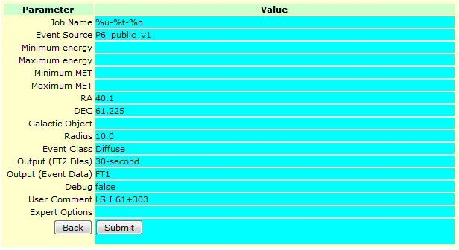
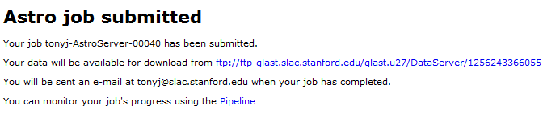
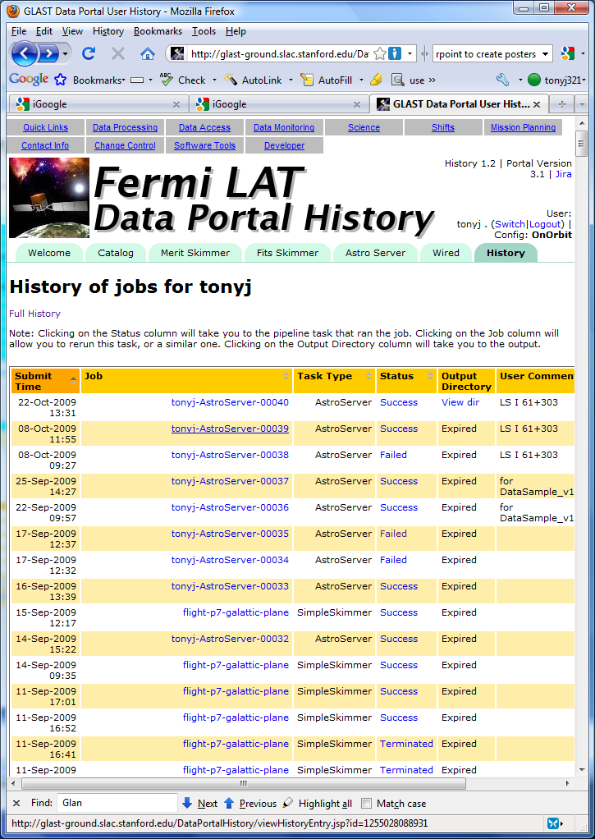
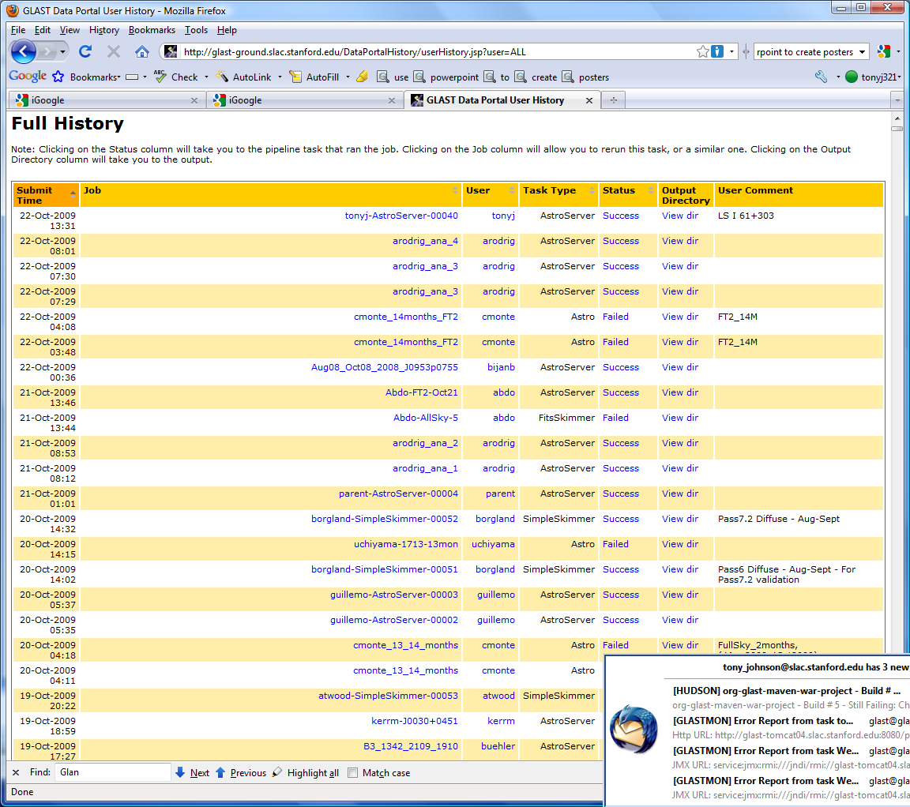
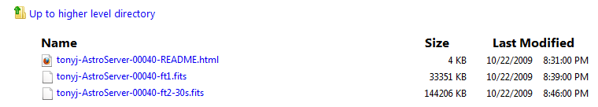
“Astro” Server Web Interface

Slide 19
Implementation
Pipeline, Web Servers implemented in Java
  Apache tomcat web server
    Redundant servers for reliability, scalability
  Java Server Pages (JSP) for web pages
    Extensive use of 3rd party and custom tag libraries
      DisplayTag for tabular data
      AIDA tld for dynamic plot generation
  JMX for monitoring, control
  JaSIG CAS single-signon for user authentication
Extensive use of database for storing state, history
  Oracle (10g, 11)
    Java Stored Procedures for performance
    GridControl for performance, tuning, montitoring

Slide 20
Pipeline and Data Catalog Implementation
SLAC
Oracle
Command
Client
read-only
Data
Catalog
Client
Catalog Web
Interface
Client
Data
Portal
Client
Client
SLAC
SLAC
Batch
Farm
Client
Job Control
Line Mode
Client
Pipeline
Server
IN2P3
Client
Batch
Farm
Job Control
Client
Oracle
INFN / Grid?
Pipeline
Web Interface
Batch
Farm
read-only
Job Control

Slide 21
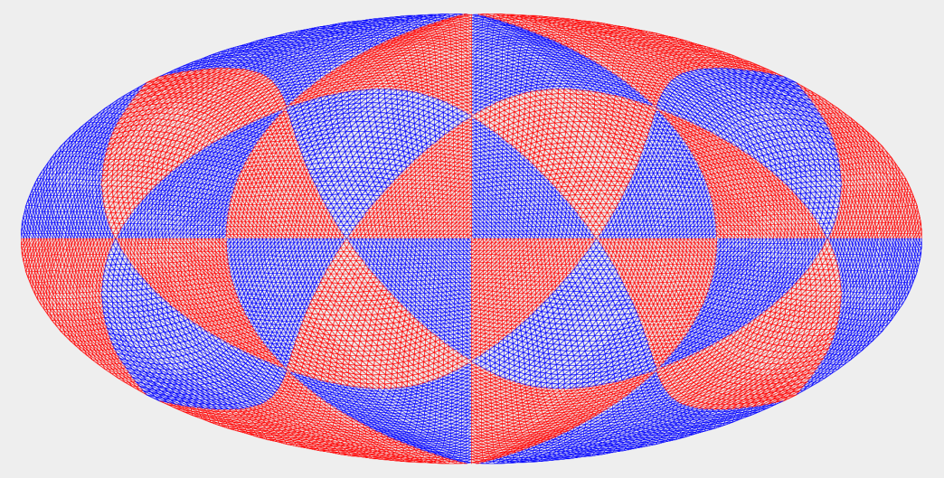

“Astro” Server Implementation
User Request
Time/Energy Range
Position in Sky
Quality
Dedicated
Oracle
Database
~500-4500 Million Photons
Within the database events are indexed by time,
energy and position using a hierarchical
triangular mesh (HTM). Database partitions are used to split the data into 1 week time bins and 32 position bins within each time bin, each containing 1024 HTM regions (shown above) . The use of HTM triangles makes it easy to identify which regions are entirely contained in the user request, and which are partially contained and require finer selection (below).
Event List
Xroot File Server
Root Tuples
Fits Files
~50 TB

Slide 22
Conclusions
Fermi data pipeline, data catalog and monitoring tools have been in production use for 4 years
  Have proved very reliable for data processing
  Web based tools allows monitoring load to be distributed world wide
Important design decision to avoid tight coupling to specific experiment
  Fermi tools already being used by other experiments
    EXO, CDMS
    Being evaluated for use by James Webb Space Telescope
Future work planned to
  Support submission of pipeline jobs to more systems
    Currently support LSF (SLAC), BQS (Lyon), Condor
    Adding support for Grid Engine, EEGE Grid
  Increase interactivity of web applications (AJAX, Web 2.0, GWT)
Interested in exploring reuse of tools and/or experience for CTA
  Good area to start may be use of pipeline for some CTA simulations

Slide 23
Extra Slides

Slide 24
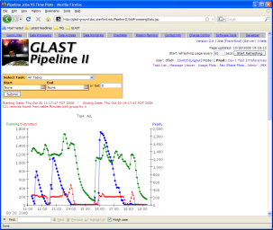
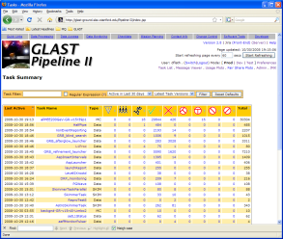
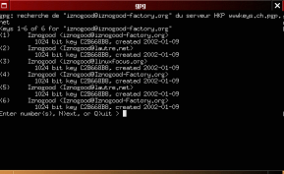
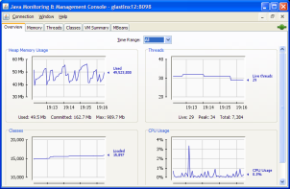
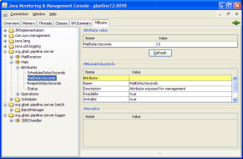
Pipeline Implementation
Connection
Pool
Back-End
Components
Middle-Ware
HTTP
Tomcat Server
Web
Application
Front-End
User Interfaces
Web Browser
Oracle
RDBMS
Stored
Procedures
JMX
RMI*
Connection
Pool
Pipeline
Server
SQL
MBean
Interface
JMX
Line-mode
Client
TNS
Data
SQL
JMX
JConsole Monitor
RMI
Scheduler
Job Control Service
Thread
Pool
Batch
Farms
Apache/James
Email
POP3

Slide 25
Technologies Used
Database
  Oracle
    Java Stored Procedures for performance
    Scheduled Server-side Jobs for monitoring, stats-gathering
    Hierarchical queries
Servers and Client Libraries (Pipeline, Data Catalog)
  Java
    Extensive use of threads, concurrency utilities for performance
  Jython interpreter for user scripts
  JMX MxBean Interfaces for monitoring, communication
  XML used for processing-task definitions
  Batch jobs use e-mail for status notification
    Apache/James Email server
Web:
  Apache/Tomcat servers
  JSP for web pages
    DisplayTag for tabular data
    AIDA tag libraries for plotting
    Custom tag libraries expose Pipeline client methods
  Java Servlets
    Serve GraphViz State diagrams
  JMX Interfaces

Slide 26
Data Catalog design goals
Support multiple storage formats
  AFS, NFS, xrootd, dCache, Grid etc ….
Support multiple file locations for same datasets
  SLAC, IN2P2, …
Allow arbitrary meta-data to be stored with datasets
  As much meta-data as possible should be extracted from the file itself to ensure integrity
Dataset access from web, command line, API
  Including search based on meta-data
Avoid tight coupling to specific experiment to allow for reuse
  Avoid tight coupling with pipeline

Slide 27
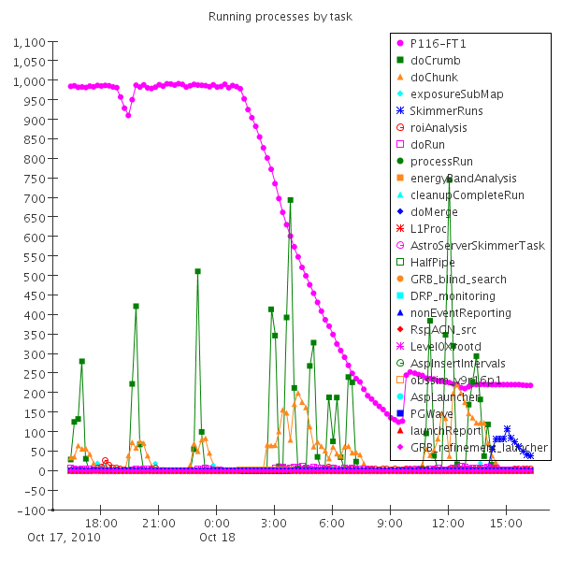
Processing Pipeline Web Interface
Pipeline web interface allows
  Many views of data processing, down to log files of individual jobs
  If jobs do fail they can be “rolled back” directly from the web interface

Slide 28
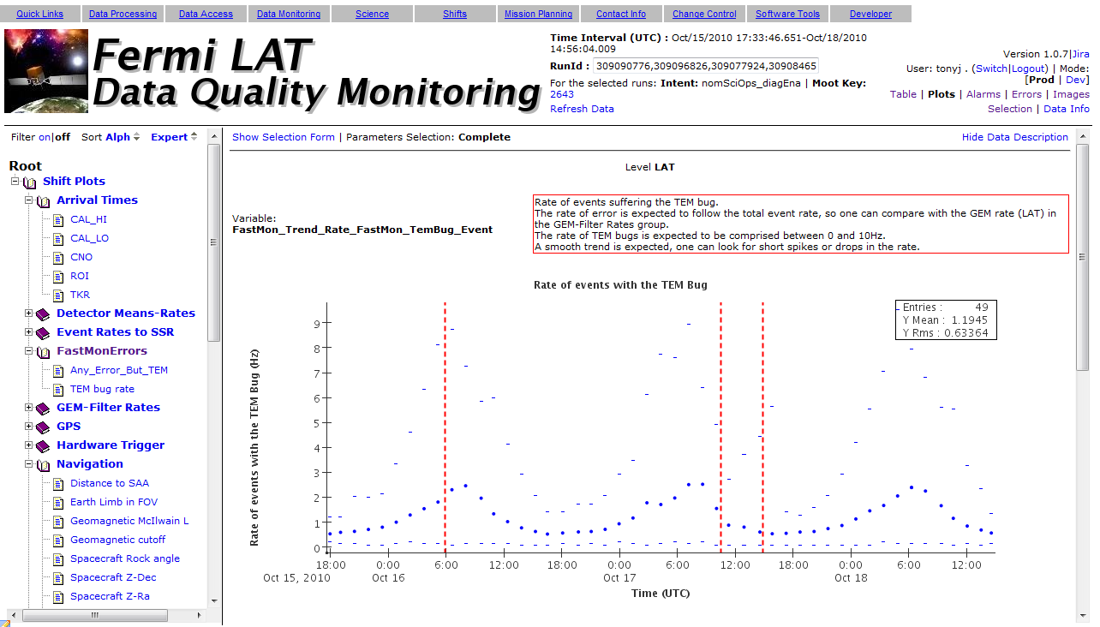
Data Quality Monitoring
Web interface allows
  Show data from single run or aggregate set of runs
  View description of each plot
  View/Print multiple plots
  Customized tree to draw attention to important plots
    Can be customized for individuals or groups

Slide 29
Telemetry Trending
Web interface allows
  Dynamic selection of time period
  Dynamic overlay of quantities
  Customized tree to draw attention to important plots
    Can be customized for individuals or groups
Cross trending of housekeeping and level 1 data

Slide 30
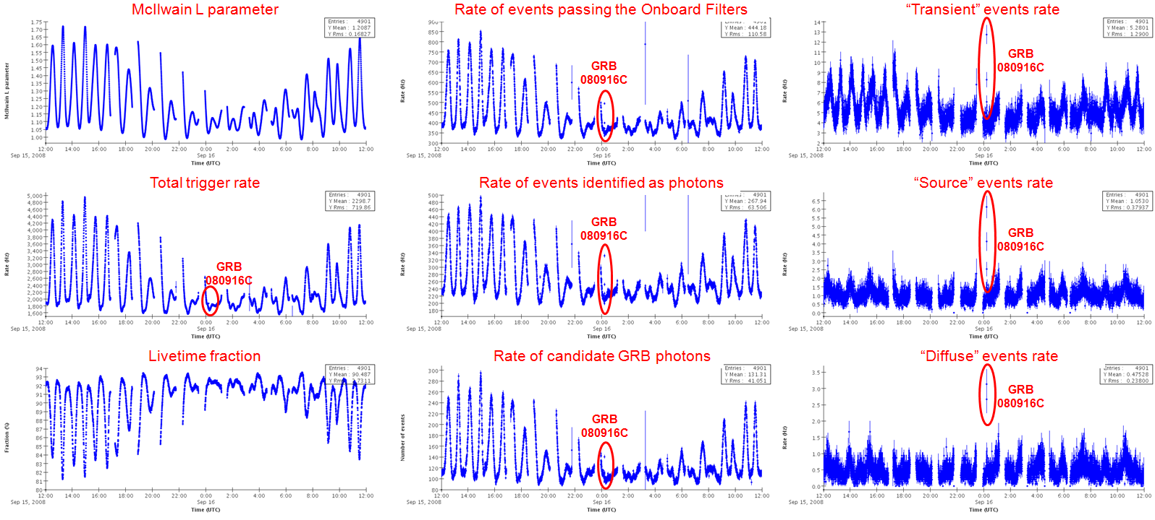
Data Quality Monitoring
The trending graphs below show some rate summary plots for the 24 hours around GRB.
Strong correlation with orbital period (~90 minutes) can clearly be seen
This burst was so bright that it can be seen even in the global rate plots.

Slide 31
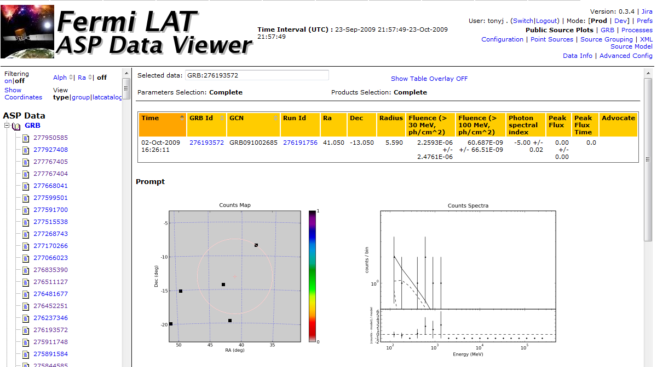
Automated Science Processing
Used to rapidly detect Gamma Ray Bursts or other flaring events
Enabled timely notification of interesting events to external astrophysical community

Slide 32
Data Catalog Web Interface
Summary of all files in a group
Meta-data associated with folders, groups and files
Logical tree allows browsing for files
Folders and Groups
Crawler runs in background and validates all files and extracts size, #events, etc

Slide 33
Acknowledgments
Software Development Team:
  Daniel Flath
  Charlotte Hee
  Karen Heidenreich
  Claudia Lavalley
  Tony Johnson
  Max Turri
Beta Testers:
  Warren Focke
  Tom Glanzman

Slide 34
Front End: Line-mode Clients
Command line tools for direct or scripted interaction with middle-ware
  Control Server
    Ping
    Restart
    Shutdown
  Upload Task Definitions
  Manage processing streams
    Create
    Delete
    Cancel
    Retry from failure point
  Query processing history
  Plus Interaction with Data Catalog

Slide 35
Front End: Web Interfaces
Provides all administrative functions available in a user-friendly interactive GUI
Interactive displays show active (and historical) processing
  Filtering by Task, Process, Status(es), Stream-range, Date-range
Processing Statistics Plots
  Provided by AIDA tag library
  System throughput plots
    Filterable by Task, Date-Range
  Individual process statistics plots
    CPU time (vs Wallclock)
    Pending time
    By Batch Host-type
Task diagrams generated by GraphViz and image-mapped to provide links to task element (Sub-tasks, processes) displays

Slide 36
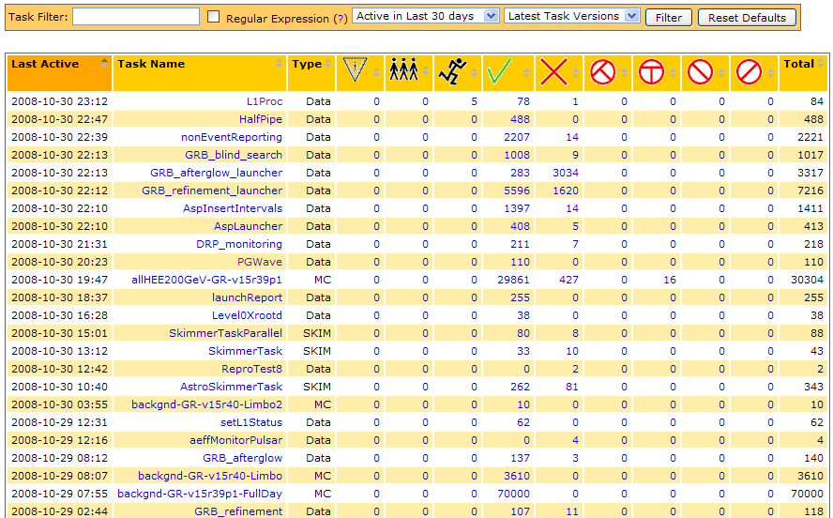
Front End: Task Summary Display

Slide 37
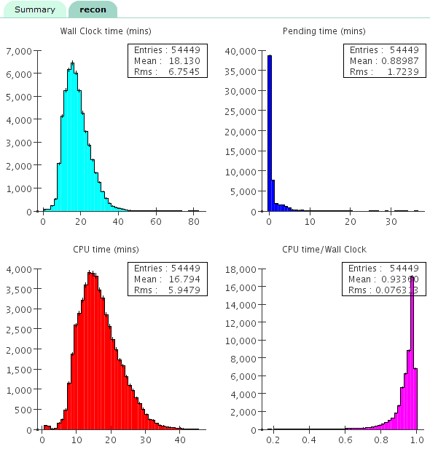
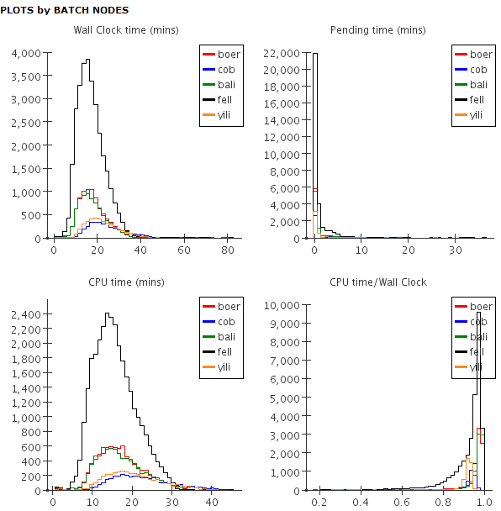
Front End: Process Detail Plots

Slide 38
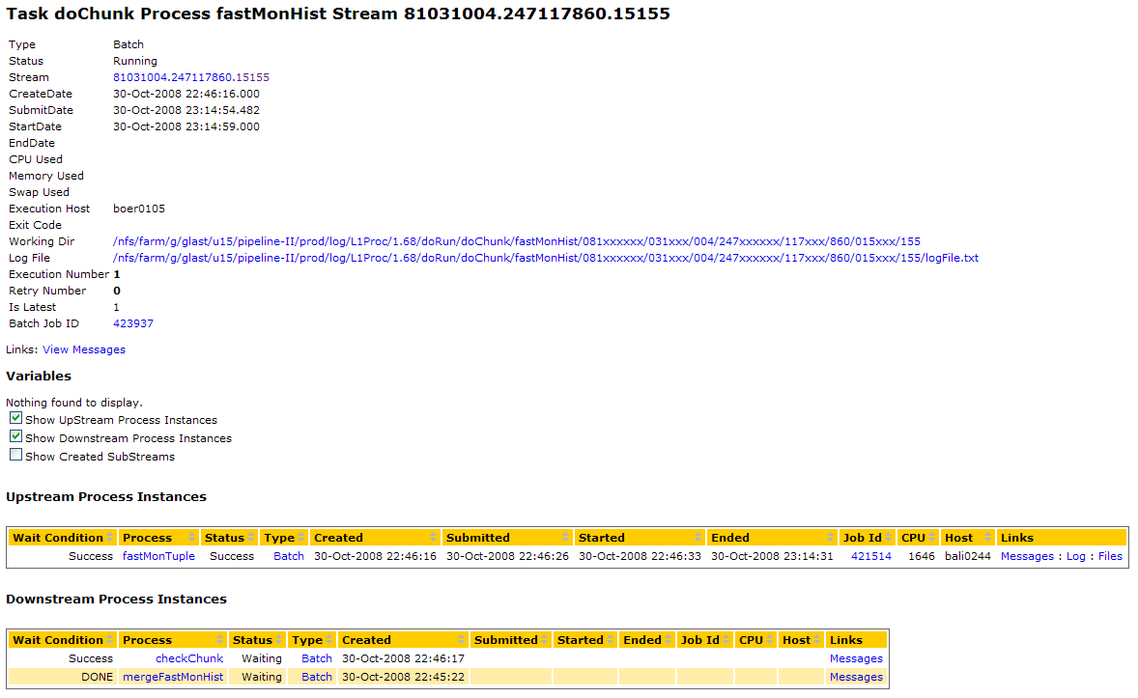
Front End: Job Detail Display

Slide 39
Middle Tier: Threading
Makes extensive use of Java Concurrency library (java.util.concurrent)
Scheduler Threads
  Look for work and delegate to Execution pool
    Ready Jobs (Script and Batch)
    Submits work to execution threads
  Handle Email status-messages
    Checks for email
    Submits status transition calculations to execution threads
    Receives confirmation from workers, deletes email
  Reaper
    Searches for ‘lost’ jobs in Batch, updates processing history accordingly
Execution Threads
  Decode email status messages and update process records
  Execute Jython script processes directly
  Submit Batch jobs to Farms
Notes:
39

